Slide 1
Management of Abdominal Infections From The surgical Perspective
Robert C Moesinger, MD
Ogden Surgical-Medical Society
October 7, 2021

Slide 2
Abdominal Infections—Historical Perspective
First Abdominal Infection for which we have a good description.
Judges 3 Ehud vs. King Eglon (?1330 BCE)
And the children of Israel did evil again in the sight of the Lord: and the Lord strengthened Eglon the king of Moab against Israel, because they had done evil in the sight of the Lord.
But when the children of Israel cried unto the Lord, the Lord raised them up a deliverer, Ehud the son of Gera, a Benjamite, a man lefthanded: and by him the children of Israel sent a present unto Eglon the king of Moab.
But Ehud made him a dagger which had two edges, of a cubit length; and he did gird it under his raiment upon his right thigh.
And he brought the present unto Eglon king of Moab: and Eglon was a very fat man.
And when he had made an end to offer the present,… [he] said, I have a secret errand unto thee, O king…
And Ehud came unto him; and he was sitting in a summer parlour, which he had for himself alone. And Ehud said, I have a message from God unto thee. And he arose out of his seat.
And Ehud put forth his left hand, and took the dagger from his right thigh, and thrust it into his belly:
And the haft also went in after the blade; and the fat closed upon the blade, so that he could not draw the dagger out of his belly; and the dirt came out.
Notes:
Competing with Utah Department of Health COVID-19 Response
I wasn’t even going to do a presentation until I found out my mother was going to be here, so I thought I would put something together

Slide 3
Abdominal Infections—Historical Perspective
From pre-history to King Eglon and beyond—to our knowledge the hundreds of thousands (?millions) of people inflicted with perforating bowel injuries died of infection or hemorrhage. A few may have survived whose bodies were smart enough on their own to create a fistula.
Hippocrates (460-377BCE) Allegedly stated that small intestine and bladder injuries were more deadly than colon???
Celsus (25BCE-50AD) Wrote 2 books about medicine (De Medicina) within an 8-volume encyclopedia (De Artibus). His writing about intestinal injury is fascinating:

Slide 4
Abdominal Infections—Historical Perspective
Sometimes the abdomen is penetrated by a stab of some sort, and it follows that intestines roll out. When this happens we must first examine whether they are uninjured, and then whether their proper colour persists.[…] The larger intestine can be sutured, not with any certain assurance, but because a doubtful hope is preferable to certain despair; for occasionally it heals up. Then if either intestine is livid or pallid or black, in which case there is necessarily no sensation, all medical aid is vain.[…]The patient is to be laid on his back with his hips raised; and if the wound is too narrow for the intestines to be easily replaced, it is to be cut until sufficiently wide. If the intestines have already become too dry, they are to be bathed with water. […] Next the assistant should gently separate the margins of the wound by means of his hands, or even by two hooks inserted into the inner membrane […] Now stitching of the surface skin only or of the inner membrane only is not enough, but both must be stitched. And there must be two rows of stitches, set closer together than in other places, partly because they can be broken here more easily by the abdominal movement, […] [10, p. 387]

Slide 5
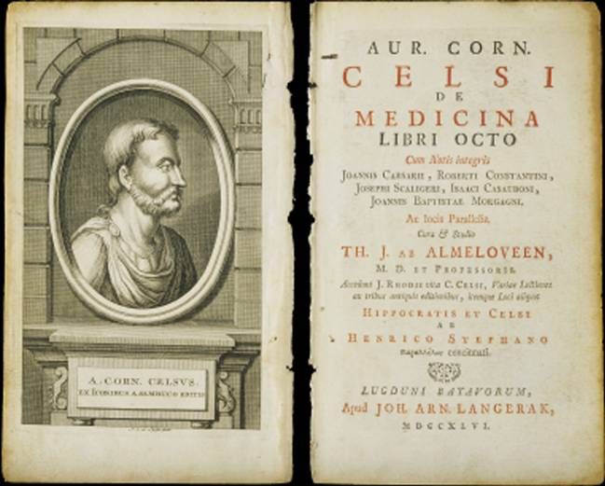
Abdominal Infections—Historical Perspective

Slide 6
Abdominal Infections—Historical Perspective
Galen (130-200) described performing operations for intestinal and abdominal wall injuries including suturing in gladiators, but no record of the mortality of these operations exist.
Matthaeus Gottfried Purman (1649-1711)
  German Army Surgeon
  Tried to do blood transfusions from animals to bleeding soldiers
  Credited with repair of an intestinal injury in the more modern era--1675

Slide 7
Abdominal Infections—Historical Perspective
In “Philosophical Transactions” the journal of the Royal Society, Dr. Abraham Vater (Ampulla of Vater) reported in 1720 on George Deppe, who was injured at the battle of Ramilies in 1706.
An apparent left colon injury resulted in prolapse and opening of the descending colon.
“The wounded and protruded intestine is inverted; and being united in the middle, it exhibits two orifices, the upper orifice communicating with the small intestines, and discharging the alvine faeces, and the lower orifice with the rectum, so that a clyster injected per anum is returned by it.”
Essentially, George Depp’s body taught us how to obtain source control and prevent a deadly abdominal infection.

Slide 8
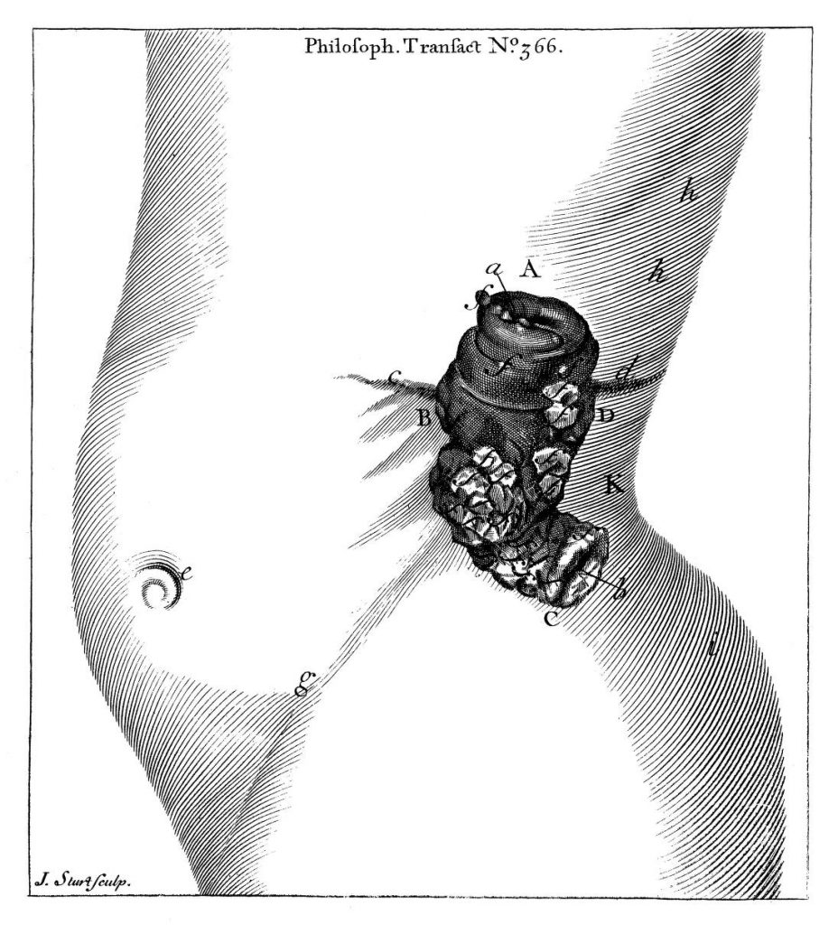
Abdominal Infections—Historical Perspective

Slide 9
Abdominal Infections—Historical Perspective
Other notable historical abdominal infections:
Queen Caroline (wife of King George II) died in 1736, 10 days after developing a strangulated umbilical hernia.
William Cheselden (1688-1752, British surgeon) had a patient who ruptured her abdominal wall. He removed the gangrenous portion of prolapsed intestine and left an umbilical enterostomy—the patient surviving for several year.
First planned colostomy (Cecostomy) in 1776 for malignant bowel obstruction by a French surgeon. Lived for 2 weeks and then died from mercury poisoning.
In 1793, a left inguinal colostomy was done by a French surgeon, C. Duret, in an infant with cloacal atresia. The patient lived 45 years.
Jean Amussat, a French surgeon, reviewed all published cases of colostomy from 1716-1839.
27 cases. 21 deaths. Mortality rate 78%

Slide 10
Abdominal Infections—Historical Perspective
World War I produced the first catastrophically large scale, well-studied series of bowel injuries and resultant abdominal sepsis.
Cuthbert Wallace, British surgeon, wrote up a series of 1288 such injuries in 1917. Among his many observations:
  Mortality of penetrating abdominal wounds—80%.
  Spontaneous recovery after perforation of abdominal viscera is possible but rare.
  In 965 operations, mortality was 53.9%.
In 1943 the US Surgeon General mandated all colonic injuries be treated with colostomy.

Slide 11
Abdominal Infections—Historical Perspective

Slide 12
Abdominal Infections—Less is More
Appendicitis
Diverticulitis
Abdominal Sepsis and Abscesses
Post-surgical Abdominal Infections
Abdominal Infections and Inflammatory Bowel Disease
COVID-19 and Abdominal Complications and Infections

Slide 13
Abdominal Infections--Appendicitis
Claudius Amyand removed an inflamed appendix in a right inguinal hernia in 1735—Amyand’s Hernia.
In 1880 Robert Lawson Tait made the first diagnosis of appendicitis and surgically removed the appendix.
250,000 appendectomies in the US each year.
About 7% of all Americans will get appendicitis.
About 15% of all Americans will get an appendectomy.

Slide 14
Abdominal Infections--Appendicitis
Appendicitis used to be an emergency.
Middle of the night appendectomies were common.
Then everything started to change:
  Drain abscesses and don’t operate on them.
  Phlegmons—give antibiotics and don’t operate on them.
  Wait until morning to do an appendectomy.
  Navy personnel with appendicitis but no surgical capability—give antibiotics
    (USS Grayback, 1942, notwithstanding…!)
  Data from Europe on the “antibiotics-first” strategy showed clinical success 50-90% of the time, but with later appendectomy (within 1 year) 10-37% of the time.
    NEJM 372;20. May 14, 2015

Slide 15
Abdominal Infections--Appendicitis
American Data:
  UCLA, 2017. 30 randomized patients. Antibiotic only patients had fewer complications that Surgical patients. Recurrence rate at 12 months—13.3%
  Stanford, 2018. 58,329 patients based on insurance claims data. Only 4.5% had antibiotic therapy. 3.9% recurrence rate. Cost identical.

Slide 16
Abdominal Infections--Appendicitis
Conclusions:
  Appendicitis can be treated with antibiotics alone with clinical resolution in 90% of patients.
  There is no increased risk of complications by trying antibiotics first.
  Recurrence rates are substantial (up to 40% by 5 years).
  It is ok to allow patients to choose, but they usually choose surgery.
  Antibiotics can be a bridge to a more convenient time for surgery.

Slide 17
Abdominal Infections--Diverticulitis
2004—3.2 million outpatients treated.
815,000 hospitalizations.
Total cost: $3 billion.
10-25% of patients with diverticulosis will develop diverticulitis.

Slide 18
Abdominal Infections--Diverticulitis
Historically, treated with antibiotics—NOT controversial.
Except in Sweden, 2012
  623 patients with uncomplicated diverticulitis randomized to antibiotics vs. supportive care.
  Complications happened in 1% of patients on antibiotics and 1.9% of patients without antibiotics. P=0.302
  Recurrence at 1 year 16% in both groups.
Except in Holland, 2017
  528 patients with uncomplicated diverticulitis randomized to antibiotics vs. observation.
  Median recovery time 12 days for antibiotics and 14 days for observation (p=0.151)
  No significant differences in complications, recurrence, resection, readmission or mortality.
Notes:
What is it with Europe always trying to do less medical care?!?!

Slide 19
Abdominal Infections--Diverticulitis
Sources
  Chabok A, Påhlman L, Hjern F, Haapaniemi S, Smedh K; AVOD Study Group. Randomized clinical trial of antibiotics in acute uncomplicated diverticulitis. Br J Surg. 2012 Apr;99(4):532-9. doi: 10.1002/bjs.8688. Epub 2012 Jan 30. PMID: 22290281.
  Daniels L, Ünlü Ç, de Korte N, van Dieren S, Stockmann HB, Vrouenraets BC, Consten EC, van der Hoeven JA, Eijsbouts QA, Faneyte IF, Bemelman WA, Dijkgraaf MG, Boermeester MA; Dutch Diverticular Disease (3D) Collaborative Study Group. Randomized clinical trial of observational versus antibiotic treatment for a first episode of CT-proven uncomplicated acute diverticulitis. Br J Surg. 2017 Jan;104(1):52-61. doi: 10.1002/bjs.10309. Epub 2016 Sep 30. PMID: 27686365.

Slide 20
Abdominal Infections—Diverticulitis
American Data: Minimal
AGA 2015: The AGA suggests that antibiotics should be used selectively, rather than routinely, in patients with acute uncomplicated diverticulitis. (Conditional recommendation, low quality of evidence).
“Selectively” not defined.
I think patients self-select based on their own biases and willingness vs. stubbornness of seeking medical care.

Slide 21
Abdominal Infections and Sepsis
Antibiotics and Source Control are key. How long should the antibiotics last?
“Trial of short-course antimicrobial therapy for intraabdominal infection”. NEJM May 21, 2015
  In patients with intraabdominal infections who had undergone an adequate source-control procedure, the outcomes after fixed-duration antibiotic therapy (approximately 4 days) were similar to those after a longer course of antibiotics (approximately 8 days) that extended until after the resolution of physiological abnormalities.

Slide 22
Abdominal Infections and Sepsis
What about frankly septic patients?
  Journal of American College of Surgeon, Apr 2016
  Randomized septic patients with intraabdominal infections to 4 days (short course) vs. up to 10 days of antibiotics.
  “There was no difference in outcomes between short and long-course antimicrobial therapy in patients with complicated intra-abdominal infection presenting with sepsis.”

Slide 23
Abdominal Infections and Sepsis
What if the patient is bacteremic?
  “Optimal Antibiotic Duration for Bloodstream Infections Secondary to Intraabdominal Infection”—Journal of Surgical Research 2021
  Retrospective Cohort Analysis of 42 patients in an ICU.
  Less than 7 days of antibiotics no different from greater than 7 days.

Slide 24
Abdominal Infections--Abscesses
Diverticular Abscesses—Systematic Review of 42 studies, 2017
  Treatment of abscesses less than 3cm adequate with antibiotics alone.
  25% had recurrent diverticulitis in long-term follow up.
Percutaneously drained abdominal abscesses of all kinds—antibiotic duration:
  “Percutaneously drained intra-abdominal infections do not require longer duration of antimicrobial therapy”—Journal of Trauma and Acute Care Surgery, July 2016
  Randomized septic patients with intraabdominal infections to 4 days (short course) vs. up to 10 days of antibiotics.
  “…there was no difference in outcome between a shorter and longer duration of antimicrobial therapy in those with percutaneously drained source control of complicated intraabdominal infections.”

Slide 26
Abdominal Infections—Postoperative
Anastomotic Leak—Perioperative Factors
  Smoking
    Vanderbilt 2015: 246 patients—left colectomy. Overall leak rate-6.5%. Non-smokers 5%. Smokers 17%
    New Zealand 233 patients with rectal cancers. Overall leak rate 14%. Smoking more important than metastatic disease.
  NSQIP 2012—13,684 patients. (Overall leak rate 3.8%) Male sex, steroid use, smoking, open approach, operative time, and preoperative chemotherapy were associated with increased anastomotic leaks
  Low preoperative hemoglobin (OR 5.40, P < 0.001), contamination of the operative field (OR 2.98, P < 0.001), hyperglycemia (OR 2.80, P = 0.003), duration of surgery of more than 3 hours (OR 1.86, P = 0.010), administration of vasopressors (OR 1.80, P = 0.010), inadequate timing of preoperative antibiotic prophylaxis (OR 1.62, P = 0.047), and application of epidural analgesia (OR, 1.81, P = 0. 014) were all associated with leaks (1562 patients in Europe and Australia, 2016-2018) Overall leak rate 8.5%.

Slide 27
Abdominal Infections—Postoperative
References
  Baucom RB, Poulose BK, Herline AJ, Muldoon RL, Cone MM, Geiger TM. Smoking as dominant risk factor for anastomotic leak after left colon resection. Am J Surg. 2015 Jul;210(1):1-5. doi: 10.1016/j.amjsurg.2014.10.033. Epub 2015 Mar 28. PMID: 25910885.
  Huisman, D. , Reudink, M. , van Rooijen, S. , Bootsma, B. , van de Brug, T. , Stens, J. , Bleeker, W. , Stassen, L. P. , Jongen, A. , Feo, C. , Targa, S. , Komen, N. , Kroon, H. , Sammour, T. , Lagae, E. A. , Talsma, A. , Wegdam, J. , de Vries Reilingh, T. , van Wely, B. , van Hoogstraten, M. , Sonneveld, D. J. , Veltkamp, S. , Verdaasdonk, E. G. , Roumen, R. M. , Slooter, G. & Daams, F. (9000). LekCheck. Annals of Surgery, Publish Ahead of Print , doi: 10.1097/SLA.0000000000003853.

Slide 28
Abdominal Infections—Inflammatory Bowel Disease

Slide 29
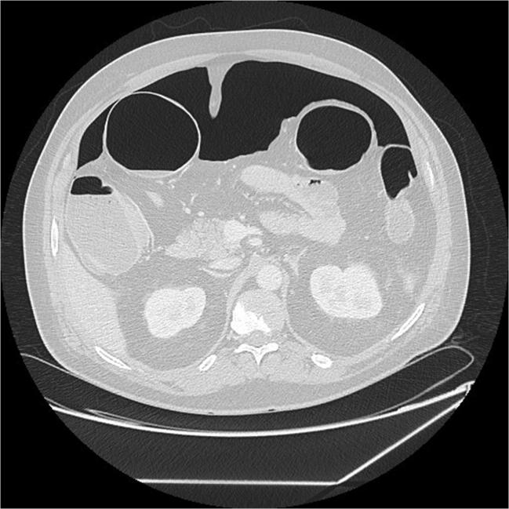
Abdominal Infections—COVID-19

Slide 30
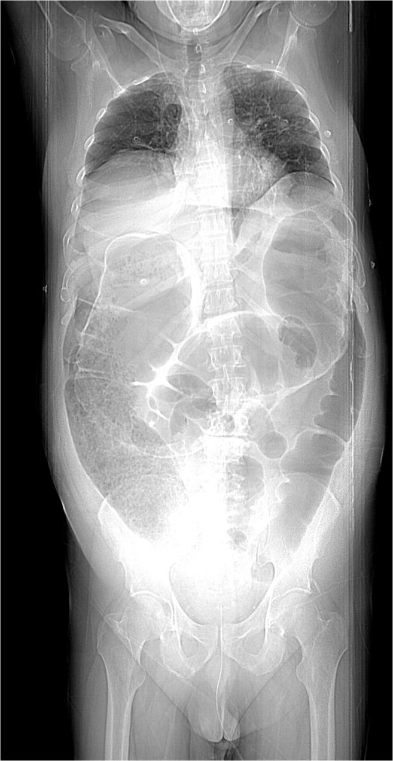
Abdominal Infections—COVID-19

Slide 31
Abdominal Infections—COVID-19
Obviously, COVID is known for its pulmonary symptoms
However, abdominal pain, diarrhea and vomiting are well documented.
COVID-19 is found in stool specimens.
Case reports of bowel perforation are showing up in the literature—Italy, Myanmar, Spain, Brazil, California.
At least 2 that I know of here in Ogden.
Predominantly Right Colon.
Predominantly Fatal.
Microembolic/ischemic? Steroid-related? Profound ileus?

Slide 32
Conclusions and Recommendations
If you are the King of a country oppressing another country, be sure that your security procedures take into account the unorthodox sword concealment of left-handed visitors.
Diverting the fecal stream to obtain source control is not always necessary, but has a strong track record dating back centuries.
Uncomplicated Appendicitis can be treated successfully with antibiotics, but recurrence rates are high and patient expectations limit this practice.
There is no benefit to antibiotic administration in uncomplicated diverticulitis in terms of complications or recurrence. Managing patient expectations is challenging in this situation.

Slide 33
Conclusions and Recommendations
Diverticular Abscesses should be percutaneously drained if greater than 3-4 cm, but antibiotic therapy alone is adequate for abscesses less than 3 cm.
Recurrence rates for diverticulitis after having an abscess are high and elective surgery should be considered.

