Slide 1
Mental Health Crisis Evaluation and Clearance from Emergency Room or Office Setting
O. Lamont McPherson, MD
Psychiatrist, McKay Dee Hospital

Slide 2
Disclosure
Speaker for Rexulti (Otsuka/Lundbeck)
Previous speaker for Abilify and Abilify Maintenna (Otsuka)

Slide 3
Outline:
Suicide as a public health problem (w/ a focus on Utah)
Risk assessment
Risk management

Slide 4
Outline:
Suicide as a public health problem (w/ a focus on Utah)
Risk assessment
Risk management

Slide 5
Suicide as a public health problem (in the United States)
Suicide rates have risen nearly 30% in the last 15 years
Suicide rates have risen in every state except Nevada
(Nevada’s remains higher than the national average)
10th leading cause of death overall
Sources:
R. Greenberg, Psychiatry News, Vol 53, No 13, July 6, 2018
A. Ellis Nutt, The Washington Post, June 7, 2018

Slide 6
Suicide as a public health problem (in the United States)
2nd leading cause of death ages 15-34
Has risen 21% for men, 50% for women
Sources:
R. Greenberg, Psychiatry News, Vol 53, No 13, July 6, 2018
A. Ellis Nutt, The Washington Post, June 7, 2018

Slide 7
Suicide as a public health problem (in Utah)
Utah ranks 5th in the nation!
Utah has been consistently higher than the national rate for more than a decade
Suicide is the leading cause of death for ages 10-17
Sources:
Utah Governor's Youth Suicide Prevention Taskforce, Jan 31, 2018
Violence and Injury Prevention Program (VIPP) Website

Slide 8
Suicide as a public health problem (in Utah)
A questionnaire was given to Utah students in grades 8-12.

Slide 9
Suicide as a public health problem (in Utah)
A questionnaire was given to Utah students in grades 8-12.
Out of a class size 36, how many had seriously considered suicide that year?

Slide 10
Suicide as a public health problem (in Utah)
A questionnaire was given to Utah students in grades 8-12.
Out of a class size 36, how many had seriously considered suicide that year?
6 (16.6%)
Sources:
Utah Governor's Youth Suicide Prevention Taskforce, Jan 31, 2018
Violence and Injury Prevention Program (VIPP) Website

Slide 11
Why a public health problem?

Slide 12
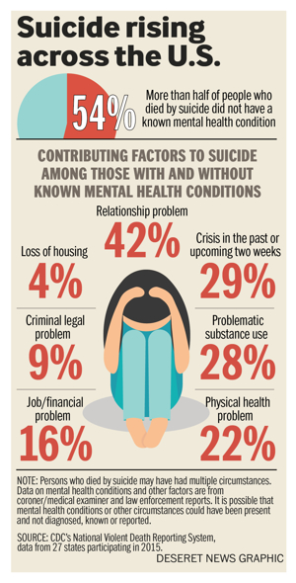
Source: CDC’s National Violent Death Reporting System, data from 27 states participating in 2015 (Deseret News)

Slide 13
Suicide as a public health problem (in Utah)
“We are never going to have the opportunity to rely on just one strategy. There needs to be a comprehensive approach touching all systems, all community partners.”
--- Kimberly Myers, Utah's State Coordinator for Suicide Prevention and Crisis Services in the Department of Human Services

Slide 14
Suicide as a public health problem (in Utah)
Bottom line: this means we need EVERYONE’S help

Slide 15
Why is Utah 5th?

Slide 16
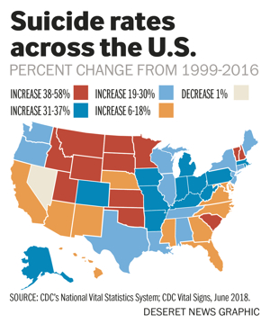
Why Utah?

Slide 17
Geography? ks 5th in the Nation
3
6
2
7
5
9
4
8
10
1
Source: Utah Governor’s Youth Suicide Prevention Taskforce (Doug Thomas-Director), referencing WISQARS 2014 Suicide Fatality Rates ages 10+
Notes:
The intermountain west has 6 of the 10 leading rates

Slide 18
Comparing high and low gun ownership states
 | Low gun ownership | High gun ownership
Suicide attempts (08-09) | 303,400 | 246,000
Completed suicides | 6,038 | 11,889
-- By firearm | 1,697 | 7,492
-- By other means | 4,341 | 4,397
Population (2004) | 31.3 million | 31.5 million
% with firearms in home | 15% | 50%
Low gun ownership states: NY, Mass., NJ, Connecticut, Rhode Island, Illinois
High gun ownership states: Wyoming, Montana, Alaska, South Dakota, Arkansas, West Virginia, Alabama, Idaho, Mississippi, North Dakota, Kentucky, Tennessee, Louisiana, Missouri, Utah, Oklahoma, Iowa
Sources:
-Miller, Barber, Azrael, White. Am J Epi 2013.
-State-level HH gun ownership from 2004 BRFSS; attempts from NSDUH
Notes:
18

Slide 19
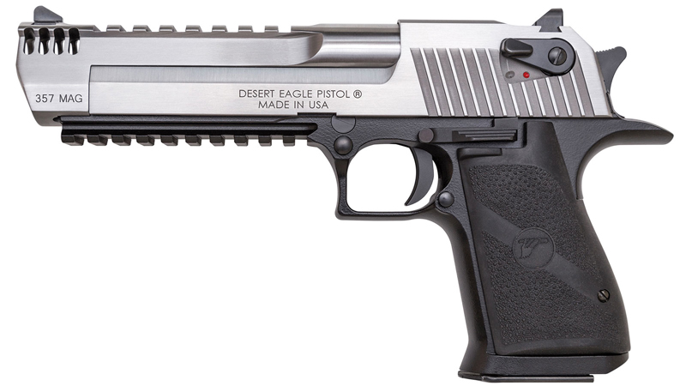
Why Utah: access to guns & why methods matter
.
Notes:
The intermountain west has 6 of the 10 leading rates

Slide 20
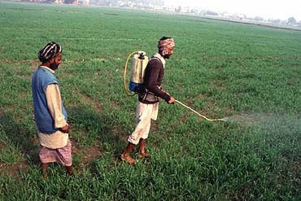
Why methods matter: Sri Lanka
In mid 1990-s Sri Lanka had
one of the highest suicide
rates in the world
Risk factors = unemployment,
alcohol, civil war, and access
to pesticides with high toxicity
Sources:
R. Greenberg, Psychiatry News, Vol 53, No 13, July 6, 2018
A. Ellis Nutt, The Washington Post, June 7, 2018

Slide 21
Why methods matter: Sri Lanka
After restriction of highly toxic pesticides, suicide dropped 50%
Nonfatal suicide attempts by pesticides did not drop
Successful suicides by other methods did not drop
Source: D Gunnel et al, The Impact of Pesticide Regulations On Suicided in Sri Lanka, Int J Epidemiology, Dec 2007, 36(6: 1235-1242)

Slide 22
Why methods matter: Sri Lanka
Implication: the notion that those highly determined to commit suicide will find another way, is, for the most part, untrue

Slide 23
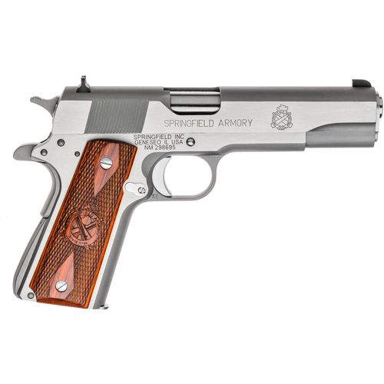
Fatality risk
83-90% fatal
1-2% fatal

Slide 24
Why methods matter: another study
Survivors (ages 13-35) of a nearly lethal suicide attempts were asked time between thought of suicide and action
How many answered less than 5 minutes?
Less than an hour?

Slide 25
Why methods matter: another study
Survivors (ages 13-35) of a nearly lethal suicide attempts were asked time between thought of suicide and action
75%
24%
Less than an hour?
How many answered less than 5 minutes?
Source: TR Simon et al, Characteristics of Impulsive Suicide Attempts and Attempters. Suicide and Life-Threatening Behavior (Journal of the American Association of Suicidology. 2001; 32 (sup): 49-59

Slide 26
Why methods matter: Catherine Barber
Suicidal crises are often brief. They are episodic, can escalate rapidly, and are difficult to predict
Some methods, especially guns, are far more lethal than others Ready access—not just intent—plays a role in method choice
90% of those who attempt and survive do not go on to die by suicide
Source: Lecture from Catherine Barber, Firearms and Suicide: considerations for youth in Utah. Harvard School of Public Health

Slide 27
Why methods matter: Catherine Barber
Suicidal crises are often brief. They are episodic, can escalate rapidly, and are difficult to predict
Some methods, especially guns, are far more lethal than others Ready access—not just intent—plays a role in method choice
90% of those who attempt and survive do not go on to die by suicide
Putting time and distance between a suicidal person and a highly lethal method–especially a gun–can save a life
Source: Lecture from Catherine Barber, Firearms and Suicide: considerations for youth in Utah. Harvard School of Public Health

Slide 28
Outline:
Suicide as a public health problem (w/ a focus on Utah)
Risk assessment
Risk management

Slide 29
Risk assessments
Assessing risk in imminent future
Reasoned and inductive
Identify risk (and protective) factors

Slide 30
Risk assessments
Helps determine level of risk
Risk level used to guide level of invasiveness
Identification of modifiable risk factors
which can guide different interventions
Good assessment technique invites more honest answers AND can be therapeutic

Slide 31
Risk and protective factors

Slide 32
Risk factors for youth: special considerations
Bullying
Screen time
Connectiveness to family, church organization, friends
LGBTQ+

Slide 33
Risk factors for youth suicide
Source: Utah Health Status Update: Risk and Protective Factors for Youth Suicide. Feb 2015 (referencing 2013 Prevention Needs Assessment)

Slide 34
Risk factors for youth suicide
Source: Utah Health Status Update: Risk and Protective Factors for Youth Suicide. Feb 0215 (referencing 2013 Prevention Needs Assessment)

Slide 35
Risk factors for youth suicide
Source: Utah Health Status Update: Risk and Protective Factors for Youth Suicide. Feb 0215 (referencing 2013 Prevention Needs Assessment)

Slide 36
LGBTQ youth and suicide risk
Nationally:
Approx 3 x more likely to seriously contemplate suicide
Approx 5 x more likely to attempt
Currently, Utah does not collect data for this
Source: CDC. (2016). Sexual Identity, Sex of Sexual Contacts, and Health-Risk Behaviors Among Students in Grades 9-12: Youth Risk Behavior Surveillance. Atlanta, GA: U.S. Department of Health and Human Services.

Slide 37
Assessment: other considerations
Benefits of structured rating scales
Potential benefits of involving family
Some recommended interviewing techniques

Slide 38
Columbia Suicide Severity Rating Scale (CSSRS)
Multiple studies show reliability and validity
Provides consistent language
No training required
Structured format reminds examiners of major potential risk (and protective) factors
Allows tracking over time
Objective

Slide 39
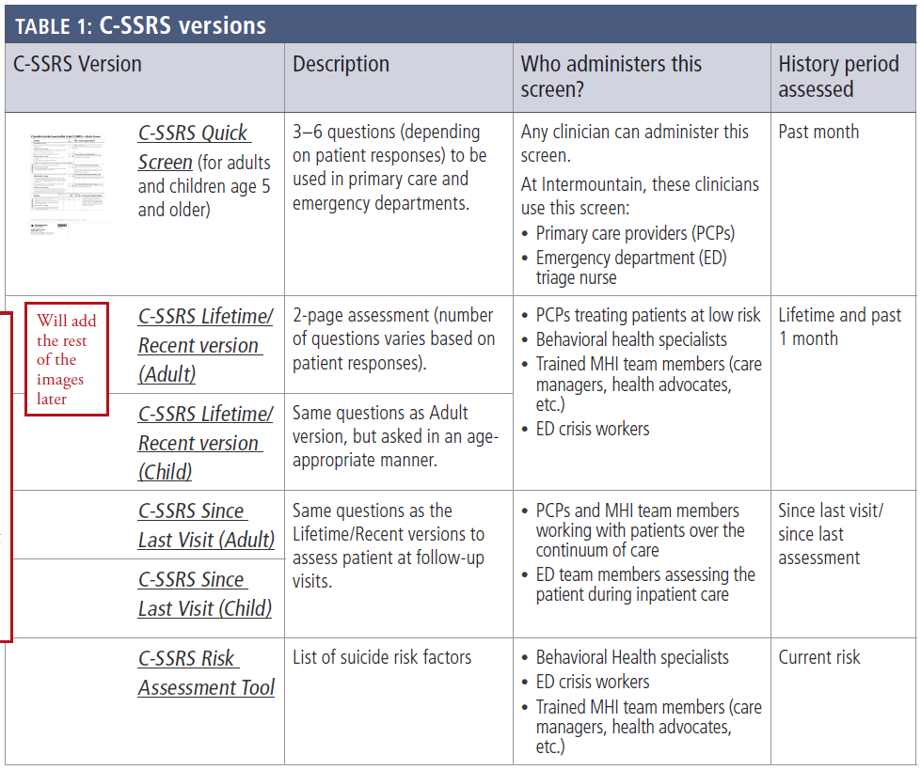

Slide 40
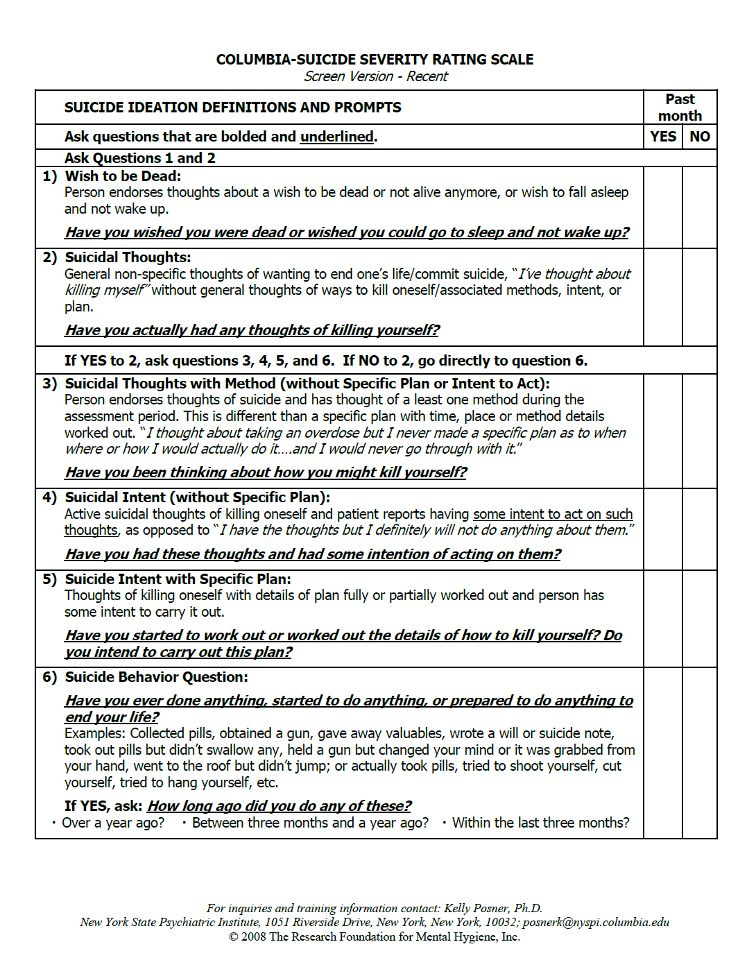

Slide 41
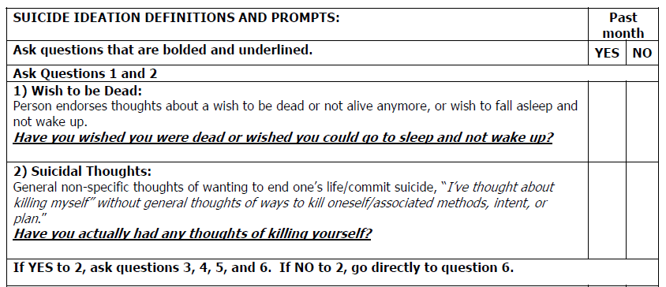

Slide 42
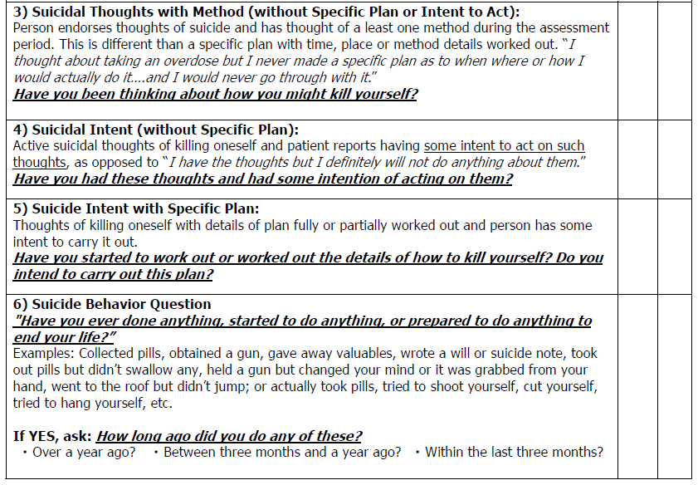

Slide 43
Outline:
Suicide as a public health problem (w/ a focus on Utah)
Risk assessment
Risk management

Slide 44
Addressing risk factors
Risk Factor
Substance use
Stress (marital, employment, social)
Bullying at school
Depression, anxiety, sleep
Perceived lack of social support
Access to means

Slide 45
Addressing risk factors
Intervention
Substance referral, AA/NA, meds
Counseling
Risk Factor | Intervention
Substance use | Substance tx, Rx, AA/NA
Stress (marital, employment, social) | Therapy
Bullying at school | School counselor
Depression, anxiety, sleep | Therapy, Rx, etc. → Sx relief
Perceived lack of social support | Family, friends, church
Access to means | Secure the means

Slide 46
Addressing risk factors
Intervention
Substance referral, AA/NA, meds
Counseling
Risk Factor | Intervention
Substance use | Substance tx, Rx, AA/NA
Stress (marital, employment, social) | Therapy
Bullying at school | School counselor
Depression, anxiety, sleep | Therapy, Rx, etc. → Sx relief
Perceived lack of social support | Family, friends, church
Access to means | Secure the means
Don’t forget!!

Slide 47
Gun ownership and risk
“Gun owners are not more likely than non-owners to consider or attempt suicide; they are simply more likely to die in a suicide attempt”
--Grossman et al. Gun storage practices and risk of youth suicide and unintentional firearm injuries. JAMA. 2005;293(6): 707-14

Slide 48
Reducing access to firearms
In Utah, over 80% of firearms used in youth suicide belonged to a parent
Parents usually believe guns are inaccessible or that kids would never handle them inappropriately
One study – parents who said their kids had never handled the gun in their home--22% of kids said they had
Source: M. Sobelson, MPH. Harvard T.H. Chan School of Public Health. Reducing Access to Lethal Means to Prevent Youth Suicide: A review of literature and best practices for UH health providers.

Slide 49
Reducing access to firearms
Online videos exist showing how to break cable locks
One study— 33% had unlocked guns at home on the day of ER visit
Studies show that assessment of pediatric patient’s access to guns or firearm safety is not discussed in ER’s or psychiatrist’s office as often as one might think
Source: M. Sobelson, MPH. Harvard T.H. Chan School of Public Health. Reducing Access to Lethal Means to Prevent Youth Suicide: A review of literature and best practices for UH health providers.

Slide 50
Example of how to discuss
“What some parents in my practice do when their child is really struggling is store their guns away from home until things improve. I’m wondering if you’d consider a strategy like that?”—Catherine Barber
Source: Lecture from Catherine Barber, Firearms and Suicide: considerations for youth in Utah. Harvard School of Public Health

Slide 51
Securing firearms
Bad
Hide gun
Good
Gun lock
Better
Store guns unloaded and locked
Keep ammo out of house
Change combination
Best
Store guns outside of home

Slide 52
Securing firearms
Friend/relative
Police (Safe Harbor law)
Shooting ranges (some rent lockers)
Self storage facility (unloaded)

Slide 53
Recommended resources (Utah Suicide Prevention Task Force)
Crisis line: 801-587-3000
Safe UT (website and phone app)
Suicide Prevention Lifeline: 1-800-273-TALK
Veterans Crisis Line: 1-800-273-8255…

