Slide 1
What’s New in Infectious Disease in Dermatology:
From Acne to Zika
Brooks Bahr, MD, MBA
Private Practice at Bahr Dermatology, Bountiful
Assistant Professor, Department of Dermatology
University of Utah Eccles School of Medicine
Adjunct faculty, Dermatology, Rocky Vista University, St. George
I have no conflicts of interest to disclose
I will be discussing some off-label uses of medications

Slide 2
Things I love about Fall in Utah
Two meteor showers this month (Draconid and Orionid)
  Both rhyme with COVID
  New moon yesterday
Draconid shower peaks in early evening tomorrow with about ~10 meteors/hr, could be spectacular if its not cloudy
Short-lived
  like the first and hopefully last Zika epidemic
  Don’t have to stay up late to enjoy most of it
Football (Utah at USC 6 pm, BYU vs Boise State 1:3, USU (bye), WSU vs. Montana State, (Tomorrow at 8 pm)
Autumn leaves—drive Ogden Canyon!

Slide 3
Pixelated but you get the picture
  Visitogden.com (Ogden Canyon scenic byway)

Slide 4
Objectives
Recognize some common skin conditions caused by infectious organisms
Identify some of the latest developments in treating patients with these infectious skin conditions
Discuss some referral criteria that a primary care clinician could use to refer to a dermatologist

Slide 5
Acne Vulgaris and infectious mimickers
Influenced by colonization with Cutibacterium Acnes (formerly Propionibacterium Acnes) and can be both complicated and mimicked by infectious diseases
Antibiotics are a common therapy, both oral and topical, and overuse is a big concern
2016 Guidelines for management from the American Academy of Dermatology have important points regarding antibiotic stewardship, that have become the current standard of care, and are important for our ability as a society to offer appropriate and useful therapies for infectious disease to ourselves and future generations

Slide 6
Epidemiology
50 Million people in the U.S.
85% of teens get it in some form, can persist to adulthood
12% of adult women
Can cause poor self image, scarring, depression, and anxiety
Direct cost of the disease exceeds $3 billion per year
  Zaenglein et al, Guidelines of care for the management of acne vulgaris. J Amer. Acad. Derm 2016;74:5: 945-973

Slide 7
Causes and contributing factors
microbial colonization with C. acnes
follicular hyperkeratinization
sebum production
genetic factors
complex inflammatory mechanisms
neuroendocrine regulatory mechanisms
non-genetic factors
diet
  Zaenglein et al, Guidelines of care for the management of acne vulgaris. J Amer. Acad. Derm 2016;74:5: 945-973

Slide 8
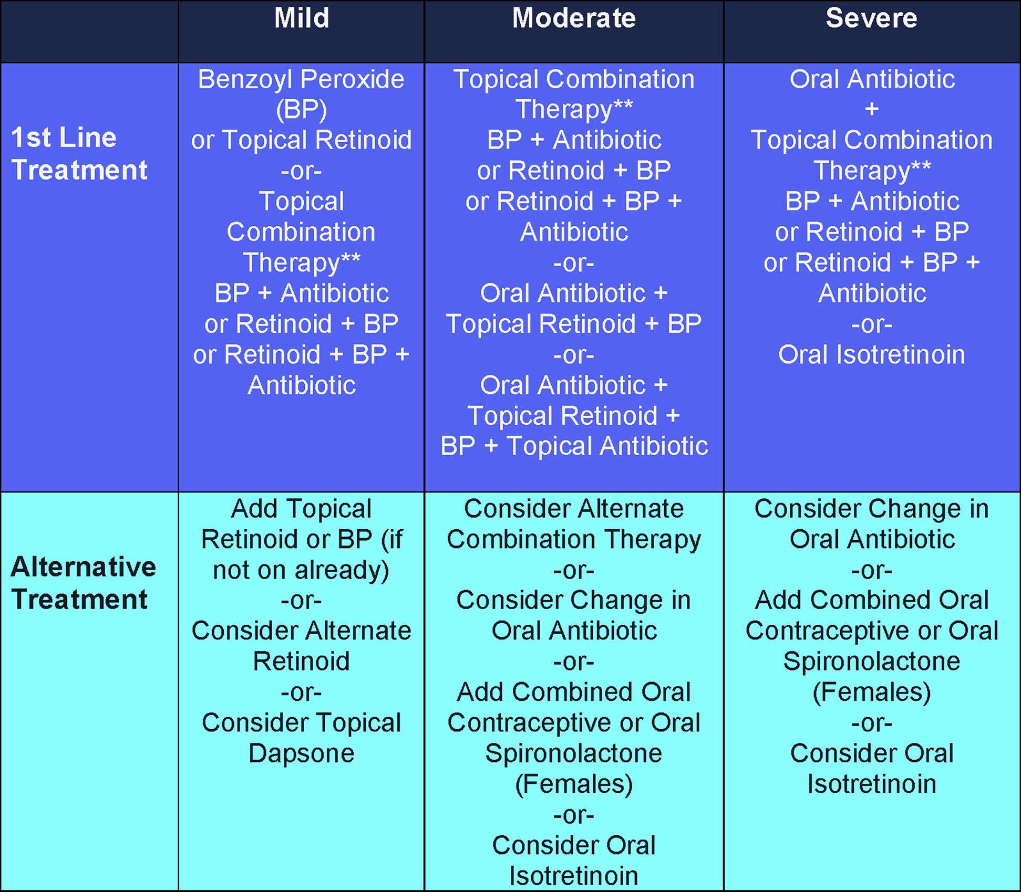

Management guidelines
Journal of the American Academy of Dermatology 2016 74945-973.e33DOI: (10.1016/j.jaad.2015.12.037)
  Zaenglein et al, Guidelines of care for the management of acne vulgaris. J Amer. Acad. Derm 2016;74:5: 945-973
Copyright © 2016 American Academy of Dermatology, Inc. Terms and Conditions

Slide 9
Management guidelines—highlights
Antibiotics
Systemic antibiotics are recommended in the management of moderate and severe acne and forms of inflammatory acne that are resistant to topical treatments
Doxycycline and minocycline are more effective than tetracycline, but neither is superior to each other, sub-microbial doses may be useful (doxy 20 mg bid or 40 mg daily) but are not superior to standard dosing
Although oral erythromycin and azithromycin can be effective in treating acne, its use should be limited to those who cannot use the tetracyclines (i.e., pregnant women or children <8 years of age). Erythromycin use should be restricted because of its increased risk of bacterial resistance
Use of systemic antibiotics, other than the tetracyclines and macrolides, is discouraged because there are limited data for their use in acne. Trimethoprim-sulfamethoxazole and trimethoprim use should be restricted to patients who are unable to tolerate tetracyclines or in treatment-resistant patients
Systemic antibiotic use should be limited to the shortest possible duration. Typically not more than 3 months. Re-evaluate at 3-4 months to minimize the development of bacterial resistance. Monotherapy with systemic antibiotics is not recommended. A subset of patients may require longer courses but should be monitored closely and re-evaluated frequently
  Zaenglein et al, Guidelines of care for the management of acne vulgaris. J Amer. Acad. Derm 2016;74:5: 945-973

Slide 10
Microbiologic testing?
Not recommended except in cases not responding to conventional therapy, or when a mimicker is suspected
Infectious acne mimickers:
  Gram-negative folliculitis
  Pityrosporum follicuilitis (not covered today)
  Staph Aureus folliculitis (not covered today)

Slide 11
Gram negative Folliculitis
80% with superficial pustules, papules and comedones
  caused by Klebsiella, Escherichia and Serratia species
20% get deep, nodular and cyst-like lesions
  caused by Proteus which can cause deep abscesses and cysts
Hot-tub folliculitis, usually caused by Pseudomonas
  Usually self limited and resolves within days, but persistent cases can be treated with dilute vinegar baths or as directed by culture

Slide 12
Gram negative Folliculitis
  Images from DermnetNZ https://dermnetnz.org/topics/gram-negative-folliculitis
  https://creativecommons.org/licenses/by-nc-nd/3.0/nz/legalcode,

Slide 13
Gram negative Folliculitis—treatment
Directed by culture results
Fluoroquinolones have fallen out of favor
  Black box warning for tendonitis and tendon rupture (Achilles), myasthenia gravis, and permanent peripheral neuropathy.
  Carries “risks of mental health side effects and serious blood sugar disturbances. . . disabling and potentially permanent side effects involving tendons, muscles, joints, nerves and the central nervous system” -FDA
TMP-SMX or ampicillin are common choices
Isotretinoin, suppresses sebum production and dries nasal mucous membranes, where causative bacteria are harbored
  FDA news release on fluoroquinolones July 10, 2018
  https://dermnetnz.org/topics/gram-negative-folliculitis

Slide 14
Viruses, common and recently worrisome
Human Papillomavirus
Molluscum Contagiosum virus
Zika Virus

Slide 15
Human Papillomavirus
Highly prevalent DNA virus
>200 total types
Prevalence of more than 42 million people in the US with >13 million new infections yearly
Resists heat and desiccation, spreads via skin-to-skin or skin-to-surface
90% of infections clear on their own within 2 years
Some persist indefinitely without treatment, and can be associated with malignant changes
  Bolognia, J. Dermatology, Ch 78: Human Papillomaviruses
  https://www.cdc.gov/hpv/parents/index.html

Slide 16
HPV: Cancers
Every year in the United States, HPV causes about 36,000 cases of cancer.
  Possibly a huge underestimate, as Beta-types (5, 8, 9, etc.) have been recently implicated in cutaneous squamous cell cancers, along with UV radiation
Cervical, vaginal, and vulvar cancer in women
Penile cancer in men
Anal and oropharyngeal cancer in both sexes
Nearly 200,000 women are diagnosed with cervical precancer
11,000 women are diagnosed with cervical cancer caused by HPV
Over 4,000 women die from cervical cancer
  https://www.cdc.gov/hpv/parents/index.html

Slide 17
HPV: Cancers
Number of Cancers Caused by HPV in the United States Each Year
Cancer | Cases in Women | Cases in Men
Back of the Throat | 2,200 | 11,800
Cervical | 11,000 | 0
Anus | 4,400 | 2,100
Vulva | 2,800 | 0
Penis | 0 | 900
Vagina | 700 | 0
Total | 21,100 | 14,800
  https://www.cdc.gov/hpv/parents/index.html

Slide 18
HPV: Vaccine
Guardasil-9 (HPV types 6 and 11 (most common causes of genital warts, and the most common high risk types 16, 18, 31, 33, 45, 52, and 58
Approved from ages 9-45
Two doses 6-12 months apart if the first one is before the 15th birthday
  3 doses if given on or after the 15th birthday (0, 1-2, then 6 months)
Everyone through age 26 years should get HPV vaccine if they were not fully vaccinated already
Some adults age 27 through 45 years who were not already vaccinated might choose to get HPV vaccine after speaking with their doctor about their risk for new HPV infections and possible benefits of vaccination for them
Health care workers who treat HPV-related conditions (Dermatologists, Obstetricians and Gynecologists, Emergency physicians, Family physicians, etc.)
  https://www.cdc.gov/hpv/parents/index.html

Slide 19
HPV: Vaccines for therapy
Egypt: 44 adult patients with multiple recalcitrant common warts
  Present for >2 years, non-responsive to at least 2 standard therapies
22 patients received intramuscular injection of bivalent HPV vaccine at 0, 1, and 6 months or until complete clearance of warts
22 patients received intralesional injection of 0.1 to 0.3 mL of bivalent HPV vaccine into the largest wart at 2-week intervals until complete clearance or for a maximum of 6 sessions
Follow up every month for 6 months
Complete clearance of warts was observed in 18 patients (81.8%) of the intralesional group and 14 patients (63.3%) of the intramuscular group; however, the difference was not statistically significant. Adverse effects were transient and insignificant, and no recurrence was reported in either group
  Nofal, A. et. Al JAAD Jan 2020

Slide 20
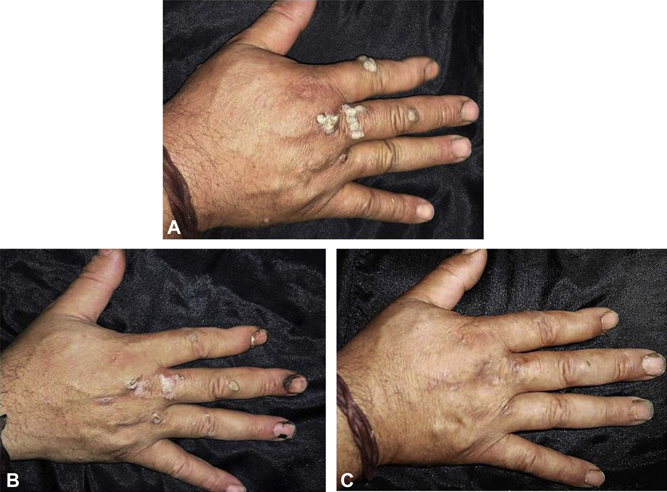
Recalcitrant multiple common warts on the dorsum of the right hand. A, Before therapy with intralesional bivalent human papillomavirus vaccine. B, Partial response after 2 sessions. C, Complete response after 4 sessions.
Journal of the American Academy of Dermatology 2020 8294-100DOI: (10.1016/j.jaad.2019.07.070)
Copyright © 2019 American Academy of Dermatology, Inc. Terms and Conditions
Notes:
Recalcitrant multiple common warts on the dorsum of the right hand. A, Before therapy with intralesional bivalent human papillomavirus vaccine. B, Partial response after 2 sessions. C, Complete response after 4 sessions.

Slide 21
HPV: Vaccines for therapy
Korea: 45 patients, single arm (no control), with multiple recalcitrant warts were injected with a recombinant 9-valent HPV vaccine (0.5 mL) at 0, 2, and 6 months. A recalcitrant wart was defined as a lesion persisting for more than 1 year and not responding to at least 2 conventional therapies. Patients who received concomitant treatments for warts during vaccination were excluded
At 3 months after the final dose of the HPV vaccine, 28 patients (62.2%) showed “complete response” (complete clearance of all warts), 4 patients (8.9%) showed “partial response” (decrease in the number or size of lesions but persistent lesions), and 13 (28.9%) showed “no response” (no change or increase in the number or size of lesions). The mean time to respond was 12.8 weeks (range 1-30 weeks) after the first injection, and the majority (81.3%) of the patients showed a clinical improvement after the first and second injections: 37.5% after the first injection and 43.8% after the second injection. No recurrence was observed in the complete response group
  Shin, J et. Al. JAAD in press

Slide 22
Molluscum contagiosum
A double-stranded DNA virus in the poxviridae family (smallpox, vaccinia, orf, monkeypox, etc)
With eradication of smallpox in 1980, it is the only remaining poxvirus to specifically infect humans.
Two types with indistinguishable lesions
Spread by skin-to-skin contact or by fomites
Very common in children, self limited, most cases clear within several months to several years, even without treatment
also in adults, usually sexually transmitted, more often in immunocompromised, notably HIV-infected
  Bolognia, J. Dermatology Ch 81: Other Viral Diseases; Poxvirus infections

Slide 23
Molluscum contagiosum—to treat or not?
Johns Hopkins: Telephone survey conducted 2-5 years after diagnosis of Molluscum Contagiosum (MC) in 170 children. 51.8% female, 77.1% Caucasian, median age 5 years, 46.5% had history of atopic dermatitis (AD), and those had significantly more MC lesions than those without AD
73% were not treated, 27% were, with tretinoin (8%), imiquimod (7%), cantharidin (6%), cryotherapy (5%), and curettage (4%) (4 patients got 2 treatments)
MC lesions completely resolved in 50% of children within 12 months and 70% of children within 18 months. Treatment did not shorten time to resolution
Basdag H, Rainer B, Cohen B. Molluscum contagiosum: to treat or not to treat? Experience with 170 children in an outpatient clinic setting in the northeastern United States. Pediatr Dermatol. May-Jun 2015;32(3):353-7.

Slide 24
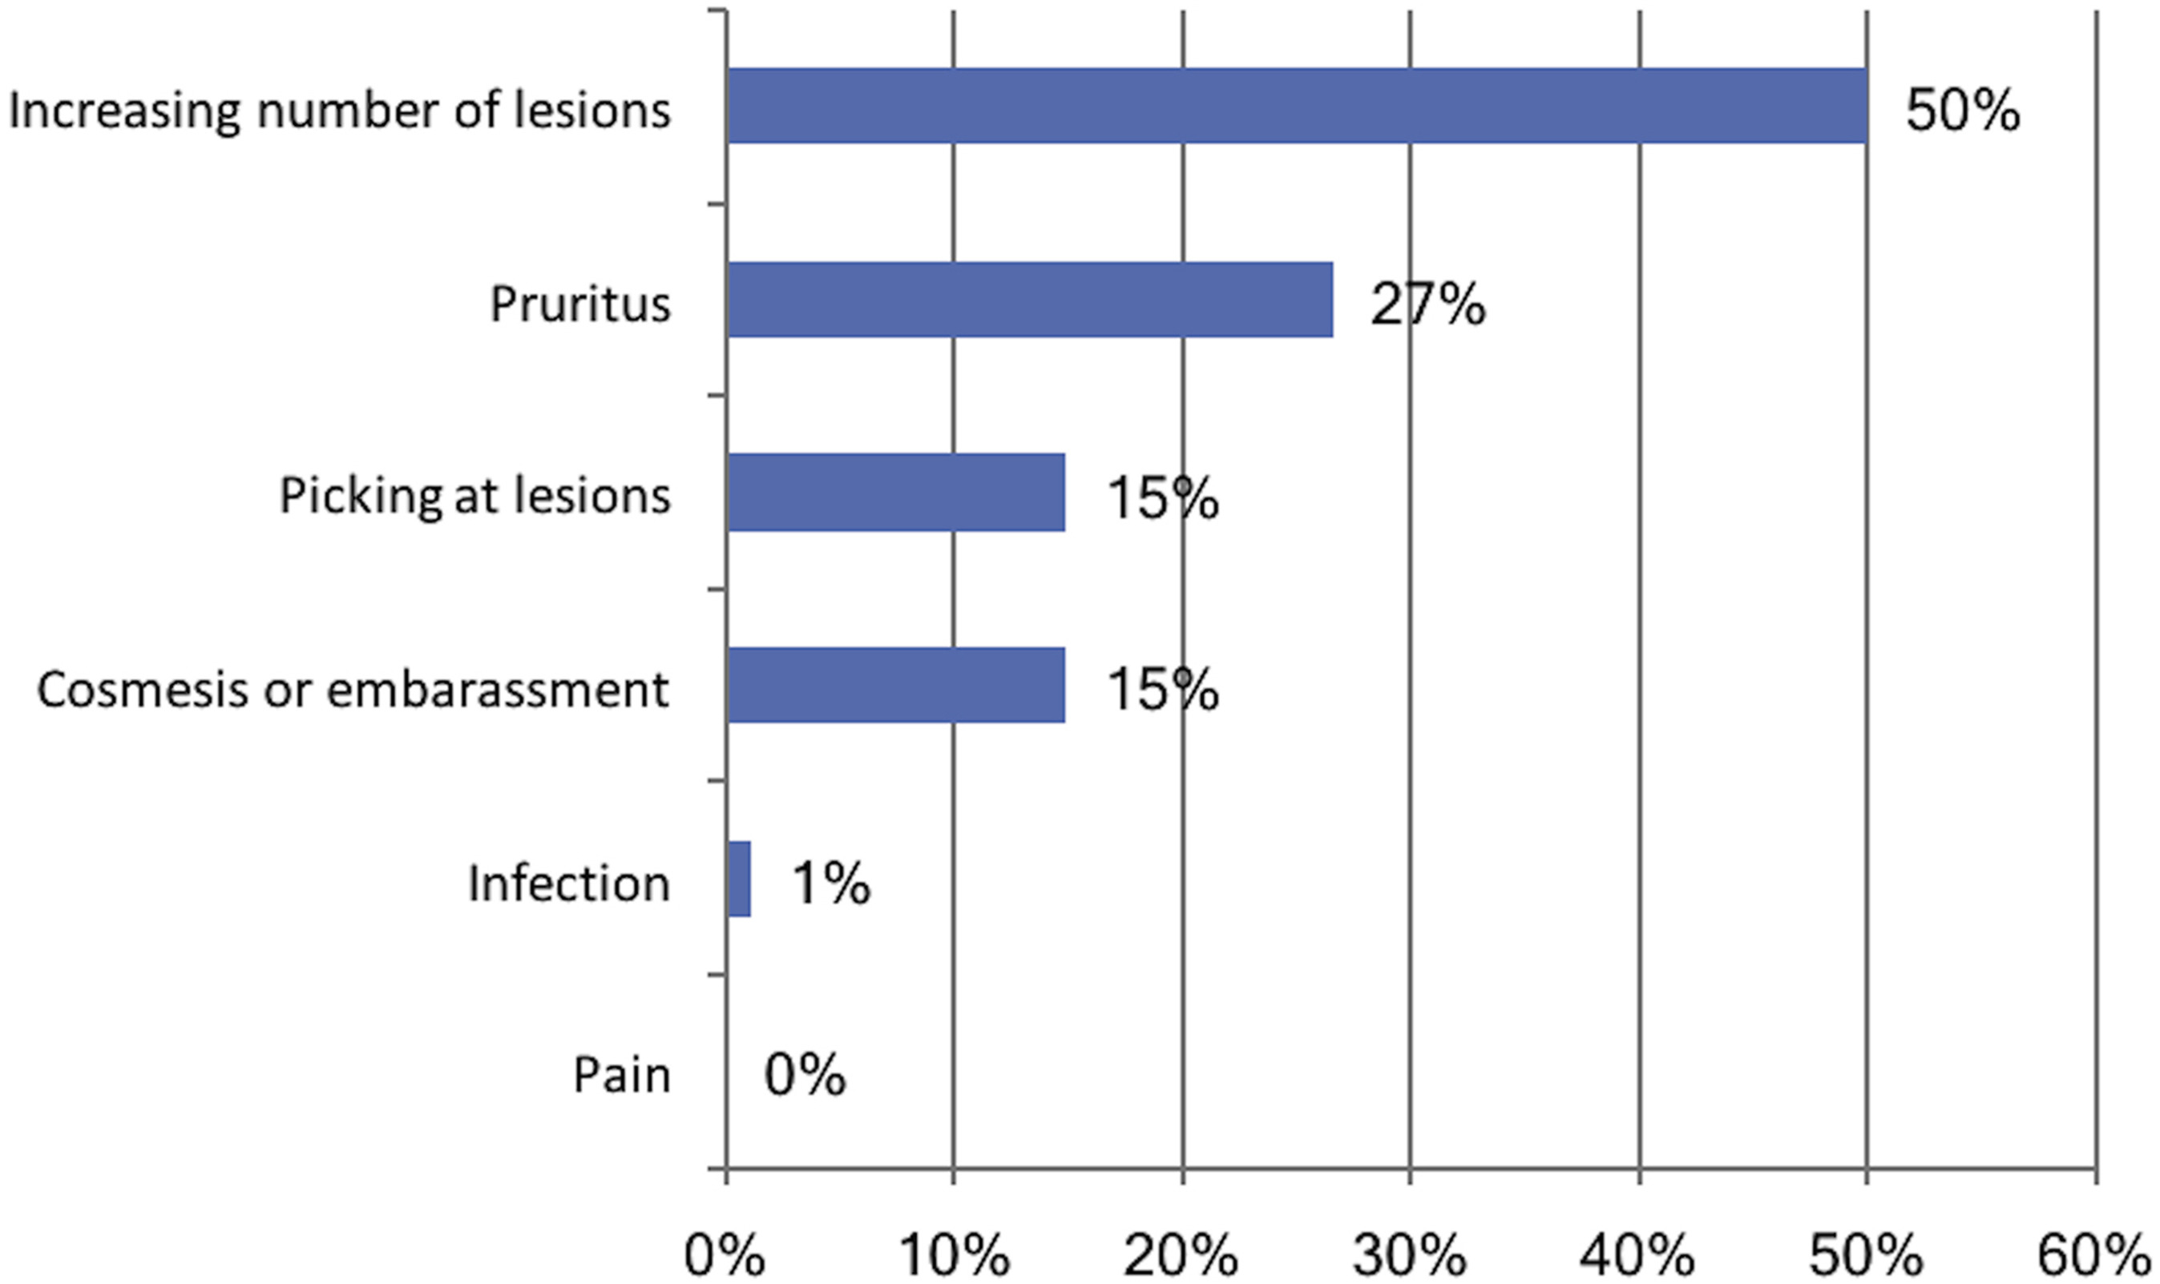
Molluscum contagiosum--treatments
When caregivers seek treatment, what reasons do they give?
Journal of the American Academy of Dermatology 2018 78198-200DOI: (10.1016/j.jaad.2017.08.044)
Jahnke M, et al. Cantharidin for treatment of facial molluscum contagiosum: A retrospective review. J Amer. Acad. Derm, Jan 2018. 78:1: p198-200
Copyright © 2017 American Academy of Dermatology, Inc. Terms and Conditions

Slide 25
Molluscum contagiosum--treatments
62 caregivers of children were contacted by phone survey in Detroit after treatment of molluscum on the face with 0.7% cantharidin solution
Average age of children was 5 years
Most common adverse events were discoloration (18%), severe blistering (10%), and severe pain (10%). “Severe” was defined as an excessive amount or an amount greater than what the caregiver expected. more than expected by the caregiver)
Often could not confirm if they washed off the cantharidin as recommended (1.5-2 hours after in-office application)
94% would recommend treatment again for facial lesions
Most common reasons for incomplete satisfaction was related to time constraints: the need for multiple office visits and preference for at-home treatments
Jahnke M, et al. Cantharidin for treatment of facial molluscum contagiosum: A retrospective review. J Amer. Acad. Derm, Jan 2018. 78:1: p198-200

Slide 26
Molluscum contagiosum--treatments
Pulsed dye laser is another effective alternative
43 patients, mean age 8.9 yrs, (range 1-48), applied a topical anesthetic under occlusion 1-2 hrs before treatment. Spot size of 7 mm, fluence of 10 J/cm2, pulse width of 450 ms
  1250 lesions, all lesions resolved and 35% had no new lesions after 2 treatments
  42 of 43 patients tolerated the procedure well enough to request a 2nd treatment
15 children aged 3-5 years, targeted once with 3 mm spot size, 8.0 J/cm2 and pulse width of 300 ms
  Children remarked laser was less painful than curettage, and all 3 patients who had new lesions wished to get the laser treatment again
  Side effects of purpura lasting 2-3 weeks, and discoloration in some treated areas
Hancox J, et al. Treatment of Molluscum contagiosum with the pulsed dye laser over a 28-month period. Cutis. 2003; 71:414-416
Omi T, et al. Recalcitrant molluscum contagiosum successfully treatd with the pulsed dye laser. Laser Therapy. 2013; 22.1:51-54

Slide 27
Zika virus: Epidemic 2015-2019
2015: 62 cases, 1-11 in Utah
2016: 5168 total, 222 from local mosquitos (6 TX, 218 FL), 45 sex, 1 lab, 1 unknown person to person, 12-22 in Utah
2017: 452 total, 7 from local mosquitos (5 TX, 2 FL), 8 from sex, 1 from laboratory transmission, 1-11 in Utah
2018: 74 total, 1 from lab, 1-11 in Utah
2019: 28 total, 1 from lab, 1-11 in Utah
2020: 4 total (all east coast)
2021: 1 total (is it over?)
  https://www.cdc.gov/zika/reporting/2021-case-counts.html

Slide 28
Zika Virus
Zika virus is a small, spherical, single-stranded enveloped RNA virus belonging to family Flaviviridae, genus Flavivirus
Zika virus was first described in humans in the 1960s in Nigeria. It was first reported outside Africa in 2007 when a case was reported on the island of Yap in Micronesia
The mosquito Aedes aegypti is the main Aedes species involved in transmitting the zika virus from infected individuals to healthy contacts. These mosquitoes breed in and around ponds of stagnant water where humans live and usually bite during daylight hours. When a human is infected the virus circulates the blood for 10 days before symptoms occur. It is during this time that the Aedes mosquito may acquire the virus, then bite and infect another unsuspecting victim
  https://www.cdc.gov/zika/index.html
  https://dermnetnz.org/topics/zika-virus

Slide 29
Aedes Mosquito
  Image from CDC Zika virus homepage https://www.cdc.gov/zika/index.html

Slide 30
Zika Virus, transmission and symptoms
Zika virus can be transmitted from an infected mother to a baby at the time of birth, or transmitted by sexual intercourse if the partner is infected
Zika virus infection arises about 10 days after a bite from an infected mosquito. It results in headache, mild fever, chills, conjunctivitis (red eyes), joint and muscle aches and an itchy rash. Other non-specific symptoms may include headache, fatigue, malaise, abdominal pain and vomiting
Dysaesthesia (numbness, tingling) may occur, as well as autonomic symptoms such as dry mouth, dry skin, dry eyes and bladder incontinence
Zika virus infection usually recovers within a week
  https://www.cdc.gov/zika/index.html
  https://dermnetnz.org/topics/zika-virus

Slide 31
Zika Virus, the rash
The rash associated with zika virus is either morbilliform (papules) or scarlatiniform (micropapules). It starts on the face on the first day of illness and spreads to trunk and limbs. The rash may affect palms and soles, which may be swollen. It begins to fade within 2–3 days and is gone completely within a week
At the same time, the eyes become sore and red and may be sensitive to the light. Small red dots, petechiae, may be observed inside the mouth on the palate
  https://www.cdc.gov/zika/index.html
  https://dermnetnz.org/topics/zika-virus

Slide 32
Zika Virus, the rash
  Images from DermnetNZ https://dermnetnz.org/topics/zika-virus
  https://creativecommons.org/licenses/by-nc-nd/3.0/nz/legalcode,

Slide 33
Zika Virus, the rash
  Images from DermnetNZ https://dermnetnz.org/topics/zika-virus
  https://creativecommons.org/licenses/by-nc-nd/3.0/nz/legalcode,

Slide 34
Zika Virus, complications
Birth Defects
  fetal loss, growth retardation, microcephaly, Intracranial calcifications
  CDC—serial ultrasound to monitor fetal growth and anatomy
Guillian-Barré syndrome
  https://www.cdc.gov/zika/index.html
  https://dermnetnz.org/topics/zika-virus

Slide 35
Zika Virus, diagnosis
No current outbreaks, dengue cases outnumber Zika by 200:1
No testing recommended in non-pregnant patients, (just test for Dengue is they have symptoms and have traveled to an endemic area)
Symptomatic pregnant women, who have traveled to an area with a dengue outbreak and a risk of Zika, should get:
  Serum PCR (NAAT) for Dengue and Zika virus, and urine PCR (NAAT) for Zika virus
  IgM testing for dengue only
Zika virus IgM testing is NOT recommended for symptomatic pregnant women
If PCR is positive, repeat to rule out false positive, and if any dengue test is positive, no further testing is recommended
  Zika IgM antibodies can persist for months to years following infection. Therefore, detecting Zika IgM antibodies might not indicate a recent infection
  There is notable cross-reactivity between dengue IgM and Zika IgM antibodies in serologic tests. Antibodies generated by a recent dengue virus infection can cause the Zika IgM to be falsely positive
  https://www.cdc.gov/zika/hc-providers/testing-guidance.html

Slide 36
Zika Virus, management
No specific treatment
Usually self-limiting and resolves with supportive therapy. Acetaminophen may be used to treat patients with fever. Aspirin and nonsteroidal anti-inflammatory drugs (NSAIDs) are not recommended
Drink plenty of fluids, rest
Avoid blood donation
Wear DEET, protective clothing, etc to protect from getting mosquito bites and potentially spreading the virus to others
  https://dermnetnz.org/topics/zika-virus

Slide 37
References
Zaenglein et al, Guidelines of care for the management of acne vulgaris. J Amer. Acad. Derm 2016;74:5: 945-973
FDA news release on fluoroquinolones July 10, 2018
https://dermnetnz.org/topics/gram-negative-folliculitis
Dermatology. Bolognia Ch 79: Human Papillomaviruses
https://www.cdc.gov/hpv/parents/index.html
https://www.cdc.gov/vaccines/hcp/vis/vis-statements/hpv.html
Nofal A, et al. Intralesional versus intramuscular bivalent human papillomavirus vaccine in the treatment of recalcitrant common warts. J. Amer. Acad. Derm Jan 2020. 82:1;p94-100
Shin J, et al. Nonavalent human papilloma virus vaccine for the treatment of multiple recalcitrant warts: An open-label study. J. Amer. Acad. Derm, in press, published online March 27, 2021
Basdag H, et al. Molluscum contagiosum: to treat or not to treat? Experience with 170 children in an outpatient clinic setting in the northeastern United States. Pediatr Dermatol. May-Jun 2015;32(3):353-7.
Jahnke M, et al. Cantharidin for treatment of facial molluscum contagiosum: A retrospective review. J Amer. Acad. Derm, Jan 2018. 78:1: p198-200
Dermatology. Bolognia Ch 81: Other Viral Infections
Hancox J, et al. Treatment of Molluscum contagiosum with the pulsed dye laser over a 28-month period. Cutis. 2003; 71:414-416
https://www.cdc.gov/zika/reporting/2021-case-counts.html
https://www.cdc.gov/zika/hc-providers/testing-guidance.html
https://dermnetnz.org/topics/zika-virus
  https://www.cdc.gov/zika/reporting/2021-case-counts.html

Slide 38
Thank You!

