Slide 1
HIV Prevention (PrEP) Prevention is Key in Decreasing HIV
Harry Rosado-Santos, MD, FACP, AAHIVM
Associate Professor (clinical), University of Utah
Last Updated: Jul 2021

Slide 2
Land Acknowledgement
We acknowledge that this land, which is named for the Ute Tribe, is the traditional and ancestral homeland of the Shoshone, Paiute, Goshute, and Ute Tribes. We recognize and respect the enduring relationship that exists between many Indigenous peoples and their traditional homelands.
We respect the sovereign relationship between tribes, states, and the federal government, and we affirm our commitment to a partnership with Native Nations and Urban Indian communities through research, education, and community outreach activities.
diversity/utah.edu/centers/airc/

Slide 3
No conflicts of interest or relationships to disclose

Slide 4
https://www.cdc.gov/actagainstaids/index.html

Slide 5
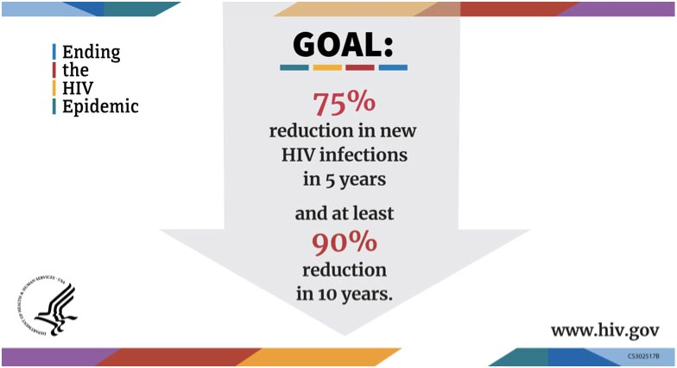
https://www.hiv.gov/federal-response/ending-the-hiv-epidemic/overview?s_cid=ht_endinghivinternet0006

Slide 6
HIV prep
https://www.cdc.gov/vitalsigns/end-hiv/index.html

Slide 7
Objectives
Identify patients at risk for acquiring HIV and when to recommend HIV PrEP (Pre-Exposure Prophylaxis)
Properly prescribe and monitor HIV PrEP according to DHHS guidelines
Updates on FTC/TAF (Descovy)
Identify patients who may be candidates for HIV nPEP (non-occupational Post Exposure Prophylaxis)
Review how PrEP may be implemented into your practice

Slide 8
New HIV Diagnosis in Utah
In 2019:
134 New HIV Diagnoses
2,625 People Living with Diagnosed HIV
https://ptc.health.utah.gov/wp-content/uploads/2020/09/2019_HIV-and-STD-Prevention-and-Surveillance-Program_Surveillance-Update.pdf

Slide 9
Geography of HIV Diagnosis in Utah
https://ptc.health.utah.gov/wp-content/uploads/2020/09/2019_HIV-and-STD-Prevention-and-Surveillance-Program_Surveillance-Update.pdf

Slide 10
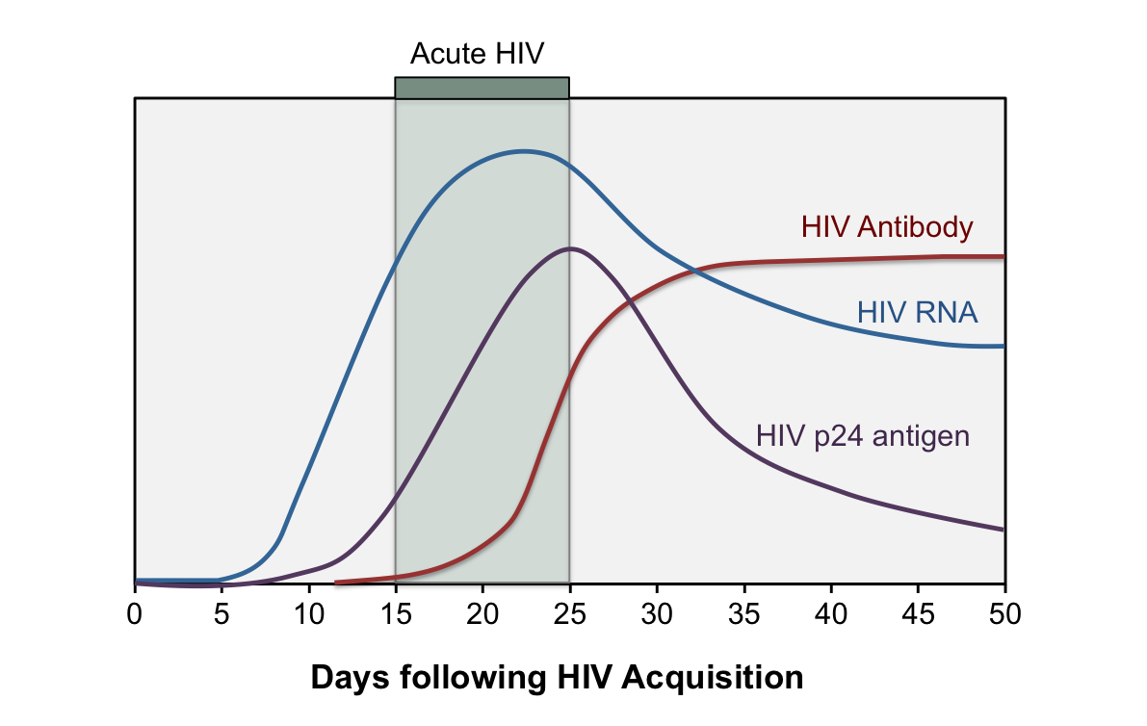
Notes:
Acute HIV is defined as the phase of HIV disease that occurs immediately after HIV acquisition and is characterized by detectable HIV RNA or HIV p24 antigen in the absence of anti-HIV antibodies
The laboratory diagnosis of acute HIV-1 infection is most reliably made with a positive HIV RNA (or HIV-1 p24 antigen) with a concomitant negative (or indeterminate) HIV antibody assay
Since HIV p24 antigen is detected approximately 1 week prior to HIV antibody, the fourth-generation HIV antigen-antibody tests have become an attractive initial screening test that has improved diagnosis of persons with acute HIV infection
Regardless of what immunoassay is used, initial laboratory testing will fail to detect some individuals with very recent HIV infection. Thus, for individuals in whom initial HIV testing is nonreactive but acute HIV infection is strongly suspected, HIV RNA testing should be performed
Initial immune response
The uncontrolled initial burst of viremia in the acute phase typically causes very high plasma HIV RNA levels, often greater than 100,000 copies/mL, and is associated with a surge of inflammatory cytokines

Slide 11
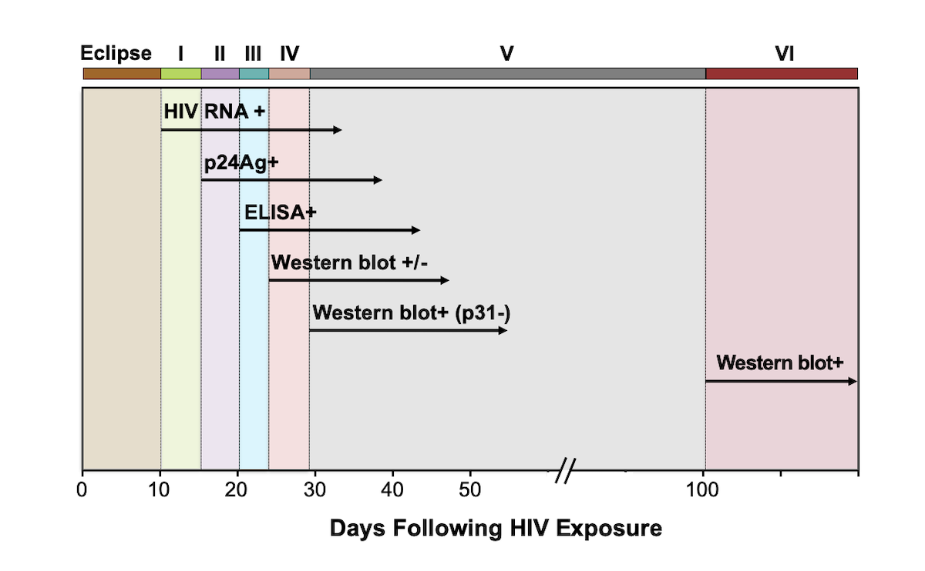
Fiebig Laboratory Staging of Early HIV Infection

Slide 12
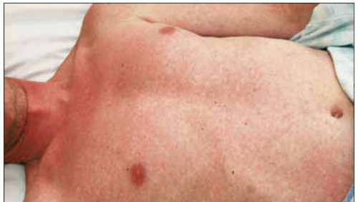
Acute HIV Infection
Skin rash

Slide 13
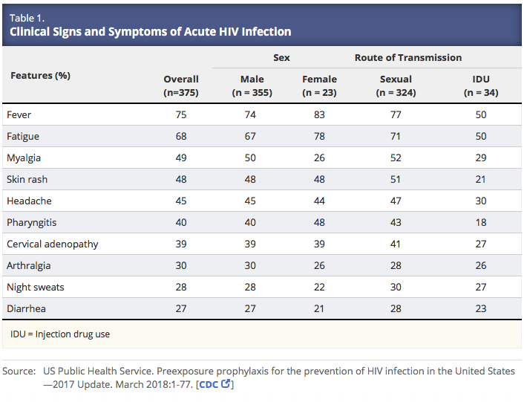

Slide 14
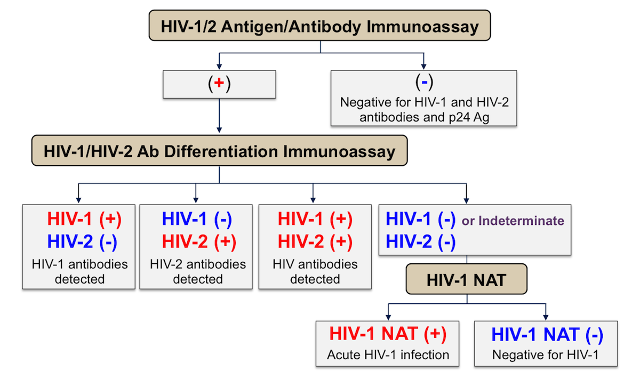
https://stacks.cdc.gov/view/cdc/50872
Notes:
The traditional HIV testing algorithm previously recommended by the Centers for Disease Control and Prevention (CDC) involved using an HIV enzyme immunoassay (EIA) as the screening assay and HIV Western immunoblot (or indirect HIV immunofluorescence assay) as the supplemental (confirmatory) test.
In June 2014, the CDC and the Association of Public Health Laboratories (APHL) published new HIV testing recommendations that use a fourth-generation HIV-1/2 antigen (p24)/antibody combination assay as the screening test and an HIV-1/2 differentiation immunoassay as a follow-up differentiation assay for all positive screening tests (Figure 1).
When the initial antigen-antibody screening test is positive, but the HIV-1/2 differentiation test is negative, an HIV-1 RNA assay is performed to determine whether the individual has acute HIV infection or a false-positive screening test.
The major advantage of the new testing algorithm is improved detection of persons with acute HIV infection (when compared with conventional third-generation EIA tests).
Nevertheless, persons with very early acute infection likely will not be detected using the p24/antibody combination assay, but may be detected with an HIV-1 RNA assay. Accordingly, if acute HIV infection is clinically suspected, an HIV RNA test should be ordered as part of the diagnostic evaluation.
The second major advantage of this new testing algorithm is the ability of the HIV-1/2 differentiation assay to detect unsuspected HIV-2 infection. The fourth-generation antigen/antibody combination assay and the HIV-1/2 differentiation assay are commercially available and can be performed rapidly.

Slide 15
Prevent
https://www.cdc.gov/mmwr/volumes/68/wr/mm6827a1.htm
Notes:
A prevention strategy in which individuals at highest risk of HIV infection take a medication regularly (along with continued behavioral risk-reduction strategies) to prevent HIV infection.
Truvada was approved for HIV PrEP by the FDA in July 2012 and is a fixed dose combination of tenofovir and emtricitabine.
Truvada is modestly effective at reducing Herpes Simplex (HSV) acquisition and has reduced the rate of Hepatitis B acquisition in certain populations.^{1, 2, 3}

Slide 19
Prevention Science Overview: Biomedical Intervention Efficacy
Modified from Abdool Karim, Lancet, 2011
Notes:
So, if we put this information in the context of other studies, if PrEP is taken as prescribed, the efficacy is huge, approaching almost 100% efficacy at preventing HIV infection.

Slide 20
PrEP for HIV Prevention: Candidates
 | MSM | Heterosexual Women and Men | Injection Drug Users
Potential indicators of substantial risk of acquiring HIV infection | HIV-positive sexual partner Recent bacterial STI High number of sex partners History of inconsistent or no condom use Commercial sex work | HIV-positive sexual partner Recent bacterial STI High number of sex partners History of inconsistent or no condom use Commercial sex work In high-prevalence area or network | HIV-positive injecting partner Sharing injection equipment Recent drug treatment (but currently injecting)
Clinically eligible | Documented negative HIV test result; no signs/symptoms of acute HIV infection Creatinine clearance ≥ 60 mL/min; no contraindicated medications Documented hepatitis B virus infection and vaccination status
https://www.cdc.gov/hiv/pdf/risk/prep/cdc-hiv-prep-guidelines-2017.pdf
Slide credit: clinicaloptions.com
Notes:
GOOD Social history including SEXUAL/Social HISTORY
CDC, Centers for Disease Control and Prevention; MSM, men who have sex with men; PrEP, pre-exposure prophylaxis; STI, sexually transmitted infection.

Slide 21
Laboratory Tests and Other Diagnostic Procedures
HIV serology
HIV 1 / 2- Ag/Ab with reflex to confirmation -
STD testing
GC/CT- throat, urine and rectal
Baseline and every 3 months for MSM and heterosexual if Hx STD
Syphilis
Baseline and every 3 months for MSM and heterosexual if Hx STD
Other testing
Pregnancy test
Notes:
Both the FDA labeling information6 and the perinatal antiretroviral treatment guidelines124 permit off-label use in pregnancy. However, data directly related to the safety of PrEP use for a developing fetus are limited.
In the PrEP trials with heterosexual women, medication was promptly discontinued for those who became pregnant, so the safety for exposed fetuses could not be adequately assessed
Additionally, TDF and FTC are widely used for the treatment of HIV infection and continued during pregnancies that occur126-128. The data on pregnancy outcomes in the Antiretroviral Pregnancy Registry provide no evidence of adverse effects among fetuses exposed to these medications.

Slide 22
Patients with Chronic Active Hepatitis B Virus Infection
Hepatitis Serology (HB S Ab/Ag, HB core Ab)
HBV and HCV infection status should be documented by screening serology before TDF/FTC or FTC/TAF are prescribed as PrEP
Patients susceptible to HBV infection should be vaccinated
Both Tenofovir DF/TAF & Emtricitabine are active against HIV infection and HBV infection
POSITIVE for hepatitis B surface antigen (HBsAg)
Consider referral to GI clinic
HBV DNA Quantitative testing for the level of HBV replication before PrEP is prescribed and every 6-12 months while taking PrEP

Slide 23
Laboratory Tests and Other Diagnostic Procedures (cont.)
Renal Function Testing
FTC/TDF (Truvada) PrEP and HBV can decrease renal function
FTC/TAF (Descovy) less renal toxicity
Any person with an eCrCl of <60 ml/min should NOT be prescribed Tenofovir DF/Emtricitabine (Descovy should be used)
Any person with an eCrCl < 30 should not be prescribe Descovy
Cockcroft-Gault Formula
Cockcroft-Gault CrCl = [(140-age) x (Wt in kg) x (0.85 if female)] / (72 x Cr)
https://www.hiv.uw.edu/page/clinical-calculators/crcl

Slide 24
Clinical Follow-up & Monitoring: 3 months
Repeat HIV testing
assess for signs or symptoms of acute HIV Infection
Repeat pregnancy testing
women who may become pregnant
Prescription or refill for 90 day prescription
Assess side effects, adherence, and HIV acquisition risk behaviors
Provide support for medication adherence and risk-reduction behaviors

Slide 25
Adverse Events
AEs observed in HIV-uninfected participants in PrEP trials
Nausea, flatulence, headaches
Potential bone and renal toxicity
Known risk associated with Tenofovir DF
Potential for other serious AEs with long-term use
Tenofovir DF/Emtricitabine commonly used in HIV infection
Potential for drug-resistant HIV infection
Infrequent in clinical trials but must exclude HIV infection
1. CDC. PrEP Guideline. 2014. 2. Grant RM, et al. N Engl J Med. 2010;363:2587-2599.
Notes:
AE, adverse event; FTC, emtricitabine; PrEP, pre-exposure prophylaxis; TDF, tenofovir. 2001
We must encourage our patients to think about the risk and benefit of PrEP because that conversation is likely going to evolve as their risks change and their health changes. We want to inform patients about adverse events observed in HIV-uninfected participants in PrEP trials.
Fortunately, these adverse events have been mild and not frequently reported. In the iPrEx trial, for example, there was a small but statistically significant side effect of early nausea which likely led to some small weight loss. As we know, tenofovir is associated with bone and renal toxicity, and there is the potential for other serious adverse effects with long-term use.
When counseling my patients, I often tell them about my experience with HIV therapy. I reassure them that tenofovir and FTC has been prescribed for many years in people living with HIV, and we have a lot of confidence in our knowledge of the medication. But I do explain that there are some areas where understanding is lacking. For example, I’ll say that men and women living with HIV often have many chronic health problems, and while HIV is likely the cause for that, we’re uncertain how much medications such as tenofovir and FTC contribute to that. So there is some acceptance on the part of the patient as to the potential for other adverse effects, especially with long-term use, and as was shown earlier, the potential for drug-resistant HIV infection if somebody had unrecognized acute HIV infection when they started taking PrEP.

Slide 26
Drug Interactions
Tenofovir disoproxil fumarate
Drugs that reduce renal function or compete for active renal tubular secretion
Acyclovir, valacyclovir, cidofovir, ganciclovir, valganciclovir
Aminoglycosides
Ledipasvir/sofosbuvir
High dose or multiple NSAIDS
Creatine supplement
Emtricitabine
No significant interactions
Notes:
Competition for active renal tubular secretion which can increase the concentration of TFV in the kidneys (MRP2, MRP4, OAT1)
Creatine is used to improve athletic performance and increase muscle strength

Slide 27
Key Considerations with HIV PrEP
HIV PrEP with TDF/FTC (Truvada) is >80-90% effective, assuming excellent adherence
Failures with good adherence are quite rare
Side effects are generally mild and transient
Screen for HIV (Ag/Ab test) before starting
Individuals continue to have high risk of STI’s after starting HIV PrEP – regular screening is important (every 3 months)
Sources: PrEP Guidelines, aidsinfo.nih.gov or cdc.gov

Slide 28
HIV PrEP- failures

Slide 29
PrEP Works, but Adherence Is Critical
Study | Efficacy Overall, % | Blood Samples With TFV Detected, % | Efficacy By Blood Detection of TFV, %
iPrEx^{[1]} | 44 | 51 | 92
iPrEx OLE^{[2]} | 49 | 71 | NR
Partners PrEP^{[3]} | 67 (TDF) 75 (TDF/FTC) | 81 | 86 (TDF) 90 (TDF/FTC)
TDF2^{[4]} | 62 | 80 | 85
Thai IDU^{[5]} | 49 | 67 | 74
Fem-PrEP^{[6]} | No efficacy | < 30 | NR
VOICE^{[7]} | No efficacy | < 30 | NR
1. Grant RM, et al. N Engl J Med. 2010;363:2587-2599. 2. Grant RM, et al. Lancet Infect Dis. 2014; 14:820-829. 3. Baeten JM, et al. N Engl J Med. 2012;367:399-410. 4. Thigpen MC, et al. N Engl J Med. 2012;367:423-434. 5. Choopanya K, et al. Lancet. 2013;381:2083-2090. 6. Van Damme L, et al. N Engl J Med. 2012;367:411-422. 7. Marrazzo J, et al. CROI 2013. Abstract 26LB.
Notes:
FTC, emtricitabine; NR, not reported; PrEP, pre-exposure prophylaxis; TDF, tenofovir disoproxil fumarate; TFV, tenofovir.
Oral PrEP works, but adherence is critical. For IPrEx, when you analyze efficacy with the detection of tenofovir in the person’s blood, it showed that if you took tenofovir as instructed, the efficacy of PrEP was 92%.

Slide 30
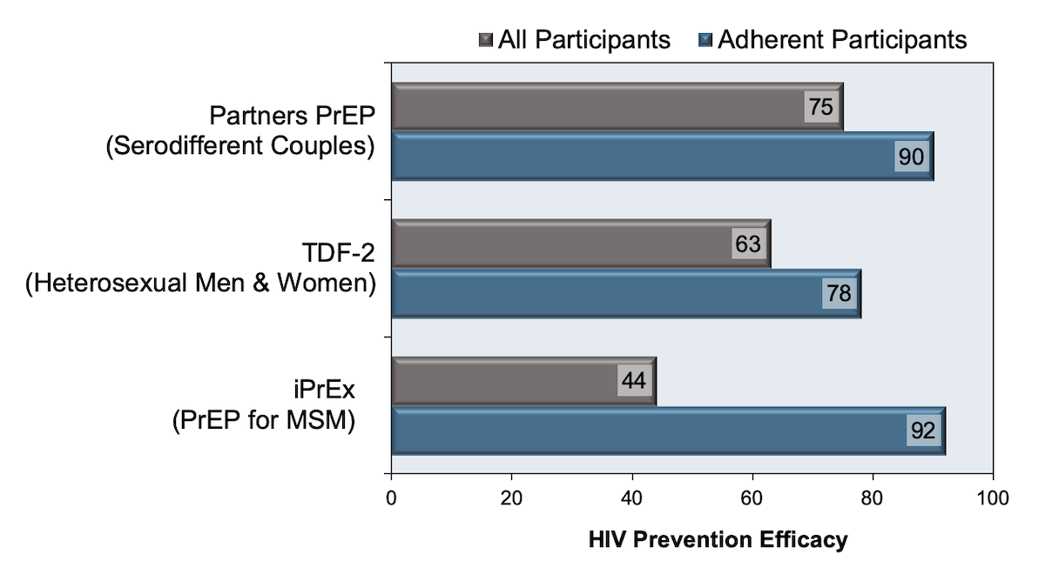
PrEP adherence

Slide 31
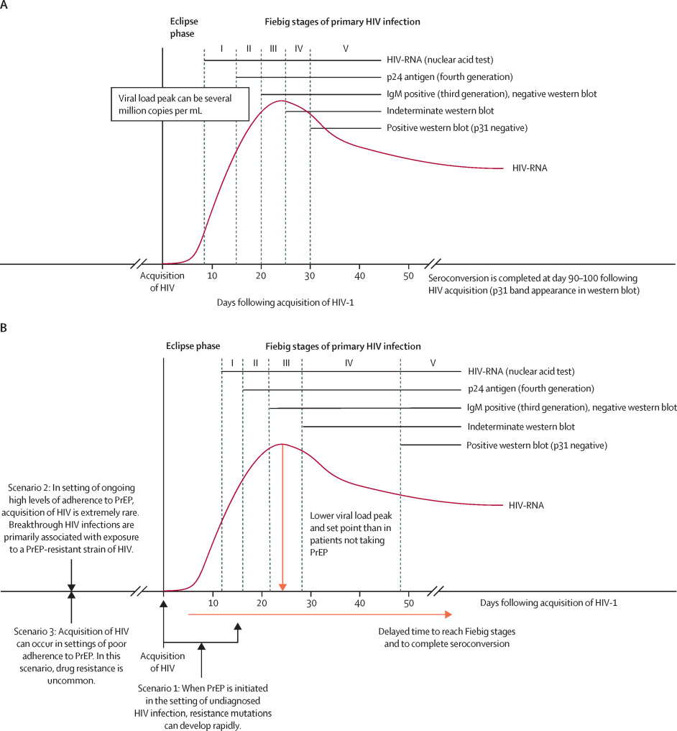

Slide 32
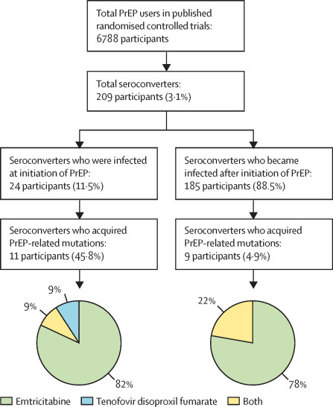
PrEP failure
Primary HIV-1 infection in users of pre-exposure prophylaxis/The Lancet HIV-Vol-8, issue 3

Slide 33
Counseling
Key messages in efficacy:
When taken daily with excellent adherence, PrEP is over 90% effective for preventing HIV (CDC)
Protective drug levels
Rectal tissues after 7 days
Blood & vaginal tissues after 20 days
If planning to stop PrEP, continue PrEP for 28 days after last potential HIV exposure
PrEP does not prevent gonorrhea, chlamydia, syphilis, genital warts, herpes, or Hepatitis C
Notes:
Competition for active renal tubular secretion which can increase the concentration of TFV in the kidneys (MRP2, MRP4, OAT1)
Creatine is used to improve athletic performance and increase muscle strength

Slide 34
Key Components of Medication Adherence Counseling
Adverse events
Barriers to adherence
Missed doses
Normalization and nonjudgement
Emphasize importance of adherence
Patient self-reporting may not reflect actual adherence
1. CDC. PrEP Guideline. 2014. 2. Van Der Straten A, et al. CROI 2014. Abstract 44. 3. Baxi SM, et al. CROI 2014. Abstract 953.
Notes:
Key components of medication adherence counseling include addressing adverse effects. So if somebody’s having persistent nausea, altered bowel movements, we want to try and identify ways in which we can reduce that adverse effect burden. We want to identify barriers to adherence, which may include shift work issues such as our case or logistical issues—getting to the pharmacy—financial issues with copayments, etc.
Respond to missed doses with normalization, nonjudgment, and emphasize the importance of adherence. Keep in mind, patient self-reporting of adherence may not reflect actual adherence. We can use other methods for this, although many are not available in the clinical realm, and that includes therapeutic drug monitoring, and also pharmacy reporting of prescription refills.

Slide 35
Accessibility to PrEP
Truvada is now generic
Cost-
Most insurance plans will cover for PrEP
Prior authorization may be required (Descovy)
Uninsured support available through Gilead advancing access program

Slide 36
PrEP

Slide 37
Ending the HIV Epidemic: Ready, Set, PrEP
Pre-exposure prophylaxis (or PrEP) medications are prescription medications that people take daily to significantly reduce their risk of acquiring HIV through sex.
PrEP can stop HIV from taking hold and spreading throughout the body. Two medications are FDA-approved for use as PrEP: TRUVADA and DESCOVY.
When taken daily, PrEP is highly effective for preventing HIV from sex.

Slide 38
Ending the HIV Epidemic: Ready, Set, PrEP
The Ready, Set, PrEP program makes PrEP medication available at no cost for qualifying recipients. To receive PrEP medication through this program, you must:
Lack prescription drug coverage
Be tested for HIV with a negative result
Have a prescription for PrEP
Talk to your healthcare provider or find a provider at HIV.gov Locator to find out if PrEP is right for you.

Slide 39
Emtricitabine + Tenofovir Alafenamide FTC/TAF (Descovy)
DESCOVY

Slide 40
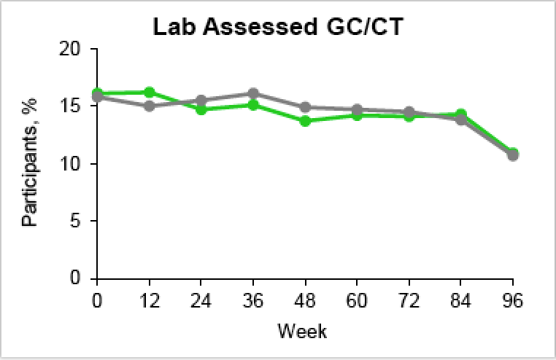
FTC/TAF vs FTC/TDF for PrEP DISCOVER: Conclusions & Concerns
Investigator conclusions:
FTC/TAF non-inferior to FTC/TDF for PrEP in high-risk cis-MSM & TGW
Both drugs well tolerated but bone & renal outcomes favored FTC/TAF
High-risk sexual behavior constant with no e/o risk compensation
Concerns:
Limited follow-up and low event rate
No participant with renal dysfunction
Generalizability
Source: Hare B et al. CROI 2019, Seattle, WA.

Slide 41
Considerations with FTC/TAF
Not indicated for cis-gender women or transgender men at risk for acquiring HIV through receptive vaginal intercourse
May be associated with weight gain
Financial assistance available

Slide 42
Summary of Key Studies Long-Acting Injectable Cabotegravir for HIV PrEP
Phase 2b/3 Trials - HPTN 083: IM CAB versus TDF-FTC for PrEP in MSM & TGW - HPTN 084: IM CAB versus TDF-FTC for PrEP in Women*
Abbreviations: CAB = cabotegravir; TDF-FTC = tenofovir DF-emtricitabine; MSM = men who have sex with men; TGW = transgender women
* Women = cisgender women (assigned female sex at birth)

Slide 43
Cabotegravir for HIV PrEP
Lead-In
Cabotegravir Injections
Tail Phase*
5 Weeks
4 Weeks
8 Weeks
8 Weeks
8 Weeks
8 Weeks…
48 Weeks
Cabotegravir 30 mg daily
Cabotegravir 600 mg IM every 4 weeks x 2 then every 8 weeks
Tenofovir DF-Emtricitabine 300/200 mg daily
*Oral tenofovir DF-emtricitabine should be initiated when the decision has been made to discontinue cabotegravir for PrEP

Slide 44
IM Cabotegravir versus TDF-FTC for PrEP in MSM and TGW HPTN 083: Results
Source: Landovitz RJ, et al. AIDS.2020. Abstract OAXLB01.

Slide 45
IM Cabotegravir versus TDF-FTC for PrEP in Cisgender Women HPTN 084: Results (n = 3,127 included in analysis)
Source: Delaney-Mortiwe S, Hosseinipour M. Results Webinar. November 16, 2020.

Slide 46
IM Cabotegravir versus TDF-FTC for PrEP in MSM and TGW HPTN 083: Results
Source: Landovitz RJ, et al. AIDS.2020. Abstract OAXLB01.

Slide 47
IM Cabotegravir versus TDF-FTC for PrEP in Cisgender Women HPTN 084: Results (n = 3,127 included in analysis)
Source: Delaney-Mortiwe S, Hosseinipour M. Results Webinar. November 16, 2020.

Slide 48
The Prep Community Clinic
Free: clinic visit, labs, STI testing and treatment, and Truvada/Descovy for PrEP
Only for those without insurance and making <400% FPL (<48,560/year)
2 Saturdays / month 9AM-1PM and last Tuesday after 5 PM at the UU Hospital ID clinic
Must call 801-585-2512 to schedule an appointment
Redwood Health Center
1525 West 2100 South
Salt Lake City, UT 84119
slcprep
@PrEPSLC
FB.com/prepslc/
healthcare.utah.edu/locations/redwood/hiv-prep-clinic.php

Slide 49
Post-Exposure Prophylaxis (PEP)

Slide 50
Post-Exposure Prophylaxis (PEP)
Unprotected high-risk exposure within 72 hours
Need to start PEP within 72 hours
3 drug regimen is used to treat for 28 days
FTC/TDF (Truvada) + Raltegravir (Isentress) OR Dolutegravir (Tivicay)
Baseline + 1 month + 3 month follow up testing

Slide 51
Summary
Prevention of HIV is possible
Healthcare workers are vital in Ending the Epidemic
HIV PrEP is an effective prevention method for HIV acquisition if taken daily
HIV Post Exposure Prophylaxis (nPEP) must be initiated within 72 hours of exposure
ADHERENCE is Key!!!

Slide 52
Harry Rosado-Santos, MD, FACP, AAHIVM harry.rosado@hsc.utah.edu
Questions?

