Slide 1
Viral infections and kidney disease
Marcellus assiago md
Northern Utah kidney specialists

Slide 2
Disclosures:
None

Slide 3
“ a virus is a piece of bad news wrapped in protein “
- Sir Peter Medewar

Slide 4
Viral pecularities
- Obligate intracellular parasites
- Replicate only in host
- No ribosomes that are necessary for protein translation
- Can not generate ATP

Slide 5
Viral potencies
- “ an inefficient virus kills its host. A clever virus stays with it “ -James Lovelock
- Not pathogenic for host cell survival
- Not strongly immunogenic to facilitate spread.
- Dual damaging and protective role of cytokines
- Adaptation with mutation ( antigenic shift and drift )
- Adaptation drives evolution of both more intricate viruses and host defenses

Slide 6
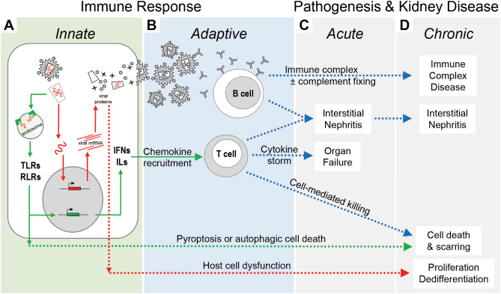
Mechanisms of injury
Bruggeman, Leslie A.. Published April 30, 2019. Volume 26, Issue 3

Slide 7
Hepatitis B
Hepatitis C
Cytomegalovirus
Human immunodeficiency virus
BK virus
Parvovirus
Dengue

Slide 8
Hepatitis b associated renal disease
Immune complex mediated
Glomerulonephritis:
-membranous nephropathy
-membranoproliferative glomerulonephritis
-IgA nephropathy
Poly arteritis nodosa

Slide 9
Membranous nephropathy
Indistinguishable from idiopathic membranous: subepithelial IC deposits
Antigen may be HBsAg, HBcAg or HBeAg
Overt liver disease present
Associated decreased GFR and hypertension
ESRD progression in 25%-35% of adults

Slide 10
Membranoproliferative gn
Basement membrane splitting, mesangial, subendothelial deposits
Antigen is HBsAg.
Nephritic syndrome +/- nephrotic proteinuria
Low C3 and C4
Mixed cryoglobulinemia( predominantly type 3 ) :
AKI, nephrotic syndrome, systemic vasculitis

Slide 11
treatment
Unclear optimal therapy
Antiviral therapy:
- Entecavir. Tenofovir
- Lamivudine: Remission of viremia + resolution of MN in 75%-80%. 20%/year resistance rate from mutation of HBV reverse transcriptase
- PEG- IFN
- Steroids: RPGN, PAN. < 6 months. Concomitant antivirals

Slide 12
Additional HBV associated lesions
Polyarteritis nodosa: HBsAg immune complex deposition in vessels
-more mesenteric artery aneurysms than renal artery
-GI vasculitis. Less severe skin lesions. Favourable response,relapse
-AKI from renal ischemia and infarction not glomerulonephritis
IgA nephropathy
Focal segmental glomerulosclerosis

Slide 13
HEPATITIS C
Chronic viremia in about 3 million in the US
Availability of direct acting antivirals(DAA)
Classic hallmark is Type 1 MPGN due to type 2 mixed cryoglobulinemia
Immune complex deposition leading to ischemia and infarction
Glomerulonephritis as cause of AKI is rare( less than 10%)
ATN, HRS, pre renal azotemia,CKD

Slide 14
Hepatitis c associated renal disease
Cryoglobulinemic GN
Membranous nephropathy
Polyarteritis nodosa
Immunotactoid/fibrillary GN

Slide 15
Warren L. Kupin
CJASN August 2017, 12 (8) 1337-1342;

Slide 16
Unique lymphotropism
Binds to B cells ->polyclonal type 3 ->monoclonal type 2 cryoglobulin
IgM kappa with RF activity + IgG( 1+3) = cryoglobulin complex
5-10 yrs, 35-50% develop type 3 mixed cryoglobulinemia
10-15yrs, 10% with type 2 MC and systemic vasculitis
Of this group, 30% with MPGN:
-HTN and nephritic syndrome
-Nephrotic syndrome(20%)

Slide 17
Clinical presentation
Variable: asymptomatic hematuria/proteinuria. Nephrotic syndrome/RPGN
C4 hypocomplementemia, sometimes C3
Rheumatoid factor positive
AST/ALT elevations
SPEP/IFE: IgM Kappa + polyclonal IgG
Membranous nephropathy/PAN/Immunotactoid/Fibrillary GN

Slide 18
Clinical presentation
Front Med (Lausanne). 2019;

Slide 19
Clinical presentation
Front Med (Lausanne). 2019;

Slide 20
C4 hypocomplementemia in >90%
Type 2 HCV associated MC with 6% chance of B cell lymphoma
Risk factor for CV death from coronary vasculitis
DAA, upon widespread availability, will re write HCV renal disease
Acute cryoglobulinemic vasculitis: control of inflammatory vasculitic symptoms

Slide 21
Antiviral therapy
B cell depletion therapy
Non specific immune suppressive therapy
Adjunct therapies
Annual screening for albuminuria, hematuria, RF, hypertension
+/- cryoglobulinemia, complements

Slide 22
HIV associated kidney disease
Evolved to ARV related disease, immune mediated kidney disease
Unclear mode of tropism with lack of classical CD4/CCR5/CXCR4 receptor
Renal manifestation : ART treatment status . Co infection with HBC/HCV
Classical HIVAN less common with ARV
APOLI genetic risk
Classic histology: collapsing GS, microcystic dilatation, interstitial inflammation, intracytoplasmic tubule reticular inclusions

Slide 23
AKI in HIV
Drug toxicity: ART common suspect but consider others( aminoglycosides, pentamidine, acyclovir)
Changes in tubular creatinine handling: cobistat/ritonavir, TMP/SMX
Limitations of serum creatinine based GFR estimates

Slide 24
HIV associated immune complex disease
Higher ART use, lower viral loads, higher CD4 counts, higher GFR in contrast to HIVAN
Less likely to progress to ESRD
No single defining antigen, Ig subtype or pattern of glomerular deposition
Unclear impact of ART on HIVICK: variable study results

Slide 25
HIV related thrombotic microangiopathy
Associated with advanced HIV
Significantly declined with advent of ART
Rapid AKI, hematuria + proteinuria, thrombocytopenia, hemolytic anemia
Challenging treatment: mainstay ART ? +steroids/FFP/plasma exchange/eculizimab

Slide 26
Clinical presentation
Manageable chronic disease
Increased risk for kidney dysfunction : acute HIV unrelated illness, ART, opportunistic infections/treatment, malignancy, unrelated glomerular disease
Broader differential imperative
Kidney biopsy often helpful

Slide 27
Cytomegalovirus
Dengue
BK virus
Parvovirus
? SARS CoV-2

Slide 28
Thank you

Slide 29
Clinical presentation

