Slide 1
Neuropsychological Assessment
Brandon Adams, psy.d.

Slide 2
DISCLOSURES
NO FINANCIAL DISCLOSURES

Slide 3
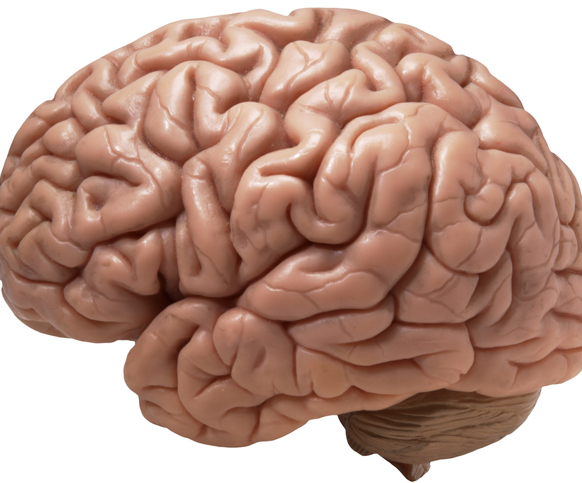
Obligatory brain picture

Slide 4
Specialty Diagnostic clarification
Psychiatry/Psychology
Diagnostic & Treatment of Mental Disorders
Neurology
Diagnosis and Treatment of disease of the CNS/PNS
Behavioral Neurology
Experimental/Research Based
Neuropsychiatry
How Disease of the Nervous System Manifest as Mental Disorders
Neuropsychology
How the Structure of the Brain/Diseases of the Brain Affect Cognition & Behavior.

Slide 5
Time…

Slide 6
Vignette
Patient is a 57-year-old male with 12 years of formal education. He was referred for an evaluation for concerns associated with a possible concussion sustained on mid-2019 secondary to an MVA. At time of presentation, he was 3-months post-accident.
Prior concussion in 2018.
He was exhibiting symptoms that he did not exhibit after his prior 2018 concussion. Specifically, he was exhibit short-term carryover impairment (frequently asking the same question).
This STM carryover impairment was observed during the initial appointment, which is not typically present to the degree exhibited 3-months post concussion. The origin of this issue warranted clarification so that appropriate treatment recommendations may be made.
Further examination revealed difficulties with attention and memory. that is not typically consistent with a concussion (or multiple concussions).
Requested a brain MRI. Radiology report stated, “Mild atrophy and mild microvascular white matter changes of aging, otherwise negative MRI of the brain.”

Slide 7
Referral reasons
Diagnostic Clarification
Diagnostic Confirmation
Baseline Assessment

Slide 8
SPECIAL TOPIC: CONCUSSIONS
NEUROPSYCHOLOGIST AS PRIMARY CARE
REHABILITATION
LONG-TERM TREATMENT PLANNING

Slide 9
For the SRT task, the examinee must press a button in response to a single stimulus presentation.
Patient’s median SRT is .323ms, which is in the 16th percentile; however, lapses in his attention were evident.
Lapse is defined as a single response >.500ms
Patient’s variability was abnormal (26% of his own RT average; 16% is normal).

Slide 10
Normal SRT ranges between .260ms-.330ms for most (16-64yo) ages.
Variability ranges between 10%-17% of SRT mean (i.e., 20-50ms).

Slide 11
Simple sustained attention test.
ISI ranges from 2-10 seconds.
Takes approximately 10 minutes to complete.
Normal performance should have no more than 1-2 lapses in attention.

Slide 12
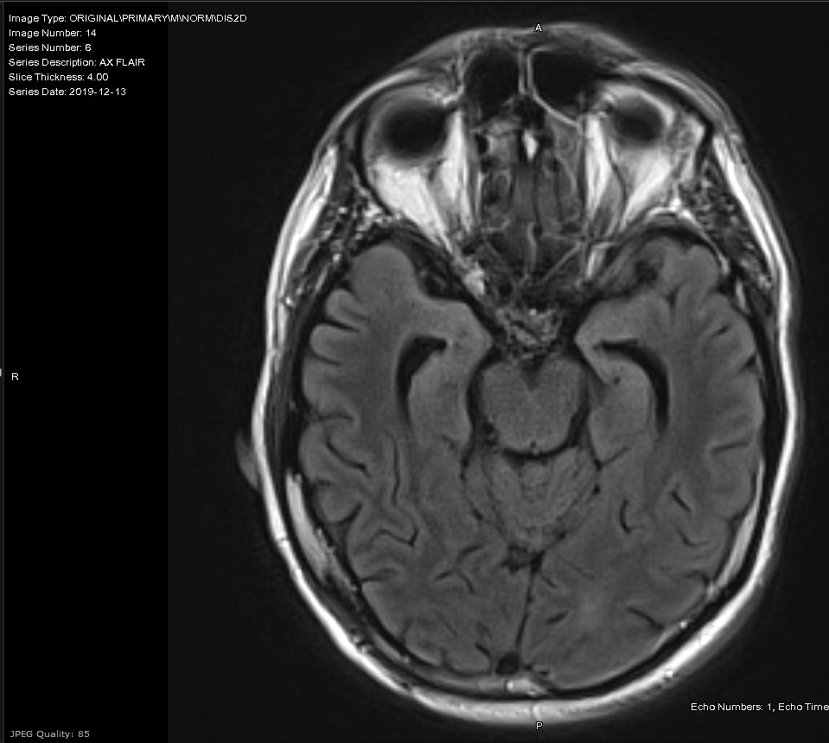
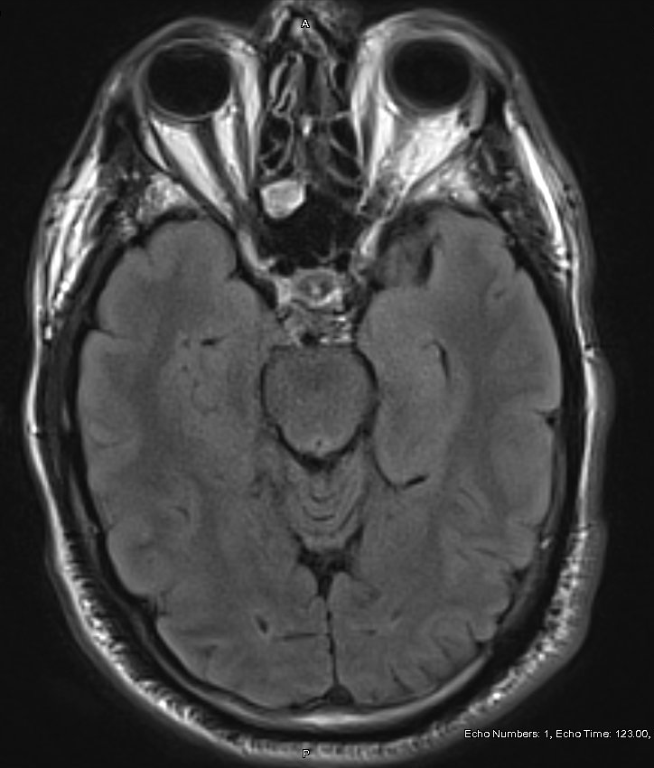
Patient
Age/Edu Control

Slide 13
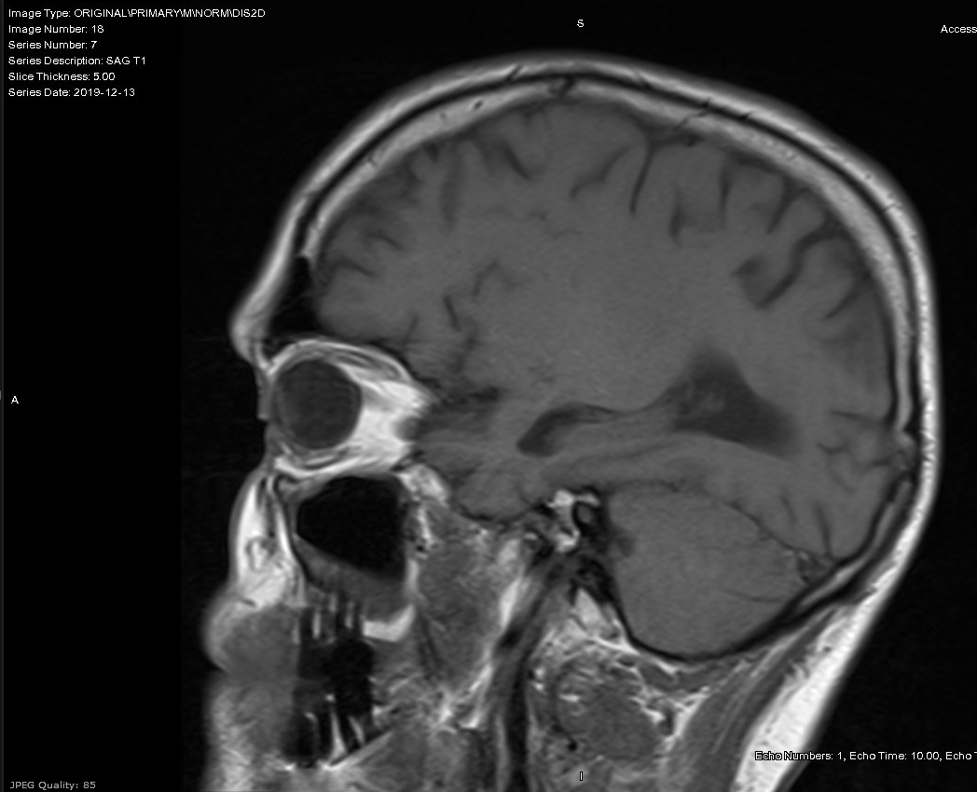
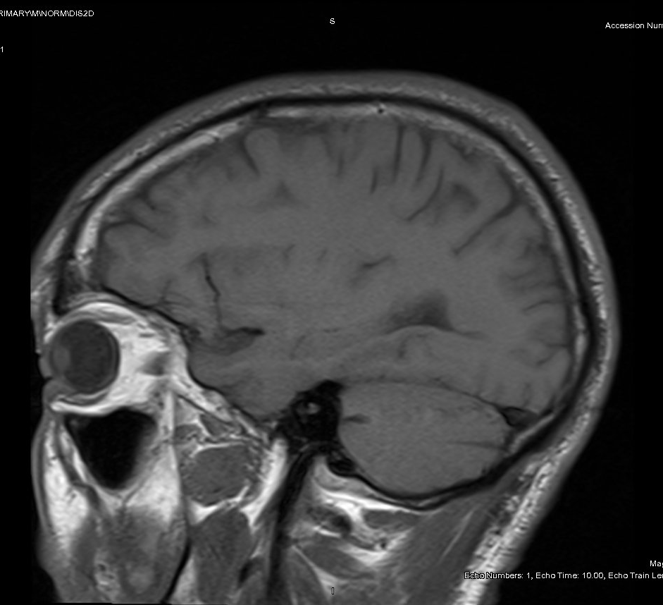
Patient
Age/Edu Control

Slide 14
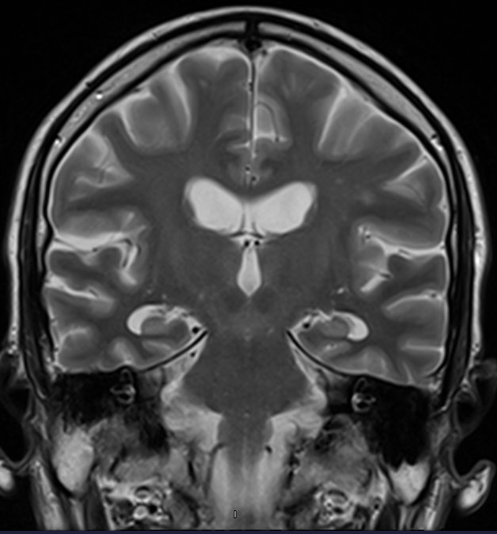
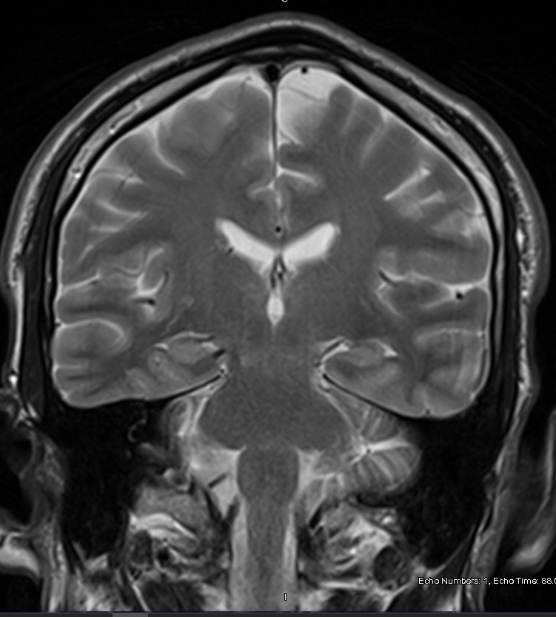
Patient
Age/Edu Control

Slide 15
Postconcussion Symptoms: The Post-Concussion Symptom Scale is a self-report measure to assess postconcussion symptom type and severity. Her raw symptom score is 60. · Physical: Headache (3/6), Nausea (0/6), Vomiting (0/6), Balance problems (0/6), Dizziness (0/6), Visual Problems (5/6), Fatigue (5/6), Sensitivity to noise (0/6) · Thinking: Mentally foggy (5/6), slowed down (5/6), Difficulty concentrating (4/6), Difficulty remembering (5/6) · Sleep: Drowsiness (4/6), Sleeping less (5/6), Sleeping more (0/6), Trouble falling asleep (4/6) · Emotional Symptoms Irritability (3/6), Sadness (0/6), Nervousness (0/6), Feeling more emotional (0/6)
Postconcussion Symptoms: The Post-Concussion Symptom Scale is a self-report measure to assess postconcussion symptom type and severity. Her raw symptom score is 36. · Physical: Headache (2/6), Nausea (0/6), Vomiting (0/6), Balance problems (0/6), Dizziness (0/6), Visual Problems (0/6), Fatigue (0/6), Sensitivity to noise (3/6) · Thinking: Mentally foggy (1/6), slowed down (1/6), Difficulty concentrating (1/6), Difficulty remembering (2/6) · Sleep: Drowsiness (0/6), Sleeping less (5/6), Sleeping more (0/6), Trouble falling asleep (5/6) · Emotional Symptoms Irritability (4/6), Sadness (4/6), Nervousness (4/6), Feeling more emotional (4/6)
Postconcussion Symptoms: The Post-Concussion Symptom Scale is a self-report measure to assess postconcussion symptom type and severity. Her raw symptom score is 8.
Postconcussion Symptoms: The Post-Concussion Symptom Scale is a self-report measure to assess postconcussion symptom type and severity. Her raw symptom score is 36. · Physical: Headache (2/6), Nausea (0/6), Vomiting (0/6), Balance problems (0/6), Dizziness (0/6), Visual Problems (0/6), Fatigue (0/6), Sensitivity to noise (3/6) · Thinking: Mentally foggy (1/6), slowed down (1/6), Difficulty concentrating (1/6), Difficulty remembering (2/6) · Sleep: Drowsiness (0/6), Sleeping less (5/6), Sleeping more (0/6), Trouble falling asleep (5/6) · Emotional Symptoms Irritability (4/6), Sadness (4/6), Nervousness (4/6), Feeling more emotional (4/6)
Notes:
Patient reportedly slept 7-8hrs/night before the accident and now sleeps 4hrs, but does not endorse drowsiness or fatigue; patient reported that she's drinking 2-3 cups of coffee/day with the last cup around 3-4pm and she is/was drinking alcohol (tequila) at night before bed to try to sleep. Her neck and shoulder pain wakes her up nightly. She also reports experiencing nightmares 2x/week that wake her as well.
She saw Dr. , who prescribed her Lunesta, which has dramatically improved the quality of her sleep. Since her sleep improved, many of her PCS symptoms have returned to baseline.

Slide 16
Date | Blood Pressure | Pulse
Pre-Injury | 135/67mmHG | 85BPM
3 Days Post Injury | 153/87mmHg | 110bpm
3-months Post Injury | 144/89mmHg | 126bpm
ED Visit Before Tx | 144/85mmHG | 134bpm
ED Visit Discharge | 142/72mmHg | 126bpm
At Presentation | 142/92mmHg | 126bpm
1-Year Post Injury | 120/57mmHg | 81BPM
Patient sustained a concussion on 03.2019. Playing in back yard & hit his head on a shed. No LOC, but felt "dazed."
Patient is a 15-year-old, male. He was referred for a neuropsychological evaluation for concerns associated with “postconcussion syndrome, suspect psychologic overlay to symptoms, significant anxiety.“

