Slide 1
Corey D. Anden, MD
SW Pennsylvania
Practice 34 yrs
Board Certified
Physical medicine and rehabilitation
Pain Medicine
Sports Medicine
Electrodiagnostic Medicine
Interests
MSK, Spine, Pain, Neuropathy, Dysfunction
Wellness – Genetics, Environment, Lifestyle, Personal Choices
A curious mind

Slide 2
THE ENDOCANNABINOID SYSTEM (ECS)
Concepts
Physiology
Pathology
Pharmacology
Components
Endocannabinoids (Ligands)
Endocannabinoid Receptors
Endocannabinoid enzymes

Slide 3
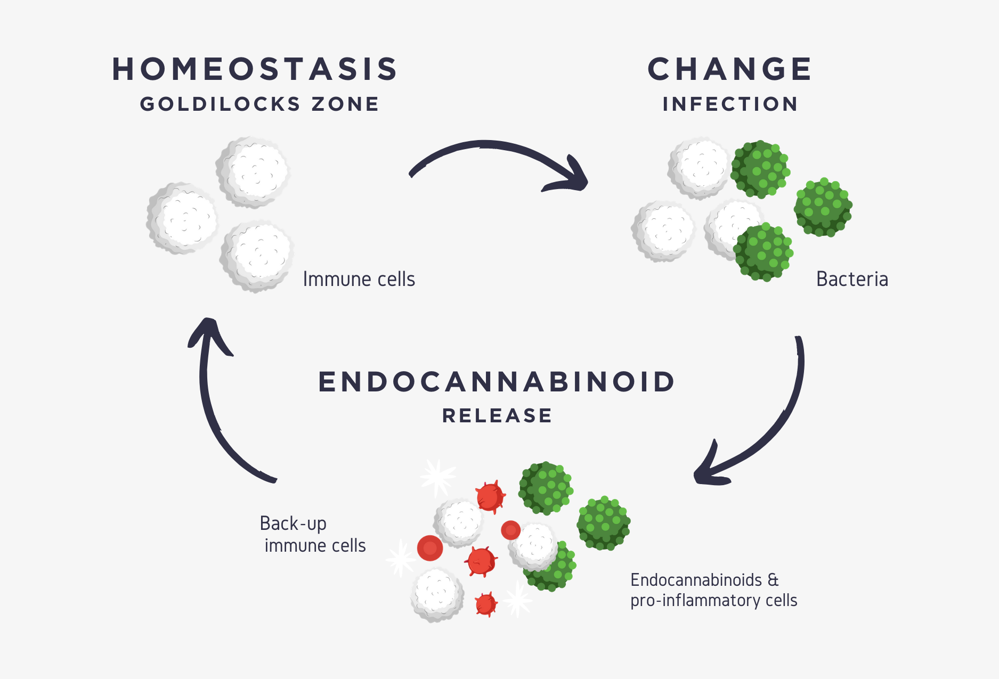
What is the endocannabinoid system (ECS)?
Ubiquitous in mammalian systems
Cellular physiological system
Regulates homeostasis

Slide 4
“The endogenous cannabinoid system—named for the cannabis plant that led to its discovery—is one of the most important physiologic systems involved in establishing and maintaining human health.” (1)

Slide 5
How was the ECS discovered?
Scientific discovery not until the late 1980s/ early 1990s, hailed by many as one of the most important discoveries of the 20th century.
Discovery possible after identification of the major phytocannabinoids in the cannabis plant in the 1960s by Raphael Mechoulam and his team in Israel
Development of synthetic cannabinoids for scientific study of the the ECS and drug development
ECS investigated via competitive radio-isotope ligand binding studies using synthetic cannabinoids and phytocannabinoids

Slide 6
Discovery of the ECS

Slide 7
Why is Cannabis trending?
Cannabis used as food, fiber and medicine for thousands of years
Historical and archeological evidence dating back at least 5000 years
Food = seeds, hemp hearts, hemp seed oil
Fiber = stalks → canvas, rope, hemcrete, clothing
Medicine = flowers, leaves (tea) → health, disease, spiritual
PubMed.gov (12/2020) cites over 35,000 scientific papers on Cannabis
Hundreds of thousands of scientific studies and journal articles

Slide 8
Cannabis Industry
Interest and investigation by scientists and clinicians, botanists, agriculturists, chemists, epidemiologists, historians, jounalists, entrepreneurs, government
Cannabis legalization supported by 67% of Americans
48 states and 3 districts (DC, Northern Mariana Islands, and Guam) allow some form of Medical Cannabis
Legal Cannabis = 20+ billion-dollar industry
Traditional Market = 100+ billion-dollar industry

Slide 9
What type of system is the ECS?
Different from the concept of anatomical and physiological body systems, such as the cardiovascular or neurological systems
Cellular system acting directly and indirectly to influence body functions in all major anatomic and physiological systems
Provides oversight, communication and modulation to maintain homeostasis
Body systems do not work in isolation but are interconnected via complex chemical networks

Slide 10
Which functions are regulated by the ECS?
Appetite
Digestion
Metabolism
Liver function
Cardiovascular function
Reproductive system function
Bone growth and remodeling
Skin function
Inflammation
Immune response modulation
Tumor cell surveillance /Apoptosis
Neuroprotection
Pain modulation
Learning and memory
Motor control
Seizure control
Mood
Sleep

Slide 11
What are the components of the ECS?
Endocannabinoid compounds are produced by many different types of cells, interact with many different types of receptors and are present transiently then readily metabolize
Endocannabinoid receptors are located in cells of the brain, spinal cord, peripheral nervous system, immune system, GI tract, endocrine tissues, reproductive organs, skin and respond to interactions with cannabinoids
Endocannabinoid enzymes participate in the formation of endocannabinoids and the breakdown of cannabinoids

Slide 12
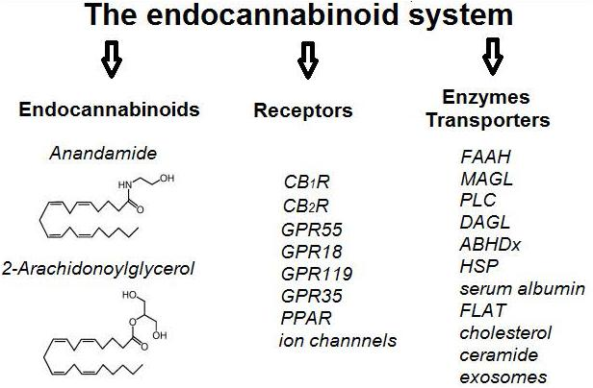

Slide 13
What are the ECS Receptors?

Slide 14
What are the main ECS Receptors?

Slide 15
What ligands interact with the ECS?
Endocannabinoids (20+)
Anadamide
2-Arachidonoylglycerol (2-AG)
Phytocannabinoids (120+)
Delta-9-THC (THC)
Cannabidiol (CBD)
Pharmaceutical / Synthetic cannabinoids (100+)
Dronabinol, Marinol, Cesamet
Epidiolex

Slide 17
ECS ligands and receptors
CB1 receptor
Endocannabinoid = Anandamide
Phytocannabinoids
Delta-9-THC = Partial agonist
CBD = FAAH inhibition -> increase anandamide
Synthetic cannabinoids = Partial or full, agonist or antagonist
Dronabinol, Marinol, Cesamet = partial agonists
JW18, Spice = Full agonist
Rimonovant = Full antagonist

Slide 18
ECS ligands and receptors
CB2 receptor
Endocannabinoid = 2-AG
Phytocannabinoids
Delta-9-THC = Partial agonist
Synthetic cannabinoids = Partial or full, agonist or antagonist
Dronabinol, Marinol, Cesamet = partial agonists
JW18, Spice = Full agonist
Rimonovant = Full antagonist

Slide 19
What are functions of the ECS Enzymes?
Production of cannabinoids
Metabolism of cannabinoids
Degradation of cannabinoids

Slide 20
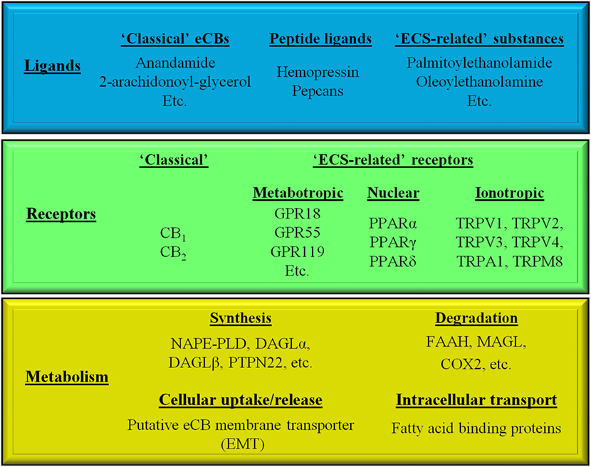

Slide 22
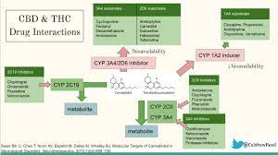

Slide 23
What Is ECS Physiology?

Slide 24
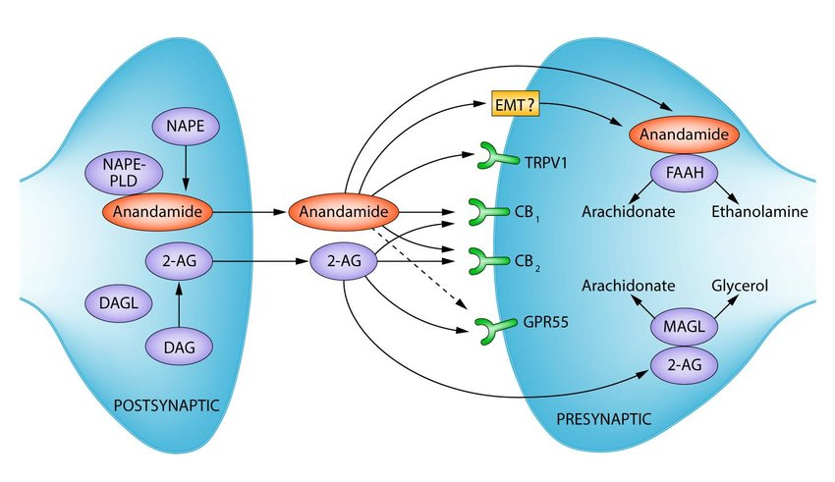

Slide 25
Expanded Endocannabidiome

Slide 26
Complex cellular processes

Slide 27
Summary of the ECS and Endocannabinoid tone
ECS network of receptors that cannabinoids act upon to elicit therapeutic effects and potential side effects.
Receptors: CB1 and CB2 are the most well studied
Endocannabinoids: anandamide (AEA) and 2-arachidonoylglycerol (2AG), attach to CB1 and CB2 receptors
Enzymes: FAAH and MAGL, break down AEA and 2AG
Endocannabinoid tone is a reflection of all these components acting together and influenced by the levels of endocannabinoids, the rate at which they are produced and metabolized, the density of receptors in the brain and other target tissues, and their binding affinity.

Slide 28
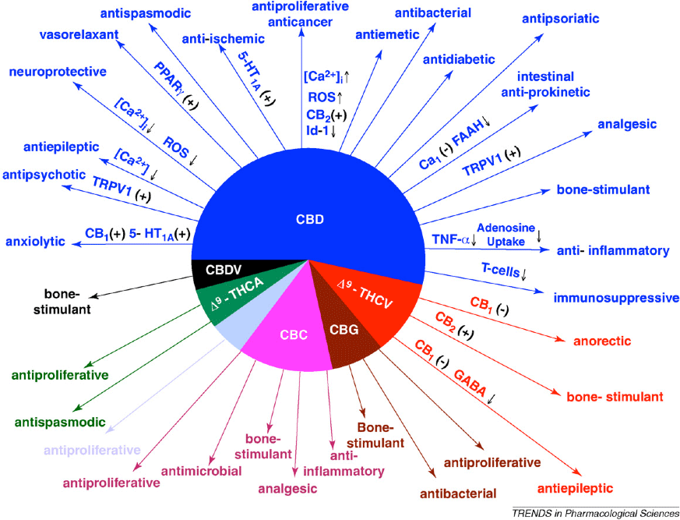

Slide 29
What about ECS Pathology?
Normal vs Dysfunctional ECS Tone
ECS deficiency syndromes
Migraine
Fibromyalgia
IBS
PTSD
ECS hyperactivity syndromes
Metabolic syndrome
Obesity

Slide 30
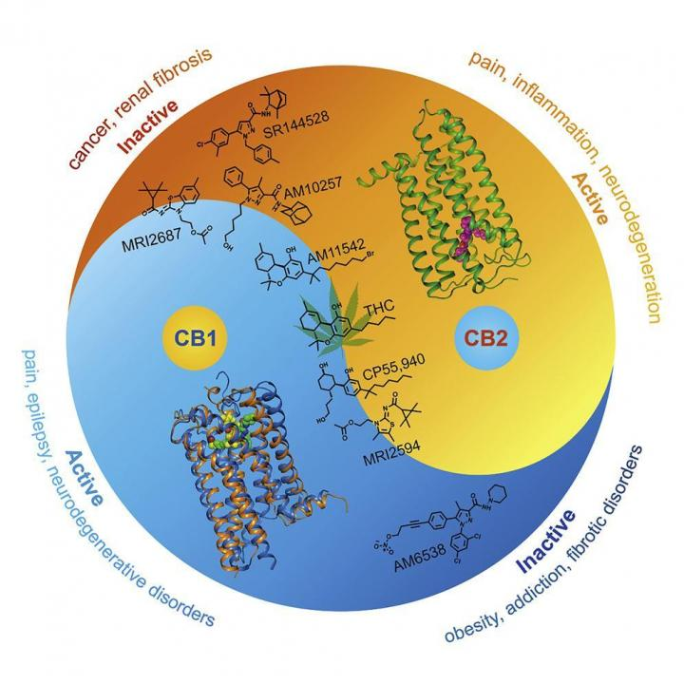

Slide 31
How do we optimize ECS tone?
Healthy lifestyle
Plant-based diet and organic products
Interaction with nature
Pleasurable and purposeful activity
Stress reduction
Spiritual awareness, meditation
Cryotherapy
Cannabinoid supplementation

Slide 32
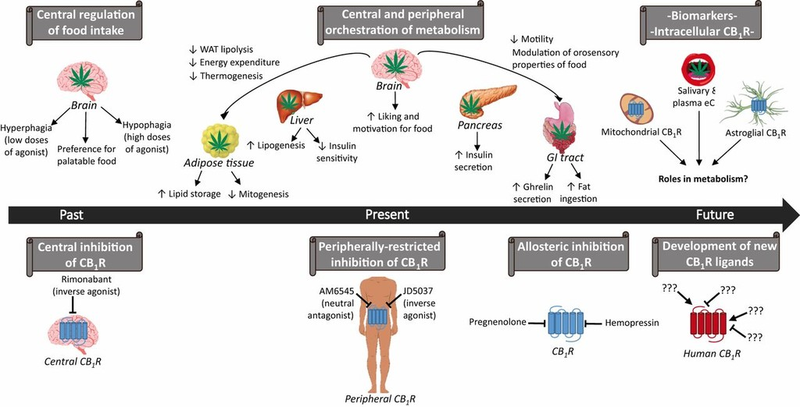

Slide 33
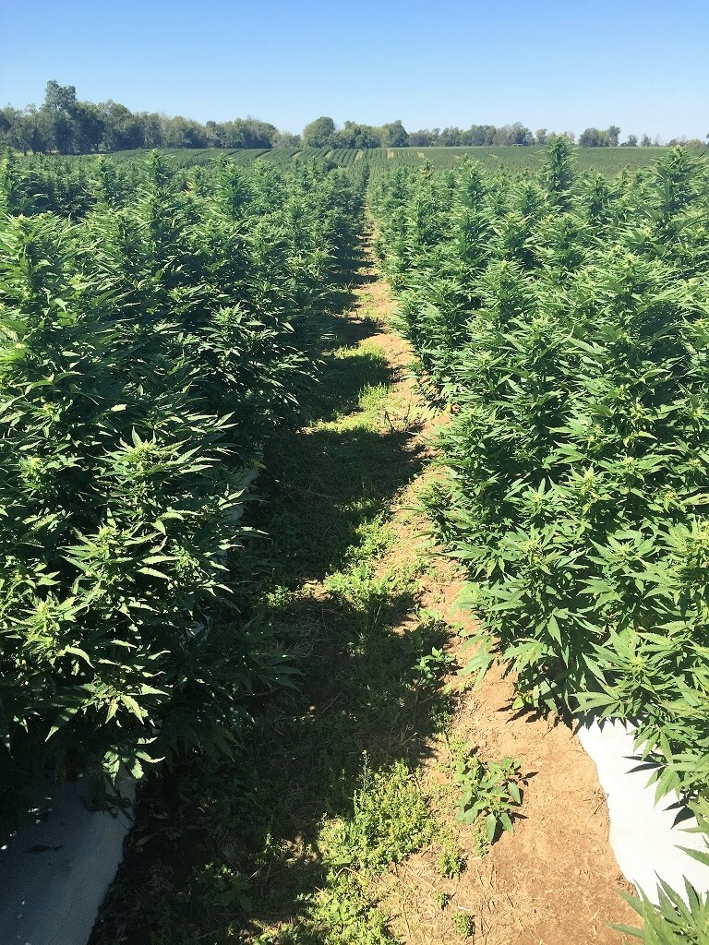
Cannabis sativa
Plant
Cola = “Bud”
Trichomes = oil containing resin glands

Slide 34
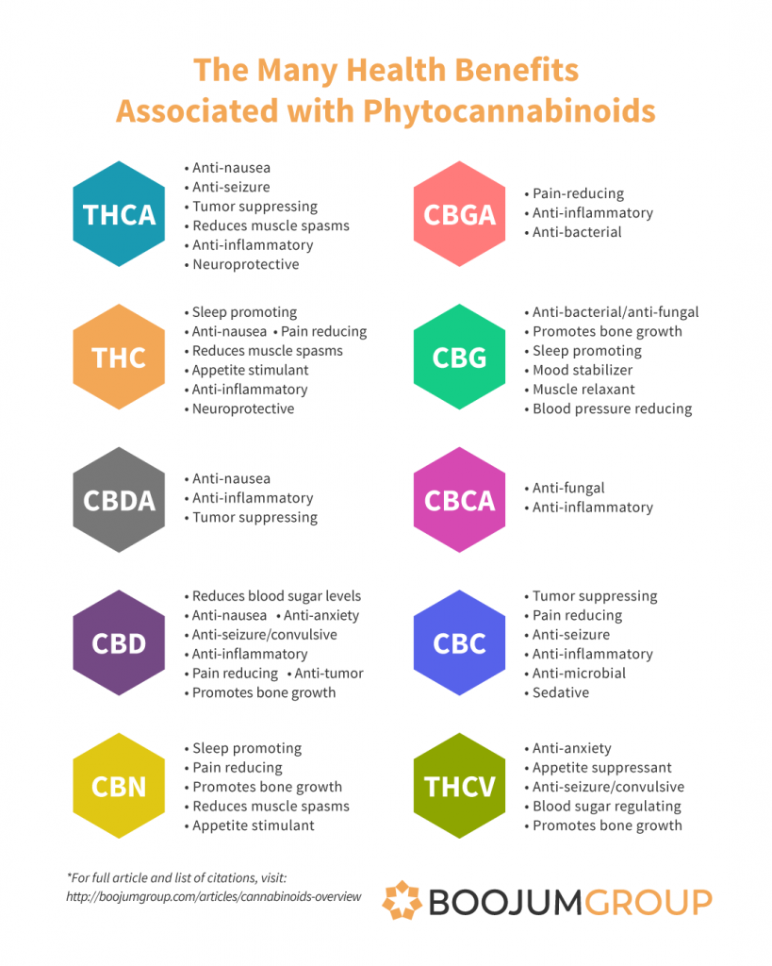

Slide 35
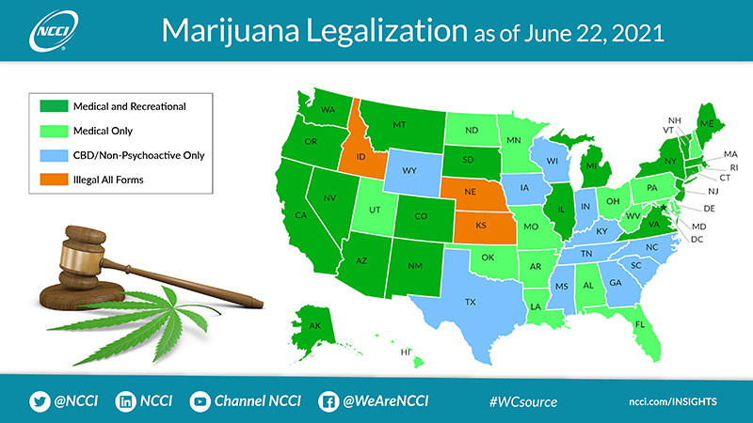

Slide 36
Resources
Society of Cannabis Clinicians
Educational courses
Webinars – Live and Recorded
Healer.com
Certification program
Goldstein, B. Cannabis is Medicine. 1st Edition. Little, Brown Spark. 9/2020.

Slide 37
References
Volume 176, Issue 3,
Kilaru A, Chapman KD. The endocannabinoid system. Essays Biochem. 2020 Sep 23;64(3):485-499. doi: 10.1042/EBC20190086. PMID: 32648908.
Li, H et al. Crystal Structure of the Human Cannabinoid Receptor CB2. Cell. 2019;176(3);459-467. doi:10.1016/j.cell.2018.12.011
Russo EB. Clinical Endocannabinoid Deficiency Reconsidered: Current Research Supports the Theory in Migraine, Fibromyalgia, Irritable Bowel, and Other Treatment-Resistant Syndromes. Cannabis Cannabinoid Res. 2016;1(1):154-165. Published 2016 Jul 1. doi:10.1089/can.2016.0009
Russo EB. Taming THC: potential cannabis synergy and phytocannabinoid-terpenoid entourage effects. Br J Pharmacol. 2011;163(7):1344-1364. doi:10.1111/j.1476-5381.2011.01238.x

