Slide 1
Whats new to my profession: Podiatry and Diabetic Wound Care
Jason Bruse, DPM FACFAS

Slide 2
Problems Podiatrists Often Treat
Heel pain, plantar fasciitis
Foot/ankle fxs
Ankle sprains/tendonitis, achilles injuries
Flatfoot reconstruction, Cavus foot reconstruction
Bunions, hammertoes
Pediatric problems: flatfoot, juvenile bunions, met-adductus, club-foot.
Neuromas
Skin problems: tinea, corns, calluses, warts
Nail problems: ingrown nails, fungal nails
Diabetic Footcare, Ulcer Care

Slide 3
Bunions
Etiology: Western countries about 30%. In countries where western shoes have been introduced, numbers have risen to match. Women > men due to shoes.
Why bunions hurt:
-Joint is off kilter, dislocated, abnormal wear pattern
-medial eminence hurts in shoes, usually women
Bunions are essentially a surgical problem.

Slide 4
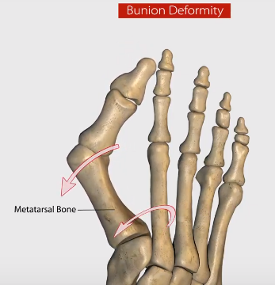

Slide 5
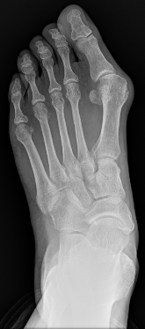
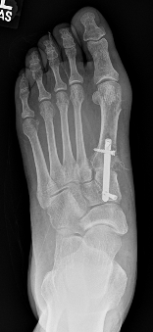
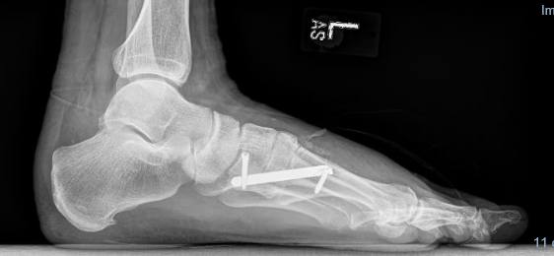
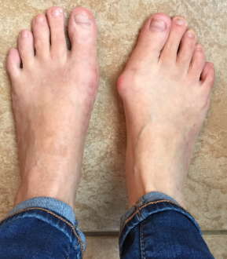
1st MTC Fusion, (Lapidus)
My main bunion surgery

Slide 6
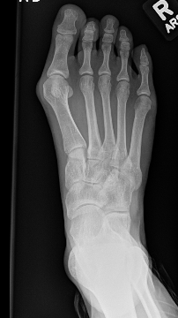
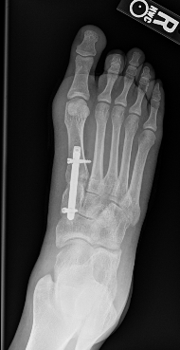
More Lapidus X-rays

Slide 7
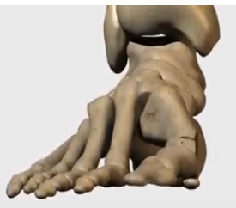
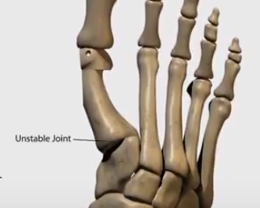
Distal Chevron: less severe angles boot 4 weeks, then shoe.

Slide 8
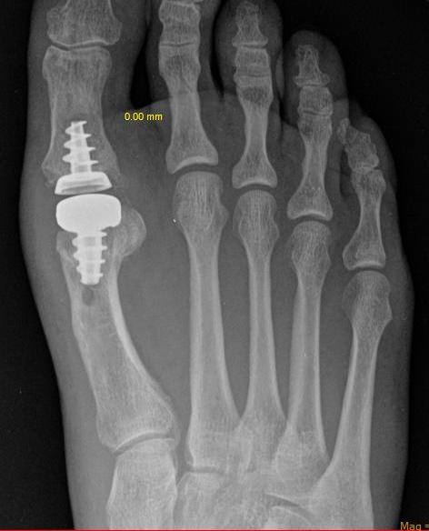
Total Joint Replacement

Slide 9
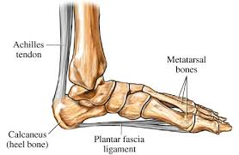
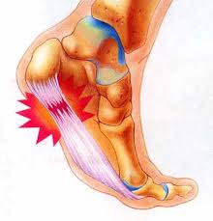
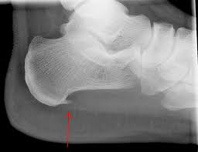
Plantar Fasciitis

Slide 10
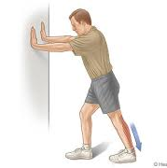
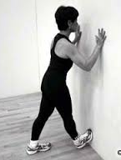
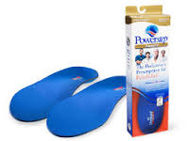
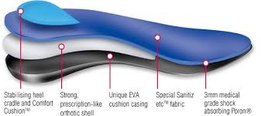
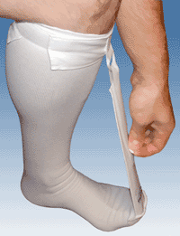
Plantar Fasciitis Treatment Protocol ”Needs to be held in constant tension to heal itself.”
Daytime Protocol
Inserts (Powersteps)
Stretching (every hour)
Ice (dip in ice water)
No barefoot
Nighttime Protocol
Strassburg Sock
www.thesock.com, $35
Rarely inject cortisone.
Rarely go to fascial release

Slide 11
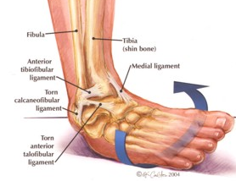
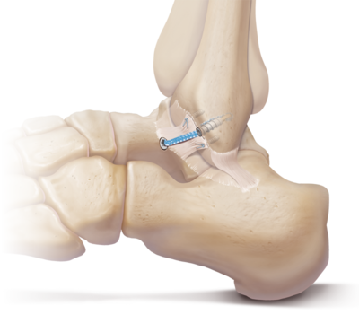
Lateral Ankle Instability
VERY common in athletes with a history of ankle sprains
The ATF (mainly) and CF ligaments are stretched or ruptured
Leads to pain, swelling, instability, sprains, early DJD
Fixable, scope and brostrum with internal brace

Slide 12
Morton’s Neuroma
Pain 3rd (or 2nd) interspace
Feels like walking on a marble
Diagnostic injx with cortisone/marcaine
Permanent tx options:
Padding, live with it
Alcohol sclerosing injx
Nerve Decompression
Sx Removal of Nerve

Slide 13
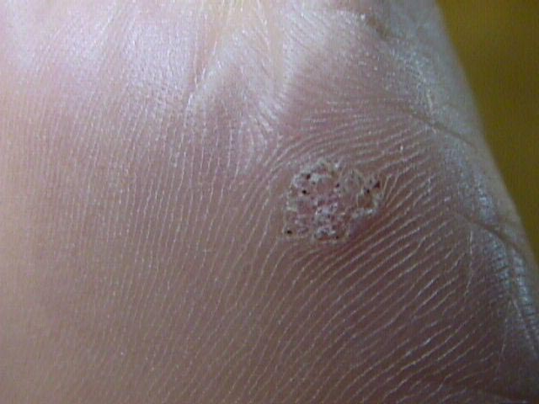
PLANTAR WARTS
HPV 11,9.
Will often resolve over time
Candida injections with Dermajet
good success, relatively fast but can be painful
Canthacur
CO₂ Laser ablation

Slide 14
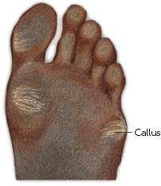
CORNS & CALLUSES
Thickening of the skin resulting from chronic irritation
often harmless
if painful try pads or a shoe change

Slide 15
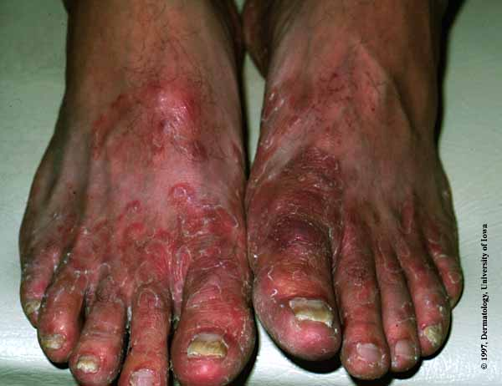
Tinea Pedis
Itching or burning
Scaling, cracking, blisters, redness
May be stinky

Slide 16
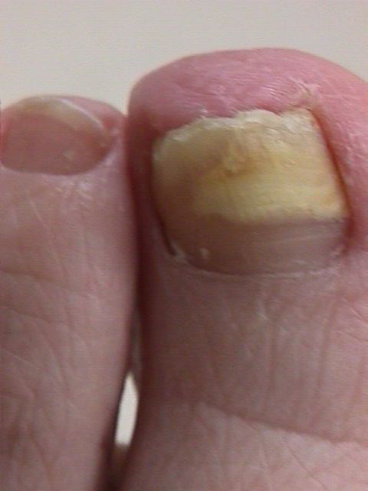
Onychomycosis
Only 3 Reliable Treatments:
Lamisil: 70% success
Laser: 80 success ($$)
Nail Removal
Important to educate patient about lifetime prevention.

Slide 17
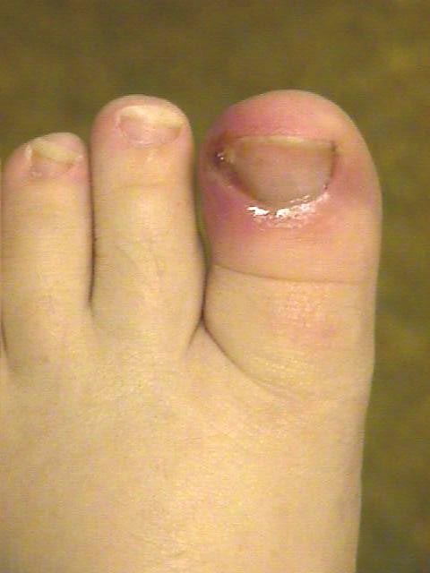
Ingrown Nails
Three Options:
Can tx with oral abx and refer
Can numb toe and avulse part of the nail
Can perform matrixectomy, either sx or chemical

Slide 18
Cost of Diabetic Ulcers
1/3 of total treatment cost of type 2 Diabetes is for diabetic foot ulcers.
Major amputation has a 3 year survival rate of 50%, worse than many cancer diagnoses.
Medicare will pay for a foot care visit every 61 days to treat nails and calluses.
*Patients do not need a doctor to trim their toenails, but it gets patients in front of the doctor often.

Slide 19
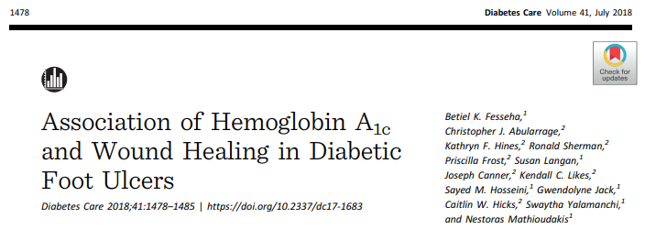
A1C and Wound Healing:
(no connection)

Slide 20
Exciting Cutting Edge Macrophage research:
Macrophage Overview: With tissue injury, monocytes travel to the area and become Macrophages. Macrophages at first create an inflammatory response to eliminate pathogens, an enzyme, SETdb2 then convert macrophages to non-inflammatory repair mode to promote healing.
In Diabetic patients, this conversion may never occur and inflammation persists.
It appears the enzyme SETdb2, responsible for macrophage conversion, does not appear.

Slide 21
Exciting Macrophage and Xanthine Oxidase Connection:

Slide 22
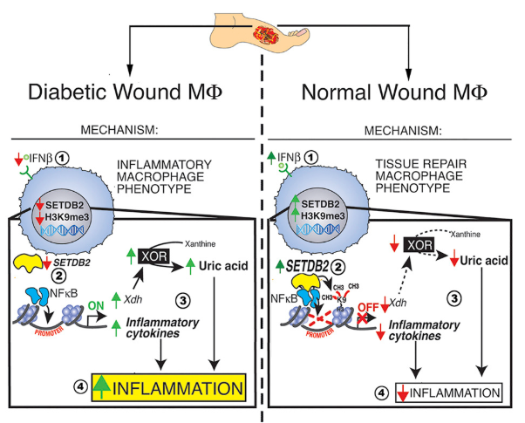
SETDB 2 and Inflammation:

Slide 23
Stay active, exercise, stretch.

Slide 24
Questions?

