Slide 1
Are Hormones Neuroprotective?
Saving Grandmother’s Brain
Sarah L Berga MD
Professor and Chair |Obstetrics and Gynecology
Jacobs School of Medicine and Biomedical Sciences
Medical Director | Obstetrics and Gynecology
Women’s Health Program Development
Oishei Children’s Hospital | Kaleida Health

Slide 2
Disclosures: Sarah L Berga MD
June 2021
CONSULTING:
Ava AG Advisory Meeting, 2.27.19, Chicago, IL
Ferring Pharmaceuticals SW Reproductive Health Advisory Board, 10.25.19, Denver, CO
ClearBlue Medical Advisory Board, 11.20.19, Washington DC
EDITORIAL BOARDS & POSITIONS:
American Journal of Obstetrics and Gynecology, Advisory Board: 2003-present (Gratis) Human Reproduction Update, Associate Editor, 2017 to 2020 (gratis)
International Society for Gynecological Endocrinology, Executive Committee Member: 2004-present (Gratis) *This presentation was a keynote address at ISGE 2020 in December
Journal of Obstetrics and Gynecology Canada, International Editorial Board: 2017-present (Gratis)
Mayo Clinic Proceedings, Editorial Board: 2019-present (Gratis)
Menopause, Editorial Board: 1999-present (Gratis)
UpToDate, Peer Review Board: 2005-present
SERVICE:
Member, Board of Trustees, Salem Academy and College, Salem, NC: 2018-present (Gratis)

Slide 3
Objectives
Delineate some of the most important clinical effects of hormones upon brain function and identify putative underlying biological mechanisms
Consider how aging modifies the effects of hormones on brain
Identify what is known - and not known - about the neural effects of estrogens, SERMs, and progestins
  Absence of evidence is not evidence of absence
Decide if the collective evidence supports the notion that hormones - when given appropriately - are neuroprotective for use in postmenopausal women

Slide 4
Will postmenopausal hormone use foster better brain health?
During perimenopause and early menopause, women report reduced quality of life due to hot flashes, insomnia, mental “fog”, trouble concentrating, difficulty with word finding, irritability, and reduced libido
Women are at increased risk for some neurodegenerative disorders, including dementia, as compared to men
Early loss of ovarian function, including surgical menopause prior to the expected time of natural menopause, increases the risk of neurodegenerative disorders and reduces QOL

Slide 5
Depression, stress, and cognitive impairment at midlife
The brain is a target of sex steroids
Several studies have identified an association between perimenopause and increased rates of depression, stress, and cognitive “fog”
  SWAN 4x increase in major depressive episodes
  Bromberger JT et al 2011
Hypothesis: Hormonal management will slow - but will not fully prevent - brain aging
  Estrogens maintain brain metabolism, synapses, mood, and cognition
  Progestins increase irritability and slow metabolism

Slide 6
Possible indications for postmenopausal hormone use
Symptom relief
Disease prevention
Disease treatment
Anti-aging
Health promotion
Perceived risk:benefit of hormone use depends on indications, perspectives of the patient and her physician, age, genetics, known and unknown biological factors, and current health status
The guidance provided by various professional groups varies widely

Slide 7
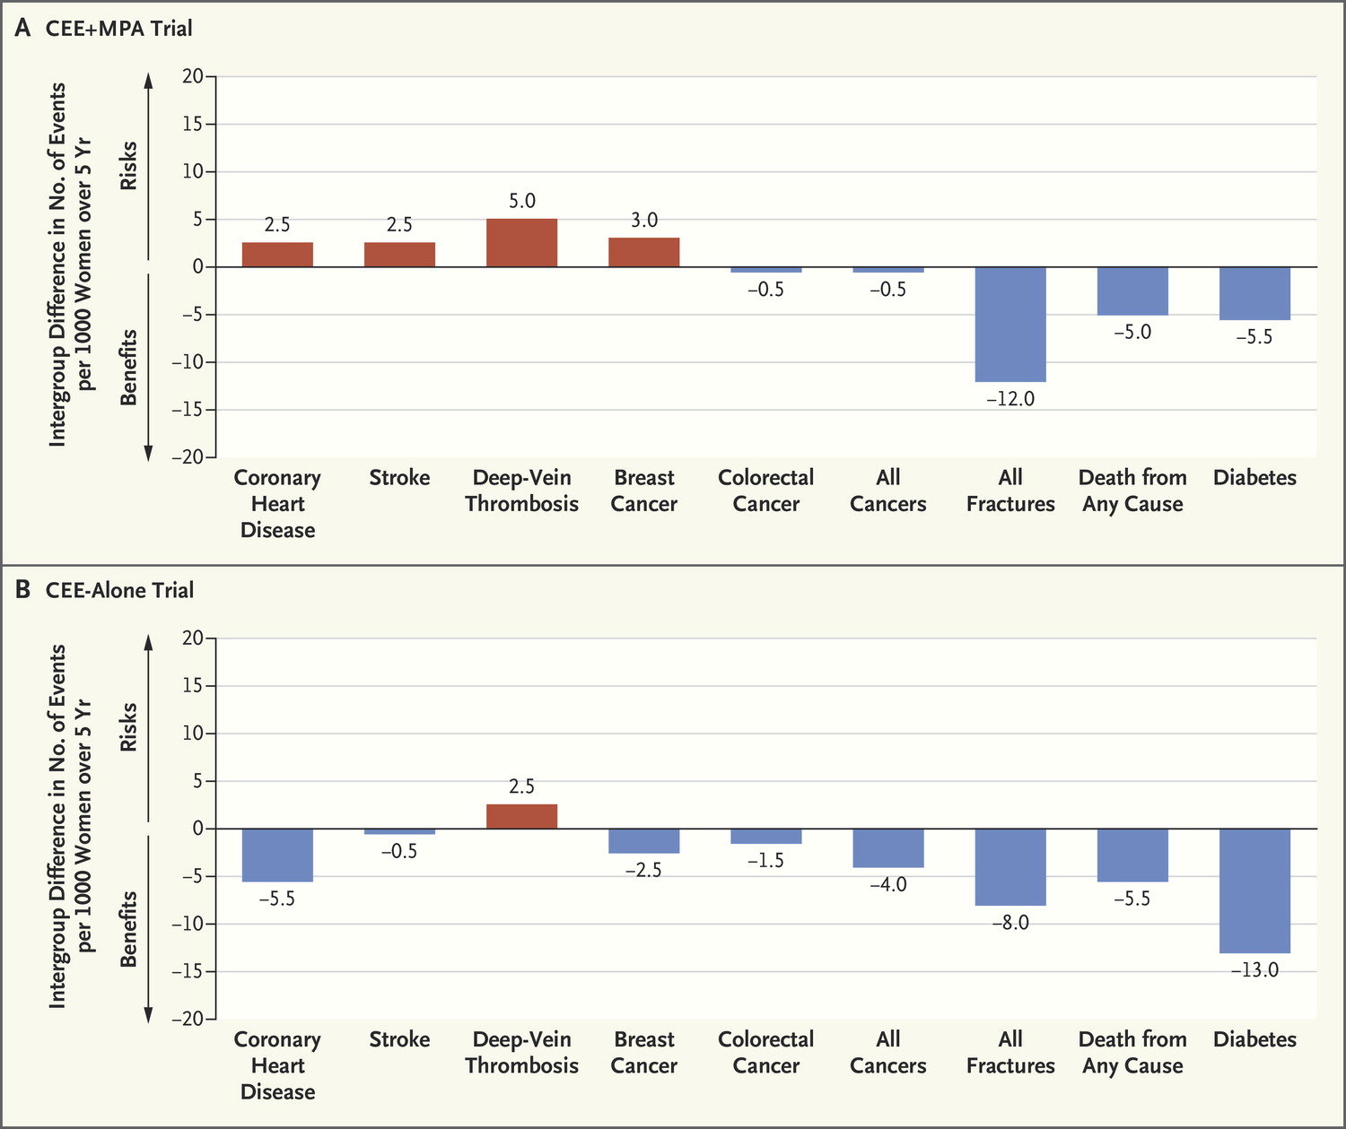
Manson JE, Kaunitz AM. N Engl J Med 2016;374:803-806.
Benefits and Risks in the Women’s Health Initiative
CVD
Strk
DVT
BC
CoCa
AllCa
FX
Mort
DM
CEE + MPA
CEE alone
Notes:
Benefits and Risks of the Two Hormone-Therapy Formulations Evaluated in the Women’s Health Initiative. Results are shown for the two formulations, conjugated equine estrogens (CEE) alone or in combination with medroxyprogesterone acetate (MPA), for women 50 to 59 years of age. Risks and benefits are expressed as the difference in number of events (number in the hormone-therapy group minus the number in the placebo group) per 1000 women over 5 years. Data are from Manson et al.5

Slide 8
Concept versus Compound
Not all estrogens are the same
  Transdermal estradiol safer than oral estradiol and both safer than oral or transdermal ethinyl estradiol or CEE
Not all progestagens are the same
Not all women are the same
Hormones are potent
  Deviations from physiological ranges yield poor outcomes – e.g. insulin, cortisol, and thyroxine
  Little attention paid to individualizing HRT / MHT
  Both too much and too little have deleterious consequences
  Dose response curve is “U”-shaped
We are justified in individualizing hormonal interventions
We need to develop newer and safer products and approaches including titration to yield better results

Slide 9
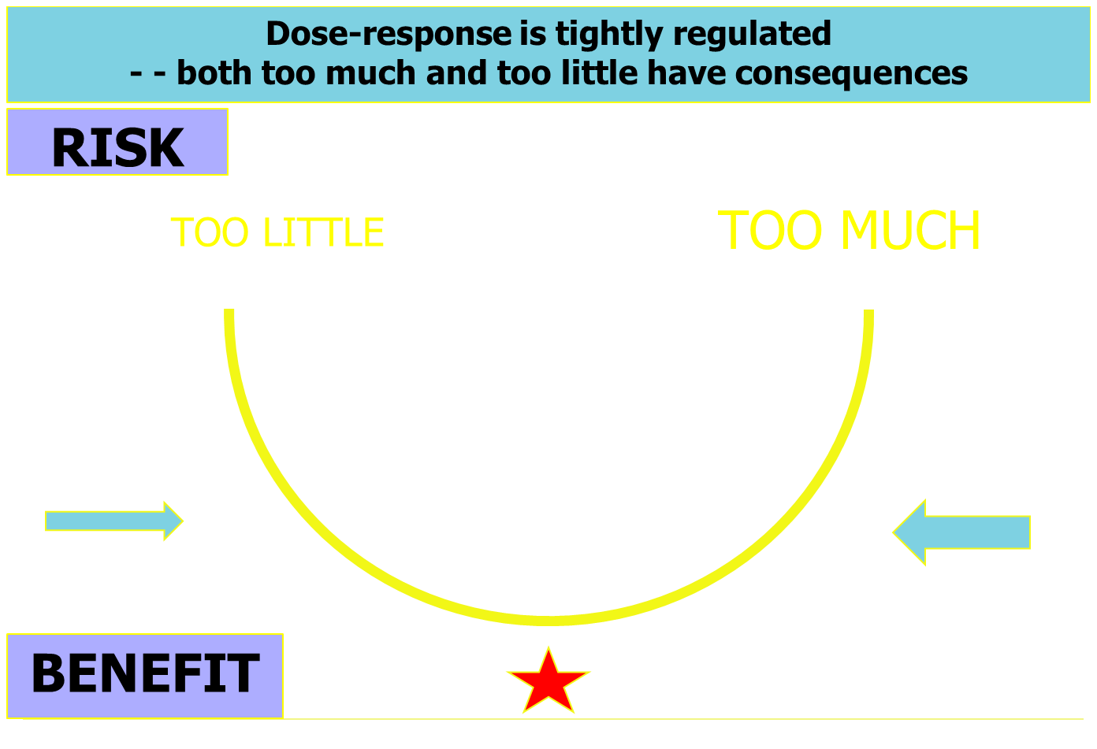
ESTRADIOL
STRESS
CORTISOL
THYROXINE
INSULIN
CALORIES
DOSE

Slide 10
Physiological benchmarks
Ovaries secrete 17β-estradiol (E2), which is metabolized primarily to estrone (E1)
The cognate ligands for estrogen receptors are E2 and E1
Steroid excursions of E2 and progesterone occur within a relatively narrow range in absence of pathophysiologic states such as PCOS, amenorrhea, and perimenopause
Mean circulating [E2] across a fully ovulatory menstrual cycle during young reproductive life is ~100 pg/mL
In reproductive life, the ratio of E2:E1 is ~1:1
The ratio is distorted to ~1:3 or ~1:4 when estradiol is administered orally due to first-pass hepatic metabolism

Slide 11
What Matters?
Host status (chronological age ≠ biological age)
Estrogen type (E2, CEE, E1S, SERM, EE, AI)
Route of administration (oral vs nonoral)
Timing of initiation (any hiatus is bad)
Duration of exposure (‘til death do us part?)

Slide 12
Not all women are the same
Age – critical variable in determining hormone action at tissue level
Weight
Personal medical history
Expectations
Lifestyle
Family history
Molecular genotype
Epigenetic status
Pharmaco-kinetics
Pharmaco-dynamics
Pharmaco-genomics
Hormones
Age
Hypothesis: Ongoing hormonal exposure may cumulatively retard aging in tissues & thereby prolong hormonal responsiveness

Slide 13
Growth, mitosis, cellular repair, & oncogenesis
Estrogen
Insulin
Cellular senescence, apoptosis, & aging phenotypes
Telomere shortening
Gene silencing
Immune senescence
HORMONE ACTION DEPENDS ON CELL SEX AND AGE
To mitose or apoptose?

Slide 14
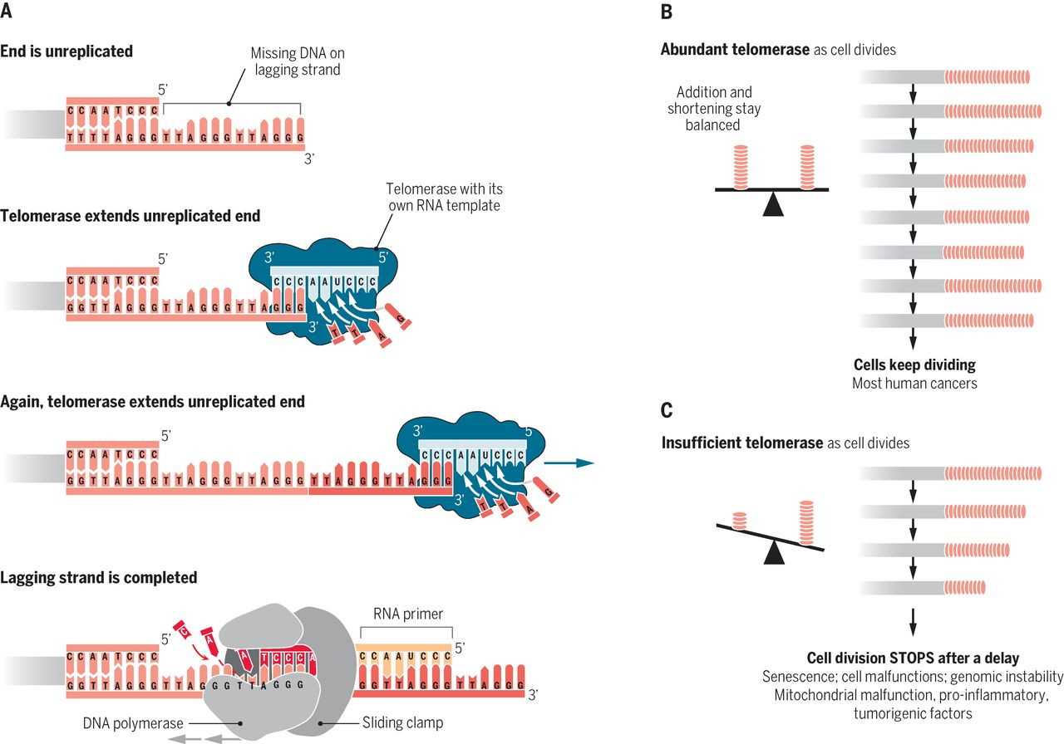

Long-term maintenance of telomeric DNA length requires telomerase
ABUNDANT
INSUFFICIENT
Blackburn et al. Science 2015;350:1193-1198
Notes:
Long-term maintenance of telomeric DNA length requires telomerase. (A) Replication of telomeric DNA. Elongation of one DNA strand, via the reverse transcriptase mechanism of telomeric DNA synthesis by telomerase, is followed by synthesis of the other telomere DNA strand by DNA polymerase. (B) As cells divide, shortening of telomeres through incomplete DNA replication and other processes causing attrition can be balanced by compensatory telomere-elongating action by telomerase. (C) Net telomere shortening when telomerase is insufficient leads to critically short telomeres. Telomere damage signaling leads to cession of cell division and other cellular responses.

Slide 15
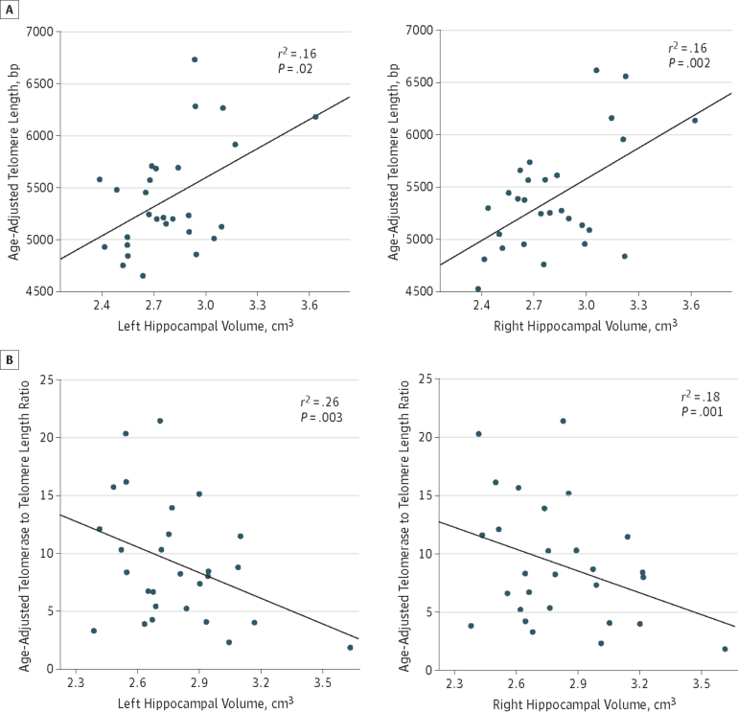
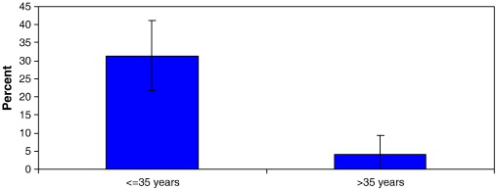
Relationship between leukocyte telomere length, telomerase activity, and hippocampal volume in early aging
Greater endogenous estrogen exposure is associated with longer telomeres in postmenopausal women at risk for cognitive decline
JAMA Neurol. 2014;71:921-923
Brain Res 2011;1379:224–231

Slide 16
Mechanisms by which sex steroids impact CNS
Organizational (the brain is sexually dimorphic)
Activational (sex-specific hormone action)
Neurotransmitter function
Receptor subtype cross-talk
Induction of receptors
Genomic and membrane effects
Oxidative metabolism (mitochondria)
Apoptosis
Neural and glial effects
Synapses
Inflammation
Neurovascular (incl blood flow)

Slide 17
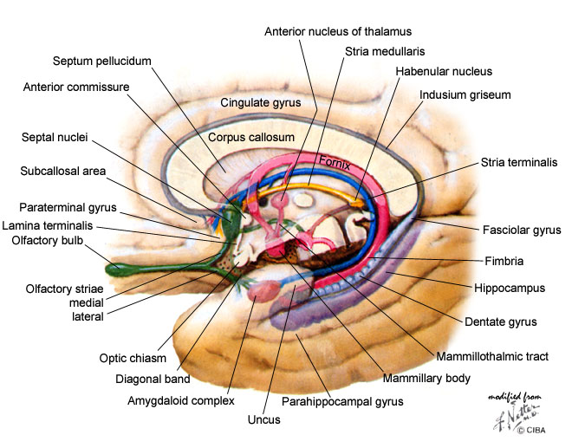
Behaviors impacted by sex steroids
Affective state
  mood, sleep, libido, sexuality, social behavior
Cognitive function
  speed of processing
Motor coordination
Neuroprotection
  multiple mechanisms
Neuronal excitability
  epilepsy threshold
Pain threshold
Auditory threshold
  lower in women than men

Slide 18
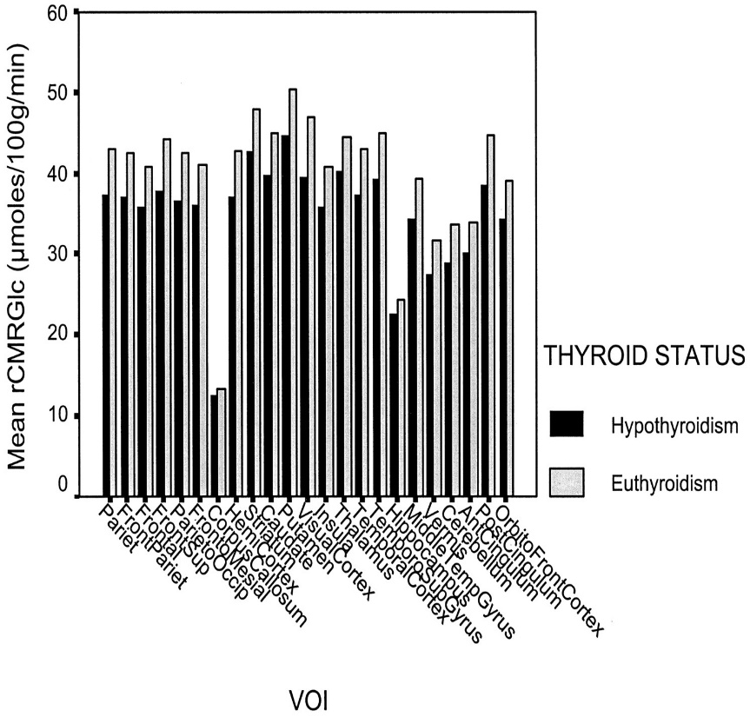
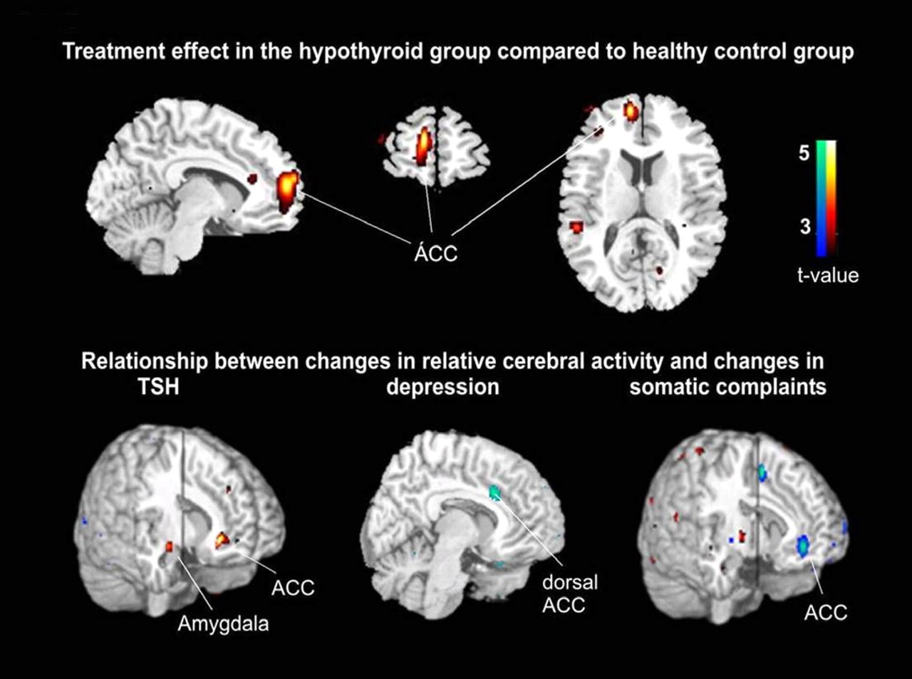
Thyroid and brain: an analogy?
Decreased CBF (↓23%) and brain metabolism (↓12%) by PET with 15-O2 and F-2-deoxyglucose after total thyroidectomy before T4. Pts were depressed, anxious, and psychomotor slow when hypothyroid. Constant EL. JCEM 2001
Brain glucose metabolism B/A T4 replacement. Reduction of behavioral complaints during thyroid HT assoc with restoration of metabolic activity. Bauer M et al. JCEM 2009

Slide 19
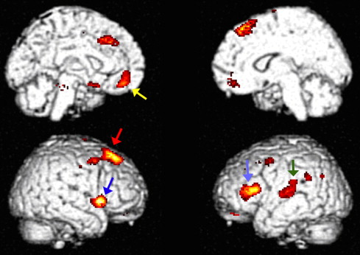
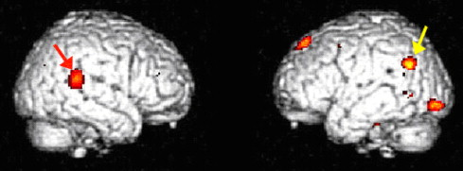
Brain metabolism and HT
PMW (mean age 58) at risk for AD taking HT for >1 y (mean 10 y) underwent 2 FDG-PET scans at 1-y (#53) and 2-y (#45) intervals to evaluate brain metabolism
Half randomized to continue & half to stop HT
18 PMW - 0.625 mg CEE (9 + progestin)
36 PMW - 0.1 mg E2 (24 + progestin)
All Provera exc 2 Prometrium (1/grp)
HT users showed relative preservation of frontal and parietal cortical metabolism
Unopposed E2 users showed better metabolism in precuneus/posterior cingulate cortical (PCC), the area wh undergoes most significant decline in earliest stages of AD
E2 users 3SD better in verbal performance than CEE users
E+P had lower metabolism than E alone
Superior frontal gyrus
Aeas of greater metabolism in E2 vs CEE users.
Yellow - Wernicke’s area.
Red - superior temporal gyrus.
Silverman DHS Psychoneuroendo 2010
Rasgon NL. PLOS ONE 2014 Vol 9, e89095

Slide 20
Methodologies and Approaches
Pieces of the puzzle
  Each model and methodology entails unique analytic approaches that provide relevant data
  AND
  Each approach has inherent limitations
Putting the pieces together
  To maximize perspective, we must synthesize available relevant information and resolve discrepancies

Slide 21
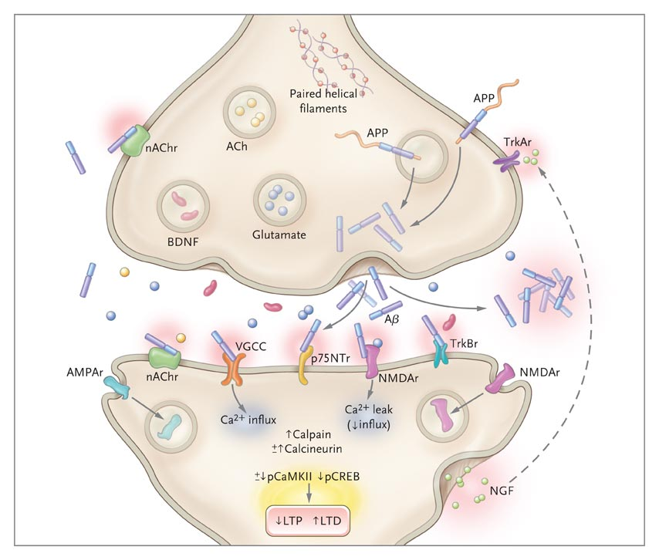

Synaptic Dysfunction in Alzheimer’s Disease
AD may be primarily a disorder of synaptic failure. Synaptic loss correlates best with cognitive decline in AD. Hippocampal synapses begin to decline in patients with mild cognitive impairment (MCI). In mild AD, about 25% are lost. Aging itself causes synaptic loss, particularly in dentate gyrus of hippocampus.
Querfurth H, LaFerla F. N Engl J Med 2010;362:329-344

Slide 22
Estradiol (E2) increases dendritic spine density in rhesus monkey hippocampus and prefrontal cortex
Young (6-8 y) and old (19-23 y) rhesus female monkeys were ovx and after 3 mo given either vehicle or E2 q 3 wks x 2
Dendritic spine density counted
↑ spine density in both young (37%) and old (35%) monkeys after E2 in hippocampus
↑ spine density (55%) in young monkeys in prefrontal cortex but not visual cortex
Hao. J Comp Neurol 2003;465:540; Tang. Cereb Cortex 2004;14:215

Slide 23
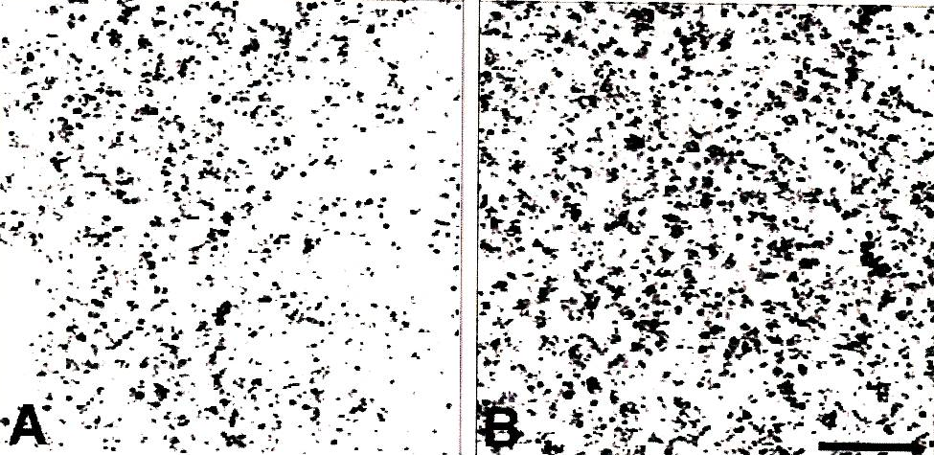
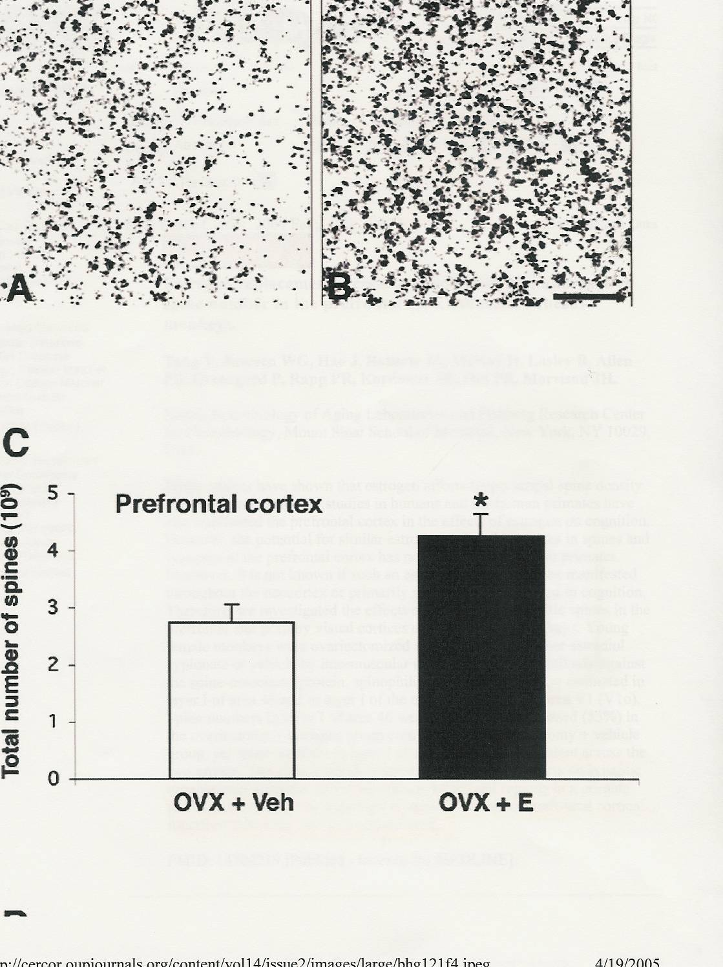
E2 ↑spine density in rhesus prefrontal cortex
Tang et al. Cereb Cortex 2004; 14: 215

Slide 24
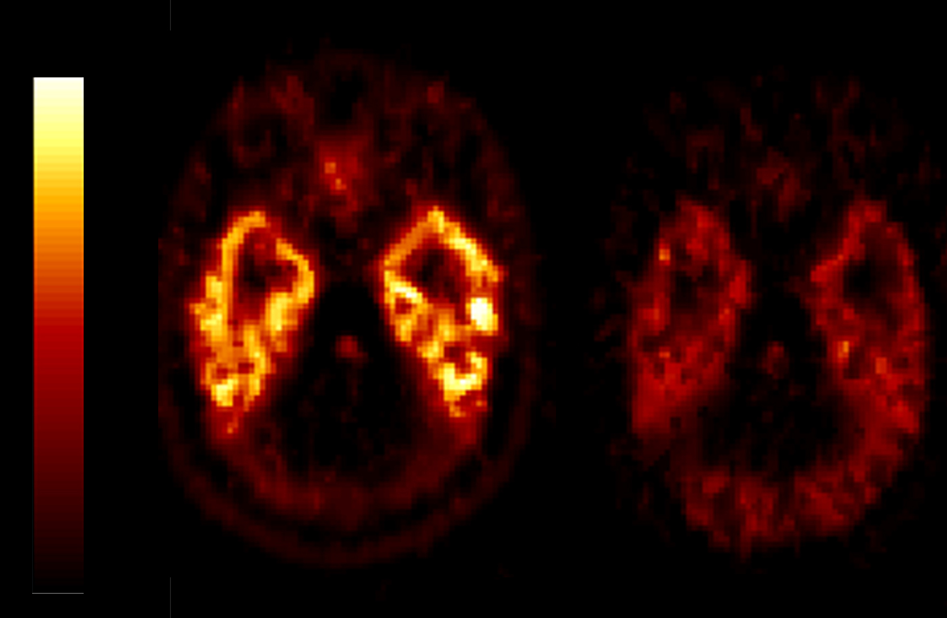
5HT1A receptor binding is lower in depressed individuals
Not Depressed
Depressed

Slide 25
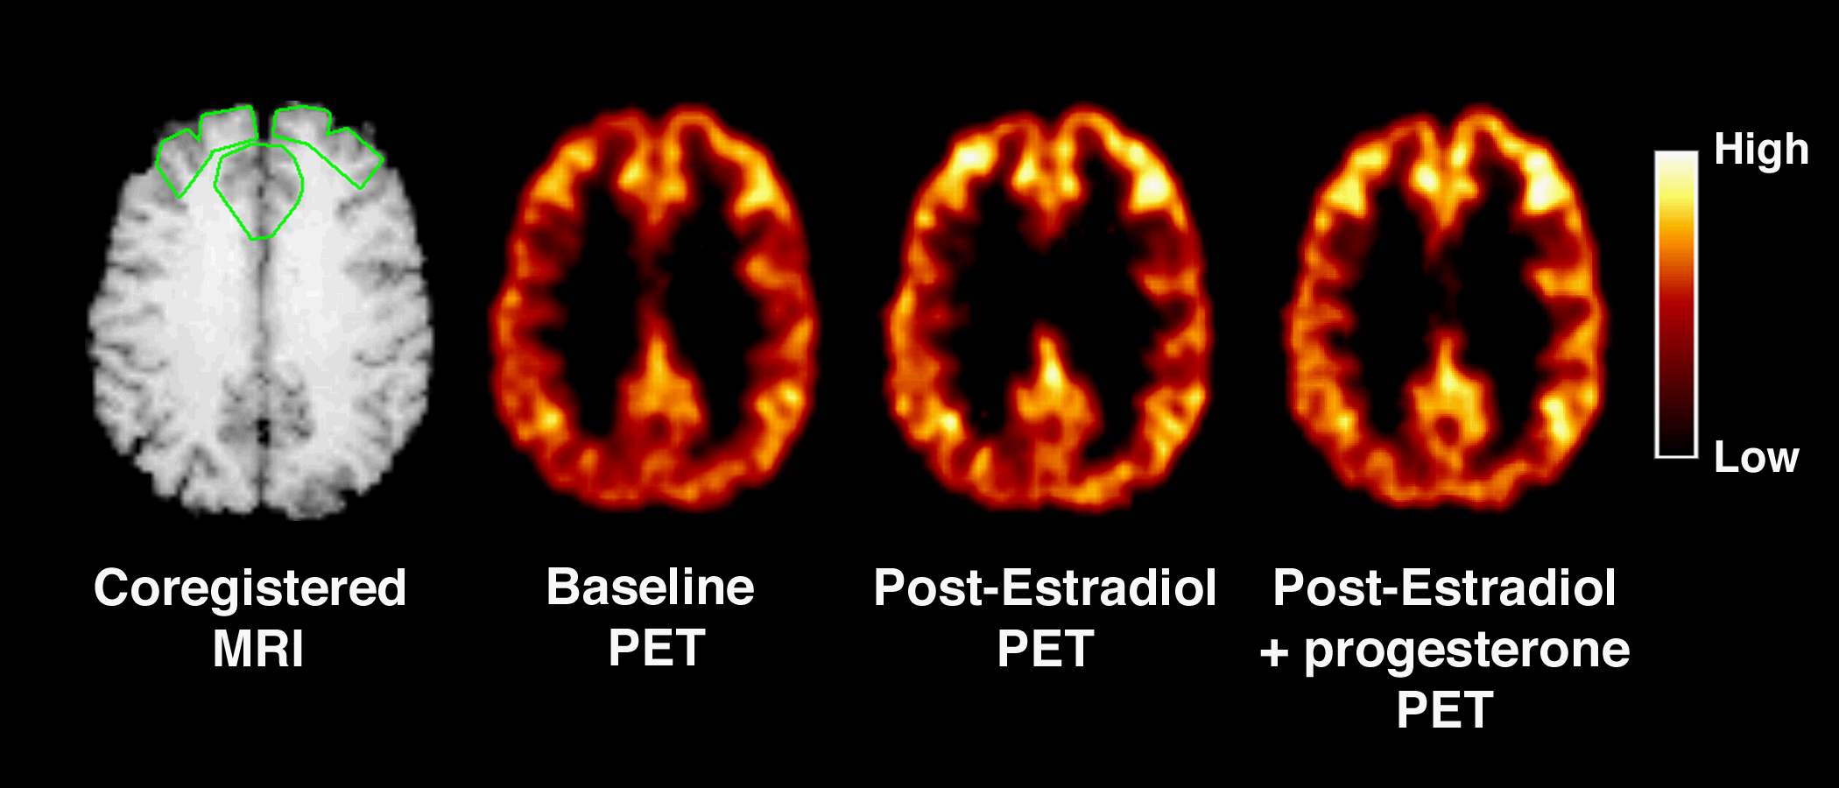
5HT2A serotonergic receptor binding in brain of postmenopausal women after E2 and then E2+P
Moses EL et al. Biol Psychiatry 2000;48:854
Moses-Kolko EL et al. Fertil Steril 2003;80:554

Slide 26
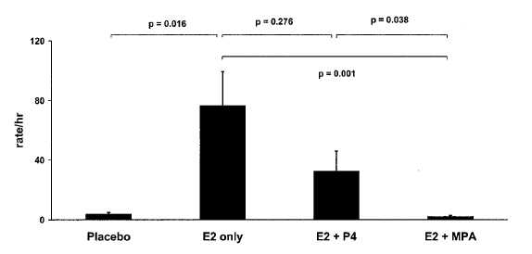
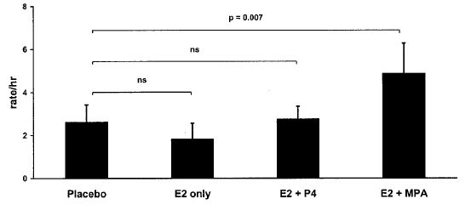
Progestins & behavior in monkeys
Female sexual initiation
Antagonistic behavior
Pazol et al JCEM 2004
Notes:
Progestins combined with estrogen as a part of an HRT regimen may reduce the behaviorally beneficial effects of estrogen. This is certainly the case for the effects of estrogen on alleviating symptoms of depression in women.
MPA could be acting through the PR to have this effect or even the GR. However, MPA could also block the conversion of P4 to allopregnanolone, a neurosteroid that binds to GABA-A receptor, inducing anxiolytic and antidepressive effects

Slide 27
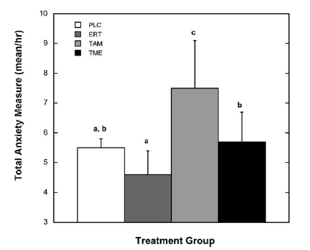
Anxiety: estradiol versus tamoxifen
In monkeys, tamoxifen was anxiogenic and antagonized the anxiolytic effects of estradiol
From Mook et al 2005
Notes:
Ongoing R12 studies
Drug - drug interactions
Tam metabolized by CYP 2D6 isoenzymes
SSRIs known to inhibit these enzymes
How does this effect tamoxifen bioactivity

Slide 28
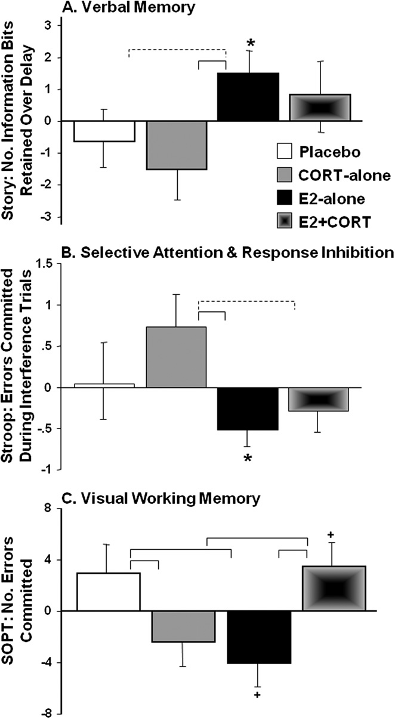
Cognitive benefits of E2 reduced by high cortisol
Verbal Memory
39 PMW rec’d 0.10 mg/day TE2 (50 pg/ml to 126 pg/ml) or plc x 8 wk
The last 4 days, half of each grp received oral hydrocortisone 90 mg/d (↑110-127%) or plc x 4 d
Selective Attn (Errors)
Visual Working Memory (Errors)
Baker. Neurobiol Aging 2012 33:829
Plc
Cort
E2
E2+Cort

Slide 29
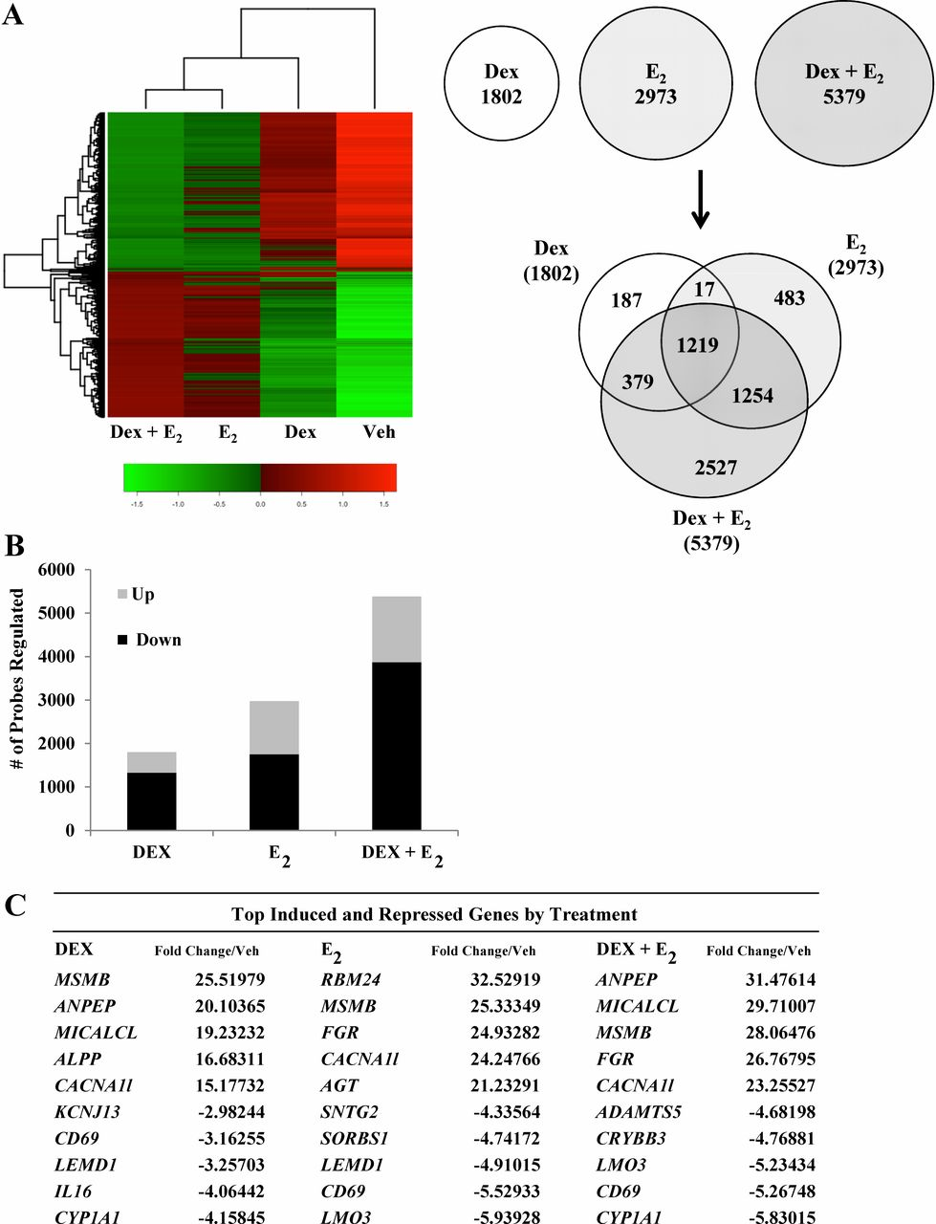
Global gene expression analysis in human uterine epithelial cells defines new targets of GC and E2 antagonism
Over 10,000 genes were significantly regulated by dexamethasone (Dex) or estradiol (E2)
Most genes were regulated by both Dex and E2 (2527) vs Dex (187) and E2 (483)
Several hundred genes coregulated by Dex and E2 were antagonistically regulated through the GC receptor (NR3C1) and ER-alpha (ESR1)
GC and ER-alpha receptors are required for transcriptional antagonism
Whirledge S et al. Biol Reprod 2013;89:66
Notes:
Dex and E₂ regulate global gene expression in human uterine epithelial cells. A) mRNA isolated from Dex-, E₂-, and Dex + E₂-treated ECC1 cells was analyzed using Whole Human Genome 4x44 multiplex format oligo array (Agilent) for gene expression. A heat map was generated with Heatplus software (BioConductor), using the averaged, normalized sample replicates of all significant probes. The number of probes that were statistically different (P < 0.01) between treatment groups were sorted by Venn diagram. B) The number of probes that were regulated are organized as either induced or repressed according to treatment group in Dex, E₂, and Dex + E₂ samples. C) The top five induced and repressed genes for each treatment group are listed. D) IPA of the top five regulated networks using the gene lists generated from Dex-, E₂₋, and Dex + E₂-treated ECC1 cells. E) Embryonic development and organ development network is presented, with expression values of the Dex, E₂, and Dex + E₂ treatment groups overlaid, as a colorimetric indicator of up- or down-regulation. F) Independent validation of Left-Right Determination Factor 1 (LEFTY1), one of the antagonized genes identified in the embryonic development and organ development network. Values were normalized to the housekeeping gene Cyclophilin B. Bar graphs show means ± SEM. **Groups with statistically different means at P < 0.01, as determined by ANOVA.

Slide 30
VTE risk in Million Women Study
3.3 million patient-years
VTE risk for E+P [RR 2.07] > E alone [1.42]
Transdermal E2 neutral [RR 0.82]
Progestins
  MPA vs other P [RR 2.67]
PE
  1:664 never
  1:475 oral E only
  1:390 norethisterone/norgestrel
  J Thromb Haemost 2012 doi:10.111/j.1538-7836.2012.04919.x

Slide 31
Stroke risk: transdermal vs oral estrogen
Population-based, nested case-control study of women ages 50-79 y
  1:4 [15710 cases and 59958 controls]
  2.85 cases/1000/year
Rate ratios [CI]
  TE overall RR 0.95 [0.75-1.20]
  OE overall RR 1.28 [1.15-1.42]
Dose
  Low TE (≤ 0.050 mg) RR 0.81 [0.62-1.05]
  High TE RR 1.89 [1.15-3.11]
  Low OE (≤ 0.625 mg, 2 mg E2) RR 1.25 [1.12-1.40]
  High OE RR 1.48 [1.16-1.90]
Progestin
  TE only RR 1.02 [0.78-1.34] OE only RR 1.35 [1.16-1.58]
  TE+P RR 0.76 [0.47-1.22] OE+P RR 1.24 [1.08-1.41]
Duration
  TE ≤ 1 yr RR 0.98 [0.50-1.91] OE ≤ 1 yr RR 1.02 [0.75-1.38]
  TE > 1 yr RR 1.13 [0.83-1.54] OE > 1 yr RR 1.35 [1.20-1.52]
Renoux C et al. BMJ 2010; 340:c2519.

Slide 32
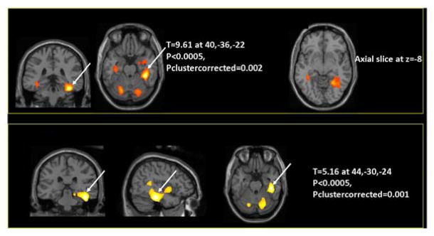
Effects of tamoxifen and anastrozole in healthy women with early stage breast cancer
Cognitive impairment more severe & more memory domains impacted in women who received tamoxifen as adjuvant tx as compared to those without adjuvant tx
Anastrozole impaired cognitive function more than tamoxifen
Bender C et al. Psychooncology 2006; 15:422; Menopause 2007;14:995; Berga SL. Anastrazole: brain draining or sparing? Lancet Oncol 2008;9:913
Hurria. Clin Breast Ca 2012; 14: 132-40

Slide 33
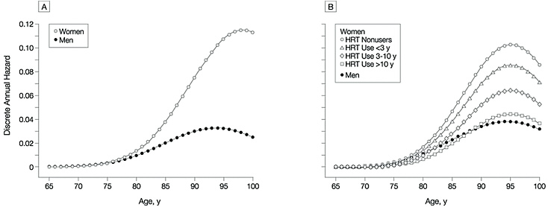
Zandi PP et al. JAMA 2002;288:2123
SEX DIFFERENCES: Dementia is higher in women than men and at least partly hormonally mediated Cache county prospective observational cohort

Slide 34
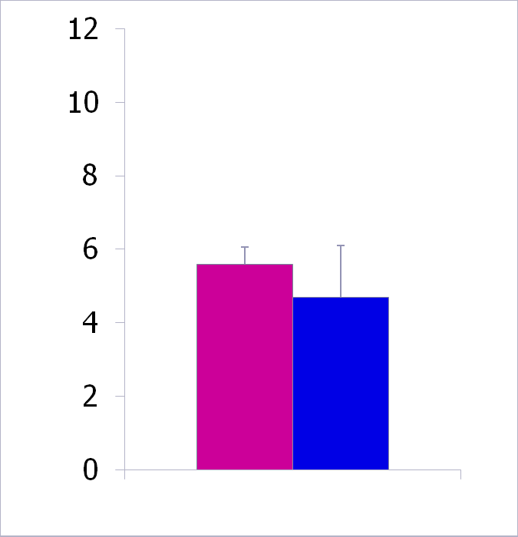
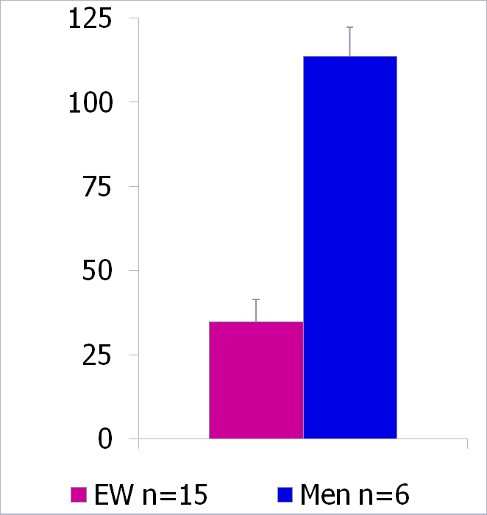
Human CSF levels of testosterone & estradiol
Testosterone (pg/ml)
Estradiol (pg/ml)

Slide 35
E2 use associated with reduced risk of death from both vascular dementia and AD
489,105 Finnish women using systemic HT from 1994-2009
581 died of vascular dementia
  E2 oral and transdermal
  P mostly norethindrone or MPA
  Risk ↓↓ ~38% by E2 or E2-P use
  1057 died of AD
    Risk ↓ ~15% after 5 years of use
  Risk reduction similar regardless of age at initiation (<60 vs ≥ 60 years)
Mikkola TS et al. JCEM 2017;102:870-877

Slide 36
Timing of exposure matters–Olmsted County MN
Prophylactic oophorectomy before age 45 y
  Death HR 1.67 (1.16-2.40)
  Depression HR 1.54 (1.04-2.26)
  Parkinson HR 1.68 (1.06-2.67)
  Dementia/CI HR 1.46 (1.13-1.90)
Rocca WA et al. Neurology 2007; Lancet Oncology 2006; Menopause 2008

Slide 37
Considerations/Summary
Estrogen therapy may protect against development of dementia, but cannot reverse it once established
  Timing of initiation may matters, but we do not know how narrow the window of opportunity is
Nonoral route may be more neuroprotective by
  Minimizing VTE risk
  Greater vasodilation
  Lower BP
  Neutral for stroke risk
Oral E may promote stroke and counteract neuroprotective effects by promoting vascular dementia

Slide 38
Considerations/Summary
Information-free zones
  Head-to-head comparative longitudinal studies of different estrogenic substances, doses, and routes have not been done
  Therapeutic target range for circulating estradiol or any other estrogenic substance unknown
  Impact of progestagens
    Differential impact for progesterone vs 21-C progestins vs 19-nortestosterone derivatives?

Slide 39
STEP 1
Select an estrogen
  Not all estrogens are the same
  The safest estrogen is transdermal estradiol
  The easiest to prescribe formulation of transdermal estradiol is a weekly patch or daily gel but some women may prefer vaginal rings
  The therapeutic goal is a circulating estradiol of 40-80 pg/ml and constant levels without peaks or troughs
  Published pharmacokinetic profiles are helpful but not necessarily indicative of any one patient

Slide 40
STEP 2
Is a progestin needed?
  Only indication is the presence of the uterus
Progestins are depressogenic and more so in those with brain vulnerabilities
Need the least progestin exposure possible for those with a uterus
Progesterone may be less depressogenic than synthetic progestins
Cyclic exposure to progestin leads to withdrawal bleeding
Continuous exposure to E + P may lead to “breakthrough” bleeding from a “thin” endometrium, adenomyosis, or fibroids
Low dose E + P given to perimenopausal women will not suppress hormonal chaos due to perimenopause
Least progestin exposure (for the brain) with the least user burden and the best bleeding pattern is a Mirena IUD

Slide 41
STEP 3
Are androgens needed?
Topic for another day…….

Slide 42
ACKNOWLEDGEMENTS
Wake Forest
Sue Appt, DVM
Tom Clarkson, DVM
Jay Kaplan, PhD
Kristen Sanders, PhD
Robert Taylor, MD, PhD
Jie Yu, MD
Emory University/Yerkes NPC
Tammy Loucks, MPH, PhD
Carolyn Cidis Meltzer, MD
Vasiliki Michopoulos, PhD, MSCR
Mark Wilson, PhD
University of Pittsburgh/Magee
Cathy Bender, RN, PhD
Judy Cameron, PhD
Eydie Kolko-Moses, MD
Marijane Krohn, PhD
Kathy Laychak, BSN
Marsha Marcus, PhD
Karen Matthews, PhD
Jane Owens, PhD
University of Florida
Donna Giles, PhD
Pennsylvania State University
Nancy Williams, PhD
University of Maryland
Gloria Hoffman, PhD
Athens Univ Medical School, Greece
  George Chrousos, MD, PhD
University of Barcelona
Fulvia Mancini, MD, PhD
University of Pavia, Italy
Benedetta Brundu, MD
FUNDING / SUPPORT
NIH (NCRR, NIMH, NICHD, NHBL )
Ortho-AFS Award
Bank of America-Giannini Foundation

