Slide 1
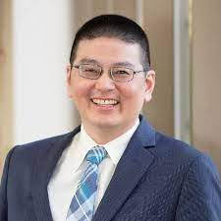
Perioperative Opioid Stewardship
Lyen C. Huang, MD, MPH, FACS, FASCRS
Assistant Professor of Surgery, University of Utah
Ogden Surgical-Medical Society CME Conference for the Curious Physician 2022

Slide 2
Financial Disclosures
No financial disclosures.
This effort is paid for through a grant from the Utah Department of Health Violence and Injury Prevention Program.
Funding: The research reported in this presentation was supported by the University of Utah Study Design and Biostatistics Center, funded partly by the National Center for Research Resources and the National Center for Advancing Translational Sciences, National Institutes of Health (UL1TR002538, KL2TR002539). The content is the responsibility solely of the authors and does not necessarily represent the official views of the National Institutes of Health.

Slide 3
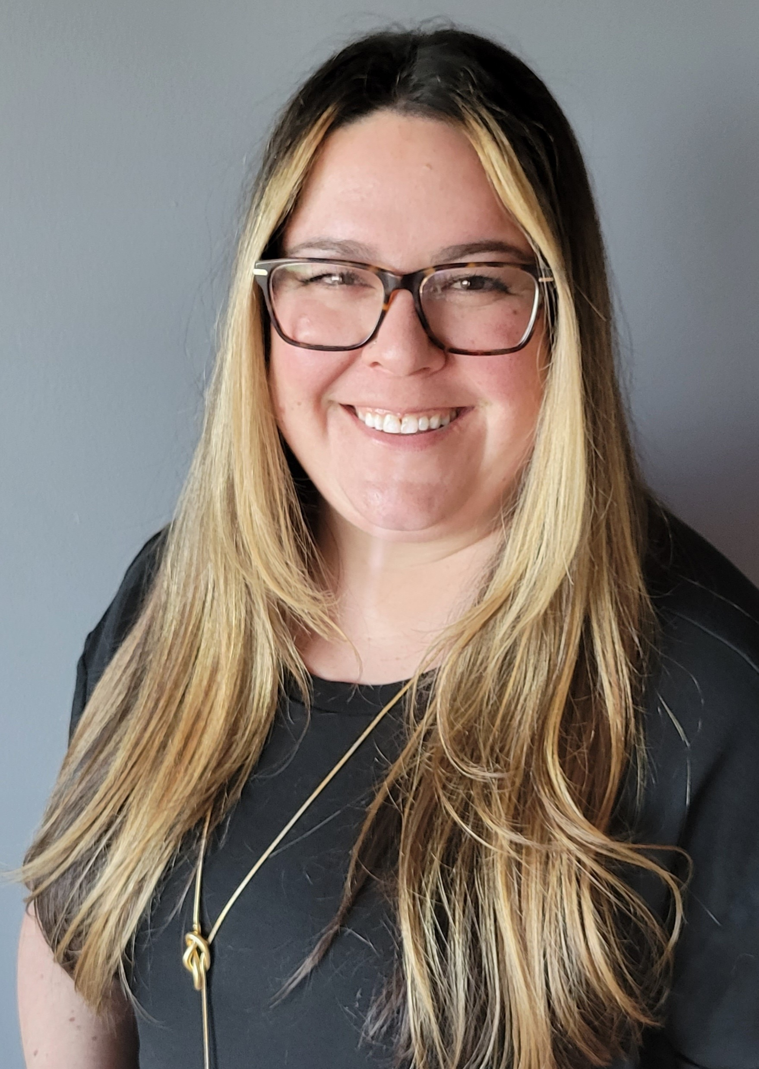
Comagine Health
Comagine Health is a nonprofit organization committed to improving outcomes in health care.
Comagine Health provides:
Training for nursing homes, emergency departments, and clinics on opioid use disorder processes
Diabetes, blood pressure and chronic kidney disease process improvement
Adrienne Butterwick is a senior improvement advisor at Comagine Health. She is here to talk with you about Comagine Health resources and trainings.
AButterwick@comagine.org | (801) 892-6646

Slide 4
Objectives
Provide an evidence-based patient-centered approach to opioid prescribing after surgery
Describe how promoting the disposal of leftover opioids is critical to opioid stewardship
Outline best practices for co-prescribing naloxone

Slide 5
Opioid Crisis

Slide 6
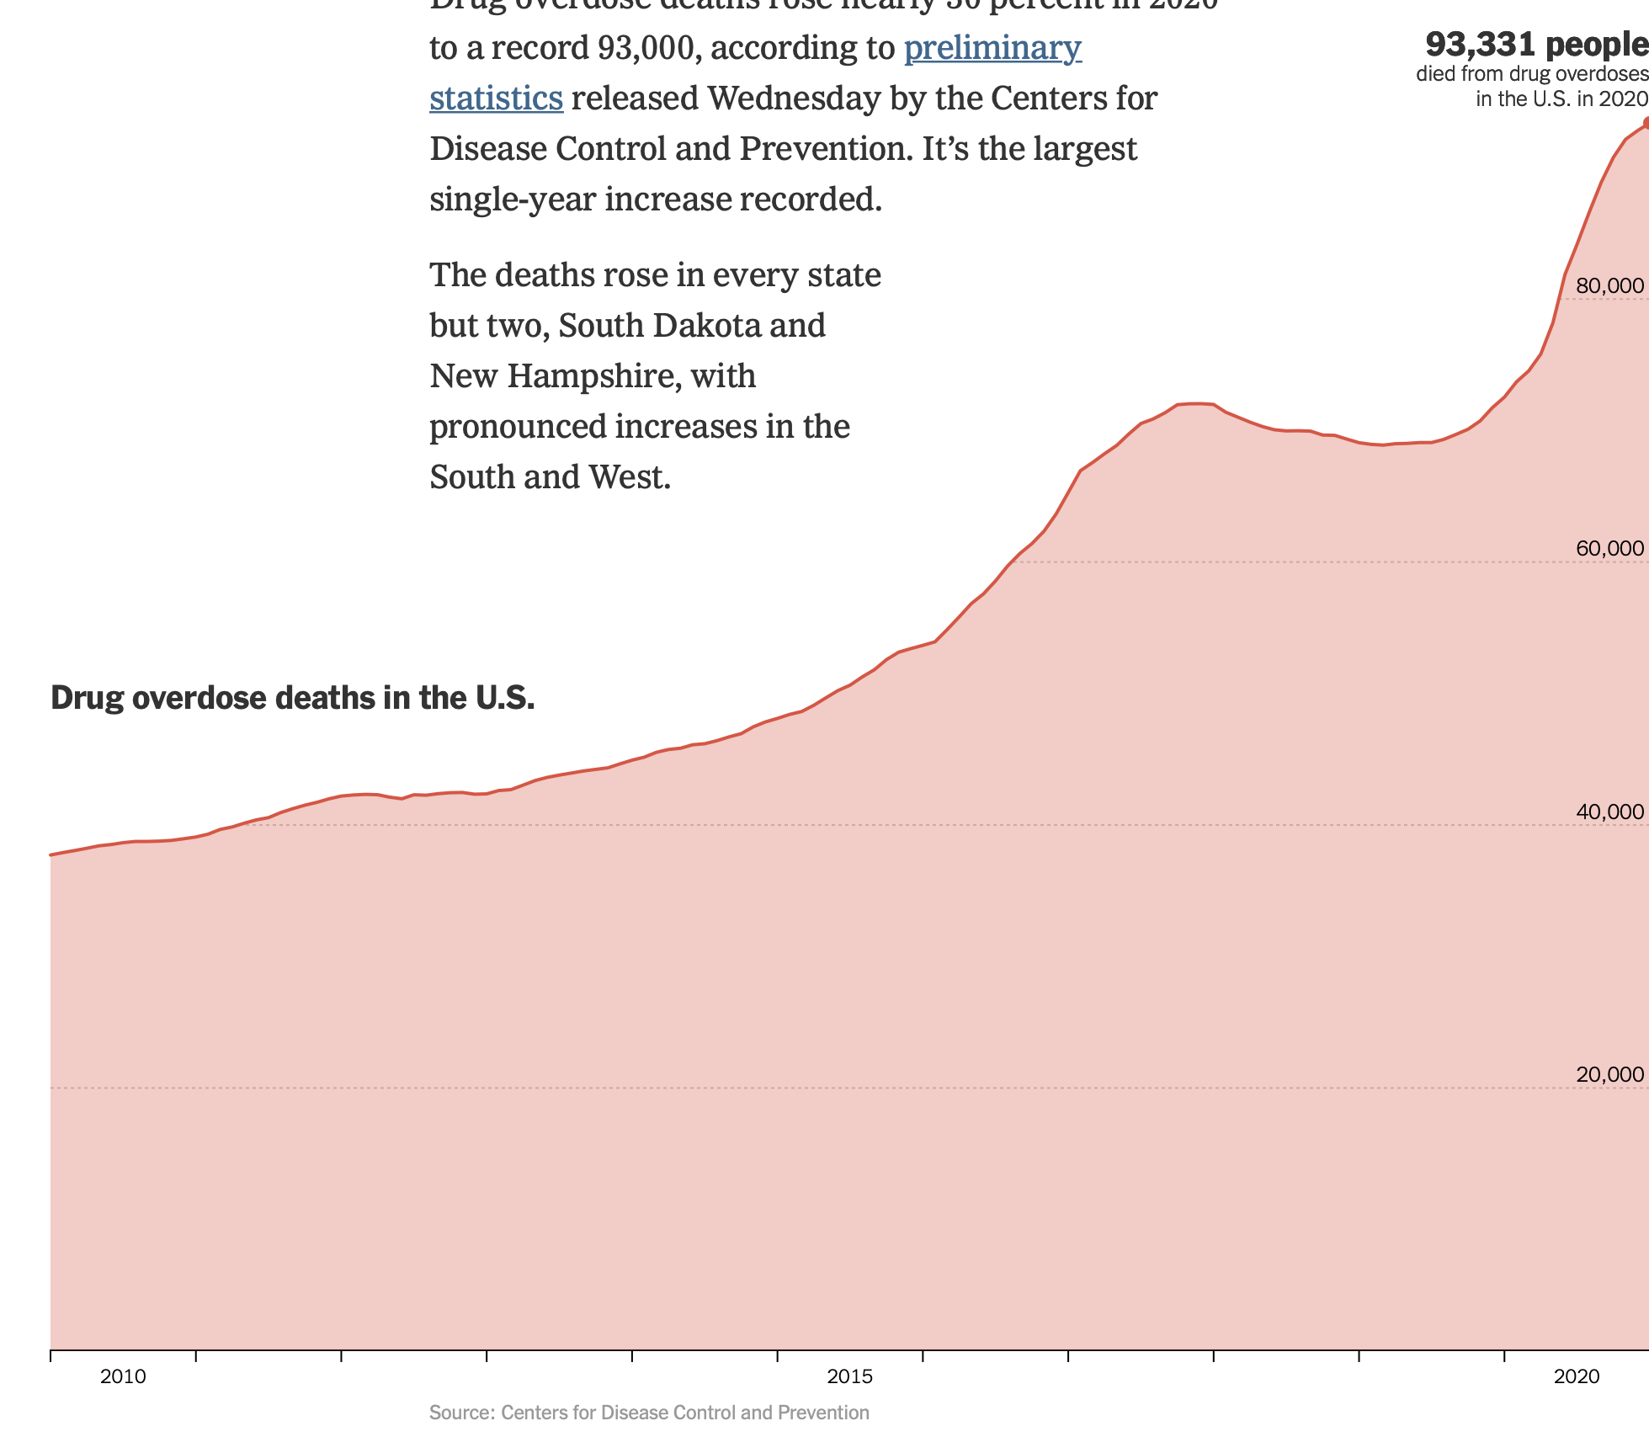
In 2020, 28% of overdose deaths were from prescription opioids
Peak car crash deaths (1972)
Peak HIV deaths (1995)
Peak gun deaths (1993)
https://www.nytimes.com/interactive/2021/07/14/upshot/drug-overdose-deaths.html
Notes:
As the COVID pandemic goes on, 30% increase in 2020 which is the largest single-year increase recorded
Deaths rose in every one of our Mountain West states

Slide 7
We are contributing to the Crisis
>64 million operations/year
60-92% have leftover opioids
2/3 of misusers got them from family or friends
First exposure for many leading to future illicit drug use
Threefold increase in poisoning and overdoses for children
0.3-15% opioid-naïve patients are still using opioids 90 days after surgery
Shah A. MMWR Morb Mortal Wkly Rep. 2017
Lee JS. J Clin Oncol 2017
Cicero 2018
Compton 2016
Notes:
A total of 68,463 eligible patients underwent curative-intent surgery and filled opioid prescriptions. Among opioid-na ̈ıve patients, the risk of new persistent opioid use was 10.4% (95% CI, 10.1% to 10.7%). One year after surgery, these patients continued filling prescriptions with daily doses similar to chronic opioid users (P = .05), equivalent to six tablets per day of 5-mg hydrocodone. Those receiving adjuvant chemotherapy had modestly higher doses (P = .002), but patients with no che- motherapy still had doses equivalent to five tablets per day of 5-mg hydrocodone. Across different procedures, the covariate-adjusted risk of new persistent opioid use in patients receiving adjuvant chemotherapy was 15% to 21%, compared with 7% to 11% for those with no chemotherap

Slide 8
The parable of the river
37% of prescriptions are for opioids
10% of all opioid prescriptions in the US
11% of prescription opioid overdoses
Notes:
https://news.sky.com/story/japan-flooding-dozens-dead-as-torrential-rain-triggers-landslides-11429191

Slide 9
Evidence-based Approach to Opioid Prescribing After Surgery

Slide 10
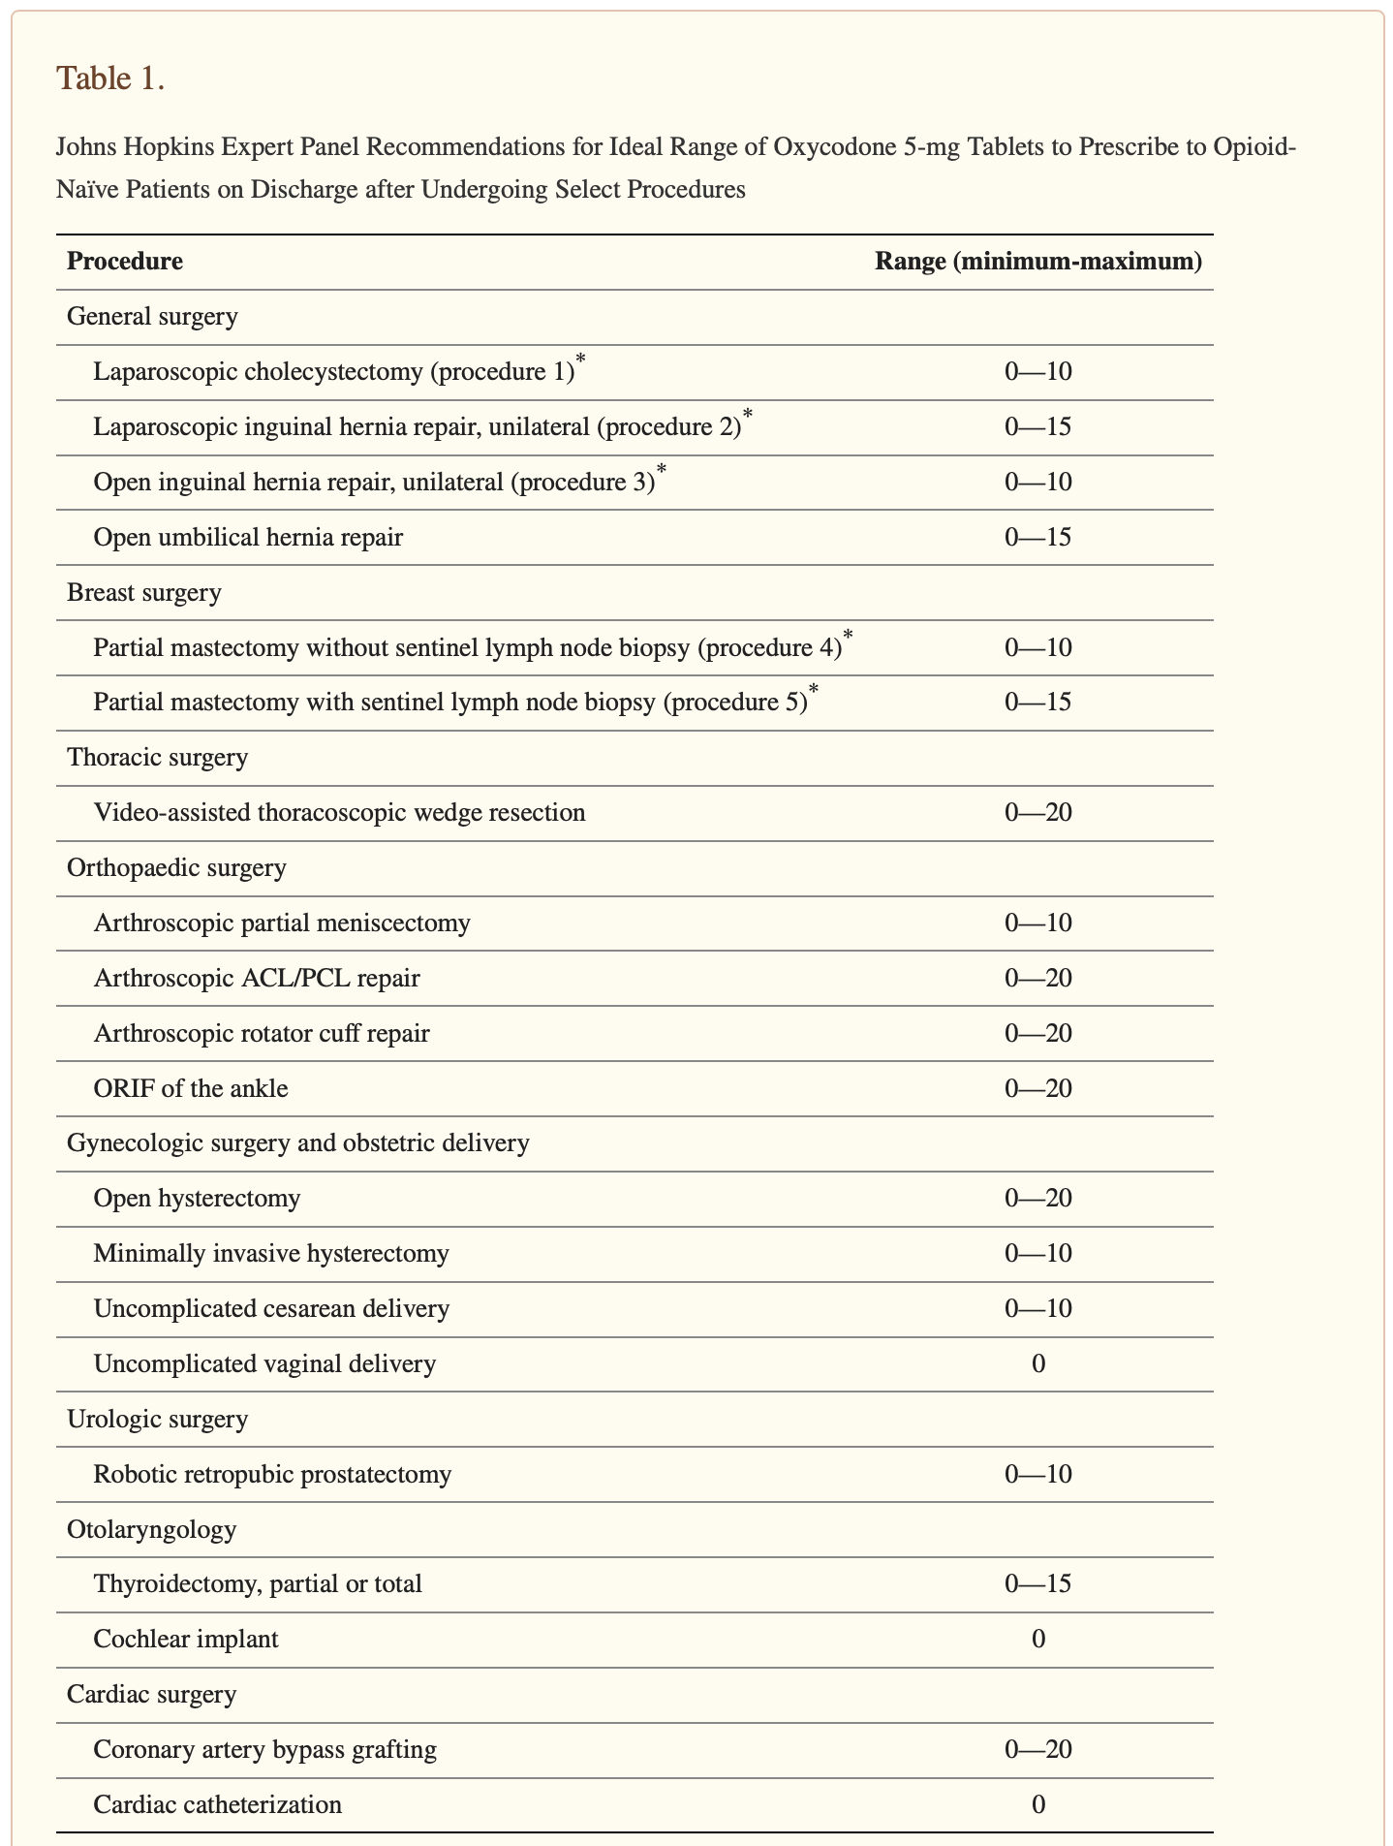
Procedure | Oxycodone 5 mg tabs
Appendectomy – Lap or Open | 0-10
Colectomy – Lap or open | 0-15
Ileostomy/Colostomy | 0-15
Open small bowel resection | 0-20
Discharge day | Oxycodone 5 mg tabs
POD 1 | 15
POD 2 – used 0 pills | 0
POD 2 – used 1-3 pills | 15
POD 3 – used ≥4 pills | 30
Notes:
https://michigan-open.org/prescribing-recommendations/
https://pubmed.ncbi.nlm.nih.gov/29198638/
https://www.ncbi.nlm.nih.gov/pmc/articles/PMC6353661/

Slide 11
The problem with arbitrary guidelines
Many of us are already prescribing less than the guidelines
Univ. of Utah, Partners HealthCare, Mayo Clinics are all prescribing below guidelines
But we’re still overprescribing by 3-6x
Robinson (2022) “Comparing Clinician Consensus Recommendations to Patient-reported Opioid Use Across Multiple Hospital Systems”, Ann Surg
Notes:
https://pubmed.ncbi.nlm.nih.gov/32590547/

Slide 12
The need for patient-centered opioid prescribing
Major abdominal surgery at the University of Utah
Many use no opioids prior to discharge (48h - 13%; 24h – 25%)
Every patient received an opioid prescription
Prescribed median of 8 oxycodone 5 mg tablets
1/3 of patients had high pain and opioid needs (≥60 MME consumed 24 hrs before discharge)
82% given a prescription that will last <48 hrs
Bleicher (2021) “Patient-centered Opioid Prescribing: Breaking Away From One-Size-Fits-All Prescribing Guidelines”, J Surg Res
Notes:
Gastric bypass, colectomy, abdominal wall reconstruction, pancreatectomy
https://pubmed.ncbi.nlm.nih.gov/33744772/
Overall, 631 patients underwent one of the included procedures during the 2-year time period. Patients were excluded for length of stay less than 48 hours (n = 28) or for missing critical data (n = 6). 598 patients were included for analysis. The median age of patients was 54 years (IQR: 41 – 65) and 381 (63.7%) were female. Roux-en-Y gastric bypass was the most common procedure, followed by colectomy (Table 1) . That doesn’t match Table 1? Abdominal wall recon then colectomy then RYGB then pancreatectomy
Many patients (n=133, 22.0%) used no opioids in the 24 hours prior to discharge but were discharged with an opioid prescription (median 60 MME/prescription, [IQR 40-120]). Some patients (n=71, 11.8%) took no opioids in the 48 hours prior to discharge but were sent home with a discharge prescription (median 60 MME/prescription, [IQR 35-135]). The majority of patients (164/200, 82%) with 24-hour PDOC greater than 60 MMEs were discharged with an opioid prescription that would have lasted < 48 hours if opioid use continued at the same rate as their 24-hour PDOC.

Slide 13
What are we doing?
 | Actual
Prescription size (median) | 15 (10-20)
Opioid Rx avoided | 0
Consumed tabs (median) | 3 (0-11)
Leftover tabs (median) | 10 (5-15)
Leftover tabs (total) | 604
Bleicher (2021) “Use of post-discharge opioid consumption patterns as a tool for evaluating opioid prescribing guidelines”, Am J Surg

Slide 14
Current prescribing is consistent or better than arbitrary guidelines
 | Actual | Dartmouth | Mayo | Michigan
Prescription size (median) | 15 (10-20) | 15 (15-30) | 15 (15-30) | 15 (10-15)
Opioid Rx avoided | 0 | 24 | 0 | 0
Consumed tabs (median) | 3 (0-11) | - | - | -
Leftover tabs (median) | 10 (5-15) | 13 (3-27) | 13.5 (8-22) | 10 (5-15)
Leftover tabs (total) | 604 | 686 | 833 | 498

Slide 15
24-hour pre-discharge opioid consumption (PDOC)
 | Actual | Dartmouth | Mayo | Michigan | 2x24 hr PDOC
Prescription size (median) | 15 (10-20) | 15 (15-30) | 15 (15-30) | 15 (10-15) | 6 (2-12)
Opioid Rx avoided | 0 | 24 | 0 | 0 | 24
Consumed tabs (median) | 3 (0-11) | - | - | - | -
Leftover tabs (median) | 10 (5-15) | 13 (3-27) | 13.5 (8-22) | 10 (5-15) | 2.5 (0-8.7)
Leftover tabs (total) | 604 | 686 | 833 | 498 | 169
14% patients got more opioid pills because of their pre-discharge needs
Notes:
The risks of prescribing fewer pills are minimal. The prescription adequacy rate using the 2 × 24-h PDOC guidelines was lower than our actual rate (74.2% vs 83.9%), meaning more patients would have theoretically required an opioid prescription refill. However, in this scenario, 24 patients (38.7%) would have not received an opioid prescription at hospital discharge (based on having a 24-h PDOC of 0 MME). Only 12 of these patients (50%) used any opioids after discharge, and 5 (20.8%) used 3 or fewer pills. If these 5 patients had not use opioids following discharge, prescriptions would have been adequate for 82.3% of patients. Additionally, these guidelines are more patient-centered. While most postoperative patients would have received fewer pills, guidelines based on inpatient opioid use could ensure patients with higher pain needs receive more opioid pills at discharge.In this cohort,if the 2 × 24-h PDOC guidelines were used, 14% of patients would have received more opioid pills. This demonstrates how discharge prescriptions based on this metric would be patient-centered, accounting for the patient and clinical factors that influence opioid requirements following hospital discharge.

Slide 16
Colorectal surgery and surgical oncology
2x 24-hour PDOC
Ok to prescribe no opioids
Max prescription size = 30 tablets
No restriction on the opioid medication
Pre-operative and pre-discharge education
Logbooks
Naloxone co-prescribing

Slide 17
Promoting Disposal of Leftover Opioids

Slide 18
https://opioids.stanford.edu/recommendation-5a

Slide 19
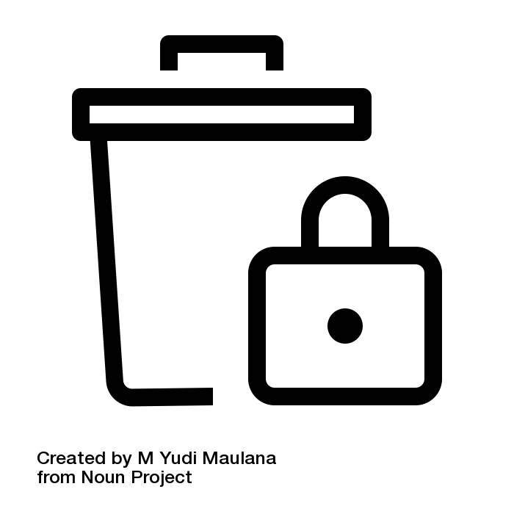
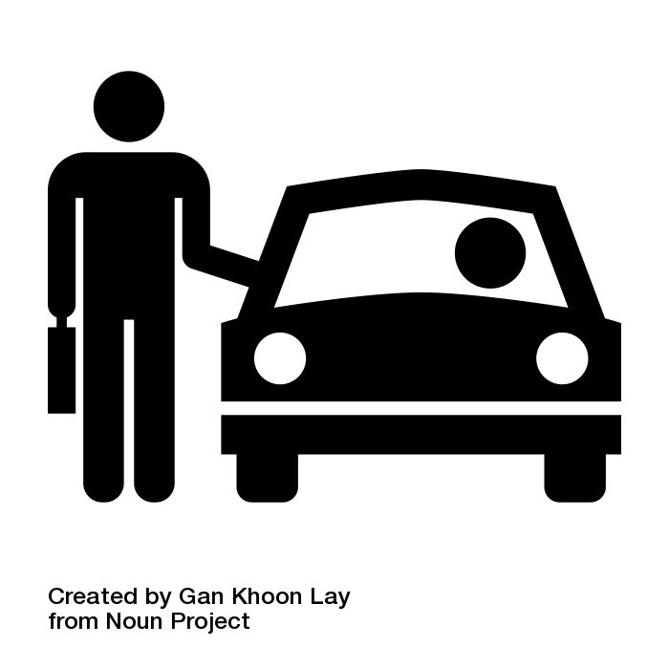
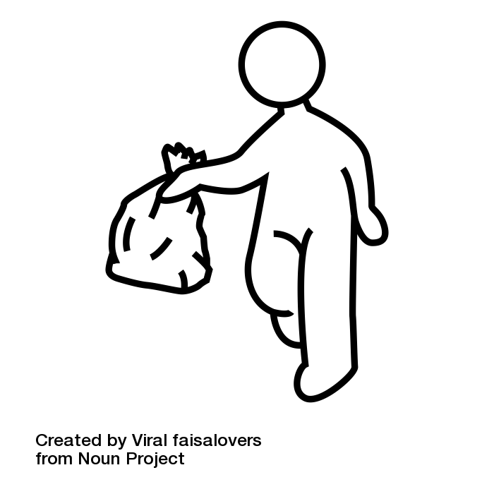
Drop boxes
0.3% of controlled meds are disposed in drop boxes
Only 9% of patients dispose
Takeback events
4-12% of returned meds are controlled substances
Patient education
8-51% disposal rate after intervention
Financial incentives
30% returned after being paid $5/pill (max $60)
Home disposal bags
55-57% of adults disposed
72% of parents disposed
Stokes (2019) “Home Disposal Kits for Leftover Opioid Medications After Surgery: Do They Work? J Surg Res

Slide 20
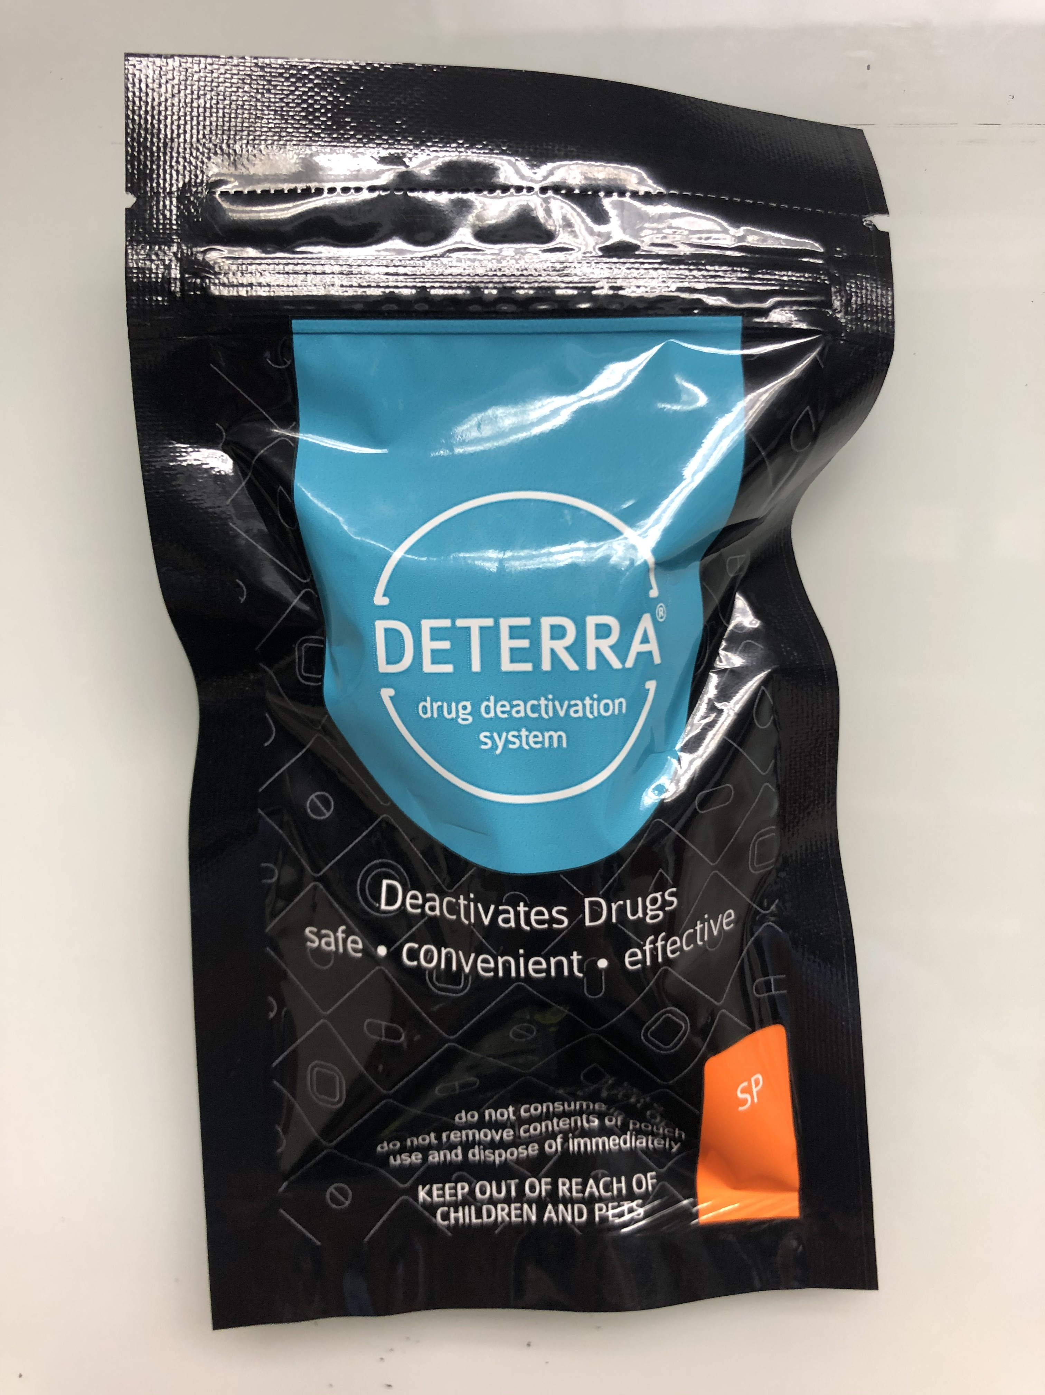
HOME DISPOSAL KITS
U of U systemwide distribution
Every patient filling an opioid or benzodiazepine prescription
77% of surgery patients with leftover opioids dispose
Only 8% do not plan to dispose

Slide 21
Naloxone Co-Prescribing

Slide 22
Naloxone Prescriptions
When naloxone is co-prescribed with opioids, the risk of opioid overdose may decrease even if the naloxone prescription does not get filled
Naloxone co-prescription appears to serve as an important educational and culture-changing strategy
The CDC began recommending co-prescriptions in some cases, outlined in the CDC’s 2016 Guidelines
https://nida.nih.gov/publications/drugfacts/naloxone

Slide 23
Patients at Risk
History of opioid poisoning, intoxication or overdose
History of substance or opioid use disorder
Suspected illicit or non-medical opioid user
Taking benzodiazepines or drinking alcohol with opioids
At risk of returning to a high dose to which they are no longer tolerant (e.g., patients recently released from prison)
Patients taking >50 MME/day (~7 tablets of oxycodone 5 mg)
Receiving rotating opioid medication regimens
Extended-release or long-acting opioid medication
New methadone or buprenorphine Rx for opioid use disorder
Respiratory, cardiac, renal disease, or smokers
JAMA. 2016;315(15):1624-1645. doi:10.1001/jama.2016.1464 Published online March 15, 2016.
Notes:
Opioid rotation (or switching) is a change in opioid drug or route of administration with the goal of improving outcomes.

Slide 24
Starting the Conversation
Providers or staff can counsel patients on the role of naloxone
It’s important to emphasize that opioids carry risks, and the patient is not being targeted or singled out.
Ask what the patient knows about naloxone.
Ask open-ended questions like “what concerns do you have?” and “what questions do you have about this medicine?”
Encourage the patient to discuss naloxone with family and friends to ensure they are prepared to use it.
https://prescribetoprevent.org/

Slide 25
Opioid Safety Language
The word “overdose” has negative connotations and prescription opioid users may not relate to it.
Instead of using the word “overdose,” consider using language like “accidental overdose,” “bad reaction” or “opioid safety.” You may also consider saying:
“Opioids can sometimes slow or even stop your breathing.”
“Naloxone is the antidote to opioids—to be [sprayed in the nose/injected] if there is a bad reaction where you can’t be woken up.”
“Naloxone is for opioid medications like an epinephrine pen is for someone with an allergy.”
https://www.chcf.org/wp-content/uploads/2017/12/PDF-NaloxoneOpioidSafetyProviders.pdf

Slide 26
Points to Remember
Naloxone rapidly reverses an opioid overdose. It attaches to opioid receptors and reverses and blocks the effects of other opioids.
Naloxone is a safe medicine. It only reverses overdoses in people with opioids in their systems.
Naloxone only works in the body for 30 to 90 minutes. Patients may need multiple doses.
In some areas, you can get naloxone from pharmacies with or without a personal prescription from community-based distribution programs, or local health departments. Cost may be a barrier.
https://www.chcf.org/wp-content/uploads/2017/12/PDF-NaloxoneOpioidSafetyProviders.pdf

Slide 27
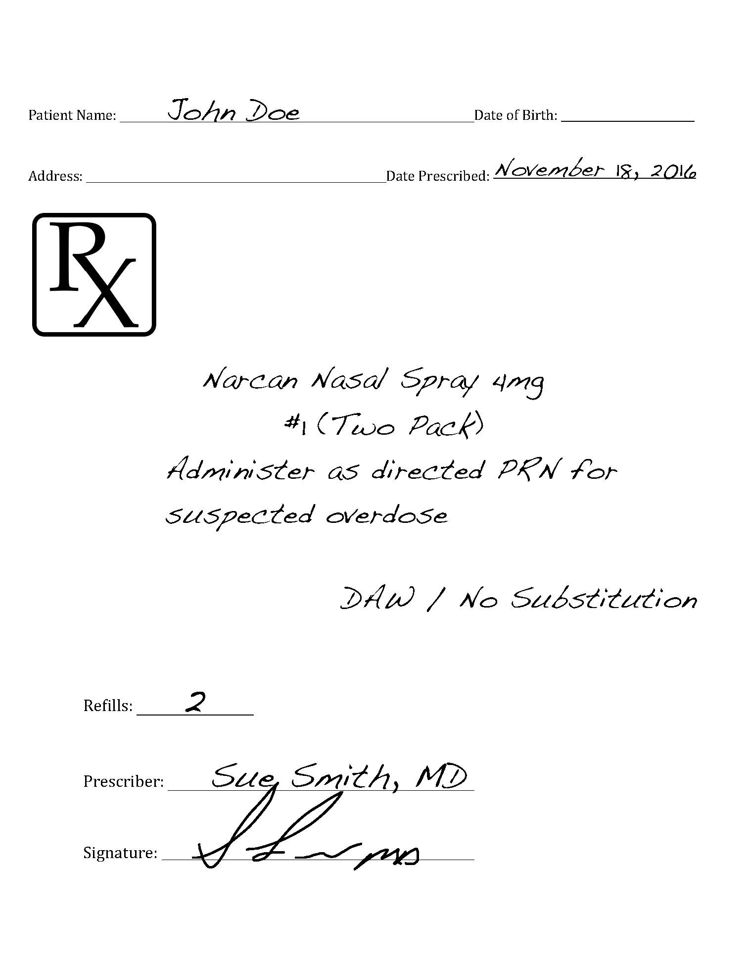
Prescription Example

Slide 28
Citations
New York Times <https://www.nytimes.com/interactive/2021/07/14/upshot/drug-overdose-deaths.html>
Shah A. MMWR Morb Mortal Wkly Rep. 2017
Lee (2017) “New Persistent Opioid Use Among Patients With Cancer After Curative-Intent Surgery”, J Clin Oncol
Cicero (2018) “Increased use of heroin as an initating opioid of abuse: Further considerations and policy implications”, Addict Behav
Compton (2016) “Relationship between Nonmedical Prescription-Opioid Use and Heroin Use”, N Engl J Med
Robinson (2022) “Comparing Clinician Consensus Recommendations to Patient-reported Opioid Use Across Multiple Hospital Systems”, Ann Surg
Bleicher (2021) “Patient-centered Opioid Prescribing: Breaking Away From One-Size-Fits-All Prescribing Guidelines”, J Surg Res
Stokes (2019) “Home Disposal Kits for Leftover Opioid Medications After Surgery: Do They Work? J Surg Res
Centers for Disease Control and Prevention. Life-Saving Naloxone from Pharmacies. More Dispensing needed despite progress. Vital Signs MMWR, August 2019. Retrieved from https://www.cdc.gov/vitalsigns/naloxone/index.html on 2022, March 11.
NIDA. 2022, Jan. 11. Naloxone DrugFacts. Retrieved from https://nida.nih.gov/publications/drugfacts/naloxone on 2022, March 14.
JAMA. 2016;315(15):1624-1645. doi:10.1001/jama.2016.1464 Published online March 15, 2016. Retrieved from file:///C:/Users/jmillsap/Downloads/jsc160004.pdf on 2022, March 14.
Shah A. MMWR Morb Mortal Wkly Rep 2017. Cicero 2018 Compton 2016.
San Francisco Department of Public Health. Naloxone for opioid safety: a provider’s guide to prescribing naloxone to patients who use opioids. January 2015.
Prescribe to Prevent. Prescribing Various Naloxone Products. Retrieved from https://prescribetoprevent.org/wp2015/wp-content/uploads/Adapt.NarcanScript.pdf

Slide 29
Questions? Lyen Huang - lyen.huang@hsc.utah.edu Jamee Millsap - jmillsap@comagine.org Adrienne Butterwick - AButterwick@comagine.org

