Slide 1
What’s New in my Specialty
Rheumatology
Effects of SARS-CoV-2 infection and vaccination on rheumatic and musculoskeletal disease (RMD)
Gregory T. Austad, MD, FACP, FACR
Tanner Memorial Clinic
Ogden Surgical Medical Society Meeting
May 2022

Slide 2
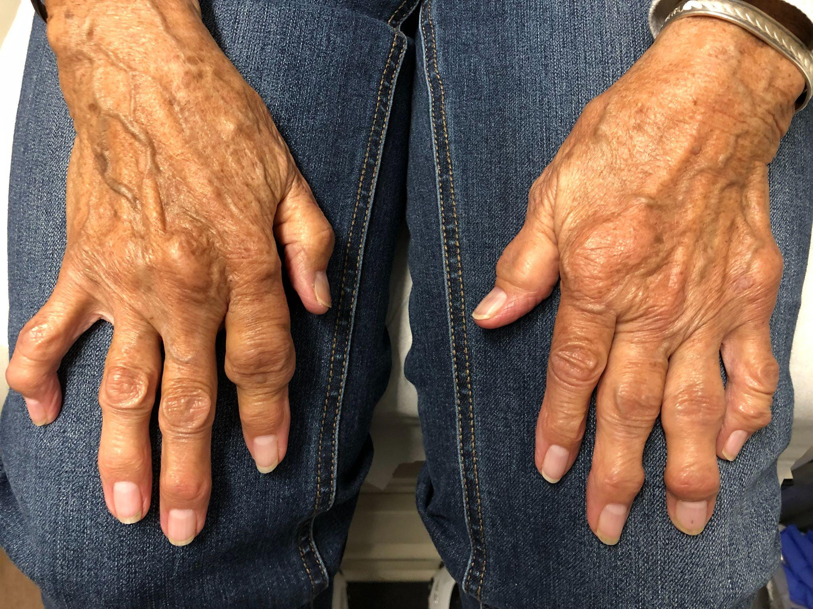
Disclosures:
None

Slide 3
Objectives:
Learn the effects of COVID-19 infection in immunosuppressed rheumatology patients
Discuss effects and efficacy of COVID-19 immunization in immunosuppressed rheumatology patients
Review updated CDC immunization guidelines for COVID-19 vaccination in immunosuppressed patients

Slide 4
Factors associated with COVID-19-related death in people with rheumatic diseases
Independent factors associated with COVID-19-related death were:
Age (66–75 years)
Male sex
Hypertension and cardiovascular disease
Chronic lung disease
Prednisolone equivalent dosage >10 mg/day
Moderate/high RMD disease activity
Rituximab, sulfasalazine, azathioprine, cyclophosphamide, cyclosporine, mycophenolate or tacrolimus
Not receiving any immunosuppressive compared with methotrexate monotherapy
Strangfeld A, et al. Ann Rheum Dis 2021;80:930–942. doi:10.1136/annrheumdis-2020-219498
Notes:
3729 patients (mean age 57 years, 68% female), 390 (10.5%) died

Slide 5
COVID-19 Infection among RMD Patients
77 patients infected with SARS-CoV-2
68.9% had a mild course (fatigue, 58.4%; fever 45.4%; URI symptoms 68.8%)
23.3% required hospitalization
1.3% mortality rate
Corticosteroid, mycophenolate and rituximab treatment lead to more serious disease course
Older age and lung disease were independent predictive factors of hospitalization
Interesting fact: All patients receiving Rituximab had severe disease
Athanasios-Dimitrios Bakasis, et al. Journal of Autoimmunity, Volume 123, September 2021, 102687
Notes:
Greek group in Athens: Suggests patients with RMD do well. Rituximab, steroids and mycophenolate treatment more severe disease. All Rituximab patients had severe disease. WERE THESE ALL VACCINATED?

Slide 6
Risk and prognosis of SARS-CoV-2 infection and vaccination against SARS-CoV-2 in RMD
5,165 records reviewed, 208 included, 90 passed quality assessment
Patients with RMDs do not face more risk of contracting SARS-CoV-2 (n=26 studies)
or worse prognosis of COVID-19 (n=14) than individuals without RMDs.
No consistent differences in risk of developing (severe) COVID-19 were found between different RMDs (n=19).
Disease activity is associated with worse COVID-19 prognosis (n=2)
Increased risk seen for glucocorticoid use (n=13).
Rituximab associated with worse COVID-19 prognosis (n=7)
Vaccine immunogenicity is negatively associated with older age, rituximab and mycophenolate
Kroon FPB, et al. Ann Rheum Dis 2022;81:422–432. doi:10.1136/annrheumdis-2021-221575
Notes:
Systematic chart review. Smaller numbers

Slide 7
Risk of COVID-19 in Rheumatoid Arthritis: National VA cohort study
67,772 patients studied, Large matched cohort study, VA database 2019
Compared the risk of COVID-19 and COVID-19 hospitalization and death for RA vs non-RA patients
1503 patients had COVID-19. 388 patients had severe COVID (hospitalization or death)
RA was associated with a higher risk of COVID-19 and COVID-19 hospitalization and death compared to non-RA controls.
Use of DMARD drugs and prednisone, Black race, self-reported Hispanic ethnicity, and presence of several chronic conditions were associated with COVID-19 and severe COVID-19 hospitalizations and death
Arthritis & Rheumatology. Vol 73. No. 12, Dec 2021, pp 2179-2188
Notes:
Mean age 67.8 years old. Mostly male, but adjusted for demographic characteristics, comorbidities, health care utilization and access and county-level COVID-19 incidence rates

Slide 8
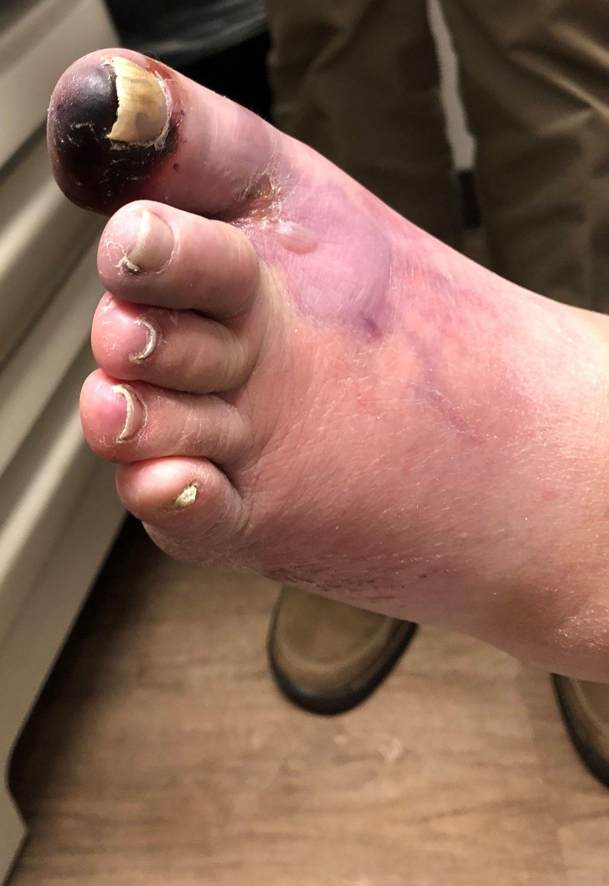

Slide 9
Rheumatologic Manifestations of COVID-19 infection or vaccination
Systemic lupus flare
Rheumatoid arthritis flares
New IgG-4 related disease
COVID toes mimicking vasculitis
Microscopic polyangiitis

Slide 10
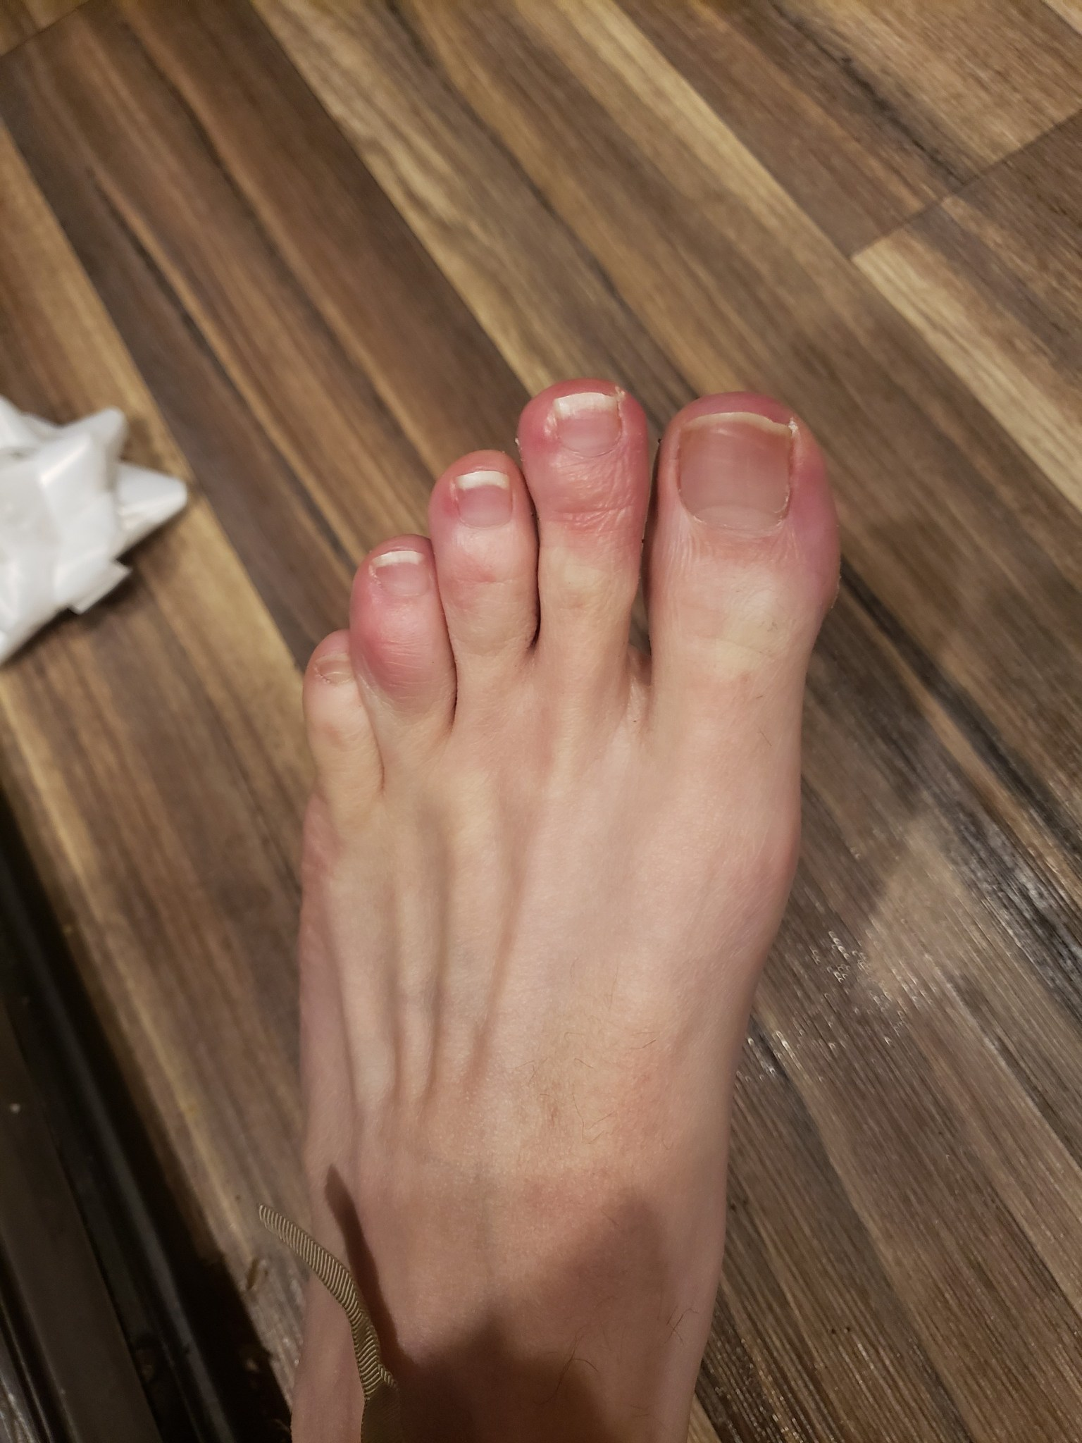
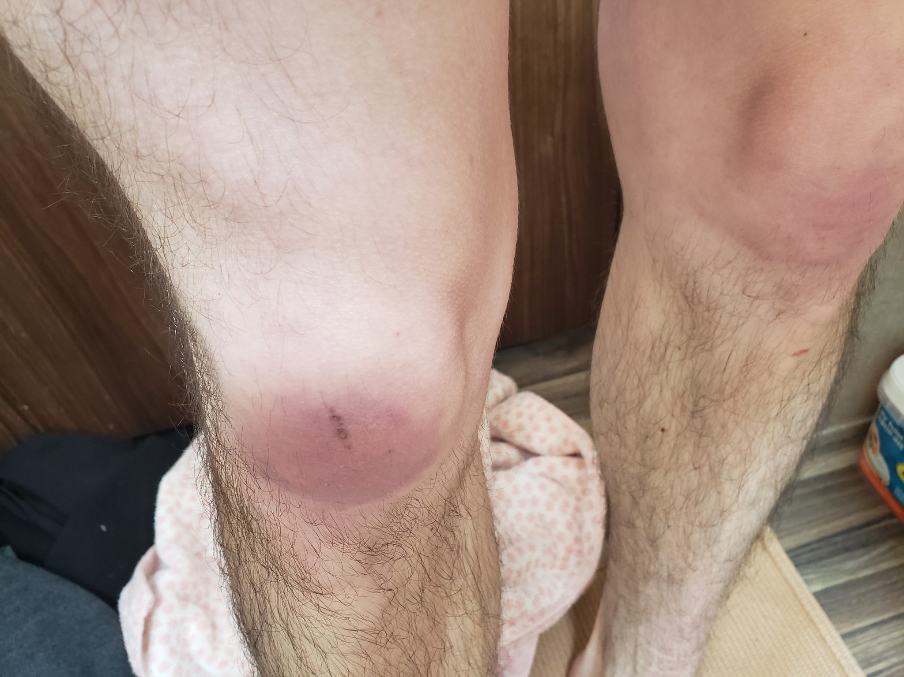

Slide 11
RMD Manifestations of COVID-19 infection
Musculoskeletal | Cutaneous | Vasculitis
Arthralgia/Myalgia | COVID toes/pseudo-chillblains | Kawasaki disease
Acute myositis | Urticarial or maculopapular rash | Large vessel stroke
Acute myocarditis | Livedoid rash with necrosis
 | Erythema elevatum diutinum
Autoinflammatory | Autoimmune antibodies
Hemophagocytic Lymphohistocytosis | +ANA, +SSA/Ro, +anti-phospholipid antibodies
Adapted from: Rheumatology International (2020) 40:1539–1554
Notes:
Literature review

Slide 12
Vasculitis as Temporally Associated With COVID-19 Infection or Vaccination
COVID-19 infection | COVID-19 vaccination
Skin purpura, arthritis | Myalgia
Constitutional symptoms | Skin purpura/arthritis
Systemic inflammatory response | Constitutional symptoms
Systemic inflammatory response | Skin purpura
Limb gangrene with necrosis | Painful left temporal artery
Panniculitis with necrosis | Carotidynia
Purpura | Headache/jaw claudication
The Journal of Rheumatology 2022;49:2 doi:10.3899/jrheum.210788, December 15 2021
Notes:
Observational report: 15 patients, 7 with COVID and no vaccine, 8 with vaccine and no COVID

Slide 13
Spectrum of short-term inflammatory MSK manifestations after COVID-19 vaccine administration: a report of 66 cases
Other features
Bursitis
Inflammatory back pain
Elevated inflammatory markers
+RF, +CCP, +ANA
Primary features:
Oligoarthritis
Polyarthritis
PMR-like symptoms
Tenosynovitis
Enthesitis
Ann Rheum Dis March 2022 Vol 81 No 3
Notes:
Italian case series, 66 patients, 16 rheumatology centers. Patients given one of four COVID vaccines approved for use in Italy: Pfizer, Moderna, J&J and Astra Zeneca. Top 5 features stat significant. Symptoms started 2-3 weeks after vaccination. Symptoms typically resolved after 2 weeks, treated with glucocorticoids.

Slide 14
Spectrum of short-term inflammatory MSK manifestations after COVID-19 vaccine administration: a report of 66 cases
Most patients treated with glucocorticoids (50%– 78%), NSAIDs (33%–52%) or analgesics (14%–28%)
DMARDs used in five (28%) patients with polyarthritis, five (24%) patients with oligoarthritis and only three (11%) patients with PMR-like presentation.
PMR-like onset with 74% achieving full remission of symptoms after 2 weeks; 67% of patients with polyarthritis had active disease after an average follow-up of 6 weeks.
Ann Rheum Dis March 2022 Vol 81 No 3

Slide 15
Additional reported RMD flares in the literature:
Giant Cell Arteritis
Leukocytoclastic vasculitis
Flare of Still’s disease
Exacerbation of subacute cutaneous lupus
Notes:
Most of these flares were moderate in severity, occurred on average 4 days from the vaccination, and responded quickly to corticosteroids. A few cases were treated with immunosuppression with generally good response and rapid recovery.

Slide 16
Efficacy of COVID-19 vaccines in immunosuppressed patients
Large cohort study comparing vaccinated (n=97688) and unvaccinated (n=42094) individuals on various immunosuppressants
Compared the three FDA approved COVID vaccines for efficacy in preventing infection and hospitalization
Taking immunosuppressants increases risk of COVID infection for vaccinated and unvaccinated patients
Pfizer and Moderna vaccines were highly effective at reducing the risk of COVID-19
J & J vaccine protection did not reach statistical significance (smaller sample size n=173)
Receiving a booster dose reduced the risk of COVID infection
Shen C, et al. Ann Rheum Dis 2022;0:1–6. doi:10.1136/annrheumdis-2021-222045
Notes:
Data collected for a year (1 Jan 2021-7 Dec 2021). University of Michigan Health System.

Slide 17
Efficacy of COVID-19 vaccines in immunosuppressed patients: meta-analysis
82 studies included
77 used mRNA vaccines, 16 viral vector vaccines, 4 inactivated whole virus vaccines
Patients with hematologic and solid organ cancers and RMD half as likely as normals to seroconvert after 1st vaccine. This improved with 2nd and 3rd vaccine doses
Organ transplant patients were 16 times less likely to seroconvert after the first vaccine, with sluggish response to the 2nd dose. Third dose required to seroconvert.
BMJ 2022;376:e068632 | doi: 10.1136/bmj-2021-068632
Notes:
Large meta-analysis published by British Medical Journal online.

Slide 18
Effects of B-cell depletion
Personal experience: mortality higher in patients on B-cell depletion therapy (Rituximab)
B-cell depleted patients don’t make antibodies to COVID-19 vaccines
Undoubted T-cell response, but unknown efficacy of that response

Slide 19
Humoral and Cellular Immune responses to SARS-CoV-2 infection and vaccination in patients with B cell depletion
B cell response based on antibody testing (ELIZA) and T cell response (interferon-gamma enzyme-linked immunospot assay) to the SARS-CoV-2 spike S1, and nucleocapsid proteins
Patients with autoimmune disease and B cell depletion: 6 previously infected, 8 vaccinated. Compared to 30 previously infected healthy controls and 30 vaccinated healthy controls
All normal controls responded with antibody production to the vaccine 30/30
None of the B-cell treated patients responded with antibodies to the vaccine 0/8
After COVID infection both normal controls and B cell treated patients had antibody responses and T-cell responses to both the Spike S1 protein and nucleocapsid proteins
Arthritis and Rheumatology. Vol 74. N0. 1. January 2022, pp 33-37

Slide 20
B Cell Reconstitution Is Strongly Associated With COVID-19 Vaccine Responsiveness in RMD patients on Rituximab
B-cell reconstitution is necessary for effectiveness of the COVID-19 vaccine
B cell reconstitution was significantly associated with a positive serologic response to the vaccine p<0.001
Significant difference in reactivity to vaccine 594 days vs median 138 days p<0.001
At <6 months, 86% had no response
AT 6-12 months, 55% had a response
At > 12 months, 13% still had no response
S. Jinich, et al. Arthritis and Rheumatology, Brief Report, Vol 0, No. 0, Month 2022, pp 1-7
Notes:
Retrospective review of 56 adult patients receiving Rituximab who received either of the mRNA COVID-19 vaccines. 594 days=19.8 months, 4.6 months

Slide 21
B-cell targeted therapy is associated with severe COVID-19 among patients with inflammatory arthritides
1 year multicenter study in 1116 successive patients receiving intravenous biologics
1116 patients total
449 infliximab
392 rituximab
170 tocilizumab
105 abatacept
10 cases of severe COVID-19 occurred. 9/10 were treated with rituximab
Rituximab remained the only factor associated with risk of hospitalization for COVID-19
Ann Rheum Dis January 2022 Vol 81 No 1
Notes:
594 days=19.8 months, 4.6 months. Factors included diabetes, age, gender, chronic lung disease, corticosteroid use, other DMARD use. Rituximab was the only factor associated with hospitalization

Slide 22
Efficacy of COVID booster Vaccinations in patients on Rituximab
55 patients–Blinded randomized trial
Booster vaccine in patients on Rituximab that did not seroconvert
Compared Booster with Astra Zeneca vs repeat Pfizer or Moderna vaccination
Patients stratified by presence of peripheral B cell measurement, not by time from last Rituxan
Endpoint: difference in SARS-CoV-2 antibody seroconversion rate
Secondary endpoint: Overall seroconversion and cellular immune response
Seroconversion rates comparable between two vaccine strategies: 22% Astra Zeneca, 32% moderna or pfizer.
T-cell response noted in 100% Astra Zeneca, 81% Moderna and Pfizer
Newly induced humoral and/or cellular responses occurred in 82% patients
Bonelli M, et al. Ann Rheum Dis 2022, 0:1-8
Notes:
Third vaccination, regardless of type, is effective in enabling seroconversion. B-cell presence is necessary and vaccination should be delayed until B-cells have repopulated. T-cell response is evident–unknown clinical significance of T-cell response

Slide 23
Rituximab during the COVID-19 pandemic: time to discuss treatment options with patients
Humoral and T-cell responses are marginal even with a booster, and a change may be necessary during the pandemic.
www.thelancet.com/rheumatology Vol 4 March 2022
Options:
Switch to another biologic therapy
Delay the next rituximab dose as long as possible
Add tixagevimab and cilgavimab (EVUSHELD).
Recombinant human IgG1k monoclonal antibodies that bind to spike protein receptor-binding domain of SARS-COV-2. This blocks attachment to human ACE2 receptor.

Slide 24
Who is moderately to severely immunosuppressed?
Receiving active cancer treatment for tumors hematologic malignancy
Received an organ transplant and are taking immunosuppressants
Received a stem cell transplant within the last 2 years or are taking immunosuppressants
Moderate or severe primary immunodeficiency (such as DiGeorge syndrome, Wiskott-Aldrich syndrome)
Advanced or untreated HIV infection
Active treatment with high-dose corticosteroids or other drugs that may suppress the immune response
https://www.cdc.gov/coronavirus/2019-ncov/vaccines/recommendations/immuno.html#mod; accessed 4/20/32022

Slide 25
ACR concensus statements:
Healthcare provider is responsible for engaging the RMD patient in a discussion to assess COVID-19 vaccination status and engage in a shared decision-making about receiving the COVID-19 vaccine.
RMD patients are at higher risk for hospitalized COVID-19 and worse outcomes compared to the general population.
RMD patients should be prioritized for vaccination before the nonprioritized general population of similar age and sex.
American College of Rheumatology Guidance for COVID-19 Vaccination in Patients with Rheumatic and Musculoskeletal Diseases – Version 5. Feb 2022

Slide 26
ACR concensus statements:
Beyond allergy to vaccine components, there are no known contraindications to COVID-19 vaccination for RMD patients.
The response to COVID-19 vaccination for RMD patients on systemic immunomodulatory therapies is blunted in its magnitude and duration compared to the general population.
A risk exists for RMD flare following COVID-19 vaccination. However, the benefit of COVID-19 vaccination outweighs the potential risk for new onset autoimmunity.
American College of Rheumatology Guidance for COVID-19 Vaccination in Patients with Rheumatic and Musculoskeletal Diseases – Version 5. Feb 2022

Slide 27
What are the current CDC vaccine recommendations for immunocompromised patients?
Pfizer | Moderna
Age 12+ | Age 18+
3 primary doses First and second doses separated by 3 weeks Second and third separated by 4 weeks | 3 primary doses separated by 4 weeks
4th dose 3 months later | 4th dose 3 months later
5th optional dose 4 months later | 5th optional dose 4 months later

Slide 28
What about the J&J vaccine?
Age Group 18+
Two doses to complete primary series: 1st dose J&J, 2nd dose Pfizer or Moderna vaccines given 4 weeks after the 1st dose
Booster: Pfizer or Moderna given 2 months after the 2nd dose
Moderately or severely immunocompromised patients can choose to receive a 2nd booster (4th dose) of an mRNA vaccine at least 4 months after their first booster.
https://www.cdc.gov/coronavirus/2019-ncov/vaccines/recommendations/immuno.html; accessed 4/20/2022
Notes:
The booster can be given 2 months after the second dose. A fourth dose of vaccine can be given 4 months after the 3rd dose for immunosuppressed patients.

Slide 29
Conclusion:
COVID-19 infection places rheumatology patients at risk
COVID-19 vaccines are effective at reducing the risk of severe infection and hospitalization but vaccine responses are blunted in the immunosuppressed, requiring COVID-19 booster vaccines
Treatment with B-cell depletion treatments increases likelihood for severe COVID-19 infection, requiring additional interventions
Waiting for B-cell repletion prior to a COVID-19 booster enhances likelihood of seroconversion
COVID-19 infection and vaccination both can flare rheumatologic diseases in a variety of ways. These flares are usually self-limited.
Although information about the effect of COVID-19 infections and immunizations was initially sparse, it is now being published plentifully
Patients on immunosuppressive therapy should be on their 4th or 5th COVID vaccine

