Slide 1
OGDEN SURICAL-MEDICAL SOCIETY Conference FOR THE Curious Clinician
May 18, 2022

Slide 2
Navigating the Crossroads - Diagnostic Error and Telemedicine
This presentation has no ineligible company content, promotes no ineligible company, and is not financially supported by any ineligible company. I receive no financial remuneration from any ineligible company related to this presentation.

Slide 3
The content of this publication or presentation is intended for educational purposes only; is not an official position statement of Mutual Insurance Company of Arizona (MICA); and should not be considered or relied upon as professional, medical, or legal advice or as a substitute for your professional judgment. Consult your attorney about your individual situation and the applicable laws. The authors, presenters, and editors made a reasonable effort to ensure the accuracy of the information at the time of publication or presentation but do not warrant or guarantee accuracy, completeness, or currency of such information. As medical and legal information is constantly changing and evolving check for updated information and consult your attorney before making decisions.

Slide 4
Identify potential breakdowns in the telediagnostic process
Implement at least one risk strategy to improve the telediagnostic process
Recognize an opportunity to manage patient expectations for telemedicine
This Photo by Unknown Author is licensed under CC BY-SA

Slide 5
Diagnostic Error Now
Difficult to pinpoint frequency
Primary allegation in 32% of over 21,000 closed claims all medical professional liability (“MPL”) claims
Most common chief medical factor in 41% of pediatric closed claims originating in EDs and urgent care centers
Top allegation/leading cause of claim-related death and disability in study spanning 25 years of “traditional” patient care
Only 2% of closed MPL claims involved telehealth
Exponential growth in telemedicine, majority of physicians “adapting” because not trained in telediagnosis
This Photo by Unknown Author is licensed under CC BY-SA

Slide 6
Defining the Problem
Graber and Gordon say an erroneous diagnosis can be . . .
National Academy of Medicine says diagnostic error is . . .
MICA says diagnostic errors include . . .

Slide 7
It’s a Moving Target
No-fault Factors
System Factors
Cognitive Factors
OGDEN SURGICAL-MEDICAL SOCIETY Conference FOR THE Curious Clinician

Slide 8
Who’s at Risk
Top 10 Presenting Medical Conditions
Top 5 Specialties
Abdominal and pelvic pain
Dorsalgia
Pain in throat and chest
Unspecified lump in breast
Malignant neoplasm screening
Breathing abnormality
Other joint disorder
Headache
General examination encounter without complaint
Other soft tissue disorder
Radiology
Internal medicine
Family medicine
Ob-gyn Surgery
Emergency Medicine

Slide 9
Cancers
11.1%
Infections
10.2%
Spinal abscess
Vascular Events
8.7%
Aortic aneurysm & dissection
Meningitis & encephalitis
Endocarditis
Sepsis
Pneumonia
Arterial thromboembolism
Venous thromboembolism
Stroke
Myocardial infarction
Lung
Melanoma
Colorectal
Breast
Prostate

Slide 10
It’s Like . . .
Infrastructure to enable it
Specialized training
Keen appreciation for its limits
New language for patients
Physical examinations
Evidence is limited and mixed

Slide 11
This Photo by Unknown Author is licensed under CC BY-NC-ND
“Perhaps the single most burning question going in to this project—and coming out of it—is when must a patient be seen in-person and when may they be seen virtually.”
Graber, M.L., Schrandt, S. (2021). Improving telediagnosis: A call to action. Society to Improve Diagnosis in Medicine. TeleDx-Final-Report-Update.pdf (improvediagnosis.org)

Slide 12
Telediagnostic Strategies
Referral for 2nd opinion or consult
Checklist or “diagnostic time-out”
Continuing medical education

Slide 13
“…but My Doctor Never Told Me That!”
Potential allegations of negligence
Potential areas of noncompliance with Utah or federal law
OGDEN SURGICAL-MEDICAL SOCIETY Conference FOR THE Curious

Slide 14
Informed Consent Strategies
Obtain and document
Template, checklist, or form with required elements
Revise process when policies, procedures, law, or technology changes
Diagnostic uncertainty

Slide 15
In-person or Online
Potential allegation of negligence
Potential areas of noncompliance with Utah and federal laws

Slide 16
Effective Encounter Type
Need for and effectiveness of telehealth vs in-person encounter and
Appropriateness of telehealth medium
Documentation of legislative criteria
Template, checklist, or form with criteria
Good faith determination of

Slide 17
The Patient Experience
My doctor can see me in 3 weeks.
This Photo by Unknown Author is licensed under CC BY-SA-NC
OGDEN SURGICAL-MEDICAL SOCIETY Conference FOR THE Curious Clinician

Slide 18
You can’t see me for
3 weeks?
OGDEN SURGICAL-MEDICAL SOCIETY Conference FOR THE Curious Clinician

Slide 20
Angry Customers Sued
Why It Matters
Starbucks for underfilling lattes
23andMe for misleading customer about the company’s ability to predict health risks
McDonald’s for selling cheese-less fried mozzarella sticks
Facebook, now Meta, for tracking online activity even when users were not signed in
Philip Morris, R.J. Reynolds, Brown & Williamson, and Lorillard after smokers died from lung cancer
Kellogg’s because strawberry Pop-Tarts contain pears and apples
So do angry patients
OGDEN SURGICAL-MEDICAL SOCIETY Conference FOR THE Curious Clinician

Slide 21
Juries Rarely Decide Cases

Slide 22
“You Like Me. You Really Like Me.”

Slide 23
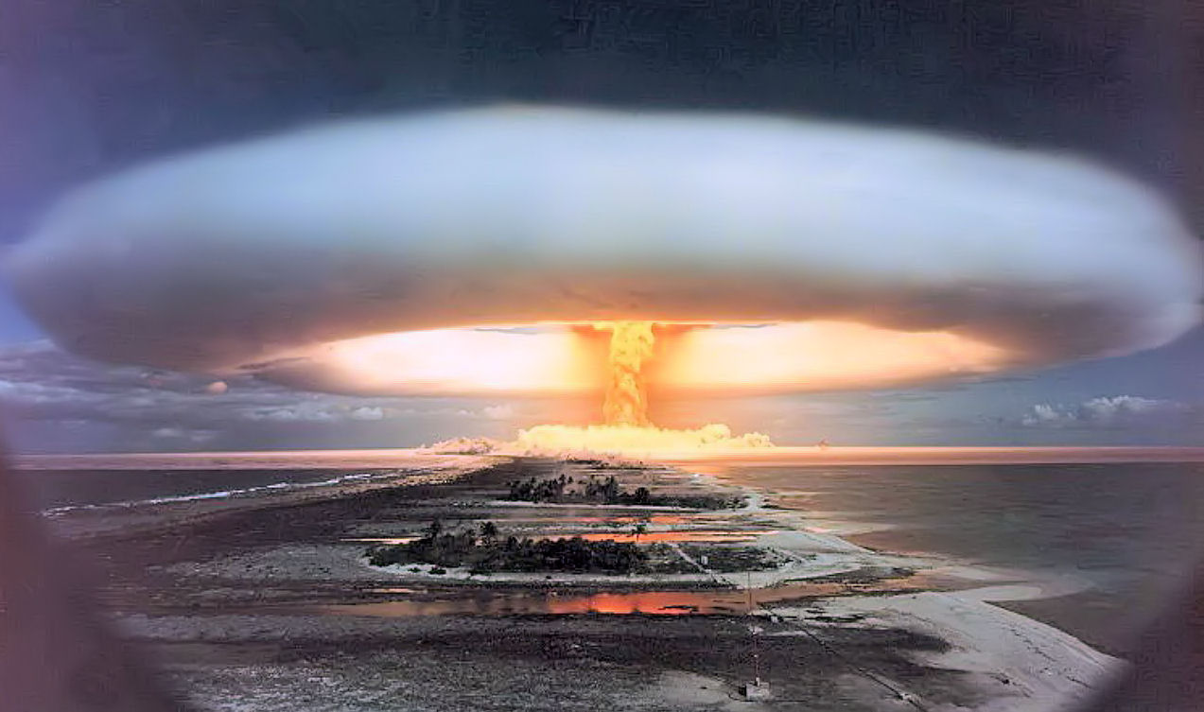
but When You Don’t Like Me
This Photo by Unknown Author is licensed under CC BY-NC-ND
Jury awards of $1 million have been gradually increasing
50 largest verdicts between 2001 and 2015 were $15-$20 million
Average verdict severity rose 50% between 2016 and 2019
Annual average of the 50 largest verdicts was $22.9 million between 2016 and 2019
2019 Baltimore jury awarded the plaintiff $230 million – one of the largest MPL awards in US history
OGDEN SURGICAL-MEDICAL SOCIETY Conference FOR THE Curious Clinician

Slide 24
PX Strategies
Spine patients prefer . . .
Established headache patients like . . .
Initial surgical consultation patients want . . .
Physicians in multiple specialties unable to physically examine the patient or test muscle strength . . .
OGDEN SURGICAL-MEDICAL SOCIETY Conference FOR THE Curious Clinician

Slide 25
More PX Strategies
In 2020, 84% of Medicare beneficiaries . . .
They used telehealth for . . .
Millennials want . . .
Generation X is willing . . .

Slide 27
It’s Hammer Time
This Photo by Unknown Author is licensed under CC BY-SA

Slide 28
OGDEN SURICAL-MEDICAL SOCIETY Conference FOR THE Curious Clinician
May 18, 2022

