Slide 1

Multiple Sclerosis
Update for Primary Care
Dr. Chris Hammond
Neurology at the Ogden Clinic

Slide 2

Disclosures:
Active advisor/speaker for EMD Serono, Jannsen.
Currently operate a MS clinic and infusion lab.

Slide 3
Objectives
Understand historical obscurity of MS
Understand clinical presentation of MS
Understand objective measures for MS
Basic understanding of FDA approved therapies for MS
Management ideas for symptoms of MS

Slide 4
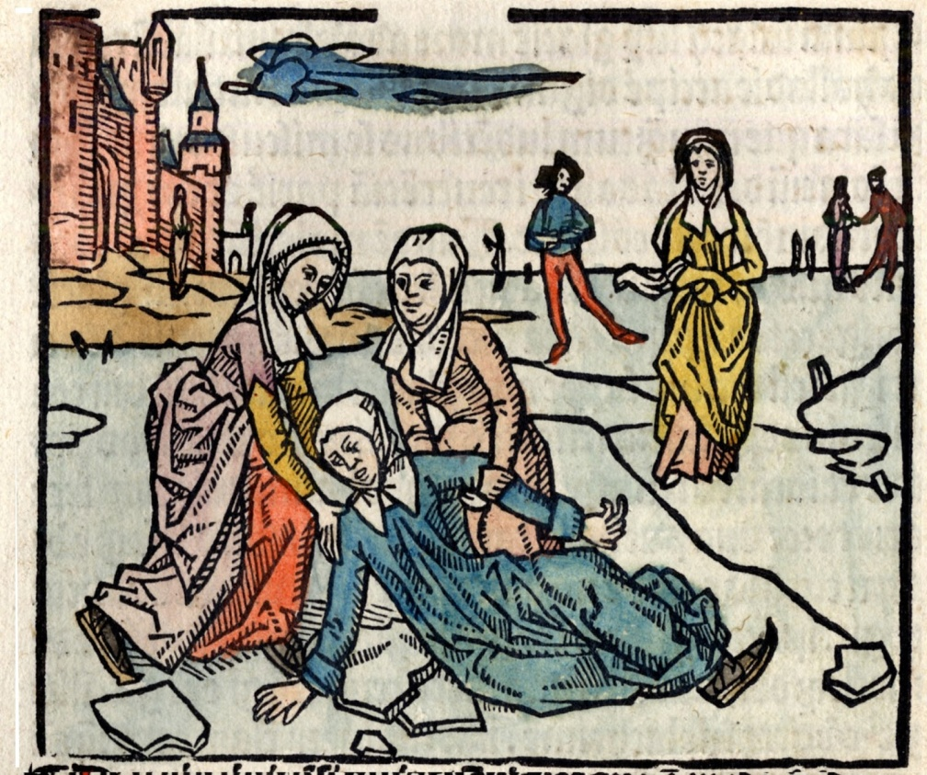
History of Multiple Sclerosis
14th century Holland, “in the case of Saint Lidwina of Schiedam”
violent pains in her teeth
hemifacial paresis
vision change
Dysequilibrium
paraparesis /ataxia
“miracles” (remissions)
- later canonized.

Slide 5

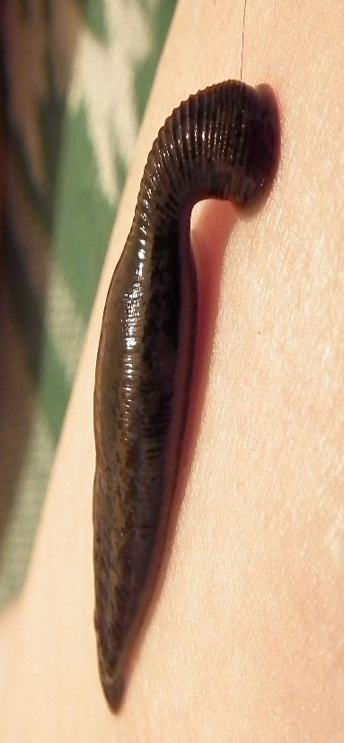
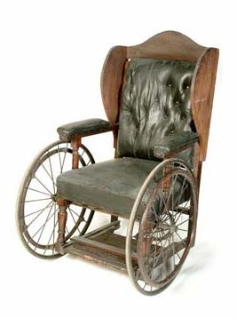
“The Journal of a Disappointed Man”
Augustus d’Este (1794-1848), grandson of England’s King George III, as the first recognizable and fully documented case of Multiple Sclerosis who himself kept copious notes of his symptoms in his personal journals.
At age 28, he developed transient vision
loss (possible optic neuritis) following a
funeral of a close friend.
Limb weakness experienced and at 49 y/o
he was experiencing progressive symptoms
in addition to tremor and nocturnal spasms.
Soon following paraplegia and dependent
on a wheelchair. In his last years he was
confined to his bed.
His treatments included leech-based
blood-letting, hydrotherapy, and dietary
regimens.
http://www.nejm.org/doi/pdf/10.1056/NEJMbkrev38300

Slide 6
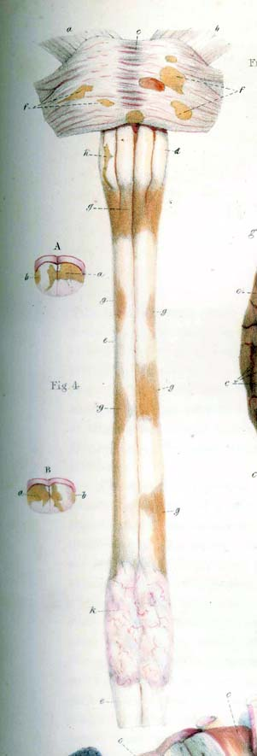
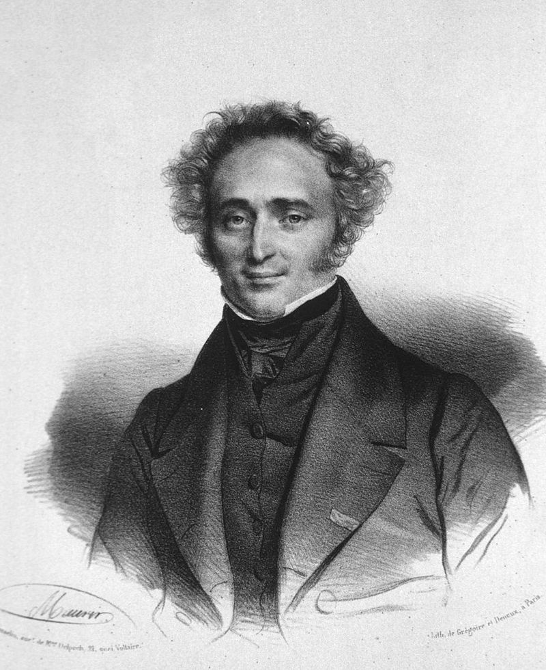
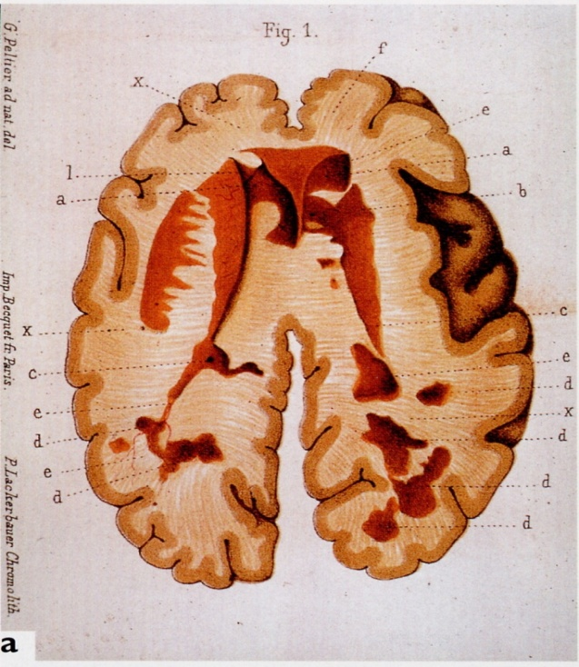
Early 1800’s: Cruvelihier
French pathologist, first described
lesions of MS.
“A peculiar diseased state”
– year 1835
Cruveilhier's Anatomie
pathologique du corps humain
(two volumes 1829-1835, 1835-1842).

Slide 7
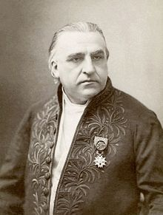

“la sclérose en plaques”
Jean Martin Charcot- French neurologist , “father of
neurology”
His work on neurosis and hypnosis earned him the
nickname “the Napoleon of neuroses.”
  (see L. Augustine Gleizes)
In 1868 he presented a case of multiple sclerosis: a
young woman with tremors, slurred speech, and
abnormal eye movements . Brain autopsy performed
described the “plaques” of multiple sclerosis.
Charcot continued to defined and describe multiple sclerosis
—how the myelin that surrounds nerve fibers is damaged.
1880 Sir William Osler (father of modern medicine)
diagnosed three cases after reading Charcot’s work.
"Iconographie photographique de la Salpêtrière" (Jean Martin Charcot, 1878)

Slide 8
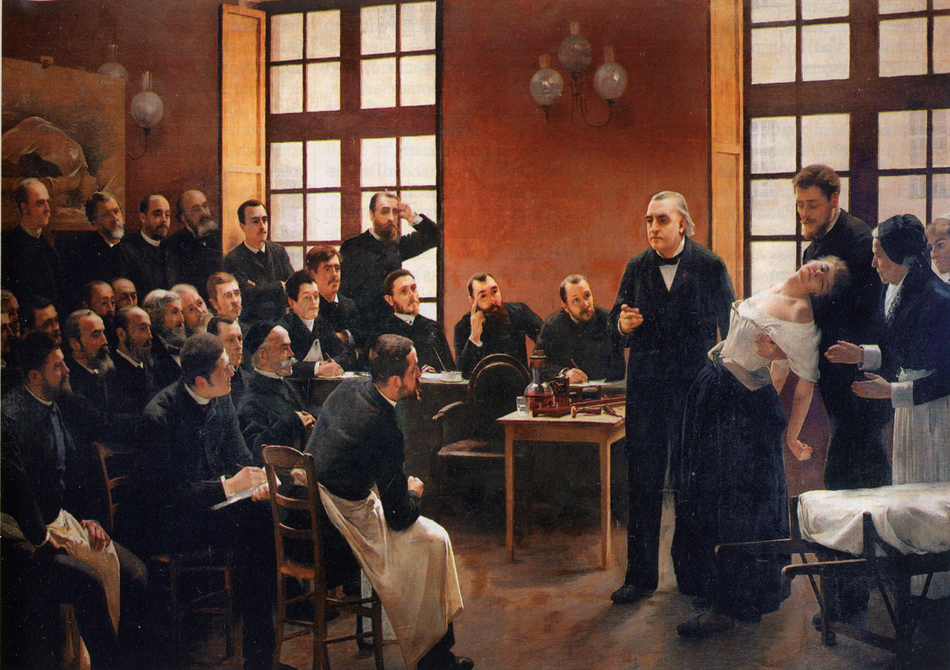
A Clinical Lesson at the Salpêtrière ("Une leçon clinique à la Salpêtrière"), a group tableau portrait painted by Pierre Aristide André Brouillet

Slide 9
Demographics and Prevalence:
Usually diagnosed between 20 and 50 but also assessed in children and the elderly.
More common in women than men (3:1)
Common in those of Northern European ancestry, recent data demonstrates broad racial penetrance.
Common in temperate areas (further from the equator)- more so recently recognized in southern areas.
The risk of getting MS is approximately:
  1/750 for the general population (0.1%)
  1/40 for person with a close relative with MS (3%)
  1/4 for an identical twin (25%)
20% of people with MS have a blood relative with MS
1 million in number in the united states
(>2.6 m world wide).

Slide 10
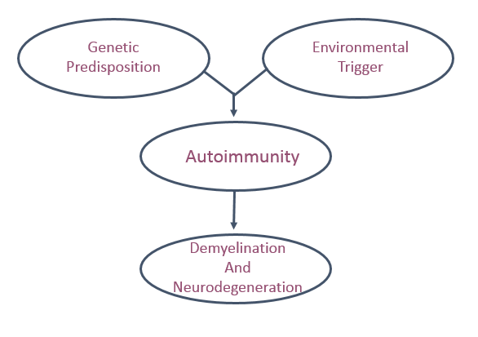
What Causes MS?

Slide 11
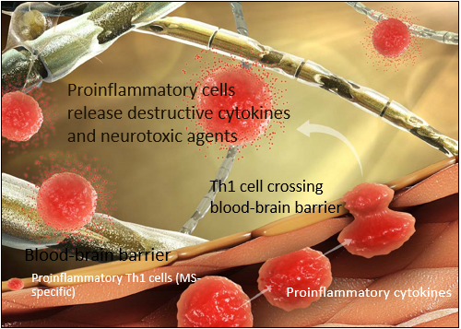
The pathophysiology of MS
MS-specific proinflammatory immune cells cross from the bloodstream into the central nervous system (CNS), secreting proinflammatory cytokines and eventually destroying myelin and facilitating neuronal death
1. Ziemssen T. J Neurol. 2005;252(suppl 5):v38-v45. 2. Yong VW, et al. Neurology. 2007;68(22 suppl 3):S32-S37. 3. Dhib-Jalbut S. Neurology. 2007;68(22 suppl 3):S13-S21.
4. Tzartos JS, et al. Am J Pathol. 2008;172(1):146-155.
Borrowed from Teva sine licentia

Slide 12
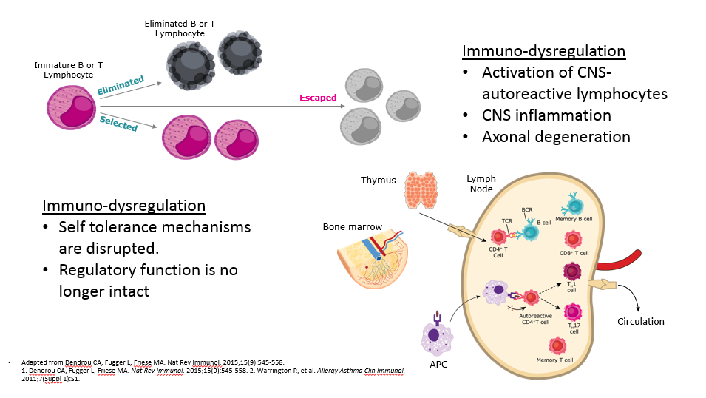
Borrowed from Genzyme sine licentia

Slide 13
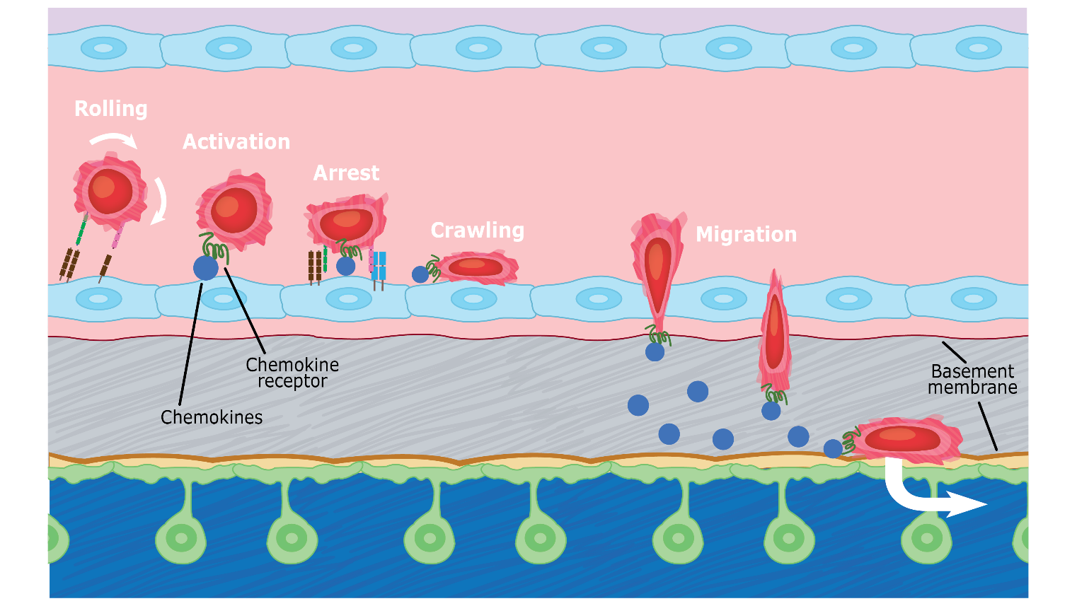
Takeshita Y, Ransohoff RM. Immunol Rev. 2012;248(1):228-239 Borrowed from Biogen sine licentia
.

Slide 14
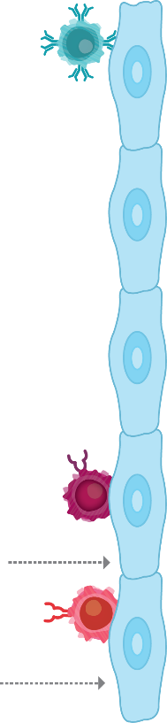
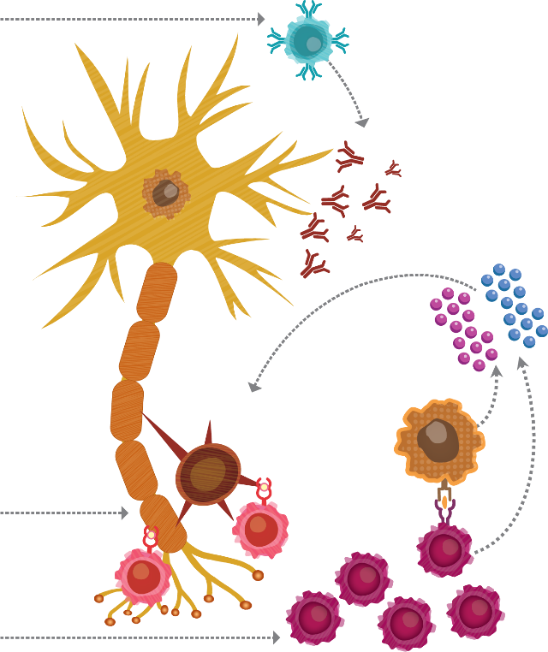

Peripheral to CNS proinflammatory mechanisms:
PERIPHERY
CNS
B Cells
CD4⁺T Cells
CD8⁺T Cells
APCs
Borrowed from EMD sine licentia

Slide 15




Progressive Pathology: inflammatory and degenerative

Slide 16
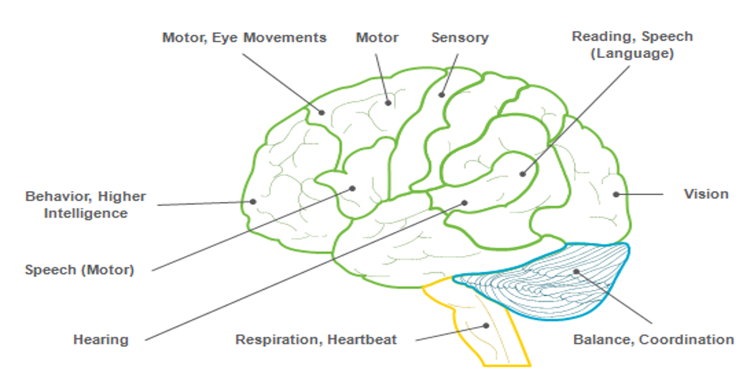
Clinical aspects:

Slide 17
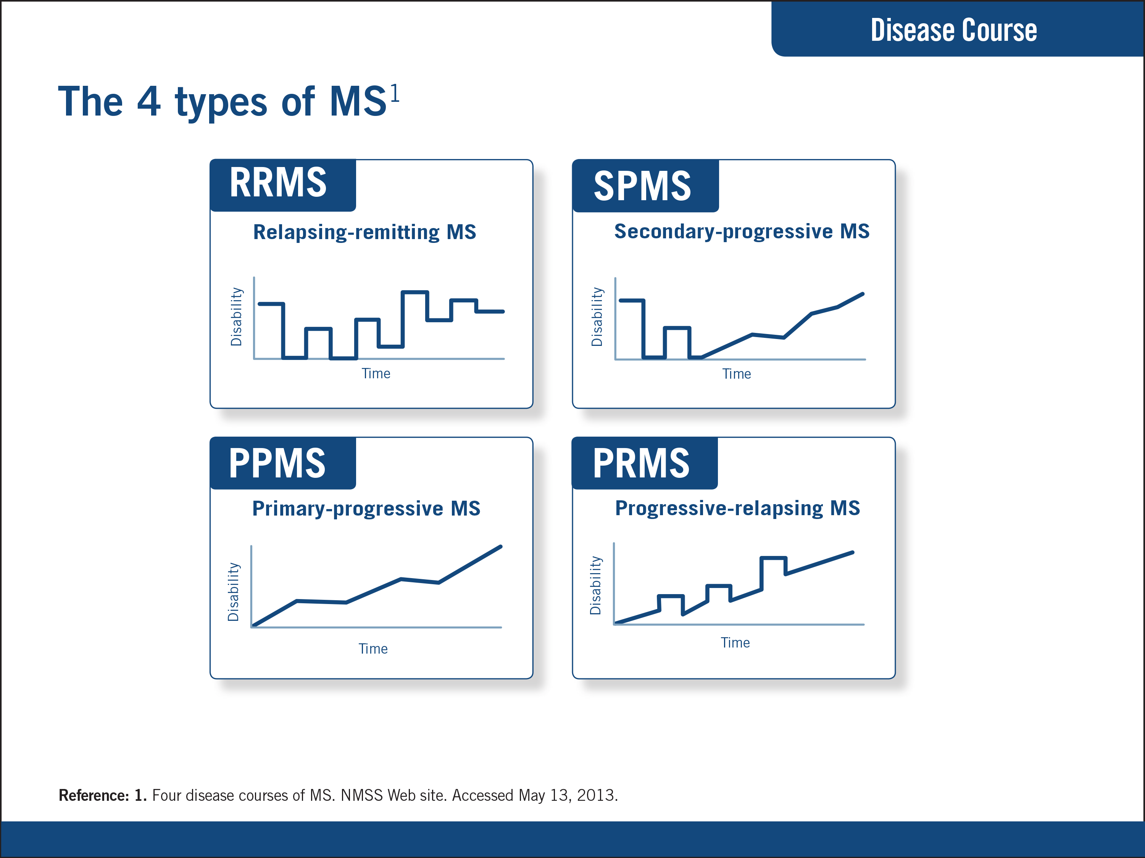

Slide 18
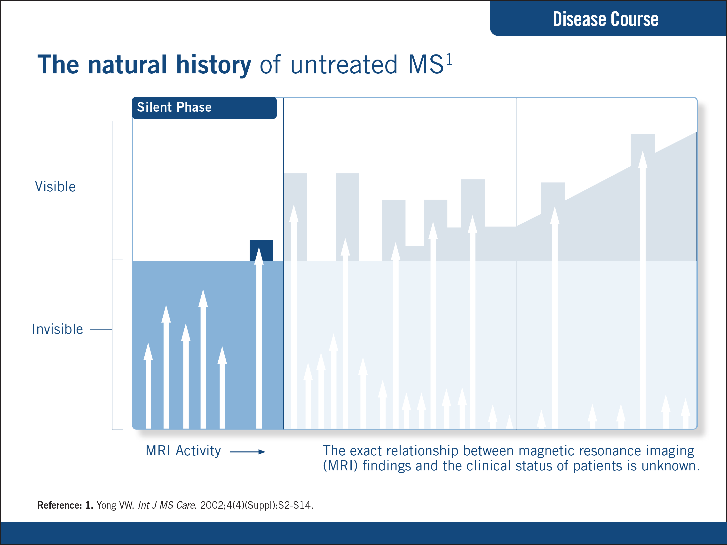
Borrowed from Teva sine licentia

Slide 19
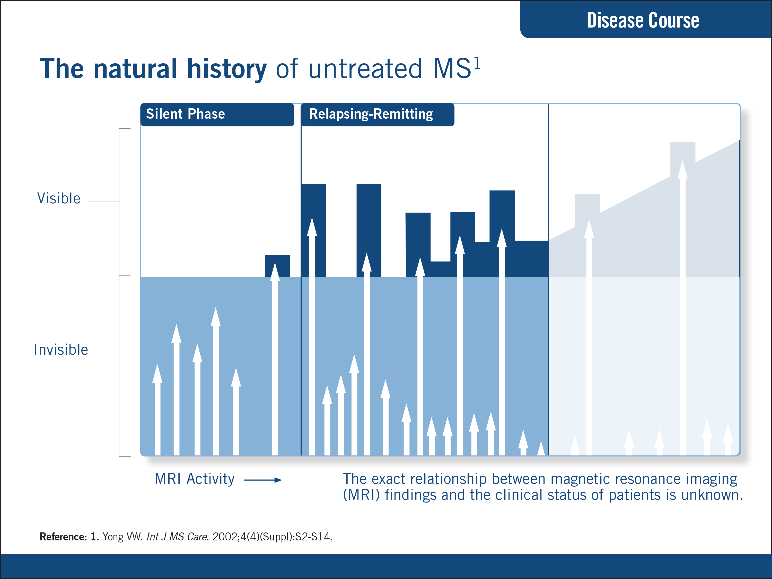

Slide 20
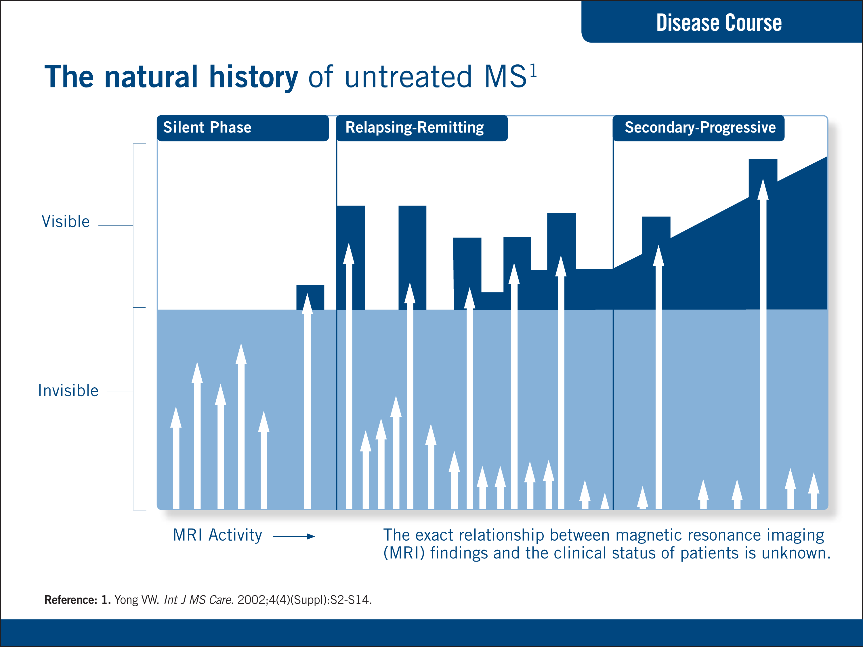

Slide 21
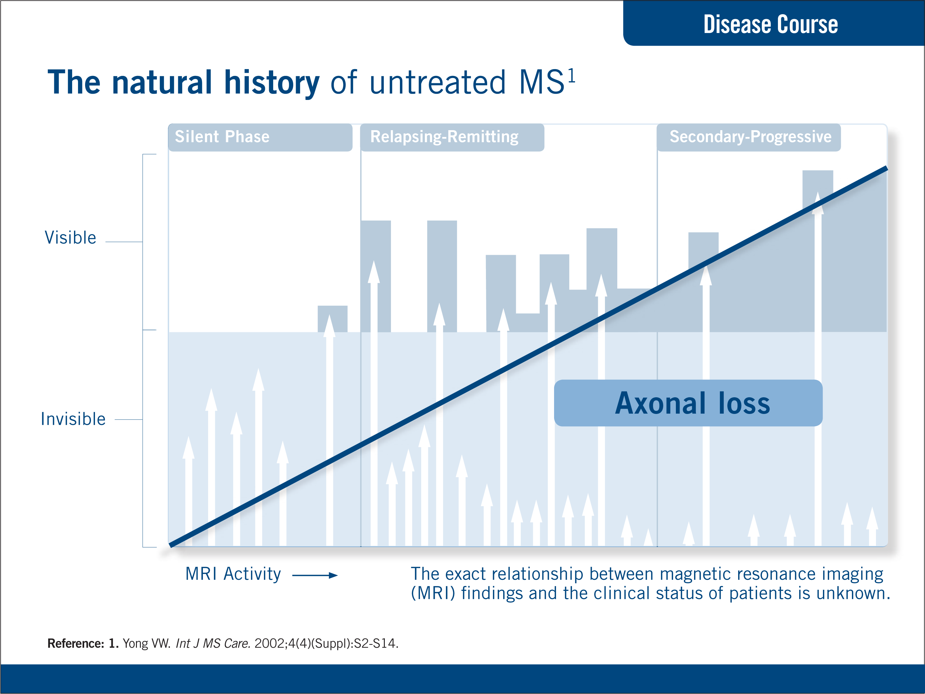

Slide 22
MS used to be thought of as a white matter disease only:
Evidence now of disease activity results in grey matter lesions and diffuse damage to brain tissue – damage is ongoing throughout space and time.
In relapsing MS, the damage to the CNS is no longer considered to consist solely of discrete macroscopic lesions affecting myelin
  Damage is diffuse and ongoing throughout the disease course
  Damage occurs in the white and grey matter
Accelerated brain atrophy proceeds throughout the disease course, and is evident even in people with RIS and CIS
Filippi M, Rocca MA. J Neurol 2005;252:16–24.
De Stefano N et al. Neurology 2010;74:1868–76.

Slide 23
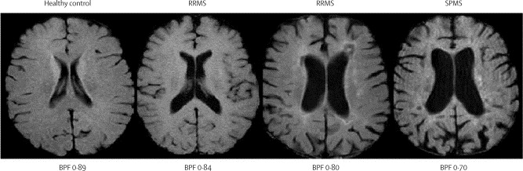
In healthy adults, brain atrophy occurs : 0.15% per year.
Untreated MS: 0.5–1.35% per year.
De Stefano N et al. J Neurol Neurosurg Psychiatry 2015;doi:10.1136/jnnp-2014-309903.De Stefano N et al. CNS Drugs 2014;28:147–56.

Slide 24
Neurological reserve: the brain’s finite capacity to retain function by remodelling itself to compensate for loss of nerve cells and fibres
Neurological reserve may explain why:
  MS-related brain injury can go undetected during the early phase of the disease
  MS can be undiagnosed and untreated for a long time

Slide 25
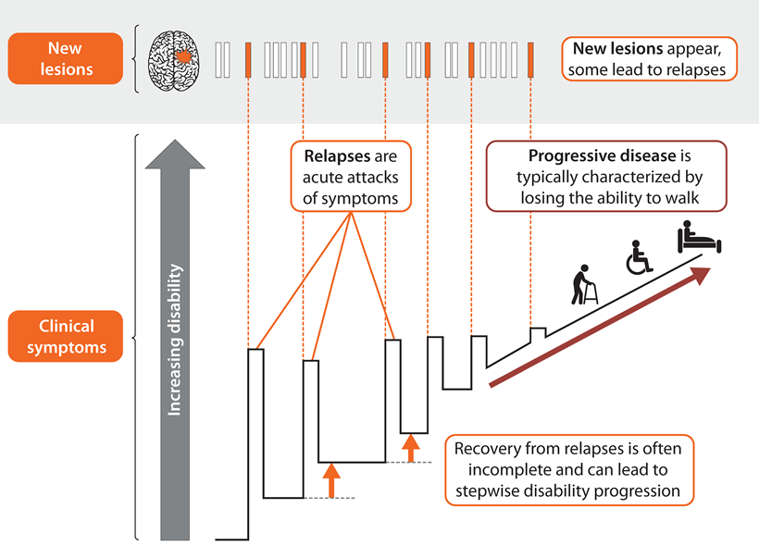

Slide 26
Diagnostic criteria evolution for clinically definite MS
Poser criteria (1983)¹ = 2 attacks and evidence of separate lesions (vague and non-specific, especially applied in modern times with understood several “MS mimickers”
McDonald criteria (2001. 2005) and modified McDonald criteria (2010, 2017)
  2001: Formally incorporated magnetic resonance imaging (MRI) and lesions into the established diagnostic workup that focuses on neurologic history and examination, as well as paraclinical laboratory examinations
  2005: follow-up MRI with new typical MS-like lesion(s) without corresponding symptoms could represent “new attack in space and time”
  2017: allows single attack in addition to positive CSF
  Allows for more rapid diagnosis, with equivalent or improved specificity and/or sensitivity with perhaps fewer required MRI examinations clarify and simplify the diagnostic process
  Broader range of applicability in pediatric populations and assessing progressive types of MS
1. Poser criteria. All About Multiple Sclerosis Web site. 2. Polman CH, et al. Ann Neurol. 2005;58(6):840-846. 3. Polman CH, et al. Ann Neurol. 2011;69:292-302

Slide 27
Ancillary Testing
  CSF testing can provide evidence of chronic CNS inflammation
    The CSF is tested for oligoclonal bands found in 90% to 95% of patients with clinically definite MS
    Combined with MRI and clinical data, the presence of oligoclonal bands helps facilitate a diagnosis of MS
  Visual evoked potential (VEP), OTC?
  Conduction delay of the “P100” relatively sparing amplitude is suggestive of demyelination, symptomatic or not.
  Radiographic…
1. Cerebrospinal fluid (CSF). NMSS Web site

Slide 28
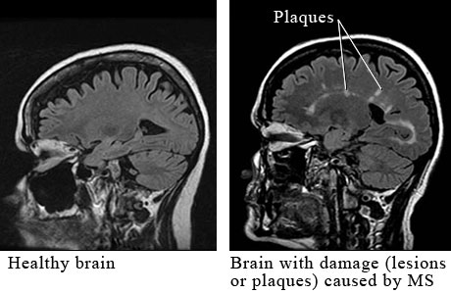
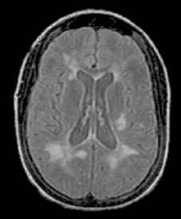
Diagnostics:
Magnetic resonance imaging (MRI)

Slide 29
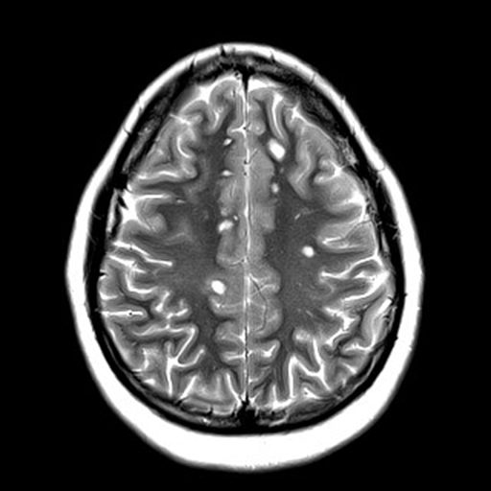
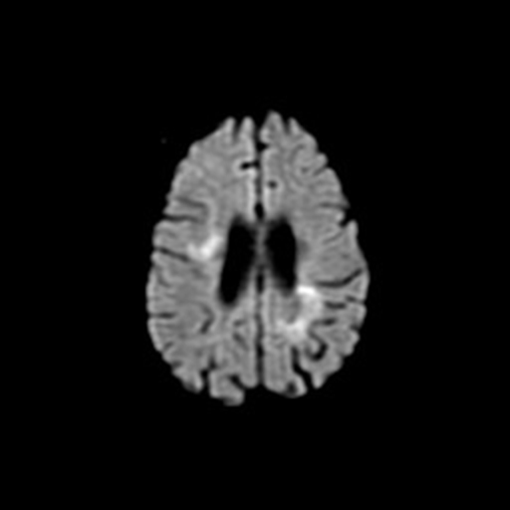
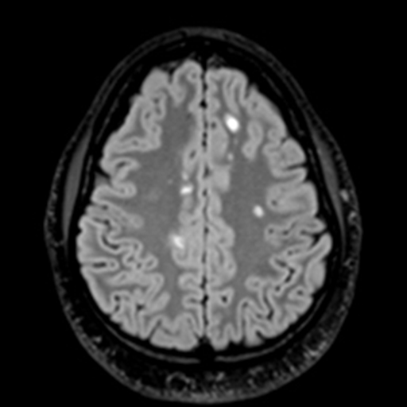
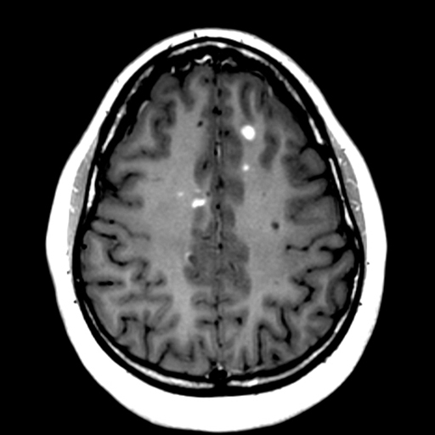
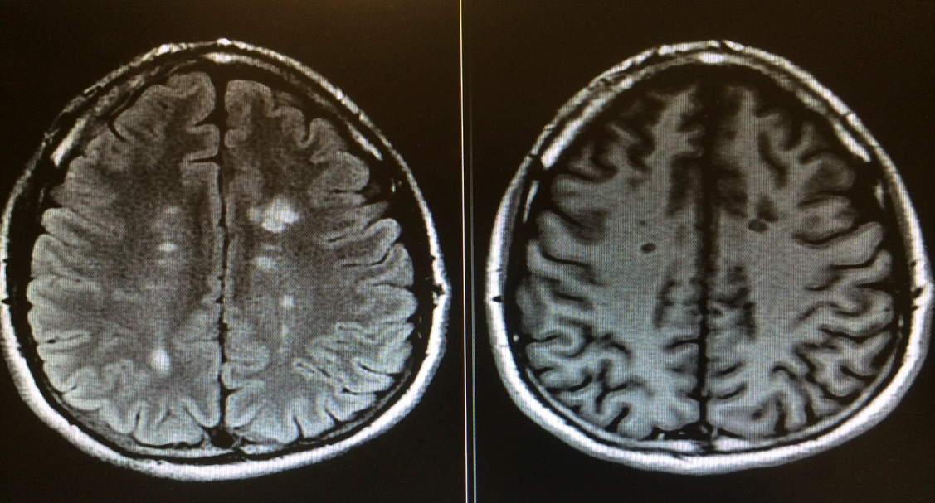
Metrics of MRI
DWI
(Diffusion weighted imaging)
FLAIR
(Fluid attenuated inversion recovery)
T1 Gd+
T1 hypointense

Slide 30
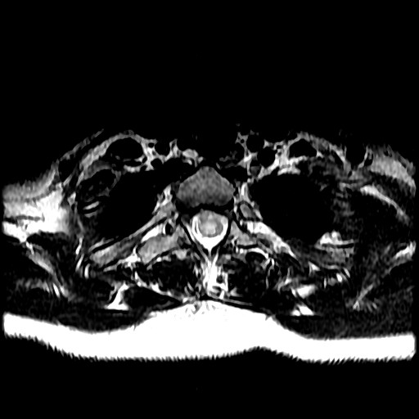
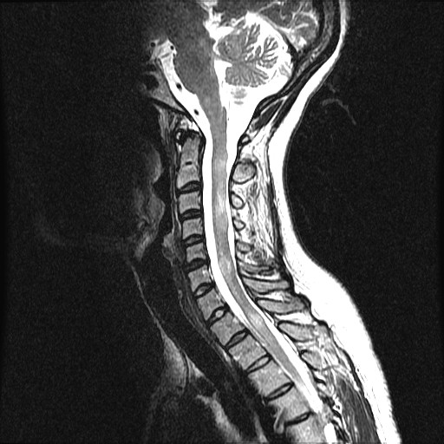
T2 imaging of the spinal cord (routine often includes cervical and thoracic for evaluation of active and “silent” lesions

Slide 31
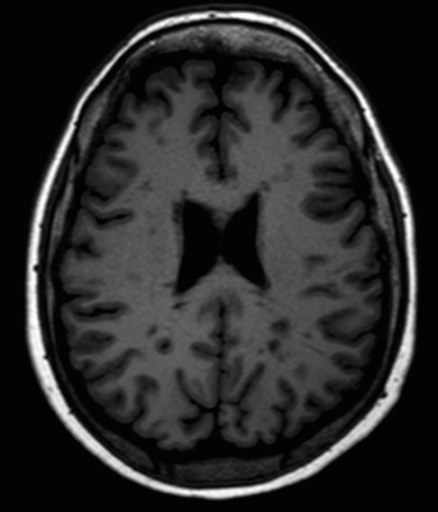
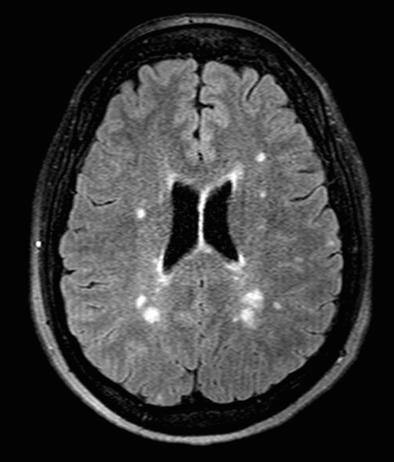
Chronic black holes represent irreversible damage contribute to brain atrophy and increased disability⁷
Defined as T1 hypointense lesions persisting ≥6 months
Evolving chronic black holes indicate
Significant demyelination
Gliosis and axonal loss irreversible
T1 black holes
FLAIR with correlating lesions
References: 1. Filippi M, et al. Neurology. 2001;57(4):731-733. 2. Sahraian MA, et al. Acta Neurol Scand. 2010;122:1-8. 3. Sinnecker T, et al. Arch Neurol. 2012;69(6):739-745. 4. Kappos L, et al. Lancet. 1999;353(9157):964-969. 5. van Walderveen MAA, et al. Neurology. 1998;50(5):1282-1288. 6. van Waesberghe JH, et al. Ann Neurol. 1999;46(5):747-754. 7. Paolillo A, et al. J Neurol Sci. 2000;174(2):85-91.

Slide 32

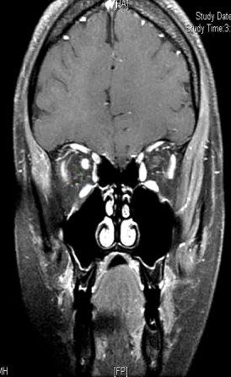
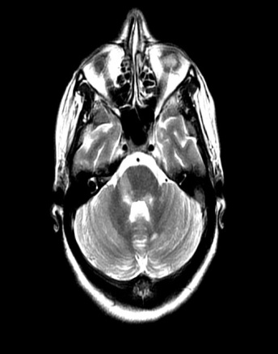
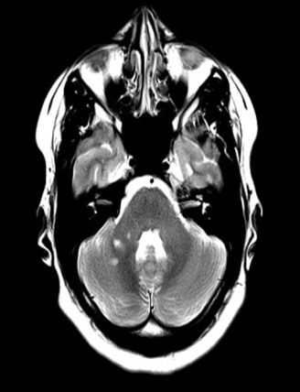
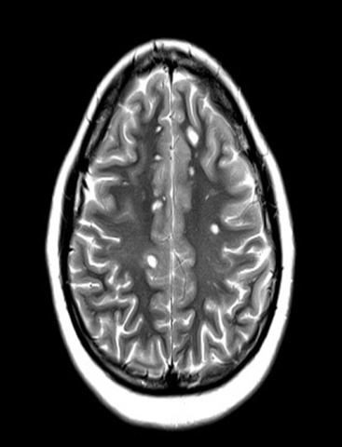
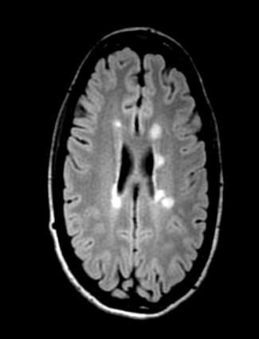
Location matters
Spinal cord
Optic nerve
Brainstem
Cerebellum
Juxtacortical
Periventricular
Clinical signs and symptoms can be localized to regions of inflammation and some lesions impact prognosis more than others, on the basis of localization^{1,} i.e. high spinal cord lesion load may correlate to greater disability^{1,2}
References: 1. National Multiple Sclerosis Society. Multiple Sclerosis for the Physician Assistant. http://www.nationalmssociety.org/NationalMSSociety/ media/MSNationalFiles/Brochures/Brochure-MS-for-the-Physician-Assistant_-A-Practical-Primer.pdf. Accessed July 27, 2015. 2. Zivadinov R, et al. J Neurol. 2008;255(Suppl 1):61-74.

Slide 33
Therapeutics
No cure but modulate

Slide 34
Early Treatments
Nightshade, arsenic, mercury, and the injection of malaria parasites.
In 1951, cortisone was first used to treat MS exacerbations.
ACTH followed.
…bee stings, goat serum, LDN, jugular venoplasty...

Slide 35
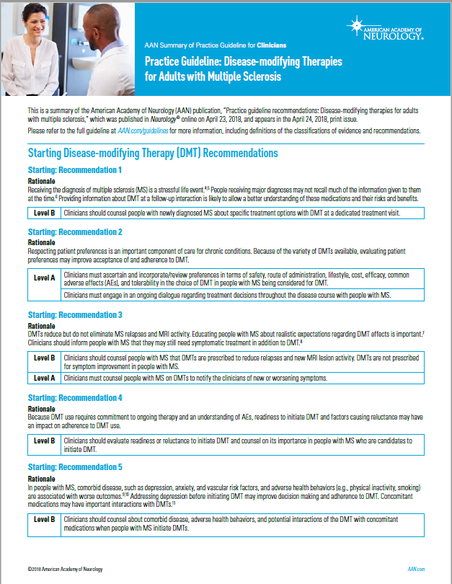
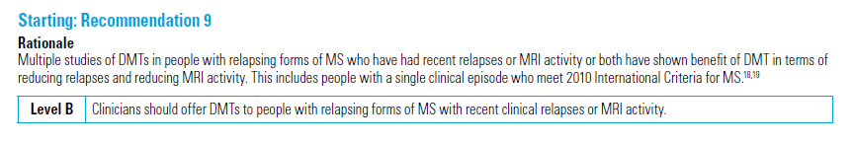

Slide 36
FDA approved therapies – Self-injectables
Interferon therapy (modulates cytokine, interleukin and peptide production) – 2 molecules with different dosing/delivery/frequency.
  Interferon beta-1b) SC 3/week SC (Betaseron, Extavia)
  Interferon beta-1a) IM q weekly (Avonex)
  Interferon beta-1a SC q 2 weeks (Plegadry)
  Interferon beta-1a) 3 x per week SC (Rebif)
Glatiramer acetate (polypeptide that modulates T-regulatory production)
  Copaxone and generic daily to 3/week SC
  Glatopa daily SC

Slide 37
FDA approved therapies - Oral
  “S1Ps” Sphingosine-1-phosphate receptor modulators: fingolimod [Gilenya], ozanimod [Zeposia], spionimod [Mayzent], posesimod [Ponvory]– antagonizes S1P and sequesters lymphocytes.
    AR/SE: hepatic, CA, ID (viral), cardiac/pulmonary, macular
  Fumurates: dimethyl fumerate [Tecfidera, generic], diroximel fumerate [Vumerity], monomethyl fumerate [Bafiertam]- Nuclear factor erythroid-2-related factor 2 (NrF-2) activators.
    AR/SE: lymphocytopenia, ID, flushing, GI issues.
  Teriflunomide [Aubagio]: pyrimidine synthase inhibitor.
    AR/SE: hair thinning, hepatic, GI, neuropathy, renal, ID (bact)
  Cladribine [Mavenclad]: phosphorylated adenosine, DNA analog-cytotoxic
    AR/SE: CA, ID (HSV, VZV, HBV…)

Slide 38
FDA approved therapies – intravenous infusions
Mitoxantrone (Novantrone): rarely used due to cardiotoxicity and cancer risks.
Natalizumaub (Tysabri): Alpha-integrin inhibitor.
  AR/SE: PML, infusion Rx, melanoma, hepatic, other ID
Alemtuzumab (Lamtrada): CD52 inhibitor, reduces lymphocytes
  AR/SE: thyroid disease, CA
Ocrelizumab (Ocrevus®): monoclonal CD20 binder, reduces/eliminates B cells
  AR/SE: infusion reactions, BrCA, ID
  Ofatumumab [Kesimpta], monthly SC

Slide 39
No evidence of disease activity (NEDA)
NEDA is commonly characterized by¹
No new relapse
No new/enlarging T2 and/or Gd+ lesions
No new worsening of EDSS¹
More advanced concepts of NEDA also include normalizing of brain atrophy²
EDSS, Expanded Disability Status Scale.
References: 1. Stangel M, et al. Ther Adv Neurol Disord. 2015;8(1):3-13. 2. Giovannoni G, et al. Mult Scler Relat Disord. 2015;4(4):329-333.

Slide 40
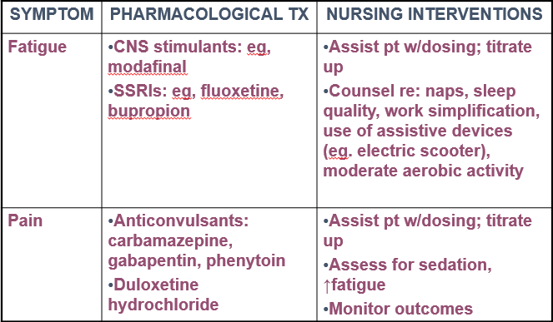
Managing MS Symptoms

Slide 41
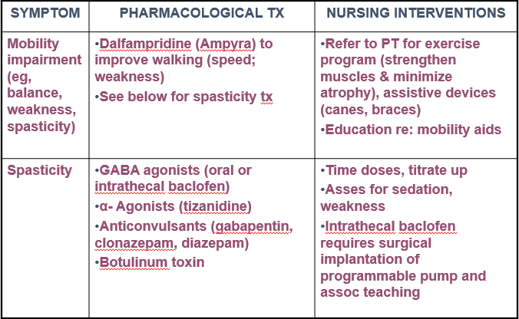
Managing MS Symptoms

Slide 42
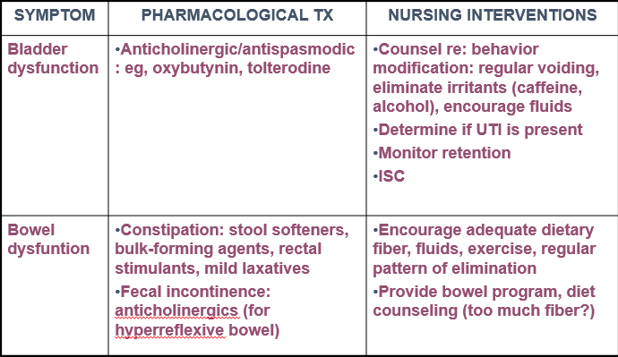
Managing MS Symptoms

Slide 43
A brain-healthy lifestyle involves:
  Increasing activities that enhance cognitive reserve
  Increasing cardiovascular fitness
  Reduced sodium intake
  Ideal body weight
  Avoid smoking
  Vitamin D optimization
  Thermodynamic regulation
  Optimizing control of comorbidities

Slide 44
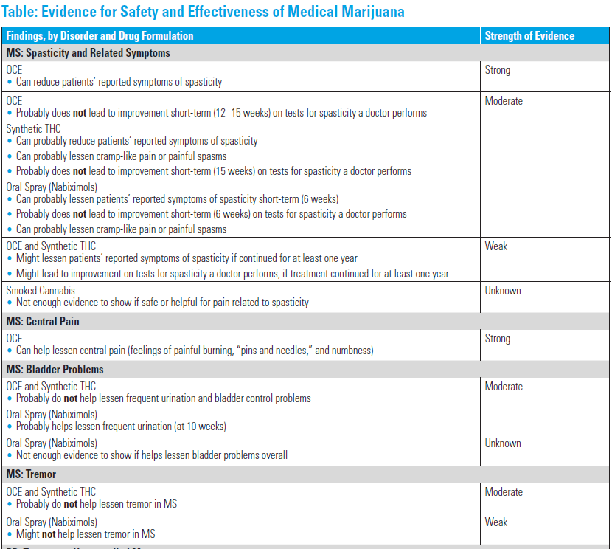
Spasticity - Evidence Supporting Use
Strong evidence that OCE pills made from pure CBD:
Can Help lessen patients’ reported spasticity symptoms short-term
Moderate evidence shows that THC pills and oral spray:
Probably help lessen patients’ reported symptoms of spasticity short-term
Probably help lessen cramp-like pain or painful spasms
Other MS Symptoms
Strong evidence shows OCE pills:
Can help lessen central pain (feelings of painful burning, “pins and needles,” and numbness)
Moderate evidence* also shows the oral spray:
Probably helps lessen frequent urination
AAN.com/guidelines

Slide 45

The Bummer
Important Concerns About Cannabis
Side effects include:
Difficulty with attention or concentration
Dizziness or fainting symptoms
Drowsiness or tiredness
Dry mouth
Feelings of intoxication
Hallucinations (seeing or hearing things that are not there)
Impaired judgement or coordination
Increased spasticity
Increased weakness
Loss of balance and falls
Nausea, vomiting, and constipation
Psychological problems such as depression or psychosis
Thinking (cognition) and memory problems
AAN.com/guidelines

Slide 46
Summary
MS is a lifelong disorder leading to unpredictable, intermittent neurological complications (inflammatory) and high risk of disability (neurodegeneration) – affecting cognitive, sensory, motor and autonomic systems compromise.
Diagnosis of MS involves assessment of neurologic symptoms, MRI evidence, and/or laboratory tests
Advanced treatment options now include target therapy involving some level of immune modulation or suppression.
All FDA approved therapies have demonstrated clinically significant reduction in number of relapses, progression of disability, and MRI advancement.
Multi-disciplinary, clinical support required for symptom management.

Slide 47
Thank you and questions

