Slide 1
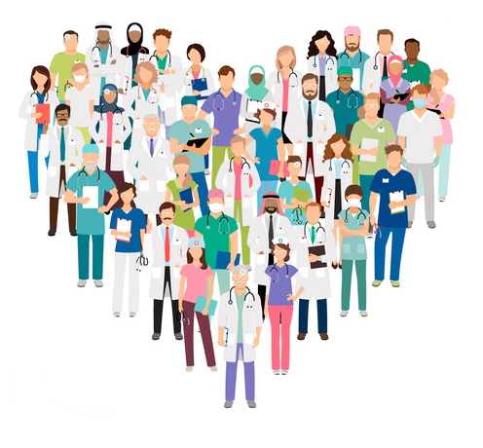
Best Practices for Gender Affirming Care
ARIEL MALAN, MHA
SHE/THEY
HEALTH EQUITY CONSULTANT
Notes:
The goal of this presentation is to provide you with a foundation to better serve transgender and gender diverse patient populations.
We are going to talk about privilege, identity, and language and how these play into our community’s experiences accessing care. So please stay present and engaged with us today as we navigate this next hour.

Slide 2
Objectives & Content to be Covered
Recall terminology and concepts critical to understanding LGBTQ+ communities
Understand the impact of bias and discrimination on health disparities experienced by gender diverse people
Identify best practice strategies for creating inclusive healthcare environments
Notes:
Some objectives and an overview of what will be covered today include:

Slide 3
Go to Slido.com
Enter #32782

Slide 4
In one word, what comes to mind when you hear health equity?

Slide 5
A person’s sexual orientation and gender identity is an important part of understanding overall health.

Slide 6
Gender is a biological determination assigned at birth.

Slide 7
Reflection Exercise
I am certain that my children will be given curricular materials that testify to the existence and validity of my sexual orientation and family structure.
I do not need to fight for legal and social recognition of myself or my family.
I can walk down the street with my opposite-gender partner or spouse holding hands without fear of being bullied, harassed or assaulted based solely on my sexual orientation.
I can use public restrooms without fear of verbal abuse, physical intimidation, or arrest.
Strangers don’t assume they can ask me about what my genitals look like and how I have sex.
I am called by the name I provide and no one asks what my real name is.
I do not worry that if I end up in the emergency room that my gender will keep me from getting appropriate treatment.
I do not have to go through an extensive psychological exam to receive basic medical care.
Notes:
1 minute
I want to do a very brief reflection exercise. This won’t be a group discussion but something for you all personally to think about.
I want you to read these statements on the slide, and decide if that statement is true or false for you. We’re going to take 1 minute, and you can write down how many you answered true and false to, or just keep that estimate in your head. Then we’ll come back.
-------------------------------------------------------------------------------------------------------------------------------------------------If you were able to answer true to the majority of these questions you may have privilege related to your gender identity and sexual orientation. Privilege can be associated with various intersecting identities and social categories including age, education, class, race etc. Recognizing our privilege is an important step towards understanding health equity and inclusion, because it opens up the conversation to talk about how certain groups of people have been marginalized. Which helps us name the system of oppression for example racism, sexism, transphobia, homophobia and create strategies for reducing those inequities.
We also want to recognize that there is a power dynamic that exists between healthcare provider and patient. You all have the power to either be a gate keeper or gate opener regarding healthcare access. So keep this in mind throughout the presentation.

Slide 8
Counting our Communities
20 Million
>2 Million
7-9%
Notes:
A new study released in 2021 showed us that at least 20 million adults identify as LGBTQ+ and more than 2 million of those adults identify as transgender. Millions more could identify with terms more expansive than LGBTQ+. And this is just looking at adults, not youth. But we know that 7-9% of youth are also identifying with terms within the LGBTQ+ umbrella. However these numbers are still underreported because there is stigma in self-identifying as LGBTQ as well as differences in definitions of who the community is and lack of consistent questions over time. We also know that survey methodology will impact if people feel safe answering these questions.
Prevalence helps us understand health disparities, pervasiveneness of anti-LGBT discrimination and economic impacts of equal rights provisions. A few factors that contribute to the increases you see here include, widespread access to information and language that is better capturing the diverse array of identities that exist within gender and sexuality. And safety is a large factor in when and how people come out about their identity. Previous generations of LGBTQ+ people have been forced to stay in the closet because the political and social climate was not safe. So what’s important to recognize is LGBTQ+ people have existed since the beginning of time but we’re just getting to the point where we’re collecting data on these communities, so if you’re wondering how this might impact your practice, you should know that you are already coming across LGBTQ+ patients. But we’ll talk about how you can be an advocate for collecting this information so you can better understand who you’re serving.

Slide 9
Terminology & Concepts

Slide 10
Human Experience
Notes:
Everyone has a sexual orientation, a gender identity, a gender expression and a sex assigned at birth, even if we don’t think about them. It’s important to recognize that someone’s gender identity does not necessarily predict their gender expression or sexual orientation, all of these concepts are independent of each other.
The terminology that we use about gender and sexuality has evolved over time and how people describe their identity and how they identify also changes over time. So we approach these concepts from a very fluid perspective.
My goal is to help you understand the differences between all of these and how each of these are important health information for all of your patients.

Slide 11
Sex Assigned at Birth
Intersex
Assigned Female at Birth
Assigned Male at Birth
Based on the presence of a vulva
Based on the presence of a penis
Umbrella term for differences in sex development
Notes:
Sex assigned at birth, sometimes referred to as biological or anatomical sex, is the sex that an infant is assigned when they are born. We say assigned because medical practice dictates we assign a sex based off of external genitalia or physical characteristics. Without extensive testing, we cannot determine an infant’s sex because sex is more than just the genitals we have, it also includes our chromosomal makeup, hormone levels, and other sex characteristics. Despite the fact that sex is extremely variable we categorize bodies into two types; male and female. Folks who fall outside of the binary male/female assignments are defined as intersex. Intersex people are born with differences in sex development so this can be differences in any of the things we just mentioned chromosomes, hormones, sex characteristics or genitals.
Sex assigned at birth is confused with legal sex because it’s common practice to include sex on legal documents such as birth certificates and drivers licenses. But this can be an inaccurate assumption that these are the same but folks can actually change their gender marker on their IDs. This is why most electronic health records include both “legal sex” and “sex assigned at birth”. We cannot look at someone’s legal sex and expect that to give us any information about a person’s organs or health needs. So it’s important to differentiate between legal documentation and a person's sex assigned at birth.

Slide 12
Gender Identity
Notes:
Gender has commonly been confused with sex assigned at birth but gender is completely separate from what we consider sex.
So to define gender identity, this is our internal sense of gender, who we feel like we are. This is why it’s impossible for us to know someone’s gender identity without asking them and we shouldn’t assume someone’s gender based on their name, appearance or how their voice sounds.
Some terms that you might hear, starting with cisgender. This refers to someone who identifies with the sex they were assigned at birth. For example an assigned female at birth individual, that identifies as a woman.
Transgender refers to someone who doesn’t identify with the sex they were assigned at birth. For example, an assigned male at birth individual, who identifies as a woman. This is one example of many combinations that can exist.
These last three identity terms are becoming increasingly more common as language evolves to support the fluidity of gender. Non-binary and gender fluid identities are part of the gender diversity umbrella just like transgender, however these identity groups are sometimes even more stigmatized because they do not ascribe to the binary of female or male.

Slide 13
Gender is a Social Construct
Notes:
Gender is a social construct defined by the culture we live in, for colonized Western society the binary of man and woman represents our culture’s ideas of gender. When a child is assigned female or male, that information is then used to culturally and socially gender the child, blues vs. pinks, boys vs girls toys and gender roles and so on. This binary was created to differentiate the races, which we’ll talk about next. For centuries we have perpetuated stereotypes and assumptions of gender that place people in boxes of what a man and woman should look and act like, with no room for variation. The gender binary has also contributed to what we call cis and hetero normativity, meaning we assume that the people around us are either cisgender or heterosexual. This bleeds into the language we use, the way we talk about bodies, and a history of healthcare oppression for LGBTQ+ people.
But we want to remember that gender is a spectrum of experience and no one person experiences their gender in the same way.

Slide 14
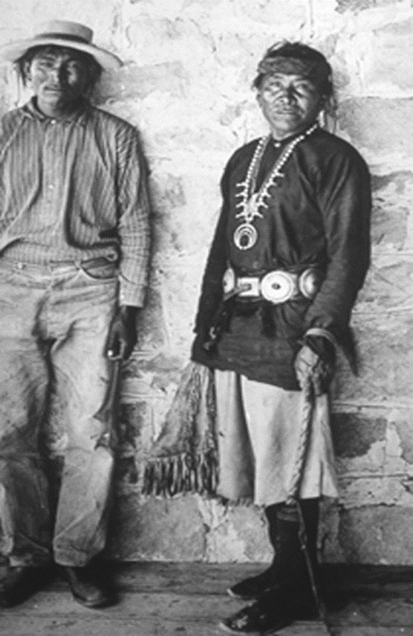
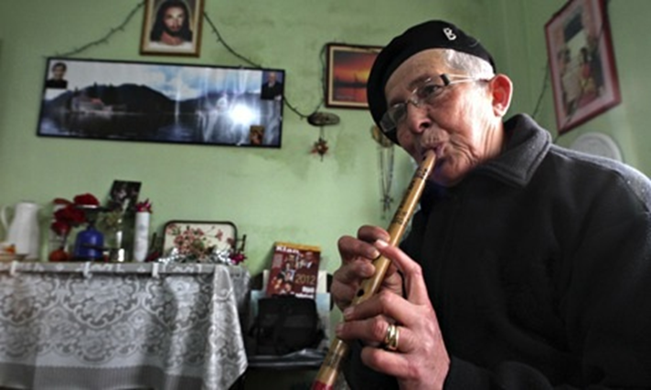
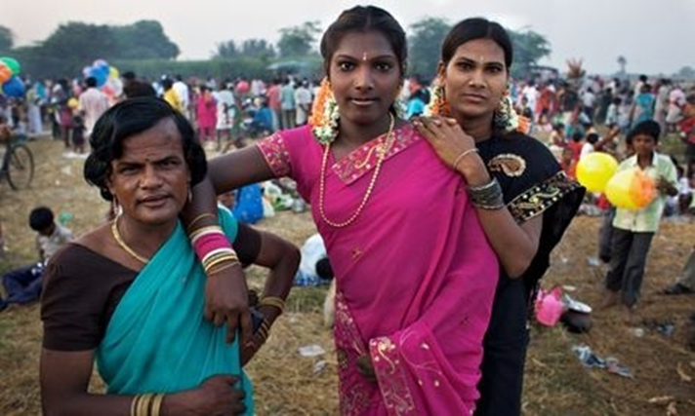
Gender Diversity is Global
Notes:
Not all cultures experience gender and gender roles in the same way as Western society. Cultures across the world recognize multiple genders and intersex people as sacred and important within their societies.
It’s important to understand where our ideas of gender originated and how these cultural ideas have been used throughout history to see where we are today. Gender and sex are not universal and are race specific meaning these concepts in American and European history have been used as weapons to demonize Black and Indigenous people. White colonizers used words like “savagery” and “sexual ambiguity” to describe Black and Indigenous people as less civilized compared to white people. This rhetoric was used to justify assimilation of indigenous peoples, colonization of the Americas, criminalization and murder of non-white and gender non-conforming people. This same binary that was used to oppress Black and indigenous people was also used to justify denying women rights on the basis of nature, and is used again today to condone the proposition of laws that target trans and non-binary people on the basis of sex. Now we don’t hear these same words today when talking about the gender binary, but this continues to come up time and time again as justification and reasoning to police who should and shouldn’t exist in public spaces.

Slide 15
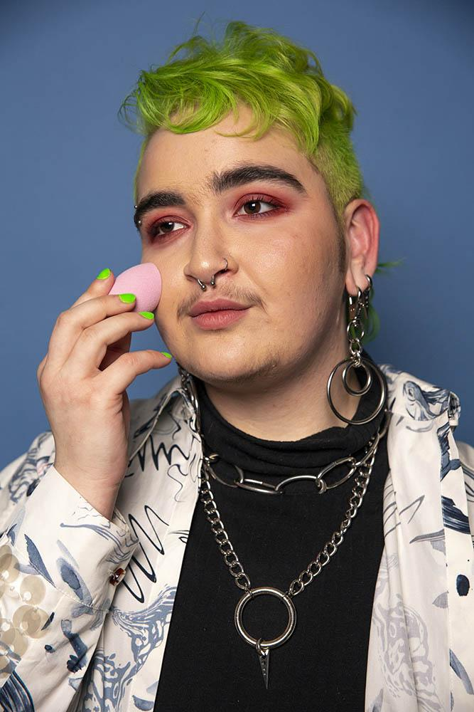
Gender Expression
Notes:
Gender expression is that outward expression of our gender which can be depicted through clothing, hair styles, body language, etc. Again, someone’s gender identity will not necessarily indicate their gender expression and vice versa. Exploring gender expression is a natural part of our development as humans, but not everyone is provided that space to do so, especially if that exploration is different than the social gender you were assigned when you were born.

Slide 16
Gender Affirmation
Social: coming out, dress/style, mannerisms, voice
Body modifications: tucking, binding, prosthetics
Legal: gender marker, legal name on birth certificate, drivers license, at school
Medical: HRT, fertility treatment, OBGYN care
Surgical: top and bottom surgery, facial feminization
Notes:
For some transgender people, there may be a goal to medically transition so that their physical body more aligns with their internal sense of gender, however there are many people who do not identify with a binary representation of gender. This is why we don’t assume that everyone wants medical or surgical transition or what that path looks like.
Gender affirmation is also not unique to transgender people, cisgender people may choose to affirm their gender in very similar ways. So let’s talk about how people may choose to affirm their gender.
Social affirmation can be about the coming out process, communicating to friends and family about a new name or new pronouns. It could be trying out new ways of dressing or how you present yourself. For many people, finding a gender expression that fits them in this way may be all they want.
Body modifications could be reversible ways of altering our bodies. Because certain body parts may represent trauma or bring up dysphoria for folks, they may use the process of binding the chest to have a more masculine appearing chest or tucking to remove the appearance of a penis.
Another path are legal changes to a person’s gender marker on their legal documents or their name. This is a fairly expensive process and not always accessible so it’s common that transgender people will have a name that they use that’s different than their legal documents.
Medical and surgical options are also available. This can look like hormone therapy, puberty blockers for adolescents, or even top surgery and/or bottom surgery.
This process of figuring out our gender is very normal and what people want for their bodies is variable and unique so the best thing we as healthcare teams and allies can do is normalize this conversation and provide support.

Slide 17
Sexual Orientation
Identity
Behavior
Desire
Do you consider yourself gay, lesbian, bisexual, straight, queer or something else?
What gender(s) are your sexual partner(s)?
What gender(s) are you attracted to physically and emotionally?
Notes:
Sexual orientation can be thought of in 3 dimensions: identity, behavior and desire. Sexual orientation is how a person identifies their physical, emotional and romantic attachments to others. In healthcare we need to know not only how our patients self-identify but also their behaviors in order to provide appropriate preventative health screenings. There are may folks who may use the identity of straight but have sex with people of the same gender as them, this is why it’s important to ask these behavioral questions which may come up in a sexual health history.

Slide 18
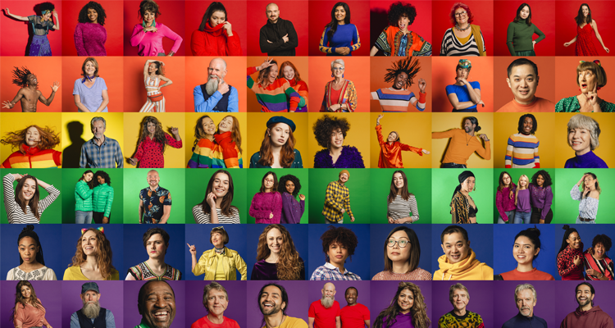
All Communities use Labels
Lesbian
Gay
Bisexual
Queer
Asexual
Pansexual
…..
Notes:
Labels for our identities mean different things to different people. And the most important thing to remember is that it’s ok not to know what they all mean but recognize that there are many ways we self-define ourselves and to use the label that people have given you, do not assume a label based on appearance, partners or behavior. This is not unique to the LGBTQ+ community, many communities have terms and labels they use to self-define so this is a generally applicable rule and it’s ok to ask a patient, can you tell me what this label means to you? To better understand the context and how they define it.
You can refer to a great glossary of terms at the end of this presentation to dive deeper on some of these.

Slide 19
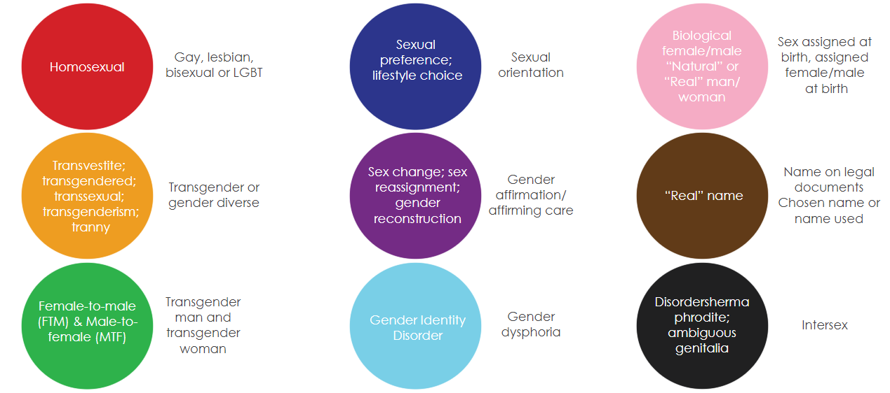
Language Changes
Disorders of sex development; hermaphrodite; ambiguous genitalia
Notes:
As terminology evolves it’s important to avoid outdated terms that create stigma against these communities accessing care. We recognize that sometimes the terminology that the medical community uses doesn’t represent the actual community’s lived experience.

Slide 20
Unique Experiences of LGBTQ People
Chosen Family
Familial rejection is common, so many LGBTQ people will choose family outside of biological ties.
Deadnaming Using the birth or former name of a transgender person without their consent.
Misgendering Referring to someone with a pronoun that does not correctly reflect their gender.
Outing
Involuntary or unwanted disclosure of someone’s gender identity or sexual orientation.
Notes:
We talked about the first two already but let’s focus on the last three.
Deadnaming refers to using a transgender or non-binary person’s former or birth name instead of their chosen name.
Misgendering refers to using a set of pronouns for someone based on assumption of how they look or sound. Both of these are incredibly damaging to someone’s trust in our healthcare system and providers and contributes to poor mental and physical health outcomes.
Outing is the involuntary or unwanted disclosure of another person’s sexual orientation or gender identity. This becomes important when we collect SOGI information as well as referring to people in our waiting rooms.

Slide 21
Bias & Discrimination as Barriers to Care

Slide 22
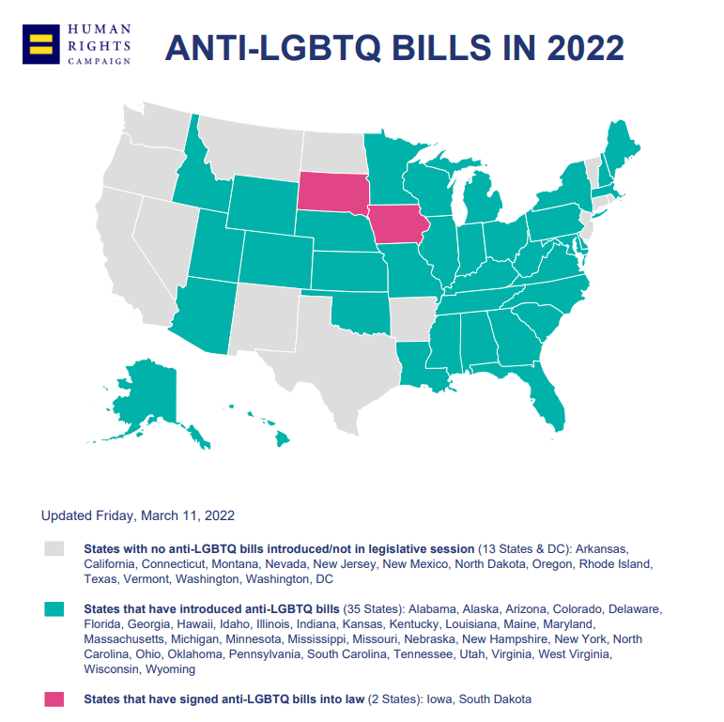
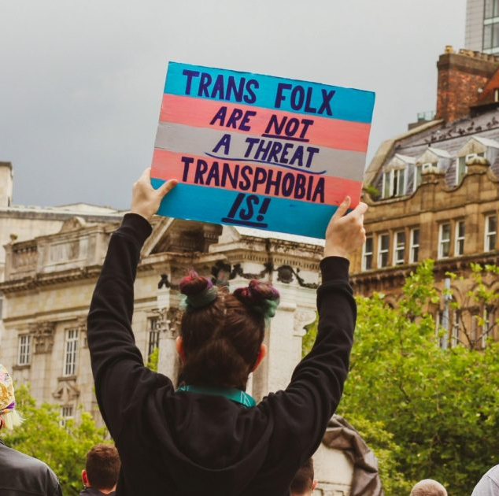
Notes:
This year we have seen a record number of bills introduced that target transgender youth. The primary ones attempt to ban gender affirming care for minors to banning trans girls from participating in sports. These attacks are led by nationally recognized hate groups and are fueled by bias and misinformation. Gender diverse identities are inherently political because they challenge our society’s understanding of gender and the status quo. But my primary reason of bringing this up is to remind healthcare institutions that gender affirming medical care is evidence based, supported by hundreds of medical and professional associations across the world, and is proven to reduce the risk of suicide in transgender people struggling with gender dysphoria.
We need to continue to support our communities as they access care with us and also speak up about the misinformation that is spread in these bills. Due to the politicized nature of transgender lives, research has only barely started scratching the surface on the long term effects of gender affirmation and access to gender affirming medical care. But what we do know is that gender affirmation is suicide prevention. This is not just access to gender affirming services but affirming people's gender by using their chosen name and pronouns and respecting their choices for their health.

Slide 23
Loss of relationships
Denial of medical service
School bullying
63%
Teacher harassment
Homelessness
Loss of a job
Physical & sexual assault
Eviction
Incarceration
Notes:
The National Transgender Discrimination Survey shows us how broad of an impact bias has on gender diverse people’s lives. The report found that 63% of participants had experienced serious forms of discrimination in various areas of their lives including…..
Systemic bias is embedded in every major system our society utilizes, it’s created significant inequities for many communities, transgender people and trans people of color being hit the hardest. Recognizing where our communities are coming from when they walk through our doors is important so that we can address social determinants of health and reduce inequity.

Slide 24
Stigma/Discrimination
Interpersonal Stigma
Structural Stigma
Intrapersonal Stigma
Intersectionality
Race
Gender
Ability
Age
Sexual Orientation
Education
Impacts
Mental Health
Physical Health
Access to Care
Access to Competent Care
Health Disparities/Inequities
Notes:
Many transgender people will delay or avoid seeing a medical provider because they fear discrimination, and according to the previous survey, only 28% of people were out to all their medical providers and about 70% of transgender people have experienced more than 1 of the following in a healthcare setting:
Denied care because of their sexual orientation or gender identity
Providers use harsh or abusive language
Providers refusing to touch them or use excessive precautions
Providers blaming them for their health status
Providers were physically rough or abusive
Intersectionality plays a role in how these experiences are exacerbated for certain groups. Intersectionality is the overlapping social categories that we all have as people including our race, gender, ability, education, sexual orientation and much more. We know that some of these social categories have a compounding affect on health disparities and experiences of discrimination. For example a 2019 study on HIV rates showed that 14% of transgender women have HIV, but when race is accounted for, about 44% of black trans women have HIV and 26% of Hispanic trans women. This is just one example of why it’s important to view healthcare experiences from an intersectional lens.
Discrimination and bias are barriers to care for many marginalized communities and contribute to why we see poor health outcomes in our communities

Slide 25
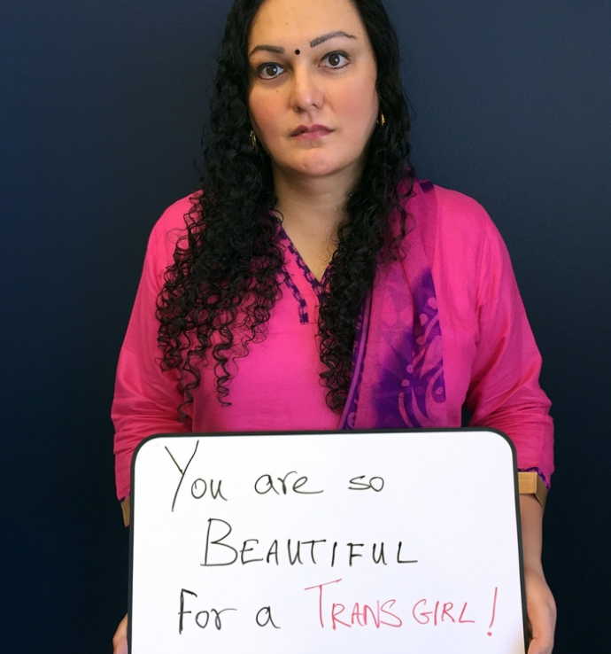
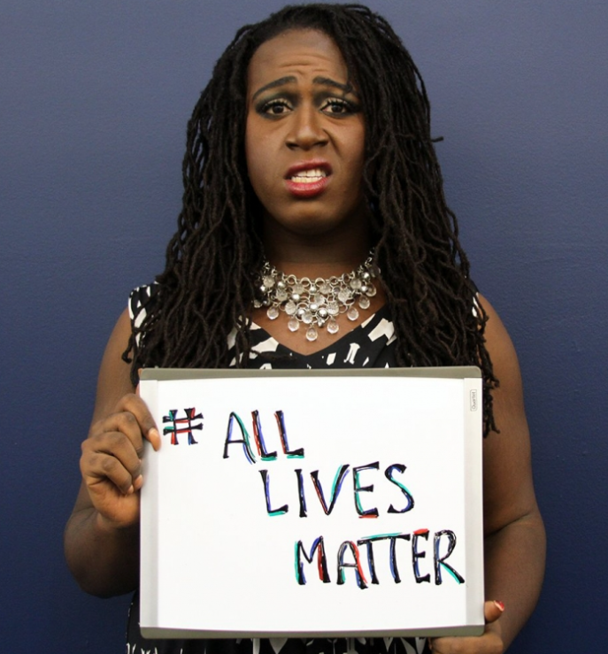
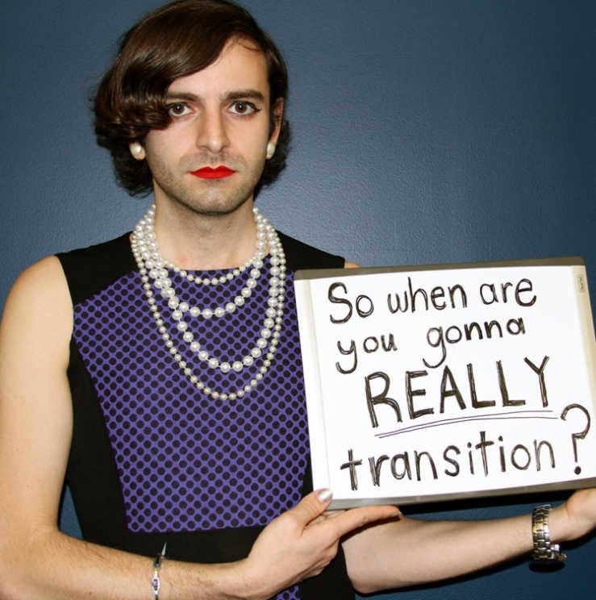
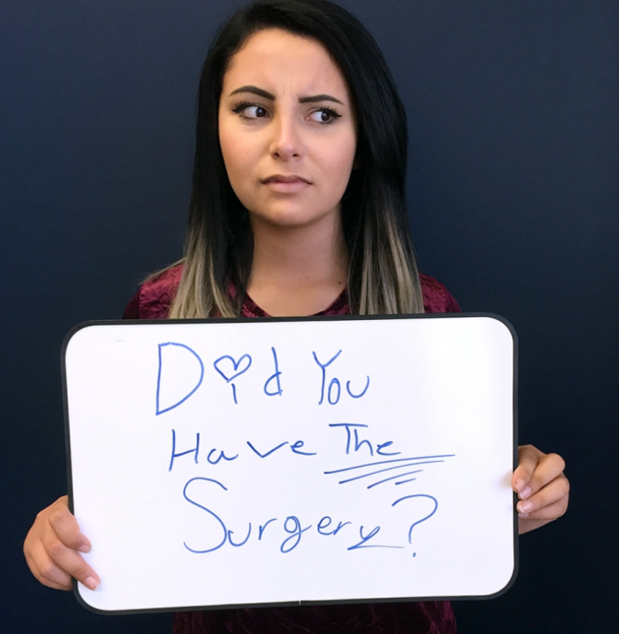
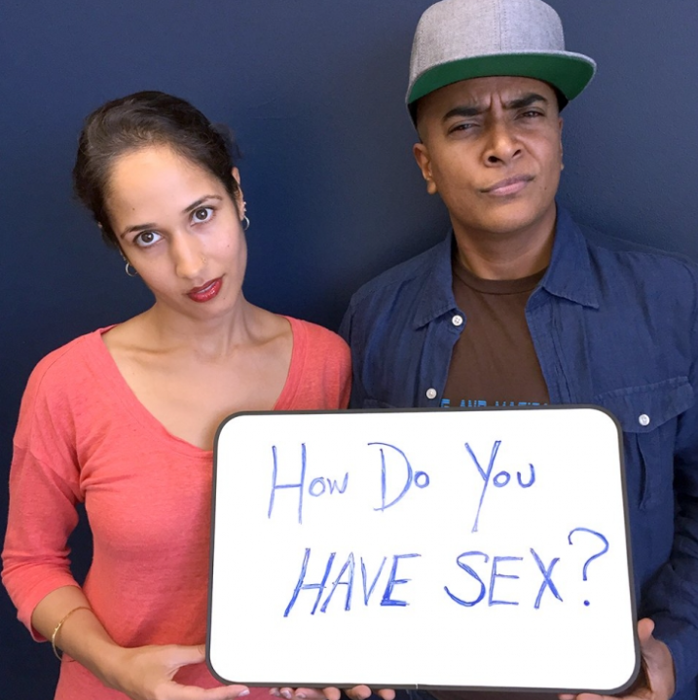
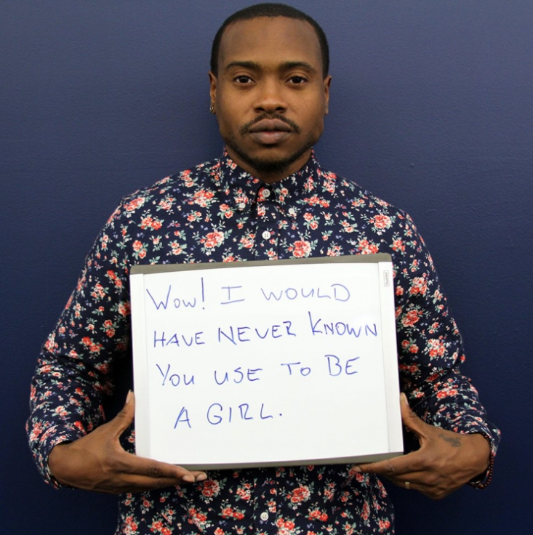
Microagressions
“I did then what I knew how to do. Now that I know better, I do better.”
– Maya Angelou
Notes:
Microagressions are the most common experiences our communities report. These are insensitive comments that are painful because they have to do with a person’s identity that’s discriminated against or subject to stereotypes. They happen casually, frequently, and often without any harm intended. Many marginalized groups experience microagressions or minority stress and this is multiplied when you have intersecting identities across race, nationality, age, disability etc.
Research shows that microagressions take a toll on both our mental and physical health. It impacts all of our environments and healthcare is not exempt. They are tied to implicit bias, which are the attitudes, stereotypes, and assumptions that we’re not necessarily aware of, usually based on cultural factors of how/when/and where we grew up. But once we're aware of what these experiences look like, we are more prepared to recognize them when they come up and hold ourselves and others accountable when we hear them.

Slide 26
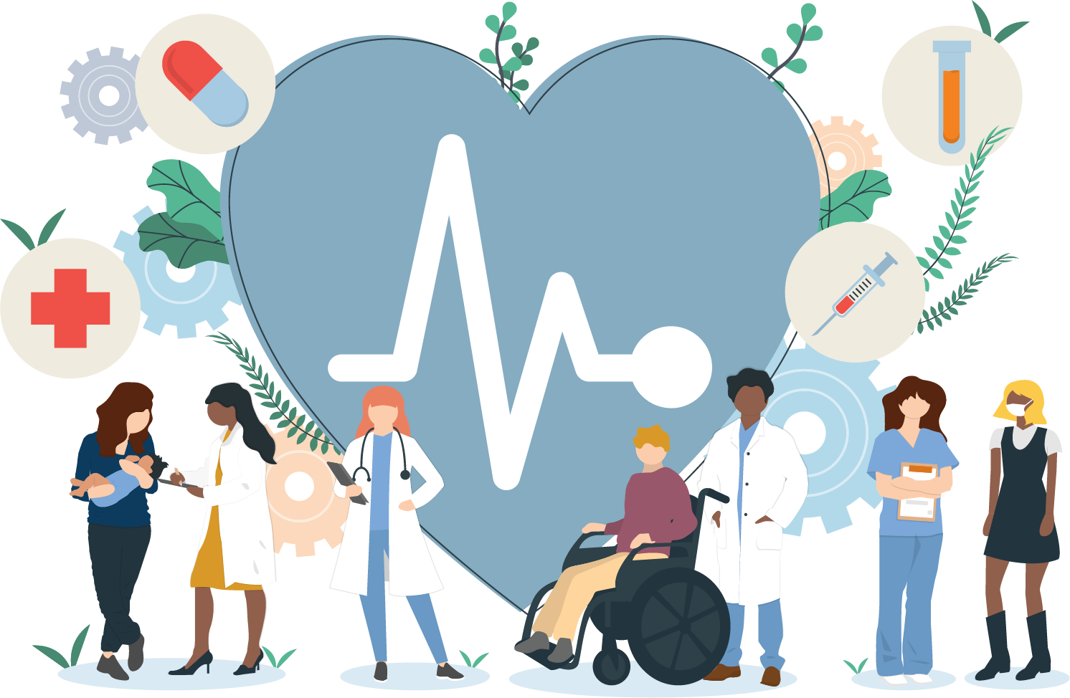
Best Practices

Slide 27
What Matters to Patients
Notes:
I want to start this section with a video from some of our very own patients highlighting positive experiences they’ve had with healthcare providers. This is about 8 minutes long.
It’s about 7 minutes 53 seconds

Slide 28
Asking for Chosen Name
1. What name would you like us to use?
2. What is your legal name?
Notes:
Everyone has a name that they go by. For some it might be Charlie instead of Charles, or Sam instead of Susan. Because people’s legal names may not be the names they choose to go by it’s best to ask people, what name would you like us to use? to know how they want to be referred to.
And understanding that you need their legal name to bill for insurance, asking.... what is your legal name? Explaining how and why their legal name has to be used for this process but letting them know you will refer to them by their chosen name.

Slide 29
Pronouns
Examples: How to ask patients about their pronouns
What pronouns do you use?
My name is Sam, I use they/them. How about you?
How do you like to be addressed?
Notes:
In the same thread of referring to people by their chosen name to respect them, we also want to refer to people by the pronouns they choose.
Pronouns are the words we use instead of someone’s name, common examples include she/he/they, but there are other pronouns too.
Examples of how to ask people their pronouns could be what pronouns do you use? or introducing yourself first with your name and pronouns and asking theirs, or how do you like to be addressed?
Sharing your pronouns is an important step towards creating a welcoming environment. You can start practicing this in work meetings when introducing yourself to coworkers and in your everyday life. We use pronouns all the time, but the point of this is to recognize we sometimes make assumptions that are incorrect and to get in the habit of asking people.

Slide 30
Misgendering & Managing Mistakes
Notes:
By using they/them to refer to people until you know their pronouns, you can avoid accidentally misgendering someone.
It’s ok to make mistakes but say “thank you” if someone corrects you about a misstep, moving forward with those correct pronouns and if you catch yourself misgendering someone, quickly correct yourself and move forward. This shows people you acknowledge the mistake, but you don’t make the other person uncomfortable by profusely apologizing.
Our communities are receptive to when they hear these acknowledgements and it highlights how you want to respect them.

Slide 31
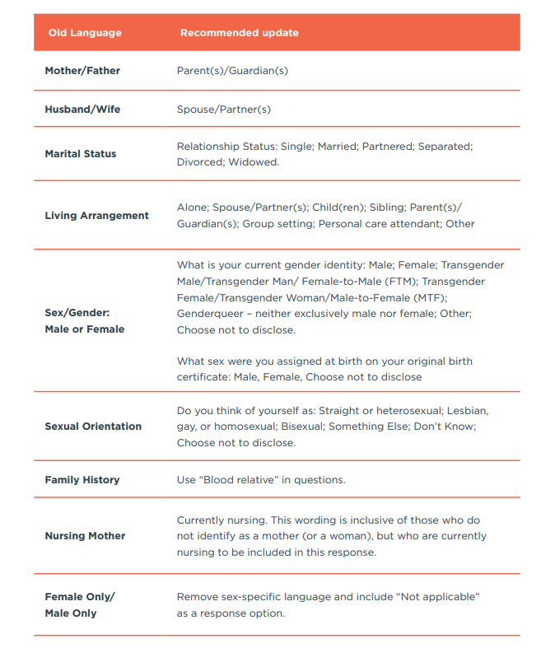
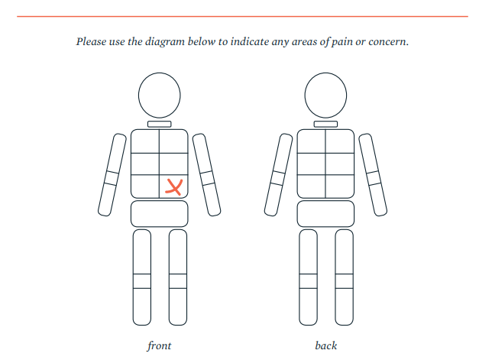
Gender Inclusive Language
Notes:
The language we use affects how safe, included and welcome people feel when accessing our spaces. Gender inclusive language is about de-gendering our day to day language and using gender neutral alternatives. We can avoid unnecessarily gendering terms and identifiers and allow people to fill in the blanks with what language they would like us to use. We can do this with all of our intake forms, questionnaires as well as diagrams.
For example, many of these terms indicate a heteronormative assumption about a person’s life and their relationship dynamics. Some people have two moms, some people aren’t married but have partners, some people have chosen family instead of biological family that they lean on during healthcare emergencies. So it’s important to really neutralize these terms so that people can provide you with the details that fit their lives.

Slide 32
Talking About Bodies
Notes:
So much of the way we talk about medicine and bodies is also gendered by habit, and this can be invalidating and distressing for trans patients, which in turn creates barriers to health. Practicing with different language that affirms trans patients means more welcoming and accessible services for all patients.

Slide 33
Asking Patients About SOGI
Patient portal or any intake paperwork sent via email
In clinic during the check in process
Notes:
The process of asking all patients about their SOGI or sexual orientation and gender identity, empowers healthcare systems to get to know patients better, and provide them with culturally responsive, patient-centered services they need.
The Institute of Medicine, Joint Commission, CMS and others recommend asking all patients these questions. We can ask these annually and at the same time as other demographic information including race and ethnicity to normalize this conversation. This also recognizes that identities can change over time.
There are many ways we can collect SOGI information. A patient portal is a great way for patients to self-identify in the privacy of their own home ahead of time. An ipad at check in or paper intake form can collect this during registration or a more preferred method by patients is having the MA, nurse, or provider collect this information in a private setting.
If patients are hesitant to provide this information you can remind them that this is private information protected by HIPAA that is kept in their medical record, is asked of all patients, and helps providers provide patient centered quality care.

Slide 34
Recommended SOGI Questions
How we ask these questions can impact if people feel safe answering them.
Notes:
The best ways to ask these questions are on the right hand side……..
This will depend on what your electronic medical record will accommodate for options but asking SOGI in this way allows flexibility for patients to update their identities over time and allows systems to measure how they’re improving health outcomes in their local communities.

Slide 35
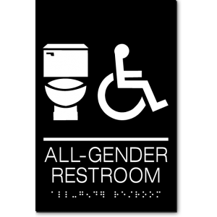
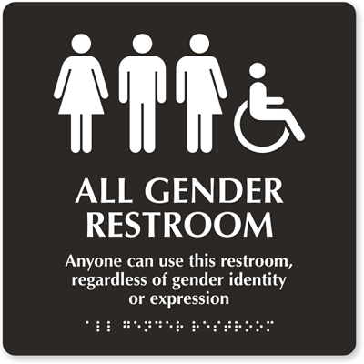
Inclusive Policies
Non-discrimination policies
Does it include sexual orientation, gender identity, and gender expression?
Inpatient bed policies
Are patients assigned to beds based on gender identity or legal sex?
Patient bill of rights
Rights to privacy explicitly including transgender status
Restroom policies
Mark all single stall restrooms as All Gender, if you can’t make sure you have a policy that allows people to use the restroom that aligns with their gender identity
Gender transition guidelines for employees
A guide for managers on how to support transgender employees who pursue medical or surgical gender affirmation
Notes:
It’s also important that our institutions have inclusive policies and that both employees and patients are aware of these policies.
This could include non-discrimination policies that are comprehensive including sexual orientation, gender identity, and gender expression.
In patient bed policies that are assigned based on gender identity rather than legal sex.
A patient bill of rights indicating that SOGI data is protected under HIPAA.
Restroom policies that support equal access to facilities. If you have unisex or single stall restrooms updating the signage to say “All Gender” or to just include symbols of what things are the in the bathrooms like a toilet, a sink, a changing table etc.
And lastly, gender transition guidelines for employees. This helps managers support gender diverse employees who may pursue medical or surgical gender affirmation in the workplace.

Slide 36
“I love when I go somewhere and I see even a tiny LGBTQ flag or a small card welcoming LGBTQ patients or customers. It’s almost like your level of anxiety goes down a bit. The more people see that, see us, and meet me, the more they realize I’m just like you.”
Patient stories

Slide 37
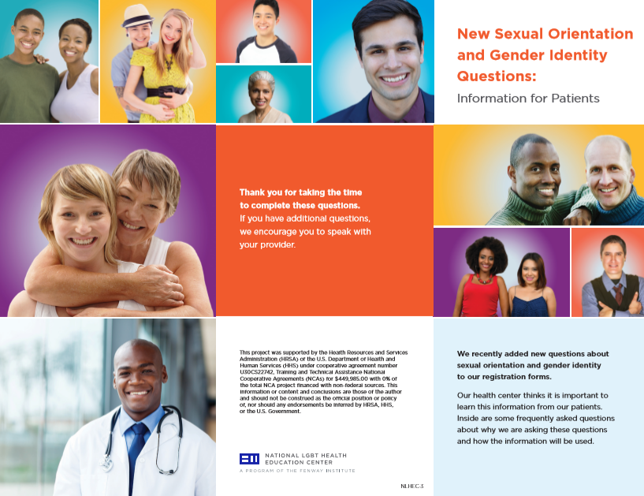
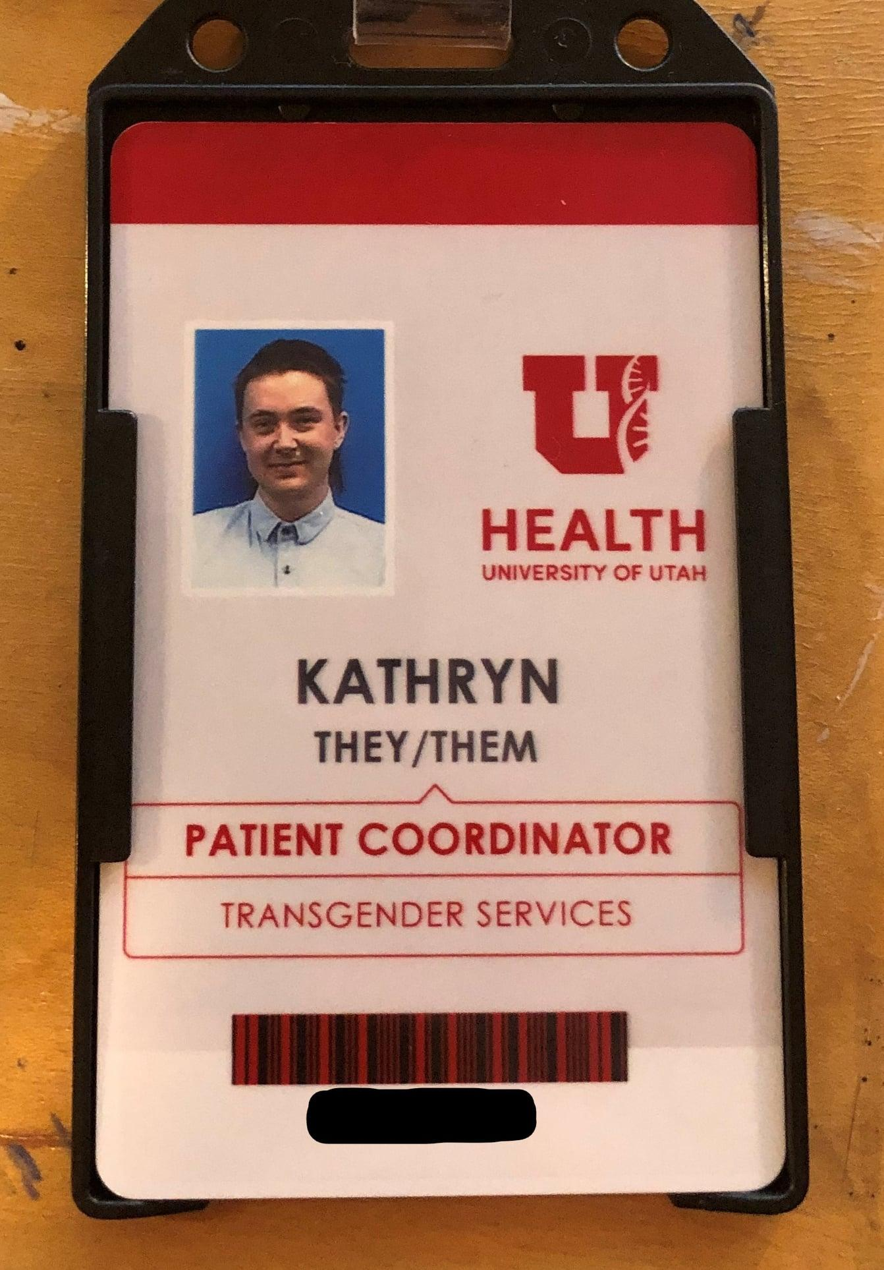
Notes:
Another element of safety and inclusion is within signs of affirmation. Research shows us that LGBTQ+ people will look for subtle signs of affirmation in their environment to determine acceptance.
There are many ways that signal to this community that we recognize them including:
Staff wearing pronoun pins or adding pronouns to their name badges
Rainbow pins or items in your work spaces
Signs that are explicit in recognizing who you serve
Brochures about LGBTQ+ people’s health depicting LGBT families and people
Participation in LGBTQ+ specific designations or accreditations
And participating in LGBTQ+ marketing events such as Pride

Slide 38
Do’s
Don’ts
Do mirror the language a patient is using about their identity
Do refer to patients by their chosen name and pronouns
Do ask, when in doubt (if it’s appropriate to their care, not because you’re curious)
Do respect a patient’s choice in how they identify
Do frame all questions in a respectful manner
Do acknowledge and try to mitigate the power dynamic between healthcare provider and patient
Don’t assume anatomy based on legal sex or gender marker
Don’t use stereotypes or ask questions that are not necessary for care
Don’t assume person’s orientation or identity based on gender, appearance, partner(s), or behaviors
Don’t assume all people use traditional labels
Notes:
If you're thinking to yourself this is a lot of information, you are right, here are some key takeaways from this presentation today we hope you can continue to be curious and learn from folks by listening.

Slide 39
“99% of the time, I do not give a single care about someone's innate knowledge of transition matters and trans care, what I really care about is someone's ability to treat me like a fellow human being and their ability to really be honest with me about not knowing something where they can say, 'Hey, I don't know about this, but I think I know someone who does, and I will go find out and work with you on getting the care that you need.'"
Patient stories

Slide 40
Accountability is Key
LGBTQ+ people have a history of experiencing stigma/discrimination
Don’t be surprised if a mistake results in a person becoming upset
Don’t personalize the reaction
Apologize when people become upset, even if it was well-intentioned, this can defuse the situation and re-establish constructive dialogue
Don’t be afraid to correct colleagues if they make insensitive comments or make a mistake too
Notes:
So now that you have this information, how do we prepare for our next interactions? We need to remember that…
It’s ok not have all the answers, but be willing to work with the individual IN getting the answers they need for their healthcare.

Slide 41
Further resources
Community Resources
Continuing Education
Transgender Health Program
Utah Pride Center
Genderbands
Encircle
LGBT Allied Lawyers of Utah
LGBTQ Affirmative Therapists Guild of Utah
Know Your Healthcare Rights
LGBTQIA Health Education Center
LGBTQIA Glossary of Terms for Healthcare Teams
Trans Hub
Building Trust with your Transgender Patients
Pronouns
Human Rights Campaign Transgender FAQs
Notes:
Resources listed here include continuing education for everyone who wants to learn more about these topics and resources for our patients.

Slide 42
Free, CME eligible, Online Canvas Course
Topics include:
1) Getting to know the community
2) Barriers to care
3) Transgender medicine
4) Inclusive data collection
5) Best practices

Slide 43
Thank You!

