Slide 1
Telling Who I Am Before I Forget: Field Notes on My Dementia
Gerda Saunders offers a first-person account of her experiences with her own early-onset dementia
Notes:
Opening slide while we get ready

Slide 2
Objectives
After attending the presentation, physicians and other health providers will be able to assist their patients/clients and those who care for them by:
Assessing the growing body of first-person dementia narratives (handout)
Appraising the crucial role of the primary care physician in developing with their dementia patients and their families a “dementia vocabulary,” that is, establishing the (outer) limits of what is comfortable for the patient and her family to talk about
Applying the “dementia vocabulary” to
help the patient understand her current situation
guide her through the full diagnostic process
provide detailed information on the prognosis so that she and her family can plan for their future
Planning for and talking about her situation within a broader community gives the patient peace of mind
Extrapolate the following perceptions of the patient in this “case study” to their own patients:
To the patient, her behavior always seems rational at that moment, no matter how bizzare
The patient’s view of how her dementia impacts her often differs from the people around her
The impact of her dementia diagnosis on this patient’s identity and sense of self is ego-crushing
This patient and her family are living a joyous and productive life after her diagnosis
Notes:
Kate to address

Slide 3
Even early-onset patients’ may exhibit odd behavior; from the inside, the behavior seems “rational”
SECTION OUTLINE
“Dementing”
Working memory
My mother
Early symptoms
Notes:
Gerda will address this slide

Slide 4
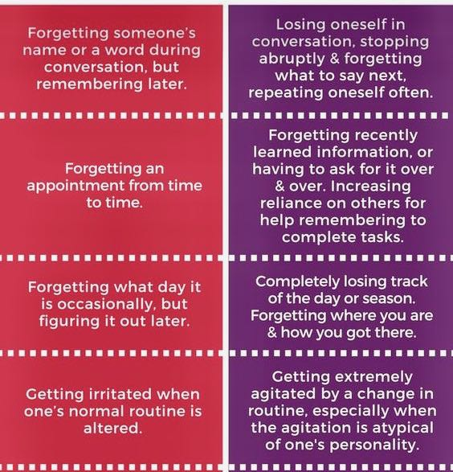
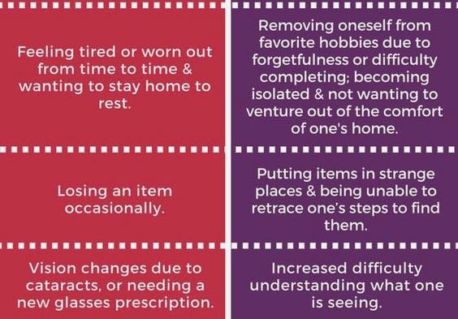
Even early-onset patients’ may exhibit odd behavior; from the inside, the behavior seems “rational”
“DEMENTING”
Senior Moments vs Dementia Senior Moments vs Dementia (contd)
Notes:
Gerda will address this slide

Slide 5
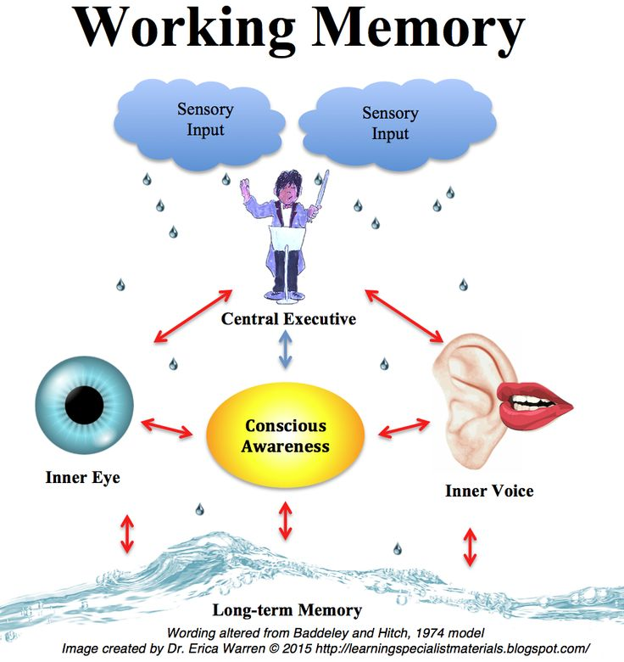
Even early-onset patients’ may exhibit odd behavior; from the inside, the behavior seems “rational”
WORKING MEMORY
Notes:
Kate will address this slide

Slide 6
Even early-onset patients’ may exhibit odd behavior; from the inside, the behavior seems “rational”
MY MOTHER: LATE SYMPTOMS
ME: EARLY SYMPTOMS
Although the early signs vary, common early symptoms of dementia include:
memory problems, particularly remembering recent events
increasing confusion
reduced concentration
personality or behavior changes
apathy and withdrawal or depression
loss of ability to do everyday tasks
Notes:
Kate will address this slide

Slide 7
The primary physician’s role can and should be a crucial component of a dementia patient’s diagnosis and ongoing care
SECTION OUTLINE
Consulting medical experts
My primary care physician LISTENED: helped create a “dementia vocabulary”
Diagnosis
Global Deterioration Scale for Degenerative Dementia (DGS)
Notes:
Gerda will address this slide

Slide 8
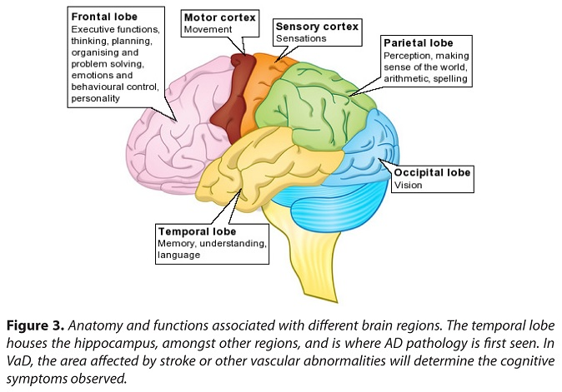
The primary physician’s role can and should be a crucial component of a dementia patient’s diagnosis and ongoing care
CONSULTING MEDICAL EXPERTS
Notes:
Gerda will address this slide

Slide 9
The primary physician’s role can and should be a crucial component of a dementia patient’s diagnosis and ongoing care
ROLE OF PRIMARY CARE PHYSICIAN
“DEMENTIA VOCABULARY”
In our family, it is okay to use the following words in relation to my dementia:
“crazy” behavior
zombie
dementing
assisted death
assisted suicide
“death trip”
etc
We do not assume that these words will be okay with other people, except when we are clients and they are professionals whom we pay, for example, our doctors, lawyer, financial advisor, tax lady.
Dr. Eborn listened to our concerns and helped us understand the impacts
Needs
Questions
Advice
Discussion
Notes:
Gerda will address this slide

Slide 10
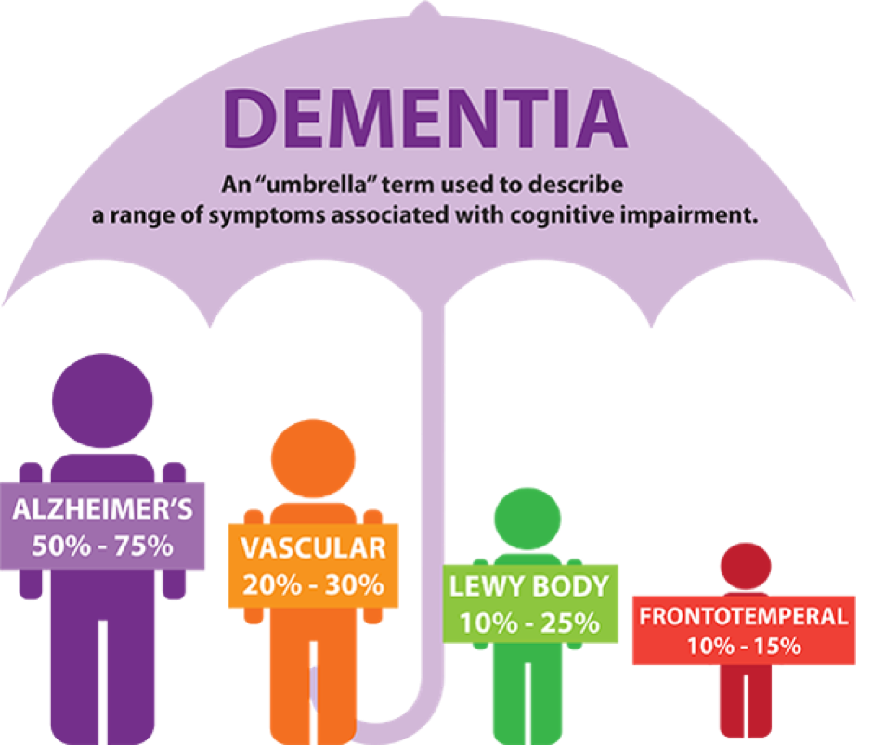
The primary physician’s role can and should be a crucial component of a dementia patient’s diagnosis and ongoing care
DIAGNOSIS
Notes:
Gerda will address this slide

Slide 11
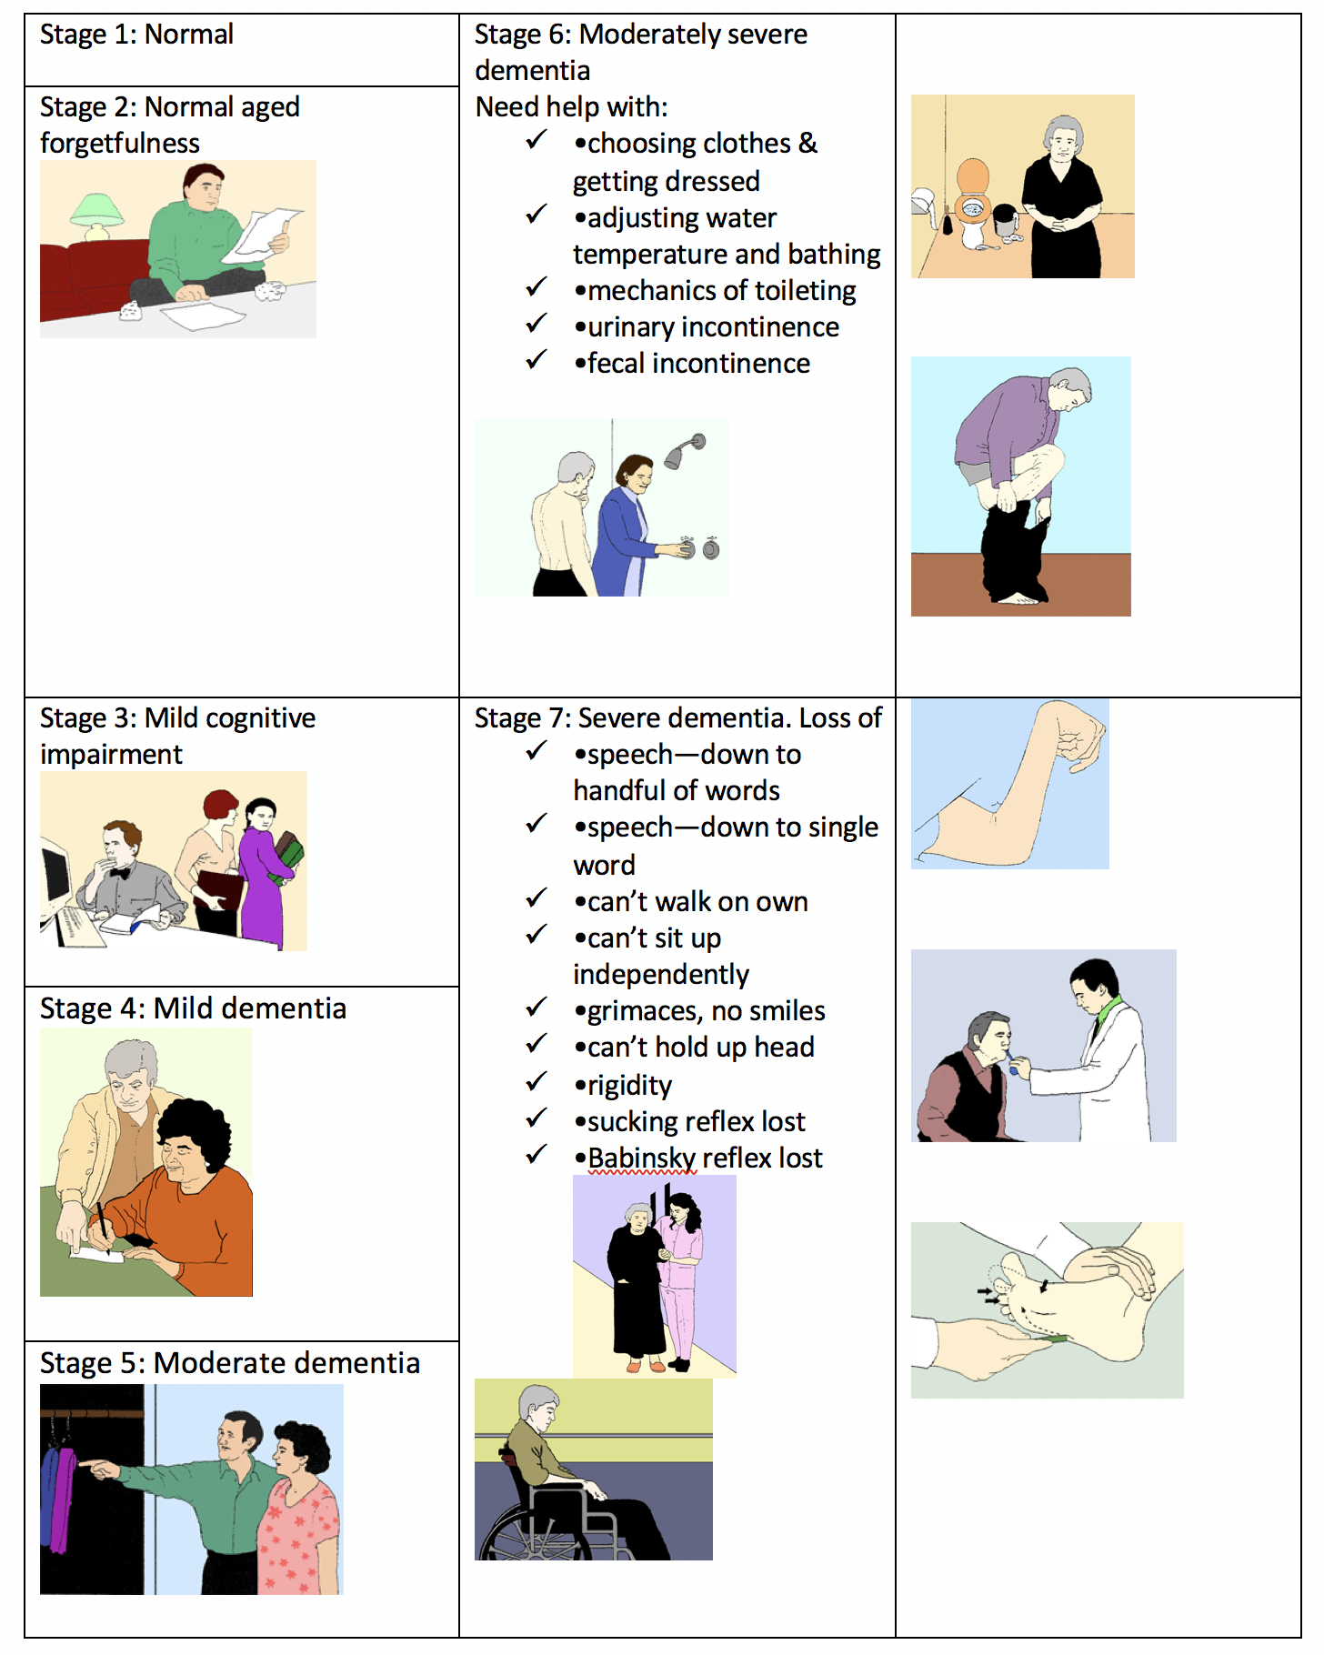
The primary physician’s role can and should be a crucial component of a dementia patient’s diagnosis and ongoing care
GLOBAL DETERIORATION SCALE FOR DEGENERATIVE DEMENTIA
Notes:
Kate will address this slide

Slide 12
Planning and talking about the diagnosis with family
SECTION OUTLINE
Who to tell
Made-in-America family
Speaking truth to children
Notes:
Gerda will address this slide

Slide 13
Planning and talking about the diagnosis to yourself
SECTION OUTLINE
Retirement, Journal: just the facts
Dementia Field Notes
When disturbed, do research
Notes:
Gerda will address this slide

Slide 14
Planning and talking about the diagnosis to yourself
RETIREMENT, JOURNAL: JUST THE FACTS
DEMENTIA FIELD NOTES
07-25-2013
When I put away my salad bowl after lunch, it appeared oval rather than round. I turned it the other way and it still looked oval. It made me feel disconnected from myself—as if it were not me looking at the bowl. I took a nap, then checked the bowl again. It was round.
6-11-2013
Since I started having trouble remembering which items go with what when I pick something to wear for the day, I have started writing down the components of the outfit after I have taken an hour to figure it out.
Notes:
Gerda will address this slide

Slide 15
Planning and talking about the diagnosis to yourself
WHEN DISTURBED, DO RESEARCH
Once university graduates’ dementia overcomes their coping skills, they “suffer a memory loss 50% percent faster than someone with a minimal education.”
Albert Einstein College of Medicine at Yeshiva University
Notes:
Gerda will address this slide

Slide 16
The impact of her diagnosis on this patient’s identity and sense of self was/is disorienting, disturbing, and ongoing
SECTION OUTLINE
Doña Quixote
Memento Mori (art to remind you that you will die)
“Friend of my heart, for weal or woe”
Notes:
Gerda will address this slide

Slide 17
Personal dementia narratives are changing the way we think of people with dementia
SECTION OUTLINE
Living death
“Zombies”
Language and identity
The kinder, gentler zombie
Notes:
Gerda will address this slide

Slide 18
The impact of language on identity
SECTION OUTLINE
The biomedical model of dementia
Categories: descriptive vs normative/prescriptive
The biospsychosocial model of dementia
Narrative medicine
Follow the money: higher wages and more training for dementia caretakers
Assisted suicide
Black Panther
Notes:
Gerda will address this slide

Slide 19
The impact of language on identity
THE BIOMEDICAL DEFINITION OF DEMENTIA
Definition: Dementia is “a disease that [leads to] significant loss of intellectual abilities, such as memory capacity, that is severe enough to interfere with social or occupational functioning. ”
MedicineNet.com. 1996-2914. Web. 12 July 2014.
CATEGORIES: DESCRIPTIVE VS NORMATIVE/PRESCRIPTIVE
Notes:
Gerda will address this slide

Slide 20
The impact of language on identity
BIOPSYCHOSOCIAL MODEL OF DEMENTIA
Definition: Biopsychosocial models advocate approaches to dementia that assume “the person is present and approaches AD as a condition shaped and defined by the social and interpersonal contexts rather than by neurological changes alone.”
“Susan Behuniak “The Living Dead: The Construction of People with Alzheimer’s Disease as Zombies.” Aging & Society 3 (2011): 70-92. Cambridge University Press. Web. 7 June 2014. Behuniak is citing Thomas Kitwood.
Notes:
Gerda will address this slide

Slide 21
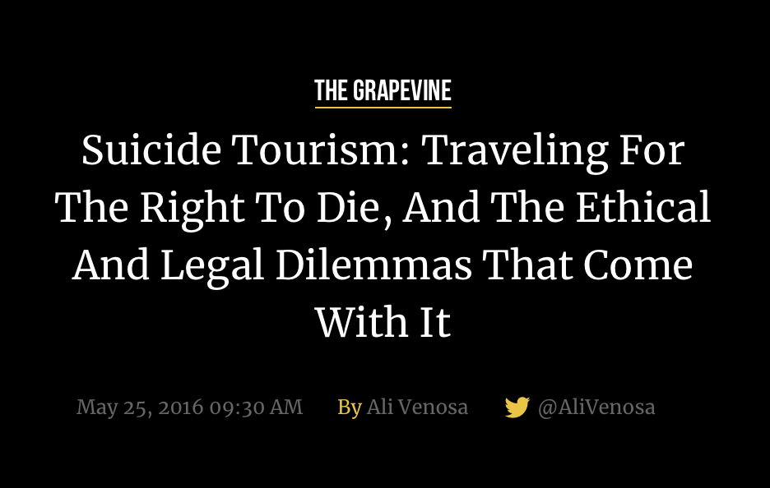
The impact of language on identity
Narrative medicine (handout)
Follow the money: higher wages and more training for dementia caretakers
Assisted suicide
Black Panther
Notes:
Gerda will address this slide

Slide 22
Planning and talking about the diagnosis to a broader community brings peace to the patient
SECTION OUTLINE
My biggest fear
Averting my biggest fear: The Saunders Family Dementia Project
Our village
Recruiting professionals to our village
Advance Health Care Directives
Notes:
Gerda will address this slide

Slide 23
Extrapolate This patient and her family are living joyously after her diagnosis
SECTION OUTLINE
“Let go, let god”
Caesar’s Last Breath
My village, my universe
Notes:
Gerda will address this slide

Slide 24
Extrapolate This patient and her family are living joyously after her diagnosis
“LET GO, LET GOD”
CAESAR’S LAST BREATH
"When you take a single breath, how many molecules of gas
you intake would have come from the dying breath of
Caesar?”
MY VILLAGE, MY UNIVERSE
Notes:
Gerda will address this slide

