Slide 1
Public Health
Presented by Brian Bennion
Executive Director/Health Officer
Weber-Morgan Health Department

Slide 2
OVERVIEW
FEDERAL AGENCIES
EPA
CDC
STATE AGENCIES
STATE HEALTH DEPARTMENT (DOH)
DEPARTMENT OF ENVIROMENTAL QUALITY (DEQ)
DEPARTMENT OF AGRICULTURE
LOCAL HEALTH DEPARTMENTS
13 LOCAL HEALTH DEPARTMENTS

Slide 3
OUR MISSION
To assess, promote, and protect the public health needs of our community, enhance the quality of our environment, and assure access to appropriate services delivered by professional staff dedicated to excellence and innovation.

Slide 4
Our Values
Accountability
Communication
Customer Service
Dedication
Empowerment
Proactivity
Professionalism
Respect
Sound Practice
Teamwork

Slide 5
Our Vision
Healthy individuals and families thriving in a clean and safe community.

Slide 6
Local Public Health System
Police
Community Centers
Home Health
MCOs
Faith Organizations
Health Department
EMS
Corrections
Hospitals
Parks
Schools
Elected Officials
Doctors
Mass Transit
Nursing Homes
Philanthropist
Environmental Health
Civic Groups
CHCs
Fire
Tribal Health
Laboratories
Drug Treatment
Economic Development
Mental Health
Employers
Notes:
State: A Public Health System is complex. Here is a depiction of the complexity of a public health system and examples of organizations and groups that comprise the network.
You can see many of the system partners represented who contribute to health and delivery of the Essential Public Health Services.

Slide 7
“Health care matters to all of us some of the time, public health matters to all of us all of the time”
-- C. Everett Koop

Slide 9
Perspective
There were about 8,000 cars in the U.S., only 10 miles of concrete pavement, few spray cans to destroy the ozone layer. Everyone ate natural foods. The air was relatively unpolluted, and the ground was free of aluminum cans. There were no sugar substitutes and no artificial coloring. We had no atomic waste or PCBs, and our average life expectancy was 47.
The year was 1900.

Slide 10
Perspective
Today we are doing everything wrong, and the life expectancy is up to 79 years, and if we are not careful, it could hit 90.
--William J. McIlrath

Slide 11
Public Health Achievements
Since 1900, the average lifespan of persons in the US has lengthened by greater than 30 years; 25 years of this gain are attributable to advances in public health.
Vaccinations:
Eradication of smallpox and polio
Control of measles, rubella, tetanus, diphtheria, pertussis, and other infectious diseases

Slide 12
Public Health Achievements
Motor-Vehicle Safety:
Safer vehicles and highways
Increase use of seat-belts and car seats
Motorcycle helmets
Decreased the occurrence of drinking and driving
No texting and driving
Safer Workplaces:
40% reduction in the rate of fatal occupational injuries since 1980
Black Lung, Silicosis, Injuries (OSHA)

Slide 13
Public Health Achievements
Control of Infectious Diseases:
Clean Water and Improved Sanitation
John Snow – cholera outbreak in London in 1848
TB and STDs – antimicrobial therapy has been critical in controlling these diseases
Decline Deaths from Coronary Heart Disease and Stroke:
Risk Factors – smoking and high blood pressure control coupled with improved access to early detection and better treatment
Since 1972, death rates for coronary heart disease have decreased 51%

Slide 14
Public Health Achievements
Safer and Healthier Foods:
Decreases in microbial contamination and increases in nutritional content
Almost eliminated major nutritional deficiency diseases such as rickets, goiter and pellagra
Healthier Mothers and Babies:
WIC
Better hygiene and nutrition, availability of antibiotics, greater access to health care, etc.
Since 1900, infant mortality has decreased by 90%, and maternal mortality has decreased by 99%

Slide 15
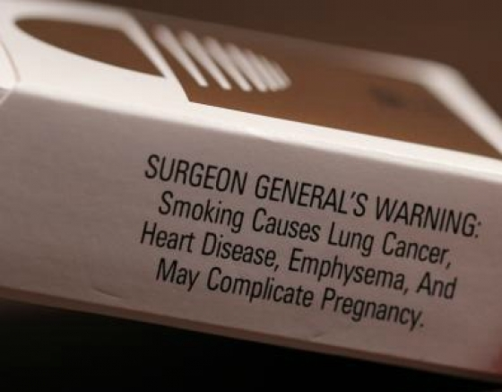
Public Health Achievements
Recognition of Tobacco use as a Health Hazard:
Since the 1964 Surgeon General’s report on the health risks of smoking the prevalence of smoking among adults has decreased, and millions of smoking-related deaths have been prevented.
1995 Utah Indoor Clean Air Act : second-hand smoke.
Preventing youth access to tobacco and E-Cigarettes.

Slide 16
Ten Essential Services of Public Health

Slide 17
Weber-Morgan Health Department
Community Health Assessment (CHA)
Community Health Improvement Plan (CHIP)

Slide 18
CHIP HEALTH PRIORITIES:
Suicide/Mental Health
Obesity
Adolescent Substance Abuse
Suicide/Mental Health
Obesity
Adolescent Substance Abuse

Slide 19
Utah Campus Compact Action Agreement
9 universities across Utah pledge to work to advance the role of the university in improving community life and educating students for civic and social responsibility.

Slide 20
Coalition of Community Stakeholders
Anchor Institutions
Ogden City
Ogden Regional Medical Center
Ogden School District
Ogden-Weber Tech College
McKay-Dee Hospital
Weber-Morgan Health
Weber State University
Allies
Diversity Commission
Ogden Unified Promise Neighborhood
Non-profits
Businesses
Religious Organizations
Residents
Ogden East Central Neighbors
Anchors
Residents
Allies
Education
Housing
Health

Slide 21
Ogden’s East Central Neighborhood
Health
Housing
Education

Slide 22
Organizational Structure
WSU Research Foundation
Housing Implementation Team
Education Implementation Team
Health Implementation Team
Ogden Civic Action Network Advisory Board

Slide 23
Health Subcommittee

Slide 24
Ogden CAN Health Subcommittee Partners
Area Residents
Circles Weber County
Get Healthy Utah
Intermountain McKay-Dee Hospital
Midtown Community Health Center
Ogden City
Ogden Regional Medical Center
Ogden-Weber Community Action Partnership (OWCAP)
USU Extention
Weber-Morgan Health Department
Weber Human Services
Weber State University
YMCA of Northern Utah

Slide 25
Aligning Community Health Priorities
Weber-Morgan Health
McKay-Dee Hospital
Utah Health Department
Prediabetes
Prescription Opioid/Drug Abuse
Diabetes
Obesity
Physical Activity
Adolescent Substance Abuse
Suicide/
Mental Health
High Blood Pressure
Depression

Slide 26
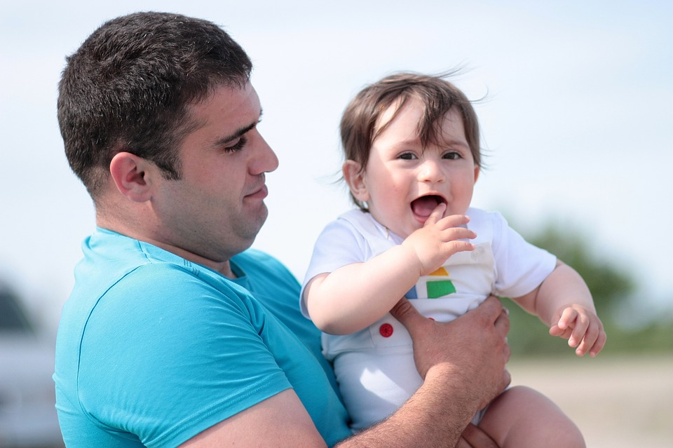
True North Statement
Quality of Life and Health are Accessible to All and Life Expectancy Increases

Slide 27
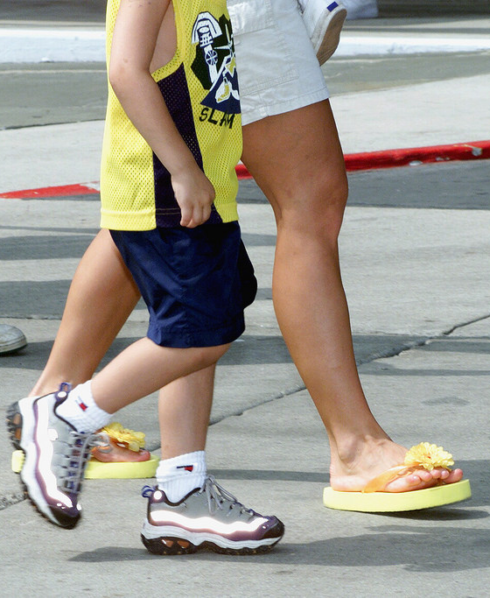
Overall Vision
Healthy Lifestyle
Everyone has access to healthy foods and activities, and everyone maintains a healthy weight
Access to Healthcare
Everyone has access to healthcare (medical home, mental health, suicide prevention, women and children)
Addiction Prevention and Recovery
Zero opioid and substance abuse related deaths
Notes:
May require more than one slide

Slide 28
Healthy Lifestyle – Indicators
Percent of persons with BMI over healthy range
Percent of adults who report consuming at least three daily servings of vegetables (1/3 being dark green or orange)

Slide 29
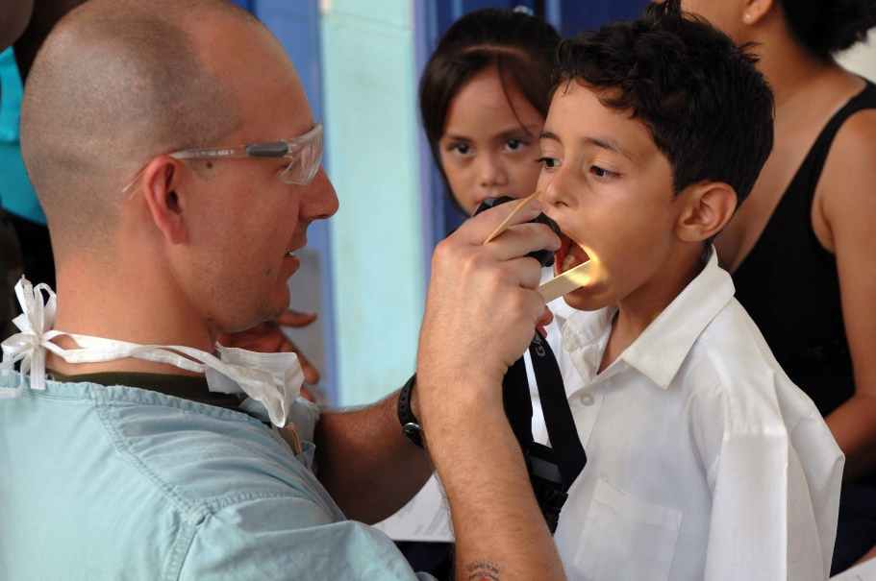
Access to Healthcare – Indicators
Medical home (including mental health) Needs further definition with possible data sources being the State Department of Health and Ogden United Promise Neighborhood
Suicide death rates Youth and adult

Slide 30
Addiction Prevention & Recovery– Indicators
Adolescent substance abuse Needs further definition
Opioid indicator Needs further definition

Slide 31
Outreach
Connect with Neighborhood Groups –
* Desire to get a pulse on the neighborhood and to determine what programs are most effective
* Attend neighborhood group meetings and interact
Present at various conferences:
* Coalition of Urban & Metropolitan Universities
“Utilizing a Civic Action Plan to Improve the Welfare of a Neighborhood”
*Campus Compact National Conference

Slide 32
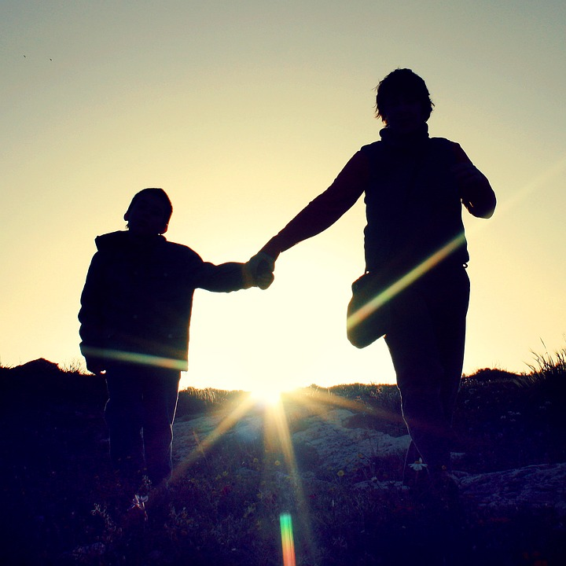
Questions?

