Slide 1
Contrast-Induced Nephropathy
Martin Gregory, MD, PhD
Ogden Medical and Surgical Society
May 17, 2018

Slide 2
Contrast-Induced Nephropathy
Common
Purely iatrogenic
Has well characterized risk factors
Timing of the precipitating event is largely predictable
Carries serious short and long-term consequences

Slide 3
Questions to be addressed
How big is the problem of CI-AKI?
Who is at risk?
What procedures carry most risk?
How to protect patients from CI-AKI?
Is contrast a concern in AKI patients?
Is contrast a concern in end-stage renal disease (ESRD) patients?
Must you dialyze an ESRD patient soon after contrast?
Is MRI with gadolinium safer?

Slide 4
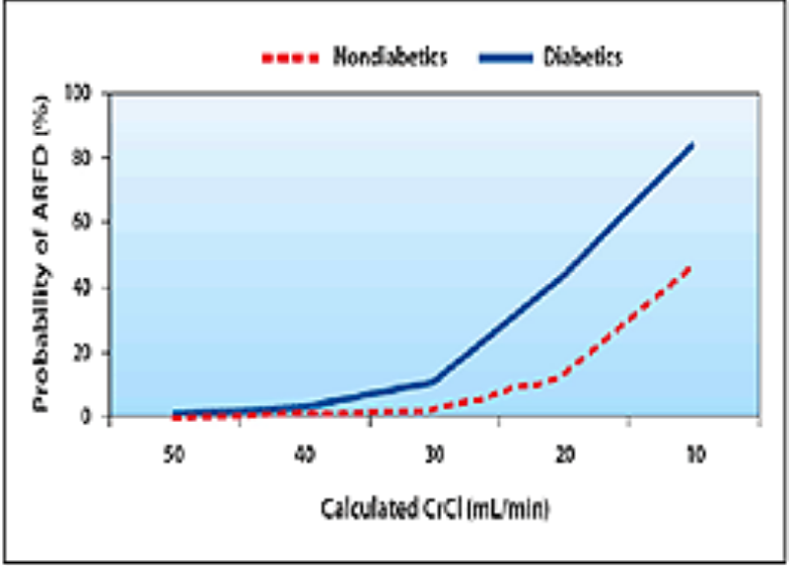
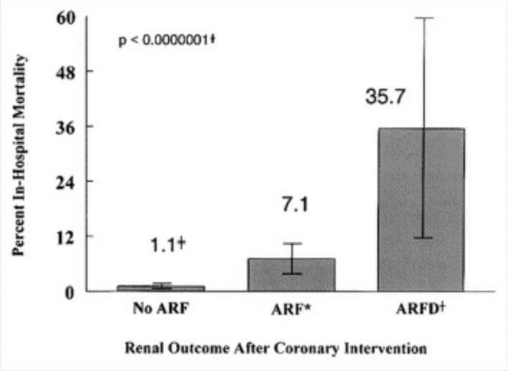
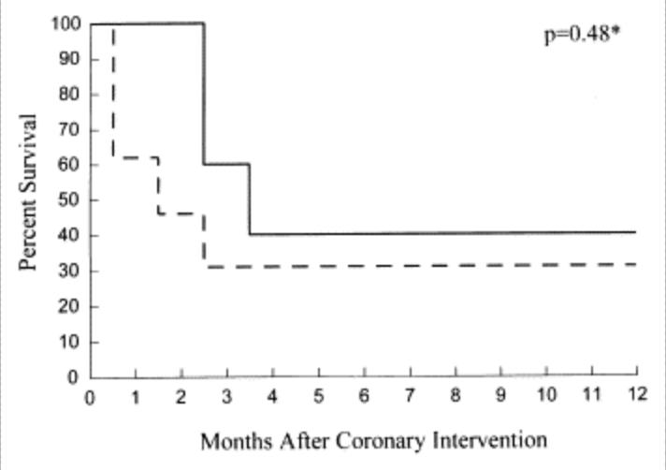
Overall incidence of CIN n is coming down. From 15% to 7% over the period 2105 to 1015
McCullough PA et al. Acute renal failure after coronary intervention: incidence, risk factors, and relationship to mortality. Am J Med 1997; 103 (5): 368-75.

Slide 5
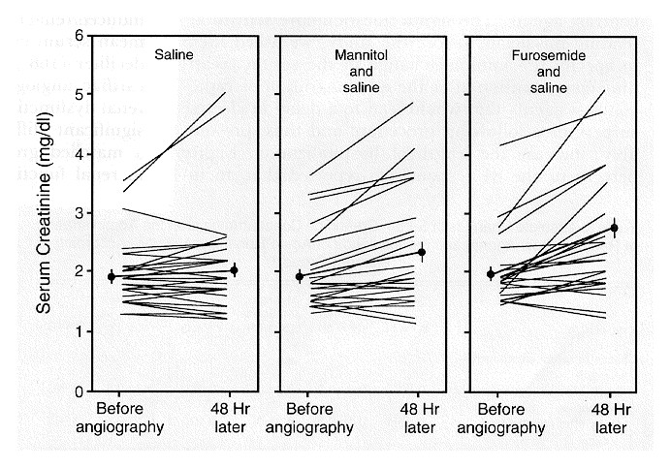
Solomon R et al. N Engl J Med 1994;331:1416-1420.
Serum Creatinine Concentrations Immediately before the Administration of Radiocontrast Agent (after 12 Hours of Hydration) and 48 Hours Later in Patients with Chronic Renal Insufficiency.
Notes:
Figure 1. Serum Creatinine Concentrations Immediately before the Administration of Radiocontrast Agent (after 12 Hours of Hydration) and 48 Hours Later in Patients with Chronic Renal Insufficiency. The mean (±SE) for each treatment group is indicated by the heavy lines and circles. The increase in serum creatinine was significantly greater in the furosemide group than in the saline group (P<0.01 by t-test). To convert values for serum creatinine to micromoles per liter, multiply by 88.4.

Slide 6
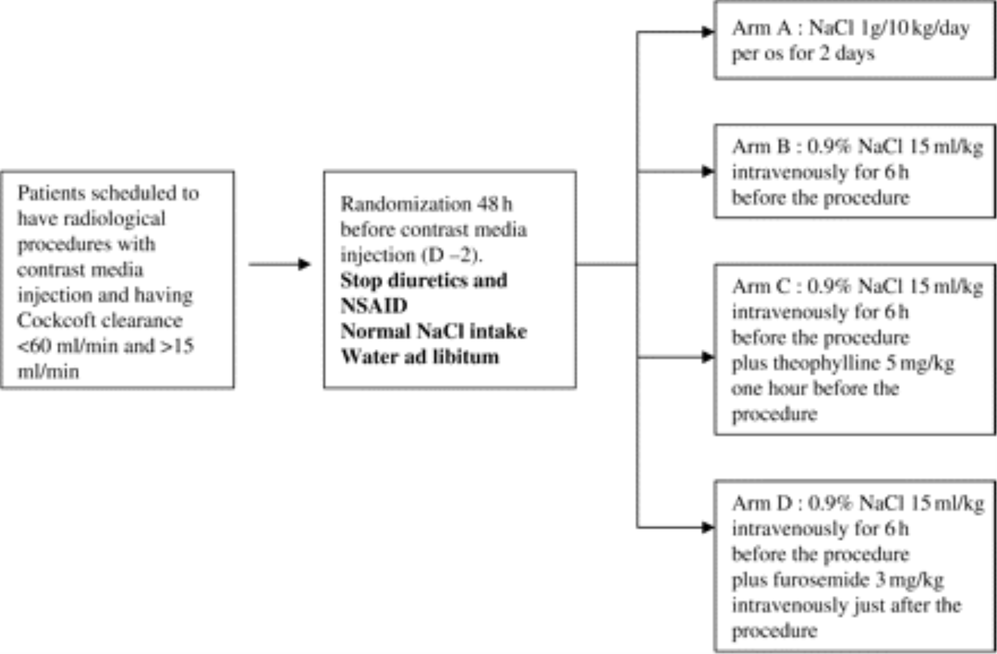
From: A randomized trial of saline hydration to prevent contrast nephropathy in chronic renal failure patients
Nephrol Dial Transplant. 2006;21(8):2120-2126. doi:10.1093/ndt/gfl133
Nephrol Dial Transplant | © The Author [2006]. Published by Oxford University Press on behalf of ERA-EDTA. All rights reserved. For Permissions, please email: journals.permissions@oxfordjournals.org
Notes:
Fig. 1. Study profile.
6

Slide 7
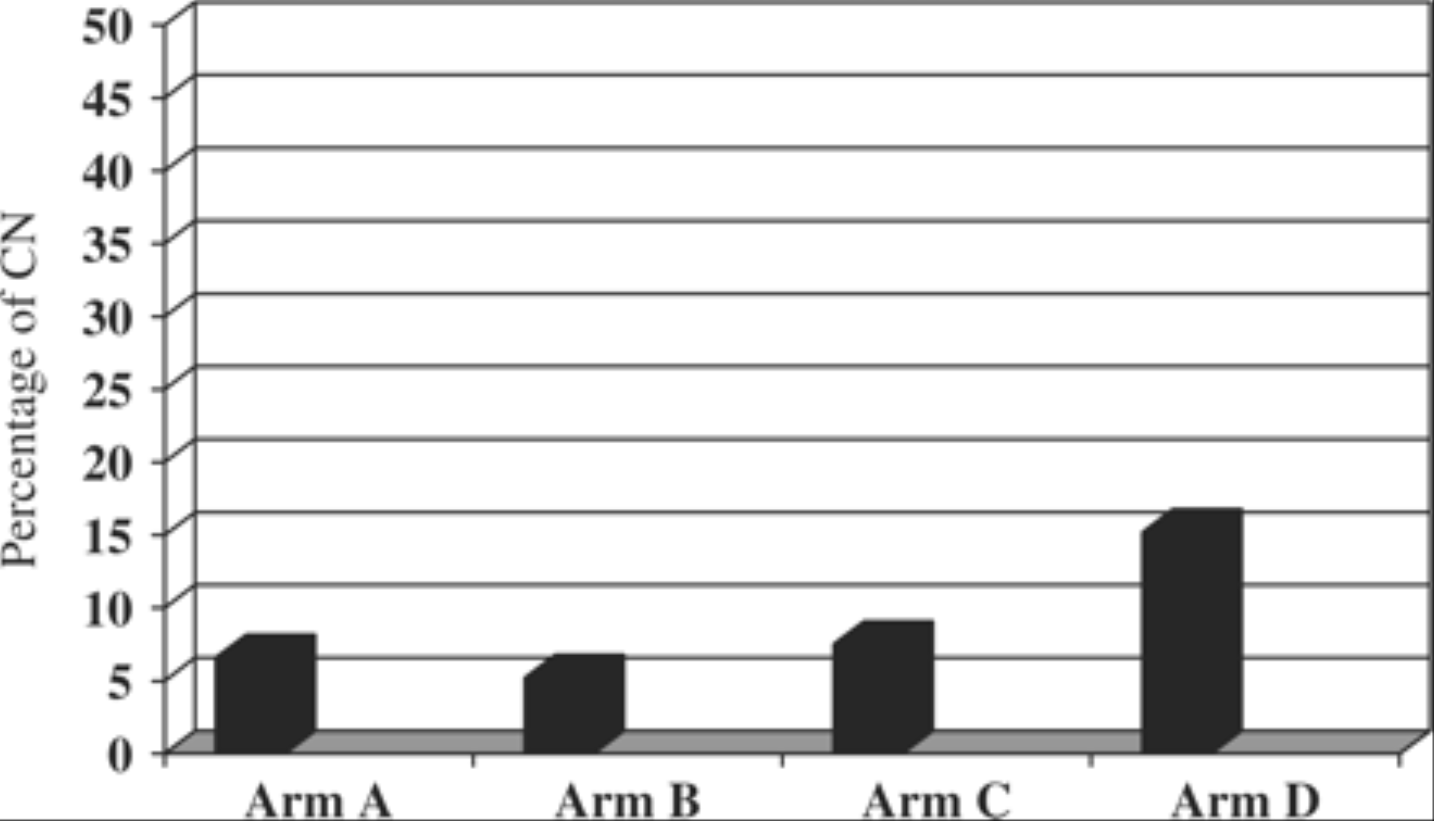
PO NaCl IV NaCl + theophylline + furosemide
76 77 80 79
From: A randomized trial of saline hydration to prevent contrast nephropathy in chronic renal failure patients
Nephrol Dial Transplant. 2006;21(8):2120-2126. doi:10.1093/ndt/gfl133
Nephrol Dial Transplant | © The Author [2006]. Published by Oxford University Press on behalf of ERA-EDTA. All rights reserved. For Permissions, please email: journals.permissions@oxfordjournals.org
Notes:
Fig. 2. Prevalence of CN in the four arms of the study.
7

Slide 8
Figure 4. Forest plot including only trials with a prespecified protocol for oral volume expansion showing resolution of heterogeneity.
Hiremath S, Akbari A, Shabana W, Fergusson DA, Knoll GA (2013) Prevention of Contrast-Induced Acute Kidney Injury: Is Simple Oral Hydration Similar To Intravenous? A Systematic Review of the Evidence. PLOS ONE 8(3): e60009. https://doi.org/10.1371/journal.pone.0060009
http://journals.plos.org/plosone/article?id=10.1371/journal.pone.0060009

Slide 9
Tonicity of Fluid
Mueller et al (2002)
NS n = 809 0.7% CIN
I/2 NS n= 811 2.0% CIN

Slide 10
Duration of volume expansion
Krasuski et al (2003)
12 hours of D5 ½ NS at 1 ml/kg/hr before catheterization 0/26 CIN
20 min of NS (250 ml) 4/37 CIN
Bader et al (2004)
2000 ml NS for 12 hrs before and 12 hours after procedure. GFR fell 18.3 ml/min/1.73m2
300 ml NS at the time of contrast. GFR fell 34.6 ml/min/1.73m2

Slide 13
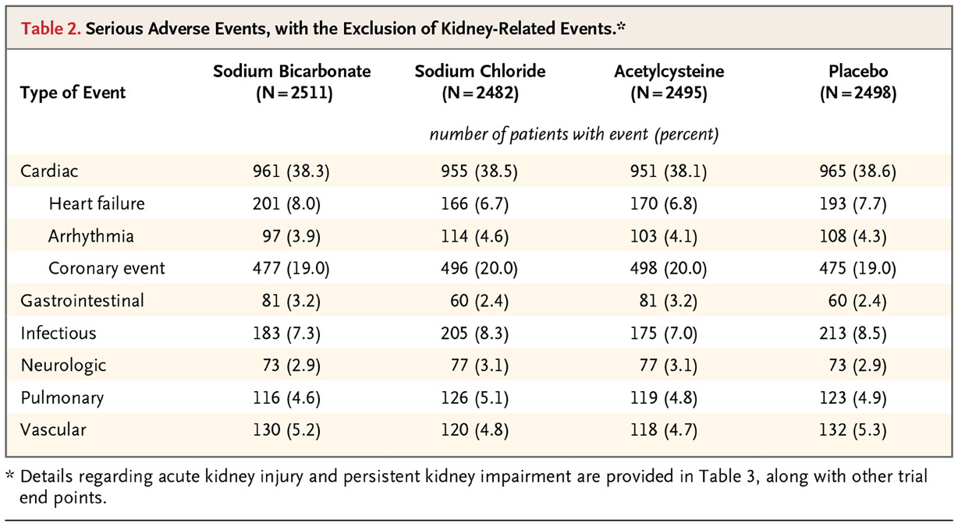
SD Weisbord et al. N Engl J Med 2018;378:603-614.
Serious Adverse Events, with the Exclusion of Kidney-Related Events.*

Slide 14
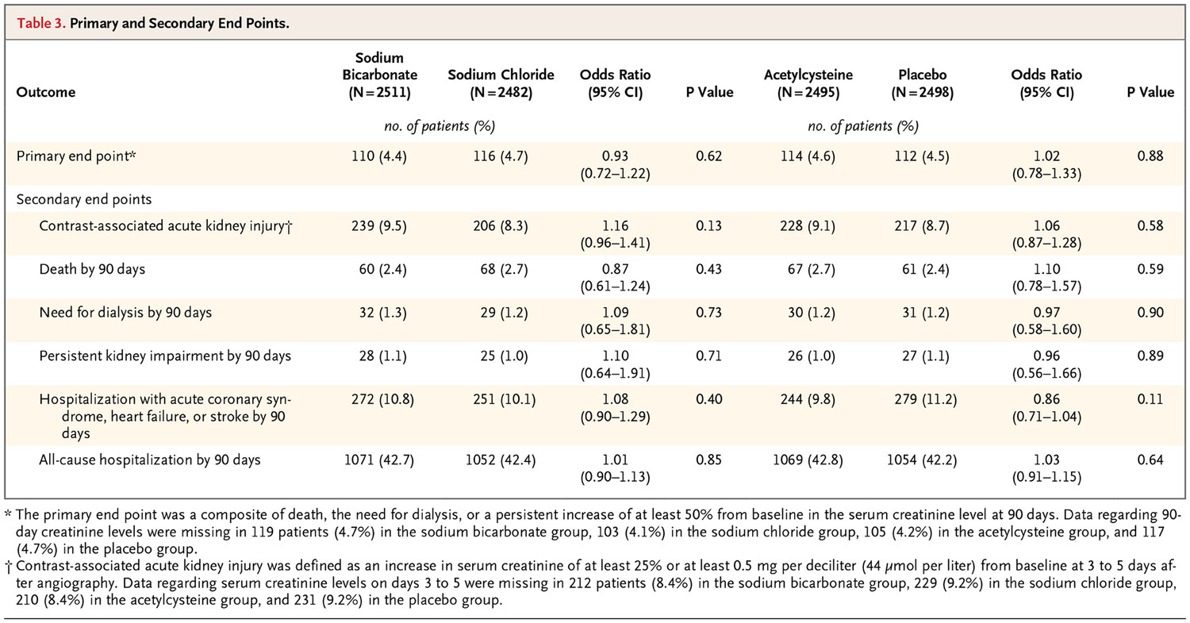
SD Weisbord et al. N Engl J Med 2018;378:603-614.
Primary and Secondary End Points.

Slide 15
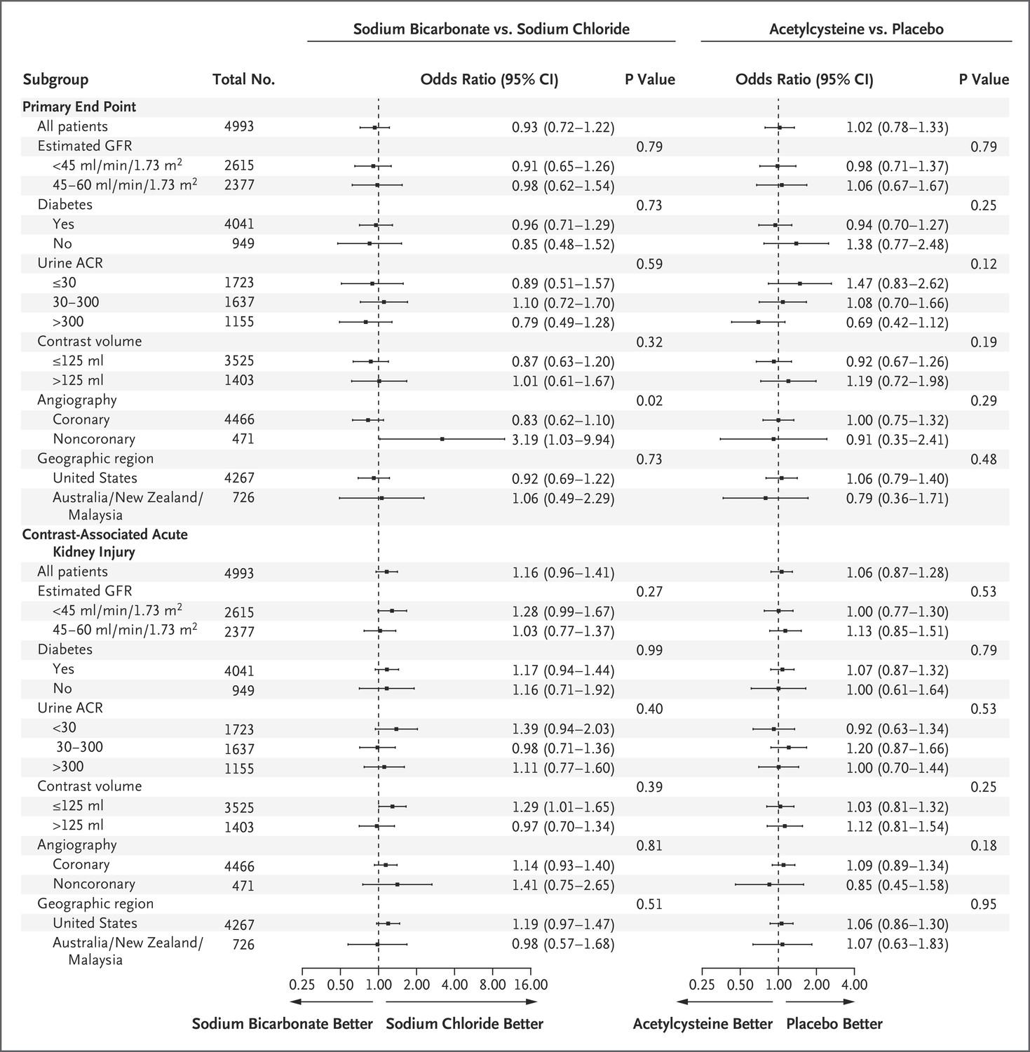
SD Weisbord et al. N Engl J Med 2018;378:603-614.
Forest Plot of Treatment Effects in Prespecified Subgroup Analyses.
Notes:
Figure 2. Forest Plot of Treatment Effects in Prespecified Subgroup Analyses. Shown are odds ratios (squares) with 95% confidence intervals (horizontal lines) and P values for the interactions between each subgroup variable with respect to the primary end point and contrast-associated acute kidney injury for the comparisons between sodium bicarbonate and sodium chloride and between acetylcysteine and placebo. The primary end point was a composite of death, the need for dialysis, or a persistent increase of at least 50% from baseline in the serum creatinine level at 90 days. Contrast-associated acute kidney injury was defined as an increase in serum creatinine of at least 25% or at least 0.5 mg per deciliter (44 μmol per liter) from baseline at 3 to 5 days after angiography. The albumin-to-creatinine ratio (ACR) was calculated with albumin measured in milligrams and creatinine measured in grams. GFR denotes glomerular filtration rate.

Slide 16
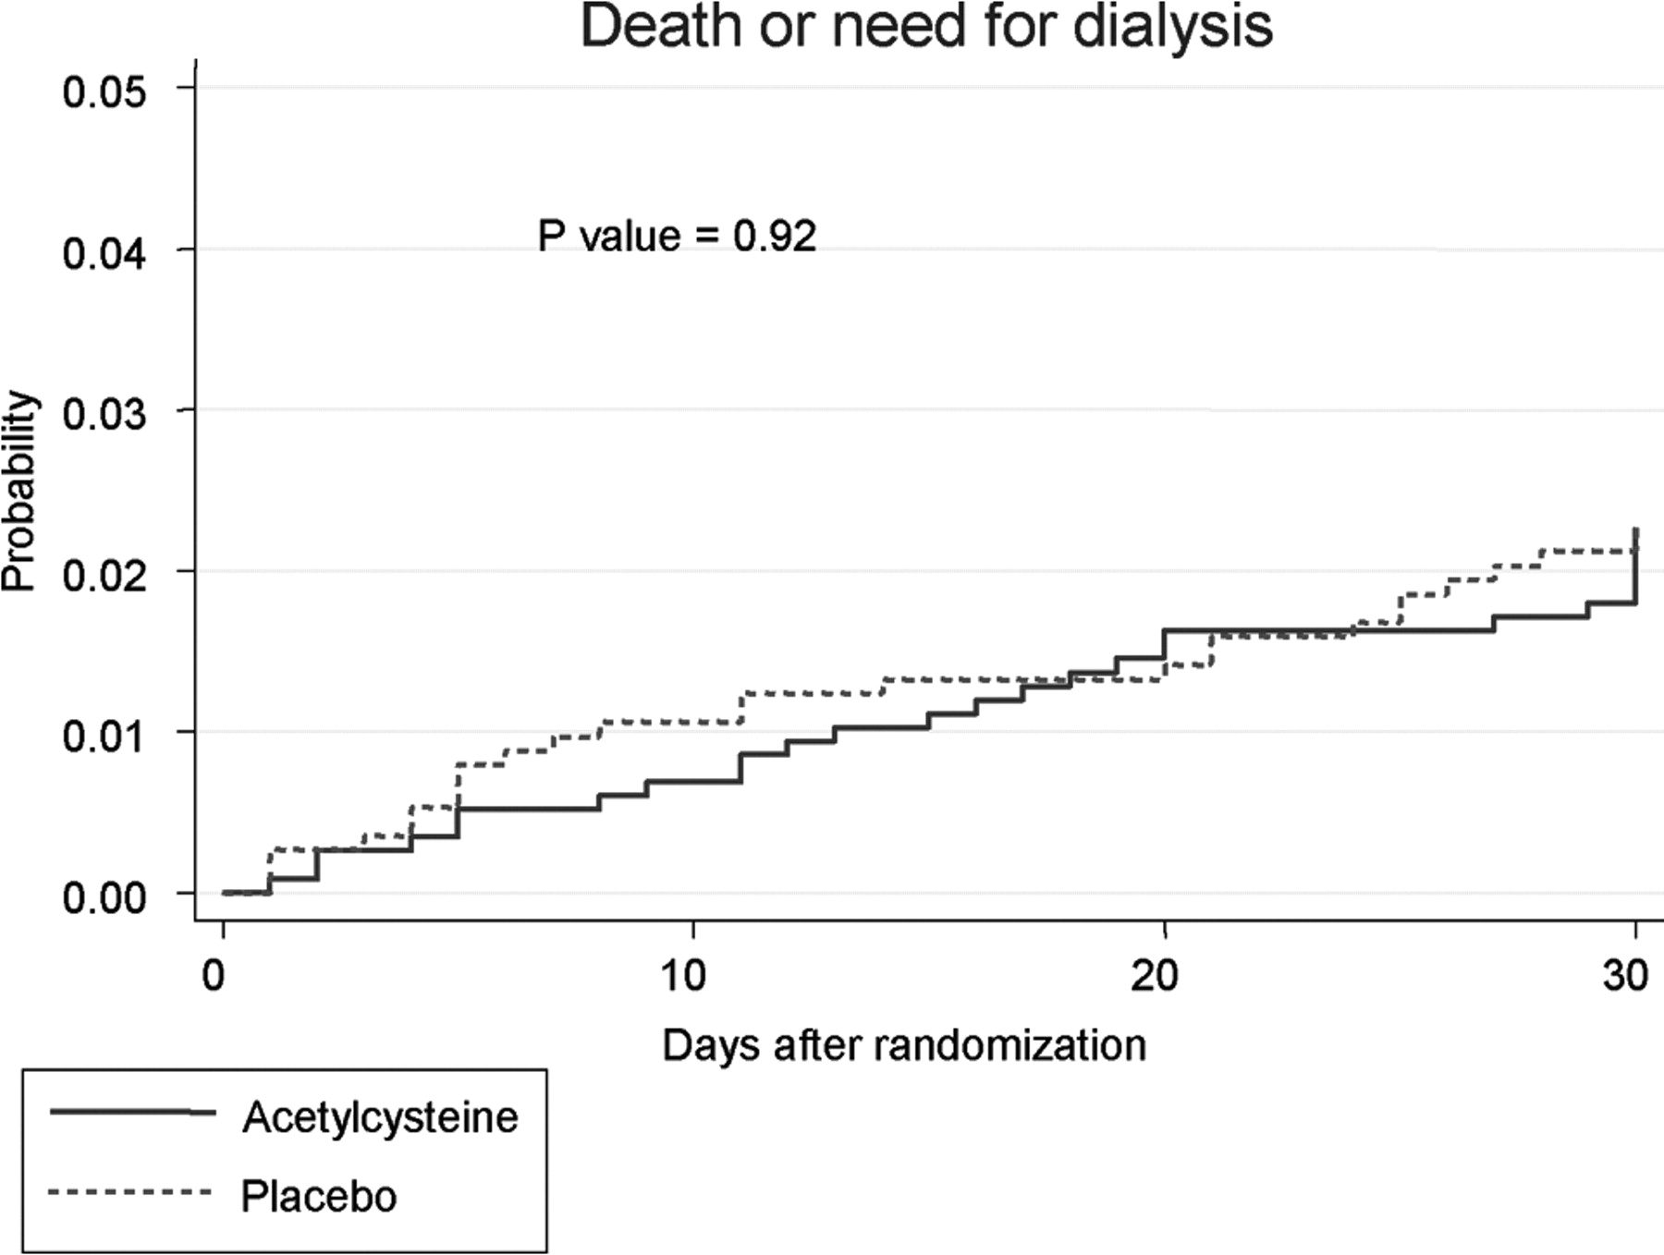
Probability of death or need for dialysis from the day of randomization (day 0) to day 30 among patients in the acetylcysteine and placebo groups.
ACT Investigators Circulation. 2011;124:1250-1259
Copyright © American Heart Association, Inc. All rights reserved.
Notes:
Probability of death or need for dialysis from the day of randomization (day 0) to day 30 among patients in the acetylcysteine and placebo groups.

Slide 17
NAC?

Slide 18
Not NAC, NaCl

Slide 19
Risks of iv contrast for CT scans are low
 | Contrast CT | Non-contrast CT | No CT
Number | 7,201 | 5,499 | 5,234
Risk of AKI* | 10.6% | 10.2% | 10.9%
Secondary outcomes including new chronic kidney disease, dialysis, and renal transplantation at 6 months also did not differ.
Caveats
- Retrospective case-control study
- Colossal patient exclusion (103,770 out of 120,572)
- Contrast tended to be avoided in patients with higher creatinine.
*Absolute increase ≥0.5 mg/dL or ≥25% increase over baseline SCr at 48 to 72 hours.
Hinson JS et al. Risk of Acute Kidney Injury After Intravenous Contrast Media Administration. Annals of Emergency Medicine. 2017; 69:577-586 http://dx.doi.org/10.1016/j.annemergmed.2016.11.021

Slide 21
When to check serum creatinine. UCSF guidelines
ANY of the following risk factors: • Age over 60 • History of “kidney disease” as an adult, including tumor and transplant • Family history of kidney failure • Diabetes treated with insulin or other prescribed medications • Hypertension (high blood pressure) • Paraproteinemia syndromes or diseases (e.g., myeloma) • Collagen vascular disease (e.g., SLE, scleroderma, rheumatoid arthritis) • Solid organ transplant.

Slide 22
Use of contrast in patients with AKI
Dearth of information
“In the setting of acute renal failure, where dialysis is being performed with the expectation of renal recovery, it may be inappropriate to administer a nephrotoxic agent that may jeopardize the reversal of renal impairment.” UCSF guidelines

Slide 23
Use of contrast in ESRD patients

Slide 24
Use of contrast in ESRD patients
If anuric, there is is no contraindication
If still producing urine, there is a risk of permanent reduction in urine volume, which is a substantial detriment to the patient.

Slide 25
Do you need to dialyze soon after contrast in renal failure patients?

Slide 26
Do you need to dialyze soon after contrast in renal failure patients?
No
Prophylactic hemodialysis after radiocontrast media in patients with renal insufficiency is potentially harmful. Vogt et al. American Journal of Medicine 2001; 111:692-8
“It should also be noted that the common belief that dialysis patients require early post-procedural dialysis is unsupported by clinical studies and expert guidelines ^{[1, 2]}. Dialysis pre-procedure may be desirable, particularly if a large dose of contrast is anticipated or in patients with heart failure.” UCSF Guidelines

Slide 27
Statins to prevent contrast nephrotoxicity
Acute administration reduced CIN by about 40% in statin naïve patients
Trend to reducing mortality, dialysis need, MACE, CKD
Simvastatin, atorvastatin, rosuvastatin all similar
High dose is more effective than low dose
Particularly useful in diabetes, CHF, and CKD with GFR 60-90

Slide 28
How to make contrast safe
Avoid contrast if you can get the information another way
Identify patients at high risk
Discontinue diuretics 48 hours ahead
Load patient with saline iv or po
Use iso-osmolar, nonionic contrast in minimum volume possible
Don’t use furosemide, theophylline, or N-acetyl cysteine
80 mg statin before procedure

Slide 29
MRI and gadolinium
Concern is for nephrogenic systemic fibrosis (NSF), not nephrotoxicity

Slide 30
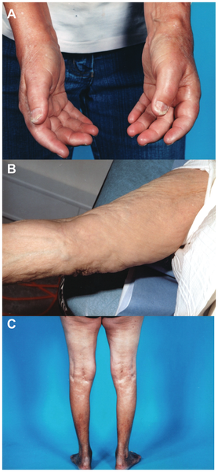
Figure 1. Clinical photos from nephrogenic systemic fibrosis patients.
Elmholdt TR, Olesen ABB, Jørgensen B, Kvist S, Skov L, et al. (2013) Nephrogenic Systemic Fibrosis in Denmark– A Nationwide Investigation. PLOS ONE 8(12): e82037. https://doi.org/10.1371/journal.pone.0082037
http://journals.plos.org/plosone/article?id=10.1371/journal.pone.0082037

Slide 31
MRI and gadolinium. UCSF guidelines
Concern is for nephrogenic systemic fibrosis (NSF), not nephrotoxicity
Risk is very low if GFR > 30. Liver transplant, hepatorenal syndrome also risk factors. Overall risk is about 0.1-10 cases per million doses in the general population. The reported incidence of NSF in patients with impaired renal function is estimated between 0.1 and 1 % for Magnevist.
Risk very low with Group II agents but avoid if GFR <30 if another means could obtain the information. If the information is needed for clinical management, proceed. If a Group III agent is used with GFR < 30, obtain informed consent. One possible case reported with gadoterate meglumine.
Patients already on hemodialysis should be dialyzed within 24 hours.
Group I agents (linear): No longer used. Gadodiamide [Omniscan], gadopentetate dimeglumine [Magnevist], gadoversetamide [OptiMARK]
Group II agents (macrocyclic): Gadoterate acid (Dotarem®), gadobutrol (Gadavist®), gadoteridol (ProHance)
Group III agents (linear): gadexotate disodium (Eovist®)

Slide 32
Questions to be addressed
How big is the problem of CIN? Still big, but less than it was. 7% of all studies
Who is at risk? CKD, diabetics, elderly, heart failure, hypovolemia
What procedures carry most risk? Angiography, high dye load
How to protect patients? Volume repletion: NS or po, Low dose isosmolar Statin.
Is contrast a concern in AKI patients? Unknown. Prudence says yes.
Is contrast a concern in end-stage renal disease (ESRD) patients? ±
Must you dialyze an ESRD patient soon after contrast? No
Is MRI with gadolinium safer? Probably.

Slide 33
Contrast NephroPathy - Useful references
Weisbord PRESERVE study. https://www.nejm.org/doi/full/10.1056/NEJMoa1710933
Feldman DN et al. Statins in the prevention of contrast-induced nephropathy. Curr Treat Options Cardio Med 2015; 17:15-26
UCSF guidelines https://radiology.ucsf.edu/patient-care/patient-safety/contrast/iodinated
Budjan et al. MR Contrast Agent Safety in the Age of Nephrogenic Systemic Fibrosis: Update 2014. Current Radiology Reports. https://link.springer.com/article/10.1007/s40134-014-0064-x

