Slide 1
The Hippocratic Oath in 2018 Medicine
Gretchen A. Case, Phd, MA
Associate Professor
Chief of Program in Medical Ethics and Humanities
“Joy of Medicine”
Ogden Surgical-Medical Society
May 18, 2018

Slide 2
Objectives
After this session, attendees will be able to:
Describe a brief history of the origins of the Hippocratic Oath and the major revisions made to the Oath.
Identify key words or passages in the Oath that most often inspire discussion or revision.
Relate aspects of the Oath, in one or more of its forms, to current practical and ethical concerns in medicine.

Slide 3
Where we will go today
What it means to take or swear an oath
A few comparisons between ancient and modern versions of the Oath
Newest revisions of the Oath
What’s left out?
What is your oath?
Questions

Slide 4
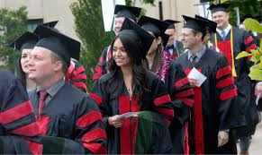
What does it mean to take or swear an oath?
Photos: Laura Seitz/Deseret News, Al Hartmann/Salt Lake Tribune

Slide 5
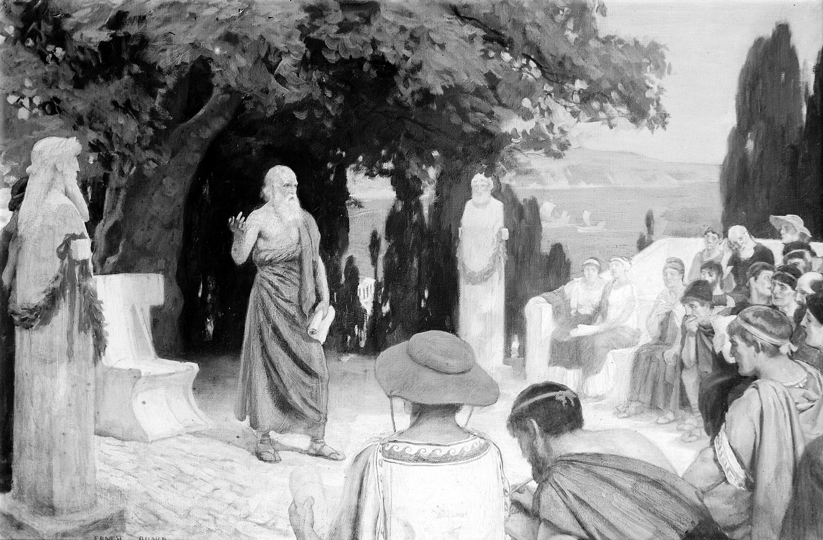
An Historic oath…
Wellcome Collection.
Notes:
Hippocrates lecturing to his students under the plane tree on the island of Cos. By http://wellcomeimages.org/indexplus/obf_images/57/6b/ae68a03a9f8829b8d5005687d09f.jpgGallery: http://wellcomeimages.org/indexplus/image/M0000138.htmlWellcome Collection gallery (2018-03-30): https://wellcomecollection.org/works/pycxphcs CC-BY-4.0, CC BY 4.0, https://commons.wikimedia.org/w/index.php?curid=36307707

Slide 6
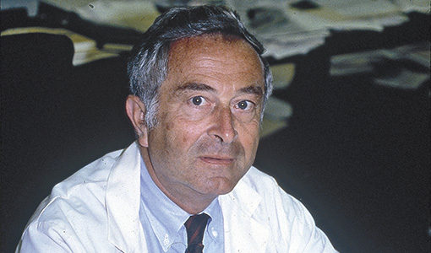
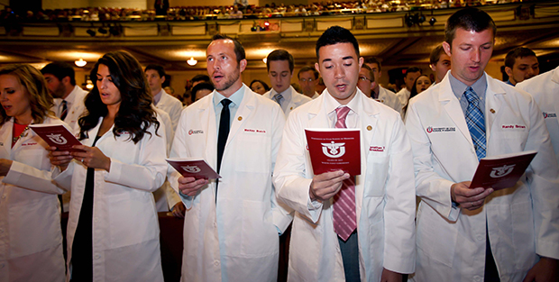
…revised: “the Lasagna Oath” (1964)
The Hippocratic Oath as adapted by physician and Tufts medical school dean Louis Lasagna; this may be the oath many of you took.
Photos: Tufts Digital Collections and Archives, Laura Seitz/Deseret News

Slide 7
Comparison: teacher and student
Ancient
revised
To hold him who taught me this art equally dear to me as my parents, to be a partner in life with him, and to fulfill his needs when required; to look upon his offspring as equals to my own siblings, and to teach them this art, if they shall wish to learn it, without fee or contract;
I will respect the hard-won scientific gains of those physicians in whose steps I walk, and gladly share such knowledge as is mine with those who are to follow.

Slide 8
Comparison: professional limits
ancient
REvised
I will not use the knife, even upon those suffering from stones, but I will leave this to those who are trained in this craft.
I will not be ashamed to say "I know not," nor will I fail to call in my colleagues when the skills of another are needed for a patient's recovery.

Slide 9
Comparison: Privacy and confidentiality
ancient
REvised
Whatever I see or hear in the lives of my patients, whether in connection with my professional practice or not, which ought not to be spoken of outside, I will keep secret, as considering all such things to be private.
I will respect the privacy of my patients, for their problems are not disclosed to me that the world may know.

Slide 10
COMPARISON: swearing an oath
ancient
REvised
So long as I maintain this Oath faithfully and without corruption, may it be granted to me to partake of life fully and the practice of my art, gaining the respect of all men for all time. However, should I transgress this Oath and violate it, may the opposite be my fate.
If I do not violate this oath, may I enjoy life and art, respected while I live and remembered with affection thereafter. May I always act so as to preserve the finest traditions of my calling and may I long experience the joy of healing those who seek my help.

Slide 11
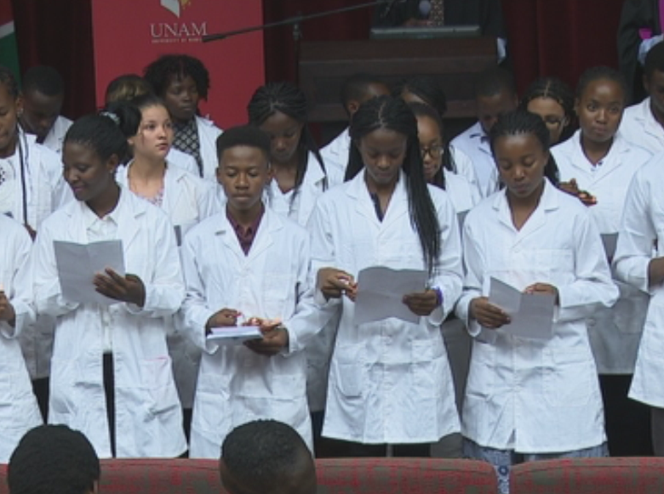
…and revised: University of Namibia School of Medicine Oath
Faculty: We, your faculty, promise to serve as worthy role models, as our own teachers have before us.
Students: We, your students, recognize the excellence and commitment of those from whom we learn.
Namibian Broadcasting Company, University of Namibia School of Medicine Prospectus
Notes:
Faculty: We promise to support your personal and professional growth, in health care settings, in the laboratory, in the community, and through your own teaching.
Students: We promise to pursue responsibly our calling to patient care, to service, and to research.
Faculty: We promise to maintain an environment where scientific integrity and ethical standards sustain your trust in us.
Students: We commit ourselves to the highest standards of academic honesty, scientific integrity and ethical practice as students and in our professional lives.
All (students and faculty members): We honor The University of Namibia, the Medical Board and our Government’s history of service to the people of this nation. We accept the challenges and opportunities of those alumni whom we follow. We vow to be professional, punctual and courteous. We vow to honor and respect life on earth, in all forms, crawling and reasoning, with intellect or with handicap, to be ambassadors of healthy living and a prosperous future. We vow to take to heart and mind that all men are created equal. We vow to uphold this pledge and our assistance to others who do the same.

Slide 12
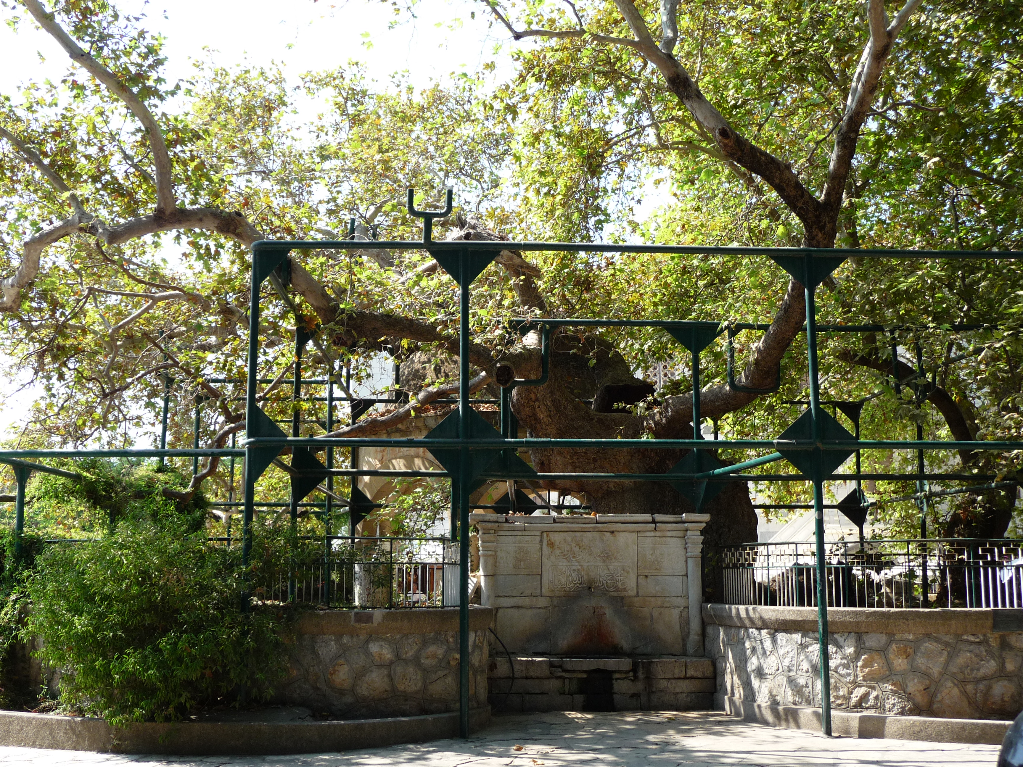
…and revised: The Physician’s Oath (2017)
AS A MEMBER OF THE MEDICAL PROFESSION:
I SOLEMNLY PLEDGE to dedicate my life to the service of humanity;
THE HEALTH AND WELL-BEING OF MY PATIENT will be my first consideration;
©2017 World Medical Association Inc.,Photo: Wikimedia Commons
Notes:
I WILL RESPECT the autonomy and dignity of my patient;
I WILL MAINTAIN the utmost respect for human life;
I WILL NOT PERMIT considerations of age, disease or disability, creed, ethnic origin, gender, nationality, political affiliation, race, sexual orientation, social standing, or any other factor to intervene between my duty and my patient;
I WILL RESPECT the secrets that are confided in me, even after the patient has died;
I WILL PRACTISE my profession with conscience and dignity and in accordance with good medical practice;
I WILL FOSTER the honour and noble traditions of the medical profession;
I WILL GIVE to my teachers, colleagues, and students the respect and gratitude that is their due;
I WILL SHARE my medical knowledge for the benefit of the patient and the advancement of healthcare;
I WILL ATTEND TO my own health, well-being, and abilities in order to provide care of the highest standard;
I WILL NOT USE my medical knowledge to violate human rights and civil liberties, even under threat;
I MAKE THESE PROMISES solemnly, freely, and upon my honour.
Photo: By JD554 - Own work, CC BY-SA 3.0, https://commons.wikimedia.org/w/index.php?curid=18948440

Slide 13
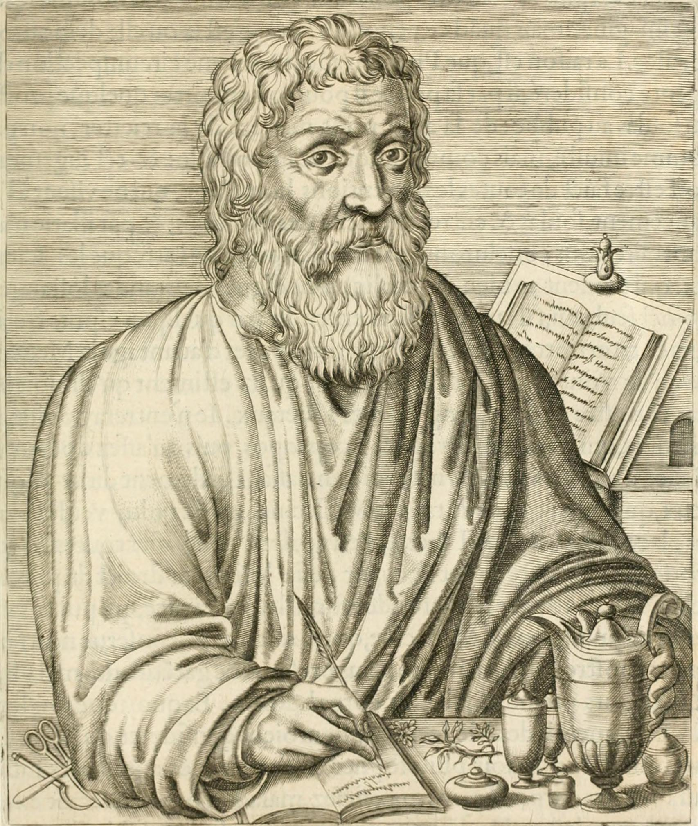
What’s left out? What must be said anew?
What we mean by
life and death
“First, Do No Harm” (Primum Non Nocere)
Spiritual or natural guides for the physician
The Internet Archive Book Images.
Notes:
By Internet Archive Book Images - https://www.flickr.com/photos/internetarchivebookimages/14781428931/Source book page: https://archive.org/stream/generalbiographyv5pt1aiki/generalbiographyv 5pt1aiki#page/n321/mode/1up , No restrictions, https://commons.wikimedia.org/w/index.php?curid=43946752

Slide 14
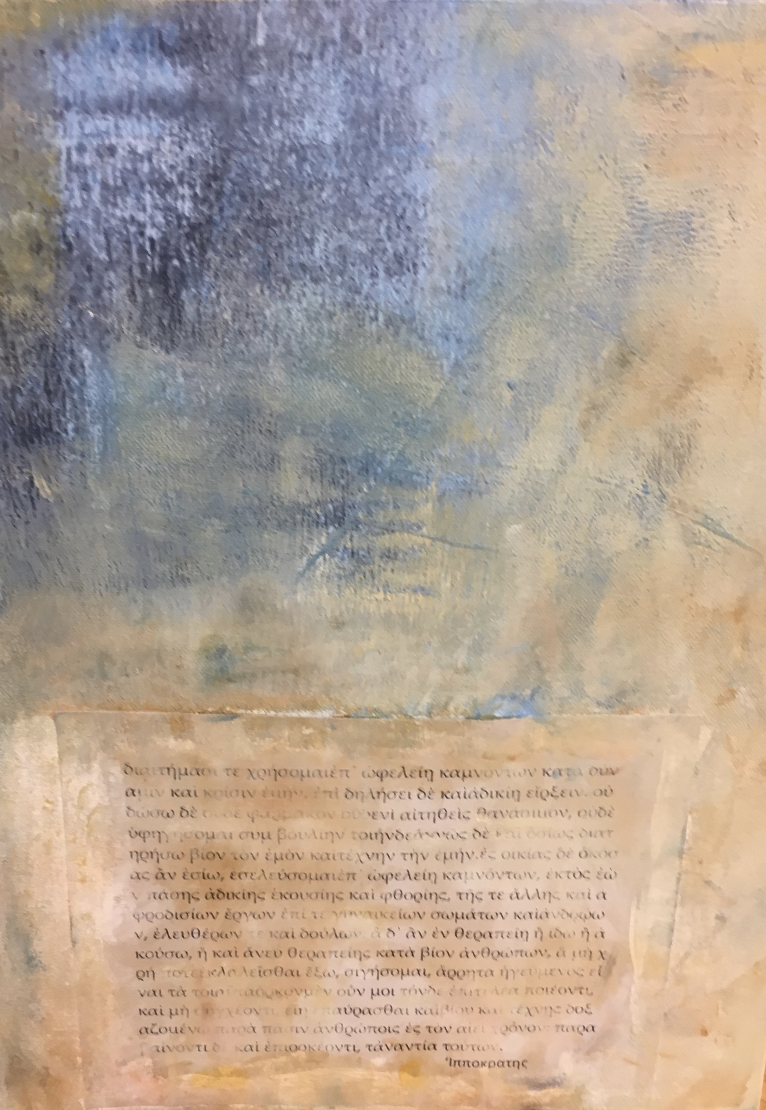
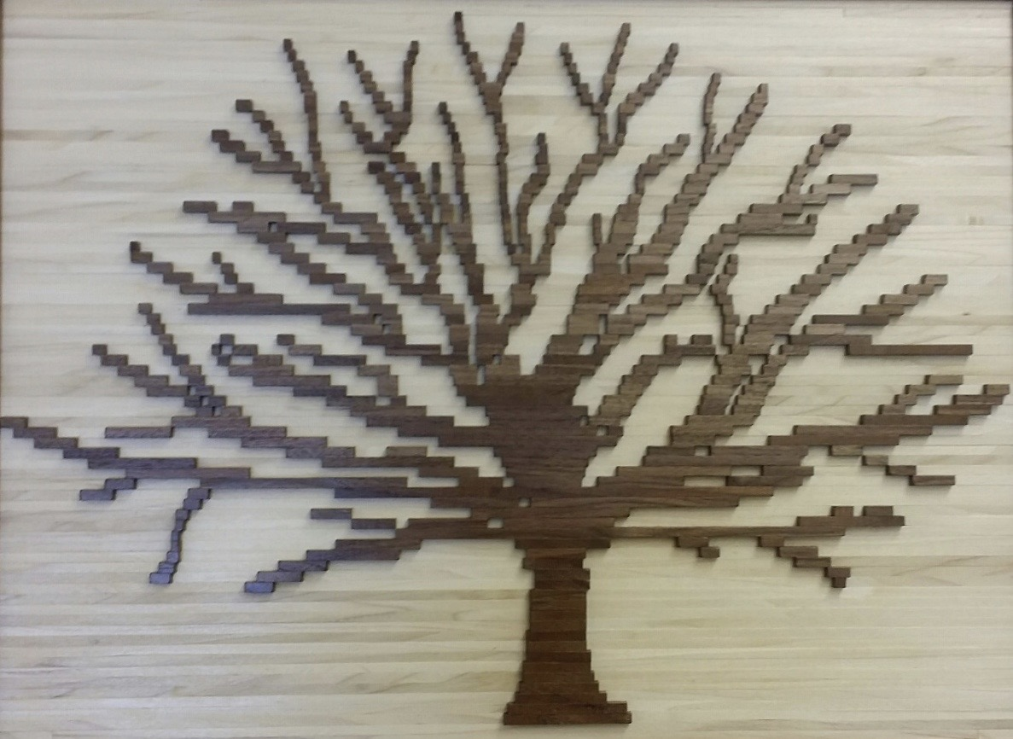
What is your oath?
Michael Bishop,Spencer Lindsay, Rachelle Perkins

