Slide 1
The 73rd Annual Conference/Meeting of the Ogden Surgical-Medical Society
May 15-18, 2018
Abdul Nasser Kaadan, MD, PhD
Visiting International Professor
Weber State University
Some of Muslim Physicians’ Achievements
during the Medieval Ages

Slide 2
Islamic Medicine
Also known as Arabic medicine, refers to the science of medicine developed in the Islamic Golden Age, and written in Arabic, the lingua franca of Islamic civilization.
Medieval Islamic physicians largely retained their authority until the rise of medicine as a part of the natural sciences, beginning with the Age of Enlightenment, nearly six hundred years after their textbooks were written. Aspects of their writings remain of interest to physicians even today.

Slide 3
The Islamic Golden Age
Is the era in the history of Islam, traditionally dated from the 8th century to the end of 16th centuries, during which much of the historically Islamic world was science, economic development, and cultural works flourished. This period is traditionally understood to have begun during the reign of the caliph Harun al-Rashid (786 to 809) with the inauguration of the House of Wisdom in Baghdad, where scholars from various parts of the world, with different cultural backgrounds were mandated to gather and translate all of the world's classical knowledge into the Arabic language.

Slide 7
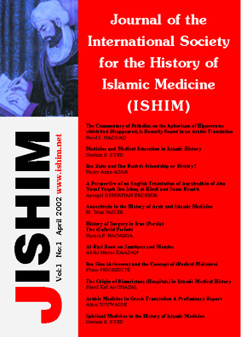

Slide 8
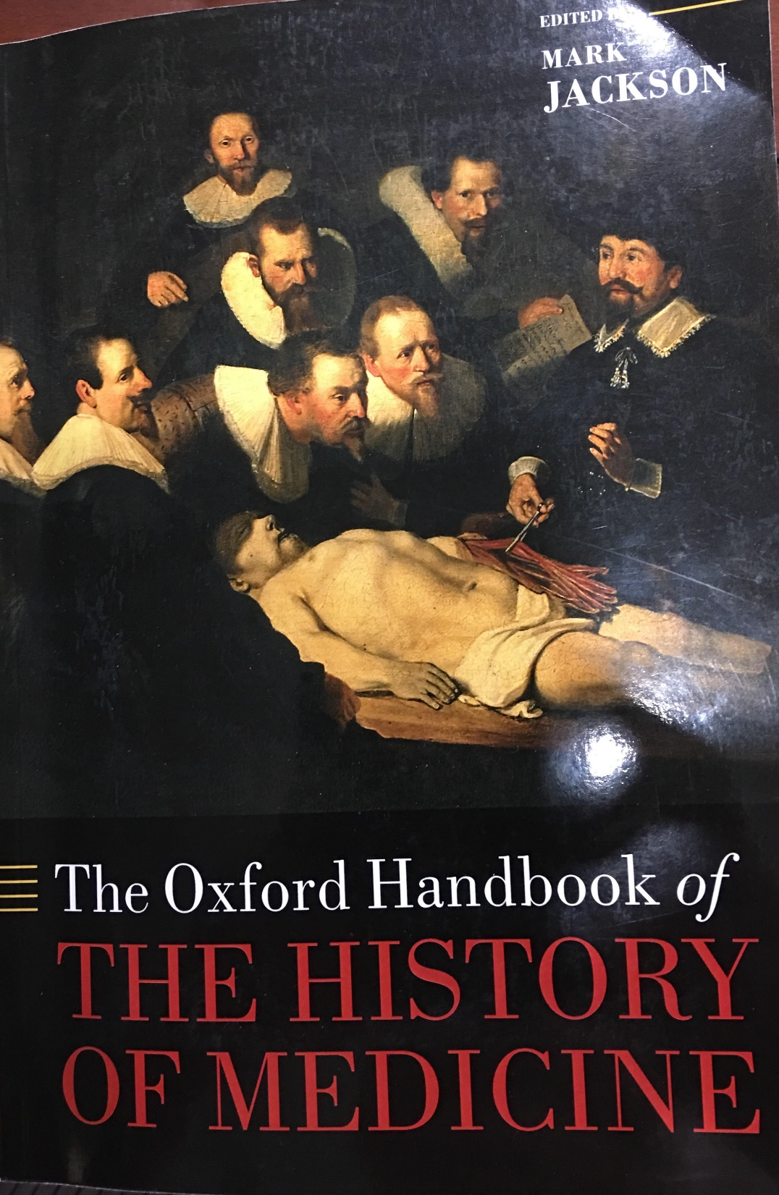

Slide 9
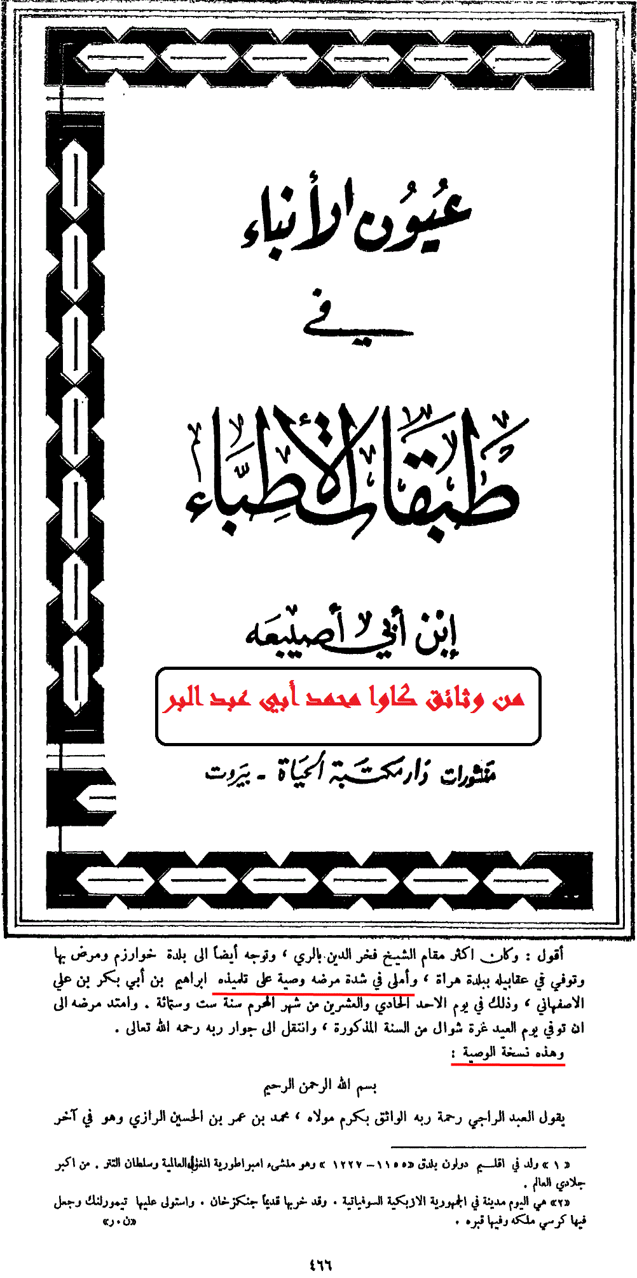

Slide 11
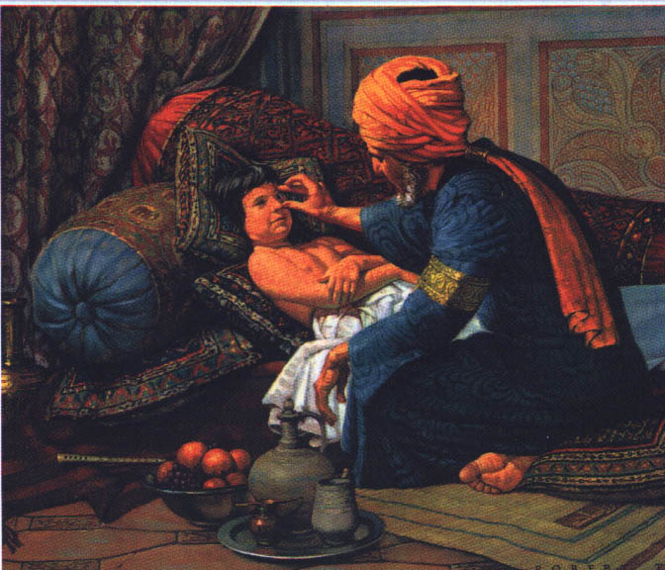

Slide 12
* Al-Razi composed more than two hundred books related to medicine, pharmacy, philosophy, music and many other sciences.
* He wrote on almost every aspect of medicine.

Slide 13
* He is considered the first who founded the experimental science especially in the field of medicine and chemistry.
* No one before and during al-Razi time was interested in the experimental science in its methodical form

Slide 14
الحاوي في الطب
Al-Hawi fil-Tibb
* This book is extremely important source for our knowledge of Greek, Indian and early Arabic Medicine.
* al-Razi was meticulous about crediting his sources.

Slide 16
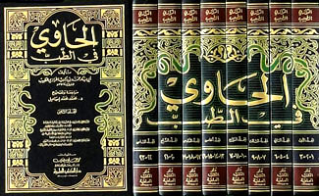

Slide 17
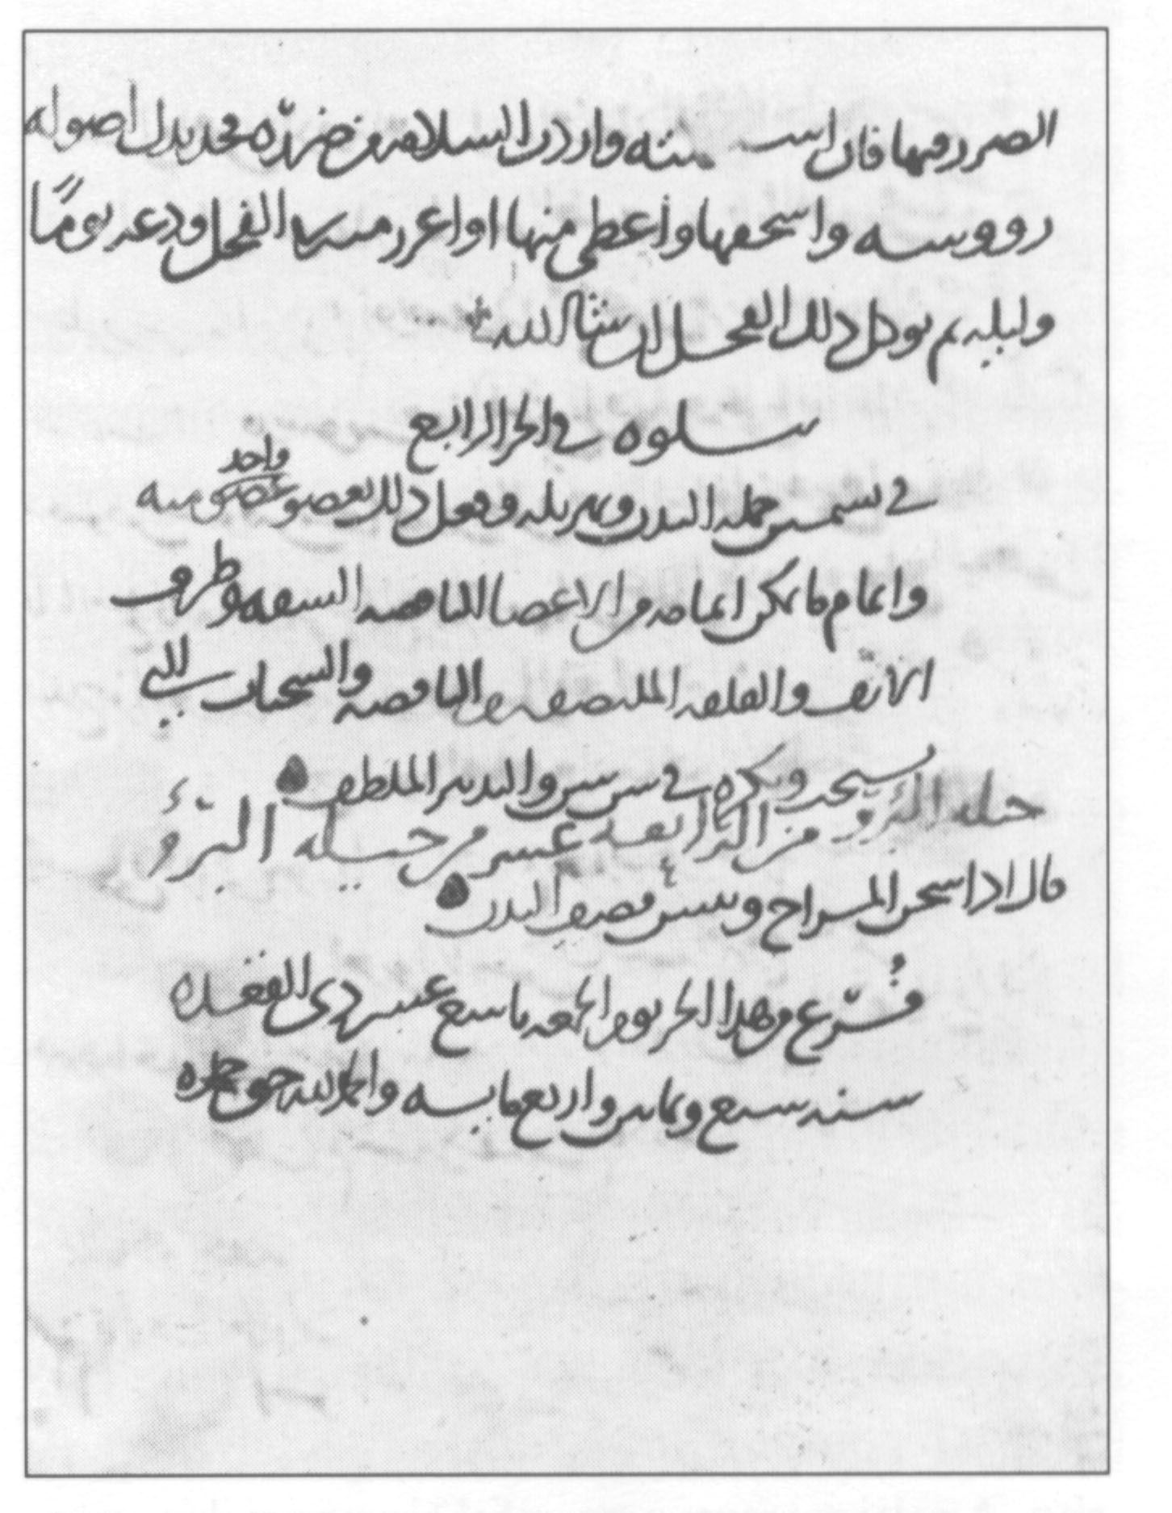
The final page of a manuscript of al-Hawi by al-Razi. It is the oldest manuscript kept in NLM, and the third oldest Arabic medical manuscript
The final page of a manuscript of al-Hawi by al-Razi. It is the oldest manuscript kept in NLM, and the third oldest Arabic medical manuscript

Slide 18
الحاوي في الطب
Al-Hawi fil-Tibb
* This comprehensive book on medicine translated into Latin in 1279 under the title of Liber Continens by Faraj ben Salem

Slide 19
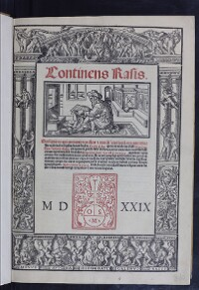

Slide 20
الحاوي في الطب
Al-Hawi fil-Tibb
* Then it was translated many times into Latin.
* It became among the nine relying on books of the medical college library of Paris in 1395.

Slide 21
- Al-Razi is considered the first who described what is called now Baker’s cyst. Which is attributed to the English surgeon William Baker (1839-1896) who described it in 1877.

Slide 22
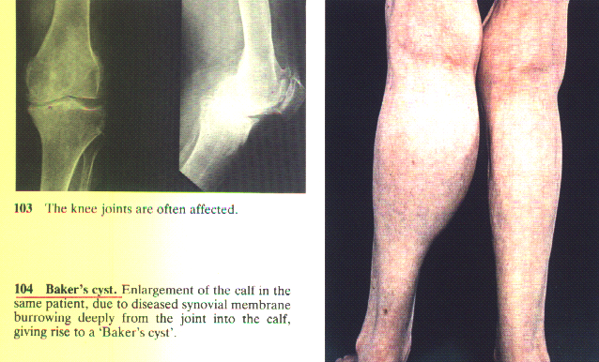

Slide 23
- He mentioned to the necessity of removing the patella (patellectomy) in the cases of comminuted fracture of the patella, which is attributed to Brooke who described it in 1937, and is called Brooke method.

Slide 24
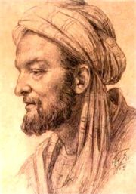
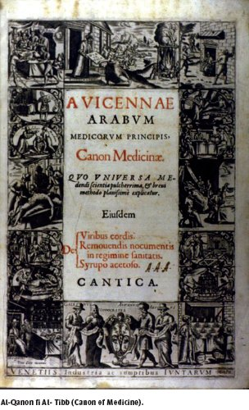
Avicenna(980-1037 A.D.) and the Canon of Medicine

Slide 25
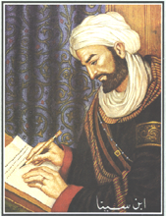

Slide 27
*Some recent historians consider
him as a philosopher more than
a physician, but
*Others consider him as a
prince of the physicians
during the Middle Ages.

Slide 28
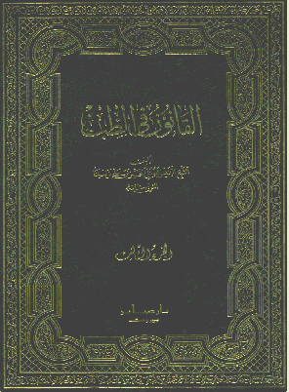
The heard cover of al-Qanun book in Arabic

Slide 29
القانون في الطب
*Al-Qanun Fit-tib
(Code of Laws in Medicine)
represents the most important
work.
* William Osler described it the
most famous medical textbook
ever written.

Slide 30
*It is considered a unique reference or
document containing all medical
knowledge until the time of Ibn-Sina
himself.
* His way of explanation made
al-Canon book the most widespread
in the Islamic and European
countries.

Slide 31
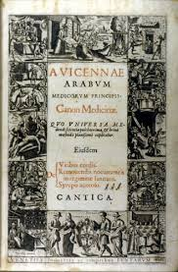

Slide 32
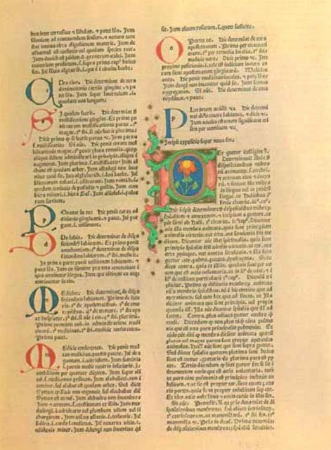
Page from an illuminated manuscript of the Latin translation of the
Canon of Medicine by Ibn Sina

Slide 33
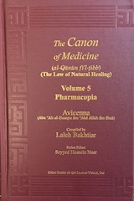

Slide 34
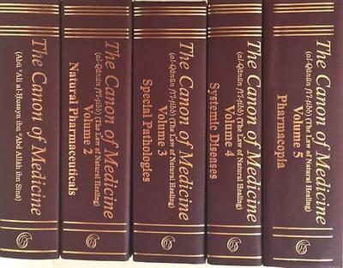

Slide 36
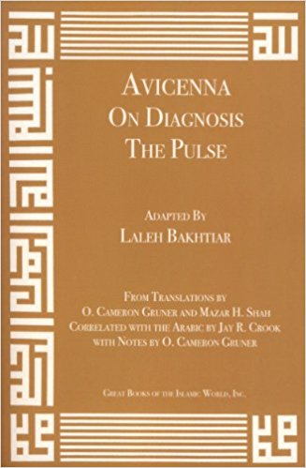

Slide 37
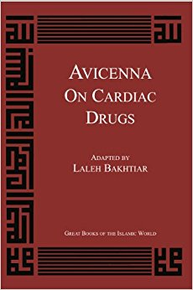

Slide 38
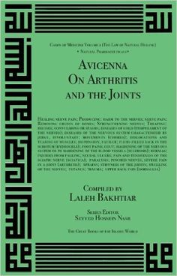

Slide 39
Ibn-Sina and Delayed Splintage Theory
Ibn Sina drew attention to the necessity of not splinting the fracture immediately, advising postponing it beyond the fifth day. Today, this is called the Theory of Delayed Splintage; now Professor George Perkins is considered the pioneer of this theory.

Slide 40
Apley AG, Solomon L: Apley’s System of Orthopedic and Fractures, p. 344, 6th ed., Butterworth & Co.,Ltd., London, 1982.

Slide 41
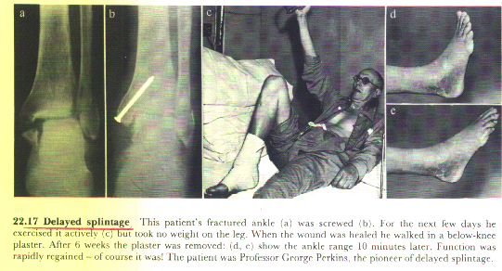

Slide 42
Ibn-Sina and Bennet's Fracture
Ibn Sina talked about what is called now “Bennett’s fracture 1882” Described by Edward H. Bennett, Dublin surgeon (1837-1907).

Slide 43
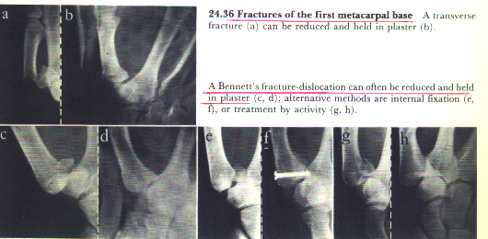

Slide 44
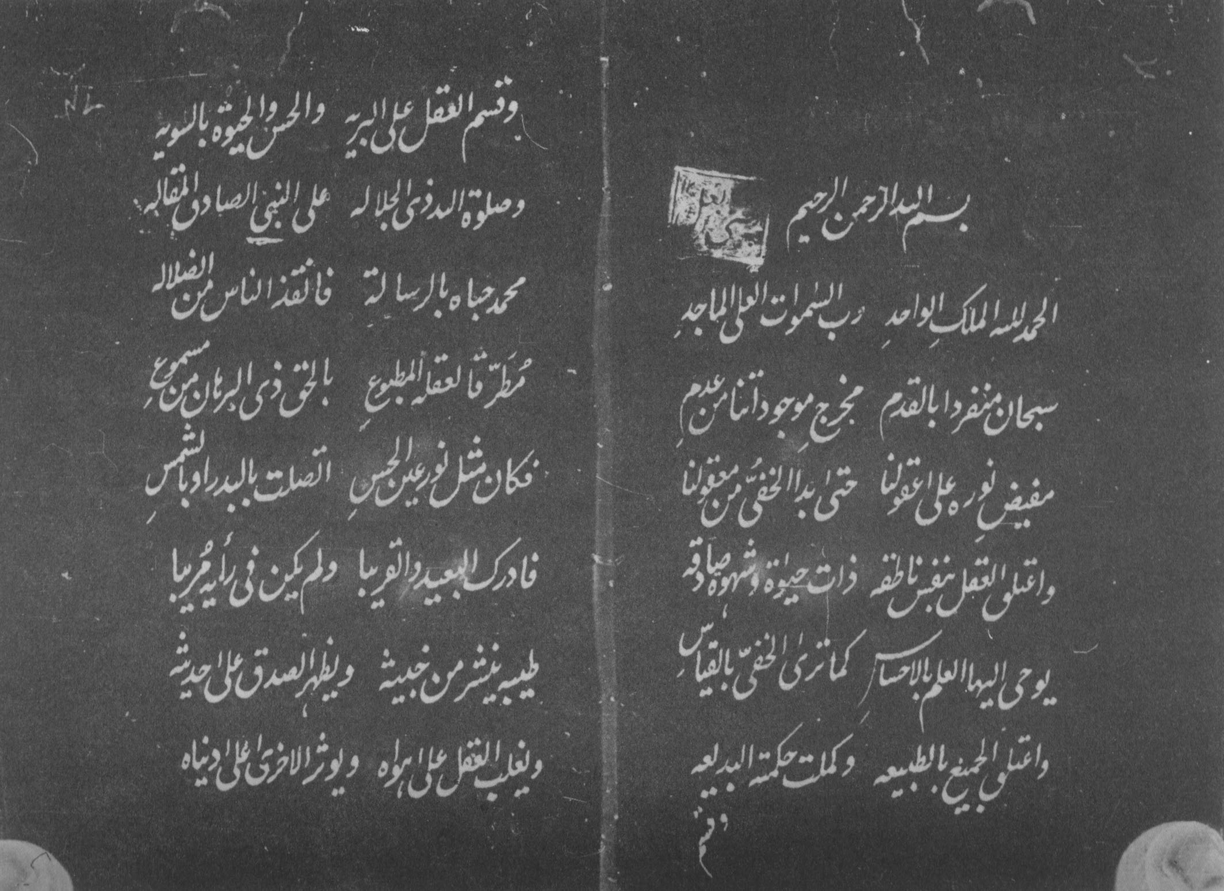
The first page of al-Orjozah
The Indian manuscript

Slide 45
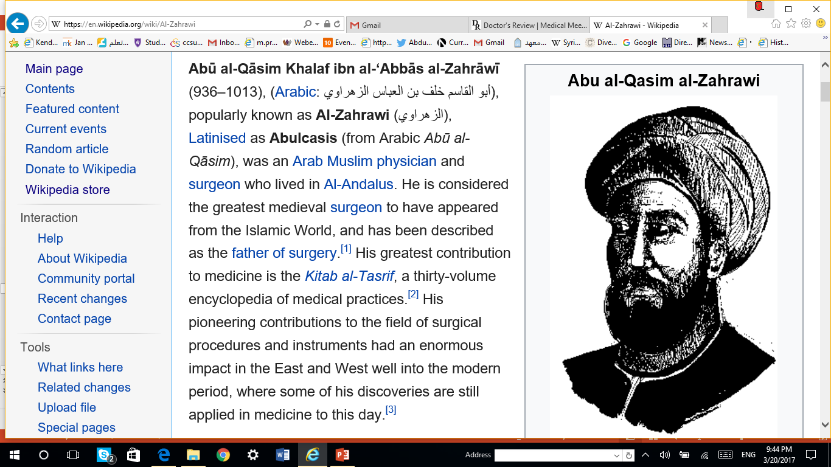

Slide 46
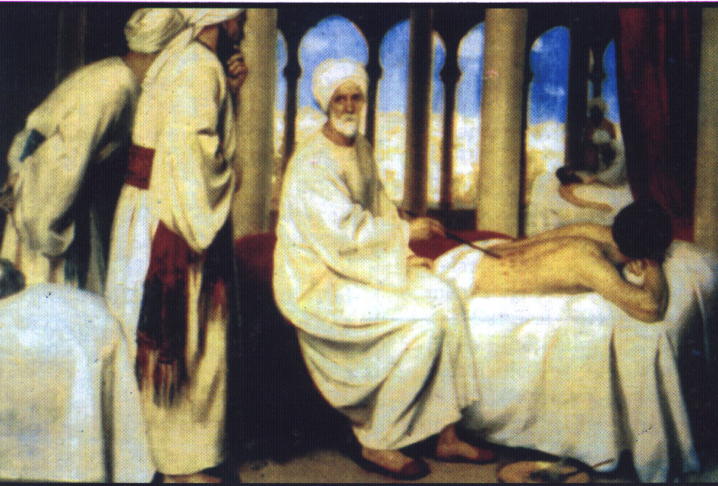

Slide 48
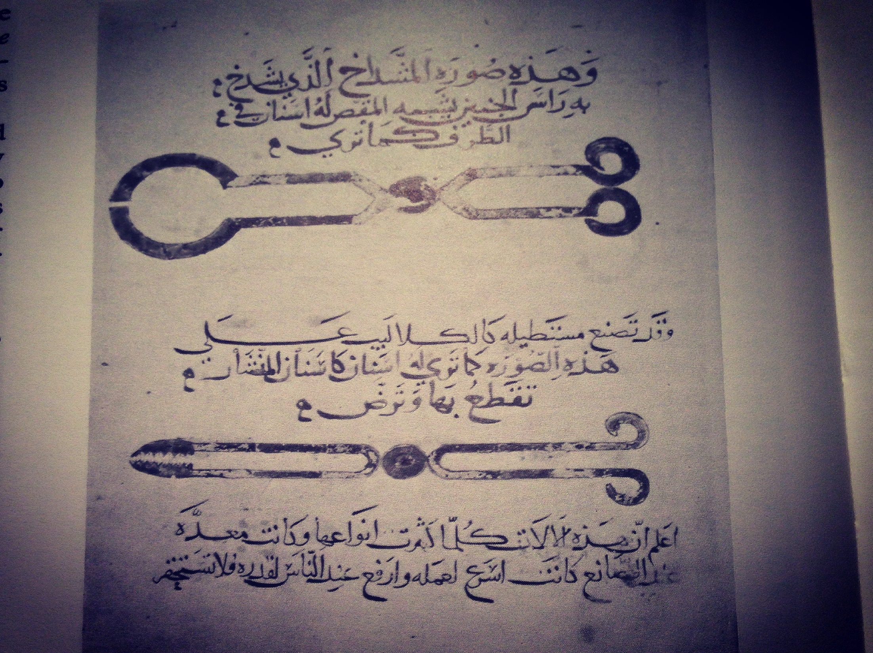

Slide 49
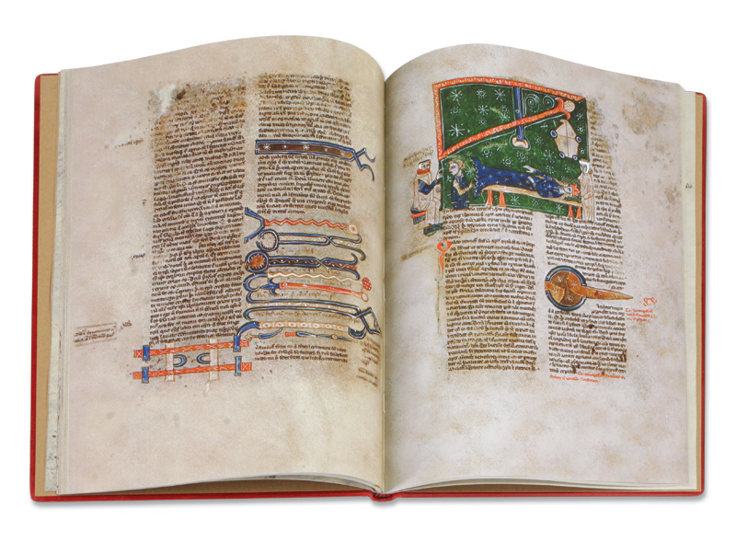

Slide 50
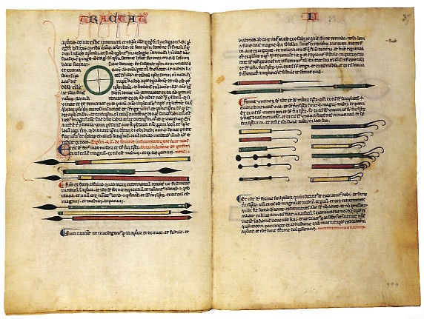

Slide 51
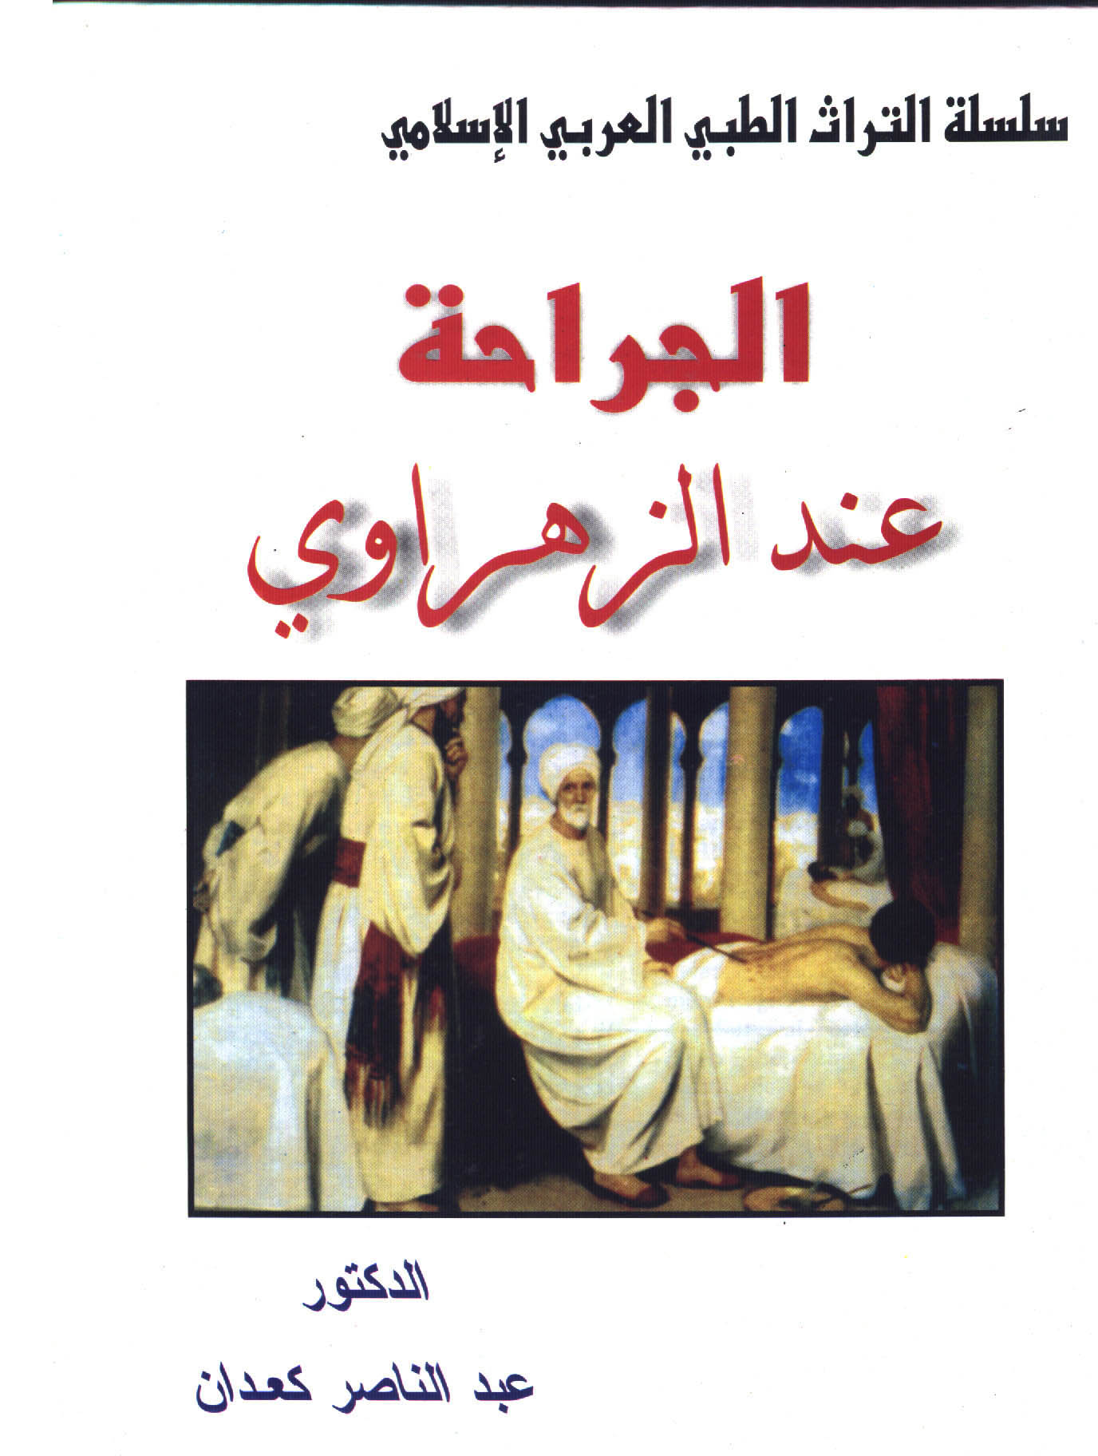

Slide 52
Chapter on the extraction of the temporal arteries.
Albucasis is mentioning to three methods for stopping Haemorrhage:
1- By ligation.
2- By cauterization.
3- By compressing the artery.

Slide 55
Albucasis mentioned to what is called now Trendelenburg Position
Which described by German Surgeon Freidrich Trendelenburg (1844-1924).

Slide 56
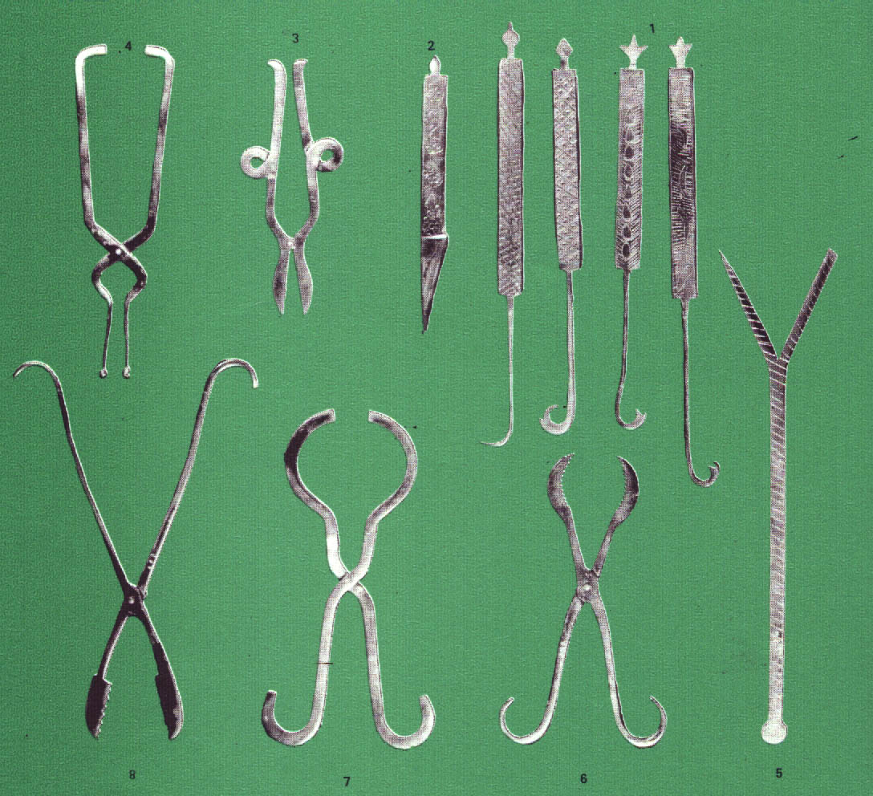

Slide 57
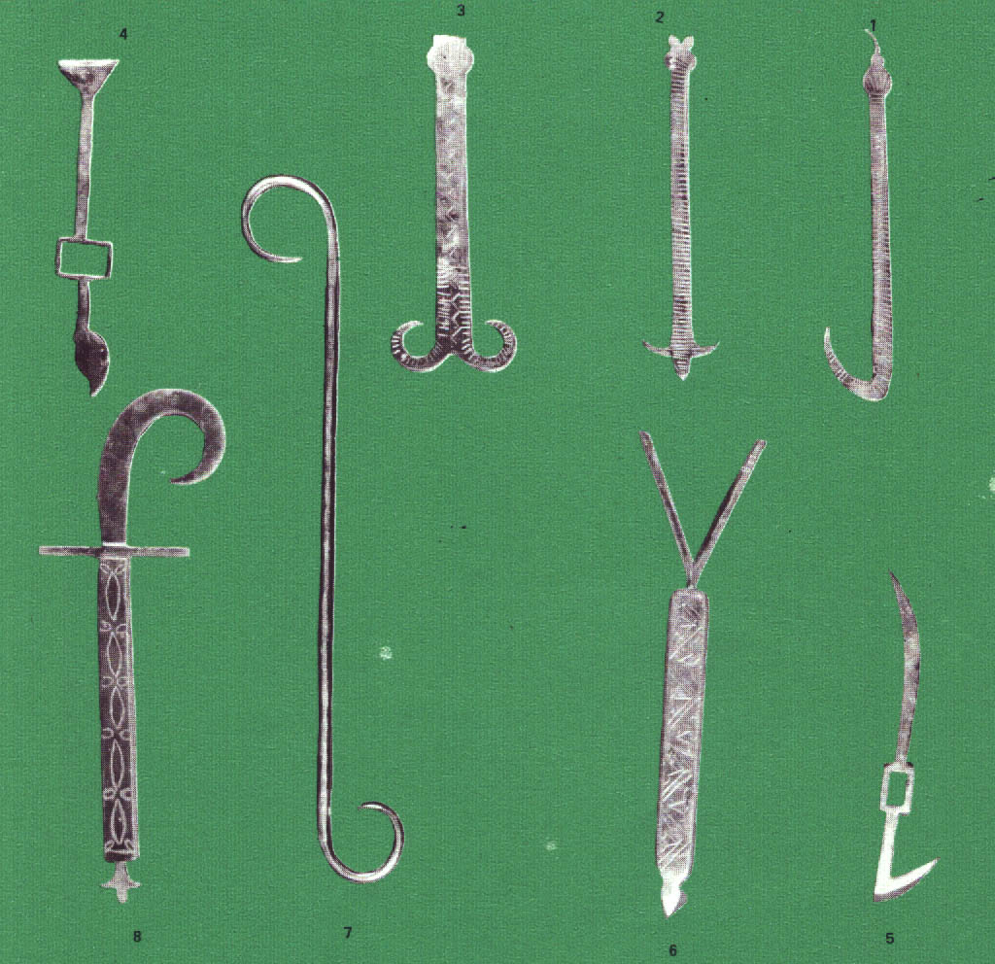

Slide 58
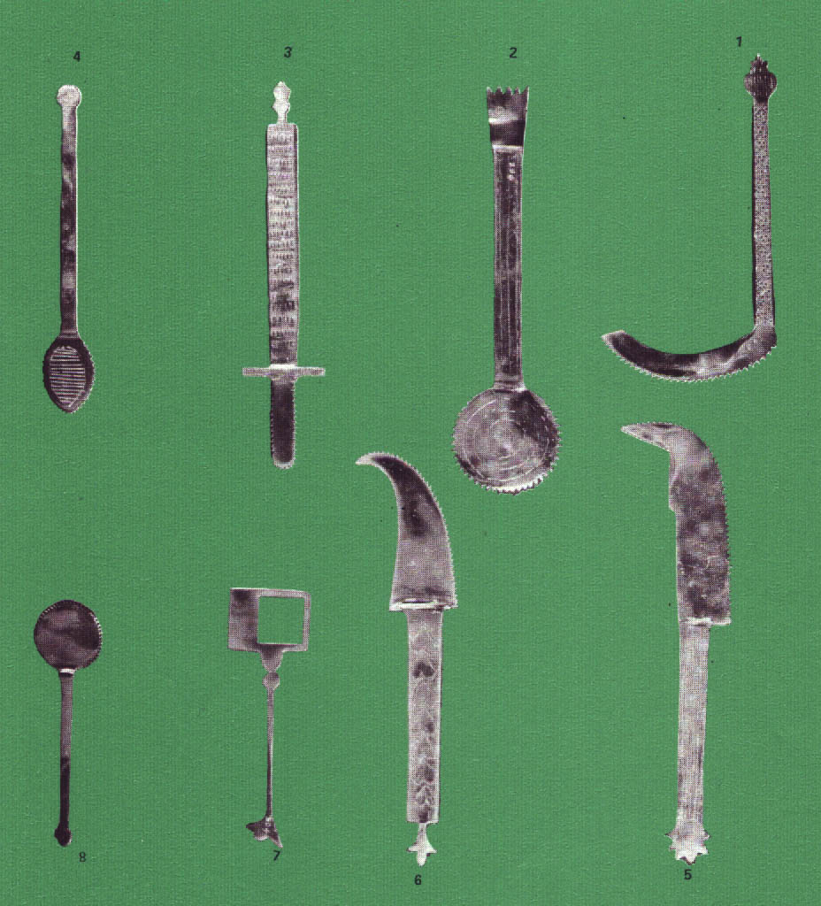

Slide 59
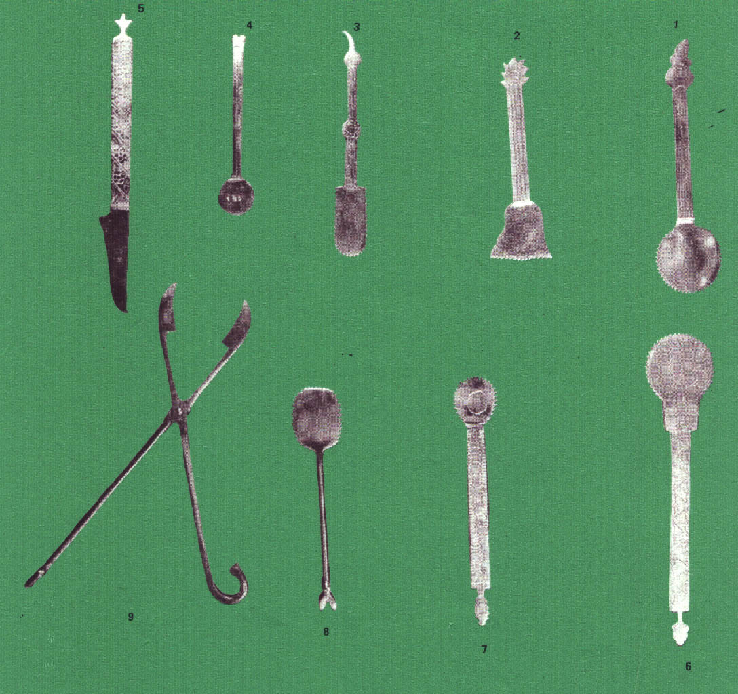

Slide 60
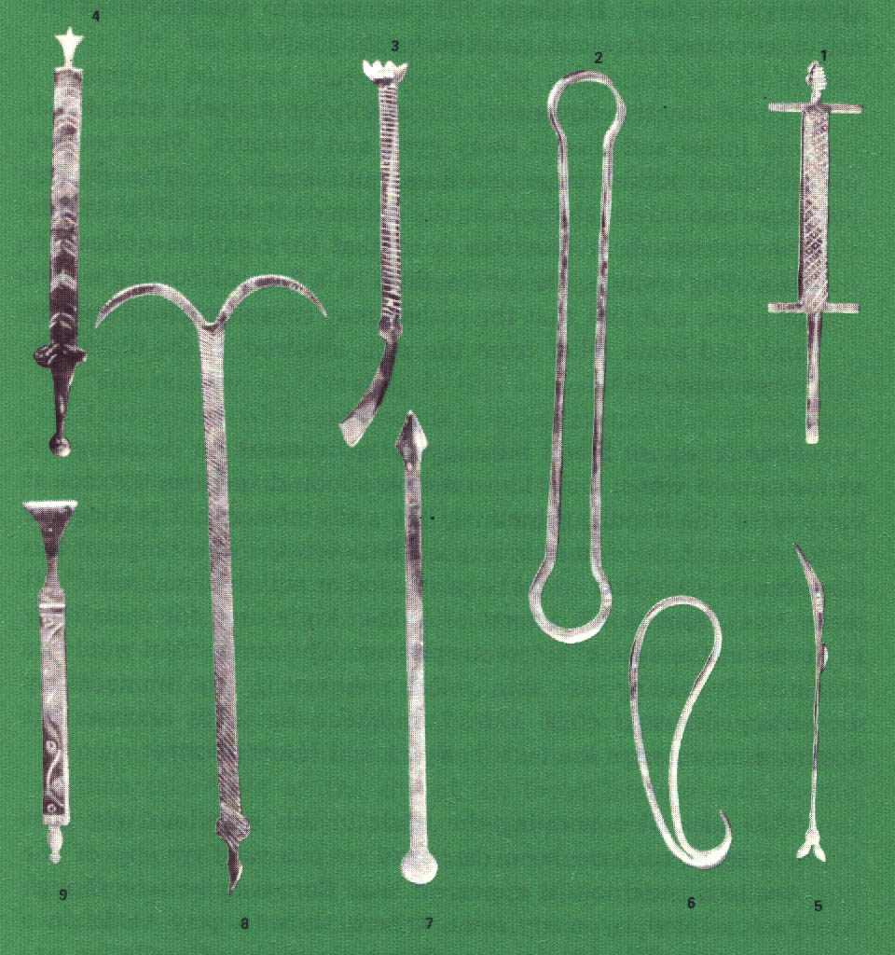

Slide 61
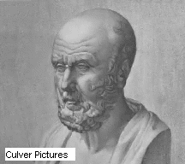
*Absent till created it,
*Dead till revived it,
*Dispersed till collected it,
*Deficient till completed it.
Medicine Was

Slide 62
Thank you

