Slide 1
New Developments in IR; Is PAE Ready for Mainstream?
Michael Sentome MD
Mountain Medical Physician Specialists
msentome@mtnmedical.com

Slide 2
Financial Disclosures
None

Slide 3
JVIR
Standards of Practice| Volume 30, ISSUE 5, P627-637.e1, May 01, 2019
Society of Interventional Radiology Multisociety Consensus Position Statement on Prostatic Artery Embolization for Treatment of Lower Urinary Tract Symptoms Attributed to Benign Prostatic Hyperplasia: From the Society of Interventional Radiology, the Cardiovascular and Interventional Radiological Society of Europe, Société Française de Radiologie, and the British Society of Interventional Radiology
Endorsed by the Asia Pacific Society of Cardiovascular and Interventional Radiology, Canadian Association for Interventional Radiology, Chinese College of Interventionalists, Interventional Radiology Society of Australasia, Japanese Society of Interventional Radiology, and Korean Society of Interventional RadiologyJustin P. McWilliams, MD
Tiago A. Bilhim, MD, PhD, EBIR
Francisco C. Carnevale, MD, PhD
Tarun Sabharwal, MBBCh, FRCSI, FRCR, EBIR
Ian McCafferty, MD, MBBS, BSc, MRCP
Alda L. Tam, MD, MBA
Show all authors
Published:March 26, 2019DOI:https://doi.org/10.1016/j.jvir.2019.02.013

Slide 4
Outline
Prostate Artery Embolization
BPH & Metrics
Efficacy in Randomized Control Trials
AUA and SIR Recommendations

Slide 5
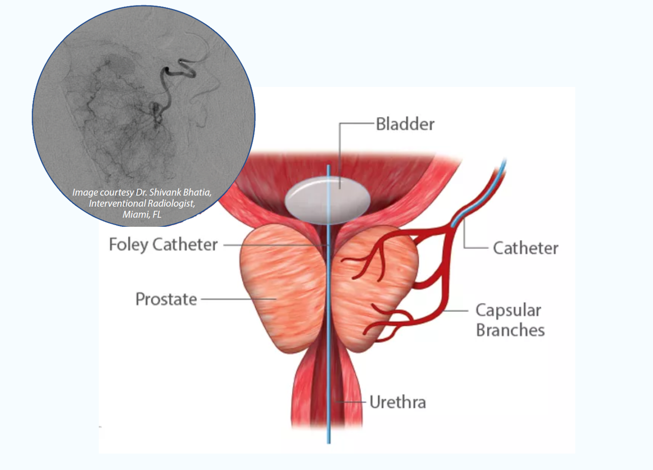
PAE; Prostate Artery Embolization
*Image courtesy of utahprostatesolutions.com 9/23/21
Notes:
Origins: Brazil / Portugal 1st – US aprox 10 years ago

Slide 6
How is it done?
Radial vs Femoral Artery Approach
Micro-catheter canulation of the prostatic artery
Wide anatomic variation though most common as branch off the inferior vesicle artery
*Schematic diagram (ipsilateral oblique view) of the 5 types of prostatic artery (PA, in blue) origin according to de Assis and Carnevale (de Assis et al. 2015). a Type I, common origin of the SVA and PA. b Type II, PA origin from the anterior division of the internal iliac, independent from and inferior to the SVA. c: Type III, PA origin from OA. d Type IV, PA origin from IPA. e Type V, less common origins, the most frequent of which (presented here) is PA origin from AIPA
SVA-superior vesical artery, OA-obturator artery, MRA-middle rectal artery, IPA-internal pudendal artery, AIPA-accessory internal pudendal artery, IGA-inferior gluteal artery, SGA-superior gluteal artery
*Moschouris, H., Dimakis, A., Papadaki, M.G. et al. Prostatic artery embolization performed in anteroposterior projections versus steep oblique projections: single centre retrospective comparative analysis. CVIR Endovasc 4, 21 (2021). https://doi.org/10.1186/s42155-021-00209-7
Notes:
Cannulation most challanging aspect of the case

Slide 7
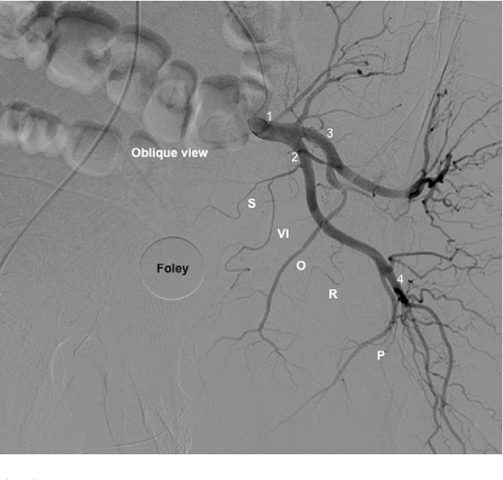
*Left hemipelvis angiogram of the internal iliac artery (IIA), under ipsilateral oblique projection. (1) IIA; (2) anterior division of the IIA; (3) posterior division of the IIA; (4) inferior gluteal artery; and PROVISO acronym: (P) internal pudendal artery; (R) middle rectal artery; (O) obturator artery; (VI) inferior vesical artery; (S) superior vesical artery under oblique view
*Anatomical Variants in Prostate Artery Embolization: A Pictorial EssayF. Carnevale, G. Soares, +3 authors G. Cerri Published 2017 Medicine CardioVascular and Interventional Radiology

Slide 8
Once Cannulated…
Micro-particle embolization
Favored size of 300-500 micron
Avoid non-target embolization of collaterals
Penile & Rectal Branches – often coiled
Same day discharge
Minimal post procedural recovery
Complications mainly secondary to non-target embolization; bladder, penis, rectum

Slide 9
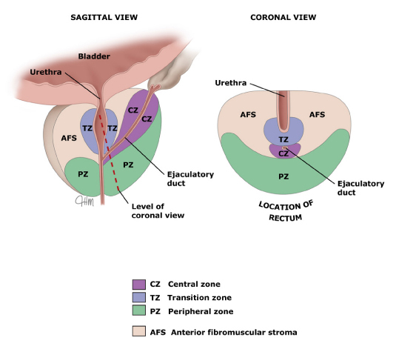
Benign Prostatic Hyperplasia
40% of men over the age of 60
Lower Urinary Tract Symptoms (LUTS)
Nocturia, frequency, hesitancy, urgency, decreased urinary stream, incomplete bladder emptying
Medical therapy is first line
Selective alph-blockers ie flomax/tamsulosin relax smooth muscles in prostate/bladder
5-alpha reductase inhibitors (finasteride) block T to DHT and reduce prostate size/rate of growth.
*Image courtesy of uptodate.com 9/23/21

Slide 10
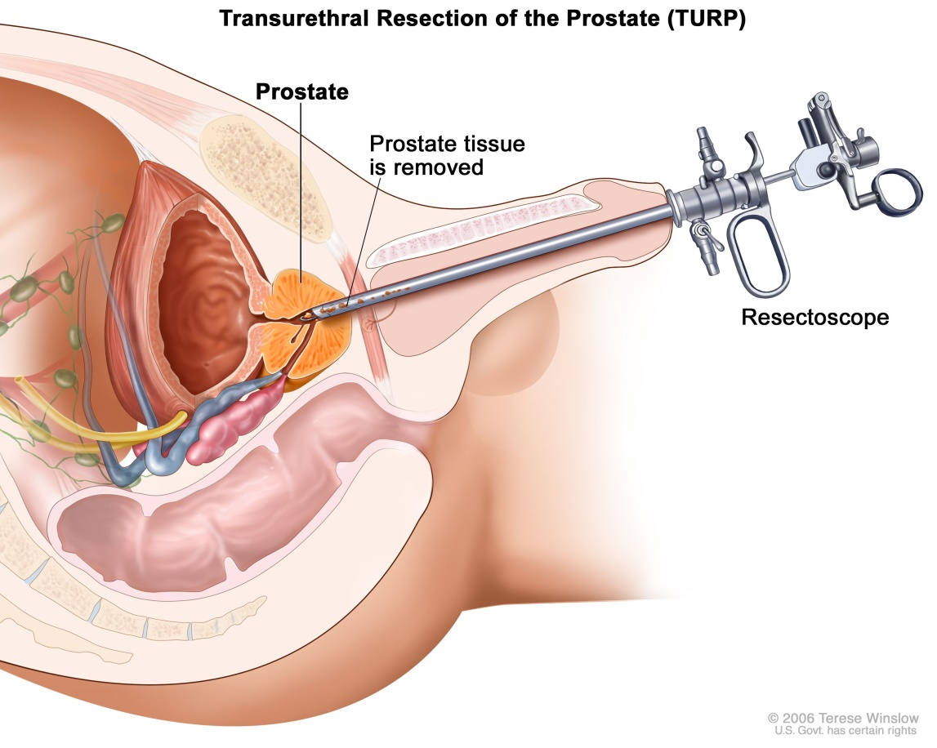
Surgical Therapy
Most common treatment modality
TURP – prostate <~80cc
2-3 day hospital course
Voiding dysfunction, bleeding/capsule perforation
Prostatectomy prostate >~80cc
3-5 day hospital course
Indwelling foley, incontinence, ED, bladder neck contracture…
*Image courtesy of cancer.gov 9/23/21

Slide 11
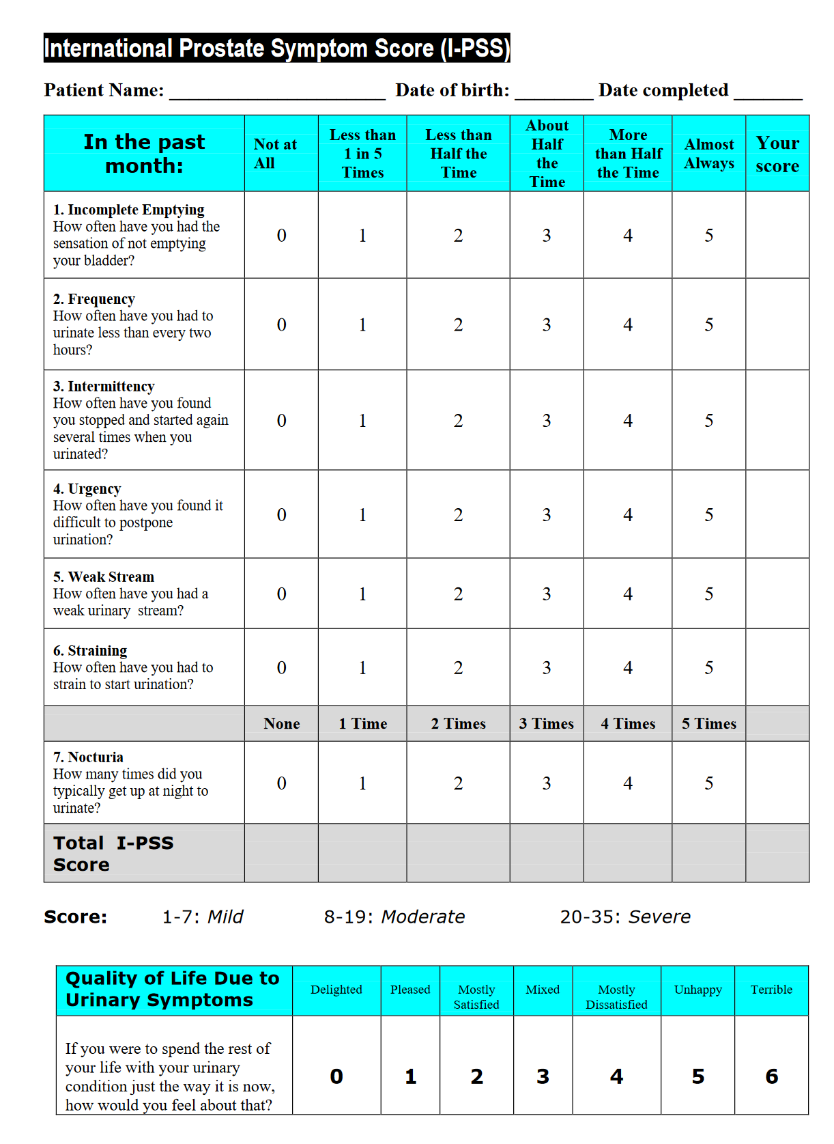
Metrics; Quantifying Symptoms
IPSS: International Prostate Symptom Score
Urinary QOL score
Delighted to Terrible

Slide 12
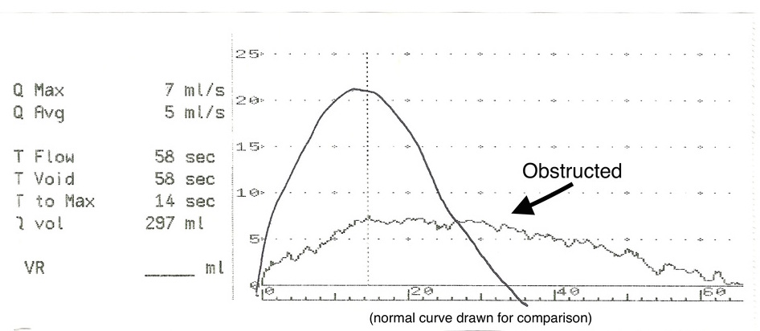
Bladder dysfunction
Confounds bladder outlet obstruction
Neurogenic bladder ect…
Urodynamic studies
Evaluate Urine flow rate/volume/peak, voiding pressures ect…
Normal flow ~12ml/sec, higher in women
*Image courtesy of centralmourology.com 9/23/21

Slide 13
The literature a decade ago..
Carnevale et al, CVIR 2010 – first case series
2 patient study with hx of indwelling foley
6 month follow up; free of foley and ‘normal’ voiding
Prostate volume reduction with MRI ~40%
Pisco et al, JVIR 2011
15 pts with symptomatic BPH who failed medical therapy
Mean f/u 8 months with IPSS score reduction of 6.5pts and peak flow increase of 4ml/sec
Notes:
Not large studies limited data

Slide 14
A lot since then
280 articles since first case series in April 2010 to Sept 2018 w/ 230 in 2014-2018
Inclusive of 2,200 patients w/ longest duration of follow-up at 6.5years
3 Randomized control trials PAE vs TURP
3 Nonrandomized comparative studies PAE vs TURP
17 Cohort studies
6 Meta-analyes

Slide 15
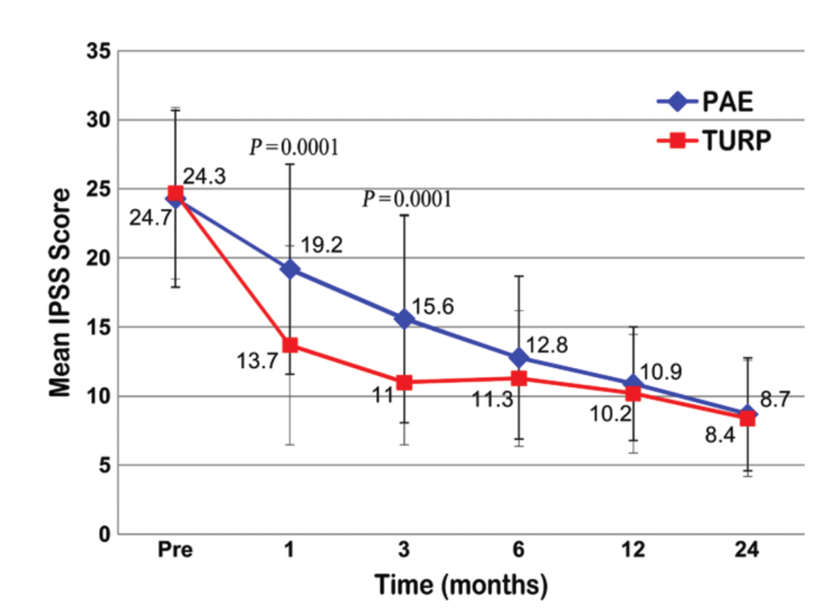
Comparative trials
Radiology 2014*
114 pts; peak flow <15ml/s prostate volume <100cc randomized to PAE vs TURP
Followed for 24 months
TURP – better functional outcomes at 1 and 3 months
All outcomes (IPSS, QOL, peak flow, PVR) equivalent at 12 and 24 months
Major complications only in TURP group
*Gao Y.A. Huang Y. Zhang R. et al.Benign prostatic hyperplasia: prostatic arterial embolization versus transurethral resection of the prostate--a prospective, randomized, and controlled clinical trial. Radiology. 2014; 270: 920-928

Slide 16
Comparative trials
Pt. Improvement
CVIR 2014*
30 patients randomized to TURP vs PAE and compared to cohort of 15 PAE with specialized technique
Prostate volumes 30-90cc; Severe LUTS by IPSS & 1 year follow-up
21.5pt improvement in TURP vs 12.5 in PAE vs 21.0 in PAE with specialized technique
Significant QOL score improvement seen in all groups but superior in TURP group
Major complications only in TURP group
*Carnevale F.C. Iscaife A. Yoshinaga E.M. et al. Transurethral resection of the prostate (TURP) versus original and PErFecTED prostate artery embolization (PAE) due to benign prostatic hyperplasia (BPH): preliminary results of a single center, prospective, urodynamic-controlled analysis.Cardiovasc Intervent Radiol. 2016; 39: 44-52

Slide 17
Comparative trials
British Medical Journal 2018*
99 pts randomized; 48 PAE & 51 TURP
Prostate volume 25-80cc; IPPS of 8 or higher; flow rate of less than 12ml/s
12 week follow up
Similar post treatment IPSS score 9.2 PAE vs 10.8 TURP (low moderate symptoms with PAE slightly but not stat. sig. better)
Peak urine flow and PVR better in TURP
+5.2ml/s vs 15.3ml/s in TURP and PVR of 200cc vs 86.4cc in TURP
TURP associated with twice as many adverse events as PAE and 3 times as many severe events
*Abt D. Hechelhammer L. Mullhaupt G. et al. Comparison of prostatic artery embolisation (PAE) versus transurethral resection of the prostate (TURP) for benign prostatic hyperplasia: randomised, open label, non-inferiority trial.Br Med J. 2018; 361: k2338

Slide 18
UK-ROPE
UK Register of Prostate Embolization published in 2018
305 patients recruited; 216 PAE and 89 TURP
Non-randomized
PAE pts were younger 66 vs 70 and larger prostate 101cc vs 66cc
1 year follow up
Both group significantly improved though greater in TURP
QOL of 3.4 vs 2.6 in TURP (‘mostly satisfied’ to ‘mixed’ range)
Peak flow 4.4ml/s vs 8.6 in TURP
Average 2 day hospital stay for TURP and 0 for PAE
Median return to normal activities was 5 days for PAE and 14 for TURP
Complication profile milder in PAE
*Ray A.F. Powell J. Speakman M.J. et al.Efficacy and safety of prostate artery embolization for benign prostatic hyperplasia: an observational study and propensity-matched comparison with transurethral resection of the prostate (the UK-ROPE study).BJU Int. 2018; 122: 270-282

Slide 19
Trends
Similar long term subjective improvement as per IPSS and QOL scoring though TURP slightly higher than PAE
Quantitative metrics favor TURP in the short term 1-3 months post intervention
PAE has lower complication rate and faster recovery
Higher medical costs in TURP

Slide 20
Outstanding issues
Defining satisfactory endpoint
Stratifying patients
Surgical intervention becomes more complex with larger prostate size
PAE easier with larger prostate size
PAE technique has evolved significantly and continues to do so (unilateral vs bilateral treatment ect.)

Slide 21
SIR
At present American Urological Association and Society of Interventional Radiology hold different positions on PAE
SIR Recommendations with strong evidence
PAE is an acceptable minimally invasive treatment option for appropriately selected men with BPH and moderate to severe LUTS. (Level of evidence: B; strength of recommendation: strong.)
PAE can be considered in patients with hematuria of prostatic origin as a method of achieving cessation of bleeding. (Level of evidence: D; strength of recommendation: strong.)
PAE should be included in the individualized patient-centered discussion regarding treatment options for BPH with LUTS. (Level of evidence: E; strength of recommendation: strong)

Slide 22
AUA
PAE is not recommended for the treatment of LUTS/BPH outside the context of a clinical trial.
While….
Aquablation may be offered to patients with LUTS attributed to BPH provided prostate volume >30/<80g, however, patients should be informed that evidence of efficacy, including longer-term retreatment rates, remains limited.
Water vapor thermal therapy may be offered to patients with LUTS/BPH provided prostate volume <80g; however, patients should be counseled regarding efficacy and retreatment rates.
Transurethral microwave therapy may be offered to patients with LUTS/BPH; however, patients should be informed that surgical retreatment rates are higher compared to TURP.
Clinicians should consider prostatic urethral lift as an option for patients with LUTS/BPH provided prostate volume <80g and verified absence of an obstructive middle lobe; however, patients should be informed that symptom reduction and flow rate improvement is less significant compared to TURP. Patients should be informed that evidence of efficacy and retreatment rates are poorly defined.

Slide 23
Coding & Final Thoughts
CPT: 37243 Vascular embolization or occlusion, for tumors, organ ischemia, or infarction.
IR has a strong PAE practice throughout the country not just in academic medical centers.
Large centers performing over 200 PAEs per year
Most patients are self referred with growth fueled by word of mouth

