Slide 1
Ogden’s City Hospitals: 1890 - 1910
John Grima, PhD
Midtown Community Health Center

Slide 2
Outline
Note on Goals & Sources
Prologue
Burch Creek Hospital & Pest House, 1883-1885, 1900-1914
Union Pacific Railroad Hospital, 1883-1896
Ogden’s City Hospitals, 1890 - 1910
Ogden City Temporary Hospital at 25th & Grant, 1890-1892
Ogden City Hospital, 28th Street, 1892-1894, 1895-1897
Ogden Medical Surgical Hospital/Ogden General, 1897-1910
Why Have We Forgotten?
Wrap-up & Conclusions

Slide 3
Goals & Sources
Goals
Memory recovery … and recompense for past omissions.
Add detail and expand available descriptions,
Fix misunderstandings,
Contextualize within then contemporary Ogden and, less, the state,
Make it stick.
Sources
Utah Digital Newspapers, University of Utah, digitalnewspapers.org,
Ogden City Recorder, GRAMA request response with detailed file listings,
Utah State Archives, Ogden Corporation, City Council Minute Books and corporate files from 1883-1900+.
Various secondary sources on Ogden, Utah and the history of medicine.
Partial list on last slide.

Slide 4
Burch Creek Hospital & Pest House: 1883-1885, 1900-1914

Slide 5
Burch Creek Hospital
Built in 1882, opened in early 1883, under the mayoral administration of T.E. Herrick, total cost about $3,000 (~$60,000 today).
Decision taken fairly quickly during summer of 1882, City response to the need to provide post injury care for indigent patients treated by private physicians and to house and care for quarantine patients, whose numbers were seen as having increased as a consequence of the railroads.
Not a ‘workshop’ facility for local physicians and their patients.
Built quickly and cheaply, financed out of current accounts.
Claimed as a humanitarian accomplishment by mayor as term ended.
Patients were mostly City Physician consignees; some from the County; a few referred and attended by a local physician; all indigent or otherwise poor.
Conditions mentioned: Pneumonia, measles, spinal concussion, recovery from amputation of frozen fingers, DTs; young woman in ‘delicate’ condition, smallpox.

Slide 6
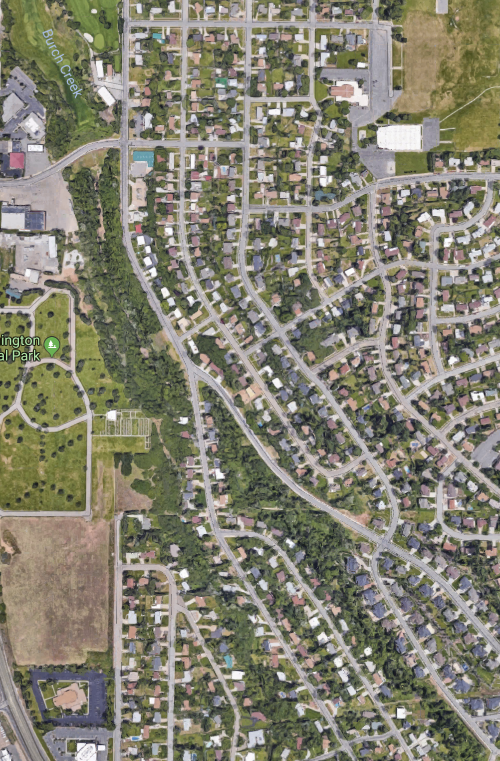
Burch Creek Hospital
Described in Council notes and press stories as 40 acres on the bench south of the city, on good land overlooking Burch Creek.
The building was a six room rectangular frame structure, a room at each end and four in the middle off of an east-west running central hall way, the end room on the west used as a kitchen, no central heat, no mention of connection to water service or electricity, no sewer.
Became an object of vandalism soon after opening and … a few years later … the subject of ghost stories.
Line shows where Burch Creek runs below a bluff or hollow.

Slide 7
Burch Creek Hospital
Initially a Mixed Financial Model:
City provided the land and facility.
“Leased” to a non-MD steward couple: Mr. & Mrs. Lorenzo Waltham, with responsibility to board and care for patients;
Stewards agreed to a per patient per day rate, bid for such with City, city having the option to accept the lowest bidder. Goal was likely to protect the City from higher, private provider charges and the risk of low occupancy, but not generate a return of capital.
Subsequently involved increased reimbursement for incurred expenses and a monthly $28 stipend for the Steward, more of a municipal service model.
Attempted unsuccessfully to gain voluntary and contractual financial support from railroads, public philanthropy, and the County.
Became a regular source of friction at City Council almost immediately:
Could the stewards be trusted? Had another city or a railroad or a family unfairly dumped patients on the City? Were these people really ill? Really indigent?

Slide 8
Burch Creek Hospital
Closed at the end of 1885 after a bitter dispute over payment between Council and the Steward.
Decision likely influenced by the availability the County as an alternate provider and evolving territorial law on the responsibilities of counties.
Ogden City patients turned over to County and sent to poor farm [in Roy].
Burch Creek facility out-of-service between 1885 and 1900 – vacant, vacant with squatters, and rented .
Eventually put back into service as “The Pest House” with a new smallpox outbreak in 1900 and continued as such up until around 1914, transferred to County management some years before closing .

Slide 9
Union Pacific Railroad Hospital: 1883 - 1896

Slide 10
UPRR Hospital
Prior to the UP having its own hospital, employees were cared for in physician offices -- one mention is with Dr. T.E. Mitchell – with their own rooming facilities or arrangements with local hotels and rooming houses:
Mitchell’s office may have been at 25th & Grant, may have become the temporary home of Ogden City Hospital in 1890.
Around 1883 the railroad bought a building – described as a dance hall – on 8th and Spring and converted it to hospital use with Drs. Mitchell and Perkins acting as physicians for the railroad, in use as such at the end of 1884 or early 1885:
3 levels, 8 wards, kitchen, dining room, and office; no obvious technical facilities;
Staffed by/operated by(?) Sisters of the Holy Cross 1887-88 – St. Lawrence Hospital.
In 1890 and 1891, the railroad undertook an expansion project, said to have improved building systems – reports do not mention clinical facilities or systems, but they may have been included.

Slide 11
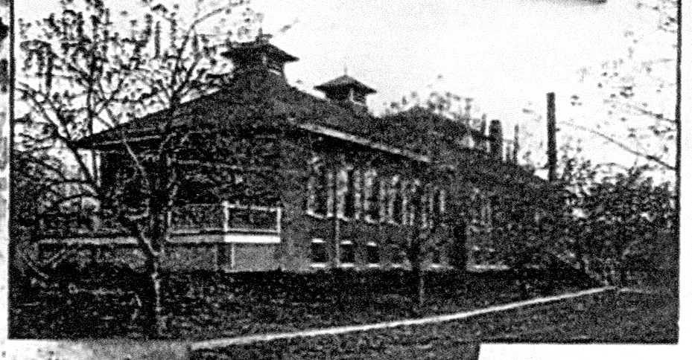
Union Pacific Hospital – 1890,
Picture Credit: Union Station Foundation, 00773 bw photo, P:\PP5\IMAGES\002\00773.JPG

Slide 12
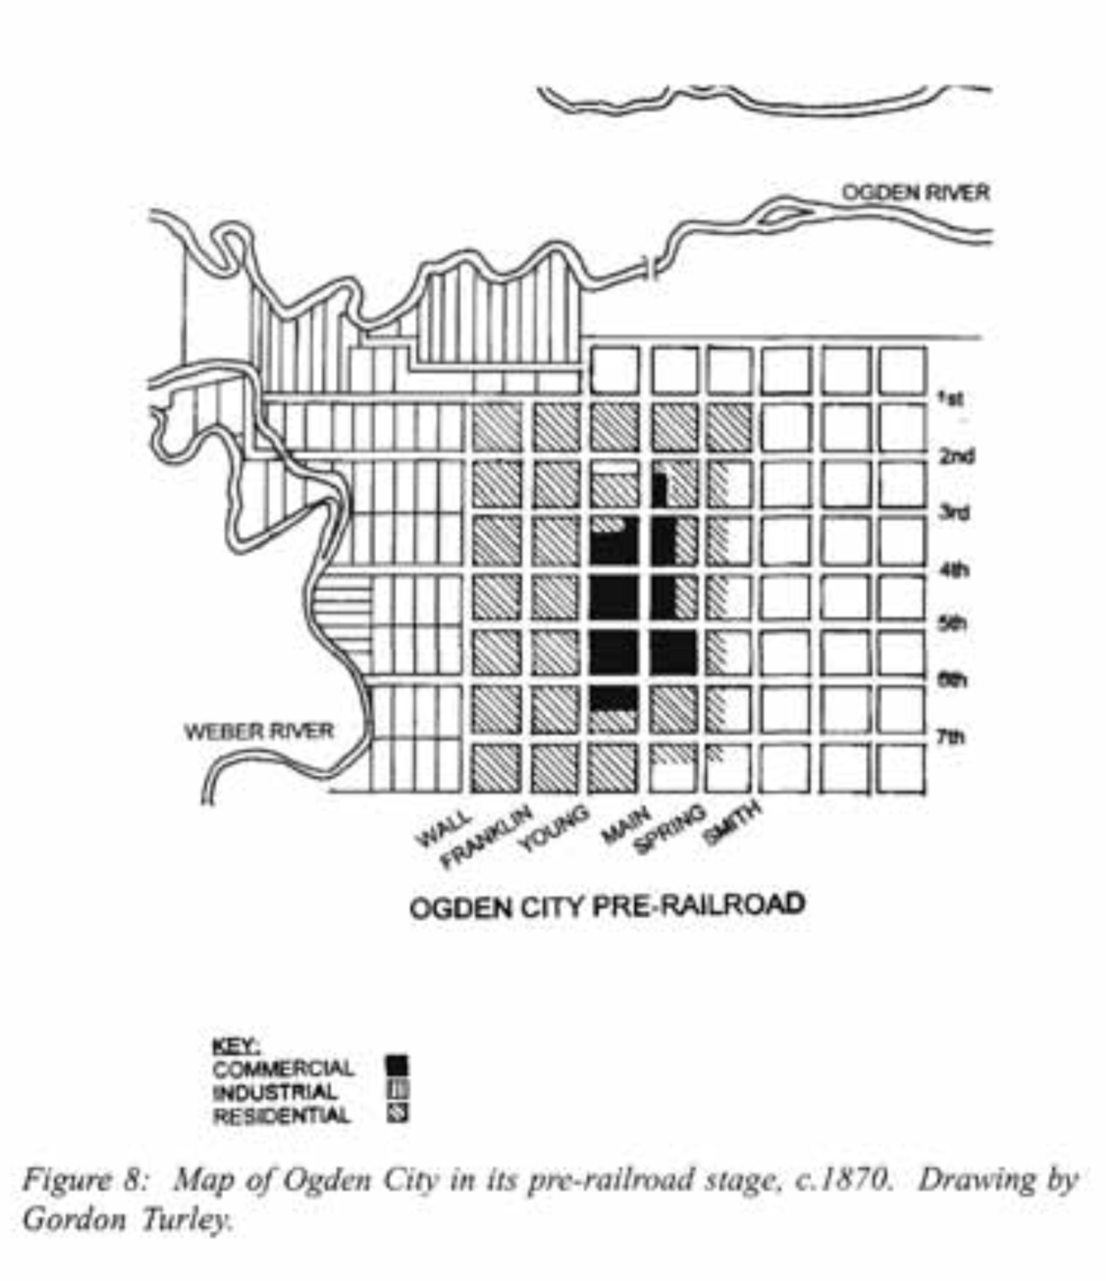
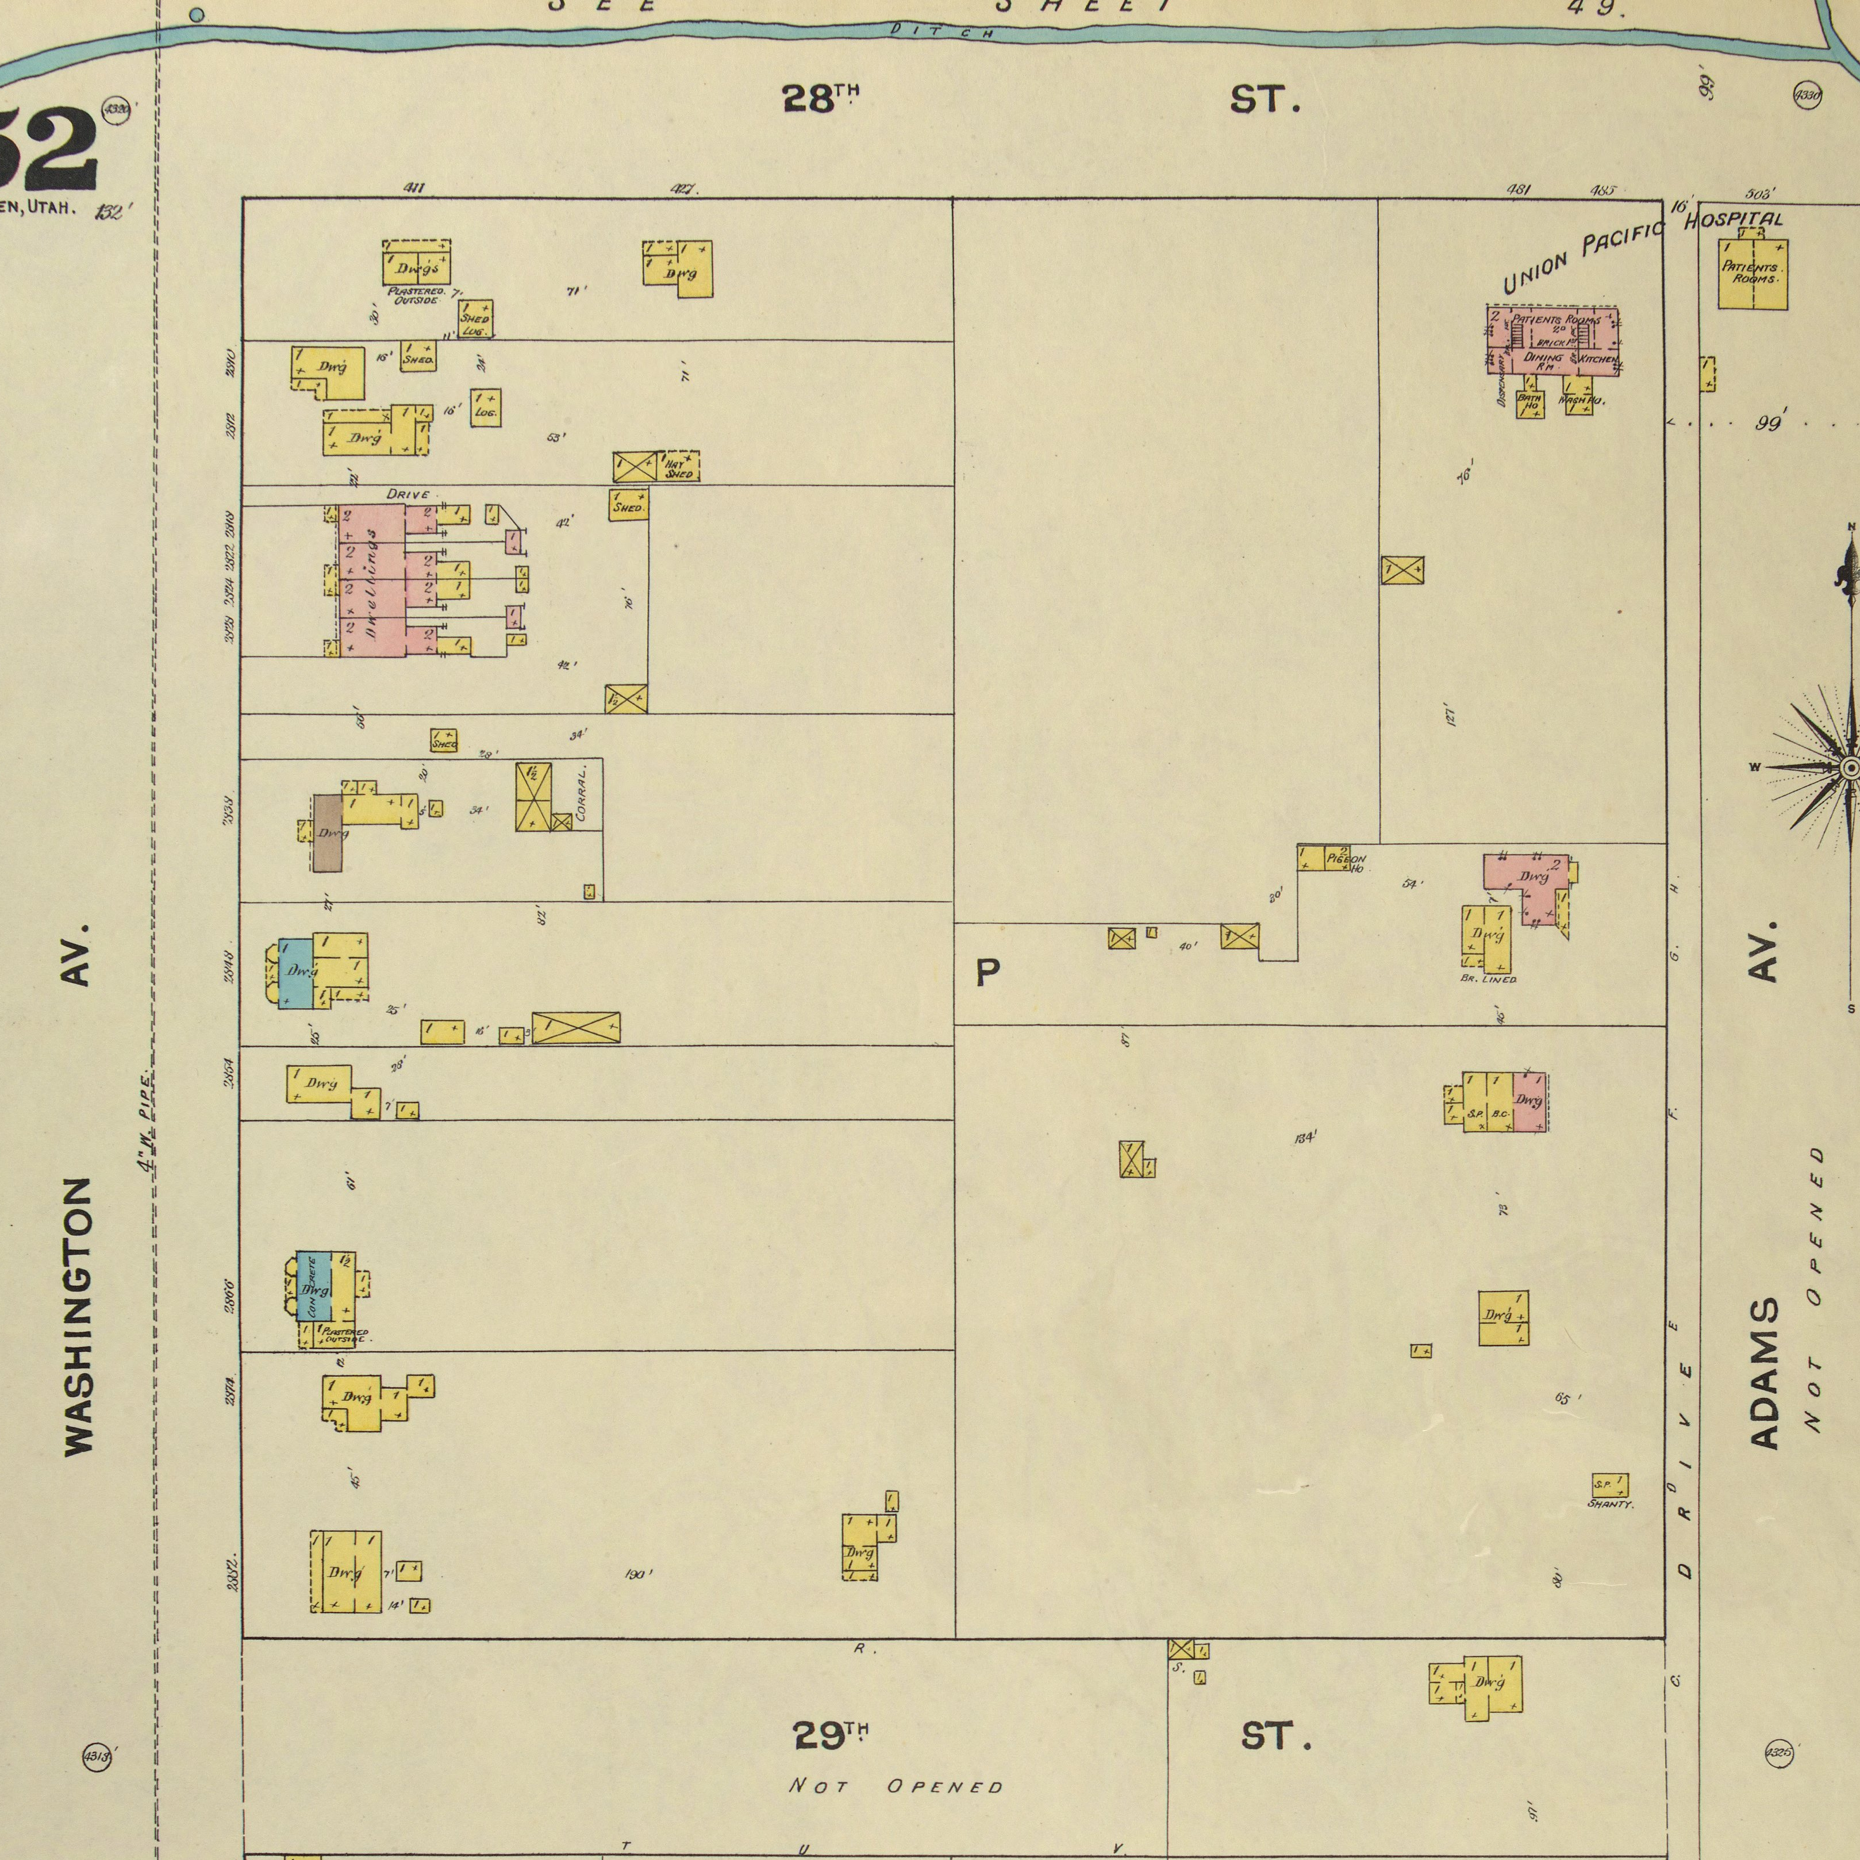
Union Pacific RR Hospital 1890 Sanborn Map
From Building by the Railyard: The Historic Commercial and Industrial Architecture of Ogden, Utah; University of Utah, 1998, p. 6.

Slide 13
UPRR Hospital
Operated as a private hospital, with services entirely paid by UPRR, funded from employee salary deductions.
Funds likely also managed so as to generate a return of capital to the railroad for the investment in facilities.
Served patients from a wide area; newspaper reports mention Idaho, Evanston, Nevada with census as high as 25.
Closed to non-railroad patients (with exceptions) … and physicians.
Ceased operation in 1896, a casualty of the UP 1893 bankruptcy, sold to Ogden school district, currently the site of George Washington Alternative High School.

Slide 14
Ogden’s City Hospitals Grant & 25th Temporary Hospital Ogden City Hospital Ogden Medical Surgical Hospital/Ogden General

Slide 15
Changing Local Circumstances
Election of 1889, Liberal Party sweep of Ogden City offices
Election outcome influenced by Edmunds-Tucker Act, changes in voter eligibility criteria, anti-church, anti-Salt Lake sentiments.
Victors not outsiders, not particularly ideological, not obviously anti-church, but determined to assert independent leadership in Ogden vis a vis Salt Lake, to put Ogden on the map as a premier railroad city.
Seemed to see a public hospital as a demonstration of seriousness and a marker in their competition with Salt Lake.
Some sentiment that care for the sick was a civic obligation, supported by some members of the medical community, but not the dominant sentiment in the goal for a hospital.

Slide 16
Changing Local Circumstances
Economic conditions were pretty good, statehood was on the horizon … must have felt like this was within economic reach.
Aware of impending UP Hospital improvements, aware that it would remain closed to locals.
Bonding was all but in place, started by prior administration in 1887.
Pushed forward an ambitious program of public spending for a new city hall and a hospital.
How ambitious were they …?

Slide 17
1890 Ogden City Hall
https://www.pinterest.com/pin/160651911682682479/?lp=true

Slide 18
Evolving Hospital Utility*
Evolution of surgery, nursing and support services and the availability of transportation for prospective patients created conditions for hospitals to serve as ‘physician workshops’.
Community attitudes became more supportive of hospital care for general patients without regards to social class and wealth.
Community attitudes (across the country … and in Ogden) came to see the possession of a ‘modern’ hospital as a mark of modernity, of community success.
Potential for payment from private patients grew, suggesting greater opportunity for service and scale.
*The Care of Strangers: The Rise of America’s Hospital System, Charles E Rosenberg, 1987, Johns Hopkins University Press.

Slide 19
H. J. Power’s Case for a New Hospital: Necessary & Better
Necessary for the medical treatment of the destitute sick
Accidents, sickness and pauperism are increasing in proportion to our rapid increase in population
Giving patients over to the Poor Farm has been attended with suffering and great danger to life
Surgery is dangerous in settings without necessary conveniences – heat, post-operative nursing care
There is economy in facility of service. A hospital can be constructed to enable getting the sick well in the greatest numbers with reasonable comfort, in the quickest and most economical way – how to do the most good with the least money.
*Ogden Standard, 1889 11 13, City Council, p. 4. Utah Digital Newspapers, accessed 10 Feb 2017. https://newspapers.lib.utah.edu/details?id=6243148

Slide 20
Temporary Grant Street City Hospital: 1890-1892
After a couple of false starts, in January 1890, City Physician Powers rented a building on Grant and began fitting it out, with patients already in residence.
Hospital entirely funded by City.
Food provided by City, the same vendor as the supplier for City Jail for a time;
Laundry and cleaning paid by city;
Steward employed by and paid by city;
Purchases of soap, matches, robes, drugs, transportation for patients;
City supplied surgical instruments, needles and silk; thermometers, stethoscope
… non-trivial amounts with payment authorized monthly, just like other City departments – a municipal service.

Slide 21
Grant Street City Hospital Operations
Old “moral hazard” and cost concerns emerge immediately -- Surrounding communities are [surely] dumping their indigent ill on the City … Sanitary Commission enjoined to review every admission, seek 50% contribution from County, hold salaries where they are.
By September of 1890, the City Physician was seeking to move to a larger building, settled for a small addition on the existing rental (“one room at a time” in a later reference as to the need for a new permanent facility).
Not just quarantine management. Evidence of surgical procedures, care provided by medical school trained physicians, concern for sanitation, access to medicine and medical supplies.
No evidence either way of private patients being treated.

Slide 22
1891 City Physician & Hospital Report
Activity from February 18, 1891 - February 18, 1892
Number of patients in Hospital on Feb 18, 1891, 12
Number of patients in Hospital on Feb 18, 1892, 8
Number of patient treated in the Hospital, 91
Number of free patients treated outside the Hospital, 246
Number of visits made to Hospital cases, 738
Number of visits made to free cases outside, 269
Number of visits made by free patients to [city physician’s private] office, 380
Total number of cases coming under the care of the City Physician, 337
Number of deaths occurring among City cases, 4
Number of Hospital deaths during year, 15
Number of cases requiring surgical intervention, 54, all with satisfactory results
Other Statistics
28 [of the 91] hospital cases were Ogden ‘natives’, the rest from other localities
44 cases of contagious disease quarantined
550 births [none in the hospital]
235 reported deaths [first year during which death certificates are required, partial year]
2 arrests made an account of efforts to restrict the illegal practice of medicine vis a vis City ordinances
Supplementary Material

Slide 23
1891 City Physician & Hospital Report (continued)
Department expenses for the year:
Steward’s salary 732.00
City Physician Salary 500.00
Boarding patients 1,713.00
Drugs, dressings, splints, etc 1,111.35
Plumbing, repair, coal, telephone, etc 494.51
-----------------------
4,550.86
Average of 13.50 / case treated by the City, $1.48 attributable to City Physician.
“The condition of trade and building together with the stringent state of finances have brought patients to this department who never had been nor probably never will be again, thus adding a temporary charge to the City that may never occur again.”
“… a tendency on the part of outside towns to transport indigent sick and injured into our city … a resolute stand on the part of the Health Commission to not admit them has very materially checked the practice.”
“in the judgment of the Health Commission [and] the City Attorney, patients … in a temporary state of financial embarrassment … are responsible for the expense incurred when they shall have recovered … effective in freeing the City … without wronging anyone or denying needy cases …”
“If it were not for these various restrictions which are legitimate the Hospital services of the City would absorb a large part of the City’s revenues as every ward would be crowded to its utmost capacity all the time.”
G.H. Jones, City Physician, February 18, 1892.
Supplementary Material

Slide 24
Ogden City Hospital: New Building
1890: Property search authorized, begun.
1891, May: Issuance of bonds authorized, available to issue since end of 1889, with editorial support for bonding and related projects from Ogden Standard … there will be glitches and an attempt to secure Federal money, but bonds will eventually be sold.
1891, August: Notice to architects of a competition for plans for a hospital, restricted to Ogden architects.
1891, September: Property acquired on 28th Street between Madison and Monroe – still a little ‘country’ at the time;
1891, September: Plans submitted by G.A. d’Hemecort accepted; construction bids advertised and due 21 September.
Might d’Hemecort have also worked on the UP project?
1891, October: Contract awarded to Richardson & Son of Ogden; construction begins.

Slide 25
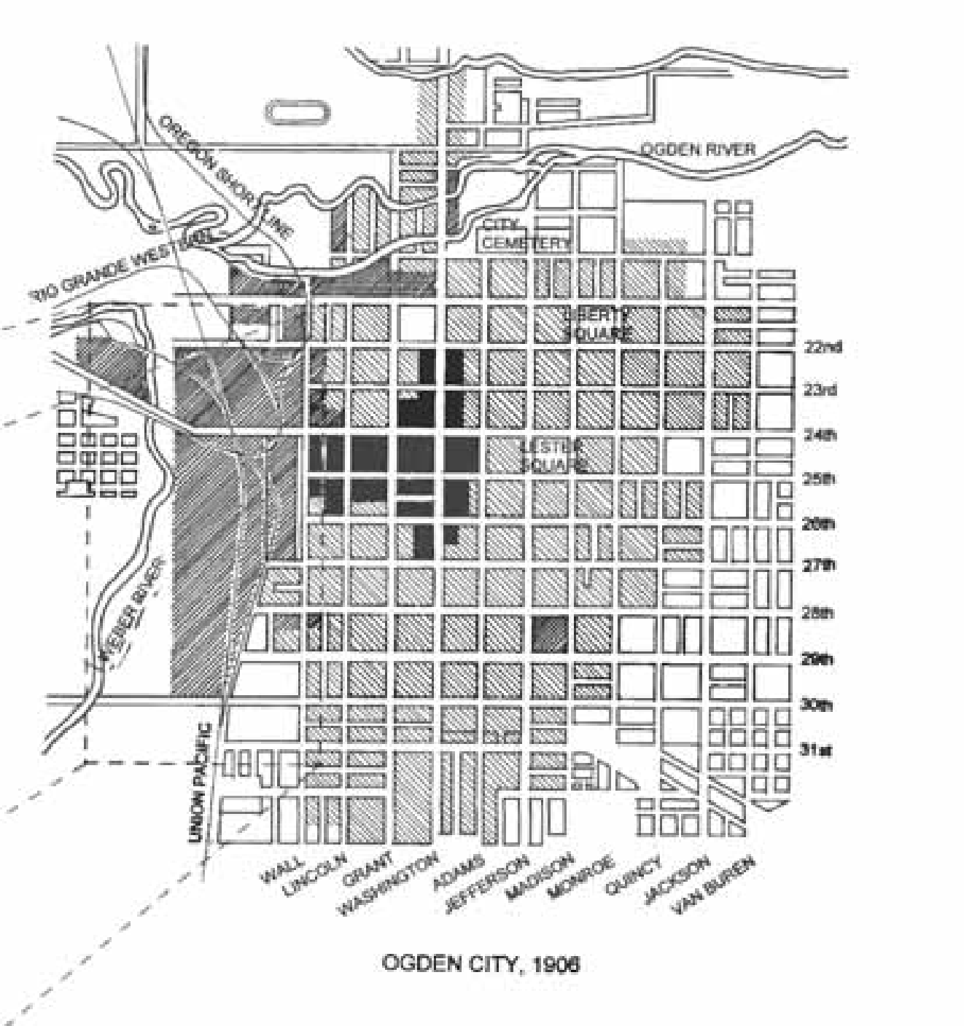
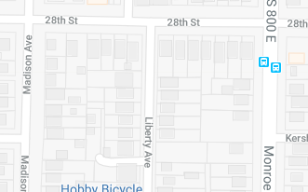
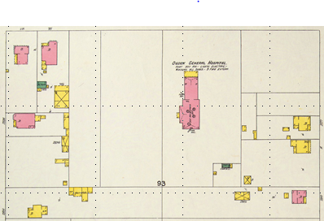
1906 Sanborn Map overlaid on current streets.
(Not to scale.)
From Building by the Railyard: The Historic Commercial and Industrial Architecture of Ogden, Utah; University of Utah, 1998, p. 6.

Slide 26
New Ogden City Hospital: Facility
Hospital Described:
A two-story building divided into a main building and two wings, only one wing (the west wing) to be constructed in the first round of building.
Built of brick and stone, 124’ x 128’ (124’ x 64’ or 62’ x 128’; ~10,000 sf)
Expected to cost $40,000.
Main building 39x84, two stories with a basement.
Entry from 28th to a veranda built to accept a stretcher from an ambulance.
Operating room and pharmacy on the left in the single story section, house surgeon’s quarters on the right.
The first floor of the two story structure contains patient wards, toilet rooms, dining room.
In the basement, a kitchen, pantry, dining room, storeroom and fuel room.
On the second floor, rooms to be used as private wards apart from the regular wards.
A combined system of warm air heating delivered through flues, with foul air removed through registers and vented to the outside – first system of its type in any Ogden building
Connected to City water, but not to sewer (1898), not initially to electricity (1892)
2nd largest hospital in the state when completed, square footage and number of beds.
From the Ogden Standard Examiner, 1891 09 01, p.6, “Our Public Buildings”.

Slide 27
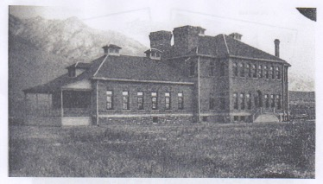
Ogden City Hospital / Ogden General
Union Pacific Hospital
Picture Credit: Union Station Foundation, 00773 bw photo, P:\PP5\IMAGES\002\00773.JPG

Slide 28
Ogden City Hospital: Organization
1891-92: Mayor and supporting members of Council prevail over suggestion that hospital should be leased to a third party to operate, maintain it as an extension of City government.
1892, January/February: Regulations for hospital drafted, debated, moved to full Council. Key concerns:
Abuse of the City’s charity,
Access to the facility by city officials;
Inclusion criteria for community physicians – medical school educated;
Terms of use for non-sponsored patients and physicians;
Bonding of principal employees and accounting.
Also included rules for patient deportment.
1892, May: Finishing site work begins; furnishings allowance approved (it will be exceeded).
1892, May: Mayor authorized to hire “such help for the hospital as in his judgment is fit.”
Expected to operate at or near break-even through careful attention to prevention of abuses, cultivation of private business – subsidies to not exceed their experience at the temporary hospital.

Slide 29
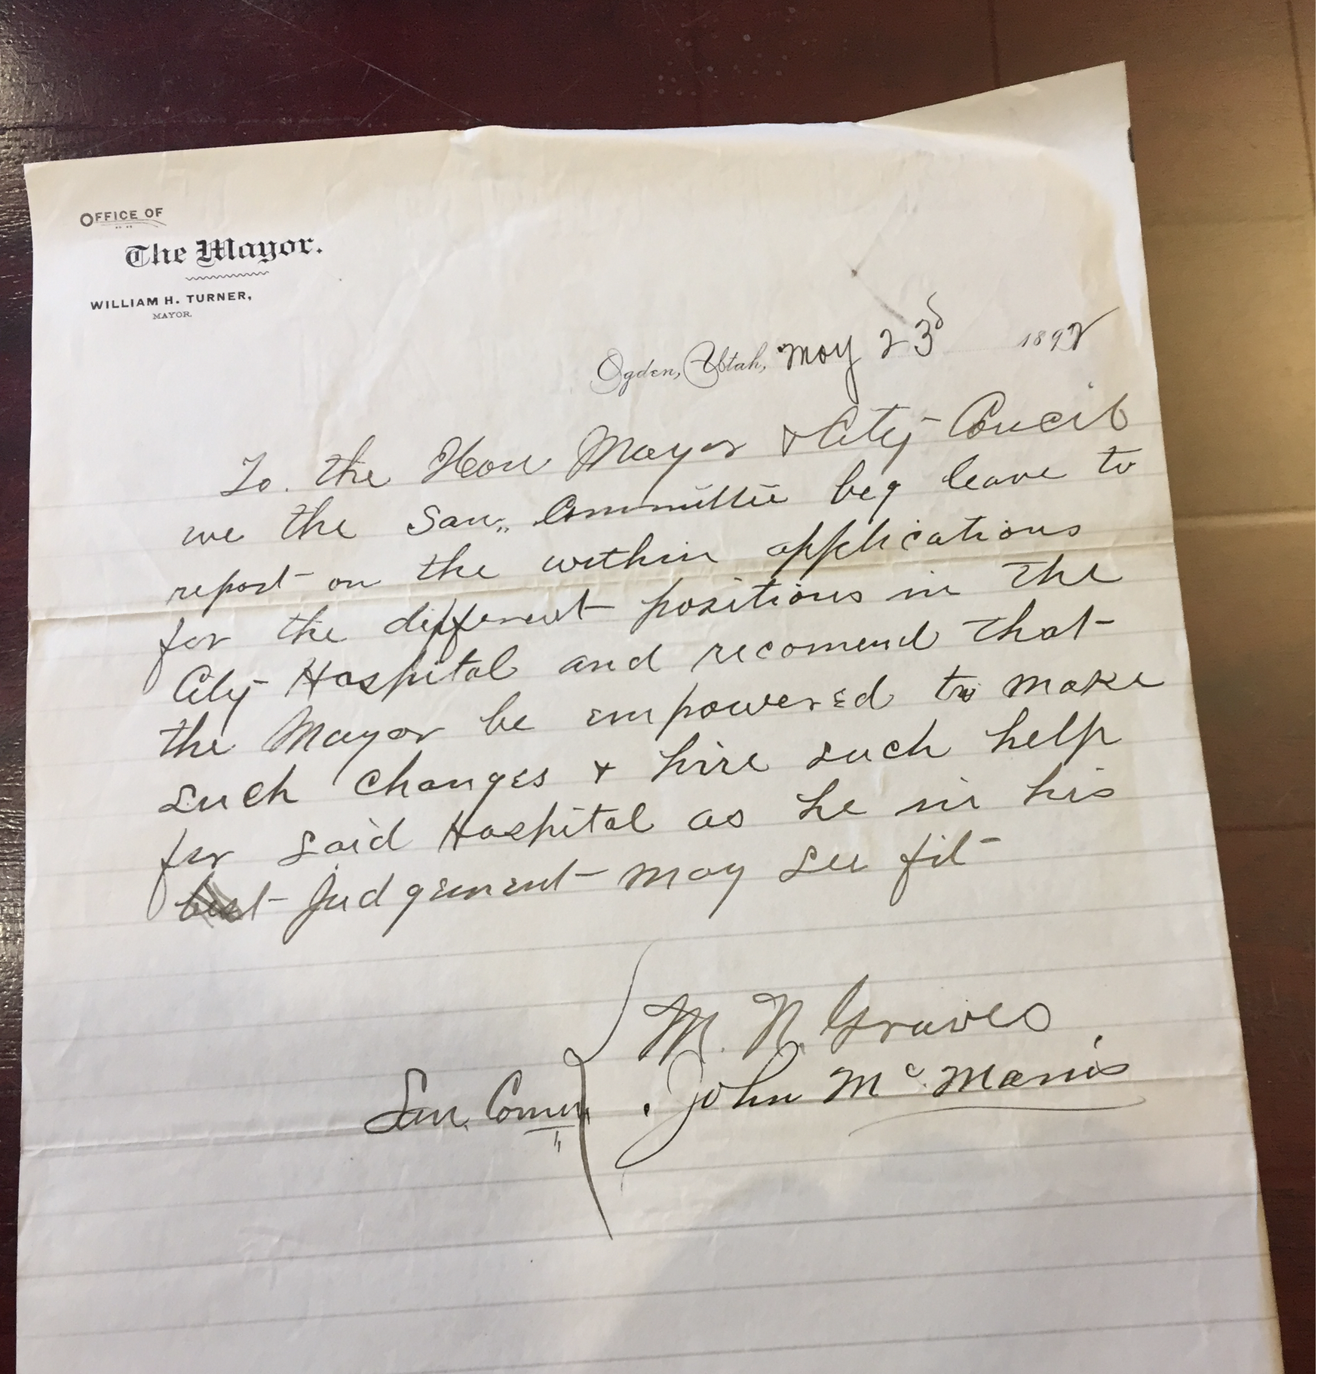
Mayor’s Authorization for Conduct of Hospital Operations
Ogden, Utah, May 23d, 1892
To the Hon. Mayor & City Coucil,
We the San. Committee beg leave to report on the within applications for the different positions in the City Hospital and recomend that the Mayor be impowered to make such changes & hire such help for said Hospital as he in his Judgement may see fit.
M.N. Graves, John McManis
San. Committee
Supplementary Material

Slide 30
Chronological Context of Ogden City Hospital
Year | Hospital | City | # of Beds | Sponsorship
1874 | St. Marks Hospital | Salt Lake | 6; 12 | Religious (Episcopal)
1875 | Holy Cross Hospital | Salt Lake | 13 | Religious (Catholic)
1882 | Deseret Hospital (Closed in 1890) | Salt Lake | ~ 20 - 45 | Religious (LDS)
1882 | Holy Cross 200 South Replacement | Salt Lake | 125 | Religious (Catholic)
1885 | Territorial Insane Asylum | Provo |  | Territorial Government
1886 | Union Pacific RR Hospital | Ogden | ~25 | UPRR
1892 | Ogden City Hospital | Ogden | 50 | Municipal Government
1893 | St. Marks 800 North Replacement | Salt Lake | 35 | Religious (Episcopal)
1905 | LDS/Groves Hospital | Salt Lake | >100 | Religious (LDS)
1911 | Dee Memorial Hospital | Ogden | 100 | Private Not-for-Profit
1912 | Salt Lake County Hospital | Salt Lake | 25 | County Government
… first acute care hospital outside of Salt Lake, first non-denominational, non-proprietary acute care hospital in Utah, 2nd largest acute care hospital in the state at time of opening and for the next ten years …
https://stmarkshospital.com/about/history/full-hospital-history.dot http://mormonhistoricsites.org/historic-holy-cross-chapel/
The Salt Lake Tribune from Salt Lake City, Utah, 11 05 1960, Page 24
http://slco.org/archives/additional-records/county-hospital/

Slide 31
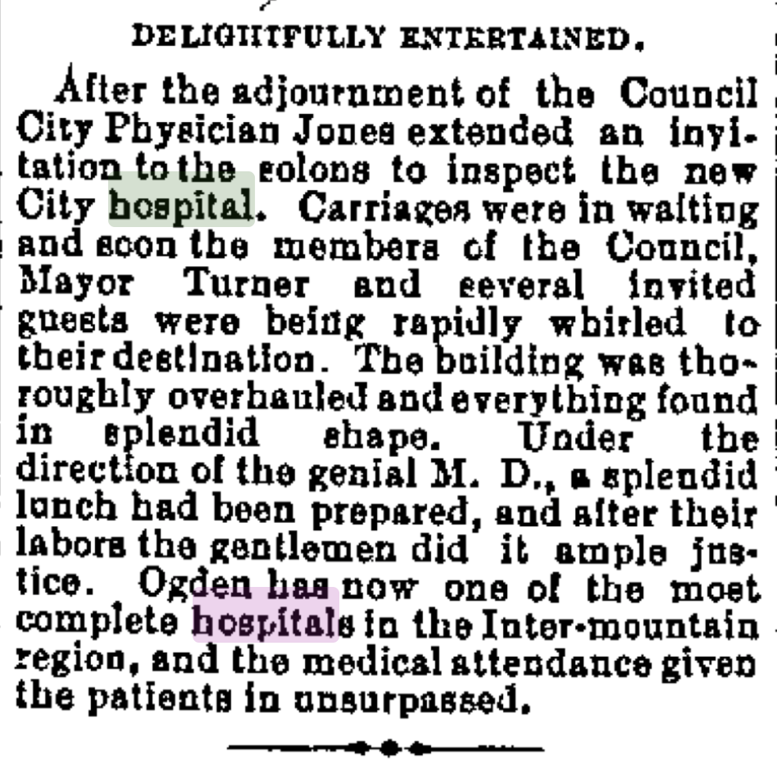
Welcome
Ogden Standard, 1892-06-08: “Ogden has now one of the most complete hospitals in the Inter-mountain region, and the medical attendance given the patients is unsurpassed.”
Seen also as a boost for the local economy – patients will not travel to Salt Lake, will be attracted to shop in Ogden.
Point of pride for Mayor Turner’s 1893 state-of-the-city address to Council.
Report on City hosted opening reception.
From Ogden Standard, 1892 06 28.

Slide 32
Rocky Start
1892, June – December:
Immediate problems with cesspool and waste disposal, need to revisit construction, add wiring for electric lights – ie, no wiring in the original plans.
July, a large number of pigs removed from an adjoining property.
September, several days of census = 1; patient arrested and sent to asylum in Provo.
Not meeting goals for paying patients.
1893:
March Grand Jury Report from 4th Judicial District, Utah Territory, citing problems with the facility and recommending improvements.
May & June … Really bad timing – Panic of 1893 hits, 500 banks, 1,500 commercial firms fail nationally, Union Pacific goes into receivership in October, Council begins talking retrenchment … .

Slide 33
Panic of 1893
1893 economic crisis challenges City’s Model for Operating Hospital
Severe (but not clearly described) disruption of city revenues;
Editorial pressure for cutbacks in government and City expenditures identifying hospital as an unaffordable luxury for a City of Ogden’s status.
The hospital was now a significant expense; it represented ~5% of the total projected 1894 budget.
July 17, 1893, a majority of city council, now composed of an equal number of Republicans (Liberal skew) and Democrats (People’s skew), votes to close the hospital, with Standard Examiner editorial support; also votes for spending and hiring freezes.
July 25, Special Meeting, Mayor reads a veto of the July 17 retrenchment plan, including closure of hospital. Veto is sustained.
New committee appointed to study further retrenchment options, but the hospital has survived.

Slide 34
City Hospital Challenges: 1894-1896
1894: Conflict continues over cost and operating philosophy within city government
Several attempts by council cohort to force sale of the facility to the county (which did not want to buy it);
Attempts to end City operations and lease the hospital to limit city exposure to costs;
Opposed by Ladies Charitable Association petition and prominent physicians;
Compromise position reached in August 1894 with lease to Frank Sherwood, immediate past steward, for 18 months, with Mayor, City Physician and Sanitary Committee in titular control.
1894–96: Conflicts over Indigents, Role of City & County
County chafes at expense of maintaining patients at City Hospital;
County Government Act of 1896, reprising responsibilities delegated to Counties in 1888, generates confusion, competitive intentions on the part of the County; leads some Ogden City Council members to feel that the City has been relieved of the burden of maintaining a hospital, needs no longer maintain the service;
County looks at possibility of establishing its own hospital; briefly does so in basement of County building in early 1897; ceases operation almost immediately.

Slide 35
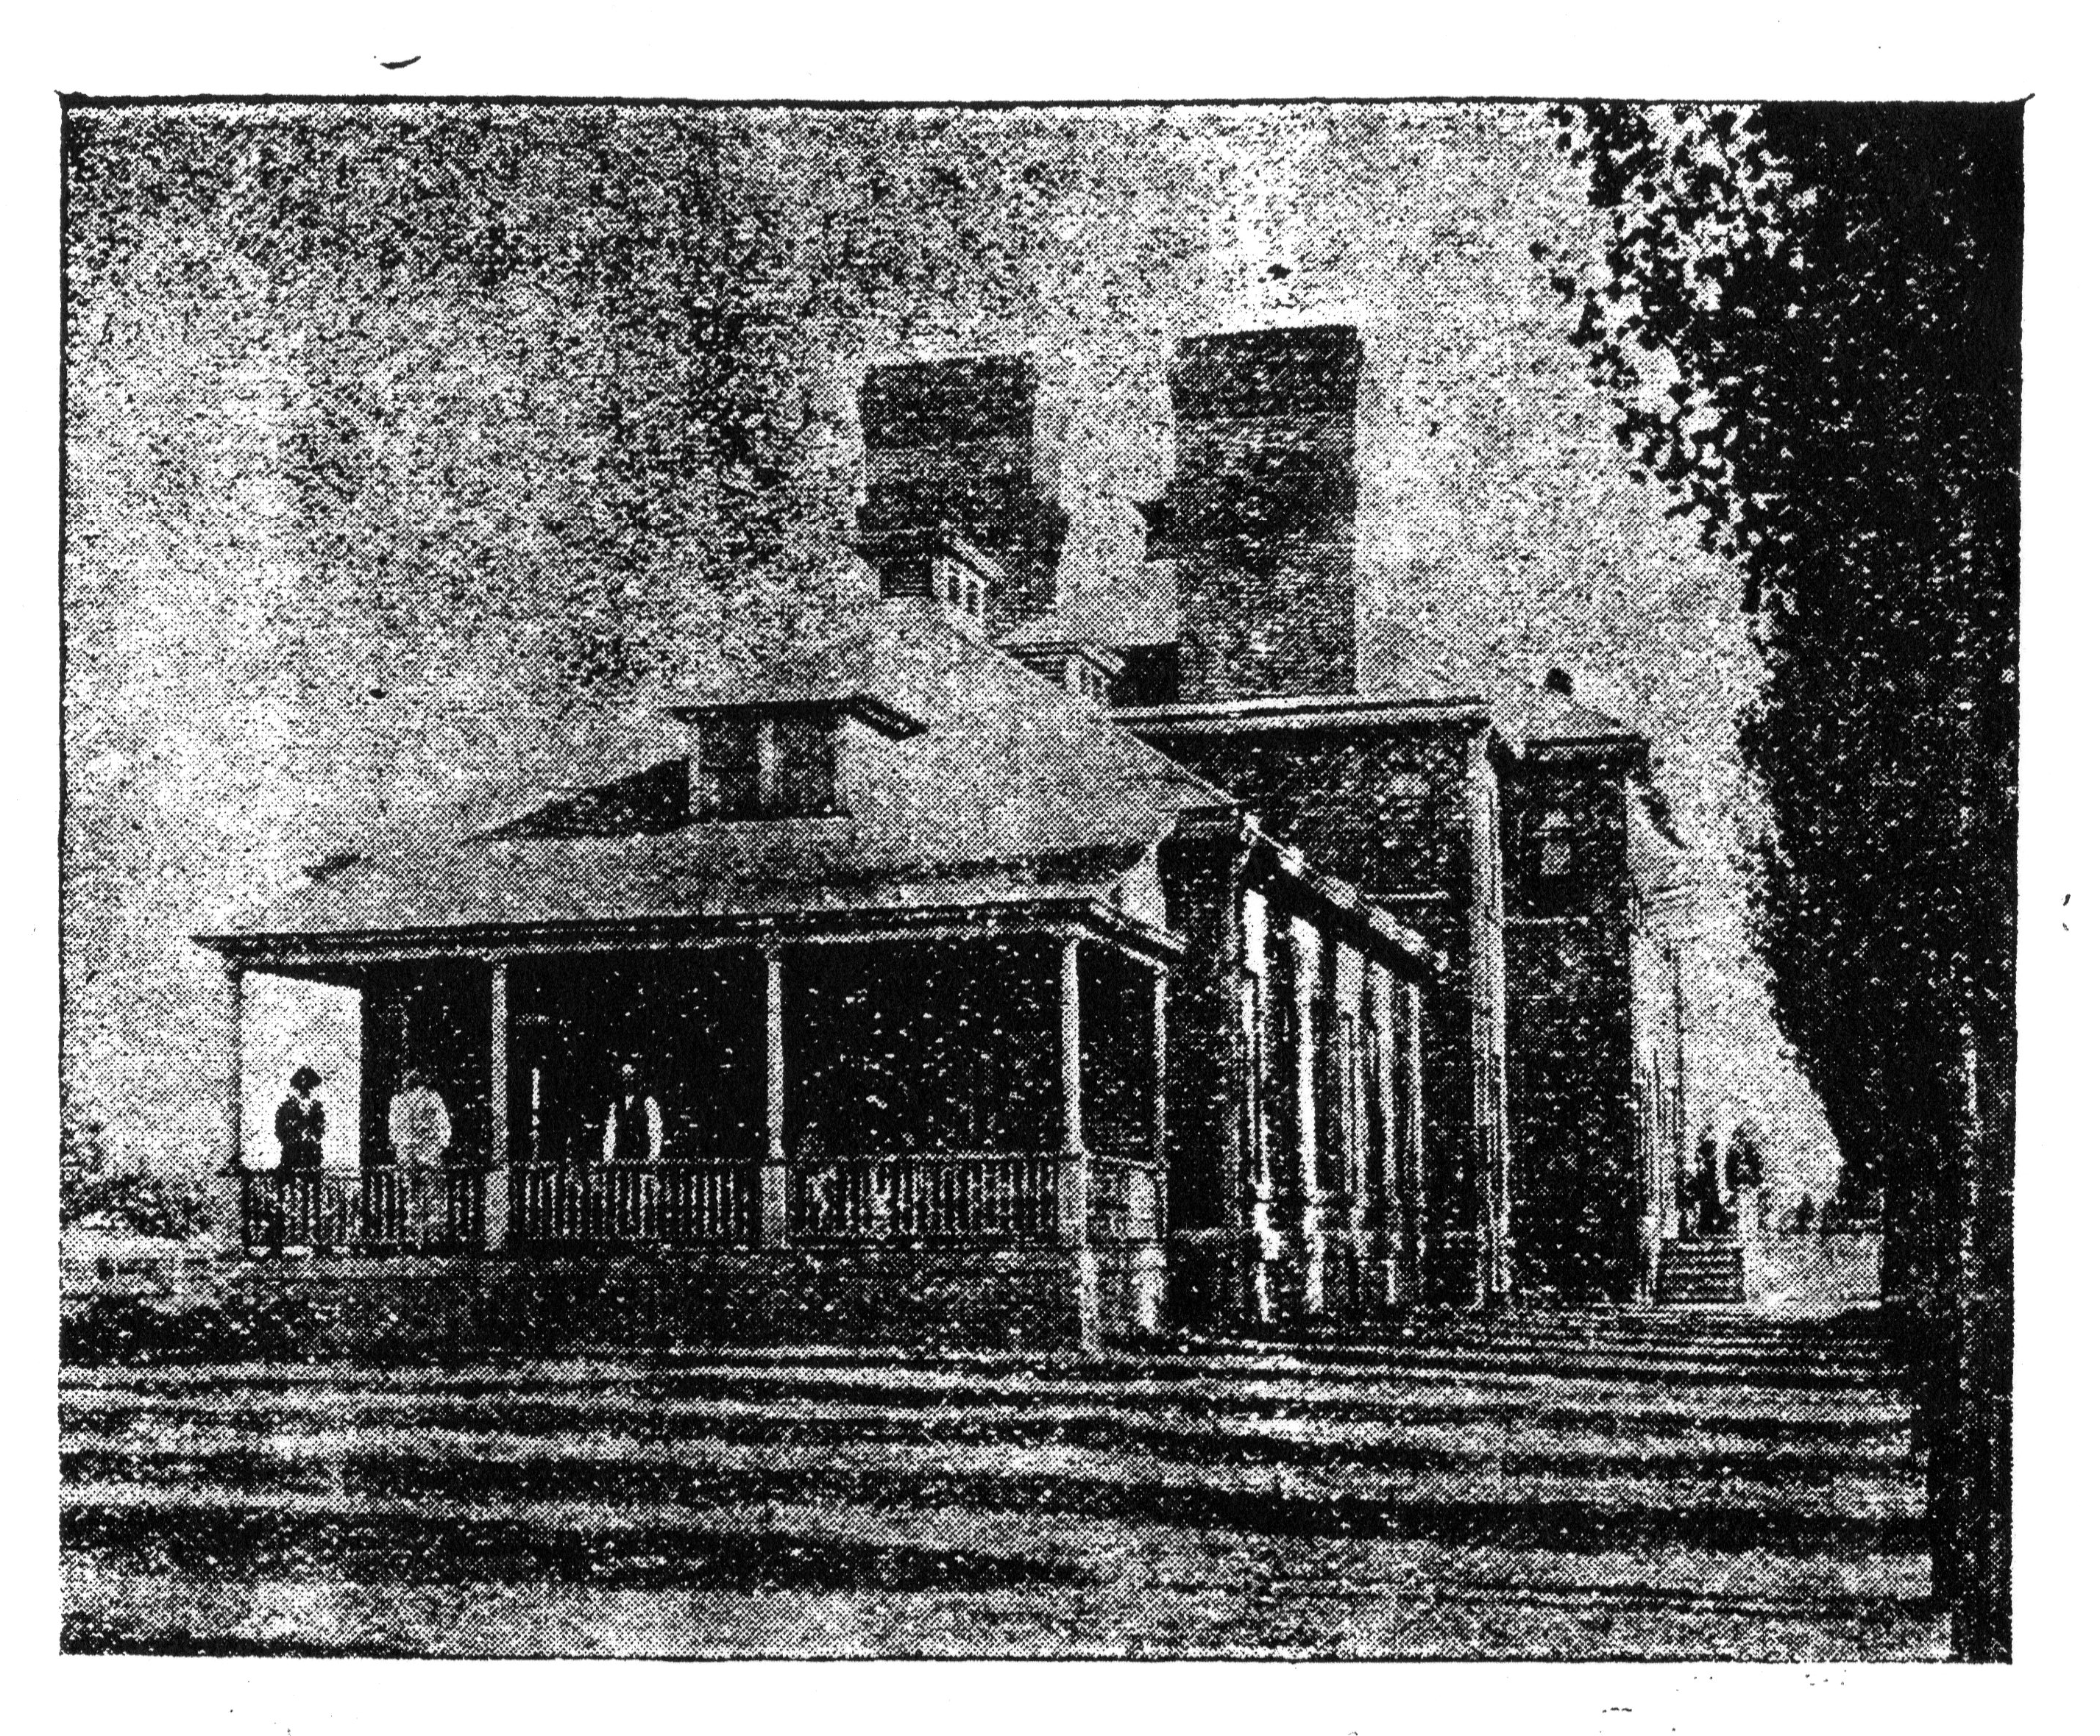
Ogden Medical & Surgical Hospital: 1897 – 1911 (Ogden General)
From Industrial Utah, July 15, 1901, p. 18)

Slide 36
Ogden General/Ogden Medical Surgical Hospital
Late 1896, settlements in UPRR bankruptcy of 1893 force closure of UPRR hospital in Ogden;
Buildings and contents are sold to generate cash to repay creditors, share holders;
Creates both the possibility and the need for non-railroad providers to be contracted for care of RR employees, while similar contracts were something of a norm for other railroads and large corporations, boosting component of paying patients for a hospital.
Thus in an unexpected way, the Panic of 1893 was a key factor in the Ogden hospital’s finally achieving financial viability.

Slide 37
Ogden General/Ogden Medical Surgical Hospital
Ogden Medical Surgical Corporation forms in late 1896, seeks to take over lease for management of hospital.
Not the only competitors for the lease, probably not the lowest cost option – decision to work with OMSC suggests a desire to install and maintain a professional level of quality at the hospital.
Physician owned corporation: Drs. Gordon, Coulter, Driver, Joyce & Hyde – group includes current and future City and County Physicians, railway and other corporate employee physician service contractors.
First terms call for a fixed lease payment with the corporation responsible for all operations;
Subsequently revised so that annual lease payments were forgiven in exchange for the promise of investment of an equal amount in facility upgrades;
Amounts appear to have been non-nominal – but still not large enough to generate a return on the original investment or a contribution to debt service for the City.
First lease 3yrs 1897-1900; Renewed for ten years through 1910.

Slide 38
Ogden General/Ogden Medical Surgical Hospital
Model in Practice:
City provided land and facilities – capital investment;
County, large employers underwrote care for a portion of persons to be served;
Physician corporation operated the hospital, taking the City’s place as employer of staff and provided minor capital;
Corporation enabled maintenance of separate accounts for hospital and physician revenues, protection of physicians’ personal businesses from that of the hospital.

Slide 39
Ogden General/Ogden Medical Surgical Hospital
Features promoted at the time: 50 beds; Men’s & women’s wards; private rooms; special provisions for surgery, children and maternity, special precaution against the dangers incident to confinement; staff in all branches of medicine and surgery; open to all reputable physicians.
Specialty services listed: Surgery, Obstetrics, Eye and Ear, General Practice, Children’s Diseases, Diseases of Women, Nervous Diseases.
Greeted with renewed enthusiasm and boosterism echoing 1892 – as fine a facility as any in the Intermountain west, a boon to the local economy …
Appears to have succeeded, and achieved the transition from “facility for the poor” to a hospital for the community’s physicians and patients.

Slide 40
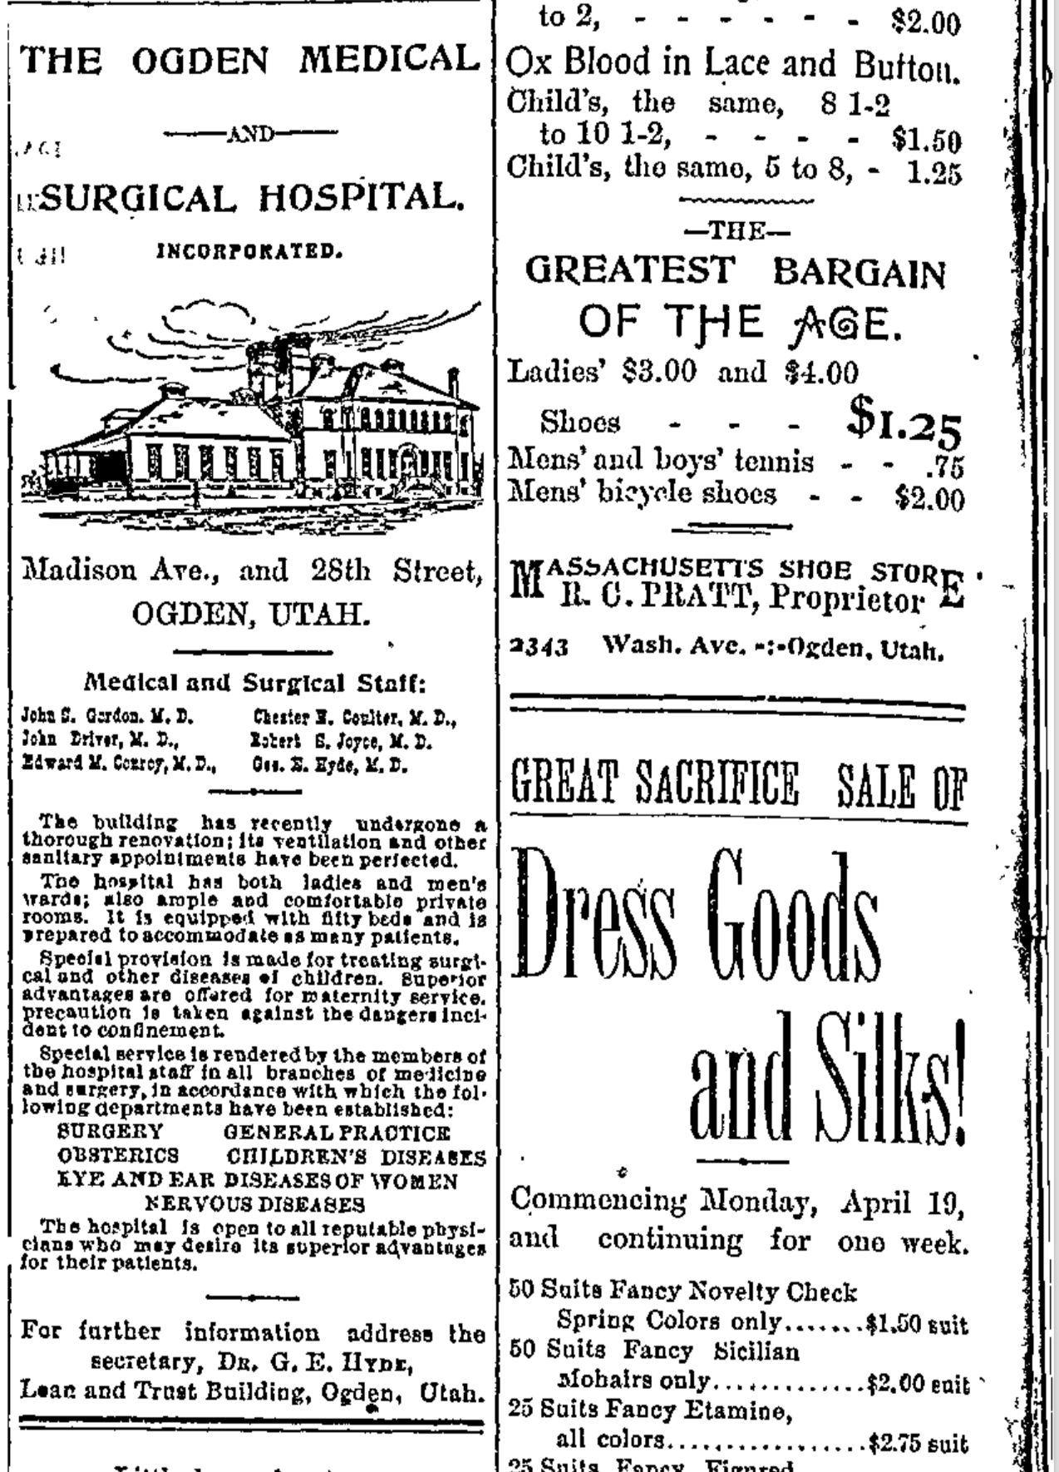
Advertisement appearing in the Ogden Standard, 1897 04 25, p 8, and as frequently a three times per week over the first year and a half of the new arrangement.

Slide 41
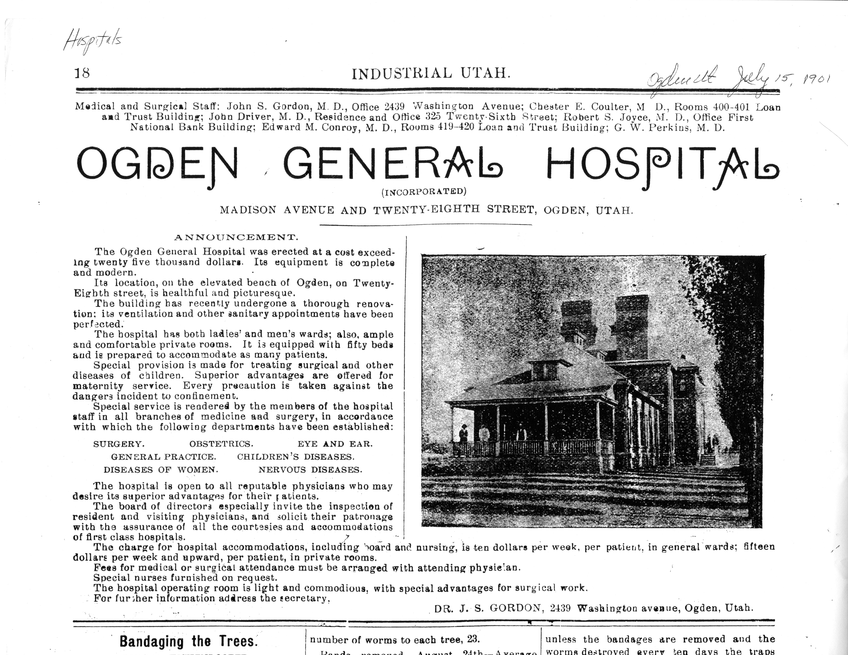

Slide 42
Observations of Ogden General
Operated for 14 years from 1897 through the 1911 with apparent stability.
Reduced Ogden City outlays for support of the hospital (as represented in newspaper reports of City Council budget reviews) to near zero.
Criticized in the press for occasionally turning away patients for inability to pay and by the County (occasionally) for the expense of supporting patients there and for turning away reporters’ inquiries seeking news and comment about specific patients.
Not otherwise much criticized or noticed in the press, except as the place where the sick and injured were taken for care.
No longer served as a pest-house or source of treatment for non-acute patients with highly contagious conditions – initiated infection control procedures to ensure that such patients were not admitted or, when admitted, were effectively isolated and then discharged to the pest house, which was reopened after 1900.
Offered a reasonably rich portfolio of surgical procedures and treatment for various medical and surgical conditions, served by a growing number of physicians.
Offered nurses training and was a regular advertiser for nursing, housekeeping and similar jobs.
Installed a nurse call system wired to serve all beds.
Served by (and perhaps owned) an ambulance … that was given priority right-of-way privileges in 1906.
Consistently admitted and took care of people from a cross-section of Ogden society – city officials, laborers, business owners and their children and families – not just the poor.
Made contributions to earthquake relief for San Francisco in 1906 and was itself a recipient of charity, an ”endowed ward” from Ogden Elks, books and other items for the use of hospitalized patients.
Drew patients from Davis, Box Elder, Idaho, Morgan, Evanston.
Had an active medical staff of 30 or more in 1910.

Slide 43
Some Case Types at Ogden General
 | 1897-98 | 1898-99 | 1899-1900 | 1900-01 | 1901-02
Trauma | 5 | 8 | 1 | 7 | 4
Infectious Disease/Med | 5 | 2 | 2 | 2 | 7
Appendectomy | 2 | 2 |  | 1 | 5
Elective Surgery | 1 | 2 | 1 | 8 | 2
Unspecified/Other | 6 | 4 | 2 | 8 | 4
 | 19 | 18 | 6 | 25 | 22
Trauma: Gun shot; kicked by horse; feet and legs crushed; unconscious.
Infectious Diseases: Meningitis, typhoid, pneumonia, measles.
Elective Surgery: Stomach cancer, necrotic foot repair, female conditions, post-amputation reset, non-trauma leg amputation, tissue removal from neck.
Other: Stroke (apoplexy), brain abscess, lame back, rheumatism.
Supplementary Material
From the “Random References” section of Ogden Standard, October 1897 – September 1902; accessed through Utah Digital Newspapers, The University of Utah. https://digitalnewspapers.org/

Slide 44
The Replacement of Ogden General
Building and site were insufficient for the growth and increased sophistication of the next generation of hospitals
Increase in the number of physicians based in Ogden and the number of things that physicians could do in hospitals, creating demand for larger, more capable facilities
32 physicians on the first staff of the Dee; 6 in the Ogden Medical Surgical Corporation in 1897
Needed a new financial model … Current model model was adequate for maintaining operations of a hospital, not adequate for upgrades, expansion or provision of charity care
All recorded capital investment in the hospital had been done by the City, either directly or in the form of forgiven lease payments for OMSC;
1900’s City considered, then backed away from new investment for replacement, first discussed as early as 1898.
No visible advocacy for continued City ownership or a return to a full municipal hospital model.

Slide 45
The Replacement of Ogden General
Between 1905 and end end of OMSC’s 10 year lease in 1907 there were a number of starts at setting the next course for the hospital:
Two or three sets of bidders proposing to take over the hospital lease;
Two separate attempts on the part of the city to auction the hospital and exit the business;
Consideration by city business leaders to form a (for-profit) stock company to take over the hospital.
Preferred model emerges with philanthropy (primarily from the Dee family) as the source of capital, and with a not-for-profit organization as the owner and operator.
City acquiesces in transfer of operations to the new venture without compensation.
Appears to mark the end of the City’s role as payer of last resort for medical care for ‘objects of public charity’.
Medical staff, patients, nursing staff, other employees, some portion of the equipment and furnishings – all transferred from Ogden General to the new Dee Memorial at its inception.

Slide 46
New Hospital, New Model
Dee Memorial Hospital
Private not-for-profit corporation responsible for all operations and capital;
Facilities, facility improvements, equipment, etc. funded by donations and retained earnings (if any), with one major donor and a number of smaller participants;
Billing of all organizations with responsibility for patient sponsorship -- Railroad funds, Utah Construction Co., etc. – similar to previous regime;
Charity care to be supported by income from endowments, other non-government, non-operating moneys;
Ideal: No worthy person/circumstance turned away.
Model succeeded in creating capital for a substantially larger and more capable replacement facility.
Ended Ogden’s experiment with publicly funded hospital services, but proved relatively short-lived as a stand alone operating model – by 1913 financial pressures exceeded the corporation’s and its sponsors’ ability to maintain it.
Only viable after takeover/intervention by the LDS Church, the model that persisted into the 1970s.

Slide 47
Takeaways
Ogden City built and operated the first non-denominational, non-railroad acute care hospital in Utah, in temporary quarters in 1890, and in a permanent facility starting in1892.
In the roughly five years between January of 1890 and the end of 1894 that first hospital was a public hospital, fully funded by the City, maintained as part of the city budget.
After 1894 – over the opposition of progressives in the community – leasing became the preferred mode for hospital operations, with the City taking its lease payments in the form of reinvestment and improvements.
The Ogden Medical Surgical Hospital corporation leased and operated the hospital from 1897 through 1911, growing its attending staff to about 30 medical school educated physicians, providing medical and surgical services to Ogden and neighboring communities.
That hospital ceased operations in 1911, absorbed by the new Dee Memorial Hospital, providing most of that hospitals initial compliment of medical staff members, employees and patients.
The grounds and building were disposed of by 1920,
… and then we mostly forgot about it.

Slide 48
Why Have We Forgotten?
The traumatic nature of the first years, the near extinguishment of the hospital in 1893 and its reorganization in 1894 under a leasing operating model?
Mistaken and often repeated impression that it DID close in 1893?
Embarrassment? Initial design flaws, fetid cesspools, pigs rutting in the side yard, lurid events?
Erasure of the building and site relatively quickly after closing in 1911 – out of sight, out of mind?
Overshadowed by the more mythic stories of the Dee Memorial and, later, St. Benedict’s?
Religious influence?
Wrong story for who we became – a secular, publicly initiated undertaking in a community that became wary of government and government provision of health services?

Slide 49
Sources (… list is still incomplete.)
James B. Allen, The development of county government in the Territory of Utah, 1860-1896, MA Thesis, Department of History, Brigham Young University, 1956.
Jennifer Jones, www.thedeadhistory.com, articles about pest houses, Roy poor farm
Milton R. Hunter, ed, Beneath Ben Lomond’s peak: A history of Weber County, 1824-1900, Publishers Press, Salt Lake City, 1966.
Kathryn MacKay, Sisters of Ogden’s Mount Benedict Monastery, UHQ, Summer 2009.
Eleanor Moler, A Tradition of Caring.
Greg Montgomery, Ogden City Planning; Ogden City Recorder’s Office; Weber County Assessors Office.
Richard Roberts and Richard Sadler, A history of Weber County, Utah State Historical Society, 1997.
Richard Roberts and Richard Sadler, Ogden: Junction City, Windsor Publications, Inc, 1985.
Charles E. Rosenberg, The care of strangers: The rise of America’s hospital System, Johns Hopkins University Press, 1987
Sanborn Fire Insurance Maps, J. Willard Marriott Library, University of Utah, Block 79, https://collections.lib.utah.edu/details?id=321176; https://collections.lib.utah.edu/search?facet_setname_s=uum_sfim
Paul Starr, The social transformation of American medicine, Basic Books, 1982.
Utah Digital Newspapers, University of Utah, digitalnewspapers.org
Stories from Salt Lake Telegram, Salt Lake Tribune, Salt Lake Herald, Ogden Junction, Ogden Herald, Ogden Standard, Ogden Standard Examiner, Deseret News, 1875 – 1911
Utah State Archives, Ogden Corporation, City Council Minute Books and corporate files from 1883-1900+
Ronald W. Walker, The Panic of 1893, Utah History Encyclopedia, https://www.uen.org/utah_history_encyclopedia/p/PANIC_1893_FINANCIAL.shtml, accessed March 23, 2018.
Weber County Medical Auxiliary, The history of medicine in Weber County from 1852 to 1980, Weber County Medical Society, 1983.
Tom Vitelli, The story of Intermountain Health Care, Intermountain Healthcare, 1995.
Wikipedia and miscellaneous internet sites.

