Slide 2
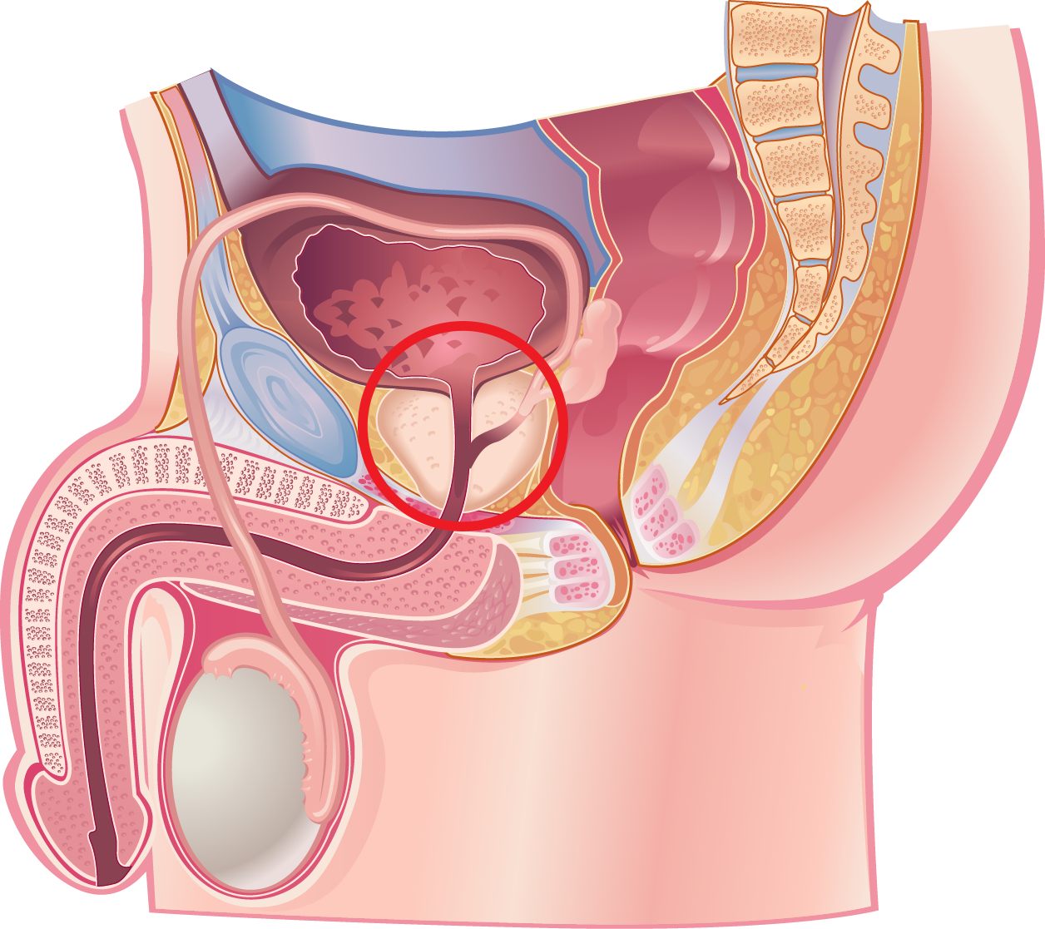
THE PROSTATE

Slide 3
PAIN IN THE ….
Cancer
Enlargement
(BPH)
Infection

Slide 4
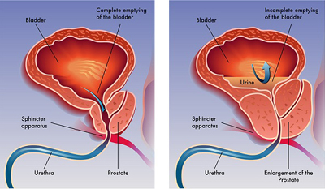
BPH

Slide 5
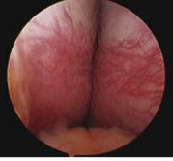
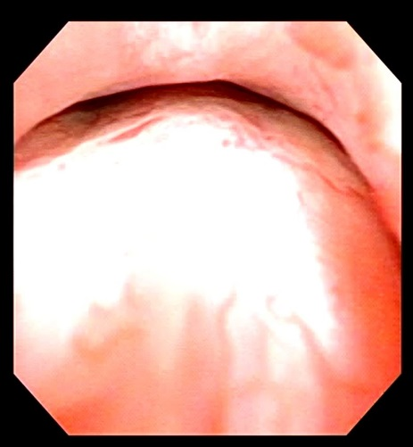
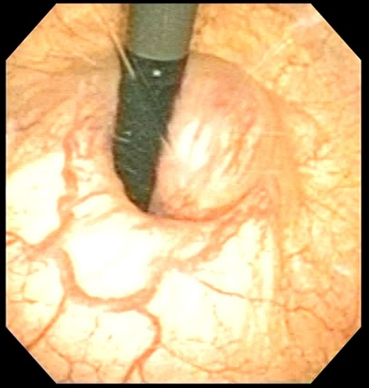
BPH

Slide 6
BPH: Symptoms
OBSTRUCTIVE
IRRITATIVE
Slow Stream
Hesitancy
Starting and stopping
Incomplete Emptying
Frequency
Urgency
Nocturia
Incontinence
(Urgency)

Slide 7
BPH: Treatment: Medication
Relax (α – blockers)
Shrink (5-ARIs)
Flomax
Rapaflo
Alfuzosin
Terazosin
Proscar
Finasteride
Avodart
Dutasteride

Slide 8
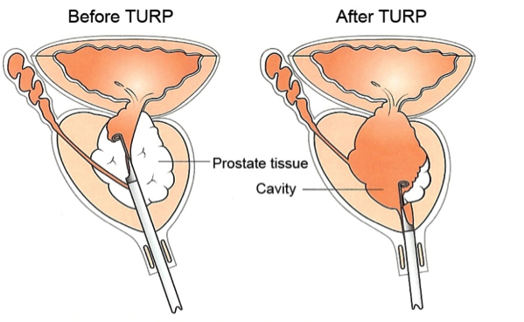
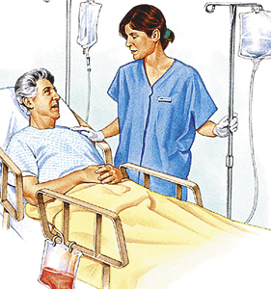
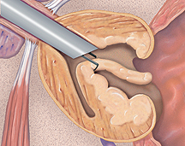
TURP

Slide 9
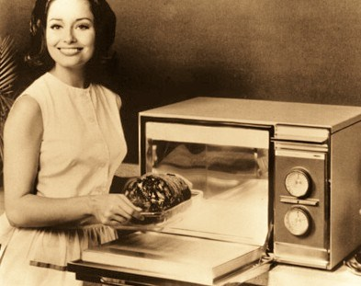
MINIMALLY INVASIVE
Microwave
TUNA (RF)

Slide 10
MINIMALLY INVASIVE

Slide 11
REZŪM

Slide 12
REZŪM

Slide 13
REZŪM
Convective RF Thermal Energy
Conductive RF Thermal Energy
Transition Zone Boundary
Heat Source
.42 mL RF Water Vapor Injection

Slide 14
REZŪM
Convective RF Thermal Energy
Conductive RF Thermal Energy
Transition Zone Boundary
Heat Source
Technology | Calories per average procedure | Joules per average procedure
Water Vapor Energy | 940 | 3,900
TUNA- RF | 5,000 | 20,000
TUMT- Microwave | 20,000 | 85,000
.42 mL RF Water Vapor Injection

Slide 15
REZŪM

Slide 16
REZŪM

Slide 17
REZŪM
 | Time | N | Mean (cm³) | Mean ∆ (cm³) | Mean % ∆
Transition Zone Volume | 1 Week | 59 | 40.1
 | 1 Month | 57 | 33.1 | -7.0 | -17.5%
 | 3 Months | 55 | 28.0 | -12.1 | -30.2%
 | 6 Months | 54 | 24.8 | -15.3 | -38.2%
Prostate Volume | 1 Week | 59 | 67.8
 | 1 Month | 57 | 58.5 | -9.3 | -13.7%
 | 3 Months | 55 | 51.7 | -16.1 | -23.7%
 | 6 Months | 54 | 47.2 | -20.6 | -30.4%

Slide 18
REZŪM – Urinary Symptoms

Slide 19
REZŪM – Sexual Function
No Dysfunction
Mild Dysfunction
Mild to Moderate Dysfunction
Moderate Dysfunction
Severe Erectile Dysfunction

Slide 20
REZŪM
These comparisons are not drawn from head-to-head studies with these competitive products – this data merely recites the data drawn from published literature involving these products. The reader should draw their own conclusions from this data.
¹ McVary KT, Roehrborn CG. Three-Year Outcomes of the Prospective, Randomized Controlled Rezūm System Study: Convective Radiofrequency Thermal Therapy for Treatment of Lower Urinary Tract Symptoms due to Benign Prostatic Hyperplasia. In Press. UROLOGY.
² Bouza C, López T, Magro A, Navalpotro L, Amate JM. Systematic review and meta-analysis of transurethral needle ablation in symptomatic benign prostatic hyperplasia. BMC Urol. 2006; 6:14.
³ Mynderse LA, Roehrborn CH, Partin AW, Preminger GM, Coté EP. Results of a 5-Year Multicenter Trial of a New Generation Cooled High Energy Transurethral Microwave Thermal Therapy Catheter for Benign Prostatic Hyperplasia. J Urol 2011,185:1804-1810.
⁴ Roehrborn et al. Three year results of the prostatic urethral L.I.F.T. study. Can J Urol. 2015;22:7772-7782.

Slide 21
REZŪM

