Slide 1
Nicotine in 2018: The State of use in Utah
Sarah Woolsey, MD, MPH, FAAFP

Slide 2
Thanks To
Kevin Nelson, MD, PhD, FAAP
Nell Hodo, MD
Steve Hanson, MPH
Utah Tobacco Free Alliance

Slide 3
“A cigarette is the only consumer product which when used as directed kills its consumer.”
- Dr. Gro Harlem Brundtland
Former WHO Director General

Slide 4
Disclosure
No conflicts of interest

Slide 5
learning objectives
Understand current tobacco and electronic cigarette usage rates in Utah
Utilize evidence-based techniques for smoking cessation interventions with patients and families
Understand how to integrate the Utah Department of Health’s proven and free cessation services into your clinical setting
Notes:
Title : Nicotine in 2018: The State of use in Utah
Objectives:
¡ Understand current tobacco and electronic cigarette usage rates in Utah
¡ Utilize evidence-based techniques for smoking cessation interventions with patients and families
¡ Understand how to integrate the Utah Department of Health’s proven and free cessation services into your clinical setting

Slide 6
By the Numbers
Notes:
LISTEN FOR a STAT that means something to you….and I have prizes for volunteers to share

Slide 7
nicotine addiction: by the numbers
More than 1,200 Utahns die each year from tobacco use
In 2017, 180,000 individuals over the age of 18 in Utah reported that they currently smoke cigarettes (8.7%)
70% of current smokers report that they plan to quit in the next year
TOBACCO PREVENTION AND CONTROL IN UTAH Fifteenth Annual Report, August 2015
http://www.tobaccofreeutah.org/pdfs/tpcpfy15report.pdf
TOBACCO PREVENTION AND CONTROL IN UTAH SEVENTEENTH ANNUAL REPORT, DECEMBER 2017
http://www.tobaccofreeutah.org/pdfs/TPCPFY%20Current%20report.pdf

Slide 8
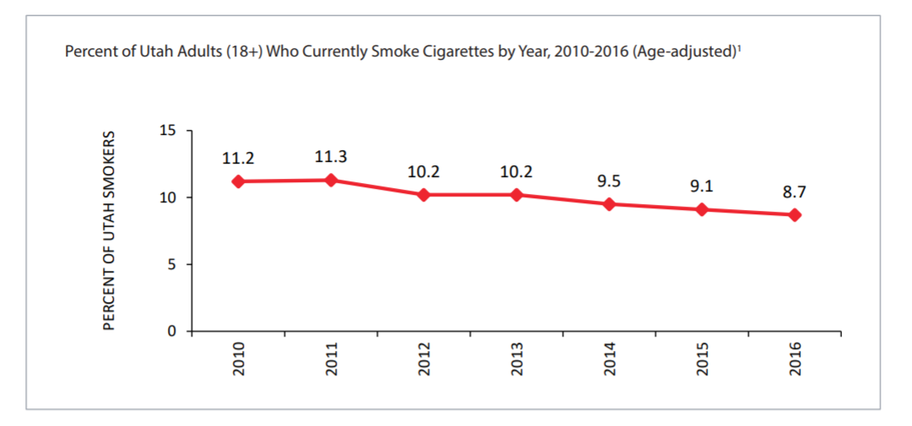
Percent of Utah Adults (18+) Who Currently Smoke Cigarettes by Year, 2010-2016
TOBACCO PREVENTION AND CONTROL IN UTAH SEVENTEENTH ANNUAL REPORT, DECEMBER 2017
http://www.tobaccofreeutah.org/pdfs/TPCPFY%20Current%20report.pdf

Slide 9
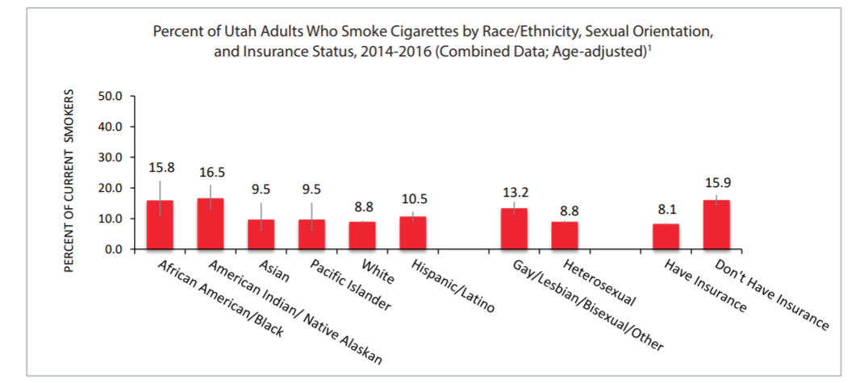
Disparities amongst Utah Adults Who Smoke Cigarettes, 2014-16
TOBACCO PREVENTION AND CONTROL IN UTAH SEVENTEENTH ANNUAL REPORT, DECEMBER 2017
http://www.tobaccofreeutah.org/pdfs/TPCPFY%20Current%20report.pdf

Slide 10
Nicotine addiction & Youth
In 1981, a Philip Morris report had the following to say about tobacco & teenagers:
Nicotine addiction is a pediatric epidemic: nearly 90% of adult smokers started before the age of 18
“Today’s teenager is tomorrow’s potential regular customer. The smoking patterns of today’s teenager are particularly important to Philip Morris.”
-PM Industry Document, 1981
AAP. Bright futures: Guidelines for health supervision of infants, children, and adolescents. 3rd ed. AAP; 2008.
Benowitz NL, Goniewicz ML. JAMA. 2013;310:685-686. ³Grana R, et al. Circulation. 2014;129:1972-1986.

Slide 11
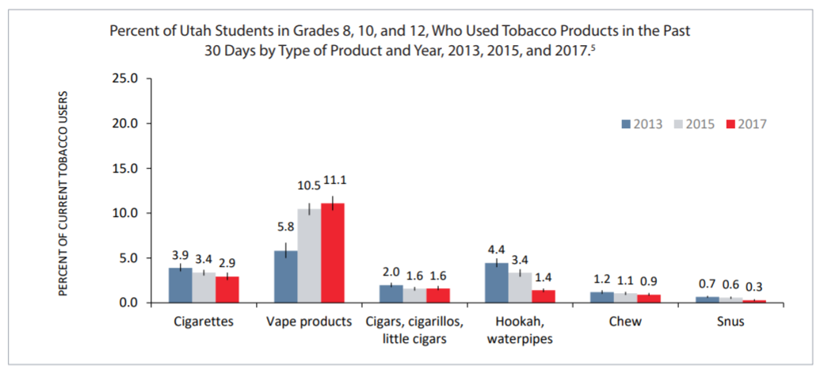
Nicotine addiction and Youth: by the numbers
TOBACCO PREVENTION AND CONTROL IN UTAH SEVENTEENTH ANNUAL REPORT, DECEMBER 2017
http://www.tobaccofreeutah.org/pdfs/TPCPFY%20Current%20report.pdf
Notes:
2.9% is the lowest recorded level of cig use in youth
Yet vapor use increases

Slide 12
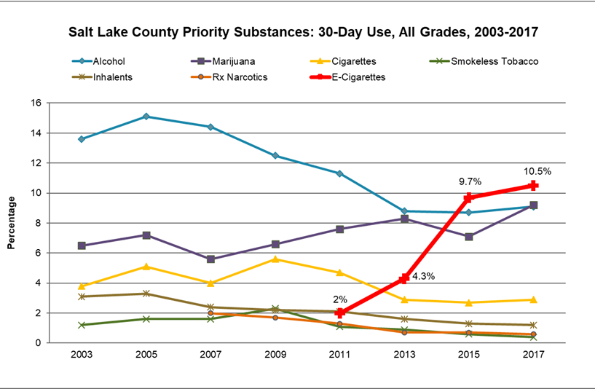
Priority Substance , SL County

Slide 13
CDC Drilldown on National Youth Tobacco Survey 2016
39 percent of those who'd tried e-cigarettes said that use by a "friend or family member" was the reason
Almost one-third said that enticing "flavors such as mint, candy, fruit or chocolate" led them to try vaping
17 percent thought e-cigarettes would be safer than other forms of tobacco
https://stacks.cdc.gov/view/cdc/51693

Slide 14
What has surprised you so far?

Slide 15
ENDS
Notes:
WHAT DOES ENDS STAND FOR?

Slide 16
Electronic nicotine delivery systems
Electronic cigarette – e-cigarette, hookah stick
Electronic nicotine delivery device
Nicotine liquid – “Juice”
“Vaping”
Can deliver more nicotine than regular cigarette

Slide 18
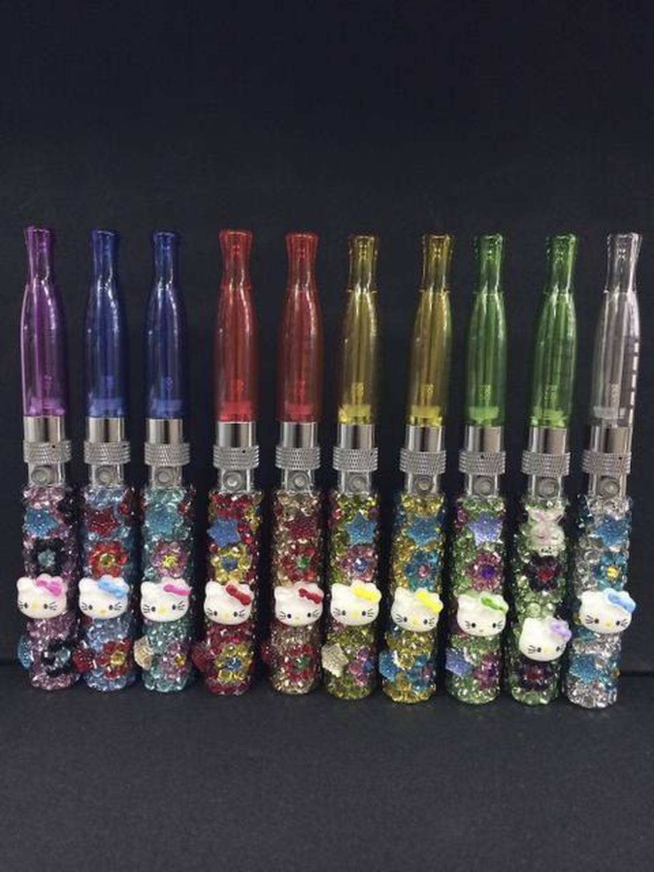

Slide 19
Notes:
More mods.

Slide 20
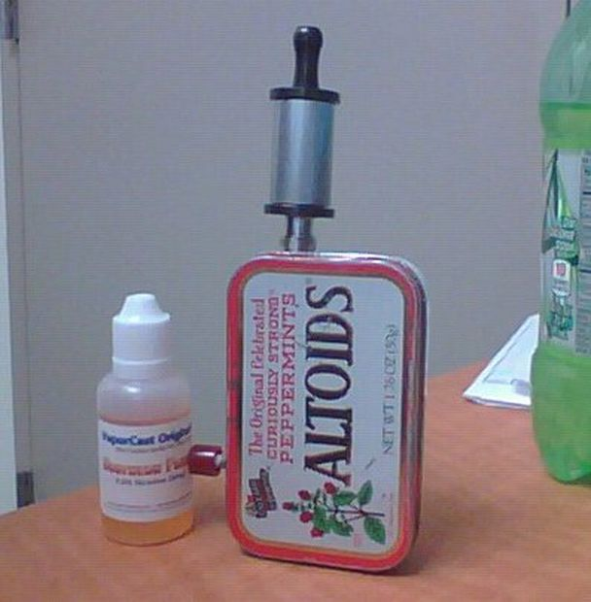

Slide 21
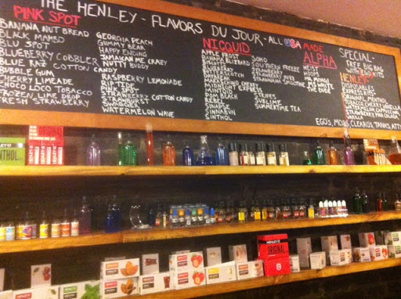

Slide 23
Electronic Cigarettes - the New Pathway to Nicotine Addiction
Since 2011, Utah youth use rates increased fivefold despite the law prohibiting sales to minors under the age of 19
Nearly one-third of teens who used e-cigarettes in the past 30 days have never tried a cigarette
A recent Utah study showed that vape and tobacco specialty stores are most likely to sell to teens
Electronic Cigarettes in Utah http://www.tobaccofreeutah.org/pdfs/e-cig%20summary%202015.pdf
Leventhal et al, JAMA 2015 Aug 18;314(7):700-7.

Slide 24
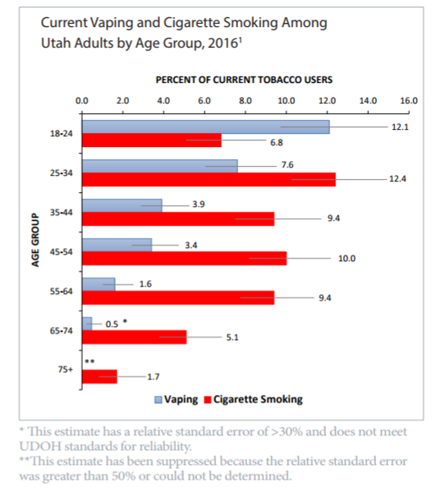
Nicotine addiction and Youth: by the numbers (cont’d)
12.1
12.4
TOBACCO PREVENTION AND CONTROL IN UTAH SEVENTEENTH ANNUAL REPORT, DECEMBER 2017
http://www.tobaccofreeutah.org/pdfs/TPCPFY%20Current%20report.pdf

Slide 25
what adults are using e-cigarettes?
Many Utah E-cigarette users continue to smoke conventional cigarettes (“dual use”)
Nearly 60% of current e-cigarette users also smoke cigarettes
Some former smokers are initiating e-cigarettes
Nearly 15% of current e-cigarette users have never smoked a conventional cigarette
National stats are 10%
Electronic Cigarettes in Utah http://www.tobaccofreeutah.org/pdfs/e-cig%20summary%202015.pdf
Weaver SR, Majeed BA, Pechacek TF. Use of electronic nicotine delivery systems and other tobacco products among USA adults, 2014. Int J Public Health 2015 Nov 12, epub ahead of print.
Notes:
February 2015 http://www.tobaccofreeutah.org/pdfs/e-cig%20summary%202015.pdf

Slide 26
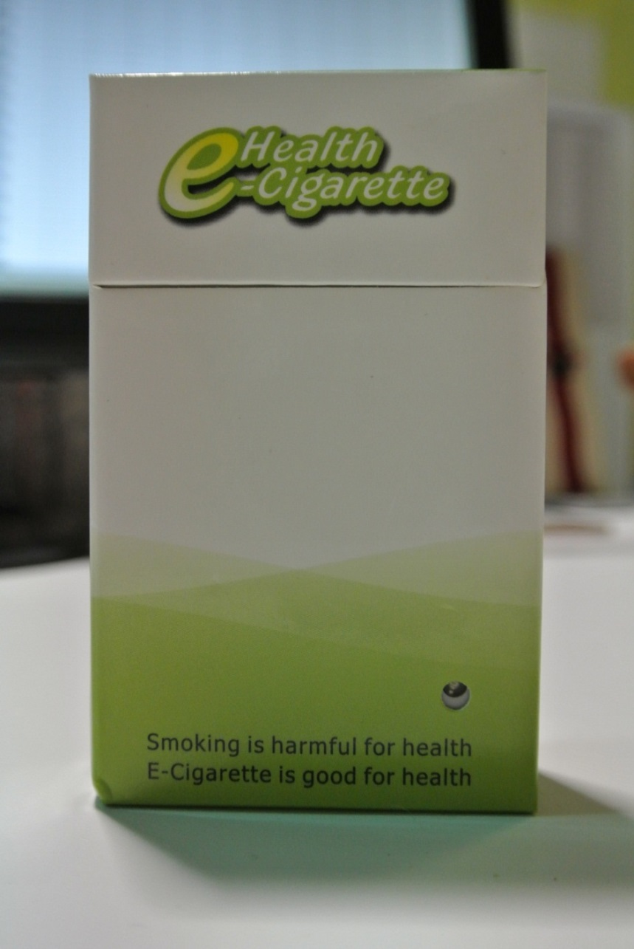

Slide 27
What do we KNOW about E-Cigarettes?

Slide 28
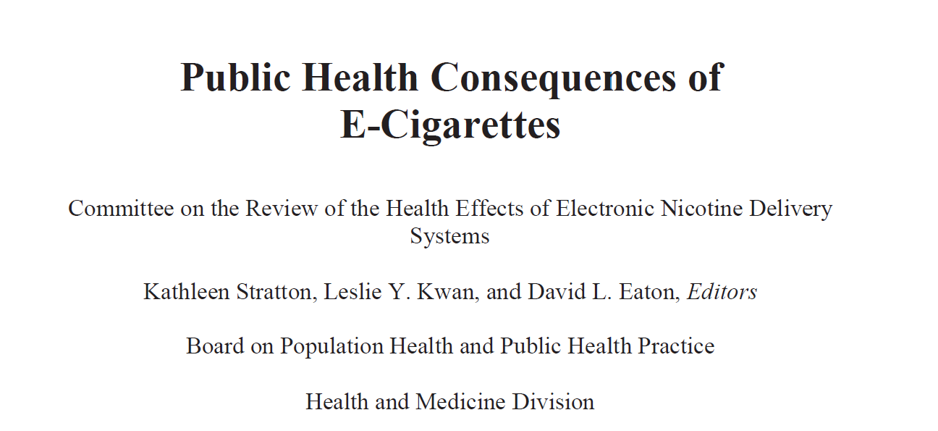
Just Out 2018
http://nap.edu/24952

Slide 29
Harm reduction
There is conclusive evidence that completely substituting e-cigarettes for conventional cigarettes reduces users’ exposure to many toxicants and carcinogens present in conventional cigarettes
There is substantial evidence that completely switching from regular use of conventional cigarettes to e-cigarettes results in reduced short-term adverse health outcomes in several organ systems
http://nap.edu/24952

Slide 30
Exposure to nicotine
There is conclusive evidence that exposure to nicotine from e-cigarettes is highly variable and depends on the characteristics of the device and the e-liquid, as well as on how the device is operated
There is substantial evidence that nicotine intake from e-cigarettes among experienced adult e-cigarette users can be comparable to that from conventional cigarettes
http://nap.edu/24952

Slide 31
Dependence and abuse liability
There is substantial evidence that e-cigarette use results in symptoms of dependence on e-cigarettes
There is moderate evidence that risk and severity of dependence is lower for e-cigarettes than for conventional cigarettes
There is moderate evidence that variability in the characteristics of e-cigarette products (nicotine concentration, flavoring, device type, and brand) is an important determinant of the risk and severity of dependence on e-cigarettes
http://nap.edu/24952

Slide 32
Exposure to toxic substances
There is conclusive evidence that in addition to nicotine, most e-cigarettes contain and emit numerous potentially toxic substances
There is substantial evidence that except for nicotine, exposure to potentially toxic substances from e-cigarettes (under typical conditions of use) is significantly lower compared with conventional cigarettes
http://nap.edu/24952

Slide 33
substantial Evidence
Causes injuries and poisonings
E-cigarette use by youth and young adults increases their risk of ever using conventional cigarettes
http://nap.edu/24952
Notes:
Child ingestions since 2011
Utah - increased 19-fold¹
U.S. increased 14-fold²
One child death³
Children less than 2 are at most risk and

Slide 34
Limited or No Available Evidence
Carcinogenicity
Respiratory effects
Reproductive and developmental effects
http://nap.edu/24952

Slide 35
Implications
FDA to delay regulation of electronic cigarettes until 2022 looking at potential role for harm reduction
Keep kids away from this
Nicotine is addictive in all forms
There is a lot we do not know yet……

Slide 36
Are they a cessation aid?
Systematic review (38 studies ) and meta-analysis (20 of the 38 studies)
Odds of quitting cigarettes were 28% LOWER in smokers using E-cigs
Smokers who identified as motivated to quit had either decreased quit rate or no change in quit rates using E-cigs
Must recognize STILL only 2 RCT, most studies observational
No unbiased comparison study has been done of E cigs vs standard NRT for cessation
Many studies are funded by tobacco companies
Various definitions of “quit” and “cessation”
Notes:
I found 1 study of Ecig vs Nicorette gum that showed equivalent quit rates and no adverse effects, but it was industry sponsored

Slide 37
Pediatric Concerns
Association between current e-cigarette use and conventional cigarette use among adolescents
SO, Ecig use in adolescents is associated with higher odds of using traditional cigarettes and lower abstinence rates from traditional cigarettes
Even kids who state no intention to smoke regular cigarettes have higher % adoption if they use E-cigs
Notes:
2014 data shows that current e cig use has a higher odds of ever smoking cigarettes and ever users of traditional cigs, if they experiment with e cigs, have a lower rate of abstinence at 1 mo. and 12 mo. from traditional cigs
New study out of Hawaii in 2016 shows the same information, odds ratios 2.8-4 in never smokers who used Ecigs starting to smoke (Wills et al, Tobacco Control Jan 2016 epub ahead of print)
ASSOCIATION NOT CAUSATION!

Slide 38
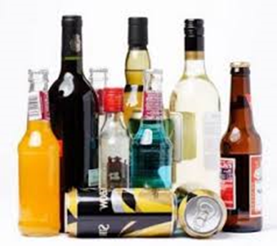
Additional concerns
While e-cigarettes have been manufactured as a nicotine delivery system, that hasn’t stopped many users from getting creative with them.
Alcohol, meth, heroin, cocaine, bath salts, and more
Marijuana: May use oil, wax infused with THC, or dried leaves
Can be deodorized
Sold on internet!
In 1 study of high school students
18% ecig users used THC in the ecig
27% if had history of THC use

Slide 39
What should I be saying to my patients about these things?
Ask about “vaping” as you screen
Use evidence-based smoking cessation methods
“Smoking Cessation Guidelines do not recommend vaping or e cigs”
Recommend avoidance of smoked tobacco and ENDS
“E-cigs and vaping reinforce the automatic habits of smoking and may hinder quitting”
Discuss safe storage of e-juice and E-cigs
Follow results of e-cigarette clinical trials
Schepers JS. Electronic cigarettes: do they have a role in smoking cessation? J Pharm Pract. 2012;25(6):611–614. Knorst et al. J Bras Pneumol. 2014 Sep-Oct; 40(5): 564–572.
Section on Tobacco Control. Clinical Practice Policy to Protect Children from Tobacco, Nicotine, and Tobacco Smoke. Pediatrics 2015; 136(5): 1008-1017.
Notes:
HB 415- rules allows to set standards for e cig nicotine labels, packaging and product quality
July 1, 2016
Poisoning related piece of legislation-2013-14 130 calls/year from e liq. Children 75% of the calls.

Slide 40
What ABOUT ENDS SURPRISES YOU?

Slide 41
Helping People Quit
Ask, Advise, Connect

Slide 42
Tobacco Dependence: a two Part Problem
Tobacco Dependence
Physiological
Behavioral
The addiction to nicotine
The habit of using tobacco
Treatment
Treatment
Medications for cessation
Behavior change program
Treatment should address the physiological and the behavioral aspects of dependence.
Notes:
Tobacco dependence is a chronic brain disease and is a condition that requires a two-prong approach for maximal treatment effectiveness.
Prolonged tobacco use of tobacco results in tobacco dependence, which is characterized as a physiological dependence (addiction to nicotine) and behavioral habit of using tobacco. Addiction can be treated with FDA-approved medications for smoking cessation, and the behavioral habit can be treated through behavior change programs, such as individualized counseling and group or online cessation programs.
The Clinical Practice Guideline for treating tobacco use and dependence (Fiore et al., 2000), which summarizes more than 6,000 published articles, advocates the combination of behavioral counseling with pharmacotherapy in treating patients who smoke.
Fiore MC, Bailey WC, Cohen SJ, et al. (2000). Treating Tobacco Use and Dependence. Clinical Practice Guideline. Rockville, MD: U.S. Department of Health and Human Services, Public Health Service.

Slide 43
Smoking Cessation Medications
Nicotine polacrilex gum
Nicorette (OTC)
Generic nicotine gum (OTC)
Nicotine lozenge
Commit (OTC)
Generic nicotine lozenge (OTC)
Nicotine transdermal patch
Nicoderm CQ (OTC)
Nicotrol (OTC)
Generic nicotine patches (OTC, Rx)
Nicotine nasal spray
Nicotrol NS (Rx)
Nicotine inhaler
Nicotrol (Rx)
Bupropion SR (Zyban)
Varenicline (Chantix)
These are the only medications that are
FDA-approved for smoking cessation.
Notes:
Currently five formulations of nicotine replacement therapy and two non-nicotine agents have FDA approvals as aids for smoking cessation (Fiore et al., 2008).
Medications that are available without a prescription include the nicotine gum, nicotine lozenge, and nicotine transdermal patch. Medications available only with a prescription are the nicotine nasal spray, nicotine inhaler, sustained-release bupropion, and varenicline. One formation of the generic transdermal patch also is available with a prescription.
Fiore MC, Jaén CR, Baker TB, et al. (2008). Treating Tobacco Use and Dependence: 2008 Update. Clinical Practice Guideline. Rockville, MD: U.S. Department of Health and Human Services. Public Health Service.

Slide 44
Ask, ADVISE, CONNECT
Ask (every visit)
This can be done by your assistant or office staff
If they smoke “Are you willing to quit at this time?”
Gauge how much the person smokes, for how long they have smoked, and if they have any interest in quitting
Prompt by Meaningful Use in EHRs (script it)
Advise
Encourage cessation and ask that all household members quit smoking
Simple, clear, personal
“This is the single best thing we can do to improve your health and the health of your child”
Connect
Use a Proactive referral
Fax their contact information to the QuitLine, right there
Have them call the QuitLine from your office/the hospital room, right there
Document in EHR so you can follow-up
Use Reactive referral
Provide client with contact information for cessation
Vidrine JAMA Intern Med. 2013 Mar 25;173(6):458-64. doi: 10.1001/jamainternmed.2013.3751
Notes:
ASK= 3 times
ADVISE-more times more likely to quit
Number of types of people that ask---MORE QUITTERS

Slide 45
Refer vs. connect
Smokers are 13 times more likely to enroll in treatment when they are directly connected to the Quit Line, as opposed to being encouraged to call on their own
Vidrine J, Shete S, Cao Y, et al. Ask-Advise-Connect: A New Approach to Smoking Treatment Delivery in Health Care Settings.JAMA Intern Med. 2013;173(6):458-464.
http://www.ncbi.nlm.nih.gov/pubmed/23440173

Slide 46
Utah Resources

Slide 47
The Utah Tobacco Quit Line
1.800.QUIT.NOW
Also available in Spanish at: 1.877.629.1585.
5 phone call visits to support quitting
10 if the caller is pregnant
Multilingual: Depending on the time of day, staff is on hand that speaks a wide variety of languages
Quitline has NO cost for patient
Supported by insurers and Tobacco Settlement monies
Free Nicotine Replacement Support
ACA requires coverage of at least 1 pharmacological and 1 behavioral treatment
waytoquit.org/refer-patients

Slide 48
Quit Line Medication Support
Free NRT:
Up to 8 weeks of patch and/or gum if no contraindications.
Combination therapy may be available, which would consist of 2 weeks of gum and up to 8 weeks of patch.
A 4-week supply is shipped directly to the participants address after the first coaching session and again after the 3rd coaching session if the participant continues coaching calls.
Eligibility:
18 and older
Ready to quit within the next 30 days
Enroll in phone coaching

Slide 49
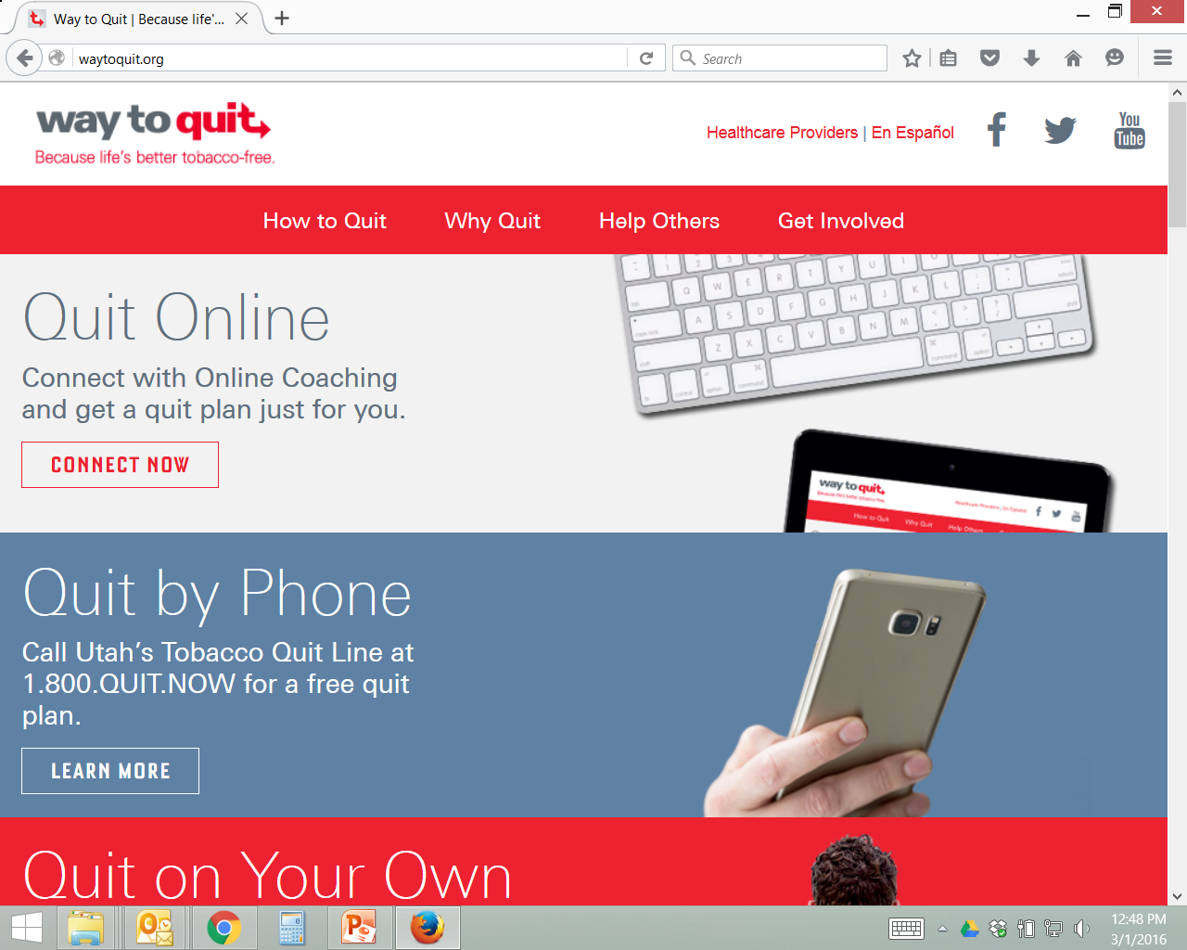
Online Referral Form
Notes:
Detailed information on the quit line and online coaching services
Cost Calculator for Quitters
Health information about the effects of smoking
Active Facebook channel where patients can connect with others who have quit, or are trying to quit for some casual support

Slide 50
Online Referral Form

Slide 51
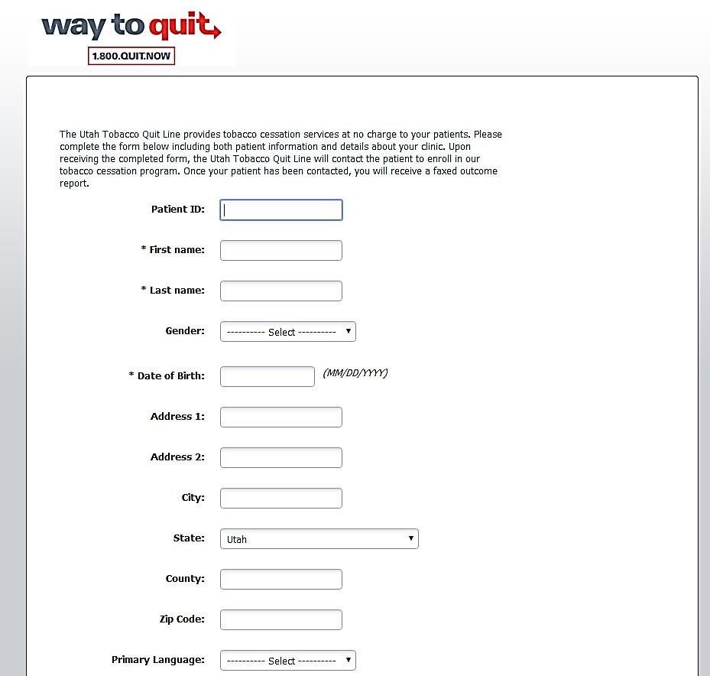
Online Referral Form

Slide 52
Referral Process
Send referral - fax or online
Quit Line calls client
Client enrolls, receives materials, NRT
Client receives quit coaching
Outcomes report sent to HIPAA-covered entities
Notes:
Step 1 - The provider determines that the patient/tobacco user should be referred to the Quit Line and discusses the fax referral form and process with him/her.
Step 2 - The provider and the tobacco user completely fill out the fax referral form.
Step 3 - The clinic faxes the form to the Quit Line at: # 1-800-483-3076.
Step 4 - The Quit Line enters the referral into their database within 24 hours of receipt and attempts are made to reach the participant, at their indicated best times, within 48 hours.
Step 5 - The Quit Line makes at least three attempts over the next five days to reach the tobacco user. For privacy reasons, no message will be left for the participant unless the participant indicated on the fax referral form that it's okay to leave a message.
If a Spanish fax referral form is received, a Spanish Quit Coach will make outbound calls.
If the birth date on the form indicates that the caller is under 19 years of age, a youth Quit Coach will make outbound calls instead of an adult Quit Coach.
Step 6 - After three attempts, the Quit Line will fax the clinic an outcome report (to be filed in the patient’s chart at the clinic), detailing one of three outcomes from the outreach:
Tobacco user reached – service accepted (will detail service user will receive).
Tobacco user reached – declined services
Tobacco user not reached.
NOTE: - Due to HIPAA (privacy legislation protecting personal health information), outcome reports can only be sent to HIPAA-covered agencies.
Step 7 - The provider continues to follow up periodically with the tobacco user. The Quit Line does not send any additional outcome reports.
Benefits of the Fax Referral Program:
Eliminates barrier of the tobacco user having to initiate the first call to the Quit Line.
Allows the provider / clinic to ensure a proactive follow-up step.
Allows the provider to receive a report on the services the tobacco user will receive.
Opportunity for the provider to take action with the tobacco user at the time of the visit.
Allows for follow-up in clinics or areas where follow-up might not otherwise be possible (like ER, etc.).

Slide 53
Questions
Sarah Woolsey, MD, FAAFP
Medical Director
HealthInsight Utah
swoolsey@healthinsight.org

