Slide 1
What’s New in Bariatric Surgery
Steven C. Simper, MD FACS
Rocky Mountain Associated Physicians

Slide 2
Disclaimers
Faculty Ethicon Speaker Bureau

Slide 3
THE PROBLEM! (CDC Data)
35% population is obese
12% extremely obese ( BMI > 40)
Over $200 billion/yr. in Health care expenditures
Almost 200,000 death/yr.
1% of eligible patients get bariatric surgery

Slide 4
Medical vs Surgical Rx (Swedish Obesity Study)

Slide 5
Medications
Bupropion/Naltrexone (Contrave)
Liraglutide (Saxenda)- GLP-1 analog
Lorcaserin (Belviq)
Orlistat (Xanical)- binds fat
Orlistat (Alli) – over the counter
Phenteramine/Topirmate (Qsymia)

Slide 6
Problem with Medical therapy
Cost
Side affects
Must be continued life long
Must try multiple combinations
Developed resistance to therapy

Slide 7
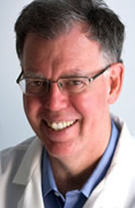
Barry Sears, PhD (biochemist)
“There are three things humans hold visceral (meaning they come from internal beliefs):
Religion
Politics
“Nutrition” (Obesity)
Author of the “zone”

Slide 8
Evidence based medicine is only pertinent if the evidence supports your own point of view
Author unknown

Slide 9
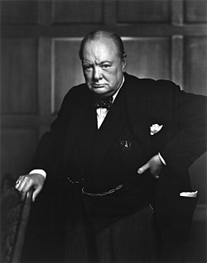
The further you look back, the clearer you look forward (Winston Churchill)

Slide 10
New Technologies?
Gastric Balloon
AspireAssist (gastrostomy tube)
Endostitch

Slide 11
Emperor’s New Cloths

Slide 12
Three things that always tell the truth

Slide 13
Children

Slide 14
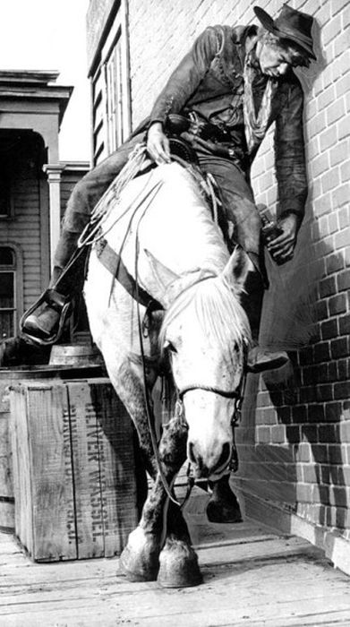
Drunks

Slide 15
Yoga Pants

Slide 16
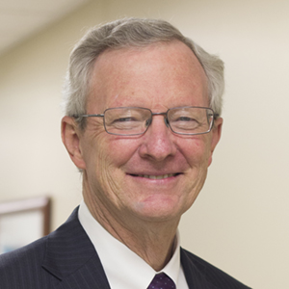
Maybe there is a 4th
Ted Adams, PhD
Lead author and organizer of the
“Utah Bariatric Study Group”

Slide 17
12-Year Weight Loss and Diabetes Remission after Roux-en-Y Gastric Bypass
Utah Obesity Study – 12-year Data
Steven C. Simper, MD FACS
Rocky Mountain Associated Physicians
Salt Lake City, Utah

Slide 18
Disclosure Statement
Receive research funding from NIH-NIDDK
Receive research funding from Ethicon Endo-Surgery

