Slide 1

Thyroid Related Eye Disease
Jackson Lever, MD
Country Hills Eye Center
May 17, 2018

Slide 2
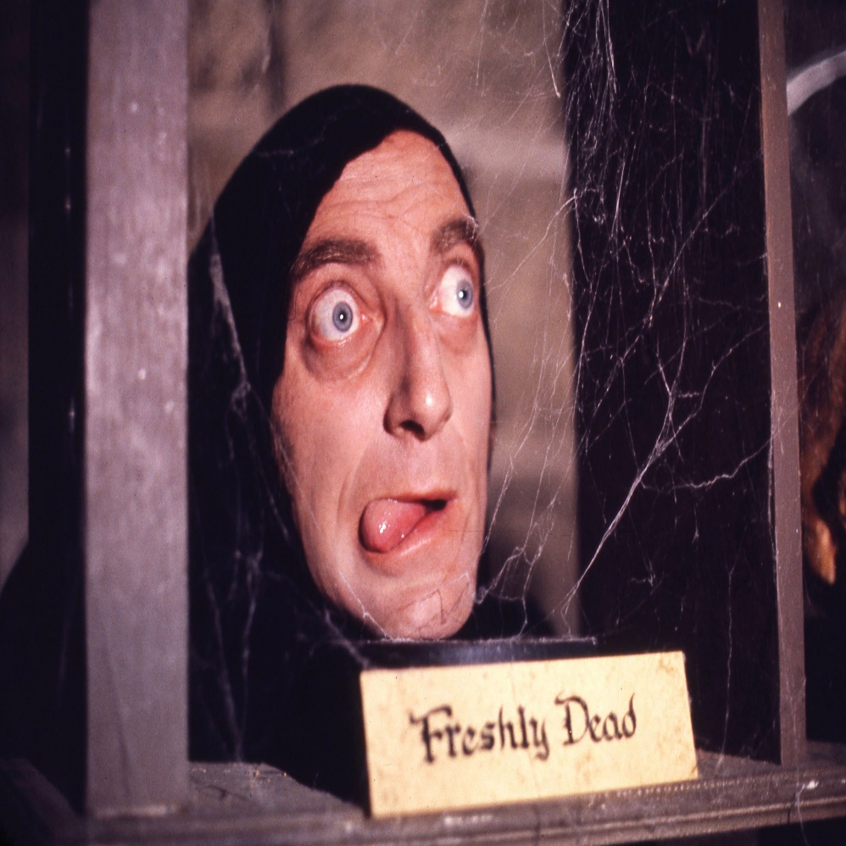
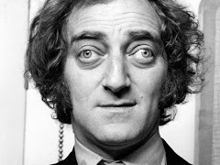
Marty Feldman
1934-1982

Slide 3
Disclosures
No financial disclosures

Slide 4
Lecture Outline
Background
Pathophysiology
Evaluation
Treatment

Slide 5
Thyroid Related Eye Disease
State of thyroid
  Hyperthyroidism
  Hypothyroidism
  Euthyroidism

Slide 6
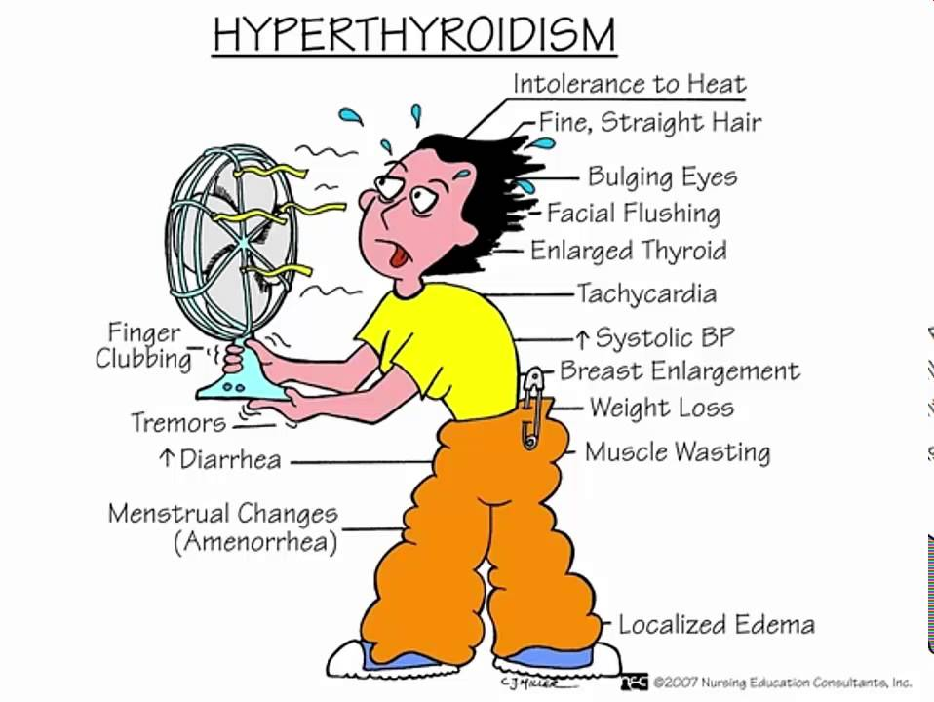
Thyroid Related Eye Disease
State of thyroid
  Hyperthyroidism
  Hypothyroidism
  Euthyroidism
www.thyroidtoxicoisis.org

Slide 7
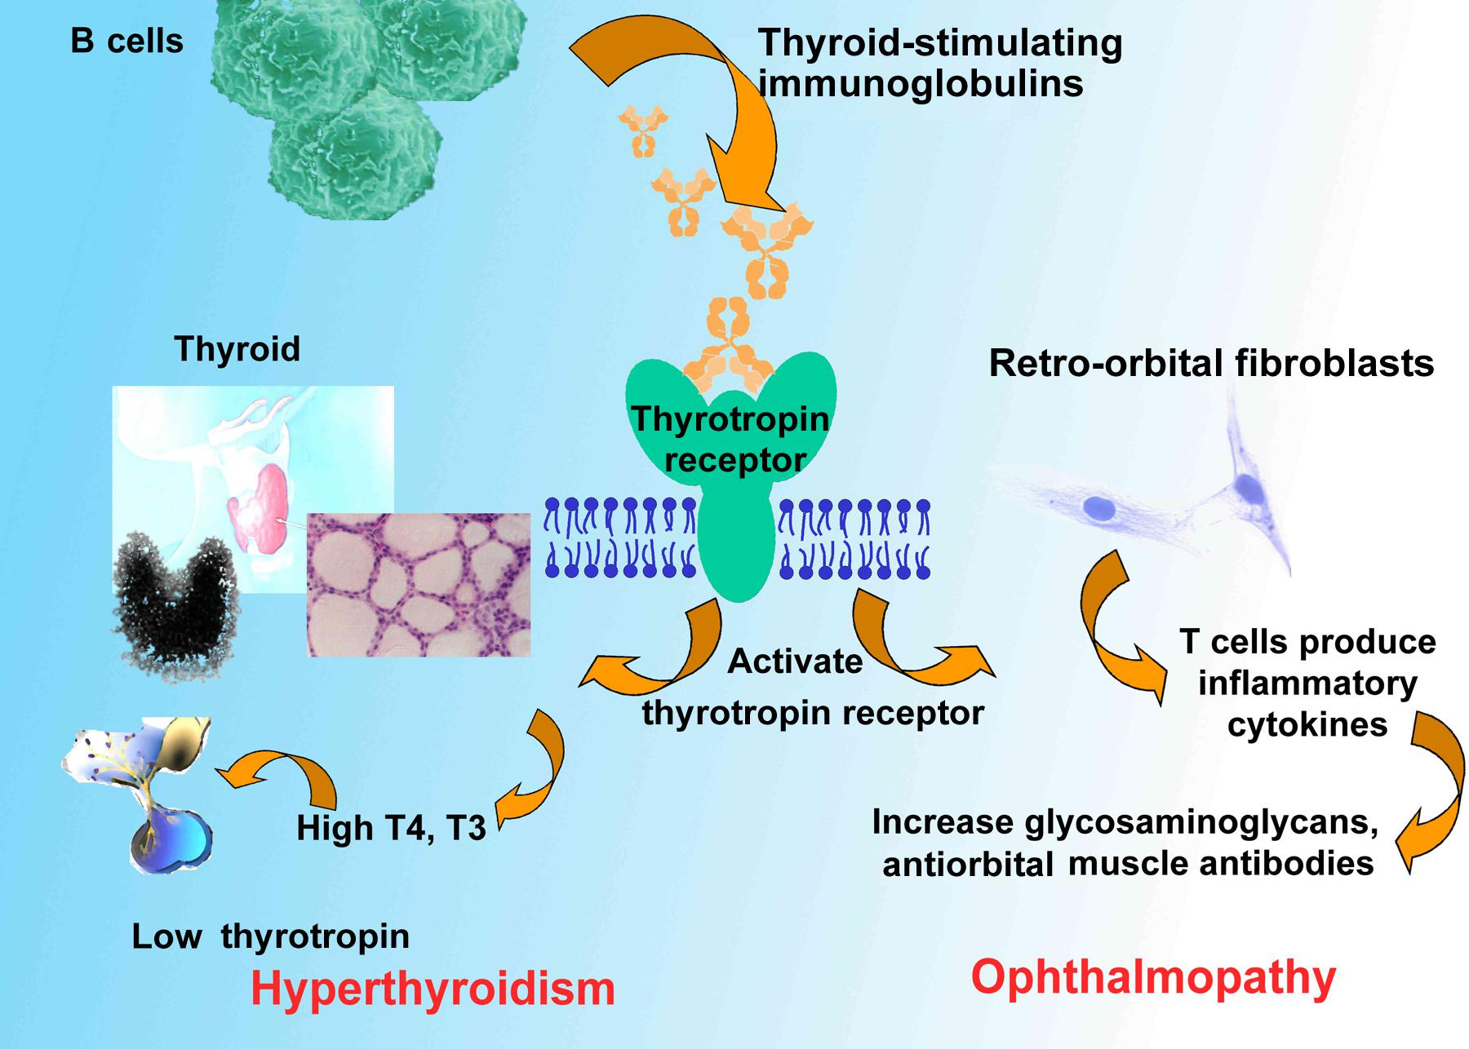
Thyroid Related Eye Disease
State of thyroid
  Hyperthyroidism
  Hypothyroidism
  Euthyroidism
Graves Disease
  Prevalence
    30/100,000

Slide 8
Thyroid Related Eye Disease
State of thyroid
  Hyperthyroidism
  Hypothyroidism
  Euthyroidism

Slide 9
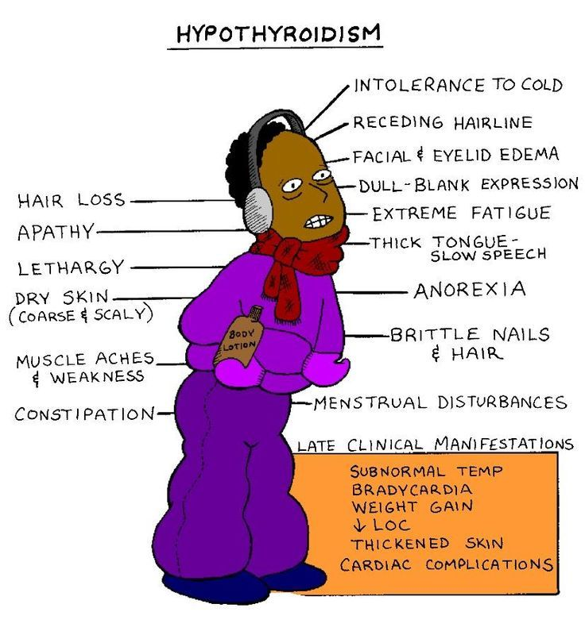
Thyroid Related Eye Disease
State of thyroid
  Hyperthyroidism
  Hypothyroidism
  Euthyroidism

Slide 10
Thyroid Related Eye Disease
State of thyroid
  Hyperthyroidism
  Hypothyroidism
  Euthyroidism
Hashimoto’s

Slide 11
Thyroid Related Eye Disease
State of thyroid
  Hyperthyroidism
  Hypothyroidism
  Euthyroidism

Slide 12

Thyroid Related Eye Disease
Risks for developing Orbitopathy
  Smoking
  Dysthyroid state
  Radioactive Iodine
Stein, JD et al. Risk factors for developing thyroid associated Ophthalmopathy among individuals with Graves’ Disease. JAMA Ophthalmol. 2015 March ; 133(3): 290–296

Slide 13
Pathophysiology

Slide 14
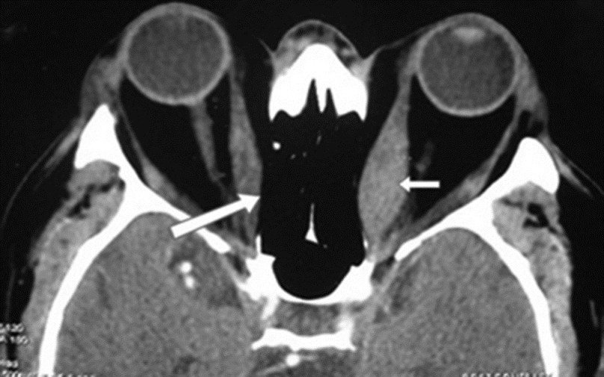

Slide 15
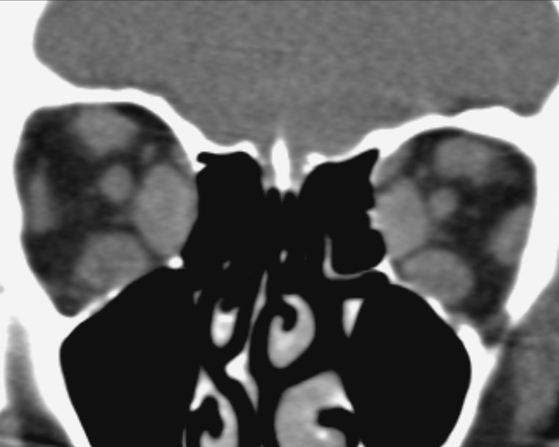

Slide 16


Slide 17
Natural History
Rundel’s Curve
  Active Phase
  Latent Phase
ACTIVITY
TIME

Slide 18
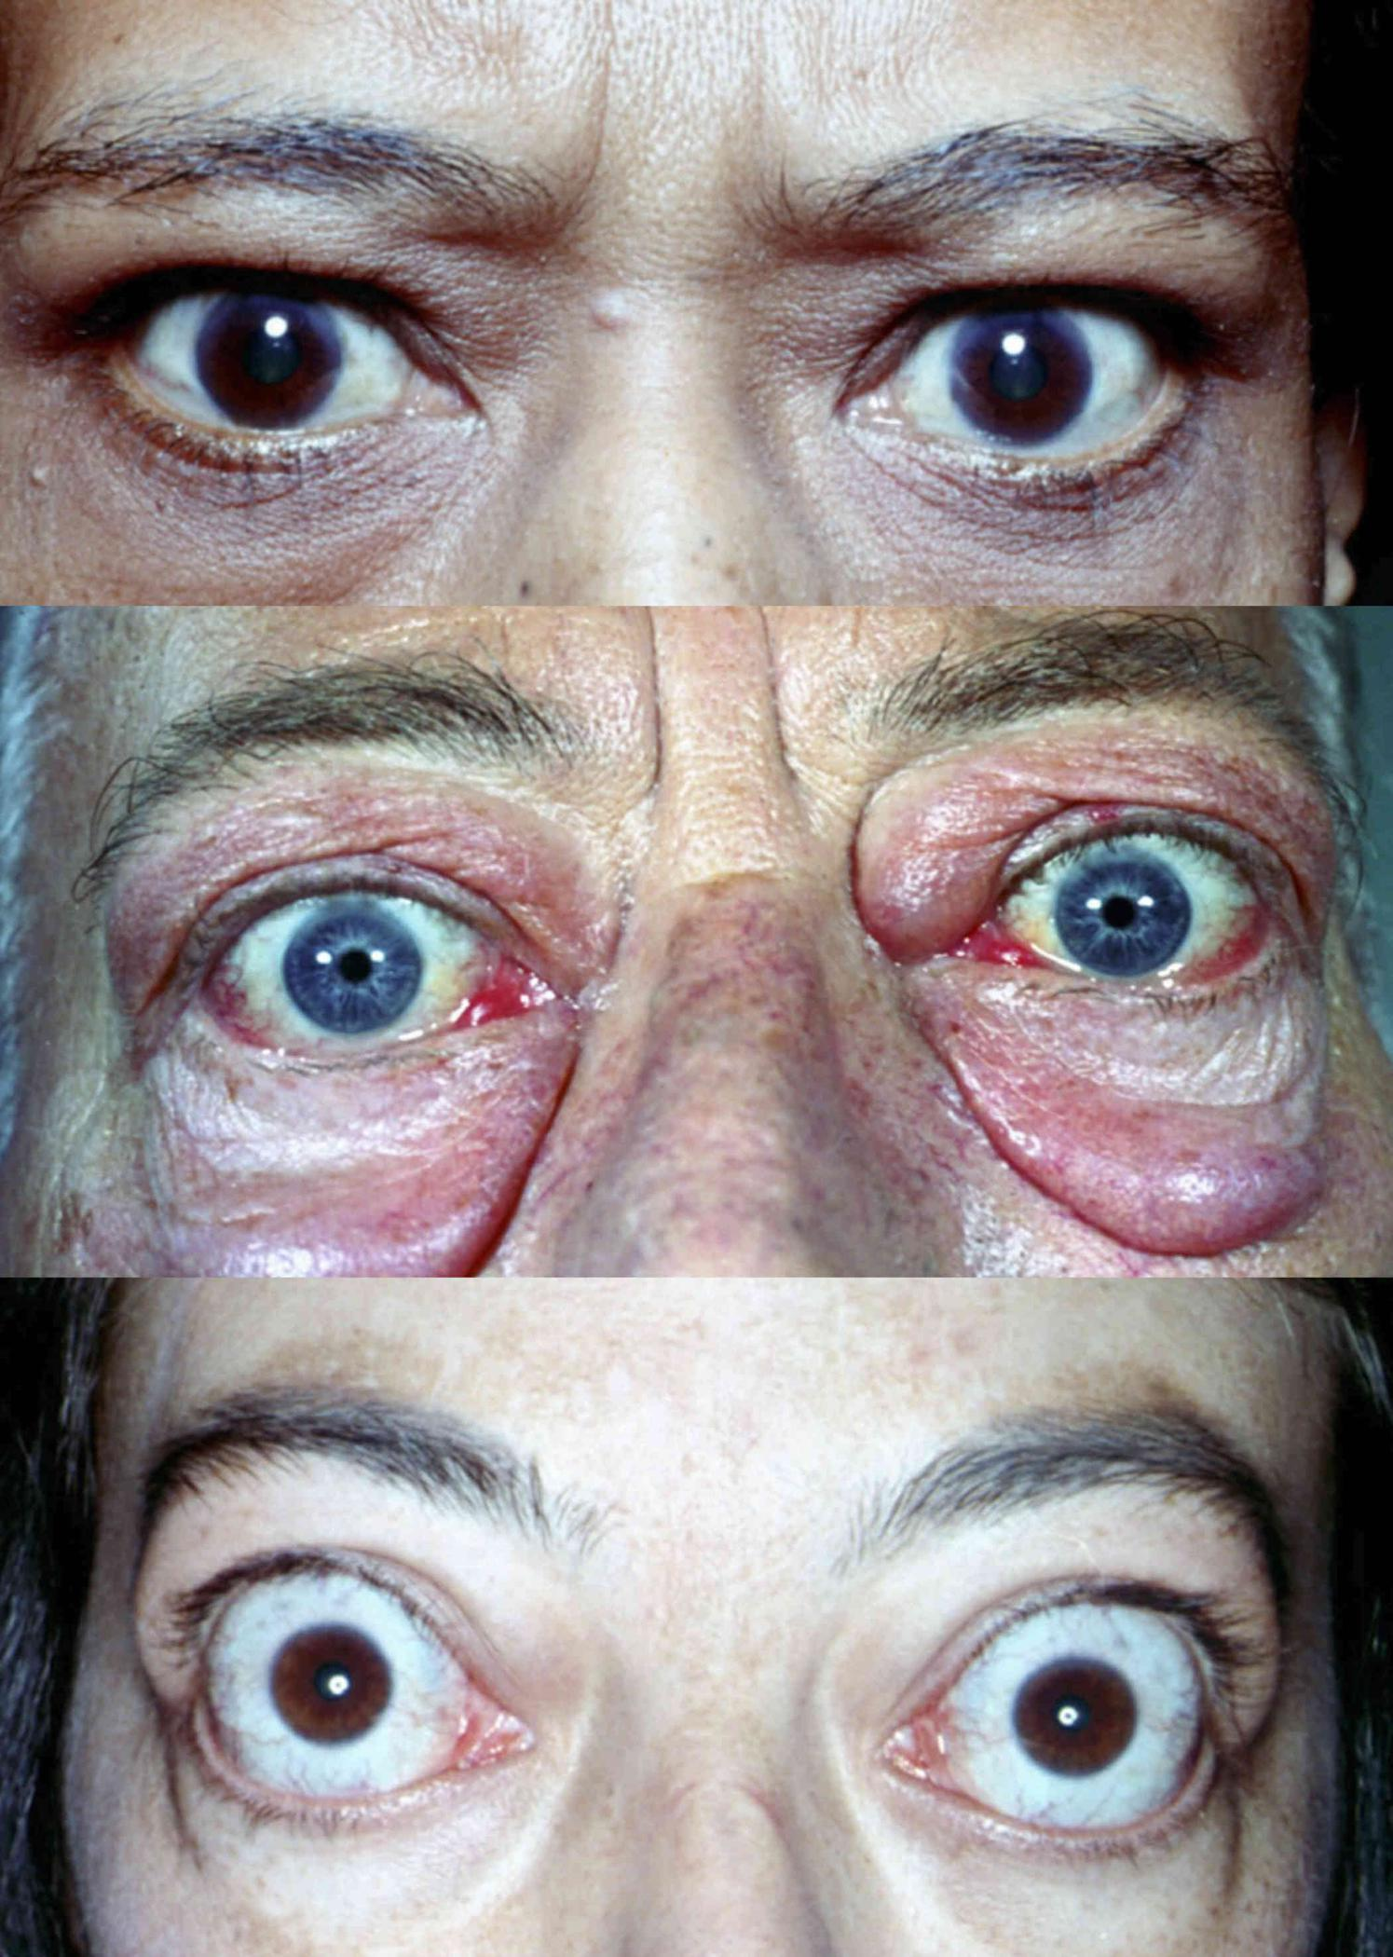

Slide 19
Clinical Evaluation
Physical Exam
  Vision
  APD
  Color Plates
  Hertel’s Exophthalmometer
  Extraocular motion
  IOP
  Anterior and Posterior Exam
Clinical Activity Score (CAS)

Slide 20
Clinical Evaluation
Clinical Activity Score (CAS)
Initial Visit (1 point each) spontaneous orbital pain in last 4 weeks Gaze-evoked orbital pain in last 4 weeks Eyelid swelling Eyelid erythema Conjunctival injection Chemosis Inflammation of caruncle or plica semilunaris CAS ≥ 3 → "Active" | Follow-up Visit (1 point each) - Criteria 1-7 Increase ≥ 2mm proptosis Decrease in uniocular motility in any one direction of ≥ 8° Decrease in visual acuity equivalent to 1 Snellen line CAS ≥ 4 → "Active"

Slide 21
Clinical Evaluation
Lab Work Up
  TSH
  T3
  Free T4
  Antibodies
    Thyrotropin Receptor
    Thyroid Peroxidase
    Thyroglobulin
Orbital Imaging
  CT Orbit WITHOUT Contrast

Slide 22
Treatment
Based on clinical activity and symptoms
ACTIVITY
TIME

Slide 23
Treatment
Based on clinical activity and symptoms
Smoking cessation
Obtain Euthyroid state
  Methimazole
  Radioactive Iodine
  Thyroidectomy

Slide 24
Treatment
Based on clinical activity and symptoms
Exposure Keratopathy
Orbital Congestion & Inflammation
Diploplia
Compressive Optic Neuropathy

Slide 25
Treatment
Exposure Keratopathy
  Lubricants
    Artificial Tears
    Ointments
    Punctal Plugs
  Moisture Chambers
  Ocular Occlusion
  Topical Steroids

Slide 26
Treatment
Orbital Congestion & Inflammation
  Oral Steroids
  Pulse IV Steroids
  Radiation
  Teprotumumab
    Human monoclonal immunoglobin IGF-IR inhibitor

Slide 27
Treatment
  Teprotumumab
    Human monoclonal immunoglobin IGF-IR inhibitor
    Received FDA “Breakthrough Designation”
    Double blinded, placebo control, randomized control trial sponsored by River Pharmaceutical
    Group 1- 8 Placebo infusions every 3 weeks
    Group 2- 8 Teprotumumab infusions every 3 weeks
      1st infusion 10mg/kg
      2-8th infusions 20mg/kg
Smith, Terry et al., Teprotumumab for Thyroid-Associated Ophthalmopathy , N Engl J Med. 2017 May 04; 376(18): 1748–1761.

Slide 29
Smith, Terry et al., Teprotumumab for Thyroid-Associated Ophthalmopathy , N Engl J Med. 2017 May 04; 376(18): 1748–1761.

Slide 30
Smith, Terry et al., Teprotumumab for Thyroid-Associated Ophthalmopathy , N Engl J Med. 2017 May 04; 376(18): 1748–1761.

Slide 31
Treatment
Surgical Approach
  Orbital decompression
  Strabismus surgery
  Eyelid retraction

Slide 32
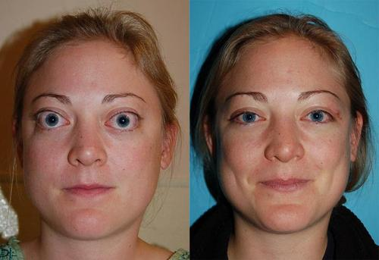
Orbital Decompression
http://thyroidnosurgery.com/hyperthyroidism/gravesdiseasethyroid-eye-disease-and-hyperthyroid-images-101/

Slide 33
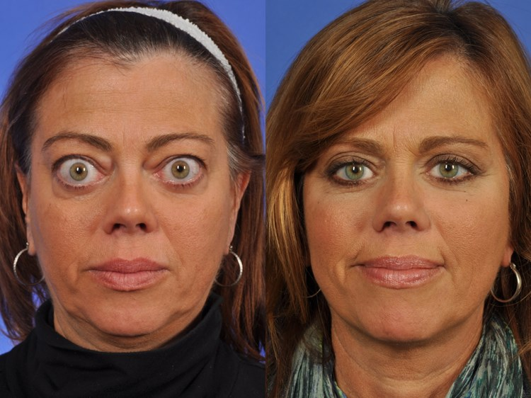
Orbital Decompression
https://www.wcosmeticsurgery.com/

Slide 34
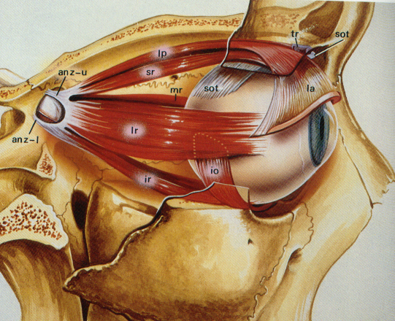
Treatment
Surgical Approach
  Orbital decompression
  Strabismus surgery
  Eyelid retraction

Slide 35
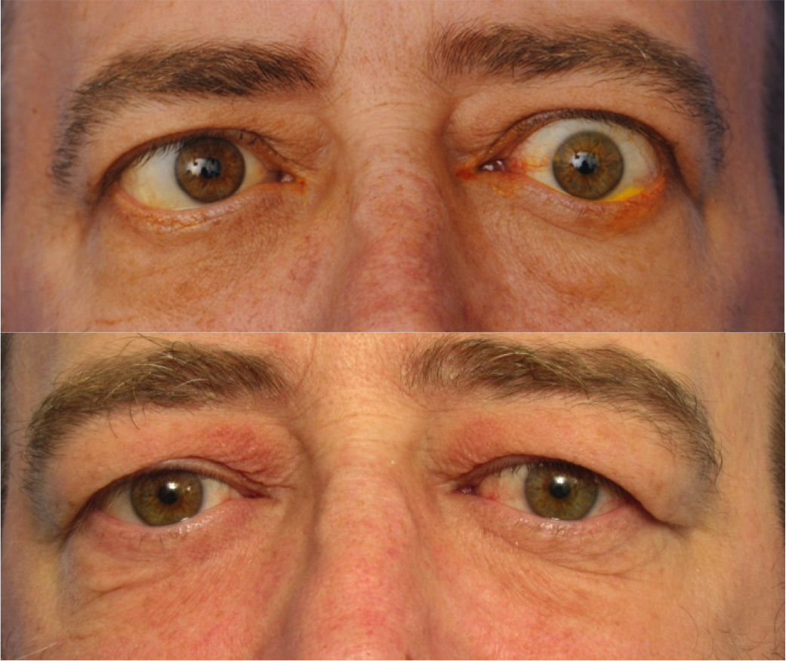
Treatment
Surgical Approach
  Orbital decompression
  Strabismus surgery
  Eyelid retraction

Slide 36
References
Smith, T et al., Teprotumumab for thyroid-associated ophthalmopathy , N Engl J Med. 2017 May 04; 376(18): 1748–1761.
Marocci, C et al. Selium and the course of mild Graves’ orbitopathy. N Engl J Med 2011;363:1920-31.
Stein, JD et al. Risk factors for developing thyroid associated Ophthalmopathy among individuals with Graves’ Disease. JAMA Ophthalmol. 2015 March ; 133(3): 290–296
Burch, HB et al. Management of Graves disease: A review. JAMA. 2015;314(23):2544-2554.
https://webeye.ophth.uiowa.edu/eyeforum/patients/thyroid-eye-disease.htm

Slide 37
Questions?

Slide 38


Jackson Lever
jlever@checdocs.org
801-430-8394 Cell
801-399-1194 Office

