Slide 1
What’s new in infectious disease pediatrics & Update on pediatric immunizations
Trahern W. (“TW”) Jones, MD
Assistant Professor, Division of Infectious Diseases
University of Utah Pediatrics
Tw.jones@hsc.Utah.edu

Slide 2
What’s new in infectious disease pediatrics

Slide 3
disclosures
I will discuss vaccines that remain under FDA Emergency Use Authorization for the age groups in question
Brand names are used for identification purposes only and do not serve as an endorsement of the brand in question
I have no relevant personal financial relationships with any drugs, therapies, or vaccines included in this lecture

Slide 4
Objectives
What do we know about the epidemiology of SARS-CoV-2 in children?
What are the harms of SARS-CoV-2 in children?
Will my child be safe in in-person school?
Why are pediatric inpatient centers full?
What’s in store for this winter?

Slide 5
What do we know about the epidemiology of SARS-CoV-2 in children?

Slide 6
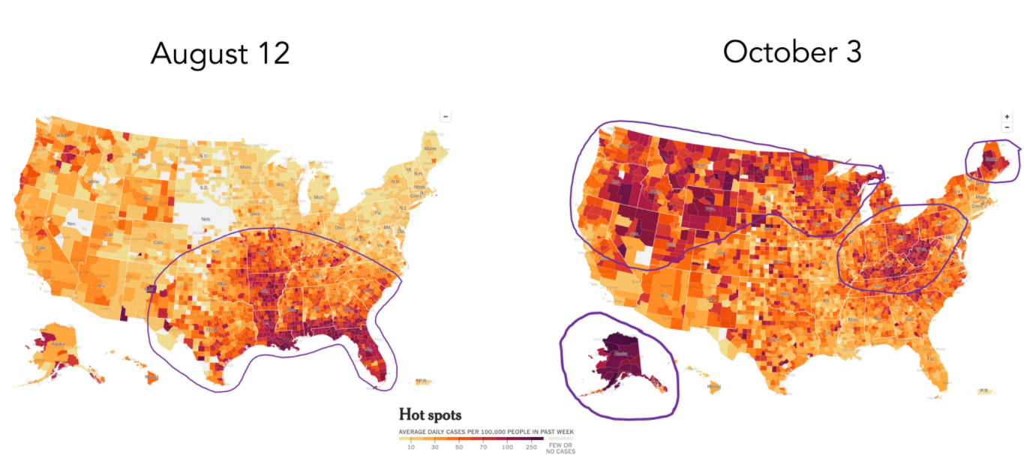
Notes:
Covid in the U.S.: Latest Map and Case Count - The New York Times (nytimes.com)

Slide 7
SARS-CoV-2 in Children: Epidemiology
US Cumulative cases
5,899,148 total child COVID-19 cases
16.2% of all cases
Overall rate: 7,838 per 100,000
Utah Cumulative cases
61,596 total child COVID-19 cases
12.2% of all COVID-19 cases
Overall rate: 7,950 per 100,000
American Academy of Pediatrics. Children and COVID-19: State Level Data Report. https://www.aap.org/en/pages/2019-novel-coronavirus-covid-19-infections/children-and-covid-19-state-level-data-report/

Slide 8
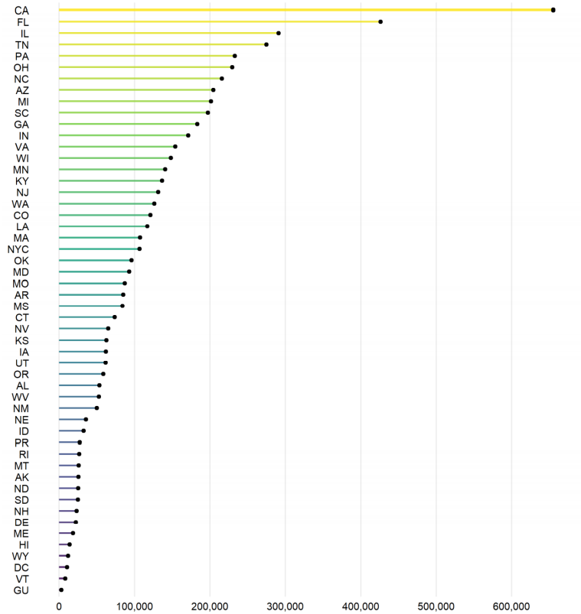
US Cumulative child COVID-19 cases by state
Notes:
American Academy of Pediatrics. Children and COVID-19: State Level Data Report. https://www.aap.org/en/pages/2019-novel-coronavirus-covid-19-infections/children-and-covid-19-state-level-data-report/

Slide 9
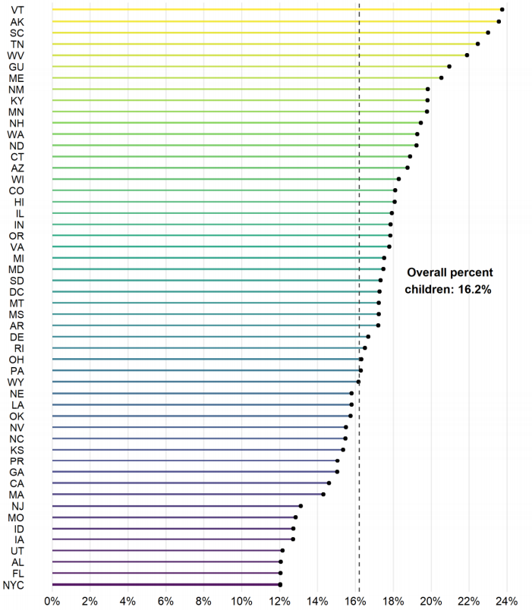
Percent of cumulative cases that were children by state
Notes:
American Academy of Pediatrics. Children and COVID-19: State Level Data Report. https://www.aap.org/en/pages/2019-novel-coronavirus-covid-19-infections/children-and-covid-19-state-level-data-report/

Slide 10
SARS-CoV-2 in Children: Epidemiology
US Change in cases
173,469 child COVID-19 cases in the past week
26.7% of all cases in the past week
American Academy of Pediatrics. Children and COVID-19: State Level Data Report. https://www.aap.org/en/pages/2019-novel-coronavirus-covid-19-infections/children-and-covid-19-state-level-data-report/

Slide 11
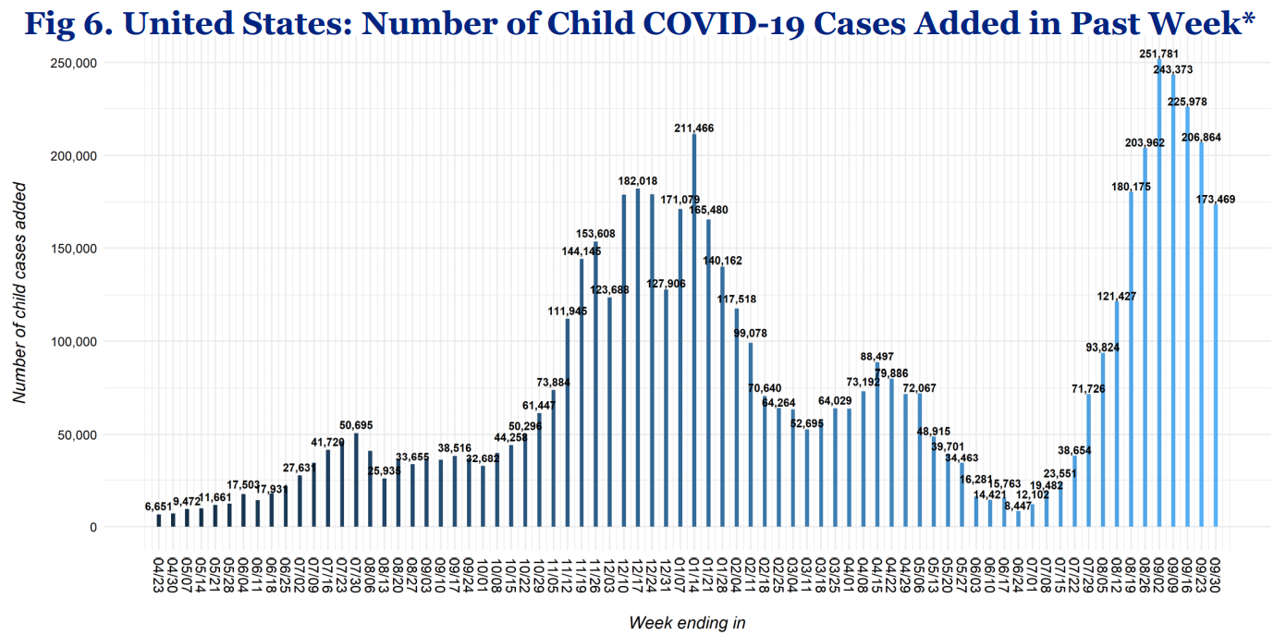
Notes:
American Academy of Pediatrics. Children and COVID-19: State Level Data Report. https://www.aap.org/en/pages/2019-novel-coronavirus-covid-19-infections/children-and-covid-19-state-level-data-report/

Slide 12
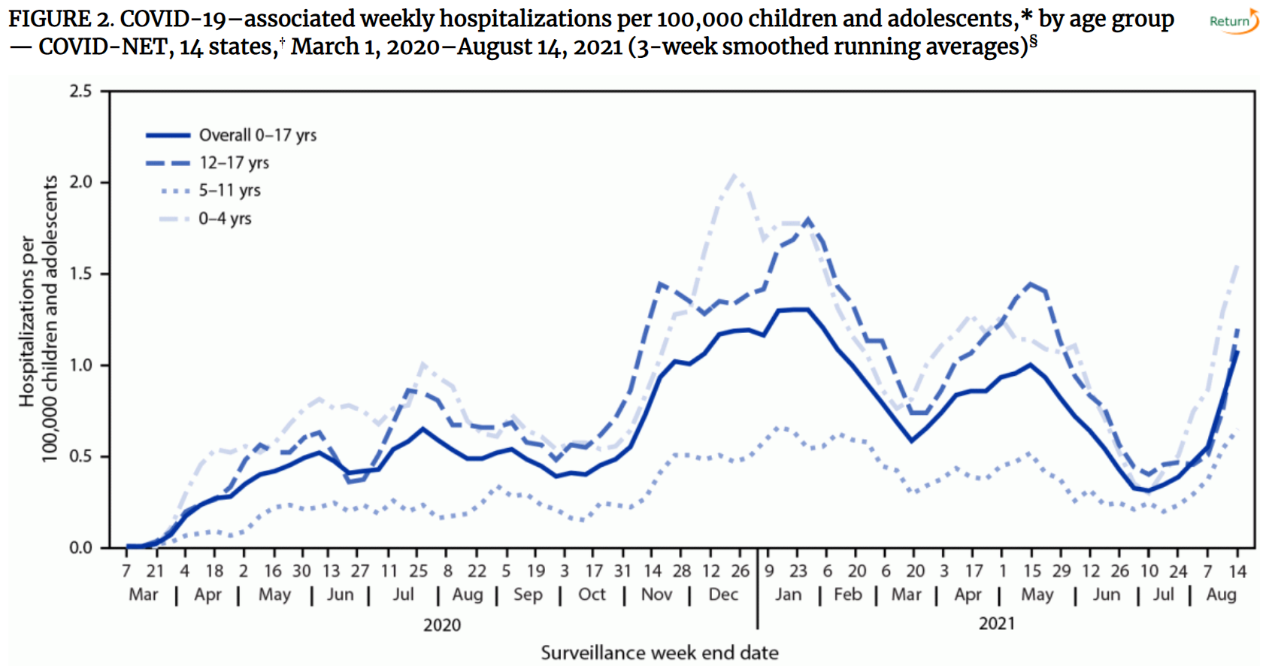

Slide 13
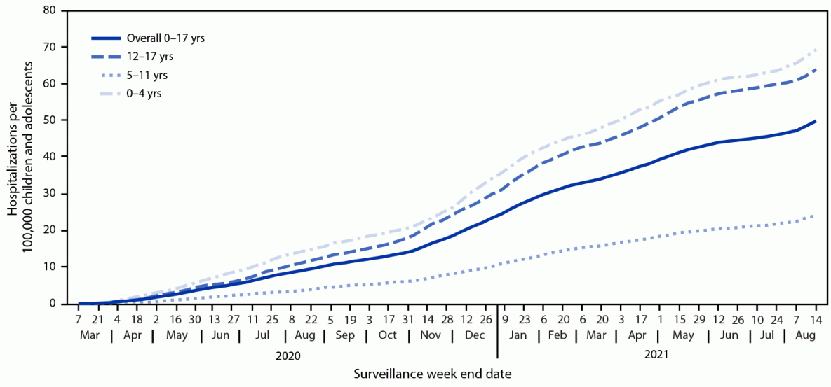
SARS-CoV-2 in Children: Epidemiology
Bimodal age distribution
Ages 0-4
Ages 12-17
Delahoy MJ, Ujamaa D, Whitaker M, et al. Hospitalizations Associated with COVID-19 Among Children and Adolescents — COVID-NET, 14 States, March 1, 2020–August 14, 2021. MMWR Morb Mortal Wkly Rep 2021;70:1255–1260.

Slide 14
SARS-CoV-2 in Children: Epidemiology
Total US pediatric deaths from COVID-19 (known):
American Academy of Pediatrics. Children and COVID-19: State Level Data Report. https://www.aap.org/en/pages/2019-novel-coronavirus-covid-19-infections/children-and-covid-19-state-level-data-report/

Slide 15
SARS-CoV-2 in Children: Epidemiology
Total US pediatric deaths from COVID-19 (known):
497
American Academy of Pediatrics. Children and COVID-19: State Level Data Report. https://www.aap.org/en/pages/2019-novel-coronavirus-covid-19-infections/children-and-covid-19-state-level-data-report/

Slide 16
What are the harms of SARS-CoV-2 in children?

Slide 17
SARS-CoV-2 in Children: harms
“COVID-19 isn’t that bad for children, right?”
Notes:
Image: Centers for Disease Control and Prevention. CDC Healthy Schools. https://www.cdc.gov/healthyschools/index.htm

Slide 18
SARS-CoV-2 in Children: harms
“COVID-19 isn’t that bad for children, right?”
No; COVID-19 is both directly and indirectly harmful to children and their families
Notes:
Image: Centers for Disease Control and Prevention. CDC Healthy Schools. https://www.cdc.gov/healthyschools/index.htm

Slide 19
SARS-CoV-2 in Children: harms
Hospitalization rate:
Cumulative hospitalization rate among 12-17 year olds for COVID-19: 51.3 per 100,000
H1N1 Pandemic: 23.9 per 100,000
Approximately 1 in 4 children hospitalized with COVID-19 require intensive care
Delahoy MJ, Ujamaa D, Whitaker M, et al. Hospitalizations Associated with COVID-19 Among Children and Adolescents — COVID-NET, 14 States, March 1, 2020–August 14, 2021. MMWR Morb Mortal Wkly Rep 2021;70:1255–1260.
Wallace M, Woodworth KR, Gargano JW, et al. The Advisory Committee on Immunization Practices’ Interim Recommendation for Use of Pfizer-BioNTech COVID-19 Vaccine in Adolescents Aged 12–15 Years — United States, May 2021. MMWR Morb Mortal Wkly Rep 2021;70:749–752.
Notes:
Wallace M, Woodworth KR, Gargano JW, et al. The Advisory Committee on Immunization Practices’ Interim Recommendation for Use of Pfizer-BioNTech COVID-19 Vaccine in Adolescents Aged 12–15 Years — United States, May 2021. MMWR Morb Mortal Wkly Rep 2021;70:749–752.

Slide 20
SARS-CoV-2 in Children: harms
Study of children involved in a summer camp outbreak who developed symptoms on returning home:
Upon sick campers returning home, households experienced a 45% secondary attack rate
10% of infected household contacts were subsequently hospitalized
Chu VT, et al. Household Transmission of SARS-CoV-2 from Children and Adolescents. N Engl J Med 2021; 385:954-956
Notes:
Chu VT, et al. Household Transmission of SARS-CoV-2 from Children and Adolescents. N Engl J Med 2021; 385:954-956
Image from Wikimedia foundation. FatlindTomini - Own work.

Slide 21
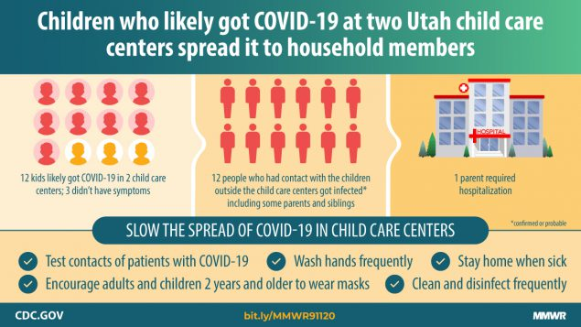
SARS-CoV-2 in Children: harms
Notes:
Lopez AS, Hill M, Antezano J, et al. Transmission Dynamics of COVID-19 Outbreaks Associated with Child Care Facilities — Salt Lake City, Utah, April–July 2020. MMWR Morb Mortal Wkly Rep 2020;69:1319–1323.

Slide 22
Will my child be safe in in-person school?

Slide 23
SARS-CoV-2 in Children: Schools
Is my child’s school safe?
Centers for Disease Control and Prevention. Science Brief: Transmission of SARS-CoV-2 in K-12 Schools and Early Care and Education Programs – Updated. https://www.cdc.gov/coronavirus/2019-ncov/science/science-briefs/transmission_k_12_schools.html
Notes:
Image from: Centers for Disease Control and Prevention. Guidance for COVID-19 Prevention in K-12 Schools. https://www.cdc.gov/coronavirus/2019-ncov/community/schools-childcare/k-12-guidance.html

Slide 24
SARS-CoV-2 in Children: Schools
Is my child’s school safe?
It depends…
Centers for Disease Control and Prevention. Science Brief: Transmission of SARS-CoV-2 in K-12 Schools and Early Care and Education Programs – Updated. https://www.cdc.gov/coronavirus/2019-ncov/science/science-briefs/transmission_k_12_schools.html
Notes:
Image from: Centers for Disease Control and Prevention. Guidance for COVID-19 Prevention in K-12 Schools. https://www.cdc.gov/coronavirus/2019-ncov/community/schools-childcare/k-12-guidance.html

Slide 25
SARS-CoV-2 in Children: Schools
Transmission within schools and daycare settings depends on multiple factors:
Centers for Disease Control and Prevention. Science Brief: Transmission of SARS-CoV-2 in K-12 Schools and Early Care and Education Programs – Updated. https://www.cdc.gov/coronavirus/2019-ncov/science/science-briefs/transmission_k_12_schools.html
Notes:
Image from: Centers for Disease Control and Prevention. Guidance for COVID-19 Prevention in K-12 Schools. https://www.cdc.gov/coronavirus/2019-ncov/community/schools-childcare/k-12-guidance.html

Slide 26
SARS-CoV-2 in Children: Schools
Transmission within schools and daycare settings depends on multiple factors:
Community Transmission
Centers for Disease Control and Prevention. Science Brief: Transmission of SARS-CoV-2 in K-12 Schools and Early Care and Education Programs – Updated. https://www.cdc.gov/coronavirus/2019-ncov/science/science-briefs/transmission_k_12_schools.html
Notes:
Image from: Centers for Disease Control and Prevention. Guidance for COVID-19 Prevention in K-12 Schools. https://www.cdc.gov/coronavirus/2019-ncov/community/schools-childcare/k-12-guidance.html

Slide 27
SARS-CoV-2 in Children: Schools
Transmission within schools and daycare settings depends on multiple factors:
Community Transmission
Types of Variants Circulating
Centers for Disease Control and Prevention. Science Brief: Transmission of SARS-CoV-2 in K-12 Schools and Early Care and Education Programs – Updated. https://www.cdc.gov/coronavirus/2019-ncov/science/science-briefs/transmission_k_12_schools.html
Notes:
Image from: Centers for Disease Control and Prevention. Guidance for COVID-19 Prevention in K-12 Schools. https://www.cdc.gov/coronavirus/2019-ncov/community/schools-childcare/k-12-guidance.html

Slide 28
SARS-CoV-2 in Children: Schools
Transmission within schools and daycare settings depends on multiple factors:
Community Transmission
Types of Variants Circulating
Staff and Student Vaccination
Centers for Disease Control and Prevention. Science Brief: Transmission of SARS-CoV-2 in K-12 Schools and Early Care and Education Programs – Updated. https://www.cdc.gov/coronavirus/2019-ncov/science/science-briefs/transmission_k_12_schools.html
Notes:
Image from: Centers for Disease Control and Prevention. Guidance for COVID-19 Prevention in K-12 Schools. https://www.cdc.gov/coronavirus/2019-ncov/community/schools-childcare/k-12-guidance.html

Slide 29
SARS-CoV-2 in Children: Schools
Transmission within schools and daycare settings depends on multiple factors:
Community Transmission
Types of Variants Circulating
Staff and Student Vaccination
Mitigation Measures
Centers for Disease Control and Prevention. Science Brief: Transmission of SARS-CoV-2 in K-12 Schools and Early Care and Education Programs – Updated. https://www.cdc.gov/coronavirus/2019-ncov/science/science-briefs/transmission_k_12_schools.html
Notes:
Image from: Centers for Disease Control and Prevention. Guidance for COVID-19 Prevention in K-12 Schools. https://www.cdc.gov/coronavirus/2019-ncov/community/schools-childcare/k-12-guidance.html

Slide 30
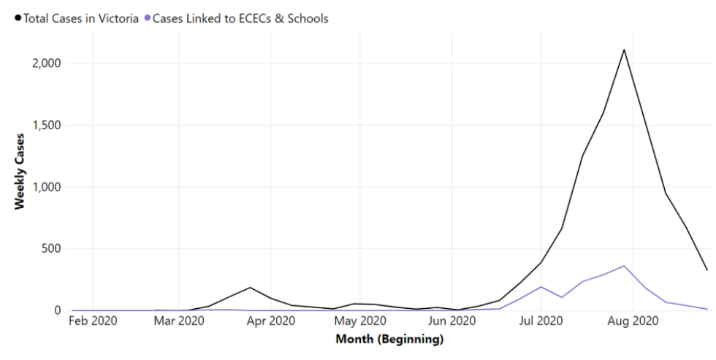
SARS-CoV-2 in Children: Schools
Community Transmission
Notes:
Russell FM, Ryan K, Snow K, et al. COVID-19 in Victorian Schools: An analysis of child-care and school outbreak data and evidence-based recommendations for opening schools and keeping them open. Report from Murdoch Children’s Research Institute and the University of Melbourne. 2020; Published 2020 September 25.

Slide 31
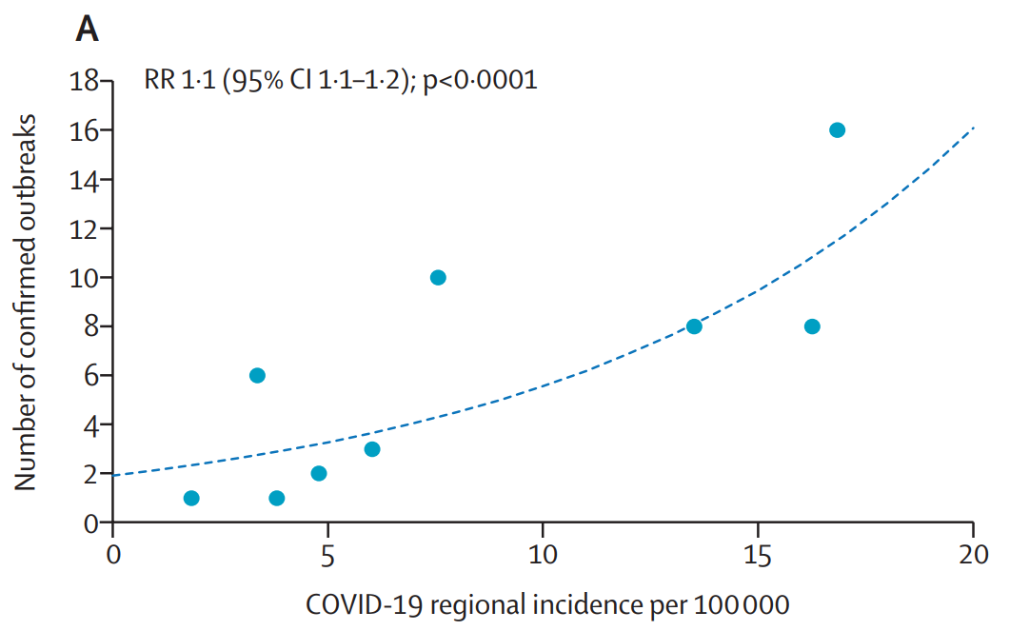

Slide 32
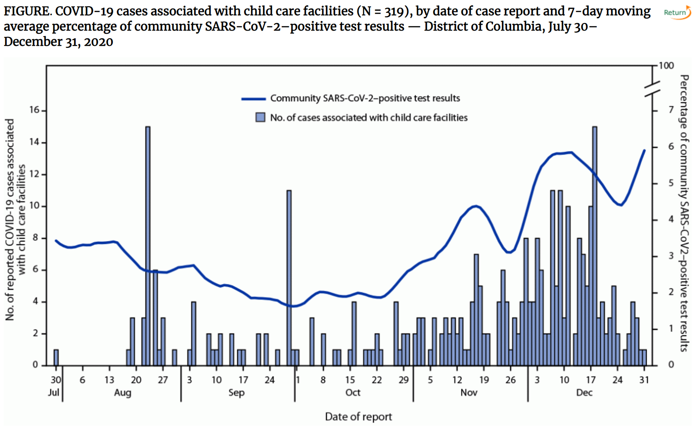
Notes:
Kim C, McGee S, Khuntia S, et al. Characteristics of COVID-19 Cases and Outbreaks at Child Care Facilities – District of Columbia, July-December 2020. MMWR Morb Mortal Wkly Rep 2021;70(20):744-748. doi:10.15585/mmwr.mm7020a3

Slide 33
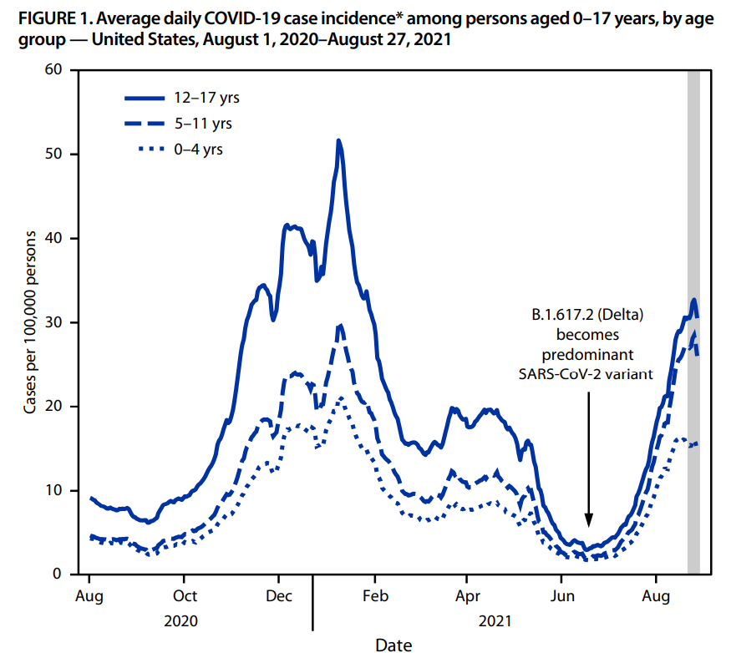
SARS-CoV-2 in Children: Schools
Variants in Circulation
Notes:
Russell FM, Ryan K, Snow K, et al. COVID-19 in Victorian Schools: An analysis of child-care and school outbreak data and evidence-based recommendations for opening schools and keeping them open. Report from Murdoch Children’s Research Institute and the University of Melbourne. 2020; Published 2020 September 25.

Slide 34
SARS-CoV-2 in Children: Schools
Basic Reproduction Number
Number of new cases that may arise from one index case
Examples of R0 by pathogen:
Rhinovirus = 1.2-1.8
Measles = 12-18
Ebola = 1.5
SARS-CoV-2 (original lineages) = 1.8-3.6 (mean 2.8)
SARS-CoV-2 (Delta) = 5-9

Slide 35
SARS-CoV-2 in Children: Schools
Staff and Student Vaccination

Slide 36
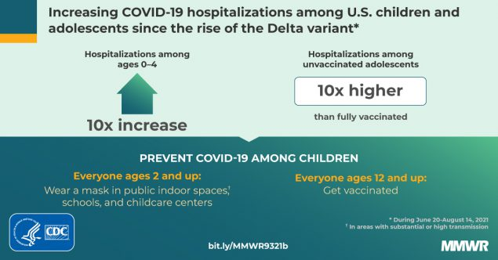
SARS-CoV-2 in Children: Schools
Staff and Student Vaccination

Slide 37
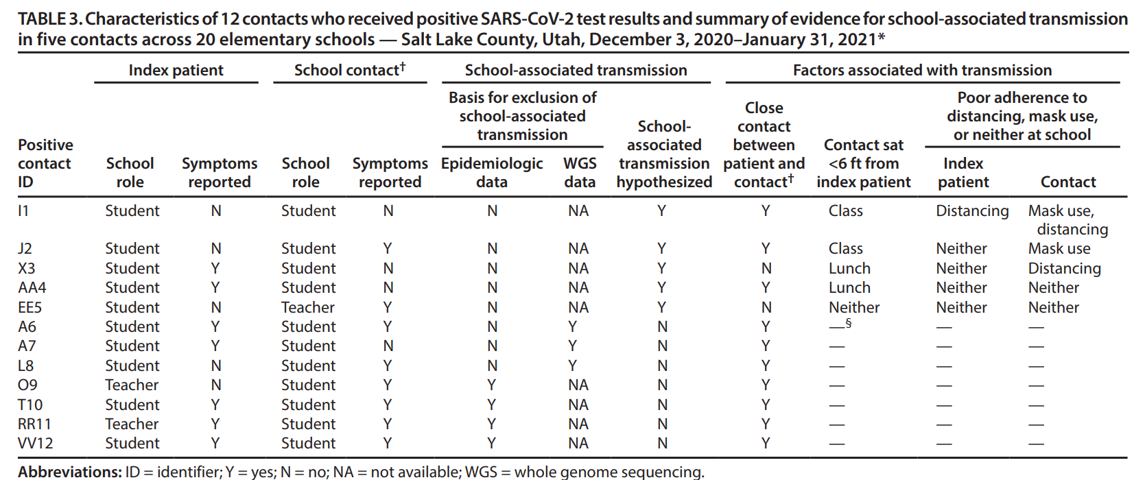
SARS-CoV-2 in Children: Schools
Mitigation Measures
Notes:
Hershow RB, Wu K, Lewis NM, et al. Low SARS-CoV-2 Transmission in Elementary Schools – Salt Lake County, Utah, December 3, 2020-January 31, 2021. MMWR Morb Mortal Wkly Rep 2021;70(12):442-448. doi:10.15585/mmwr.mm7012e3

Slide 38
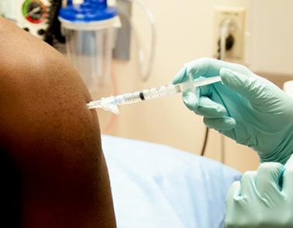
SARS-CoV-2 in Children: Schools
In-person school has numerous benefits for children and adolescents of all ages
Vaccination remains the most important public health tool to guarantee student, staff, and family safety with in-person school attendance
Mitigation measures are important adjuncts
Notes:
Image from: https://www.niaid.nih.gov/research/vaccines

Slide 39
Why are pediatric inpatient centers full?

Slide 40
Delayed Respiratory virus surge
Closures and mitigation measures during 2020 inadvertently suppressed transmission of typical respiratory pathogens
A delayed surge has resulted with an unprecedented number of cases in late summer/early fall 2021
Notes:
Image from: Intermountain Primary Children’s Hospital. https://intermountainhealthcare.org/primary-childrens/your-visit

Slide 41
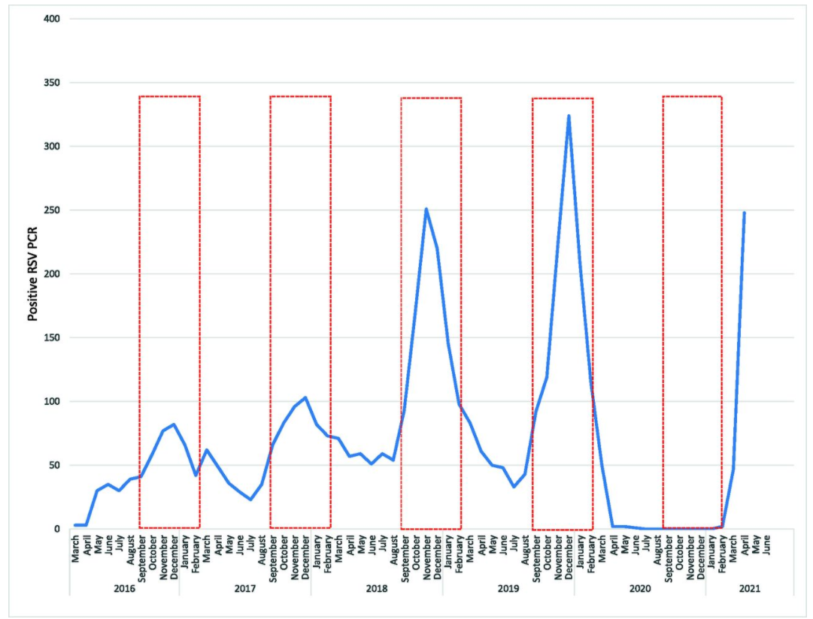
Notes:
Agha R, Avner JR. Delayed Seasonal RSV Surge Observed During the COVID-19 Pandemic. Pediatrics September 2021, 148 (3) e2021052089

Slide 42
Notes:
Courtesy Intermountain Germwatch

Slide 43
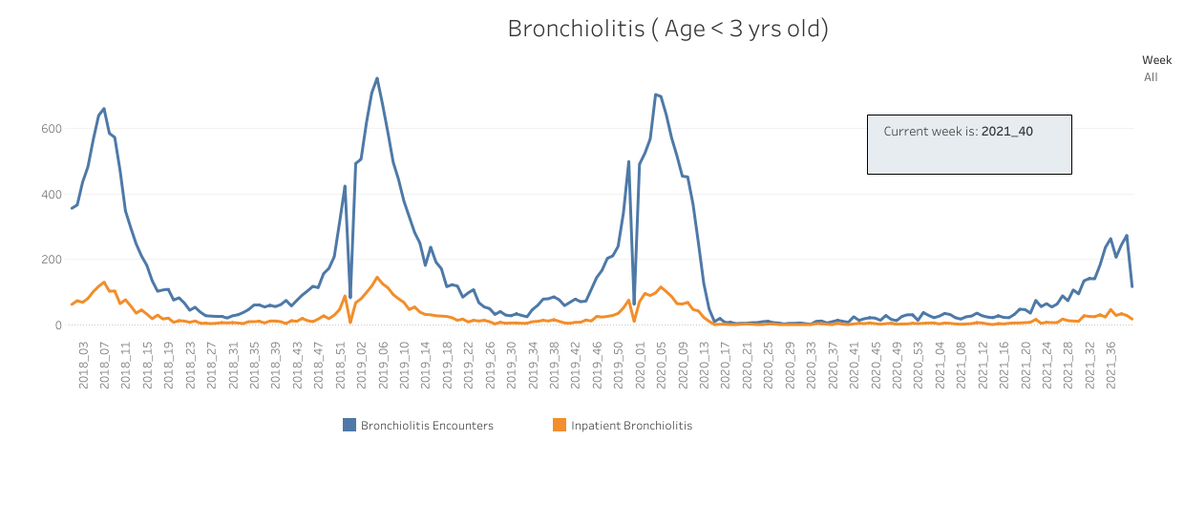
Notes:
Courtesy Intermountain Germwatch

Slide 44
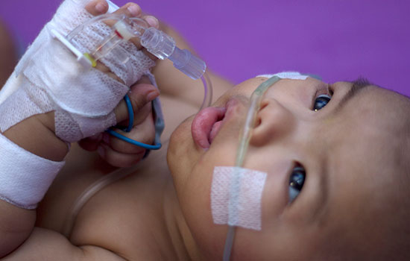
Delayed Respiratory virus surge
Palivizumab Guidance:
Infants younger than 12 months with prematurity before 29 weeks GA
Infants with chronic lung disease (<32 weeks GA)
Hemodynamically significant acyanotic heart disease
Moderate to severe pulm. HTN
Cystic fibrosis with evidence of lung disease or nutritional compromise
Notes:
American Academy of Pediatrics Committee on Infectious Diseases, American Academy of Pediatrics Bronchiolitis Guidelines Committee. Updated guidance for palivizumab prophylaxis among infants and young children at increased risk of hospitalization for respiratory syncytial virus infection. Pediatrics. 2014 Aug;134(2):e620-38.
Image from: Centers for Disease Control and Prevention. https://www.cdc.gov/rsv/high-risk/infants-young-children.html

Slide 45
Delayed Respiratory virus surge
Notes:
From: American Academy of Pediatrics. Interim Guidance for Use of Palivizumab Prophylaxis to Prevent Hospitalization From Severe Respiratory Syncytial Virus Infection During the Current Atypical Interseasonal RSV Spread. https://www.aap.org/en/pages/2019-novel-coronavirus-covid-19-infections/clinical-guidance/interim-guidance-for-use-of-palivizumab-prophylaxis-to-prevent-hospitalization/

Slide 46
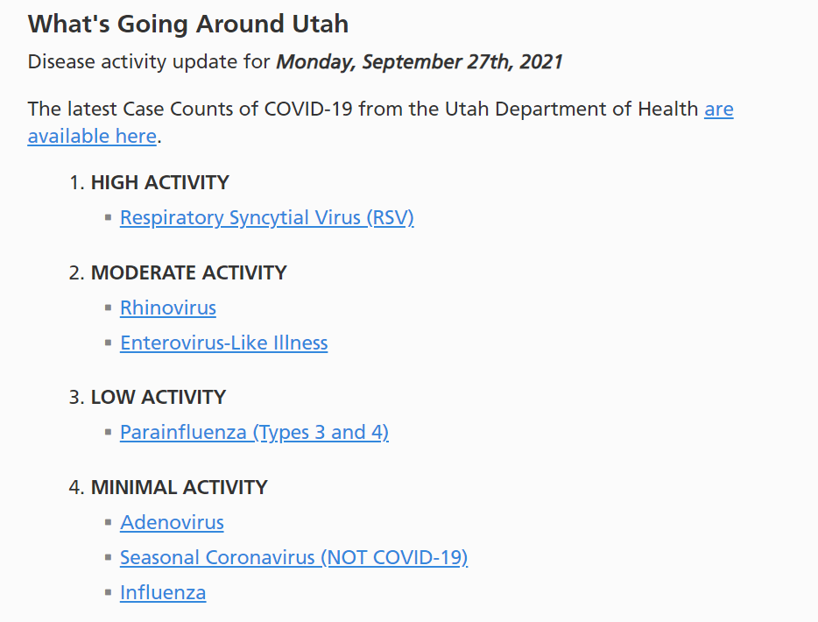
Delayed Respiratory virus surge
“Seasonal” respiratory viruses have led to consumption of health care resources with little margin for additional COVID-19 cases
Notes:
Image from: Intermountain GermWatch. https://intermountainhealthcare.org/health-information/germwatch/

Slide 47
What’s in store for this winter?

Slide 48
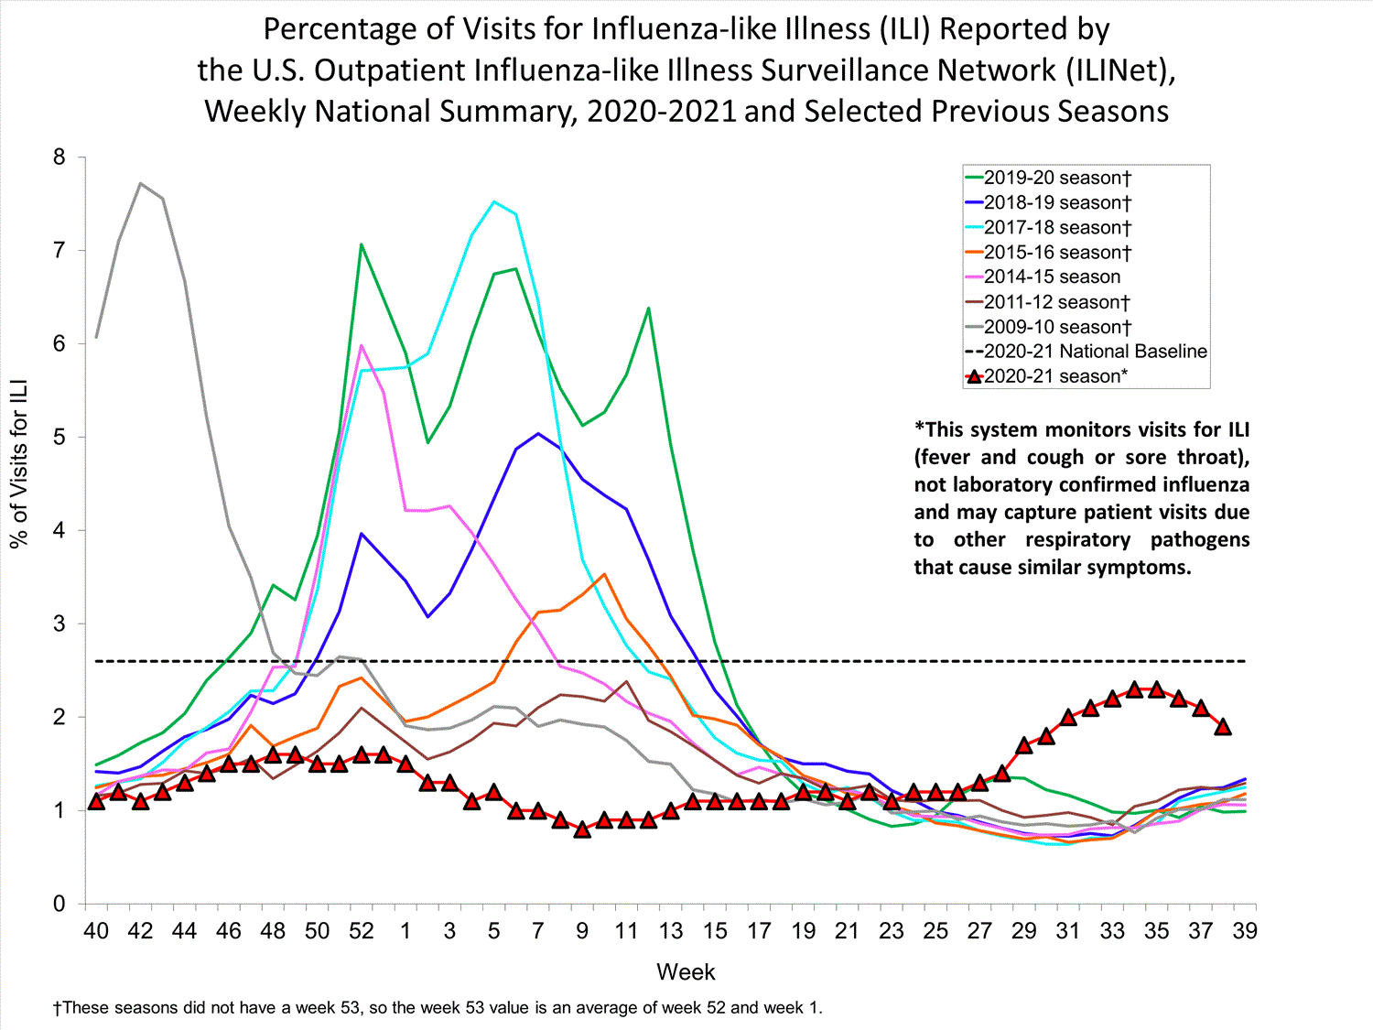
Notes:
Image from: Centers for Disease Control and Prevention. Weekly U.S. Influenza Surveillance Report. https://www.cdc.gov/flu/weekly/index.htm

Slide 49
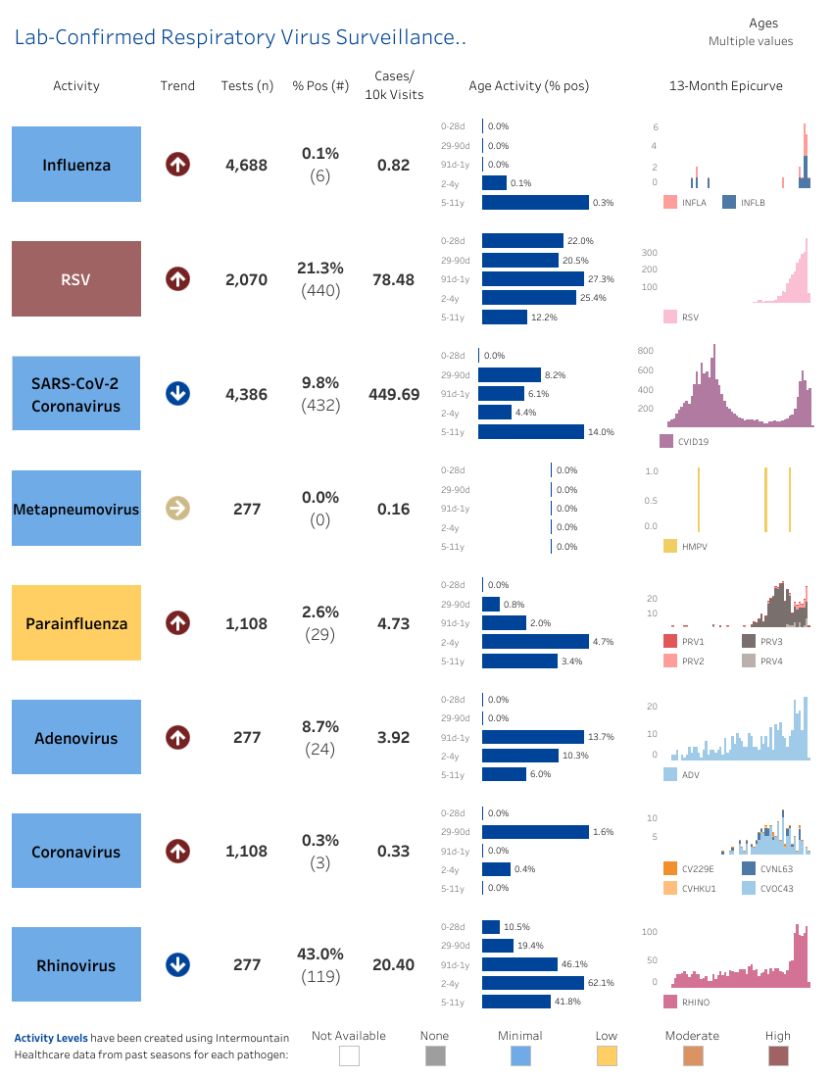
Notes:
Courtesy Intermountain Germwatch

Slide 50
Notes:
Courtesy Intermountain Germwatch

Slide 51
Objectives
What do we know about the epidemiology of SARS-CoV-2 in children?
What are the harms of SARS-CoV-2 in children?
Will my child be safe in in-person school?
Why are pediatric inpatient centers full?
What’s in store for this winter?

Slide 52
Update on pediatric immunizations

Slide 53
disclosures
I will discuss vaccines that remain under FDA Emergency Use Authorization for the age groups in question
Brand names are used for identification purposes only and do not serve as an endorsement of the brand in question
I have no relevant personal financial relationships with any drugs, therapies, or vaccines included in this lecture

Slide 54
Objectives
What is the evidence for the efficacy of immunizations for adolescents against SARS-CoV-2?
What are the adverse reactions associated with immunizing adolescents against SARS-CoV-2?
When will younger age groups be approved to receive immunizations against SARS-CoV-2?
What are the current shortfalls in immunizations across the US?
What should I know about influenza vaccination for this winter?

Slide 55
What is the evidence for the efficacy of immunizations for adolescents against SARS-CoV-2?

Slide 56
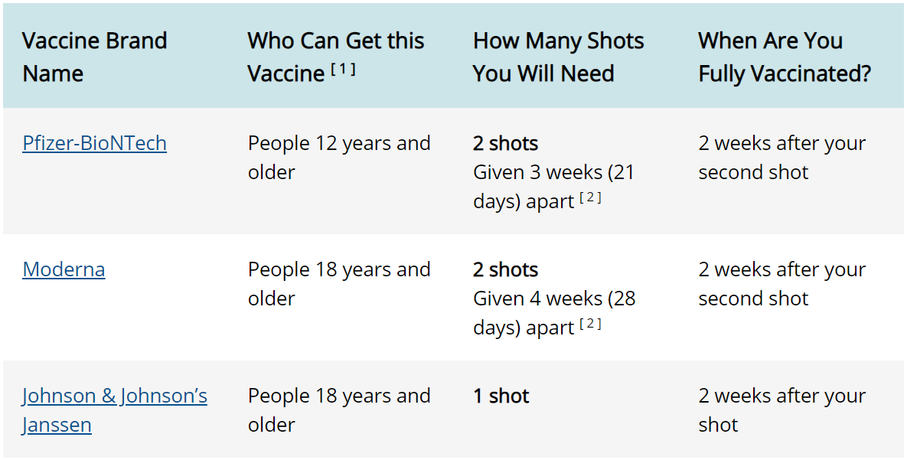
SARS-cov-2 vaccines in the us
Only 3 vaccines meet FDA approval or FDA EUA:
Notes:
Centers for Disease Control and Prevention. Different COVID-19 Vaccines. https://www.cdc.gov/coronavirus/2019-ncov/vaccines/different-vaccines.html

Slide 57
SARS-cov-2 vaccines in the us
Only 3 vaccines meet FDA approval or FDA EUA:
Notes:
Centers for Disease Control and Prevention. Different COVID-19 Vaccines. https://www.cdc.gov/coronavirus/2019-ncov/vaccines/different-vaccines.html

Slide 58
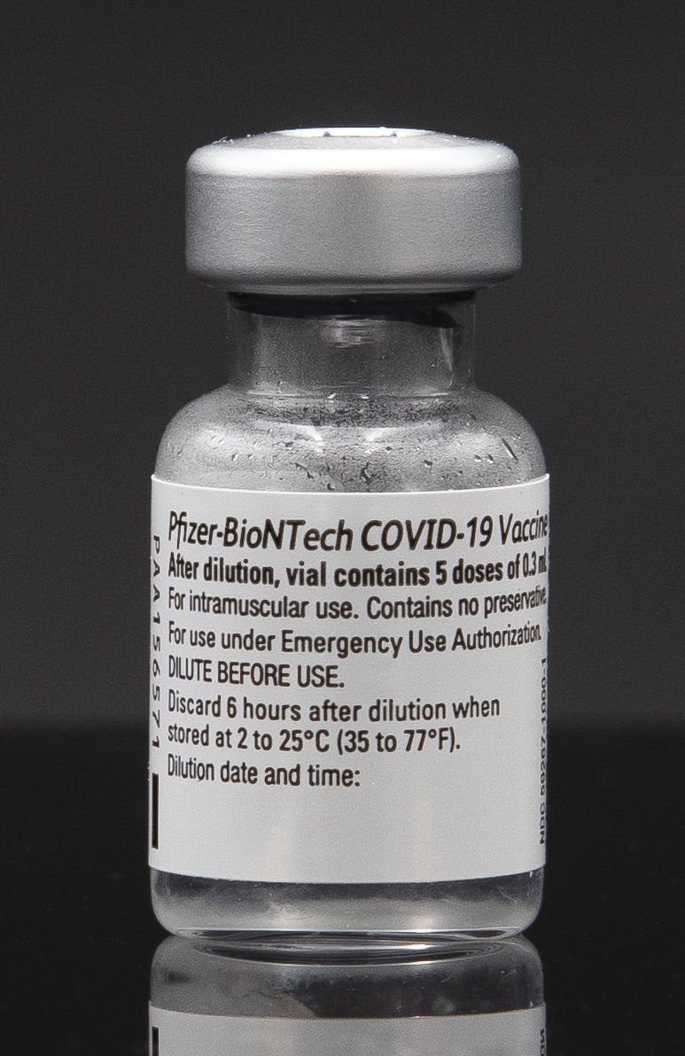
Sars-cov-2 immunization
May 10, 2021: the FDA expands emergency use authorization for the Pfizer-BioNTech COVID-19 vaccine to include adolescents aged 12-15 years
May 12, 2021: the Advisory Committee on Immunization Practices made an interim recommendation for the use of the Pfizer-BioNTech COVID-19 vaccine for adolescents 12-15 years
August 23, 2021: The FDA approves the Pfizer-BioNTech COVID-19 vaccine for individuals 16 years of age and older
Notes:
Wallace M, Woodworth KR, Gargano JW, et al. The Advisory Committee on Immunization Practices’ Interim Recommendation for Use of Pfizer-BioNTech COVID-19 Vaccine in Adolescents Aged 12–15 Years — United States, May 2021. MMWR Morb Mortal Wkly Rep 2021;70:749–752.
US Food and Drug Administration. FDA Approves First COVID-19 Vaccine. https://www.fda.gov/news-events/press-announcements/fda-approves-first-covid-19-vaccine.
Picture from Wikimedia Commons. User Arne Müseler / www.arne-mueseler.com.

Slide 59
Sars-cov-2 immunization: evidence
Methods:
Randomized, double-blind, placebo-controlled Phase II/III trial
Included 2,200 participants aged 12-15 years randomized 1:1 to receive vaccine or placebo
Median 2 months of follow-up
Wallace M, Woodworth KR, Gargano JW, et al. The Advisory Committee on Immunization Practices’ Interim Recommendation for Use of Pfizer-BioNTech COVID-19 Vaccine in Adolescents Aged 12–15 Years — United States, May 2021. MMWR Morb Mortal Wkly Rep 2021;70:749–752.
Notes:
Wallace M, Woodworth KR, Gargano JW, et al. The Advisory Committee on Immunization Practices’ Interim Recommendation for Use of Pfizer-BioNTech COVID-19 Vaccine in Adolescents Aged 12–15 Years — United States, May 2021. MMWR Morb Mortal Wkly Rep 2021;70:749–752.
Image from: National Institutes of Health. COVID-19 Vaccines. https://covid19.nih.gov/treatments-and-vaccines/covid-19-vaccines

Slide 60
Sars-cov-2 immunization: evidence
Results:
100% efficacy rate in the study population
Statistical noninferiority to patients 16-25 years in terms of neutralizing antibody immunogenicity
Wallace M, Woodworth KR, Gargano JW, et al. The Advisory Committee on Immunization Practices’ Interim Recommendation for Use of Pfizer-BioNTech COVID-19 Vaccine in Adolescents Aged 12–15 Years — United States, May 2021. MMWR Morb Mortal Wkly Rep 2021;70:749–752.
Notes:
Wallace M, Woodworth KR, Gargano JW, et al. The Advisory Committee on Immunization Practices’ Interim Recommendation for Use of Pfizer-BioNTech COVID-19 Vaccine in Adolescents Aged 12–15 Years — United States, May 2021. MMWR Morb Mortal Wkly Rep 2021;70:749–752.

Slide 61
What are the adverse reactions associated with immunizing adolescents against SARS-CoV-2?

Slide 62
Sars-cov-2 immunization: Adverse Events
Local reactions
Redness: 65% (1st dose), 55% (2nd dose)
Swelling: 78%, 54%
Pain at the injection site: 86%, 79%
Centers for Disease Control and Prevention. Local Reactions, Systemic Reactions, Adverse Events, and Serious Adverse Events: Pfizer-BioNTech COVID-19 Vaccine. https://www.cdc.gov/vaccines/covid-19/info-by-product/pfizer/reactogenicity.html
Notes:
Centers for Disease Control and Prevention. Local Reactions, Systemic Reactions, Adverse Events, and Serious Adverse Events: Pfizer-BioNTech COVID-19 Vaccine. https://www.cdc.gov/vaccines/covid-19/info-by-product/pfizer/reactogenicity.html
Image from: National Institutes of Health. COVID-19 Vaccines. https://covid19.nih.gov/treatments-and-vaccines/covid-19-vaccines

Slide 63
Sars-cov-2 immunization: Adverse Events
Systemic reactions
Fever: 10% (1st dose), 20% (2nd dose)
Fatigue: 60%, 66%
Headache: 55%, 65%
Chills: 28%, 42%
Vomiting: 3%, 3%
Diarrhea: 8%, 6%
Muscle pain: 24%, 32%
Joint pain: 10%, 16%
Centers for Disease Control and Prevention. Local Reactions, Systemic Reactions, Adverse Events, and Serious Adverse Events: Pfizer-BioNTech COVID-19 Vaccine. https://www.cdc.gov/vaccines/covid-19/info-by-product/pfizer/reactogenicity.html
Notes:
Centers for Disease Control and Prevention. Local Reactions, Systemic Reactions, Adverse Events, and Serious Adverse Events: Pfizer-BioNTech COVID-19 Vaccine. https://www.cdc.gov/vaccines/covid-19/info-by-product/pfizer/reactogenicity.html
Image from: National Institutes of Health. COVID-19 Vaccines. https://covid19.nih.gov/treatments-and-vaccines/covid-19-vaccines

Slide 64
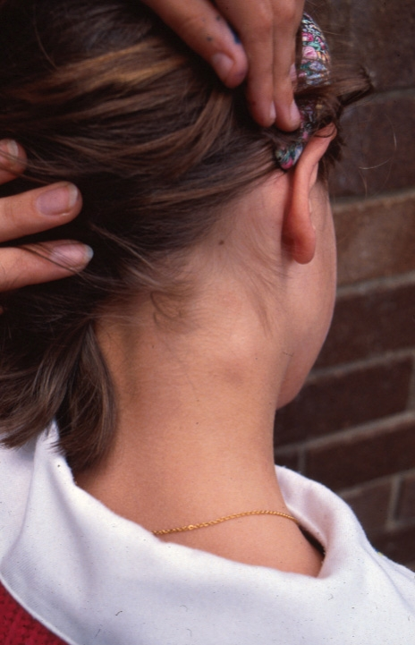
Sars-cov-2 immunization: Adverse Events
Lymphadenopathy in the arm and neck region
2-4 days following vaccination
7 cases in the vaccine group, 1 in the placebo group
Felt to be plausibly related
Typically resolved within 10 days
Centers for Disease Control and Prevention. Local Reactions, Systemic Reactions, Adverse Events, and Serious Adverse Events: Pfizer-BioNTech COVID-19 Vaccine. https://www.cdc.gov/vaccines/covid-19/info-by-product/pfizer/reactogenicity.html
Notes:
Centers for Disease Control and Prevention. Local Reactions, Systemic Reactions, Adverse Events, and Serious Adverse Events: Pfizer-BioNTech COVID-19 Vaccine. https://www.cdc.gov/vaccines/covid-19/info-by-product/pfizer/reactogenicity.html
Image from Wikimedia Commons. Hudson, Bernard - Hudson, Bernard

Slide 65
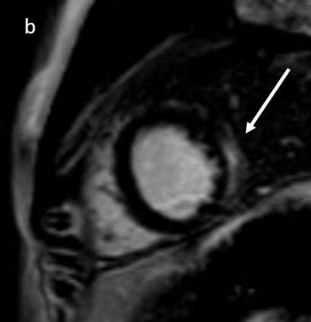
Sars-cov-2 immunization: Adverse Events
Myocarditis
More common in male adolescents
More common after the second dose
Typically within days after the vaccine dose
Generally mild, many cases resolve with NSAID or prednisone therapy alone
Centers for Disease Control and Prevention. Myocarditis and Pericarditis After mRNA COVID-19 Vaccination. https://www.cdc.gov/coronavirus/2019-ncov/vaccines/safety/myocarditis.html
Marshall M, et al. Symptomatic Acute Myocarditis in 7 Adolescents After Pfizer-BioNTech COVID-19 Vaccination. Pediatrics September 2021, 148 (3) e2021052478
Notes:
Marshall M, et al. Symptomatic Acute Myocarditis in 7 Adolescents After Pfizer-BioNTech COVID-19 Vaccination. Pediatrics September 2021, 148 (3) e2021052478

Slide 66
Sars-cov-2 immunization: Adverse Events
Thrombosis
Hippisley-Cox J, et al. BMJ August 2021
Self-controlled case series
Utilized National Immunisation Management System in the UK
Included all people who received BNT162b2 mRNA vaccine (Pfizer) or ChAdOx1 nCoV-19 vaccine (Oxford-AstraZeneca)
Included individuals 16 and older
Hippisley-Cox J, et al. Risk of thrombocytopenia and thromboembolism after covid-19 vaccination and SARS-CoV-2 positive testing: self-controlled case series study. BMJ 2021; 374
Notes:
Hippisley-Cox J, et al. Risk of thrombocytopenia and thromboembolism after covid-19 vaccination and SARS-CoV-2 positive testing: self-controlled case series study. BMJ 2021; 374

Slide 67
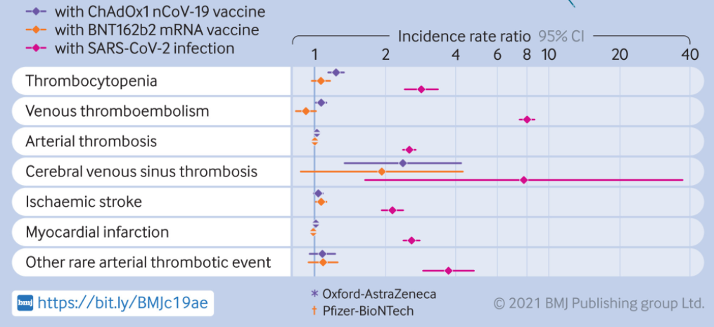
Sars-cov-2 immunization: Adverse Events
Hippisley-Cox J, et al. Risk of thrombocytopenia and thromboembolism after covid-19 vaccination and SARS-CoV-2 positive testing: self-controlled case series study. BMJ 2021; 374
Notes:
Hippisley-Cox J, et al. Risk of thrombocytopenia and thromboembolism after covid-19 vaccination and SARS-CoV-2 positive testing: self-controlled case series study. BMJ 2021; 374

Slide 68
Sars-cov-2 immunization: Adverse Events
Risks versus Benefits
Except for a select few, the personal and family risks associated contracting COVID-19 are far worse than immunization
Individuals who have had adverse reactions should see their healthcare providers
Concerns for myocarditis or thrombosis can be discussed with local subspecialists in cardiology, hematology, and infectious disease
Hippisley-Cox J, et al. Risk of thrombocytopenia and thromboembolism after covid-19 vaccination and SARS-CoV-2 positive testing: self-controlled case series study. BMJ 2021; 374
Notes:
Hippisley-Cox J, et al. Risk of thrombocytopenia and thromboembolism after covid-19 vaccination and SARS-CoV-2 positive testing: self-controlled case series study. BMJ 2021; 374

Slide 69
When will younger age groups be approved to receive immunizations against SARS-CoV-2?

Slide 70
Sars-cov-2 immunization: Ages 5-11
On September 20, Pfizer announced positive efficacy and safety data in the use of the Pfizer-BioNTech vaccine in children ages 5-11 years
The FDA plans on holding an advisory committee meeting on October 26 regarding Pfizer’s data on vaccine safety and efficacy in children ages 5-11 years
Notes:
Pfizer. PFIZER AND BIONTECH ANNOUNCE POSITIVE TOPLINE RESULTS FROM PIVOTAL TRIAL OF COVID-19 VACCINE IN CHILDREN 5 TO 11 YEARS. Https://www.pfizer.com/news/press-release/press-release-detail/pfizer-and-biontech-announce-positive-topline-results
US Food and Drug Administration. FDA to Hold Advisory Committee Meetings to Discuss Emergency Use Authorization for Booster Doses and COVID-19 Vaccines for Younger Children. https://www.fda.gov/news-events/press-announcements/fda-hold-advisory-committee-meetings-discuss-emergency-use-authorization-booster-doses-and-covid-19

Slide 71
What are the current shortfalls in immunizations across the US?

Slide 72
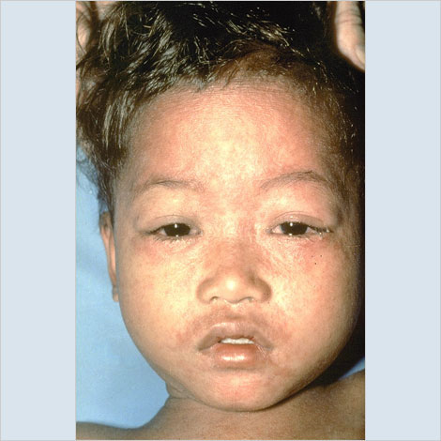
Shortfalls in immunization
The COVID-19 pandemic has disrupted normal immunization practices in most settings
Shortfalls have been noted in the US and globally
Pediatric populations are more vulnerable than before to the next outbreak of measles, mumps, or other infectious diseases
Notes:
Centers for Disease Control and Prevention. Child in later stages of measles rash (probably has had rash for 4 or 5 days). From immunize.org. http://www.immunize.org/photos/measles-photos.asp

Slide 73
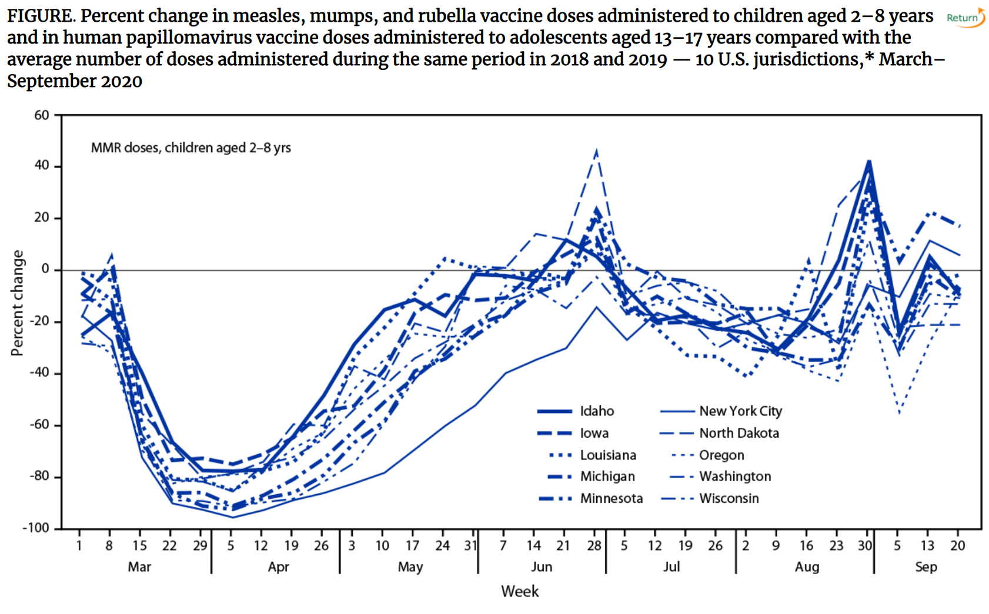
Notes:
Patel B, Murthy , Zell E, et al. Impact of the COVID-19 Pandemic on Administration of Selected Routine Childhood and Adolescent Vaccinations — 10 U.S. Jurisdictions, March–September 2020. MMWR Morb Mortal Wkly Rep 2021;70:840–845.
“Although vaccine administration rebounded during June–September 2020, approaching prepandemic levels in most jurisdictions, this increase was not sufficient to achieve the catch-up vaccination needed to address the many months when children missed routine vaccination.”

Slide 74
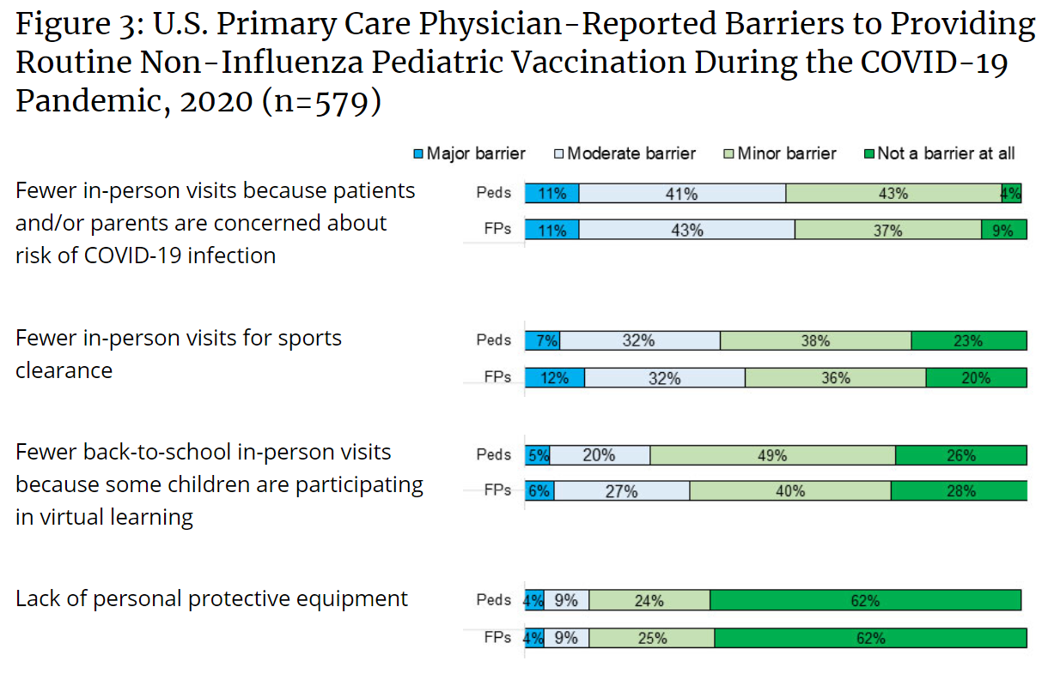
Notes:
O’Leary, ST, et al. US Primary Care Providers’ Experiences and Practices Related to Routine Pediatric Vaccination During the COVID-19 Pandemic. Centers for Disease Control and Prevention. https://www.cdc.gov/vaccines/hcp/pediatric-practices-during-COVID-19.html

Slide 75
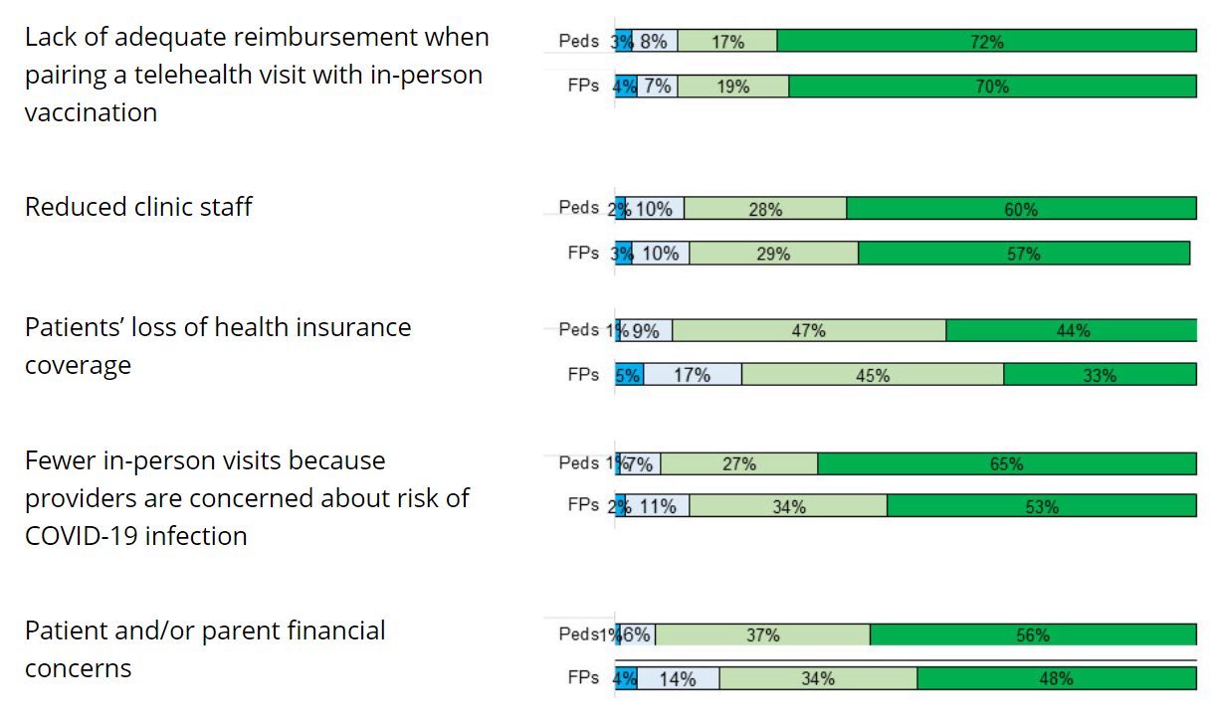
Notes:
O’Leary, ST, et al. US Primary Care Providers’ Experiences and Practices Related to Routine Pediatric Vaccination During the COVID-19 Pandemic. Centers for Disease Control and Prevention. https://www.cdc.gov/vaccines/hcp/pediatric-practices-during-COVID-19.html

Slide 76
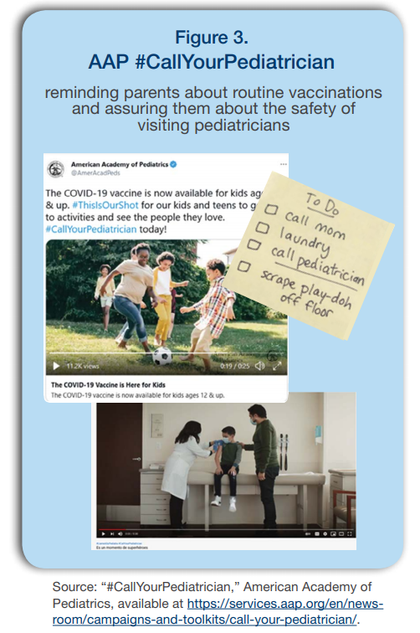
Shortfalls in immunization
Providers should reassure families about COVID-19 precautions in clinic
Novel methods for catching up on immunizations can be employed (e.g. “drive through appointments”)
Vaccine hesitancy can be addressed through dialogue, storytelling, visual imagery, and close relationships with primary care providers
Notes:
American Academy of Pediatrics. Georgetown University Health Policy Institute. Center for Children and Families. Urgent Action Needed to Catch Up on Routine Childhood Vaccinations. https://ccf.georgetown.edu/wp-content/uploads/2021/07/Kids-and-Vaccines-v4.pdf

Slide 77
What should I know about influenza vaccination for this winter?

Slide 78
Seasonal influenza
Seasonal influenza cases have appeared in Utah
Reduced population immunity due to lack of influenza virus activity since March 2020 could lead to an early, potentially severe flu season
Centers for Disease Control and Prevention. Frequently Asked Influenza (Flu) Questions: 2021-2022 Season. https://www.cdc.gov/flu/season/faq-flu-season-2021-2022.htm#what-virus
Notes:
Image from: Centers for Disease Control and Prevention. I Get It! Media resources. https://www.cdc.gov/flu/resource-center/i-get-it.htm

Slide 79
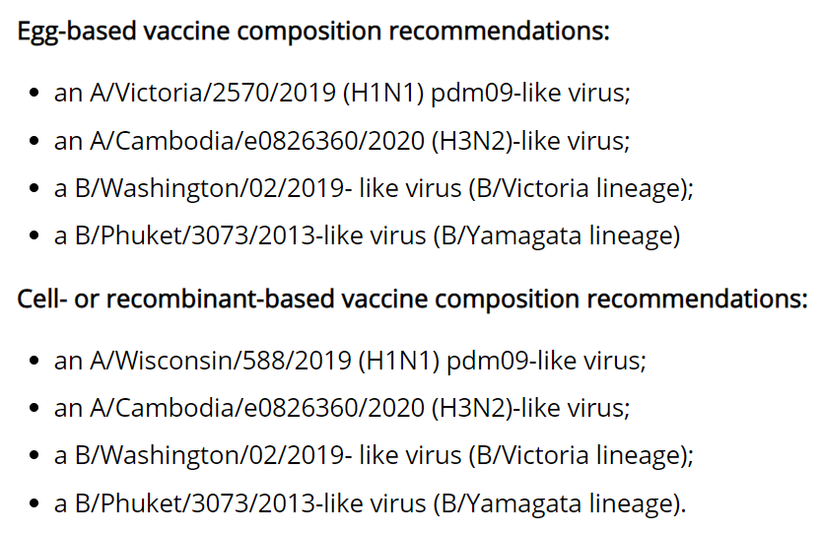
Seasonal influenza
All available flu vaccines in the US will be quadrivalent
Selected to protect against the viruses predicted to spread and cause illness this season
Centers for Disease Control and Prevention. Frequently Asked Influenza (Flu) Questions: 2021-2022 Season. https://www.cdc.gov/flu/season/faq-flu-season-2021-2022.htm#what-virus
Notes:
Centers for Disease Control and Prevention. Frequently Asked Influenza (Flu) Questions: 2021-2022 Season. https://www.cdc.gov/flu/season/faq-flu-season-2021-2022.htm#what-virus

Slide 80
Notes:
Image from: Centers for Disease Control and Prevention. I Get It! Media resources. https://www.cdc.gov/flu/resource-center/i-get-it.htm

Slide 81
Objectives
What is the evidence for the efficacy of immunizations for adolescents against SARS-CoV-2?
What are the adverse reactions associated with immunizing adolescents against SARS-CoV-2?
When will younger age groups be approved to receive immunizations against SARS-CoV-2?
What are the current shortfalls in immunizations across the US?
What should I know about influenza vaccination for this winter?

Slide 82
Comments or questions?

Slide 83
Thank you
Trahern W. (“TW”) Jones, MD
Assistant Professor, Division of Infectious Diseases
University of Utah Pediatrics
Tw.jones@hsc.Utah.edu

