Slide 1
An Update in Hepatology
Richard Gilroy
Intermountain Health Care
Now that hepatitis C is curable in all

Slide 2
Disclosures
I have significant research interests in Fatty Liver disease
  Personal
    Economic research on costing data
    Work related: most common indication for a referral for decompensated CLD
    National recognition
    Population based screening
    I have been invited to national Advisory boards and Speakers Bureaus for:
      Novartis, Gilead, Celgene, Pfizer, Merck, Salix
      AASLD, ATC, AOPO
  Economic (Program)
    Most common industry sponsored studies that we do
    this contributes to the revenues intradepartmental research initiative, the number of research personnel we have, hepatology referrals and thereby the size of our operation
    I am on advisory boards for Gilead, Salix, Novartis, and Abbvie (no references to these)

Slide 3
Objectives
Outline the initial evaluation of those with persistently elevated Liver Function Tests
Understand which medications are desirable and those one would like to stop in those with ESLD
In those with elevated liver function tests what is the role for a Liver Biopsy, or liver masses or for Liver Enzyme abnormalities and when can one treat without a biopsy

Slide 4
To be Covered
(Not in this Order)
The changing profile of End Stage Liver Disease
Update on Testing in those with End Stage Liver Disease
Population Data on NASH
  Which, Where and How to identify
NASH management and Testing
Tsunami: How big will the problem Become

Slide 5
Where Does Utah and Idaho “Currently” Stand with
Liver Disease It’s Management

Slide 6
Cirrhosis Background
Prevalence of cirrhosis in the United States population is ~ 0.27%
This corresponds to 633,323 adults in the US and 8,235 adults in Utah or Approx. 4700 patients in Idaho
Sixty-nine percent reported that they were unaware of having liver disease and it is likely greater
The following are independently associated with cirrhosis :
  non-Hispanic blacks and Mexican Americans
  those living below the poverty level
  those with less than a 12th grade education
  Diabetes, Obesity
  alcohol abuse, hepatitis C and B
  male sex
  older age
Mortality was 26.4% per 2-year interval in cirrhosis compared with 8.4% in propensity-matched controls.

Slide 7

Crude death rates from liver disease from 2014 from CDC death data
ICD-10 Codes: B15-B19 (Viral hepatitis), K70.0 (Alcoholic fatty liver), K70.1 (Alcoholic hepatitis), K70.2 (Alcoholic fibrosis and sclerosis of liver), K70.3 (Alcoholic cirrhosis of liver), K70.4 (Alcoholic hepatic failure), K70.9 (Alcoholic liver disease, unspecified), K71.7 (Toxic liver disease with fibrosis and cirrhosis of liver), K72.1 (Chronic hepatic failure), K73.0 (Chronic persistent hepatitis, not elsewhere classified), K73.1 (Chronic lobular hepatitis, not elsewhere classified), K73.2 (Chronic active hepatitis, not elsewhere classified), K73.8 (Other chronic hepatitis, not elsewhere classified), K73.9 (Chronic hepatitis, unspecified), K74.0 (Hepatic fibrosis), K74.2 (Hepatic fibrosis with hepatic sclerosis), K74.3 (Primary biliary cirrhosis), K74.5 (Biliary cirrhosis, unspecified), K74.6 (Other and unspecified cirrhosis of liver), K75.4 (Autoimmune hepatitis), K76.0 (Fatty (change of) liver, not elsewhere classified), K76.6 (Portal hypertension), K76.7 (Hepatorenal syndrome)

Slide 8
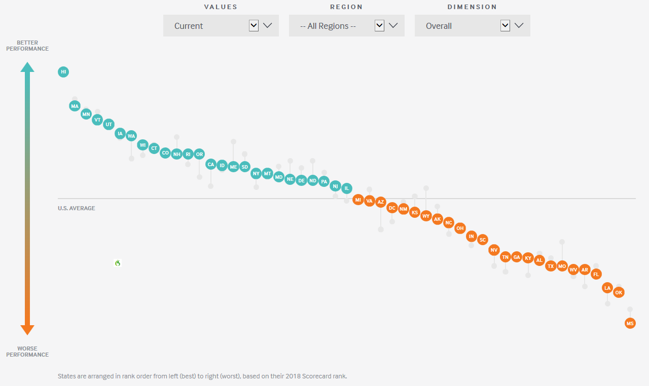
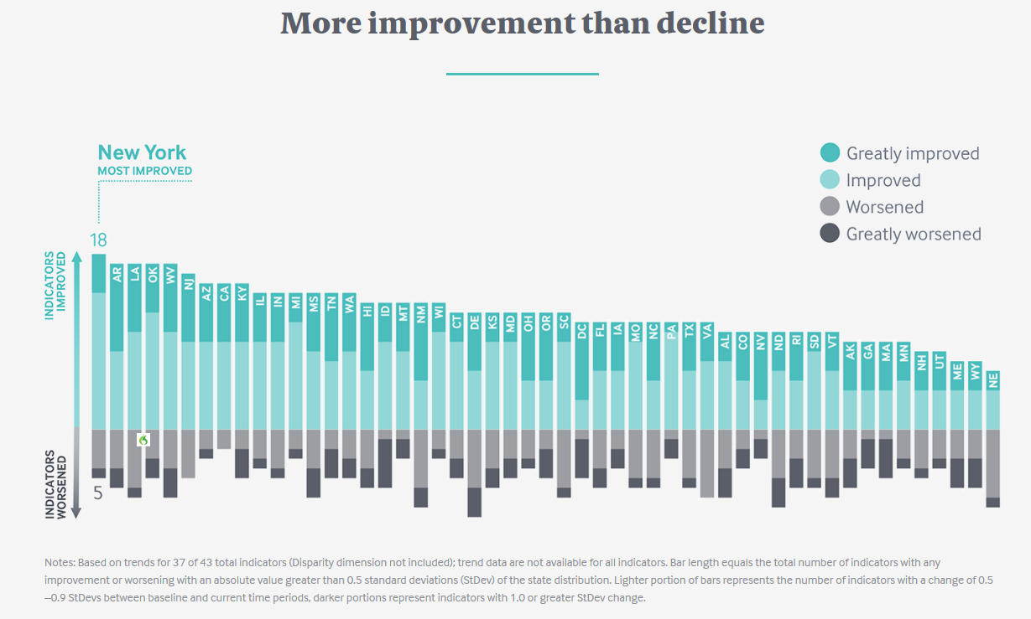
Healthcare Delivery by State

Slide 9
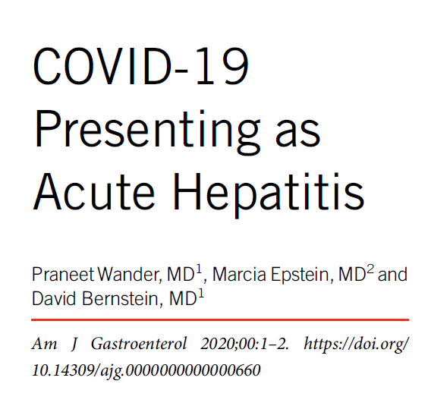
THEN………………

Slide 10
Background data Waiting List Mortality

Slide 11
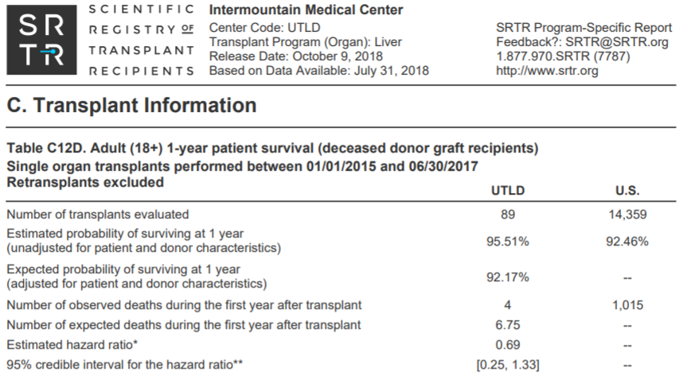
1 year outcomes IMC

Slide 12
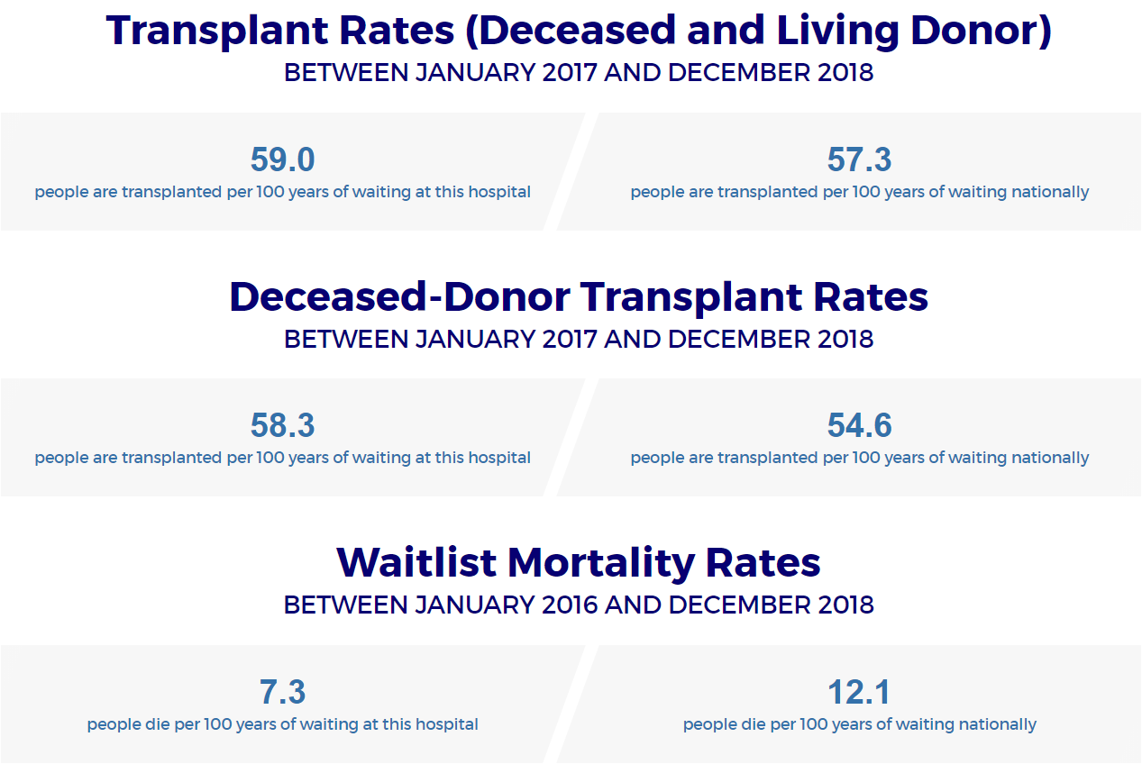
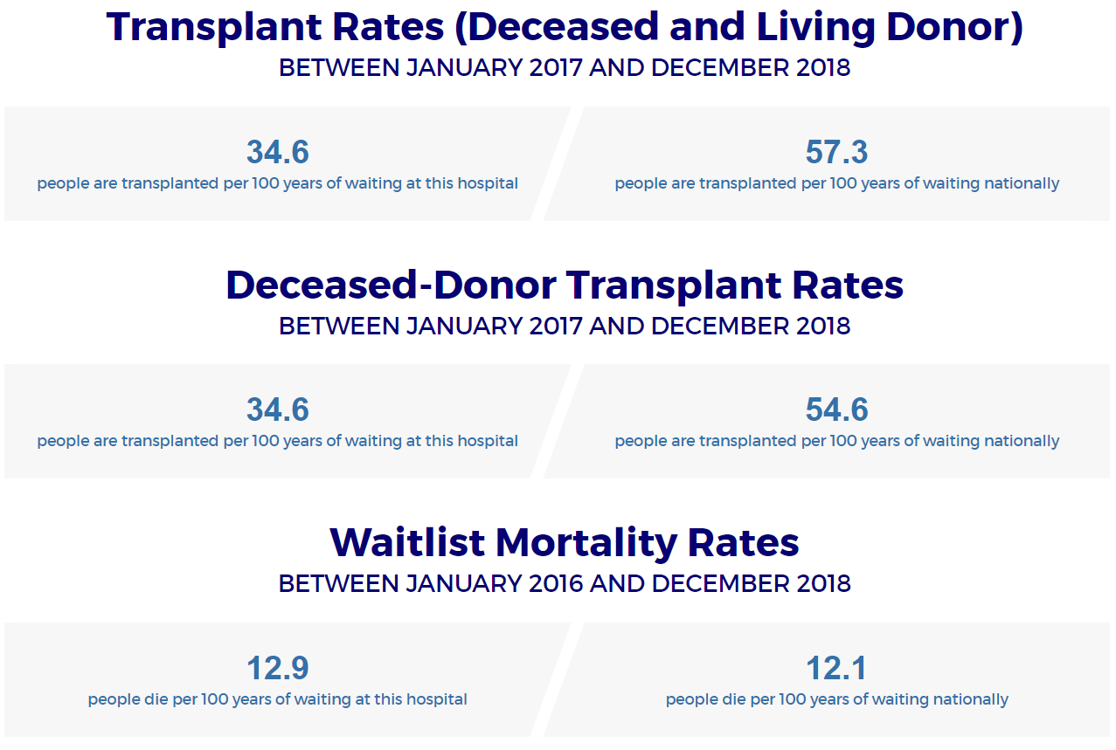
Comparative Waiting List Mortality Data Utah Programs

Slide 13

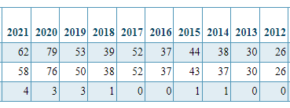
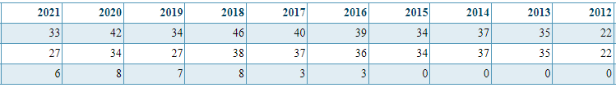
Program Comparisons
Aug
IMC
Aug
Aug
Aug
U of U

Slide 14
The Changing Profile of ESLD

Slide 15
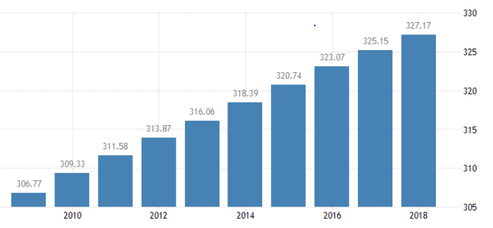

Supply and Demand In Organ Transplantation
Supply: AKA often “Damaged Goods”
  Bad Stories that are in fact Incredible Opportunities
    If someone declines an offer to you that is transplanted into someone else more than once your odds for dying on the waiting list at that program, as compared to a program that accepted the declined organ doubles
  Everyone has a different opinion on marginal and a different question of utility
    “This patient should wait for a great offer”
Demand

Slide 16
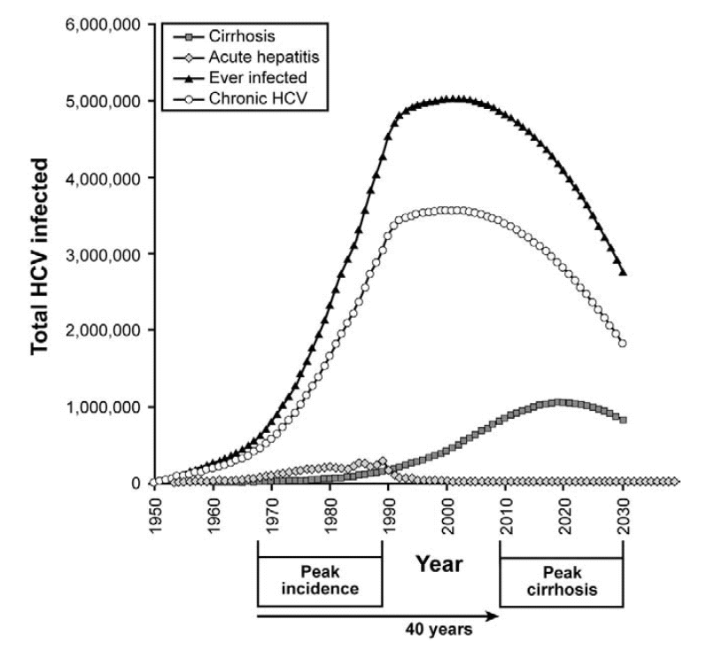
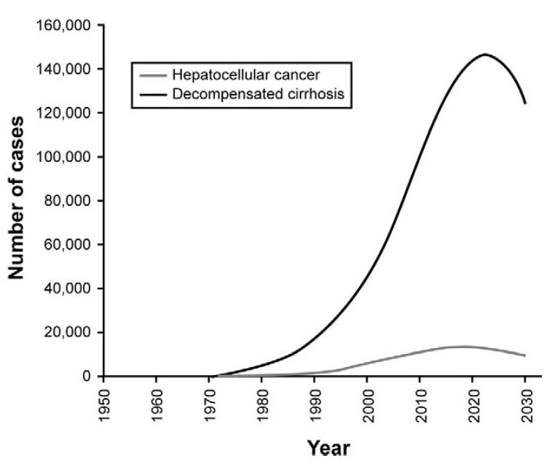
Changing Demographic of End Stage Liver Disease
It was hepatitis C
From: Davis GL, et al. Gastroenterology 2010;138(2):513-521

Slide 17
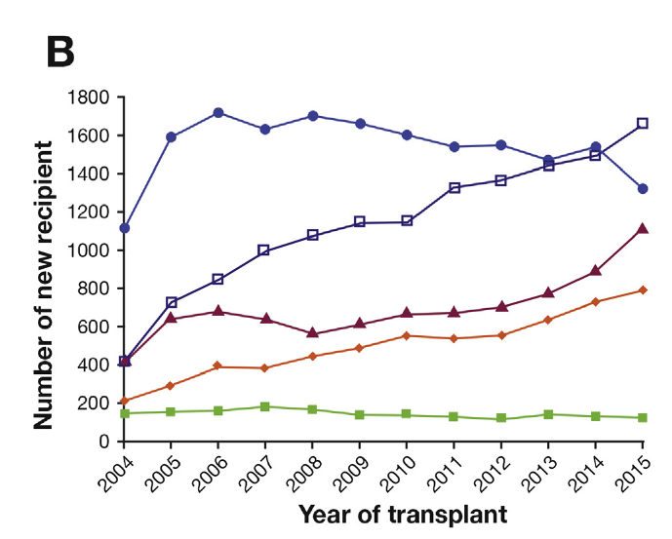
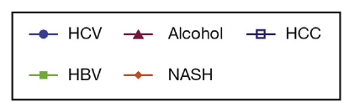
Liver Transplant Program MUST adjust to Optimally Manage NASH
Annual Incidence of HCC in those with NASH cirrhosis is 3% per year

Slide 18
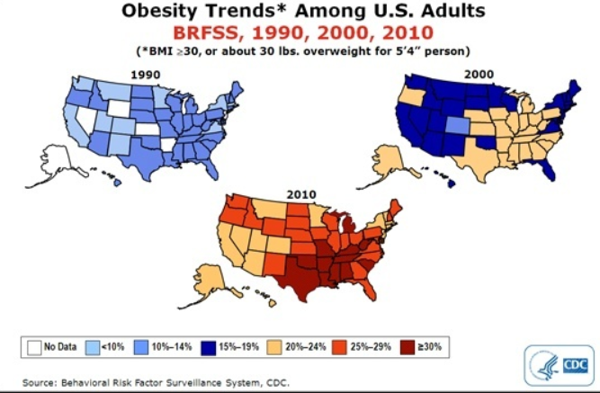
Obesity is the Driver of NASH
Trends in Obesity Over Time

Slide 19
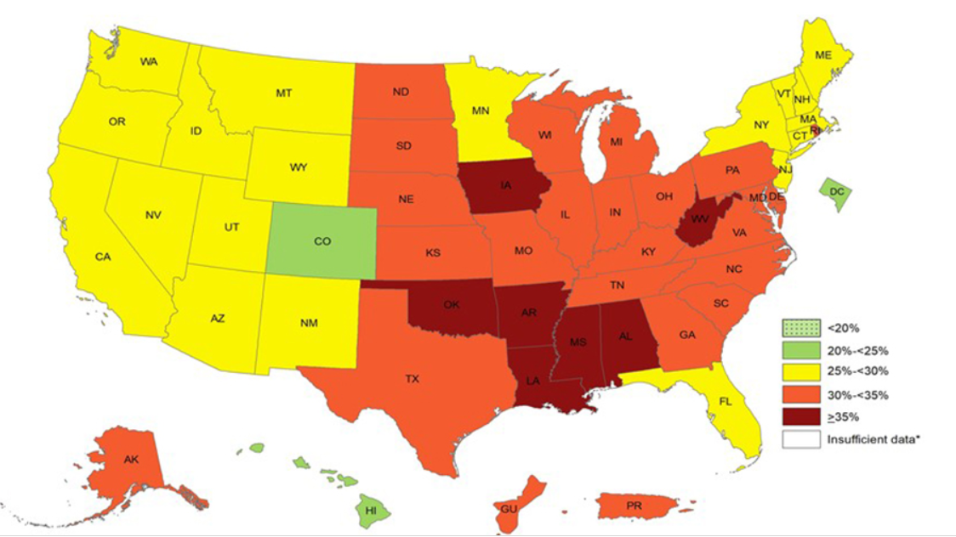
Unfortunately the Obesity Trends Continue
(2018 CDC Obesity Data)
Obesity in Utah was <10% in 1990 and is 25-30% in 2018

Slide 20
Background
In adults Hypertensive diseases, dyslipidemia, and osteoarthritis were the most expensive obesity related comorbidities in data from 2004-2013
  at the population level these are responsible for ≥$18 million annually among 100 000 individuals.
Obesity trends are continuing and with this costs continue to increase
  Estimated in 2020 to exceed $ 1,000,000,000,000 in health care costs and lost productivity
In looking at the Intermountain Medical System we see the following costs and differentials relative to Controls (DDW 2015):
Outcome | NAFLD overall | Fold change vs. controls | P-value
Annual cost before diagnosis ($, median, IQR) | 974 (277-2969) | 4.97x | <0.0001
Annual post diagnosis cost ($, median, IQR) | 2615 (1096-6888) | 3.57x | <0.0001
Overall annual cost ($, median, IQR) | 2397 (1094-5913) | 3.3x | <0.0001
% Liver Tx | 0.54% | 18x | <0.0001
Mortality | 8.4% | 1.7x | <0.0001
J Med Econ. 2015;18(12):1020-8
Eur J Public Health. 2015 Apr;25(2):255-62.
Nutrition. 2012 Sep;28(9):829-39

Slide 21
Summary on the Changing Profile
The Profile of Liver Disease in our community is very different to elsewhere in the US
  Slightly Less EtOH, A LOT MORE Primary Sclerosing Cholangitis, and NASH rates/capita at or slightly above those of other States
Little is being done to address the changing profile of CLD
  HCV will likely be eradicated as economic incentives exist
  NASH will result in 1.5 million new cirrhotics
  In those with ESLD the costs of managing them will continue to increase and the number of transplants per year will soon decrease
Ways to address this include:
  Screening
  Resources
  Existing Therapies and Novel

Slide 22
Testing in ESLD
Standard testing
  LIVER ENZYMES
    AST
    ALT
    Alkaline Phosphatase
  Liver Function:
    INR
    Bilirubin
  Cancer markers
    AFP for cirrhosis, AFP-L3 or DCGP, and in PSC Ca 19.9
  Ultrasound
    Liver Size and Shape. Spleen size, ascites (present or Absent), Gallbladder (+/- Stones, wall thickness)
  CT or MRI if a liver mass
  FibroScan
  Liver Biopsy
Ammonia Levels

Slide 23
Liver Enzymes
AST
ALT
Alk Phos

Slide 24
Function Tests
Bilirubin
  Isolated elevation in the presence of normal LEs remember Gilbert’s
INR
  An elevated INR does NOT mean patients don’t clot
  20% of those with cirrhosis develop PVT
Ammonia
  A role in acute Liver failure and Immediately Post-Transplant

Slide 25
Cancer Markers
AFP (ONLY ELEVATED in 60%)
AFP L3 & DCGP (HCC)
Ca 19.9 (multiple tumors)
Ca 125 (increased in ovarian cancer and in ascites)

Slide 26
Imaging
AASLD recommendations on Screening
  USS & AFP
  < 10 % of those with cirrhosis within
CT
  This does not diagnose cirrhosis and only implies both cirrhosis and it’s severity (CT reports interestingly not uncommonly say severe cirrhosis)
    SM, Ascites, varices are markers of a disease at greater risk for complications
    MELD and BARD scores define severity
MRI
  NOTE: new guidelines from RSNA allows for contrast in those with renal failure on dialysis
Sensitivity and specificity for tumor identification
  LI-RADs classification.
    LI-RAD 5 lesions DO NOT require a biopsy unless entering into clinical trials
  A Rule :DO NOT biopsy a liver lesion if it is recommended by radiology, REFER.

Slide 27
A Relevant Non-Fiction Story
A 31 year old woman presents to her PCP and she is considering a family and has a history of ulcerative colitis of 14 years duration
Her PCP performs a clinical evaluation and it was normal
He orders a series of lab tests that included liver functions tests
The Liver Enzymes and Function Tests showed
  Alk Phos 168
  AST 39, ALT 39
  BR 0.9, Alb 3.6 and an INR was not done
An Ultrasound was then ordered & the reports a questionable 2 cm hypodensity in the Right Lobe of the liver & a CT was suggested to clarify if this was true
A CT PET was then performed
  2 cm FDG avid mass identified in the Right Lobe of the Liver
    “This likely represents a tumor until proven otherwise and tissue evaluation is recommended”
  Colonoscopy negative
  Tumor biopsied percutaneously
Needle tract seeding into the adrenal gland and chest wall occurred
Once biopsied the patient became a Non-transplant and an unlikely cured

Slide 28
CT and MRI Scans
When evaluating a liver lesion a single phase study is NOT recommended
  A TRIPLE PHASE STUDY is NEEDED with CONTRAST
    Creatinine elevations occur after IV iodinated media
      Pre-hydrate in particular if dry
      Caution in the elderly or those with renal failure
      Speak to your radiologist
  MRI scan with contrast media are associated with a risk for Nephrogenic Systemic Fibrosis
    HOWEVER
      In patients with category G2 or G3 CKD (eGFR ≥ 30 and < 60 mL/min/1.73 m²), administration of standard doses of GBCA is safe and no additional precautions are necessary
      The position that Gadolinum Contrast Agents are absolutely contraindicated in AKI, category G4 and G5 CKD (estimated glomerular filtration rate [eGFR] < 30 mL/min/1.73 m²), and dialysis-dependent patients is outdated
(Canadian Journal of Kidney Health and Disease 2018. RSNA guideline 2016)

Slide 29
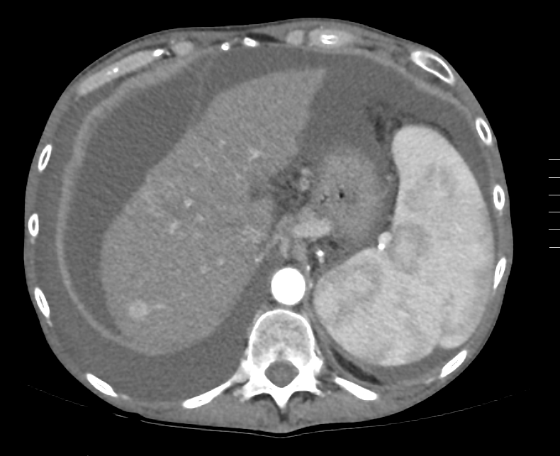
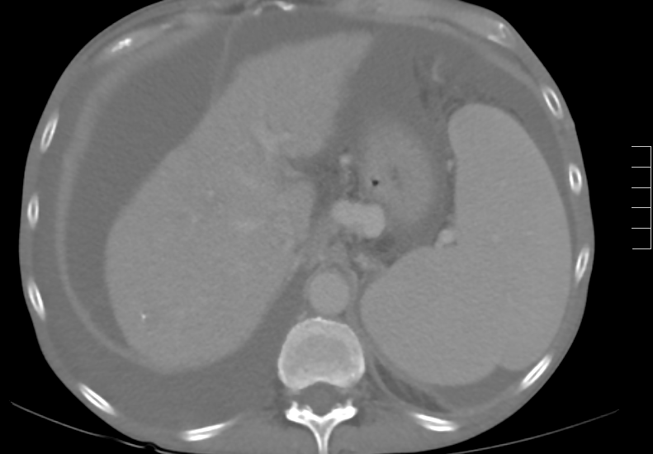
Image of a Classic Tumor
LI-RAD 5

Slide 30
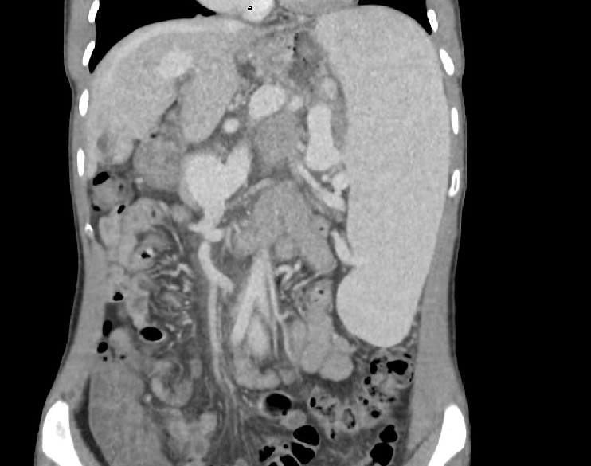
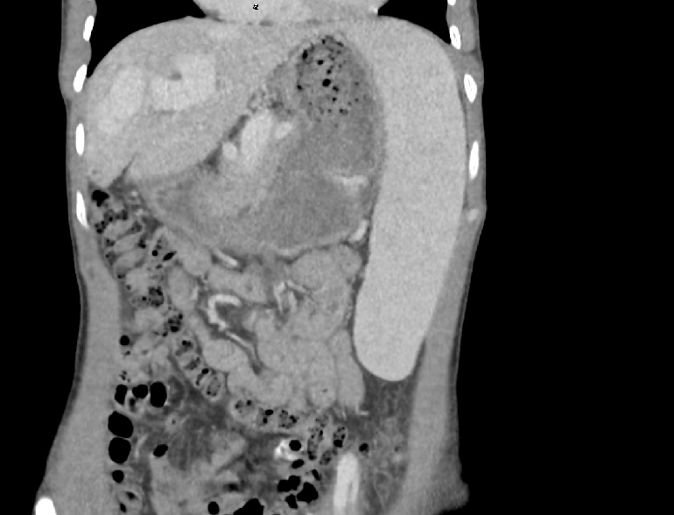
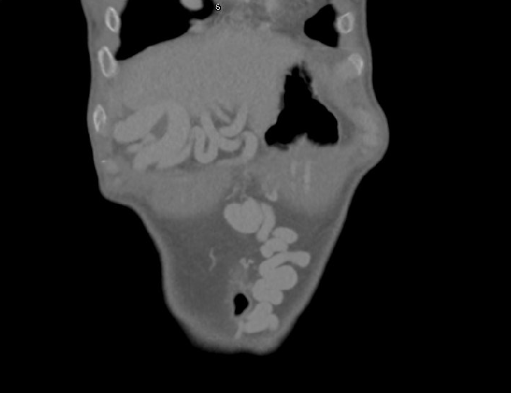
Image Shunt

Slide 31
Ammonia Levels

Slide 32
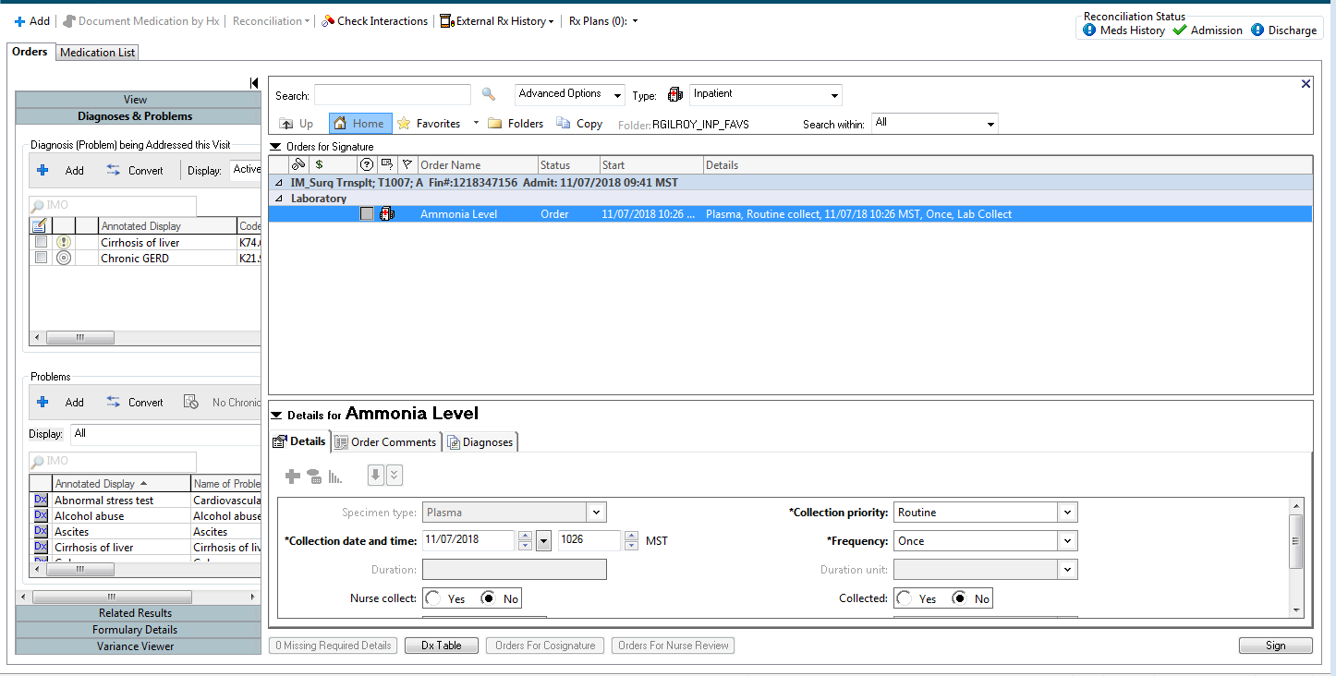
How is it Ordered at IMC

Slide 33
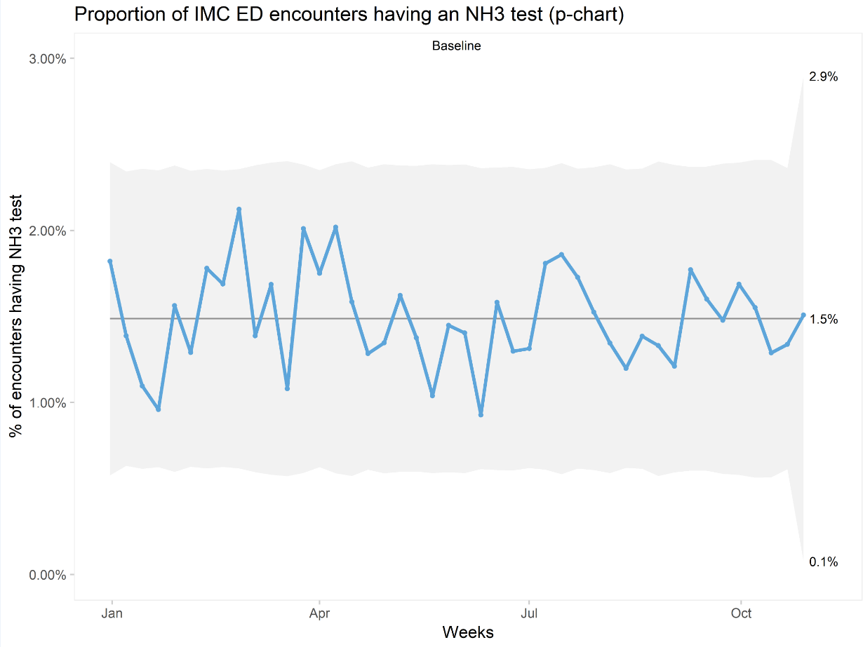
How Many Were Done at IMC in 2017
1.5%

Slide 34
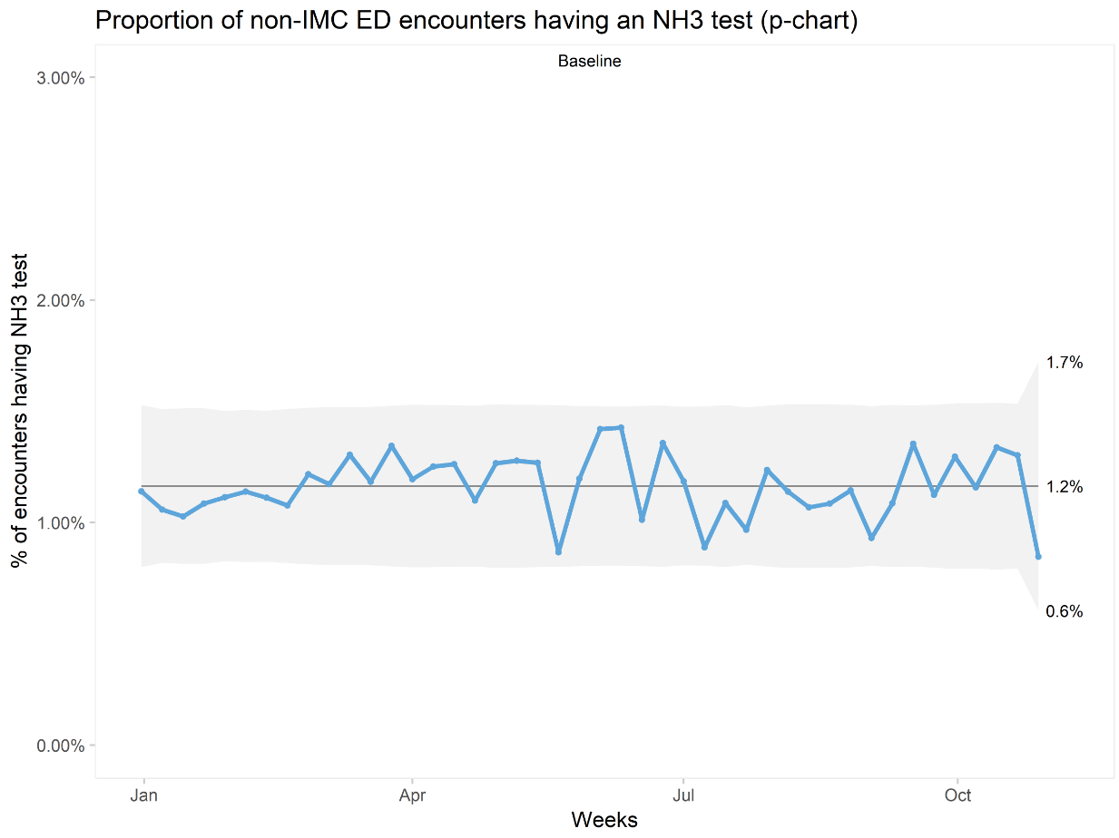
How Many Were Done at IMC in 2017
1.2%

Slide 35
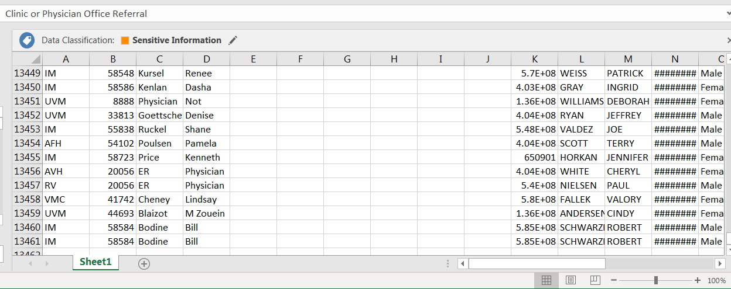
How Many Were Done at IMC in 2017
13461 tests in 2018

Slide 37
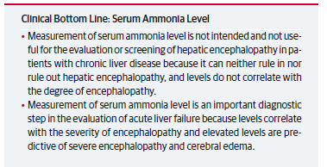

Slide 38
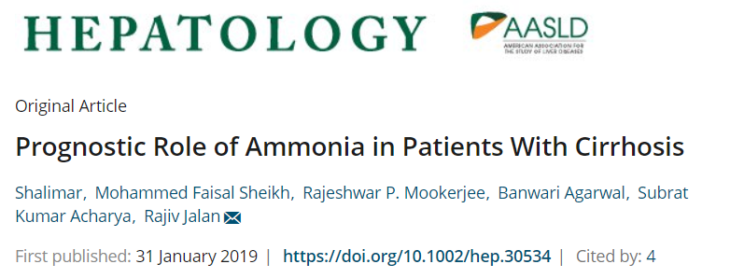
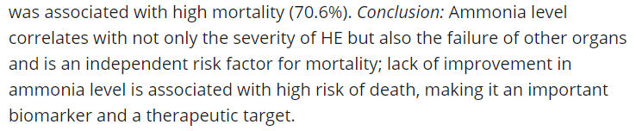

Slide 39

A few points on encephalopathy
Greater than 98% of Ammonia Levels, many not sent appropriately, were not indicated
Cost >$21 per test
Common causes must not be forgotten
  Medications (Narcotics/Benzodiazepines)
  Dehydration
  Gastrointestinal Bleeding
  Electrolyte disturbance
  Infections
  Large Shunts
  Less convincingly protein excess!
“There is virtually no point in measuring blood ammonia levels in patients with hepatic encephalopathy (but with few exceptions) as blood ammonia levels probably cause as much confusion in those requesting the measurement as occurs in the patients in whom it is being measured”
Professor Adrian Rubin, FACP, FAASLD

Slide 40
Summary Slide
Ammonia has a role in particular instances
  Confusion in the outpatient setting in a non-cirrhotic
  Acute liver failure
    Prognosis and also recovery
Ammonia Levels ordered at the frequency is unique to Utah
It is not the level that is important
With confusion in a cirrhotic seek the cause and do NOT order the test (refer any requesting specialist to me)

Slide 41
Cancer Markers
HCC is one of the most common causes of cancer death in the world.
HCC is curable with a 70% 5 year survival when detected early
Alpha Fetoprotein is a marker of HCC and also has prognostic value
  Sensitivity and specificity are suboptimal for use alone (AFP-L3 and DGCP)
  40% of tumors lack AFP
Ultrasound detects any stage HCC with 84% sensitivity (95% CI, 76%–92%), but early-stage HCC with only 47% sensitivity (95% CI, 33%–61%).
  AFP enhances the ability to detect HCC early
Ca 19.9 similarly lack sensitivity and specificity for cholangiocarcinoma. It similarly carries prognostic value to AFP
Gastroenterology. 2018 May;154(6):1706-1718

Slide 42
Liver Biopsy
Indicated for evaluating a diagnostic uncertainty that might be treated differently with the result
  Approximately 50% of the liver biopsies performed in the system were not indicated
    i.e. a person with cirrhosis rarely has an indication for a biopsy unless AIH is being considered as likely
    A liver mass does not commonly require a biopsy as there are other ways to determine the aetiology
    Biopsies come with risks (irrespective of transjugular Vs percutaneous)
Biopsies are less often being performed in non-oncology clinical trials

Slide 43
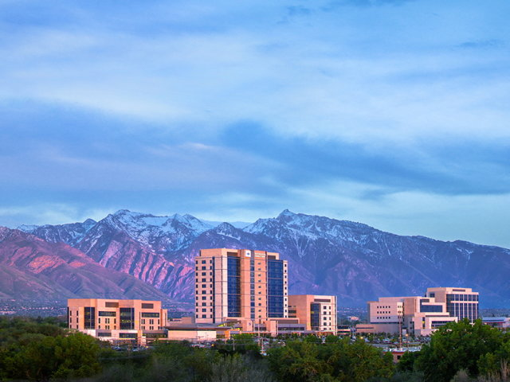

The Tip of the Iceberg
NASH at IHC
Richard Gilroy
Director of Hepatology and Medical Director if Liver Transplantation
Richard Gilroy MD

Slide 44

Tsunami

Slide 45

Fewer Donors
More Recipients
Sharing with California
Walmart, ConAgra, IBP, UNOS, Halloween

Slide 46
Obesity is the Driver of NASH
Trends in Obesity Over Time

Slide 47
Unfortunately the Obesity Trends Continue
(2018 CDC Obesity Data)
Obesity in Utah was <10% in 1990 and is 25-30% in 2018

Slide 48
Is there an Impact of Screening (aka Purpose)

Slide 49
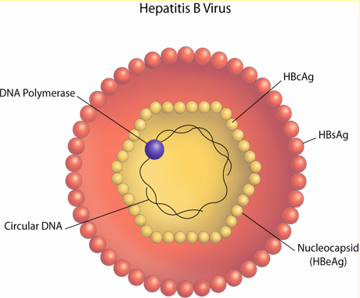
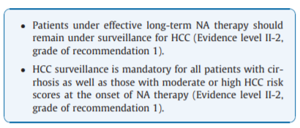
Hepatitis B and HCC Screening
Moderate or High Risk is:
Asian males 40 years of age or older
Asian females 50 years of age or older
Patients with cirrhosis
Family history of HCC
Africans older than 20 years of age

Slide 50
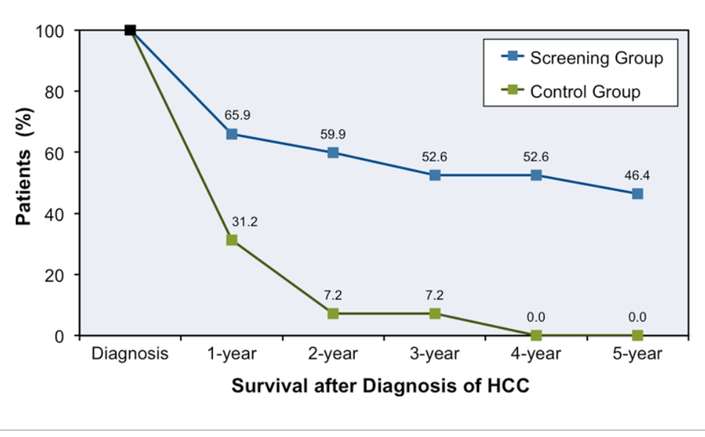
Screening in those with HBV demonstrates a
Survival Advantage

Slide 51
Pilot Studies on Screening at IHC
Pilot 1: Family Screening
  Approximately 20% of family members screened who accompany a patient presenting NASH cirrhosis have NASH with advanced fibrosis
    Youngest cirrhotic 19
    4 of the first 16 family members had cirrhosis
      50% genetically unrelated
Pilot 2: NAFLD-D Fib-4 calculations
  Approximately 20,000 individuals have NASH with fibrosis
    Only 3-5% are characterized as having NASH in their EMR
    There are approximately 1,400 patients with cirrhosis who should be screened for HCC and they are not being screened of the 2,600 in our system
Pilot 3: Pending Approval
  Fibroscan to characterize those identified to be at risk to care pathways

Slide 52
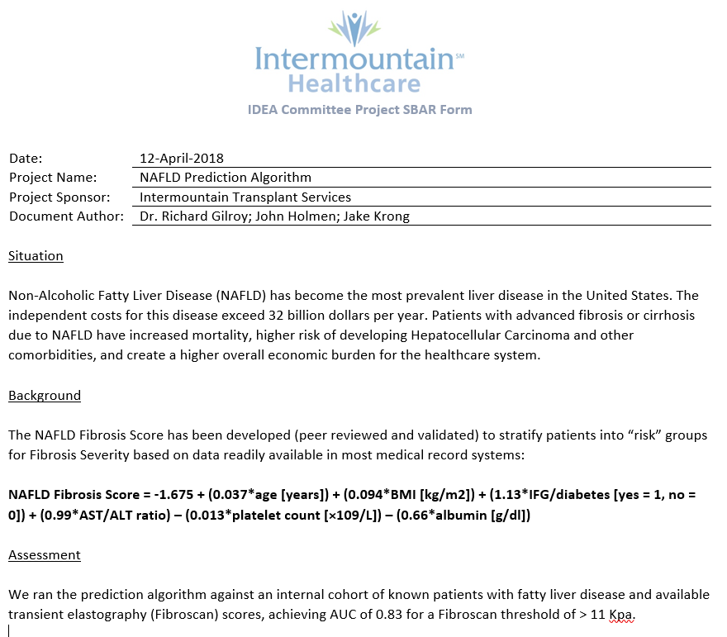

Slide 53
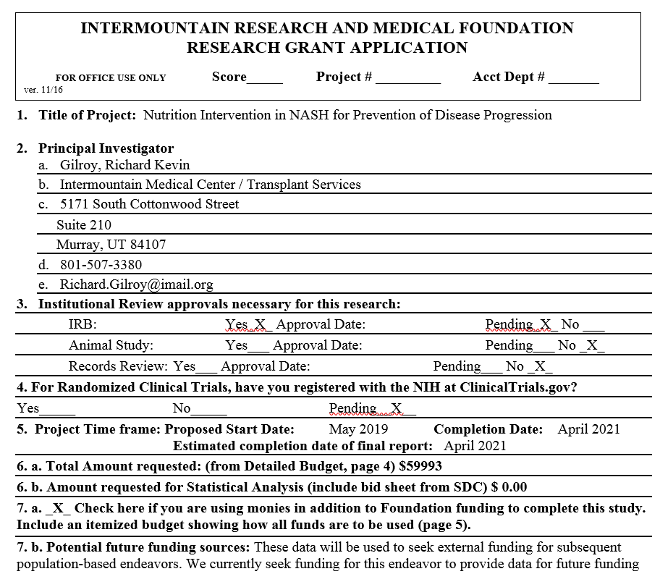

Slide 54
Summary
Patients with cirrhosis MUST be screening for HCC every 6 months with Ultrasound (USS) and AFP and in those with a high AFP consider contrast imaging over USS
NASH is the most under-recognized and yet the most common cause of cirrhosis in Utah and we are not screening those at increased risk
NASH does have treatments
  Weight loss, exercise
  Vitamin E, Pioglitazone, GLP-1 analogues, Obetacholic Acid
  Bariatric Surgery : in clinical partnership with the bariatric group
  Clinical trails

Slide 55
Summary on the Changing Profile
The Profile of Liver Disease in our community is very different to elsewhere in the US
  Slightly Less EtOH, A LOT MORE Primary Sclerosing Cholangitis, and NASH rates/capita at or slightly above those of other States
Little is being done to address the changing profile of CLD
  HCV will likely be eradicated as economic incentives exist
  NASH will result in 1.5 million new cirrhotics
  In those with ESLD the costs of managing them will continue to increase and the number of transplants per year will soon decrease
Ways to address this include:
  Screening
  Resources
  Existing Therapies and Novel

Slide 56
Alcoholic hepatitis

Slide 57
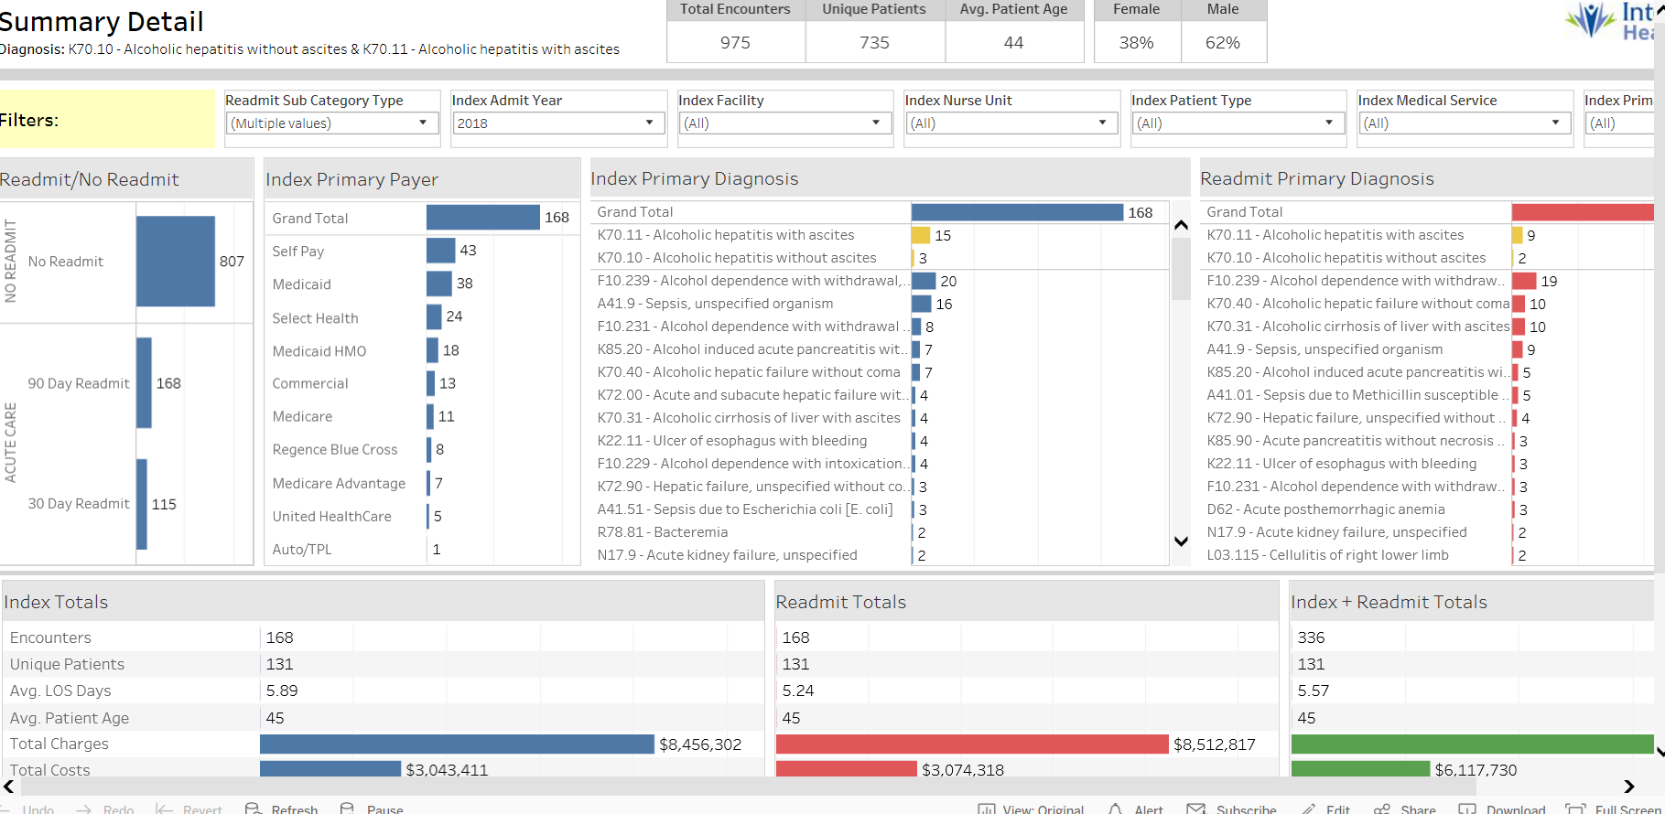
Economic Costs of CLD to Systems

Slide 58
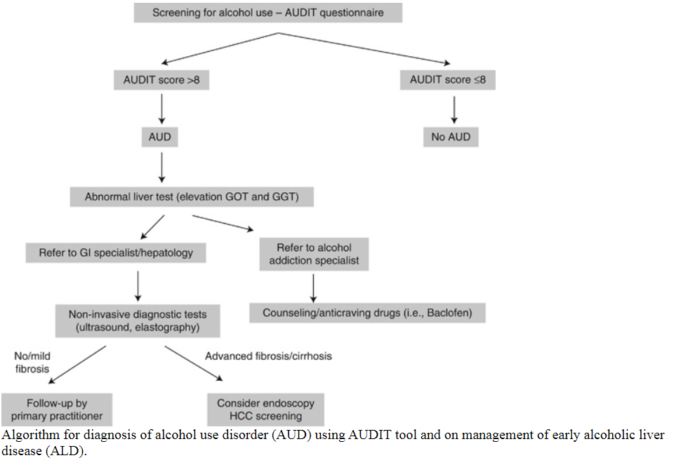

Screening for Alcohol Use

Slide 59
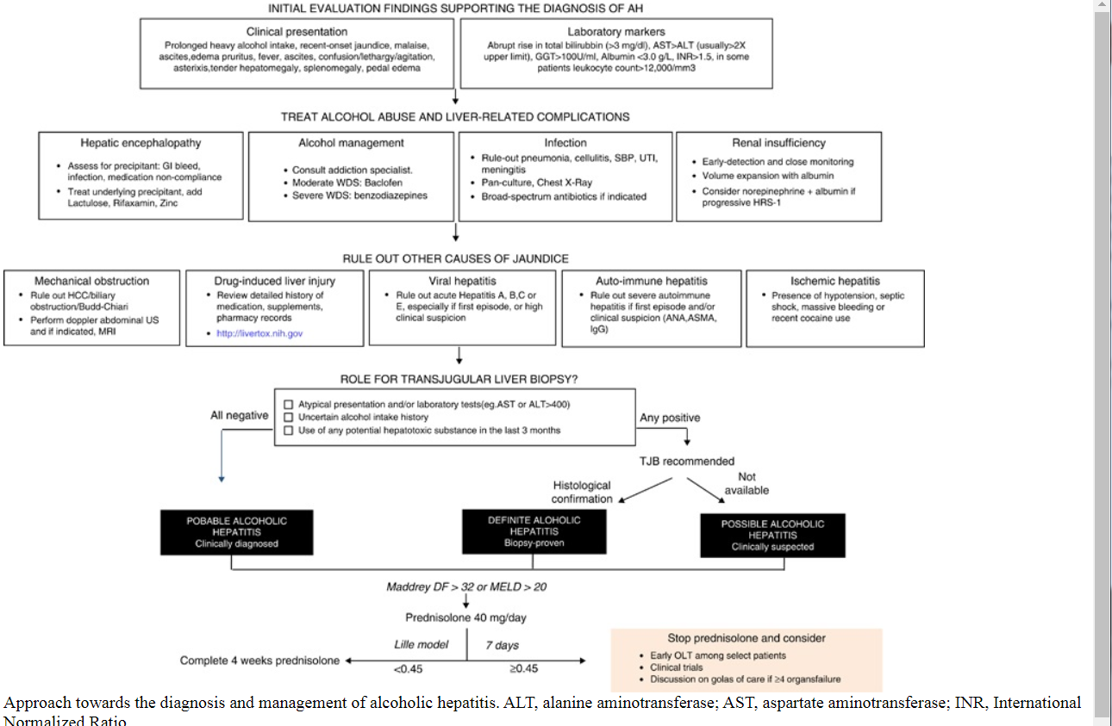
Approach to Abnormal Liver Enzymes in a Person Suspected of AUD

Slide 60
Some Important Things to Consider
Prednisone benefits only those with severe alc hep (MELD >20, DF >32
  Individual data from five randomized controlled trials and showed that steroids have survival advantage for severe AH with a 28 day survival of 85% among treated patients compared to 65% for placebo
The main contraindications for steroid treatment in patients with AH are renal failure, active gastrointestinal bleeding, uncontrolled hyperglycemia, acute pancreatitis, psychosis, and infection.
A recent Cochrane meta-analysis concluded that, overall, there is no clear evidence that steroids are effective in the management of AH.
Semin Liver Dis. 2016 Feb;36(1):56-68.

Slide 61
Enhancing Clinical Care Within the Hospital System

Slide 62
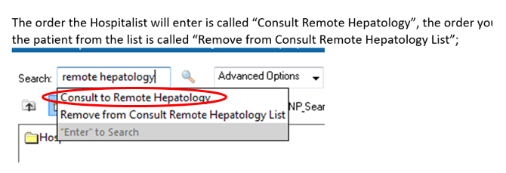
Hepatology Morning Report

Slide 63
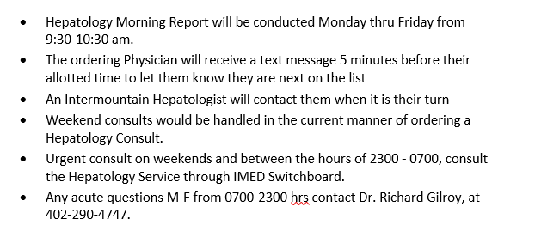
Objectives and How it works
Gastroenterology and Hepatology exist variably through the system while advanced hepatology and transplant hepatology ONLY exists in Murray
Objectives: Create early access, deliver equivalent care locally, prioritize and optimize care delivery

Slide 64
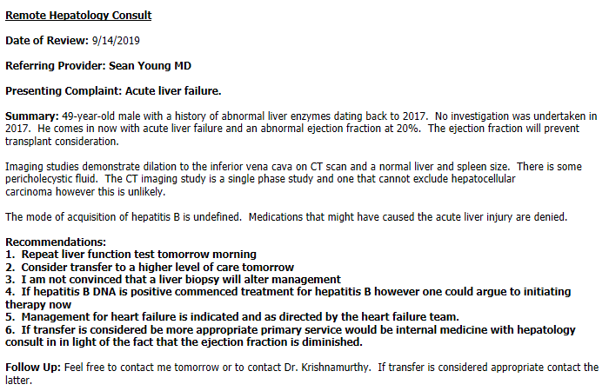
What is Received

Slide 65
Transplantation

Slide 66
Behavioral economics
A method of economic analysis that applies psychological insights into human behavior to explain economic decision-making of individuals and Institutions.

Slide 67

Who is this man, his professional degree, and in what field did he attain his Nobel Prize?

Slide 68
Game Theory
“The study of mathematical models of conflict and cooperation between intelligent and rational decision makers”
11 game theorists have won nobel prizes in economics with one of the most famous John Forbes Nash
  He described the Mixed Strategy Nash Equilibrium.
  In this more than one player each assumes to know the strategies of the other and when in equilibrium they are making the best decision for themselves.
  Games can be cooperative and non-cooperative game

Slide 69
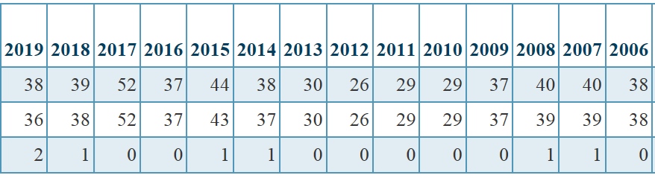

Transplant Program Comparisons Utah
(September 30, 2019)
Intermountain
University of Utah

Slide 70
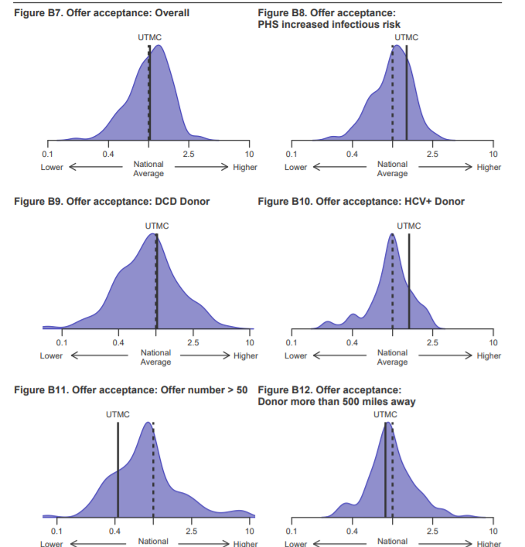
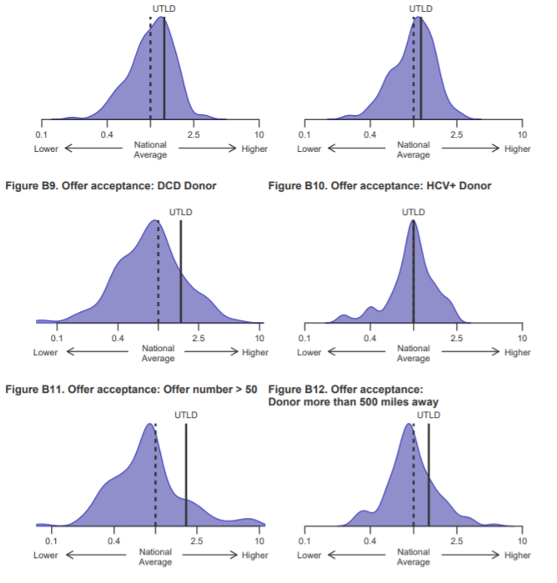
Why The Difference ?

Slide 71
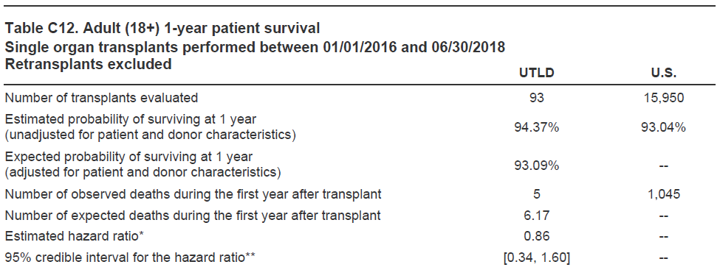
SRTR Data Comparisons

Slide 72
MELD at Transplant
OPTN: https://optn.transplant.hrsa.gov/news/median-meld-and-peld-at-transplant-scores-updated/
Note: Based on OPTN data as of September 06, 2019 for median MELD at transplant by DSA and median PELD at transplant.
Based on OPTN data as of September 13, 2019 for median MELD at transplant by region for transplant programs in OPTN Region 9.
Data subject to change based on future data submission or correction. * Median MELD score at transplant within Region.

Slide 73
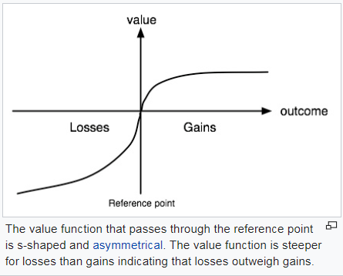
Prospect Theory
The way people choose probabilistic alternatives that involve risk, where the probabilities of outcomes are unknown
In essence the study of decisions under risk
People make decisions based upon the potential value of losses and gains rather than the final outcome
Various elements influence these decisions including:
  Heuristic (Mental shortcuts) bias decisions
  Framing Effect also influence decisions

Slide 74

Having Marc Harrison’s Keys
More Accurately Organ Transplantation is a Priority and Strategic Initiative

Slide 76
Next Steps
Over to the Floor for questions

Slide 77
Hepatology Morning Report
Origins, Barriers, Opportunities

Slide 78
Origin:
  Providers and patients across the system desired access to care
  The system has moved to value based care and has asked for consistency
  Variability in the care of some conditions is considerable and expensive

Slide 79
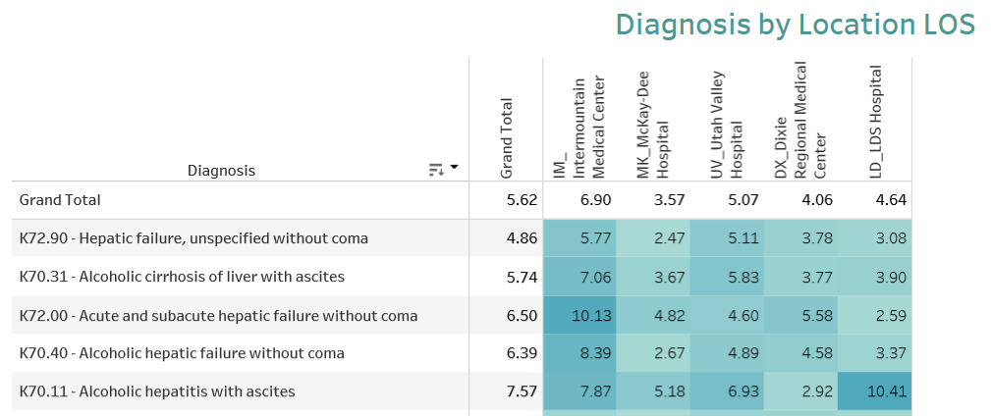
Alcoholic Liver Disease and Average LOS

Slide 80
Economic Costs of Alcohol to Systems

Slide 81
Variability in care
Alcoholic hepatitis DF > 32
  Average LOS 4.6 days to 21.6 days
  90 day readmit rates 12 to 26% (>Medicaid and Self Pay)
Investigation
  Discharge care
  Time to specialty consult
  Consistency of care/protocols for Alc hep/ HRS/Relapse prevention
  Hepatology service provider

Slide 82
Identified Objectives
Provide input to care where subspecialty care is indicated
Prevent unnecessary transfers
Expedite entry into the hepatology system
Diminish duplicity
Enhance efficiency

Slide 83
Objectives and How it works
Hepatology Liver Transplant coverage exists within the system however with great variability and advanced hepatology and transplant hepatology ONLY exists in Murray
Objectives: Create early access, deliver equivalent care locally, prioritize, enhance and optimize care delivery
Local Care DOES NOT change

Slide 84
Hepatology Morning Report

Slide 85
What is Received

Slide 86
Barriers
Uptake has been uniform at Logan, Ogden and Layton
In Utah Valley the cases have largely mostly Alc Hep and transplant listed or post-transplant patients
System is to be implemented in St George to assist local GI providers with inpatients with decompensated CLD in particular in instances where challenges exist:
  BRTO
  Transplenic recanalization of PV
  Liver tumors
  Liver biopsy decisions
  decompensated alcoholic liver disease and transplant referral, coagulopathy, ACLF

Slide 87
Opportunities
Pilot
  To date approximately 50 morning reports have occurred
    40% of morning reports are considering transfers and more than half were avoided
    Time to hepatology encounters shortened (difficult to evaluate)
    Provider satisfaction improved at the hospitalist level
    McKay Dee
      Survey 4 of 4 Gis are happy and the Ogden GI group yet to be communicated with
    Length of Stay
      Potentially shortened
        Need a years worth of data
      ER admission at McKay lessened it would appear
        Data pending
    Cost diminished
    Clinic decision making enhanced
      appropriate parties for coordinated care organized for certain encounters

Slide 88
Concerns
The endeavor for the previously mentioned reasons diminishes cost
Impacts upon local providers
  This is a non-billable guidance document and does not replace local care
    Guidance is to appropriate protocols
    Diminished unnecessary testings
    Direction to necessary testings
      A diagnostic paracentesis CAN be performed in a patient with an INR of 3 and plt of 40 without factor replacement
  This service does NOT replace local care
Rationale for implementation
  System Wide equivalent Care, Access and Cost

