Slide 1
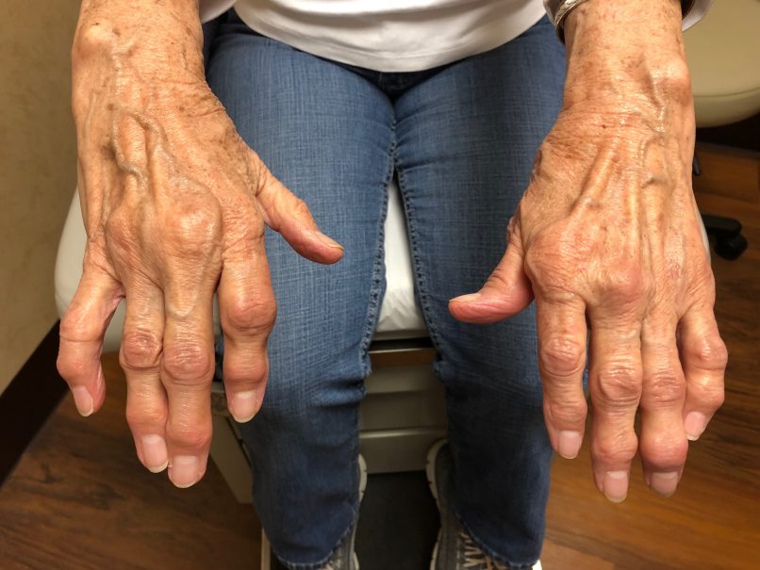
What’s new in my specialty- Rheumatoid Arthritis
Gregory T. Austad MD, FACP, FACR
Tanner Memorial Clinic
Ogden Surgical-Medical Society Meeting
2018

Slide 2
Disclosures:
-None

Slide 3
Objectives:
-Understand the mechanism of action of biologic and newer small molecule medications for treatment of rheumatoid arthritis
-Become familiar with updated guidelines for the diagnosis and management of rheumatoid arthritis
-Obtain updated guidance about appropriate vaccinations in patients with RA
-Review recommendations for perioperative management of rheumatologic medications

Slide 4
Rheum: “That which flows”
Hippocrates and Humoralism
Blood-Phlegm-Yellow bile-Black bile

Slide 5
Cytokines involved in Synovitis

Slide 6
Biologic and Small Molecule:
Infliximab
Adalimumab
Etanercept
Golimumab
Certolizumab
Abatacept
Tocilizumab
Sarilumab
Rituximab
Tofacitinib
Anakinra
Remicade
Humira
Enbrel
Simponi/Simponi Aria
Cimzia
Orencia
Actemra
Kevzara
Rituxan
Xeljanz
Kineret

Slide 7
Tocilizumab
Sarilumab

Slide 8
Small Molecule-”Jakinibs”
JAK inhibitor
Tofacitanib

Slide 9
TNF inhibitors
Infliximab
Adalimumab
Certolimumab
Etanercept
Golimumab

Slide 10
Abatacept
MHC
TCR
APC
T cell
APC
T cell
CD 28
CD 80/86
Abatacept

Slide 11
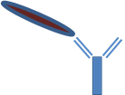
Rituximab
CD-20
B-Cell
B-Cell

Slide 12
Anakinra
IL-1 receptor antagonist
IL-1
IL-1 Receptor

Slide 13
Anakinra
IL-1 receptor antagonist
IL-1
IL-1 Receptor

Slide 14
Tocilizumab/Sarilumab
IL-6 receptor antagonist
IL-6
IL-6 Receptor

Slide 15
Tocilizumab/Sarilumab
IL-6 receptor antagonist
IL-6
IL-6 Receptor

Slide 16
JAK Inhibitors
Cytokine receptor
Cell membrane
JAK
STAT
Nucleus
STAT: signal transducer and activator of transcription; JAK: Janus Kinase

Slide 17
JAK inhibitors
Cytokine receptor
Cell membrane
JAK
STAT
Nucleus
STAT: signal transducer and activator of transcription; JAK: Janus Kinase

Slide 18
JAK inhibitors
Cytokine receptor
Cell membrane
JAK
Cytokine-dependent gene regulation is prevented.
STAT
Nucleus
STAT: signal transducer and activator of transcription; JAK: Janus Kinase

Slide 20
Arthritis Care & Research
DOI 10.1002/acr.22783
VC 2015, American College of Rheumatology
SPECIAL ARTICLE
2015 American College of Rheumatology
Guideline for the Treatment of Rheumatoid
Arthritis
New ACR RA guidelines anticipated 2019

Slide 21
Rheumatoid Arthritis Treatment Algorithm
New RA-DMARD naive
DMARD monotherapy
Low-Moderate-High Disease activity

Slide 22
DMARD
Methotrexate (MTX)
Leflunomide
Sulfasalazine
Azathioprine
Hydroxychloroquine
Cyclosporine
Minocycline

Slide 23
Rheumatoid Arthritis Treatment Algorithm
DMARD monotherapy
Combination DMARD therapy
TNF inhibitor +/- MTX
Non-TNF biologic +/- MTX
Moderate-High Disease activity

Slide 24
Rheumatoid Arthritis Treatment Algorithm
Low Disease activity-continue therapy
Combination DMARD therapy
TNF inhibitor +/- MTX
Non-TNF biologic +/- MTX
RA remission-
Taper therapy
Moderate or High Disease Activity

Slide 25
Immunization Recommendations
Advisory Committee on Immunization Practices (ACIP)
2015 ACR Guidelines for treatment of RA
Avoid live attenuated vaccines in patients on biologics (MMR, Varicella, Zoster, etc)
13-Valent pneumococcal vaccine, 1 time
23-Valent pneumococcal vaccine, booster at 5 years
Influenza vaccine, yearly
HPV vaccine
Hepatitis B series for “high risk” patients
Herpes zoster vaccine should be given prior to tofacitanib or a biologic in patients > age 50

Slide 26
Incidence and risk factors of prosthetic joint infection after total hip or knee replacement in patients with rheumatoid arthritis
Arthritis Care and Research Volume 59, Issue 12 15 December 2008 Pages 1713–1720
462 patients with RA
Total of 657 hip or knee replacements
23 (3.7%) joint arthroplasties were complicated by an infection
Revision arthroplasty and previous prosthetic joint infection of the replaced joint were significant predictors of postoperative prosthetic joint infection
RA patients with a matched cohort of OA patients were at increased risk of prosthetic joint infections

Slide 27
Safety of Surgery After Rituximab Therapy in 133 Patients With Rheumatoid Arthritis: Data From the AutoImmunity and Rituximab Registry
Arthritis Care and Research Volume 65, Issue 11, November 2013, Pages 1874–1879
133 patients, 140 procedures
94 orthopedic surgeries (67%)
23 abdominal surgeries (16.5%)
Median delay between surgery and the last RTX infusion was 6.4 months (range 4.3 to 8.7 months)
No difference in complication rates except for spine surgery where there was an increased risk.

Slide 28
Perioperative Timing of Infliximab and the Risk of Serious Infection After Elective Hip and Knee Arthroplasty
Arthritis Care and Research Volume 69, Issue 12 December 2017 Pages 1845–1854
Hospitalized infection within 30 days occurred in 270 of 4,288 surgeries (6.3%)
Glucocorticoid dosage >10 mg/day associated with increased risk of infection
Elderly age, comorbidities, revision surgery, and previous hospitalized infection associated with infection risk.
Infliximab within 4 weeks of elective knee or hip arthroplasty was not associated with a higher risk of serious infection

Slide 29
2017 American College of Rheumatology/American Association of Hip and Knee Surgeons Guideline for the Perioperative Management of Antirheumatic Medication in Patients With Rheumatic Diseases Undergoing Elective Total Hip or Total Knee Arthroplasty Arthritis Care and Research Volume 69, Issue 8, August 2017, Pages 1111–1124
Journal of Arthroplasty, Volume 32, Issue 9, September 2017, Pages 2628–2638
A panel of rheumatologists, orthopedic surgeons specializing in hip and knee arthroplasty
Multi-step systematic literature review
Includes use of DMARDs, biologics, tofacitinib, and glucocorticoids in adults with RA, SpA, JIA, or SLE who are undergoing elective THA or TKA.

Slide 30
Surgical Considerations
Continue oral DMARDs through surgery
Stop all biologics prior to surgery, schedule surgery at the end of the dosing cycle
Resume treatment no sooner than 2 weeks after surgery if there is no evidence of complication
Arthritis Care and Research
Volume 69, Issue 8
August 2017
Pages 1111–1124
Journal of Arthroplasty
Volume 32, Issue 9
September 2017
Pages 2628–2638

Slide 31
Surgical Considerations
Continue these…
Methotrexate
Leflunomide
Sulfasalazine
Hydroxychloroquine
Azathioprine
Arthritis Care and Research
Volume 69, Issue 8
August 2017
Pages 1111–1124
Journal of Arthroplasty
Volume 32, Issue 9
September 2017
Pages 2628–2638

Slide 32
Surgical Considerations
Discontinue these…
Stop
Restart
Adalimumab 2 weeks prior 2 weeks after
Etanercept 1 week prior 2 weeks after
Infliximab 8 weeks prior 2 weeks after
Golimumab 4 or 8 weeks prior 2 weeks after
Certolizumab 2 or 4 weeks prior 2 weeks after
Rituximab 6 months prior 2 weeks after
Arthritis Care and Research
Volume 69, Issue 8
August 2017
Pages 1111–1124
Journal of Arthroplasty
Volume 32, Issue 9
September 2017
Pages 2628–2638

Slide 33
Surgical Considerations
Discontinue these…
Stop
Restart
Tocilizumab 1 or 4 weeks prior 2 weeks after
Abatacept 1 or 4 weeks prior 2 weeks after
Tofacitanib 1 week before 2 weeks after
Anakinra 1 day before 2 weeks after
Arthritis Care and Research
Volume 69, Issue 8
August 2017
Pages 1111–1124
Journal of Arthroplasty
Volume 32, Issue 9
September 2017
Pages 2628–2638

Slide 34
Conclusion
-There is an ever-growing list of effective pharmacological options for treatment of rheumatoid arthritis
-RA classification criteria and treatment guidelines are available and should be used to optimize therapy for patients with rheumatoid arthritis

Slide 35
Conclusion
-Patients who will receive, or who are currently receiving immunosuppressive medications should be given appropriate vaccinations according to recommended guidelines found on the ACIP website www.cdc.gov/vaccines/acip
-Post operative infection risk can be minimized in immunosuppressed patients by carefully scheduling surgery at appropriate time intervals after biologic treatment doses

