Slide 1
Douglas P. Felt, M.D.
2 Case reports of life threatening orbital problems in children

Slide 2
History
10 year old girl with 1 day onset swelling around the right eye
No pain
No change in visual acuity
No double vision
No discharge
Was skiing that day, fell and thought she hit her eye

Slide 3
Physical Exam
Visual acuity 20/20 each eye
Normal ocular motility
Globe and orbit mildly tender on palpation
Mild periocular swelling superiorly but no redness
No gross proptosis
1mm relative exophthalmos
No ptosis
Intraocular exam normal

Slide 4
Not my patient but possible presentation

Slide 5
Main Clinical Finding
Palpable mass beneath right orbital rim
Not mobile
CT scan showed right superior orbital mass near the levator muscle
Went to the operating room that evening for orbitotomy and biopsy
Debulked the mass as much as possible without damaging surrounding structures

Slide 6
Orbital Rhabdomyosarcoma

Slide 7
Rhabdomyosarcoma (RMS)
Most common soft tissue sarcoma in children
But still very rare
About 250 to 350 cases diagnosed in US each year
Embryonal RMS is most common histopathologic type and has a more favorable prognosis
Alveolar RMS least common and worst prognosis

Slide 8
Course
Sent to PCMC next morning
No other tumor found
Treated with radiation therapy and chemotherapy
Was on chemotherapy for about 2 years and followed for a number of years after that
Removed her radiation cataract as a teenager
Now married with children
Some dry eye on that side

Slide 9
IRSG – Intergroup Rhabdomyoscarcoma Study Group
Studied 4292 patients with RMS from 1972 to 1997
Survival at 5 years increased from 55% to 71% over the period
Extent of disease at diagnosis affects prognosis

Slide 10
2nd Case – Acute pain and Swelling aroung the left eye
6 year old boy with 1 day history of pain around the left eye
No history of trauma
Otherwise well

Slide 11
Physical Exam
Vision grossly normal
Moderate swelling, redness, and induration around the left orbit
Decreased motility
Some proptosis

Slide 12
Emergency CT
Showed abscess superonasally in the left orbit
Ethmoid sinuses were opaque
Other sinuses may have been involved as well

Slide 13
Emergency surgery
Patient was admitted from the Emergency Department for emergency surgery
In the ED he was alert and not in too much distress
Temperature about 100 degrees
Arranged to go with ENT together to the OR to drain orbit and sinuses as soon as possible

Slide 14
Hospital Course
In the time it took to get him ready to go to the operating room he deteriorated rapidly
Febrile – spiked to about 104 degrees
On the way to the operating he went into status epilepticus
Emergency intubation
Canthotomy and cantholysis
Orbitotomy and abscess drained and cultured
Transferred to PCMC by helicoptor

Slide 15
Orbital Cellulitis

Slide 16
Orbital Cellulitis

Slide 17
Orbital Cellulitis

Slide 18
Orbital Cellulitis

Slide 19
Orbital Cellulitis
It is always an emergency
It is usually caused by sinusitis
Unless there is external trauma
Need to treat the sinuses as well as the orbital abscess
Orbit with its septum is a relatively nonexpandable compartment
Lateral canthotomy and cantholysis in the emergency room or office can save vision (orbital decompression)

Slide 20
Some changes in 40+Years in Ophthalmology
No team time out
Patient for tonsillectomy brought into the operating room for an enucleation for retinoblastoma
Sometimes 2 surgeries in the same operating room at the same time

Slide 21
Old Main Hospital Univ of Michigan

Slide 22
40 Years
All doctors wore white coats and ties
Department chair checked for polished shoes

Slide 23
Kellogg Eye Center

Slide 24
Radiology-films to CT to MRI to Digital

Slide 25
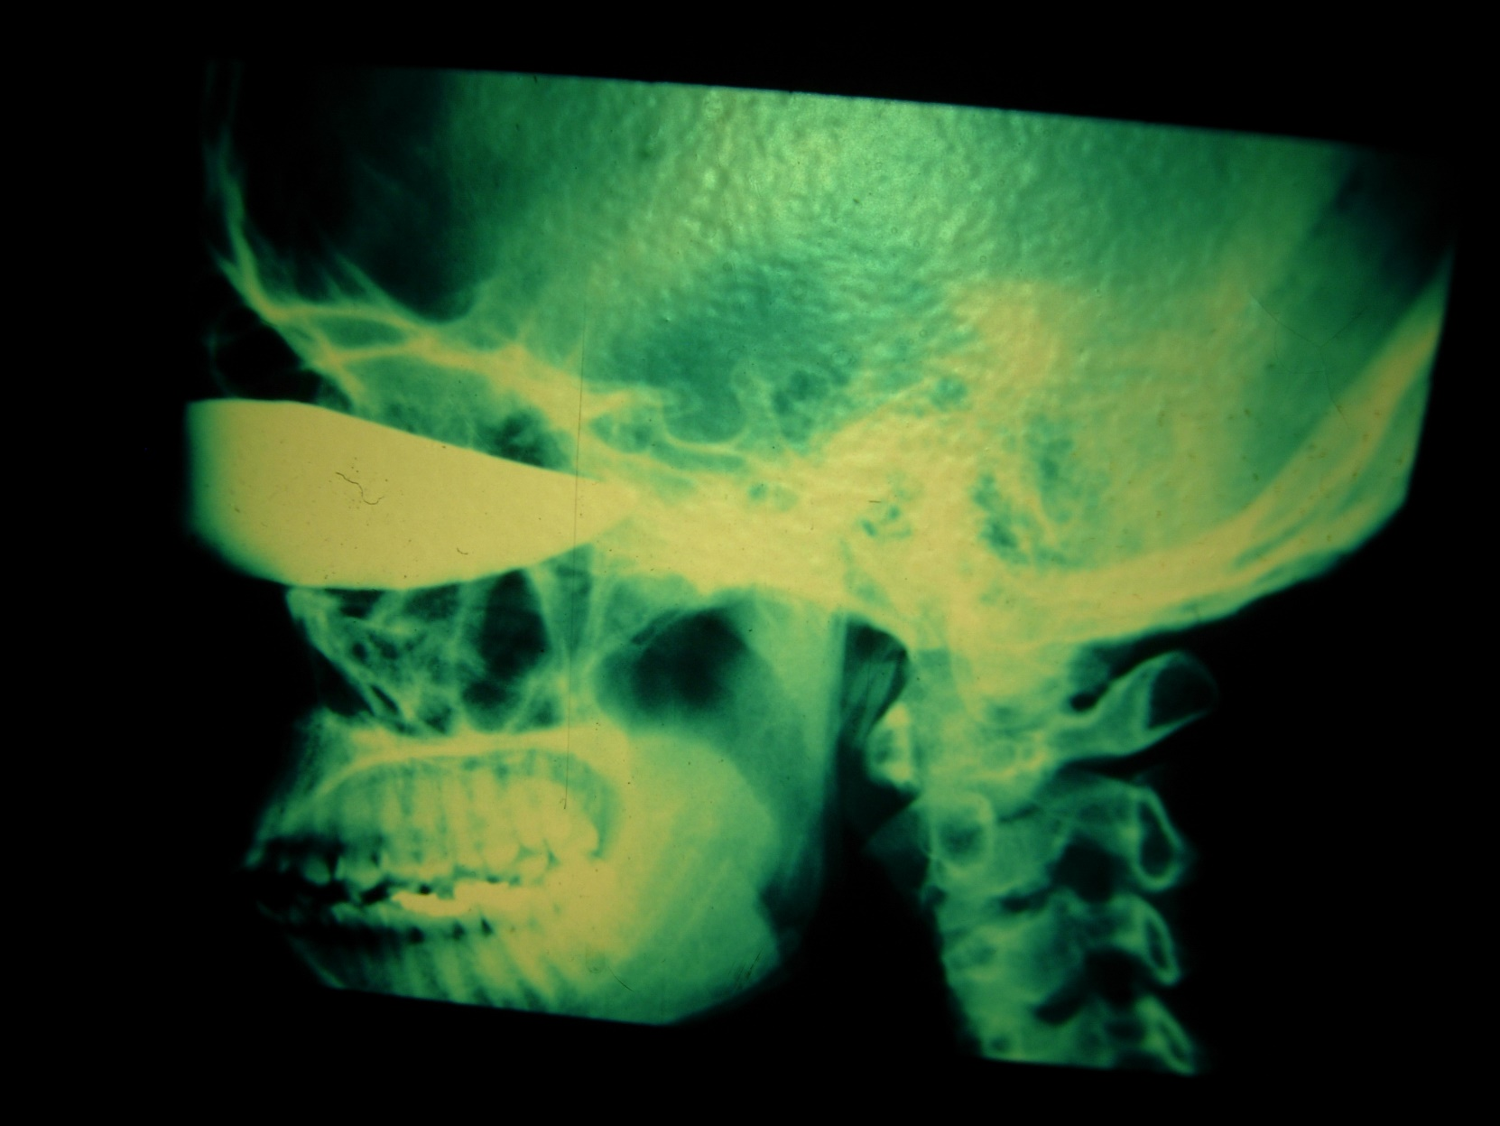

Slide 26
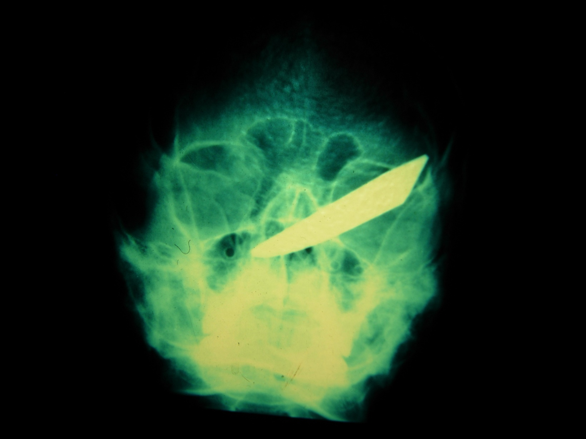

Slide 27
Dee Hospital

Slide 28
McKay Dee Hospital

Slide 29
St. Benedict’s Hospital
The first 15 years of my practice were spent in the office building attached to St. Benedict’s Hospital
Sisters of St. Benedict
Shared office space with Louis R. Snider, M.D.
Started with $400/month rent including sharing of his 2 front office employees
I started with one tech

Slide 30
Surgeries
Were all done in the hospital
No surgical centers
St. Benedict’s Hospital opened a surgical center
It is now the cardiac center
McKay Dee opened a surgical center – and now has a new surgical center

Slide 31
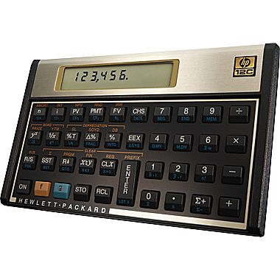
Changes
Handheld calculators
Slide rule class at Weber State College in 1970
On return from Germany in 1972 first handheld calculators were on the market
First HP scientific calculator
= $400

Slide 32
My First Computer

Slide 33
Remember these?

Slide 34
My First Cell Phone

Slide 35
Changes
RK = radial keratotomy
Fyodorov popularized it in Moscow in the 1970’s and 1980’s
Started in USA in 1979
Mostly abandoned because of progressive flattening of the cornea over time causing progressive hyperopia

Slide 36
Radial Keratotomy

Slide 37
Lasik
Lasik
Flap originally made with microkeratome = motor pushed cornea between oscillating razor blade and flat metal plate
Now flaps made with femtosecond laser
Much more predictable flaps
Much safer procedure
Custom wavefront guided laser patterns improving outcomes

Slide 38
Lasers in Ophthalmology

Slide 39
Reconstructive Surgery

Slide 40
Reconstructive Surgery

