Slide 1
What’s New in My Specialty?
Carl R. Gray, MD
May 17, 2024

Slide 2
Financial Disclosure
This presentation has no ineligible company content, promotes no ineligible company, and is not supported financially by any ineligible company. I receive no financial remuneration from any ineligible company related to this presentation.

Slide 3
OBJECTIVES
Immune Therapy, where do we stand a decade later?
Liquid biopsies and ctDNA
Designer Antibodies: Bispecific Antibodies and Antibody Drug Conjugates (ADCs)

Slide 4
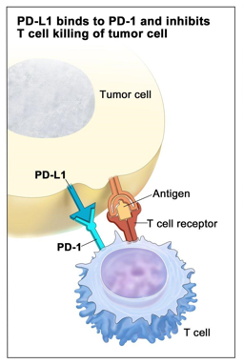
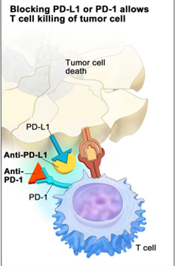
Checkpoint Inhibitors
Immune checkpoints are a normal part of the immune system to prevent an immune response from being so strong that it destroys healthy cells in the body.
Immune checkpoints engage when proteins on the surface of T cells recognize and bind to tumor cells.
When the checkpoint and cancer cells bind together, they send an “off” signal to the T cells.
This can prevent the immune system from destroying the cancer.
Checkpoint inhibitors work by blocking checkpoint proteins from binding with their partner proteins on cancer cells.
This prevents the “off” signal from being sent, allowing the T cells to kill cancer cells

Slide 5
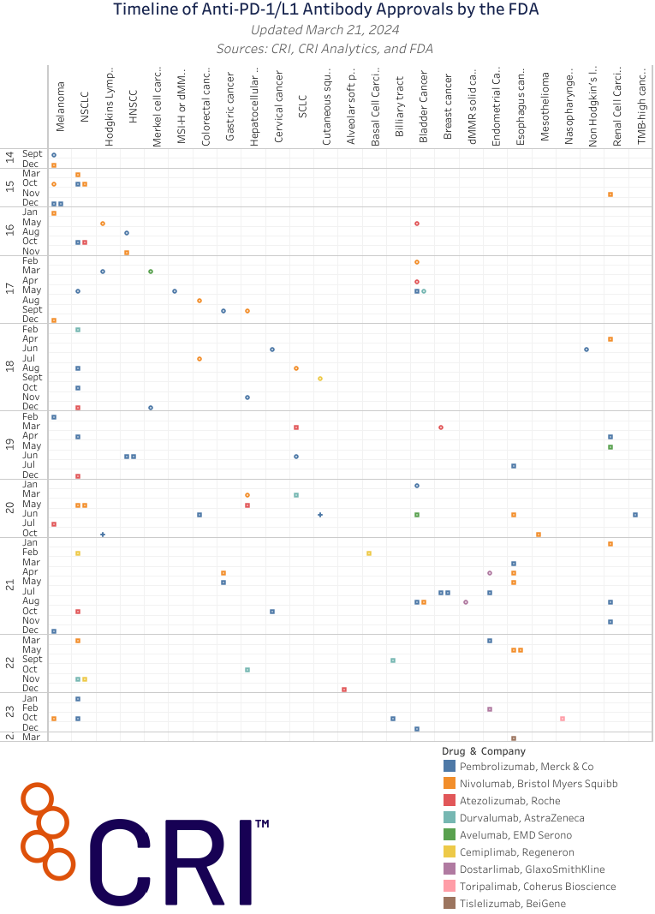
As of July 31, 2023, the FDA has approved
11 Check Point Inhibitors (CPI)
20 different cancer types have at least one CPI treatment approved
Pembrolizumab has >40 indications in cancer treatments
(AACR Cancer Progress Report 2023)

Slide 6
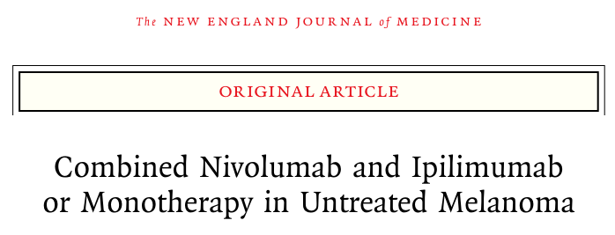
Volume 381(16):1535-1546 October 17, 2019
1296 pts were assigned, in a 1:1:1 ratio, Ipilimumab, nivolumab, or nivolumab plus ipilimumab q 3 weeks for four doses, followed by nivolumab
With a 5-year minimum follow-up in patients with metastatic melanoma, overall survival at 5 years was 52% with a combination of nivolumab plus ipilimumab, as compared with 44% with nivolumab alone and 26% with ipilimumab alone.
Programmed cell death ligand 1 (PDL-1) expression did not influence the response rate or progression-free survival.

Slide 7
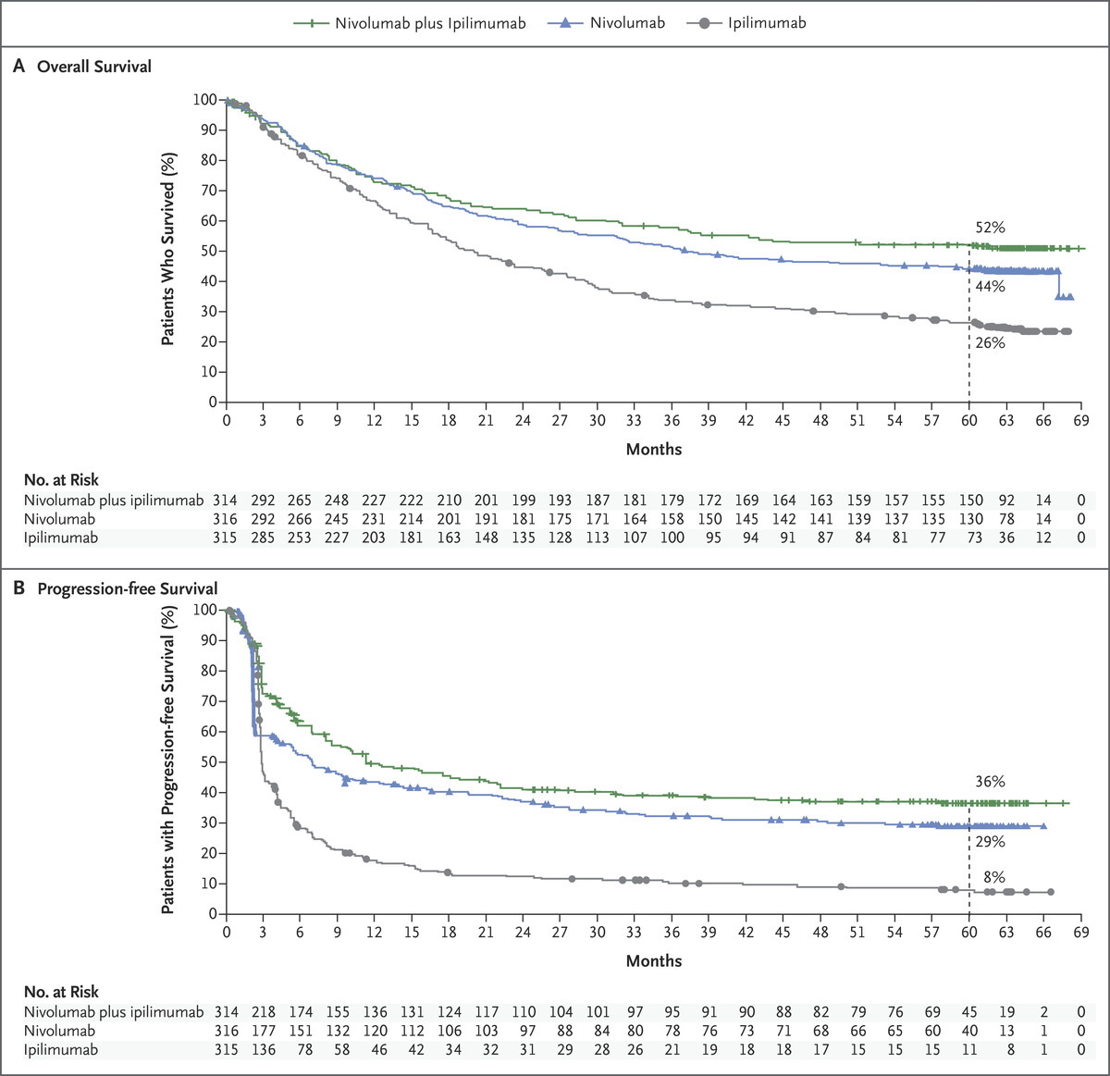
Kaplan–Meier Estimates of Survival in the Overall Population.
Take home points:
The overall survival curves plateau, suggesting long term survival (7 yr data is now out looking the same)
Prior to immunotherapy treatment, the 5-year survival for stage 4 melanoma was less than 5%
J LaLarkin et al. N Engl J Med 2019;381:1535-1546.
Notes:
Figure 1. Kaplan–Meier Estimates of Survival in the Overall Population. Patients were followed for a minimum of 60 months (dashed line). Symbols (tick marks, triangles, and circles) indicate censored data. Panel A shows the Kaplan–Meier estimates of overall survival. The median overall survival was longer than 60.0 months (95% confidence interval [CI], 38.2 to not reached) in the nivolumab-plus-ipilimumab group, 36.9 months (95% CI, 28.2 to 58.7) in the nivolumab group, and 19.9 months (95% CI, 16.8 to 24.6) in the ipilimumab group. The hazard ratio for death was 0.52 (95% CI, 0.42 to 0.64; P<0.001) for nivolumab plus ipilimumab versus ipilimumab, 0.63 (95% CI, 0.52 to 0.76; P<0.001) for nivolumab versus ipilimumab, and 0.83 (95% CI, 0.67 to 1.03) for nivolumab plus ipilimumab versus nivolumab. Overall survival at 5 years was 52% in the nivolumab-plus-ipilimumab group, 44% in the nivolumab group, and 26% in the ipilimumab group. Panel B shows the Kaplan–Meier estimates of progression-free survival as assessed by the investigator. The median progression-free survival was 11.5 months (95% CI, 8.7 to 19.3) in the nivolumab-plus-ipilimumab group, 6.9 months (95% CI, 5.1 to 10.2) in the nivolumab group, and 2.9 months (95% CI, 2.8 to 3.2) in the ipilimumab group. The hazard ratio for disease progression or death was 0.42 (95% CI, 0.35 to 0.51; P<0.001) for nivolumab plus ipilimumab versus ipilimumab, 0.53 (95% CI, 0.44 to 0.64; P<0.001) for nivolumab versus ipilimumab, and 0.79 (95% CI, 0.64 to 0.96) for nivolumab plus ipilimumab versus nivolumab. Progression-free survival at 5 years was 36% in the nivolumab-plus-ipilimumab group, 29% in the nivolumab group, and 8% in the ipilimumab group.

Slide 8
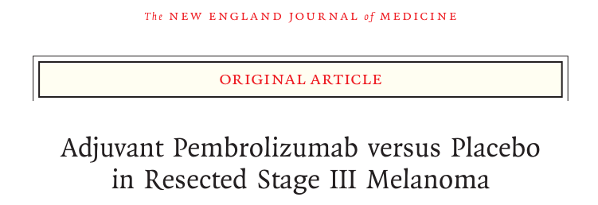
Volume 378(19):1789-1801; May 10, 2018
Patients with completely resected stage III melanoma were randomly assigned to receive 200 mg of pembrolizumab (514 patients) or placebo (505 patients) intravenously every 3 weeks for a total of 18 doses (approximately 1 year)
Results showed that adjuvant pembrolizumab every 3 weeks for a year was associated with a 1-year recurrence-free survival rate of 75%, as compared with 61% for placebo.

Slide 9
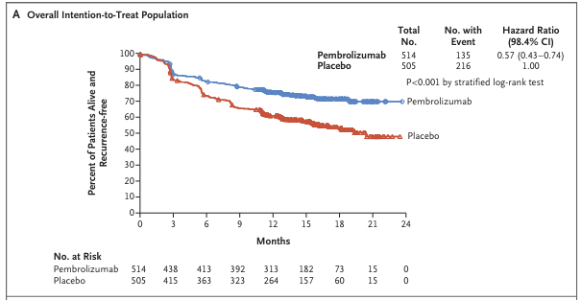
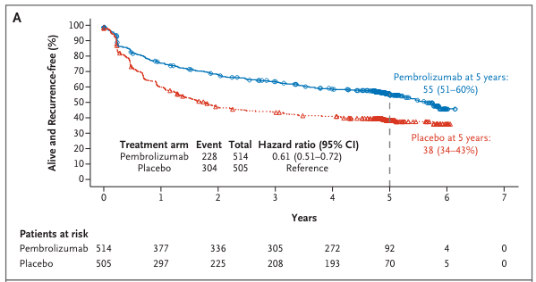
Kaplan–Meier Estimate of Recurrence-free Survival, in the Overall Intention-to-Treat Population
TOP: Original article with 2 year data 2018
BOTTOM: Updated 5 year data 2022
Take home points:
Recurrent free survival was significantly improved at original publish (2 years followup)
Recurrent free survival continues to improve compared to placebo at 5 years (sustained results)
Eggermont AMM et al. N Engl J Med 2018;378:1789-1801
September 10, 2022 DOI: 10.1056/EVIDoa2200214 NEJM Evid 2022; 1 (11)

Slide 10
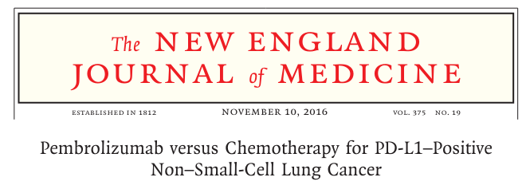
phase 3 trial, randomized 305 patients who had previously untreated advanced NSCLC with PD-L1 expression on at least 50% of tumor cells
receive either pembrolizumab (at a fixed dose of 200 mg every 3 weeks) or the investigator’s choice of platinum-based chemotherapy
Median progression-free survival was 10.3 months in the pembrolizumab group versus 6.0 months chemotherapy group
Overall survival at 6 months was 80.2% in the pembrolizumab group versus 72.4% in the chemotherapy group
The response rate was higher in the pembrolizumab group than in the chemotherapy group (44.8% vs. 27.8%)
Treatment-related grade 3-5 adverse events were less frequent (26.6% vs. 53.3%)

Slide 11
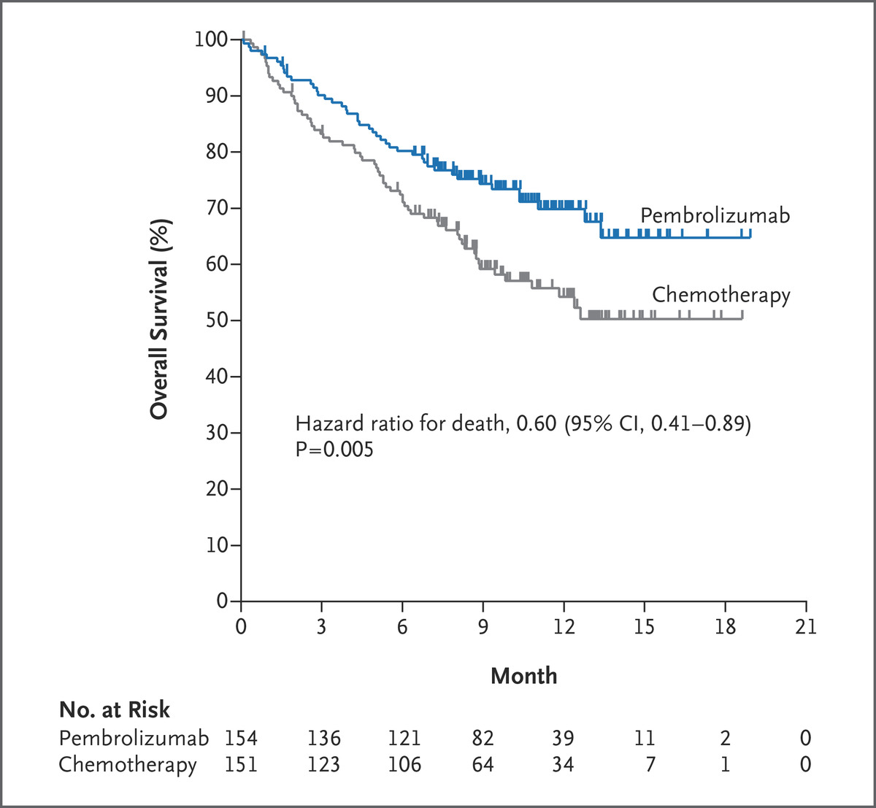
Overall Survival in the Intention-to-Treat Population.
TAKE HOME POINTS:
Immune therapy beats chemo in PDL-1>50%
Despite cross-over from the chemotherapy to pembro arm there still was a significant difference in OS
Significant less toxicity in pembro vs chemo
Reck M et al. N Engl J Med 2016;375:1823-1833.
Notes:
Figure 2. Overall Survival in the Intention-to-Treat Population. Shown are Kaplan–Meier estimates of overall survival, according to treatment group. Tick marks represent data censored at the last time the patient was known to be alive. The intention-to-treat population included all patients who underwent randomization.

Slide 12
Phase 3 trial design randomly assigned patients with stage IB to IIIA resectable NSCLC to receive nivolumab plus platinum-based chemotherapy or platinum-based chemotherapy alone, followed by resection
Median event-free survival was 31.6 mo vs 20.8 mo with nivolumab plus chemotherapy vs chemotherapy alone (P=0.005).
Pathological complete response was 24.0% and 2.2% favoring nivolumab plus chemo
Grade 3 or 4 treatment-related adverse events 33.5% of the patients in the nivolumab-plus-chemotherapy group and in 36.9% of those in the chemotherapy-alone group.

Slide 13
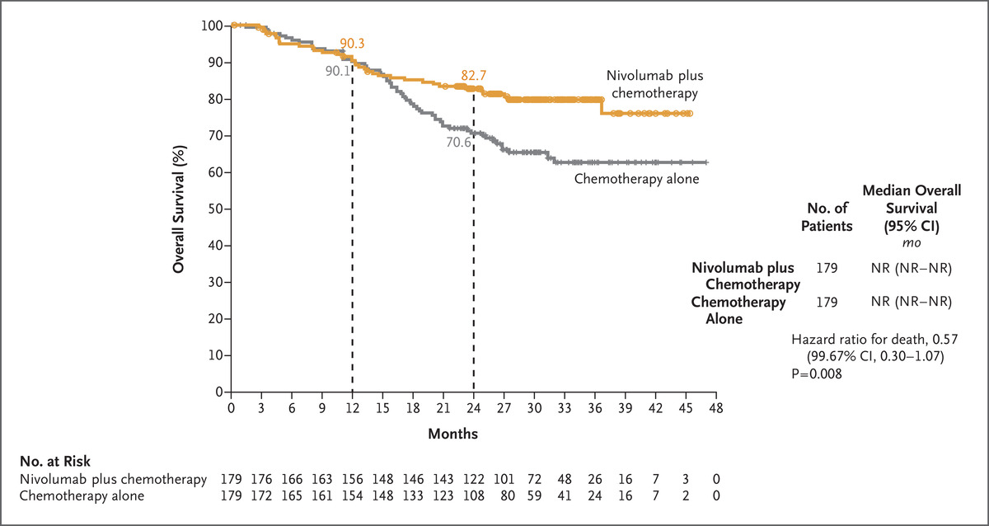
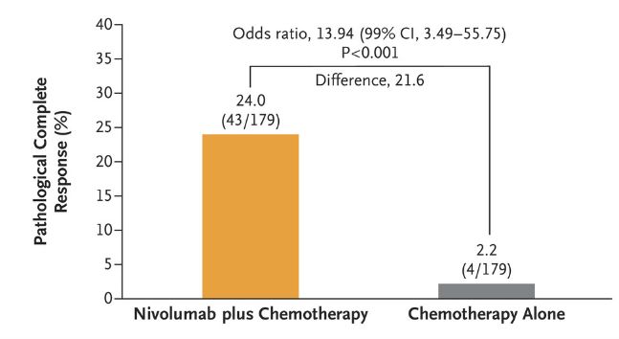
Pathologic Response
Overall Survival.
Take home points:
With the addition of 3 doses of nivolumab resulted in a 12% improvement in overall survival at 2 yrs
Pathologic response improves from 2% to 24% with the addition of nivolumab
No additional SE noted with addition of nivolumab
PM Forde et al. N Engl J Med. 2022;386:1973-1985

Slide 14
119 Patients received nivolumab 3 mg/kg plus ipilimumab 1 mg/kg once every 3 weeks (four doses) followed by nivolumab 3 mg/kg once every 2 weeks.
76% had received 2 prior systemic therapies
At median follow-up of 13.4 months, ORR was 55% (95% CI, 45.2 to 63.8), and disease control rate for $ 12 weeks was 80%. Median duration of response was not reached
Progression-free survival rates were 76% (9 months) and 71% (12 months)
OS rates were 87% (9 months) and 85% (12 months)
Statistically significant and clinically meaningful improvements were observed in patient-reported outcomes, including functioning, symptoms, and quality of life.
Grade 3 to 4 treatment-related adverse events (AEs) occurred in 32% of patients and were manageable

Slide 15
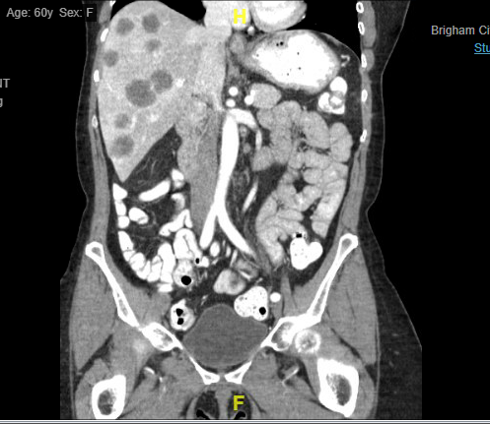
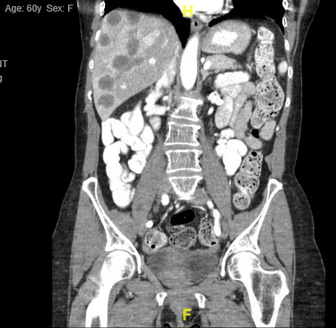
Colon Cancer
60 yrs woman presented with stage 3 but quickly progressed to stage 4 colon cancer with liver mets
microsatellite instability test positive for MSH2 and MSH6
04/24/2019 initiating FOLFOX for 6 cycles finishing on 07/03/2019, CEA 748
09/04/2019 initiating salvage chemo FOLFIRI/Avastin for 5 cycles discontinued on 11/13/2019 due to disease progression
CT Scan July 2019
CT Scan Nov 2019

Slide 16
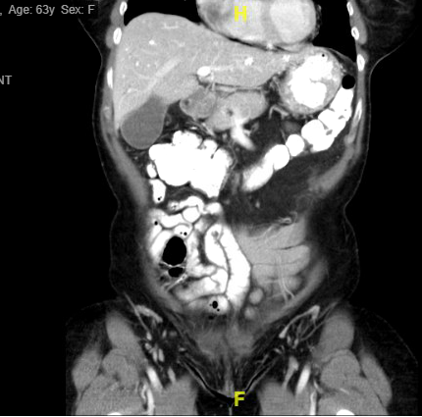
Colon Cancer
11/13/2019 initiating Opdivo/Yervoy x4 cycles
2/5/2020 continuing on Opdivo monotherapy
CEA 0.2
Sept 2022 repeat CT scans with NED
CT scan Sept 2022

Slide 17
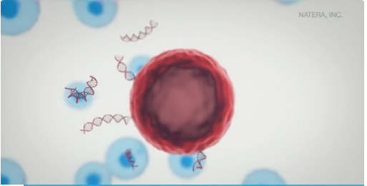
Liquid biopsies and ctDNA, where do we stand?
A. Signatera
B. Liquid Biopsies

Slide 18
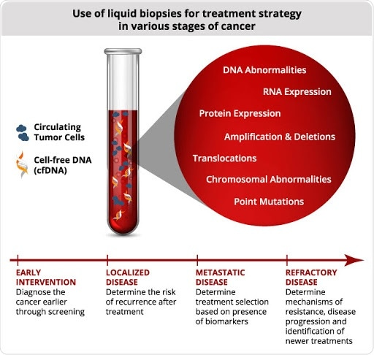
Image Credit: https://www.healio.com/hematology-oncology/learn-genomics/introduction-to-liquid-biopsies/what-is-a-liquid-biopsy

Slide 19
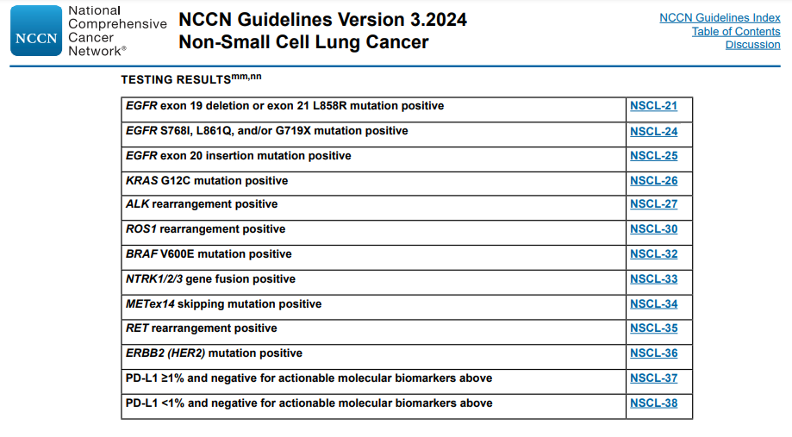

Slide 20
Leave this space blank for Zoom video feed

Slide 21
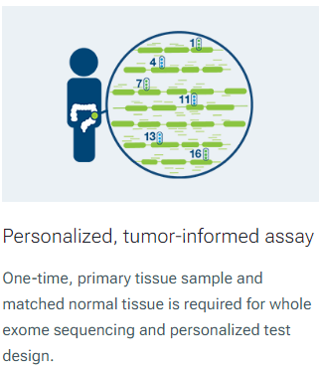
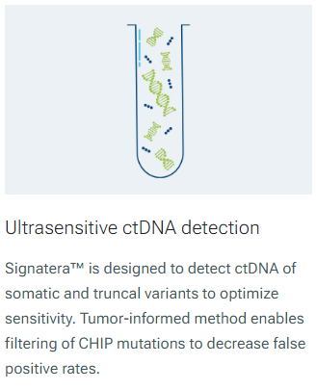
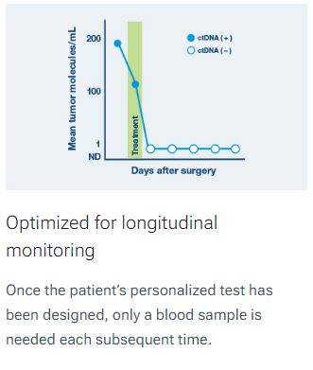
SIGNATERA

Slide 22
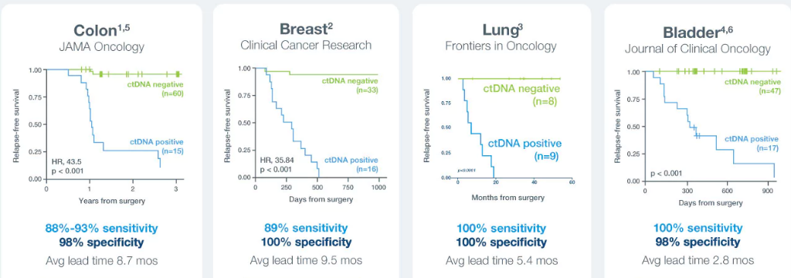
A positive Signatera™ result predicts relapse with overall positive predictive value more than 98%

Slide 23
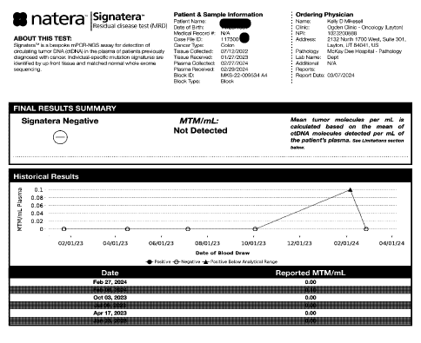

Slide 24
Designer Antibodies
A. Bispecific Antibodies
B. Antibody Drug Conjugates (ADCs)

Slide 25
Bispecific Antibodies
Bispecific antibodies can bind to two different targets on two different cells at the same time.
This is different from most antibody drugs that are currently in wide use in immune therapy that are limited to latching on to a single antigen on a single cell.
Bispecific T-cell engagers, or BiTEs — can latch onto a T cell and a tumor cell simultaneously. This close proximity enables the T cells to directly attack and kill the tumor cell.
https://blog.dana-farber.org/insight/2019/05/how-are-bispecific-antibodies-being-used-to-treat-blood-cancers/

Slide 26
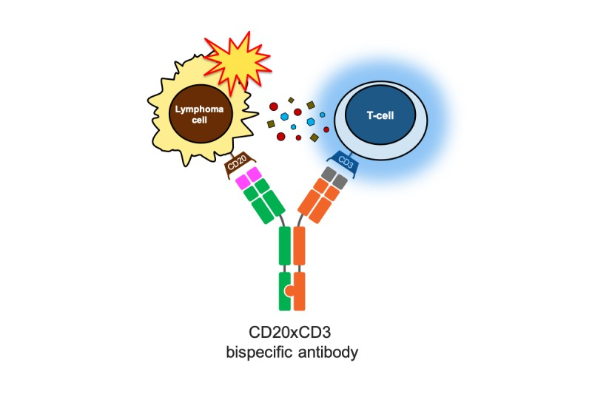
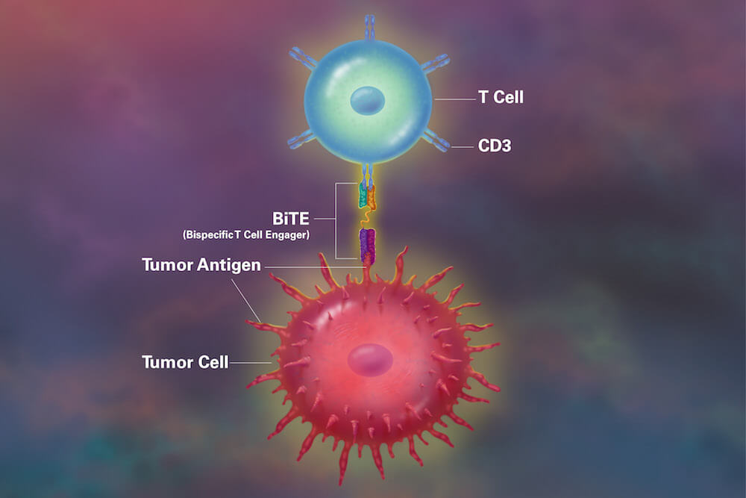
https://www.mskcc.org/clinical-updates/msk-ash-2023-insights-promising-results-for-bispecific-antibodies-as-first-line-therapies-for-patients-with-follicular-and-cell-lymphoma
https://blog.dana-farber.org/insight/2019/05/how-are-bispecific-antibodies-being-used-to-treat-blood-cancers/

Slide 27
https://www.fda.gov/drugs/spotlight-cder-science/bispecific-antibodies-area-research-and-clinical-applications
Content current as of:
02/14/2024

Slide 28
165 patients relapsed or refractory myeloma median 5 prior therapies, including triple-class exposure to an immunomodulatory drug, a proteasome inhibitor, and an anti-CD38 antibody.
Patients received a weekly subcutaneous injection of teclistamab
overall response rate was 63.0%, with 65 patients (39.4%) having a complete response or better 14.1 months
44 patients (26.7%) were found to have no minimal residual disease (MRD); the MRD-negativity rate among the patients with a complete response or better was 46%.
median duration of response was 18.4 months.
progression-free survival was 11.3 months (95% CI, 8.8 to 17.1)
Common adverse events included cytokine release syndrome (in 72.1% of the patients; grade 3, 0.6%; no grade 4), neutropenia (in 70.9%; grade 3 or 4, 64.2%), anemia (in 52.1%; grade 3 or 4, 37.0%), and thrombocytopenia (in 40.0%; grade 3 or 4, 21.2%). Infections were frequent (in 76.4%; grade 3 or 4, 44.8%). Neurotoxic events occurred in 24 patients (14.5%), including immune effector cell–associated neurotoxicity syndrome in 5 patients (3.0%; all grade 1 or 2).

Slide 29
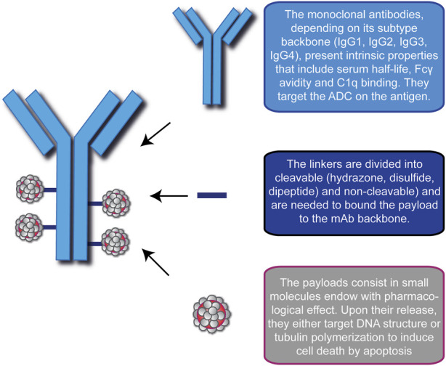
Antibody Drug Conjugates- ADCs
ADCs are one of the fastest growing anticancer drugs.
They combine the potency of anti-cancer drugs (often called payloads) with the specificity of mAbs to the tumor site, thus combining chemotherapy and immunotherapy.
They are composed of three portions, a monoclonal antibody, an organic spacer called a linker and a cytotoxic drug
this strategy offers several advantages
better drug tolerability
cytotoxicity even at low concentrations
drug stability in the bloodstream and in lysosomes
reduced off-target effects, and systemic toxicity
A comprehensive overview on antibody-drug conjugates: from the conceptualization to cancer therapy
Front Pharmacol. 2023; 14: 1274088.

Slide 30
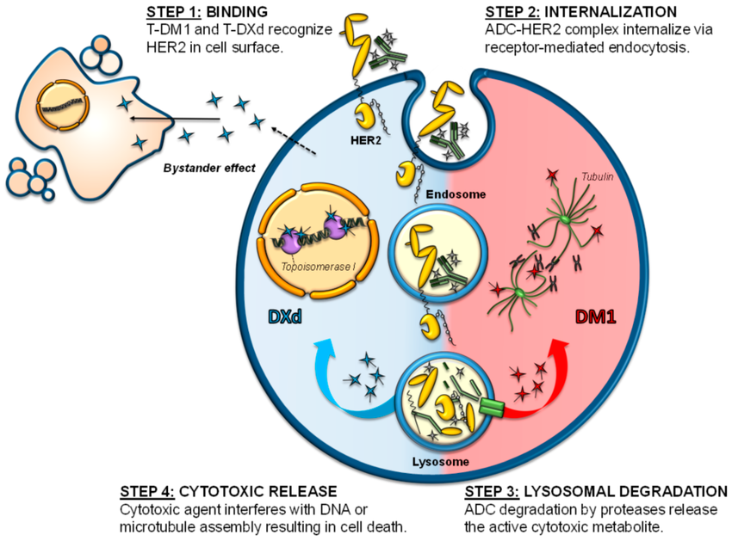
Fundamental Components:
Monoclonal antibody mAb directed toward an antigen on the tumor
cytotoxic agent called payload
connecting linker
https://www.researchgate.net/publication/357414790/figure/fig2/AS:11431281210469093@1702052568411/Mechanism-of-action-of-anti-HER2-ADCs-The-figure-schematizes-the-different-steps.tif

Slide 31
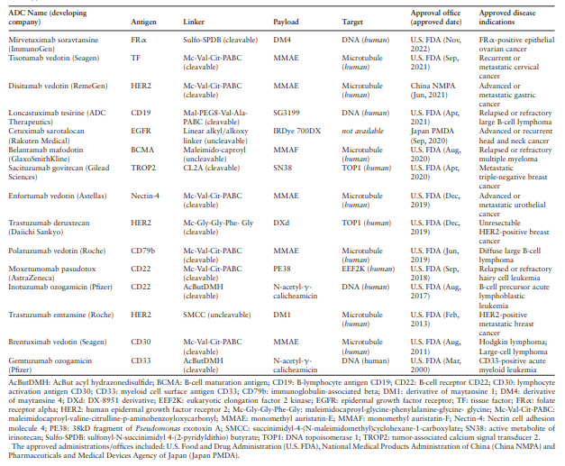
Nucleic Acids Research, Volume 52, Issue D1, 5 January 2024, Pages D1097–D1109, https://doi.org/10.1093/nar/gkad831

Slide 32
Trastuzumab-Dxd; Enhertu HER2 Low Breast CA
DESTINY-Breast04, enrolled 557 adults with metastatic or inoperable HER2-low breast cancer who had received previous chemotherapy
Nearly 90% were estrogen and/or progesterone receptor positive
Two-thirds randomized to receive T-DXd the rest to received physician choice of chemotherapy. T-DXd was given intravenously every 3 weeks with a median follow-up of about 18 months.
Progression-free survival was 10 months in the T-DXd group, compared with 5 months in the chemotherapy group.
Overall survival for T-Dxd group was 23.4 months vs 16.8 in the chemotherapy group.

Slide 33
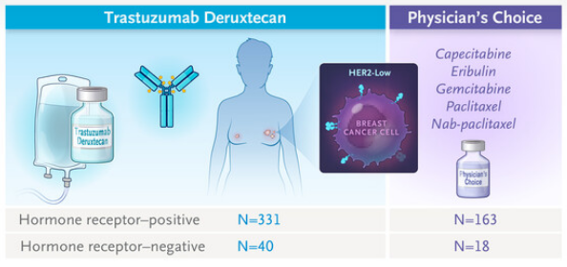
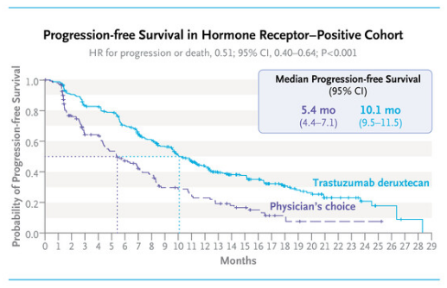
Modi S et al. N Engl J Med 2022;387:9-20

Slide 34
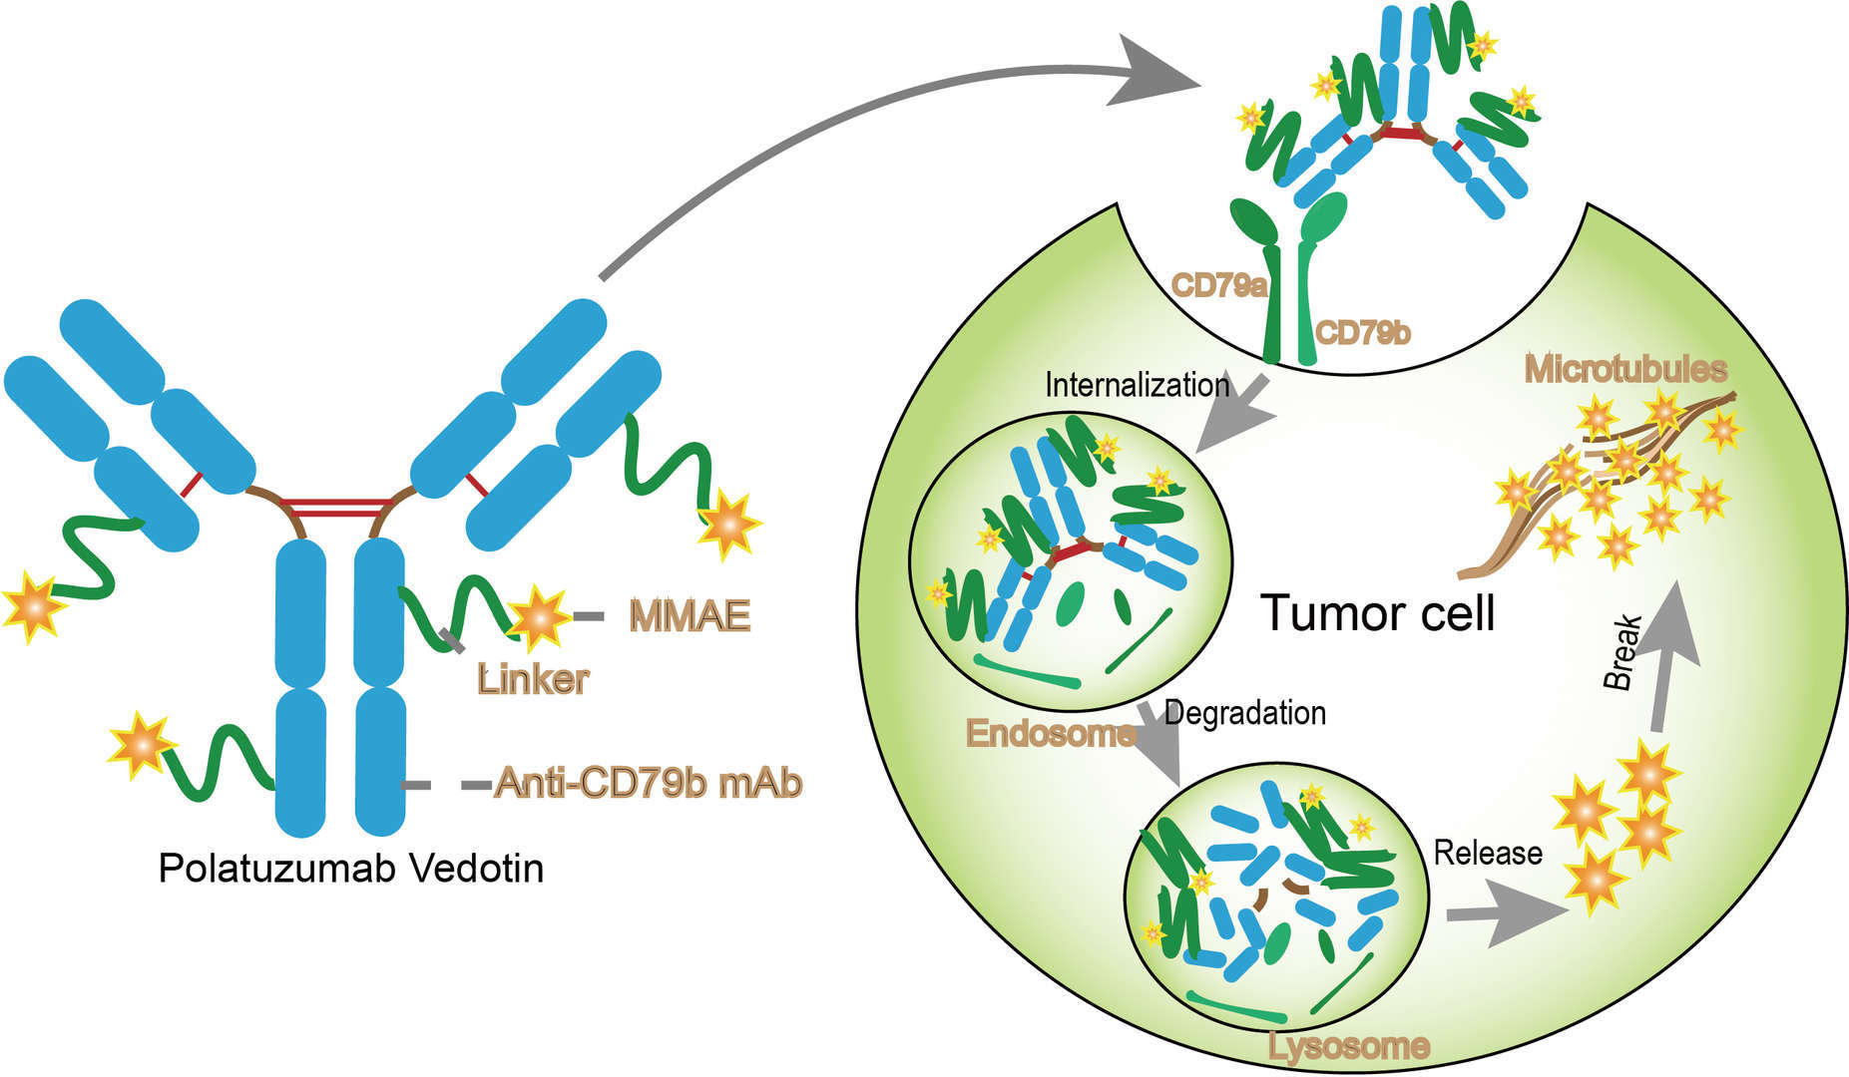
After binding to CD79b on the B-cell surface, polatuzumab vedotin is internalized and the linker is cleaved, releasing MMAE into the cell, where it inhibits division and induces apoptosis.
Drugs. 2019; 79(13): 1467–1475.

Slide 35
