Slide 1
http://commonsensehealthcareutah.org/

Slide 2
OVER 50 YRS US HEALTH EXPENDITURES UP 6X WHILE LIFE EXPECTANCY IS FLAT

Slide 3
HEALTH EXPENDITURES AS A % OF GDP IN 40 COUNTRIES

Slide 4
Dwight D. Eisenhower, 1961
“In the councils of government, we must guard against the acquisition of unwarranted influence, whether sought or unsought, by the military-industrial complex. The potential for the disastrous rise of misplaced power exists and will persist.”

Slide 5
Three Decades After Ike Warned About the Military Industrial Complex. . .
The Soviet Union collapsed under the weight of its military efforts during the Cold War
The % GDP of the Soviet Union spent on the military that distorted its economy and caused its economic demise?
Approximately 20%
Which is approximately what the US “Medical Industrial Complex” is extracting from our current GDP

Slide 6
The “rising tide of mediocrity” in American schools. . .
A persistent gap in academic achievement between children in the United States and their counterparts in other countries deprived the US economy of as much as $2.3 trillion in economic output in 2008.
McKinsey and Co. report, 2007

Slide 7
% GDP for Education is Dropping

Slide 8
Each additional year of schooling reduces mortality later in life
Adults with higher educational attainment live healthier and longer lives compared to their less educated peers.
Men and women without a high school diploma have about 57% chance of reporting fair or poor health, compared to just 9% for college graduates.
Adults with less education are more likely to smoke, have an unhealthy diet, and lack exercise.
Less educated adults report worse general health, more chronic conditions, and more functional limitations and disability.
Americans have worse health than people in other high-income countries, and have been falling further behind in recent decades. . partially due to the. .poor health of adults with low education.

Slide 9
Healthcare spending of state GDP, existing system vs. Utah Cares Utah Cares lowers spending upon implementation in 2027 and 2029

Slide 10
Massive Corporate Profits—Patients Can’t Pay
Corporate Profits in Health Care
Utah Patients-Financial Insecurity
Intermountain-$2.16 B net income thru 9/2022 (3 Q)
United Health Group 2023 profits were $22.4 B up 11% YOY
Profit expressed as a fraction of revenue greater for pharmaceutical companies (13.8% vs 7.7%).
69% Utahns had at least one health care affordability burden in 2023: forgo insurance, care, medicine or can’t pay bills because of health care cost
86% of Utahns worry can’t afford health care in future
Utah rates an F on health care affordability

Slide 11
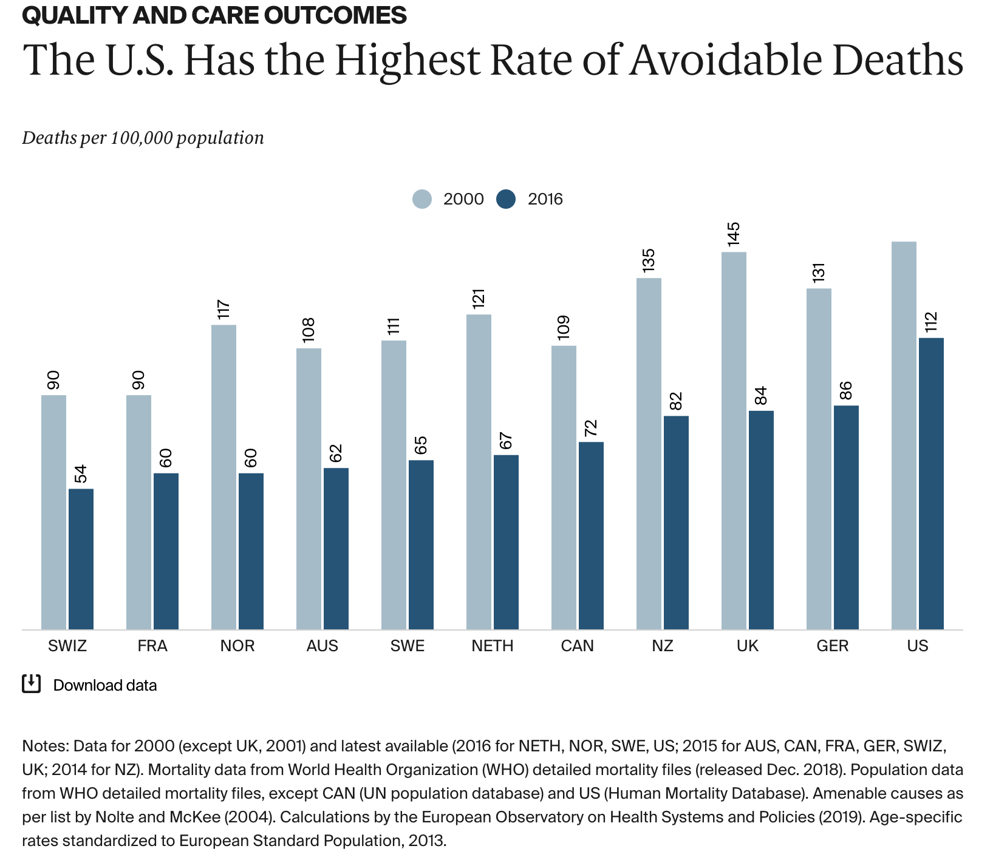

Slide 14
Utah Priority No. 1: Health Care (Costs and Accessibility)
August 2020, the Utah Foundation: Health Care the top issue for Utah voters
From 2008-2018:
Premiums up 40%
Deductibles-74%
$2800/person/year out of pocket,8th highest

Slide 15
The Problem with Health Care in Utah is Cost
According to the Utah Foundation, In 2018:
429,000 Utahns could not get the health care they needed. . .
Because they could not afford to pay for it.
According to the Matheson Center for Health Care Studies:
For 30 years Utah has 2nd highest growth rate in health expenditures in US
At this rate, health costs will double every decade in Utah

Slide 16
MEDICARE COST VS. QUALITY
Source: Baicker, K and Chandra, A. Medicare spending, the physician workforce, beneficiaries’ quality of care. Health Affairs Web Exclusive 7 April 2004; W4-184-97.

Slide 18
EXAMPLE:
COMMUNITY ACQUIRED PNEUMONIA
Source: Sanpete Hospital and Clinics

Slide 19
CAP - COST VS REIMBURSEMENT

Slide 20
Common Sense: UtahCares Non-Profit Public Health Financing
Universal and Comprehensive—Covers everyone for all needed care, no copays, deductibles, co-insurance
One trust fund pays for all necessary care for Utah residents-Simple billing saves doctors 6 hours/week
Patients choose source of care, patients come first—higher quality care = lower cost
$16 B/yr savings (total health expenditures of $40 B/yr) through lower overhead, better pricing
Current research: replace employer funding for health benefits with broad based, progressive public revenues

Slide 21
Books and Film by Joseph Q Jarvis MD MSPH
The Purple World: Healing the Harm in American Health Care
For the Hurt of My People: Original Conservatism and Better, Simpler Health Care
Healing US (Amazon Prime or healingusnetwork.com)

Slide 22
http://commonsensehealthcareutah.org/

Slide 24
What is the purpose of health care delivery? Profits? Sales? Patient Care?
For the hurt of my poor people I am hurt, I mourn, and dismay has taken hold of me. Is there no balm in Gilead? Is there no physician there? Why then has the health of my poor people not been restored? Jeremiah 8:21-22 (NSRV)

