Slide 1
Cardiac PET/CT Update
Mariam Nassif, MD, FACC

Slide 2
Financial Disclosure
This presentation has no ineligible company content, promotes no ineligible company, and is not supported financially by any ineligible company. I receive no financial remuneration from any ineligible company related to this presentation.

Slide 3
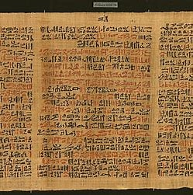
Eber Papyrus
Ebers Papyrus
Size | length: c. 20 meters
Created | c. 1550 BCE
Discovered | Egypt
Present location | Leipzig, Saxony, Germany
“Shouldst though examine a patient with stomach disease suffering from pain in the arms, the breast, and on the side of the stomach, say: 'Death threatens.”
And if though examinst a man for illness in his cardia, and he has pains in his arm, in his breast, and in side of his cardia, and it is said of him: It is illness, then thou shalt say thereof: it is death that threatens him.

Slide 4
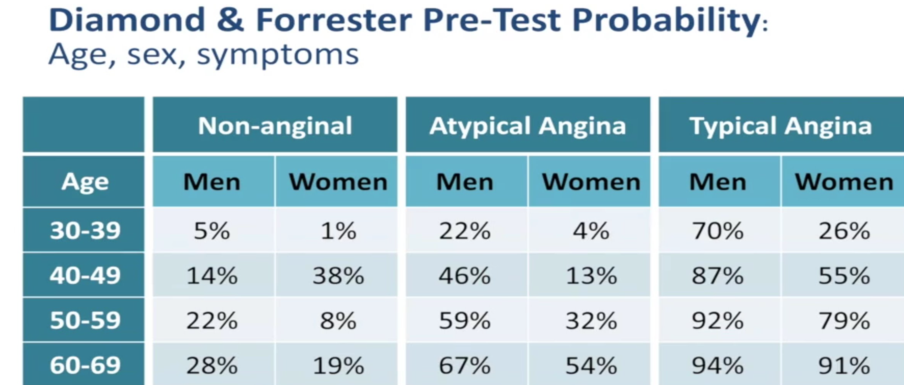
Significantly Overestimates the risk

Slide 6
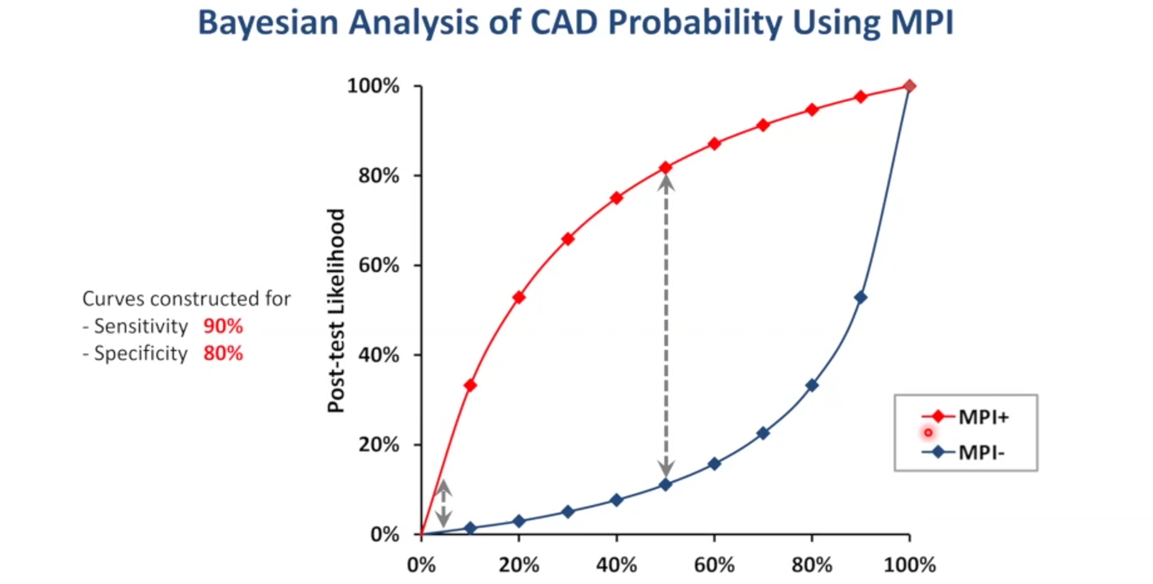
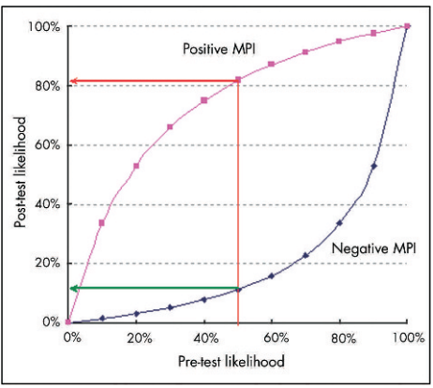
CY LOONG, C ANAGNOSTOPOULOS Heart 2004; (90 supplementV) :v2-v9

Slide 8
The Basis of Nuclear
Ischemic Imaging

Slide 9
J. Clin. Med. 2019, 8(2), 255; https://doi.org/10.3390/jcm8020255

Slide 10
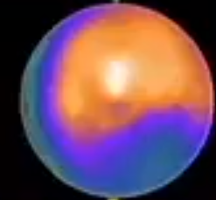
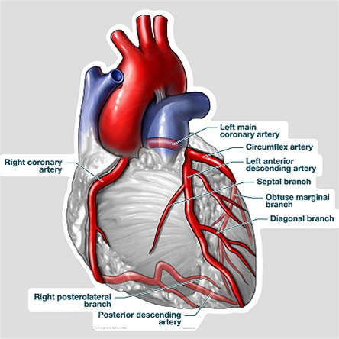
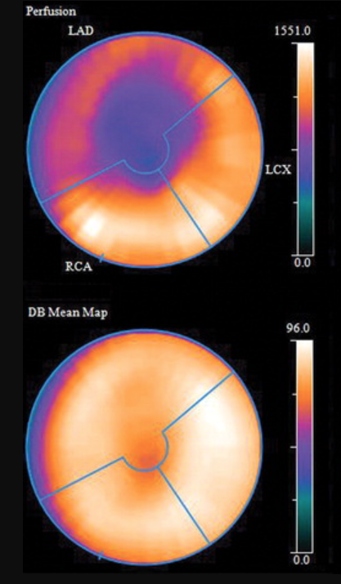
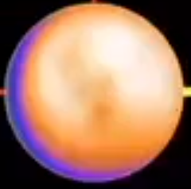

Slide 11
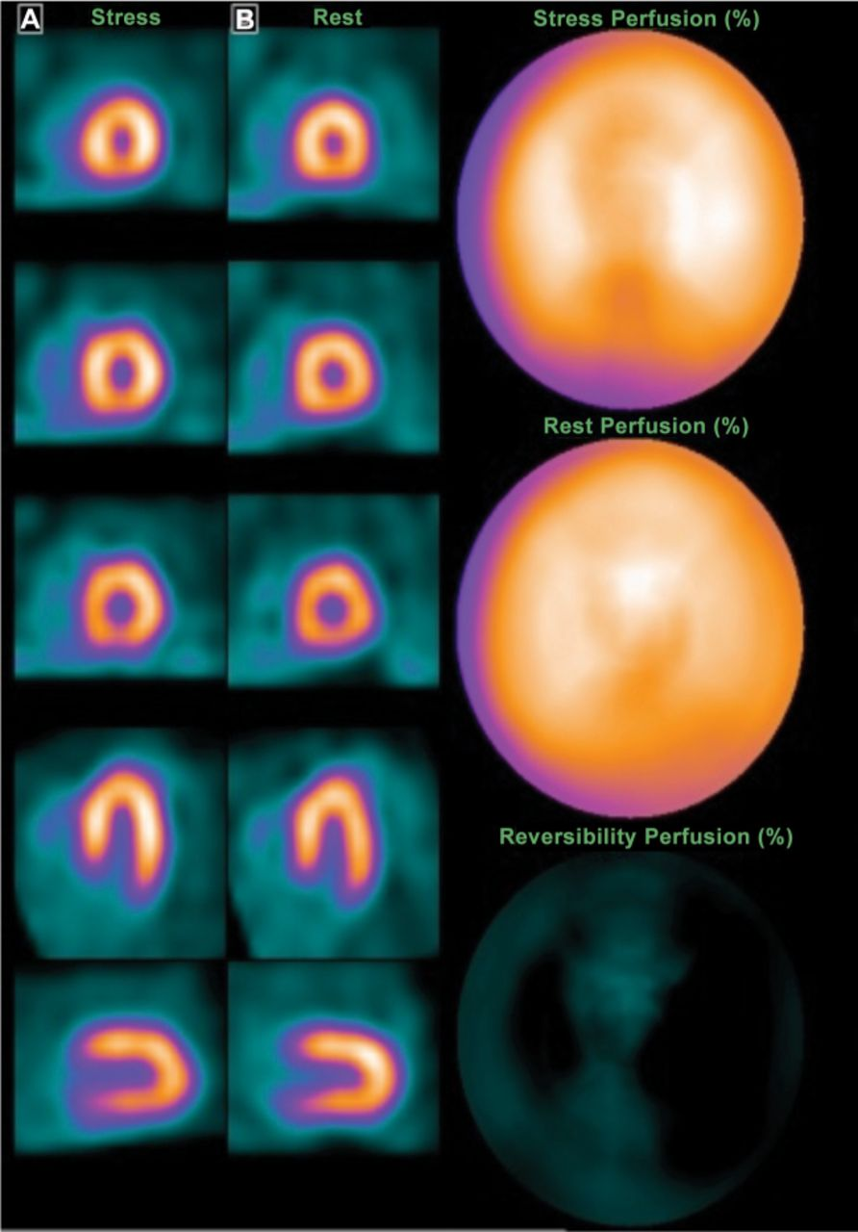
Normal Myocardial perfusion study

Slide 12
PET CT MPI
Treadmill
Can be done with
N13 ammonia
Physical half life: 10 minutes
Needs a cyclotron on site
Pharmacologic
Can be done with
82 Rubidium
Physical half life is 76 seconds.
89 Str/89 Rb generator
B. N13 ammonia
Physical half life: 10 minutes
Needs a cyclotron on site

Slide 13
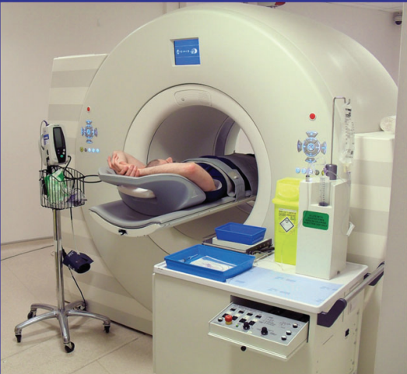
PET CT MYOCARDIAL PERFUSION IMAGING

Slide 16
82 RB PET CT MPI
1- Coronary calcium score.
2- Myocardial perfusion images.
3- Myocardial blood flow quantification
(MBF):
-Rest myocardial blood flow (rest MBF).
-Stress myocardial blood flow (stress MBF).
-Coronary flow reserve (CRF).
4- Assessment of LV function at rest and peak exercise.

Slide 17
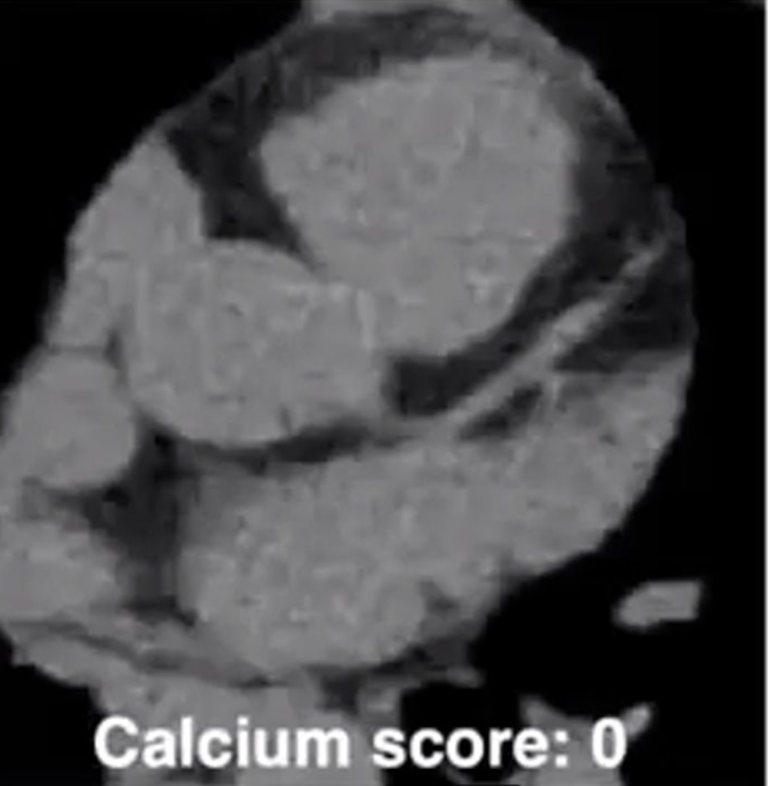
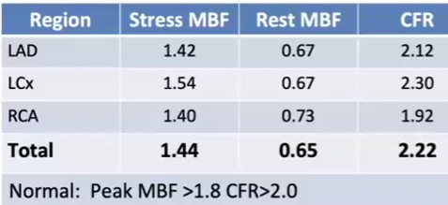
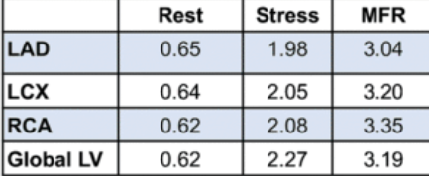

Slide 18
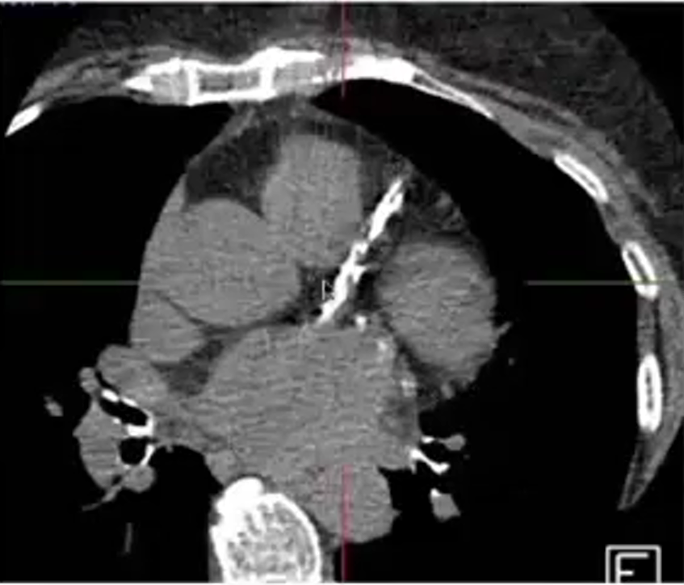
Courtesy of Dr. Marcello Di Carli

Slide 19
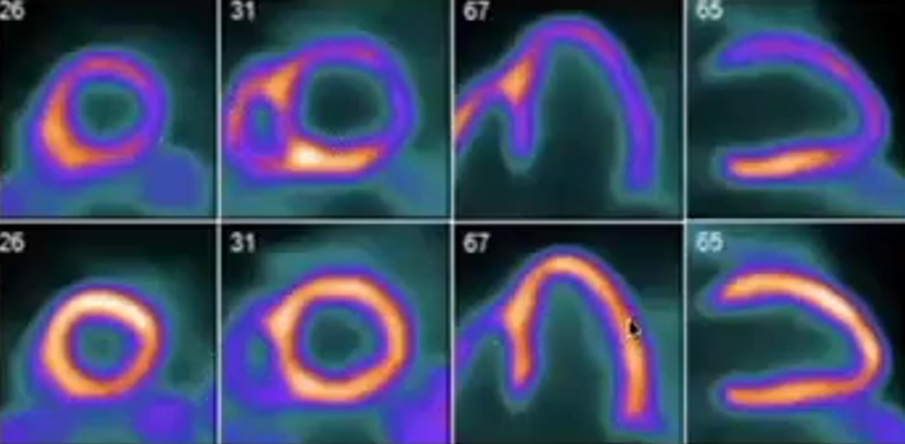
Courtesy of Dr. Marcello Di Carli

Slide 20
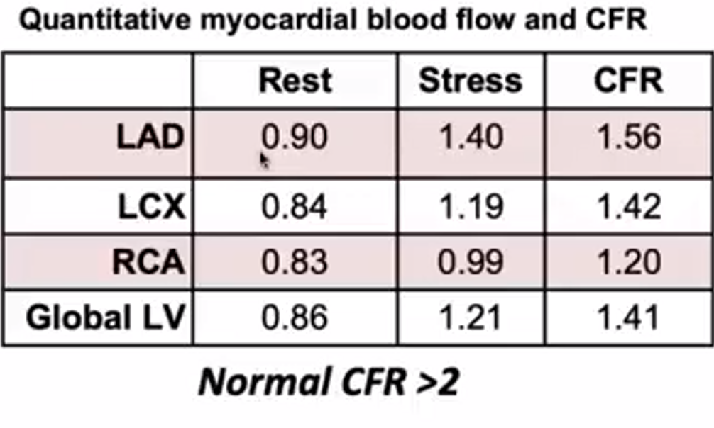

Slide 21
Why PET CT?

Slide 23
Obese patients
Large breasts
Gut uptake is less of a concern

Slide 25
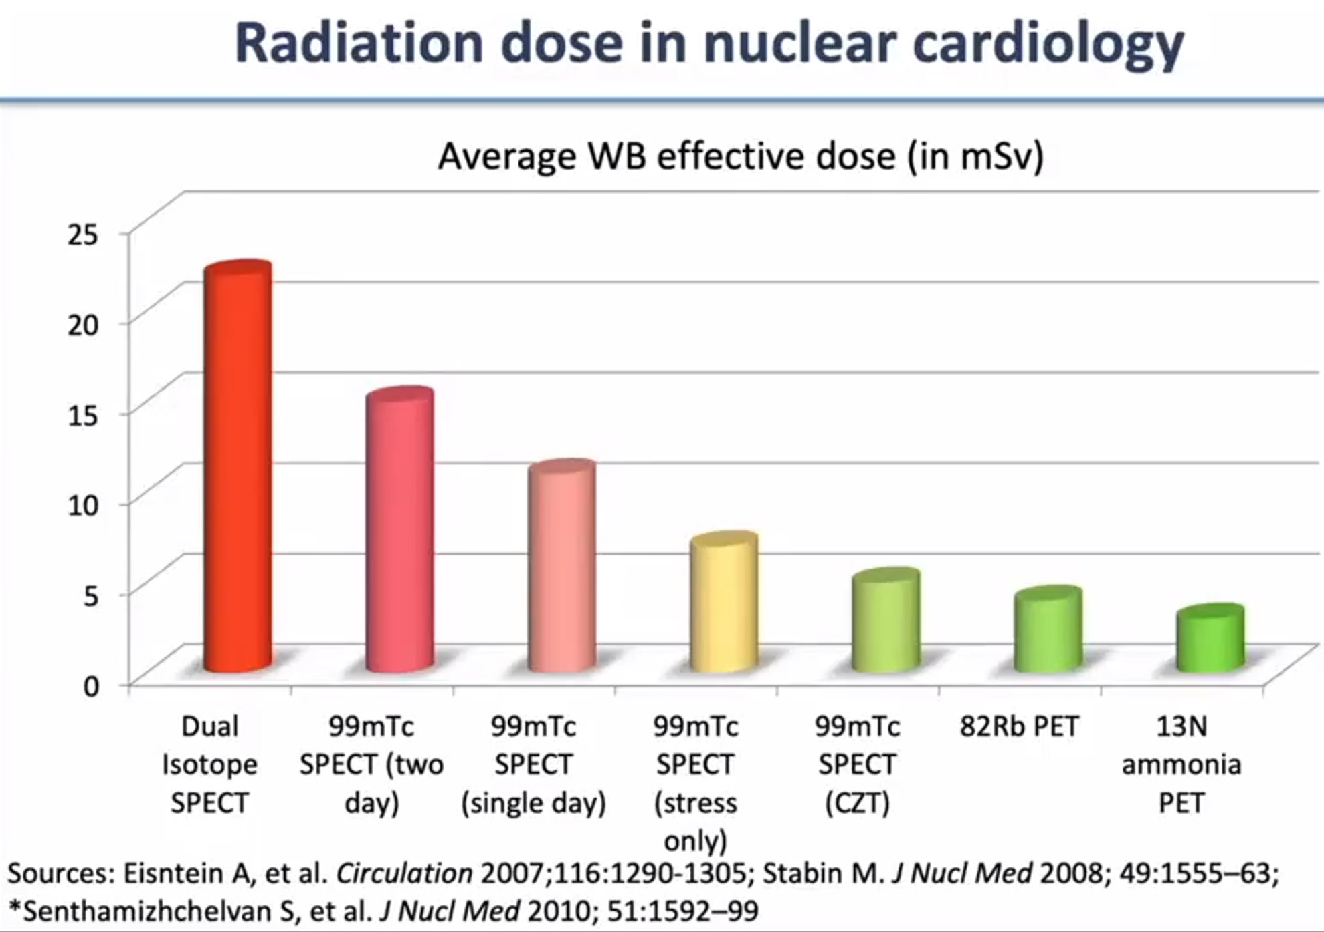

Slide 26
Prognostic
Value of Pet.

Slide 28
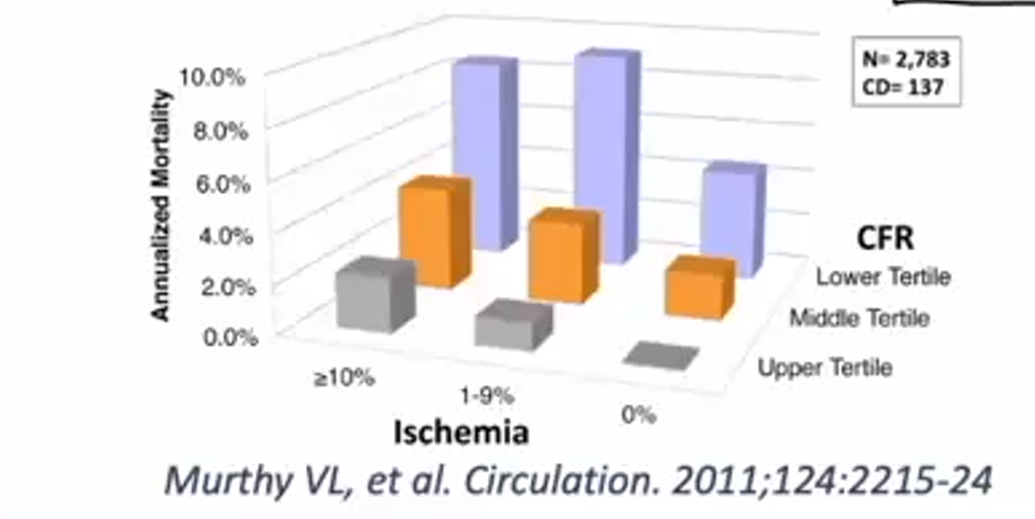

Slide 29
CORONARY CALCIUM SCORE

Slide 30
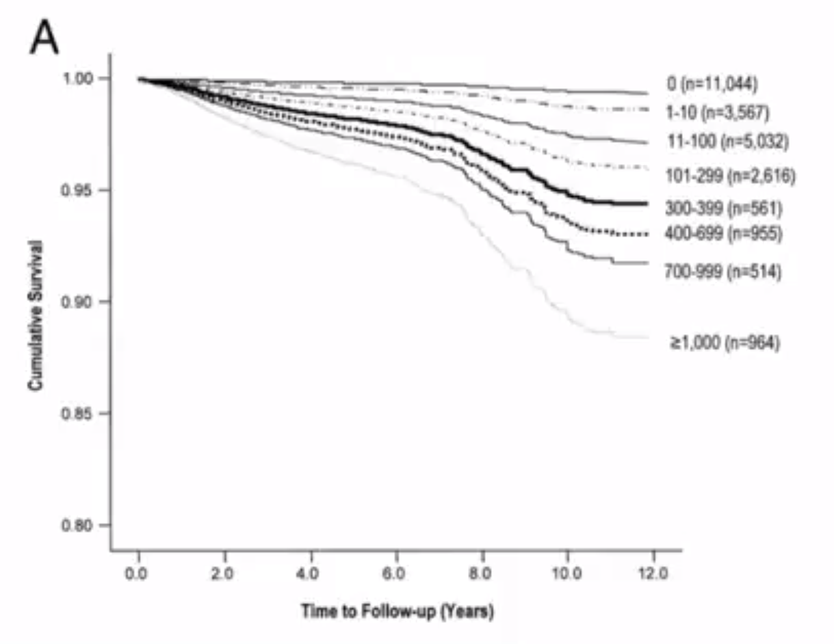
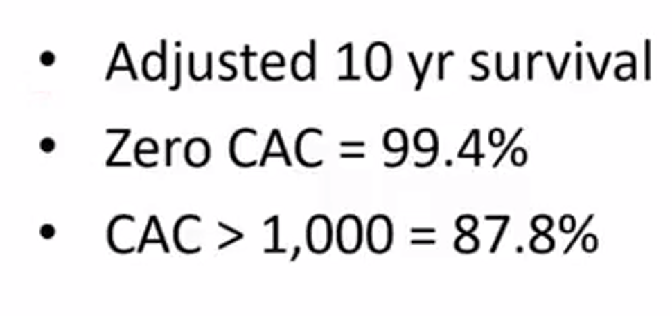
Coronary calcium score Alone

Slide 34
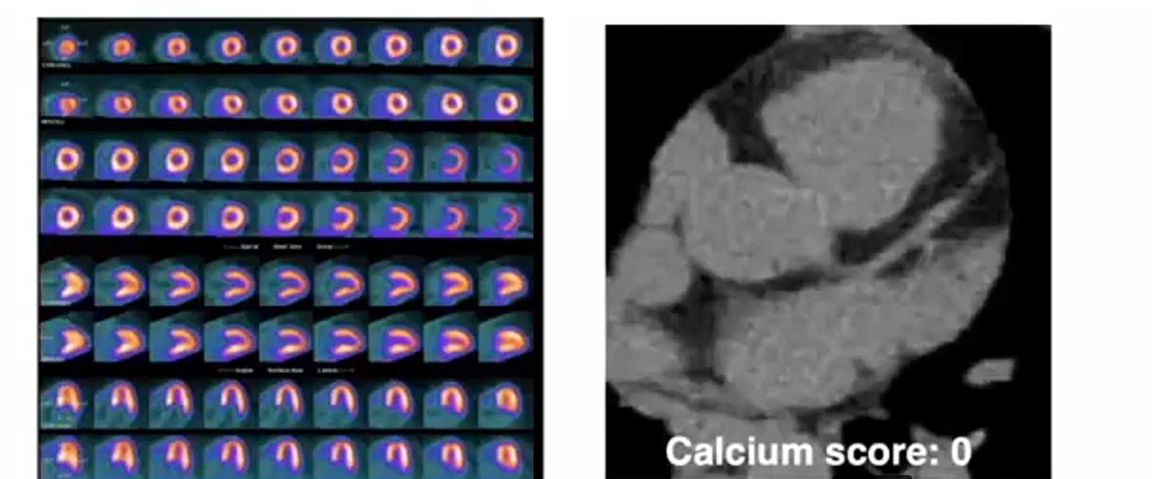

Slide 35
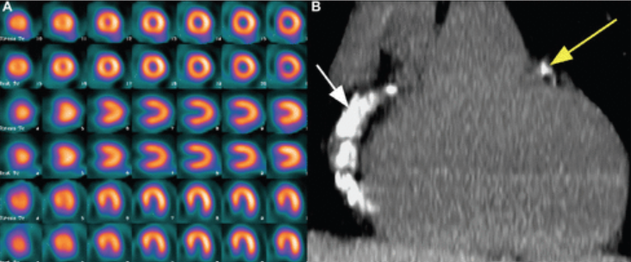
Normal myocardial perfusion in a patient with extensive coronary artery calcification
Ann Saudi Med. 2017 Mar-Apr; 37(2): 154–160.

Slide 38
When should you order PET?
1- Diagnosis
Patients who need Pharmacologic stress test.
-Inability to exercise.
-LBBB, pacemaker.
Patients with equivocal treadmill testing.
Obese patients
Patients with Large breast attenuation artifact
2- To determine Prognosis In patients with known CAD.
Cardiac PET imaging allows risk stratification which in turn help tailor the best management strategy medical vs interventional for the individual patient.
3- To determine Response to therapy In patients with known CAD and prior coronary revascularization, cardiac PET imaging provides important information regarding the adequacy of revascularization. In patients with known CAD on medical therapy, cardiac PET can evaluate the ability of the patient’s medical regimen at reducing myocardial ischemia

Slide 40
Thank You!

Slide 41
Other PET CT Applications
1- Evaluation of myocardial viability to determine the right candidate for revascularization in patients with ischemic cardiomyopathy.
2- Evaluation of active inflamation, such as determination of the presence of active sarcoidosis.
3- Evaulation of infection in prothetic valve endocarditis.

Slide 42
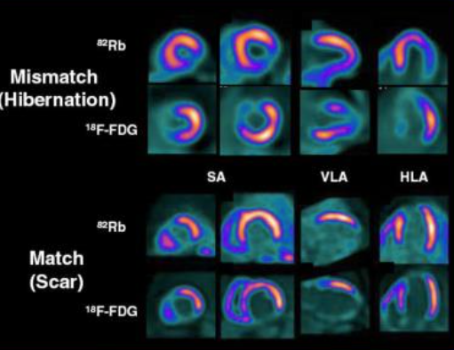
Role of PET CT In determination of Myocardial Viability

Slide 44
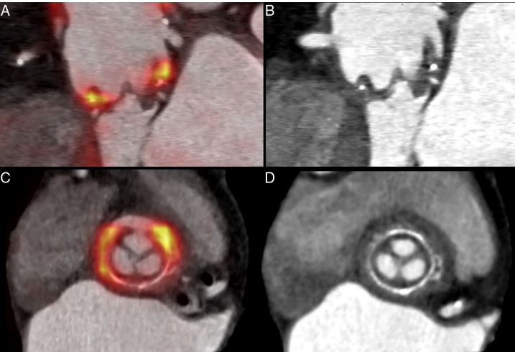
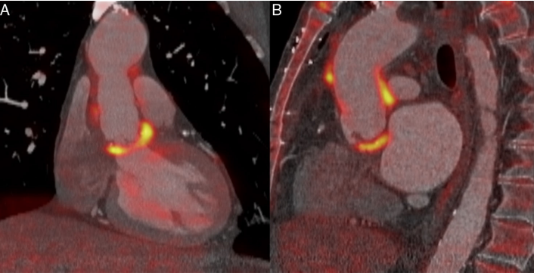
Hybrid PET CT FDG improves diagnosis of prothetic valve endocarditis

Slide 45
Courtesy of Dr. Jamieson M Bourque, MD.

Slide 50
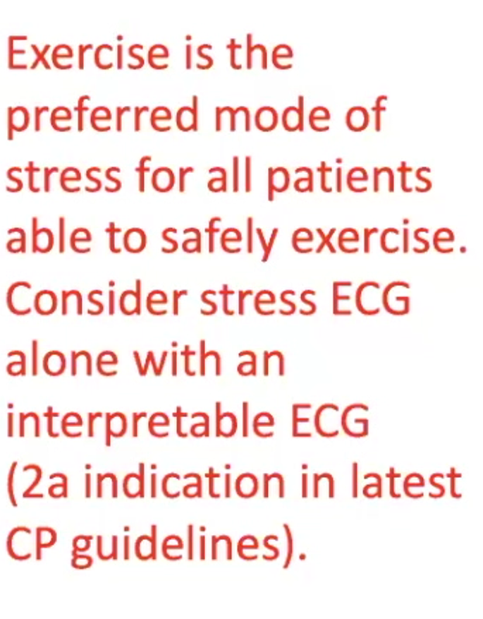
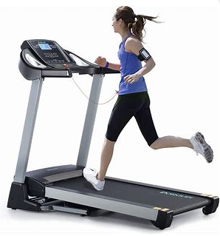
2021 AHA/ACC/ASE/CHEST/SAEM/SCCT/SCMR Guideline for the Evaluation and Diagnosis of Chest Pain: A Report of the American College of Cardiology/American Heart Association Joint Committee on Clinical Practice Guidelines

Slide 51
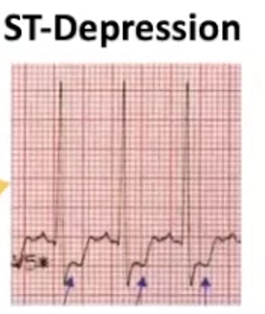

Slide 52
Courtesy of Dr. Jamieson M Bourque, MD.

Slide 53
Stress Testing
Stress method
Imaging
Nuclear
SPECT
PET
Echo
MRI
Exercise
Treadmill
Stationary Bike
Pharmacologic
Vasodilators
Inotropes

Slide 54
Pharmacologic Testing

Slide 55
Pharmacologic
stress test
LVH
Digoxin therapy

Slide 57
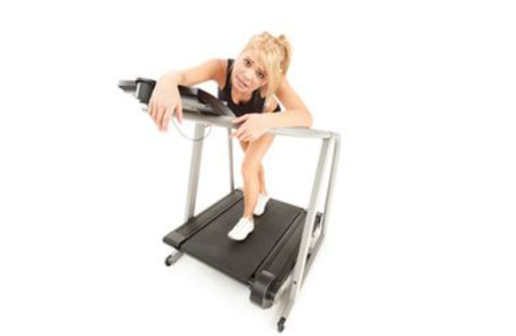
Criteria to transition to pharmacologic stress

Slide 59
CAD Evaluation
Anatomic Testing
Coronary calcium score
Coronary CTA
Cardiac catheterization
Functional /Hemodynamic Testing
Stress Testing
FFR

Slide 60
Stress Testing
Stress method
+/- Imaging
Nuclear
Echo
MRI
Exercise
Treadmill
Stationary Bike
Pharmacologic
Vasodilators
Inotropes

Slide 63
PET CT MPI
Treadmill
Can be done with
N13 ammonia
Physical half life: 10 minutes
Needs a cyclotron on site
F18 Flurpiridaz
Physical half life 110 minutes
Unit dose
Not FDA approved yet
Pharmacologic
Can be done with
82 Rubidium
Physical half life is 76 seconds.
89 Str/89 Rb generator

Slide 65
