Slide 1
What’s New in Sports Medicine?
Brett Martindale, MD

Slide 2
Disclosure
This presentation has no ineligible company content, promotes no ineligible company, and is not supported by any ineligible company. I receive no financial remuneration from any ineligible company related to this presentation.

Slide 3
A lot of things…
Concussion management
R.I.C.E vs. M.E.A.T.
Ultrasound diagnostics and intervention
Trigger point/myofascial theory
Rehabilitation protocols
Early sports specialization
Elbow epidemic in throwers (especially baseball pitchers)

Slide 4
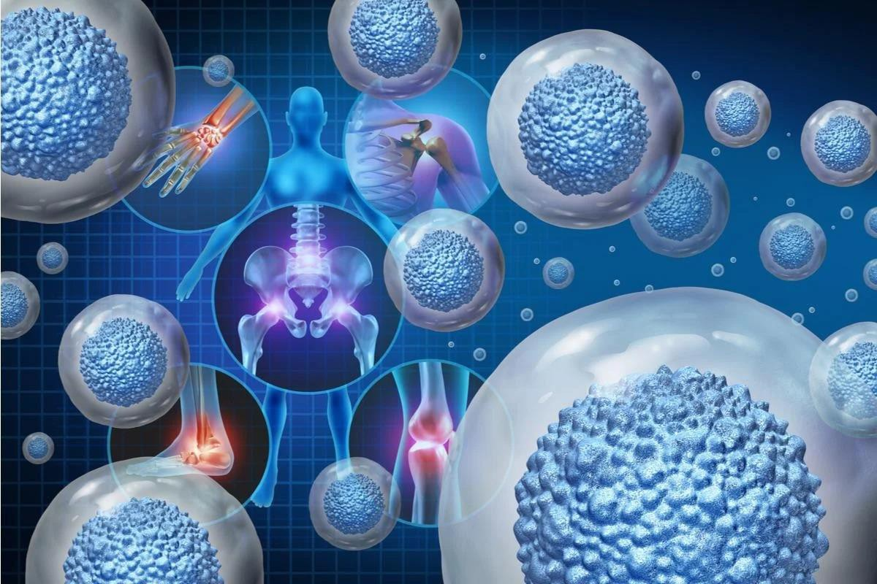
Regenerative Medicine
Enabling and enhancing the body’s natural repair mechanisms to restore the function of otherwise poorly healing or irreparable tissues in situ.¹
1. Li Z, et al. Tissue Engineering for Musculoskeletal Regeneration and Disease Modeling. Handb Exp Pharmacol. 2021;265:235-268. PMID: 33471201; PMCID: PMC8049527.

Slide 5
Regenerative Medicine
Coined in 1992
FDA and Congress sanctioned this term in the 2016
21st Century Cares Act
Controversy surrounds the term because of many unfounded claims incorrectly applied to it, with indiscriminate use and aggressive marketing (which hinders progress in this field)
Encompasses many modalities (Orthobiologics, prolotherapy, exosomes, shock-wave therapy, etc.)

Slide 6
The Problem - Physiology
Tendinopathy and Osteoarthritis
Protracted (tendon) or no known (OA) healing capacity

Slide 7
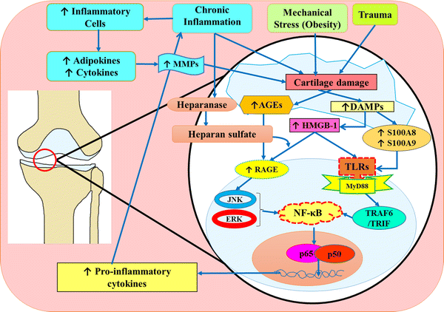
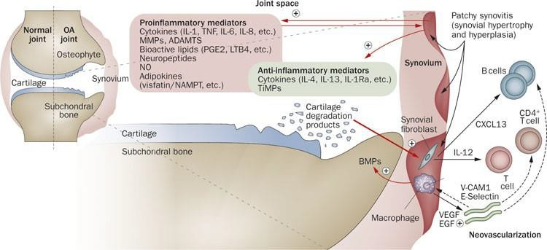
Osteoarthritis pathophysiology
Rosenberg, J.H., Rai, V., Dilisio, M.F. et al. Damage- associated molecular patterns in the pathogenesis of osteoarthritis: potentially novel therapeutic targets. Mol Cell Biochem 434, 171–179 (2017). https://doi.org/10.1007/s11010-017-3047-4
Sellam, J., Berenbaum, F. The role of synovitis in pathophysiology and clinical symptoms of osteoarthritis. Nat Rev Rheumatol 6, 625–635
(2010). https://doi.org/10.1038/nrrheum.2010.159

Slide 8
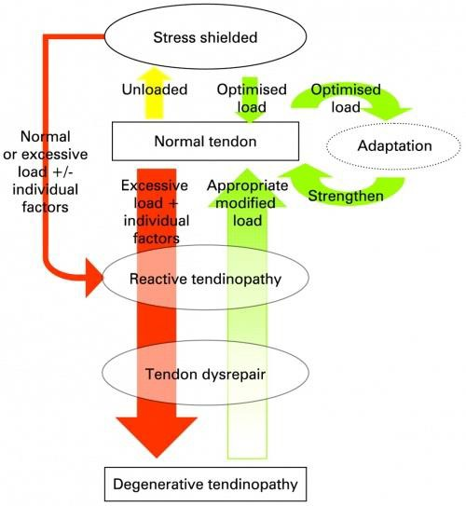
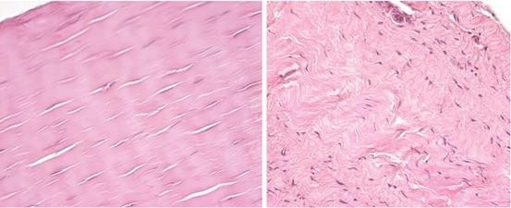
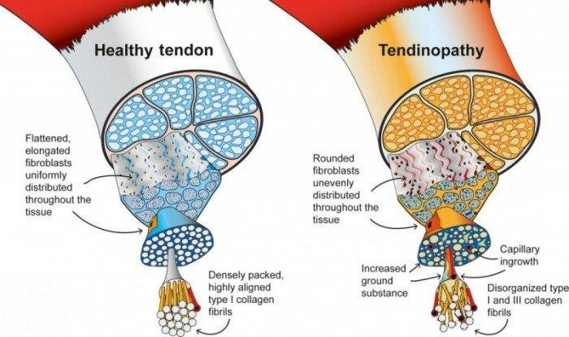
Tendonopathy pathophysiology

Slide 9
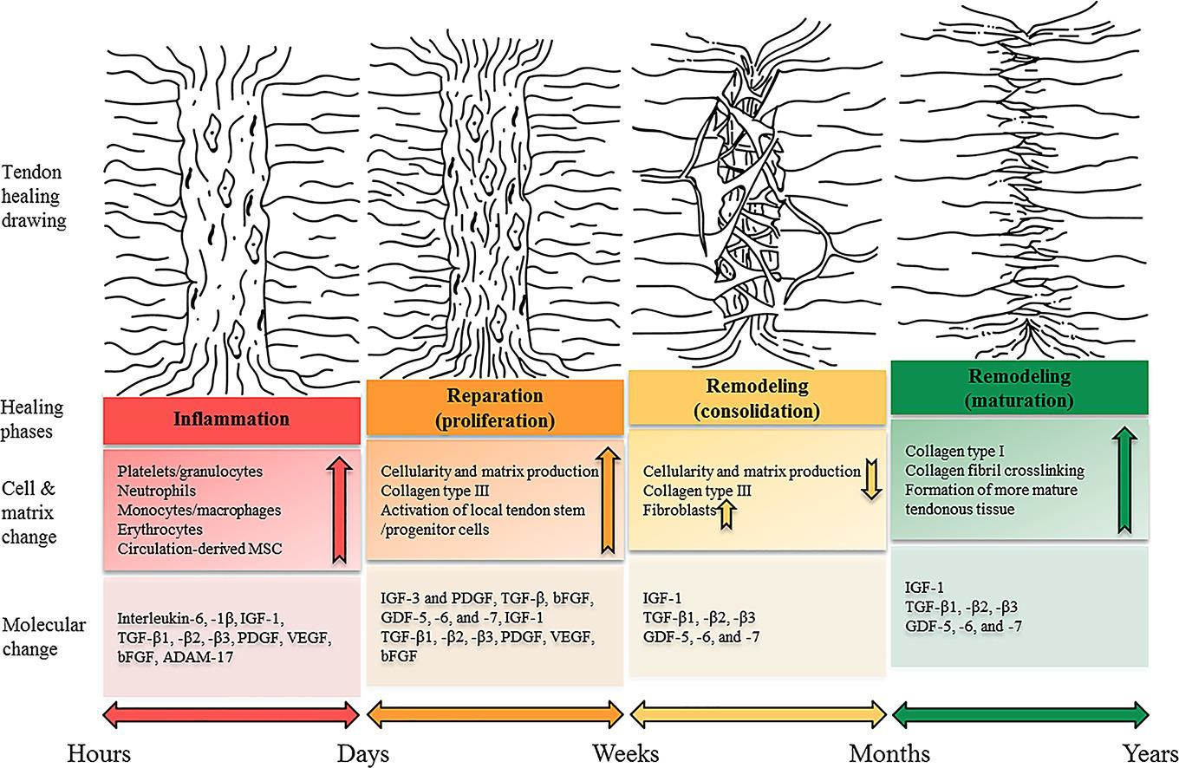
Tendon (soft tissue) Healing
Schneider M, et al. Rescue plan for Achilles: Therapeutics steering the fate and functions of stem cells in tendon wound healing, Advanced Drug Delivery Reviews, Volume 129, 2018, Pages 352-375, ISSN 0169-409X, https://doi.org/10.1016/j.addr.2017.12.016. (https://www.sciencedirect.com/science/article/pii/S0169409X17303198)

Slide 10
The Problem - Treatment
Patients have a history of failed treatments
Near-term and long-term goals of the patient
What does the patient feel comfortable with?
Most don’t want surgery
Most don’t want to keep doing PT if they don’t see effect

Slide 11
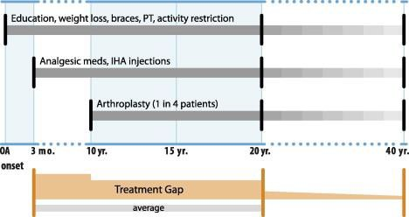
Treatment Gap
Nicholas J. et al. Clinical and economic consequences of the treatment gap in knee osteoarthritis management, Medical Hypotheses, Volume 76, Issue 6, 2011, Pages 887-892, ISSN
0306-9877, https://doi.org/10.1016/j.mehy.2011.02.044.

Slide 12
Regenerative Medicine
Can play a role in filling that physiology and treatment gap
Extracorporeal Shock Wave Therapy (ESWT)
Orthobiologics, especially platelet rich plasma
(PRP)

Slide 13
Extracorporeal Shock Wave

Slide 14
ESWT
Research led to pulverizing kidney stones in 1980
Bone density noticeably increased in these patients
MSK studies started in early ‘90s
Acoustic pressure waves which propagate faster than sound
Causes abrupt tensile and shear stress on tissues, eliciting a healing response

Slide 15
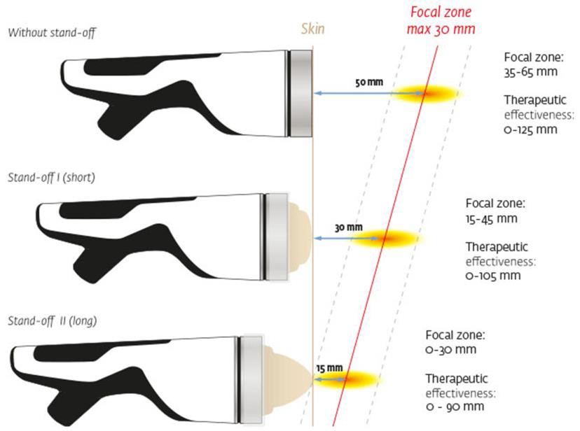
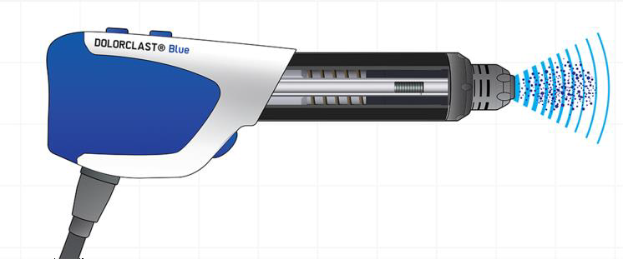
ESWT Types
Focused
True shock wave
Focuses to a single point at a
greater depth
Radial
Oscillating pressure wave
Energy spread from a single point, but does not penetrate as deeply

Slide 16
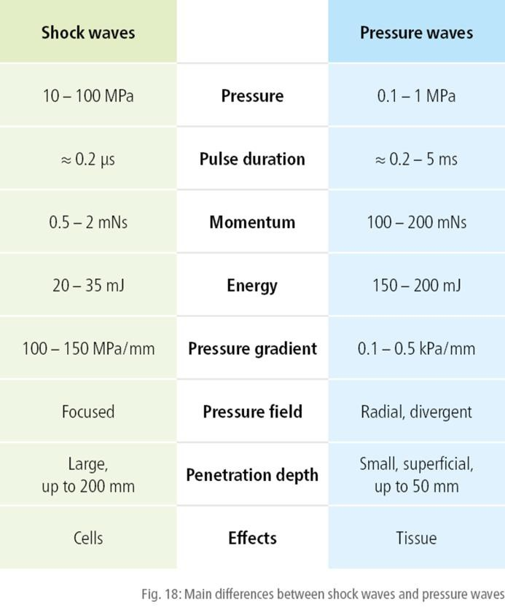
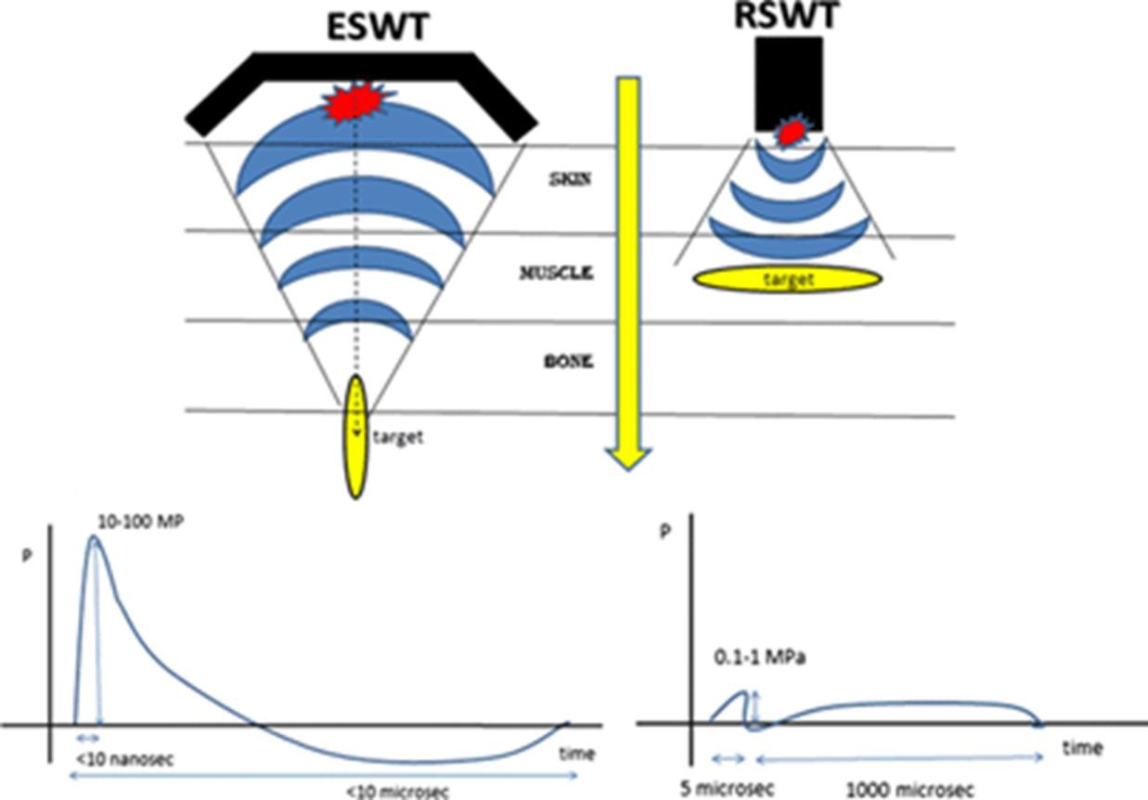
ESWT

Slide 17
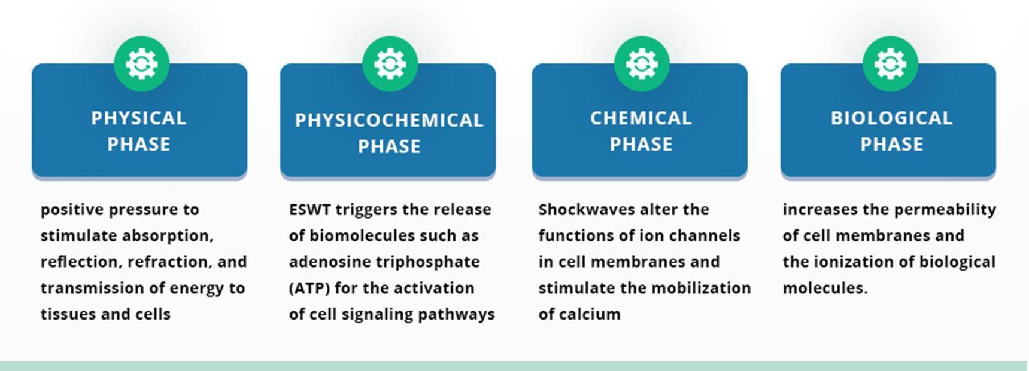
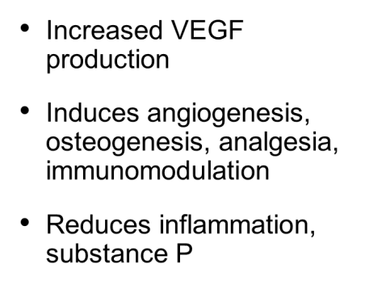
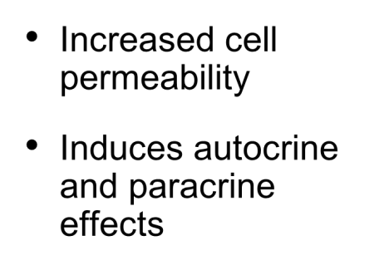
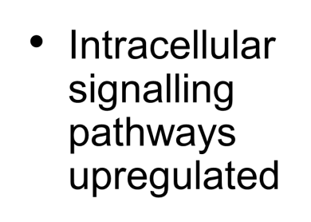
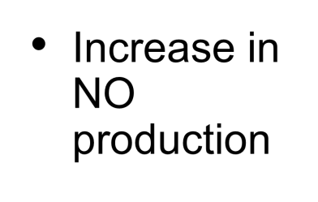
ESWT: Mechanism of Action

Slide 18
ESWT: Applicability
Tendinopathy
Plantar fasciitis
Achilles tendinitis
Patellar tendinitis
Trochanteric “bursitis”
Rotator cuff
Tennis/golfer elbow
Wrist tendinitis
Stress fracture/nonunion
Bone marrow lesions (arthritis)
Muscle strain
Muscle/myofascial pain
Neuropathy (e.g. carpal tunnel syndrome)

Slide 19
ESWT: Studies
Achilles tendinopathy
Furia 2006, Rompe 2007, Rasmussen 2008, Rompe 2009,
Abdelkader 2021, Rompe 2008, Pinitkwamdee 2020
Plantar fasciopathy
Rompe 1996, Rompe 2003, Ogden 2004, Theodore 2004, Kudo
2006, Gollwizter 2007, Gollwitzer 2015, Gerdesmeyer 2008,
Marks 2008, Hawamdeh 2016, Ibrahim 2017
Lateral epicondylitis
Pettrone 2005, Rompe 2004, Spacca 2005, Yan 2017
Stress Fracture/Nonunion
Moretti 2009, Albisetti 2010, Sansone 2022

Slide 20
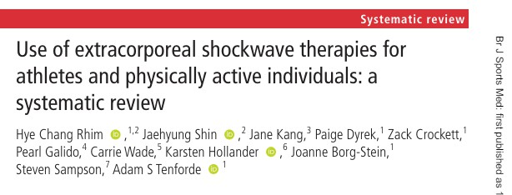
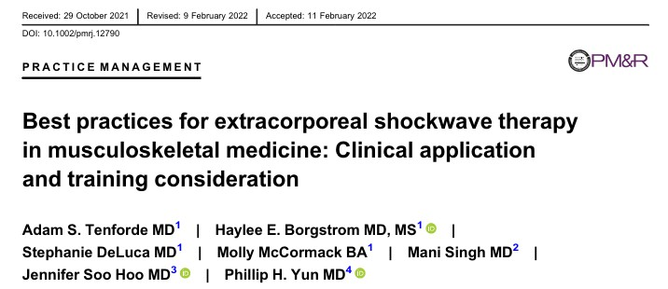
ESWT: Studies

Slide 21
ESWT: General Protocol
3-6 weekly sessions (each lasting 10-15 minutes)
Radial to surrounding tissues, focused directly on
pathologic area
Clinical focusing, titrating energy to tolerance

Slide 22
ESWT: Practicalities
Pain relief often immediate, but temporary (hyperstimulation analgesia)
May improve through the course of treatment, but greatest effects are 4-6 weeks following treatment
Patients may continue normal activity (“in-season” treatment)
Easily combined with other treatments (especially PT,
but also dry needling, massage, PRP, surgery)

Slide 23
ESWT
Contraindications
Active cancer in area of
treatment
Pregnancy (gravidity in the treatment area)
Infection or DVT in treatment
area)
Open physes???
Overlying lungs???
Adverse Effects
No known serious side effects
Sensory nerve hyperstimulation can lead to temporary paresthesia
Pain during application
Petechiae/ecchymosis or edema at treatment site

Slide 24
ESWT: Personal Experience
53 y/o female with 18 mos. left shoulder pain
Tried CSI, barbotage, PT, no effect
3 sessions of ESWT

Slide 25
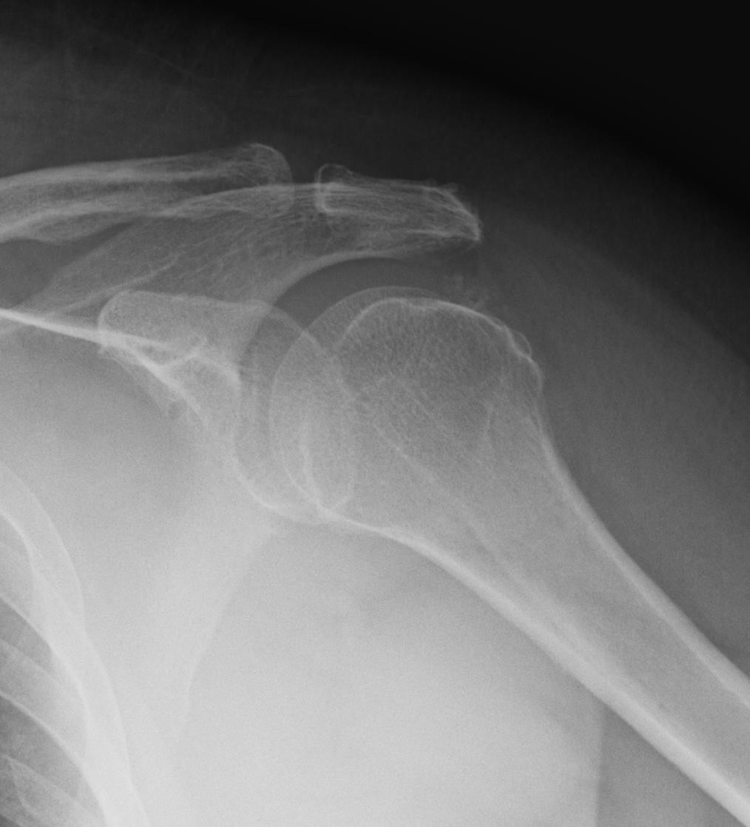
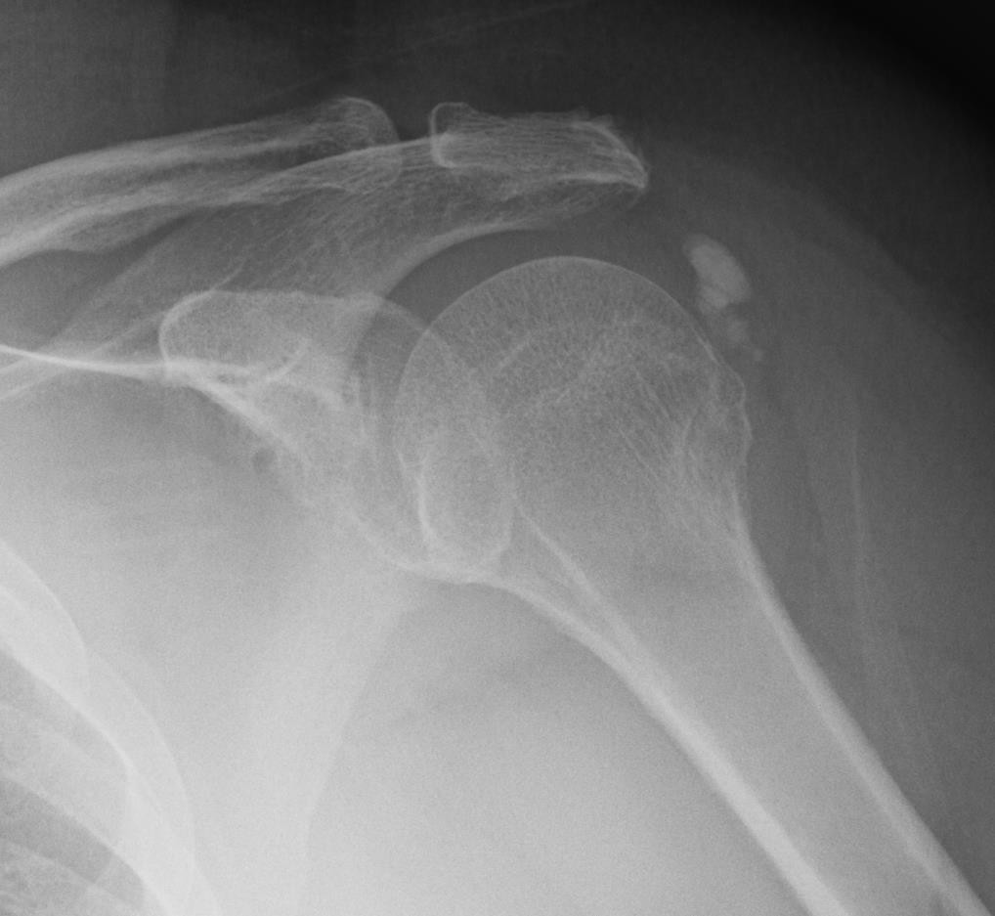
ESWT: Personal Experience

Slide 26
ESWT: Personal Experience
49 y/o male former collegiate runner (now recreational) with >1yr of insertional Achilles tendon pain
3 sessions of ESWT
Had his first pain free run in over a year

Slide 27
Extracorporeal Shock Wave
ESWT is a non-invasive, minimally interruptive treatment for a wide variety of musculoskeletal disorders, particularly in adjunct, without any known serious side effects.

Slide 28
Orthobiologics

Slide 29
Orthobiologics
Prolotherapy? Needle Tenotomy?
Platelet Rich Plasma
Autologous conditioned plasma, autologous conditioned serum, Autologous protein solution, Alpha-2 macroglobulin
Bone Marrow
Adipose Tissue
Perinatal Tissues

Slide 30
Platelet Rich Plasma (PRP)
Autologous plasma which has a platelet concentration above baseline
Leukocyte rich (leukocyte concentration above baseline)
Leukocyte poor (leukocyte concentration below
baseline)
Which leukocytes present (granulocytes and/or agranulocytes)
RBC content

Slide 31
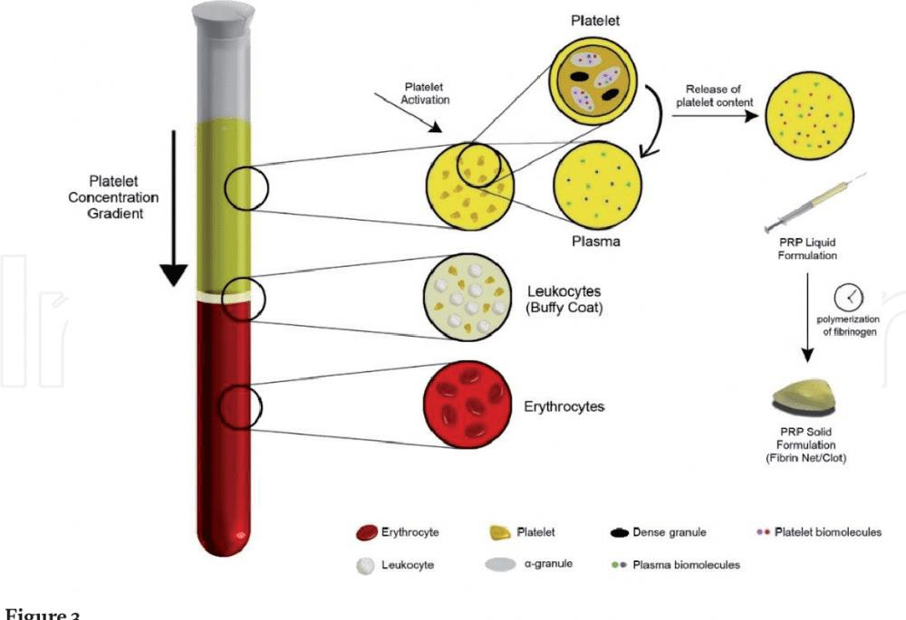
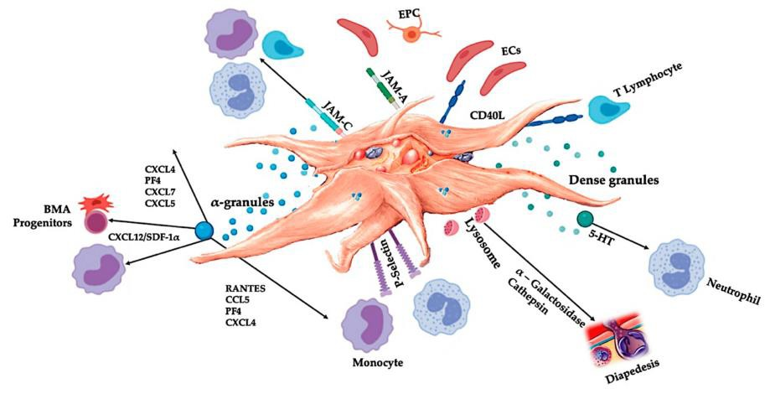
Platelet Rich Plasma (PRP)
PRP is inflammatorily complex
May be contextual
Plasma itself has signaling molecules

Slide 32
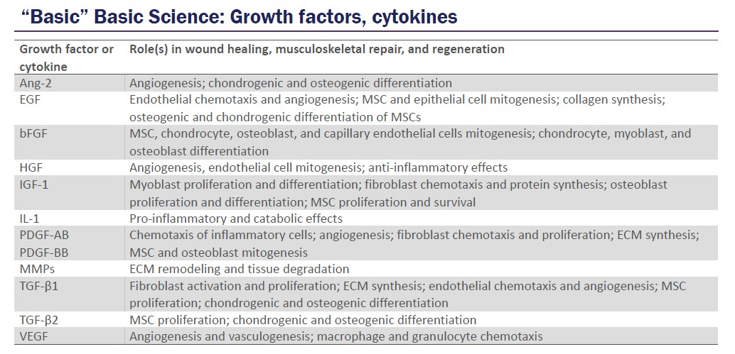
PRP: Physiology
Yuan, X.(., Gellhorn, A.C. (2020). Platelet-Rich Plasma. In: Cooper, G., Herrera, J., Kirkbride, J., Perlman, Z. (eds) Regenerative Medicine for Spine and Joint Pain.
Springer, Cham. https://doi.org/10.1007/978-3-030- 42771-9_5

Slide 33
PRP: Applicability
Tendinopathy
Plantar fasciitis
Achilles tendinitis
Patellar tendinitis
Trochanteric “bursitis”
Rotator cuff
Tennis/golfer elbow
Wrist tendinitis
Osteoarthritis
Ligamentous injury (e.g. UCL or ATFL tear)
Meniscus tears?
Carpal tunnel syndrome?
Adhesive capsulitis?

Slide 34
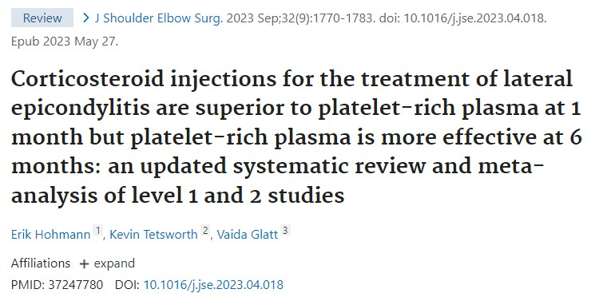
PRP: Studies
Lateral epicondylitis
Hastie 2018, Shim 2022, Niemiec 2022, Li 2022,
Kamble 2023

Slide 35
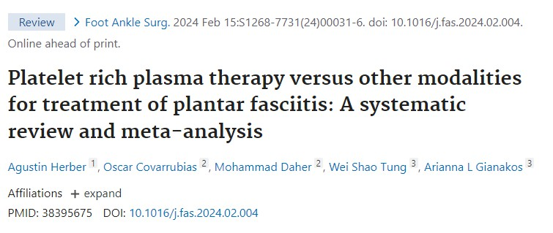
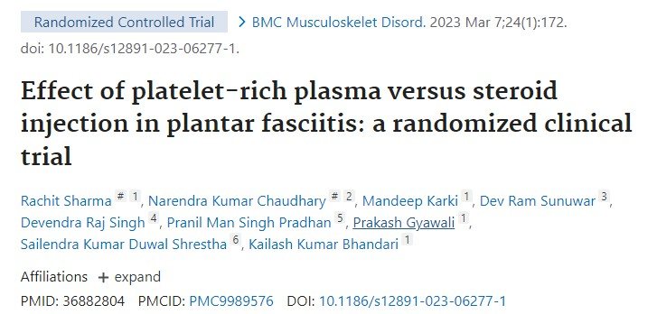
PRP: Studies
Plantar fasciitis

Slide 36
PRP: Studies
Achilles tendinitis (Huang 2023, Desouza 2023)
Patellar tendinitis (Bosco 2023)
Gluteal tendinitis (Fitzbpatrick 2018)
Rotator cuff (Dakkak 2024, Shen 2024, Desouza
2024)
UCL tear (Fucaloro 2024)
Generally more heterogeneity in the results for above issues.

Slide 37
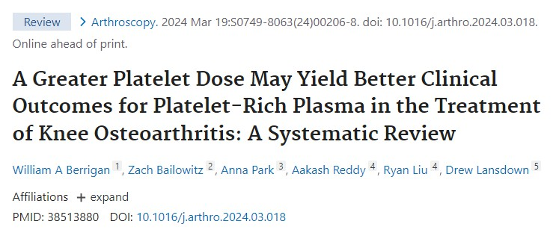
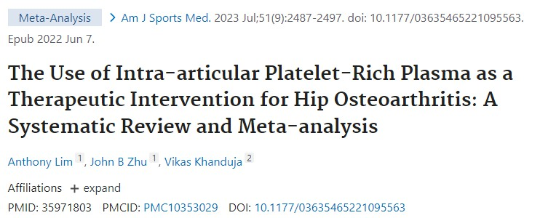
PRP: Studies
Osteoarthritis

Slide 38
PRP: Knowledge Gaps
Leukocyte rich vs. poor
Granulocytes vs. agranulocytes
Platelet concentration, platelet:leukocyte ratio
Post-procedure protocols
Rehabilitation intensity/timing
Immobilization vs early movement
NSAIDs OK?
Number of injections to perform

Slide 39
PRP: Practicalities
Often significant discomfort in the days following administration (more mild generally with joints)
Usually calming to baseline within 10-14 days
Maximal effect is often 2-6 months after
administration
Because of the downtime, considered an “off-season” treatment
Should ideally be combined with rehabilitation
protocols

Slide 40
PRP
Contraindications
Active infection
Cancer?
NSAIDs?
Anti-coagulants?
Hematologic disease?
Adverse Effects
Same as other injections therapies (infection, though this is typically much less common)
Discomfort following injection
Hyperacute response

Slide 41
PRP: Personal Experience
50 y/o female with right lateral epicondylitis
Took 12+ weeks to start noticing improvement
Desired contralateral side treatment about 1 year later
48 y/o male with left trochanteric tendinitis
Pain-free in 4 weeks
67 y/o female with left knee OA
Relief with 1 injection for about 1 year, repeated twice

Slide 42
Orthobiologics: Horizons
Exosomes
Allogeneic cells
Stimulation of instrinsic stem cells
True stem cells (e.g. human skeletal stem cell)
Immune cell sub-type roles, selective activation
Gene editing (CRISPR)
Isolate individual or selective growth factors/cytokines

Slide 43
Regenerative Medicine
Can stimulate innate healing responses
Fills a treatment gap for tendinopathy and osteoarthritis
“Another tool in the toolbox”
Significant knowledge gaps for ideal utilization
Exploited to make false claims
Tremendous potential
Right patient, right drug, right dose, right route, and
right time

Slide 44
Thank you
Brett Martindale, MD
Brett.Martindale@ogdenclinic.com

