Slide 1
Diagnosis and Management of Hypertension in the Pediatric Population
Matt Grinsell, MD, PhD
5/16/2024
Division of Nephrology and Hypertension
University of Utah

Slide 2
Disclosure
This presentation has no ineligible company content, promotes no ineligible company, and is not supported financially by any ineligible company. I receive no financial remuneration from any ineligible company related to this presentation.
I will briefly discuss helpful apps for BP screening.
I will disclose that I have no problem telling my dog he is my favorite in front of my adult children.

Slide 3
Goals
Review best practices for diagnosis and management of hypertension in the pediatric population.
Epidemiology, etiology and definition of pediatric hypertension.
Evaluation of pediatric hypertension.
Management/referral.

Slide 4
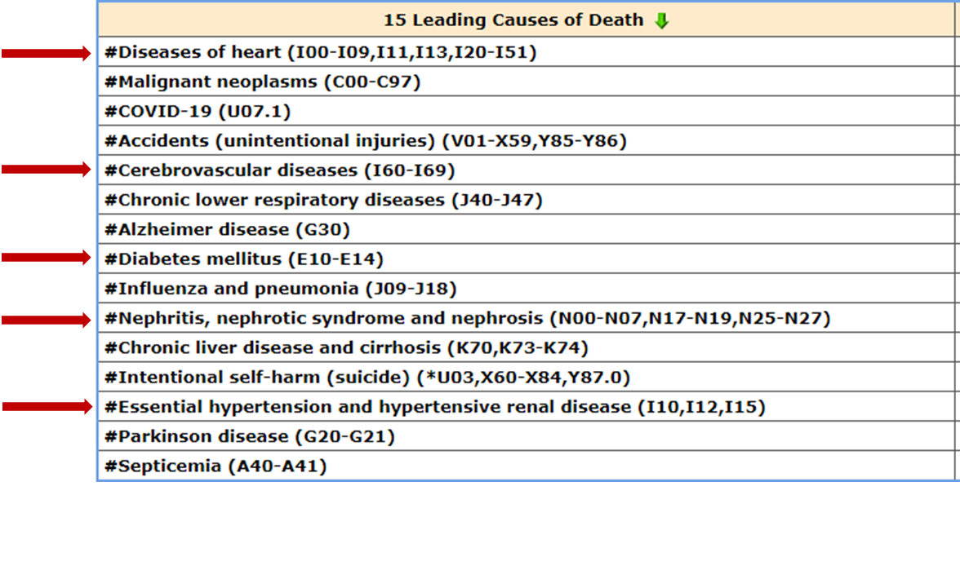
Hypertension-Globally
Approximately 30% (1.4 Billion) adults worldwide have Hypertension (HTN).
HTN is a leading modifiable risk factor for cardiovascular disease worldwide.
HTN is associated with number of leading causes of death.
Circulation. 2016;133(4):447–454
https://www.cdc.gov/nchs/fastats/hypertension.htm

Slide 5
Hypertension-Adult vs. Pediatrics
USA: 48.1% adults either have BP above 130/80 or are on medications.
~25% of patients with HTN have BP in goal range.
HTN most common indication for:
Medical office visits.
Chronic medication use.
Prevalence increases with age:
18-39 y/o 22%.
40-59 y/o 55%.
>60 y/o 75%.
With wisdom comes HTN.

Slide 6
Hypertension-Adult vs. Pediatrics
3.5-4% of the pediatric population have HTN.
8-10% have elevated blood pressure.
Childhood BP predicts adult BP.
Adolescent HTN in particular tracks to adult HTN.
85-90% of the pediatric population are in the ideal BP range.
How do we identify the other 35-40% of the population that will become hypertensive as adults?

Slide 7
Case 1
7 y/o female presents for WCC. She has been your patient since birth along with her 4 siblings.
During check-in, MA obtains patient height and weight without shoes or coats.
Vital signs are obtained with pt seated.
MA obtains brief parental report that pt has had:
2-3 days of headaches, bloody nose last night, lasted about 45 minutes.
Pt had an episode of dark brown urine this am when she got up.

Slide 8
Case 1
While reviewing the visit documentation prior to entering the exam room, the EHR notifies you that her blood pressure is 136/92, which is Stage 2 HTN.
BP was obtained by MA trained in selecting proper size BP cuff for pediatric patients using an automated device.
You review that you just saw her 3 weeks ago for fever and she was strep positive and was treated appropriately. BP at that time was 92/60.
Wt is also up 1.2 kg from last visit.

Slide 9
AAP Key Action Statements: BP Screening
BP should be measured ANNUALLY in patients ≥3 y of age.
Important to use proper size BP cuff.
BP should be checked at EACH MEDICAL VISIT for patients at each healthcare visit if the have:
Obesity.
Kidney disease.
Diabetes.
Hx aortic coarctation.
Hx prematurity .
Administration of BP elevating meds.
-More on this later

Slide 10
Pediatric Nephrology Clinic Cuffs

Slide 11
AAP Key Action Statement: BP Screening
Oscillometric devices may be used for BP screening in children and adolescents.
IF elevated BP is suspected on the basis of oscillometric readings, confirmatory measurements should be obtained by auscultation.
Currently used BP standard tables are based on ausculatation measurements.

Slide 12
Case 1
Ht 125 cm (75%)
Wt: 25 kg (up 1.2 kg) (75%)
Previously 23.8 kg (60%)
Temp 37.6C
HR 115 BPM
RR 22/min
Then you think: Headaches, nosebleeds and dark urine?
Almost like she read the chapter on how to present.
Now What?
Well, we need to figure out what Stage 2 HTN means and what to do about it.

Slide 13
Hypertension-Definition
Since 2017, AAP has aligned the definition, categorization and terminology for HTN for 13 y/o and above with the 2017 AHA and ACC definitions for adult patients.
12 y/o and under are derived from approximately 50,000 children and adolescents in the NHANES database.
This generates a statistical bell curve for categorizing pediatric HTN

Slide 14
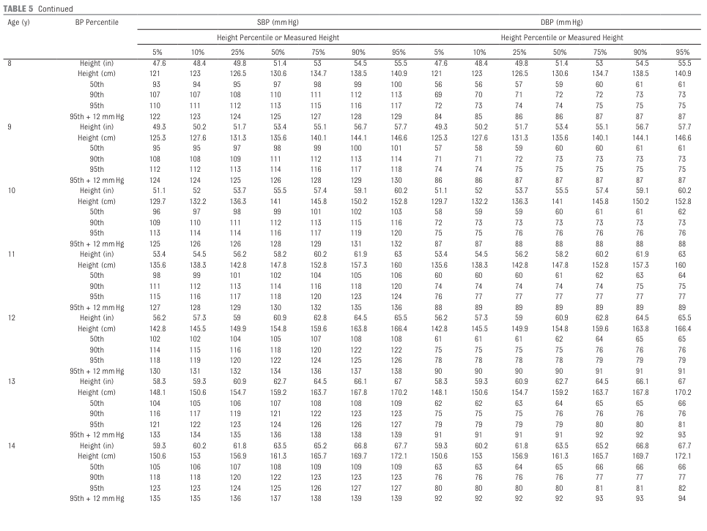
Pediatric HTN:Using BP Tables <12
7 y/o girl at 135 cm in height with BP 136/92

Slide 15
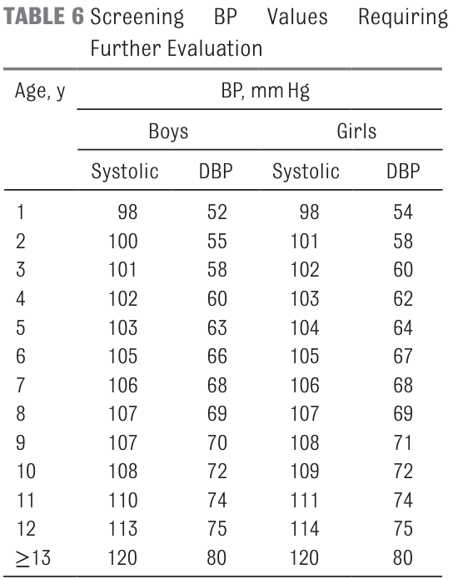
Useful Pediatric BP Apps/Table
8 y/o girl at 135 cm in height with BP 118/77

Slide 16
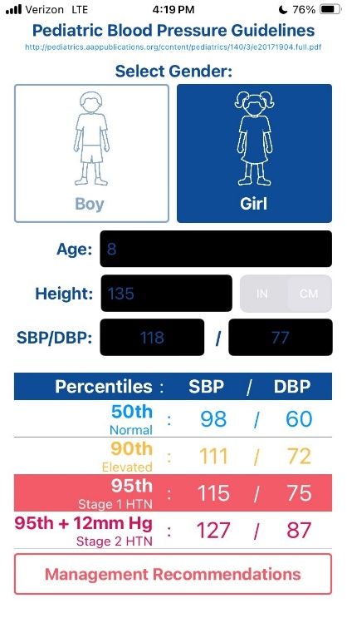
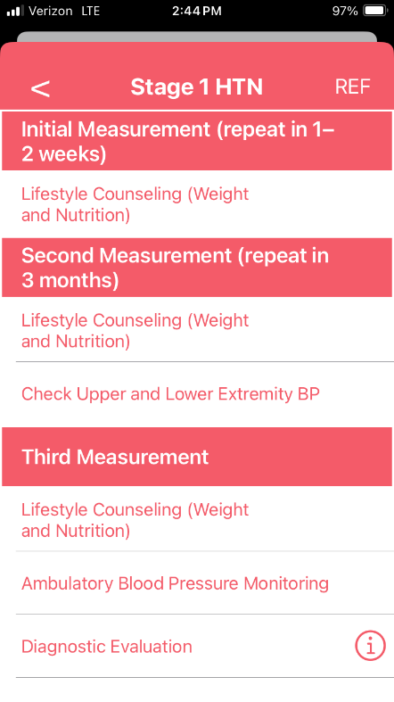
Useful Pediatric BP Apps
8 y/o girl at 135 cm in height with BP 118/77.
I am not paid by these companies.

Slide 17
Case 1
So, 7 y/o female, 2-3 days HA, bloody nose and dark urine this am.
BP 136/92 on initial automatic BP screen.
You start asking questions.
HA started a few days ago, definitely not in the front, but maybe behind the ears some. Can’t really describe character, but maybe throbbing.
Tylenol and advil have helped HA a little.
Dark urine this am was first ever episode. No pain, burning, hesitancy, urgency or increased frequency of urine reported.
PT is otherwise alert, sitting in moms lap.

Slide 18
AAP Key Action Statements
In children and adolescents being evaluated for high BP, the provider should obtain:
Perinatal history.
Appropriate nutritional history.
Physical activity history.
Psychosocial history.
Family history.
Perform a physical examination to identify findings suggestive of secondary causes of HTN.

Slide 19
Case 1
Fortunately, you know this patient and family well.
PMH pretty unremarkable
Term pregnancy, no pre- or post-natal complications.
Up to date on vaccines.
PE tubes at 2 years old.
No admissions ever.
Pt with ADHD on low dose stimulant meds for school.
No FH of HTN, kidney disease, MI, stroke or death at <40 yo.
PT is active on the swim team. All of the sibs swim as well.
Family generally eats home cooking, eats out once a week.

Slide 20
Review of Systems for HTN
Headache.
Blurry vision.
Epistaxis.
Nausea/vomiting.
Poor feeding.
Flushing.
Cough.
Ringing/Buzzing in ears.
Diaphoresis.
Edema
Abdominal pain.
Shortness of breath.
Heart palpitations/irregular rhythms.
Slurred speech.
Confusion.
Fatigue.
Anxiety.
Seizures.
Muscle tremors.

Slide 21
Case 1
Manual BP recheck by you in right arm 128/90 (Down from 136/92).
This still Stage 2 HTN for a 7 y/o female at 125 cm in height.
Lungs clear.
Oropharynx clear with some dried blood in nose.
Maybe her eyes look a little puffy.
Trace pitting edema over shins about halfway up to knee.

Slide 22
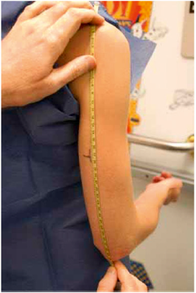
BP-Manual Measurement
Sitting quietly for 3-5 minutes, back supported, feet uncrossed on floor.
Right arm supported with cuff placed at the level of the heart.
Use proper size cuff with cuff bladder covering 80-100% arm circumference.
Multiple cuff sizes necessary.
Cuff placed at midpoint of arm.
inflate cuff to 20-30 points above 95%.
SBP = 1st Korotkoff sound “opening snap”.
DBP = Disappearance of sounds.
IF sounds go to 0, DBP is at sound muffling.
Leg BP, pt in prone position, cuff mid-thigh.
Leg BP averages 10-20% higher than arm BP.

Slide 23
AAP Key Action Statement: HTN Diagnosis
Trained health care professionals in the office setting should make a diagnosis of HTN if a child or adolescent has auscultatory confirmed BP readings ≥95th percentile at 3 different visits.
I don’t think this child should wait for 2 more visits.

Slide 24
Case 1
So, she has stage 2 HTN, and HR upper end normal range.
This is a good time to consider reaching out to pediatric nephrology.
In the meantime, we need to figure out what is going on.
Pretty broad etiology DDX.
Need to arrange lab and imaging evaluation.

Slide 25
Etiology of HTN in Pediatrics
Primary (essential) - no identifiable underlying cause. This has increased with obesity epidemic.
Now the predominant etiology of HTN in adolescents.
Thought to be a complex interplay of environmental and genetic factors.

Slide 26
Secondary Causes of HTN-Renal Origin
Renal structural, parenchymal and renovascular abnormalities account for 35-80% of secondary HTN.
In one recent study of Angiotensin Receptor Blockers ( ARB’s) in children <6 y/o, 63-74% pf patients enrolled had renal oprigin of HTN.
If you are thinking of blood pressure problems in children, check the kidney.
If you are worried about the kidney, check the blood pressure.

Slide 27
Secondary Causes of HTN-Nonrenal
Endocrine disorders-Thyroid, mineralocorticoid expression or receptor abnormalities, CAH.
Neuroendocrine: PCC, Paraganglioma, neuroblastoma.
Aortic coarctation, CHD.
Single Gene Disorders: Liddle, Gordon, ARPKD, ADPKD, Alport syndrome.
Ingestions, environmental exposures such as heavy metals.
Miscellaneous disorders: Williams syndrome, cyclical vomiting, systemic vasculitides.

Slide 28
Secondary Causes-Pharmacologic Agents
Decongestants.
Caffeine.
NSAIDS.
Herbal and nutritional supplements: Ma Huang, ephedra, licorice root, guarana.
National Center for Complimentary and Integrative Health (NCCIH).
Stimulant medications.
OCP.
Steroids.
Calcineurin inhibitors.

Slide 29
Case 1
So, she has HTN, HR upper end normal range.
Need to evaluate for secondary causes of HTN.
Laboratory evaluation can vary widely.
Labs ordered:
UA with micro and reflex to culture
Pt had blood and protein in UA, no LE or nitrite
Renal Function panel
CBC with diff
C3/C4

Slide 30
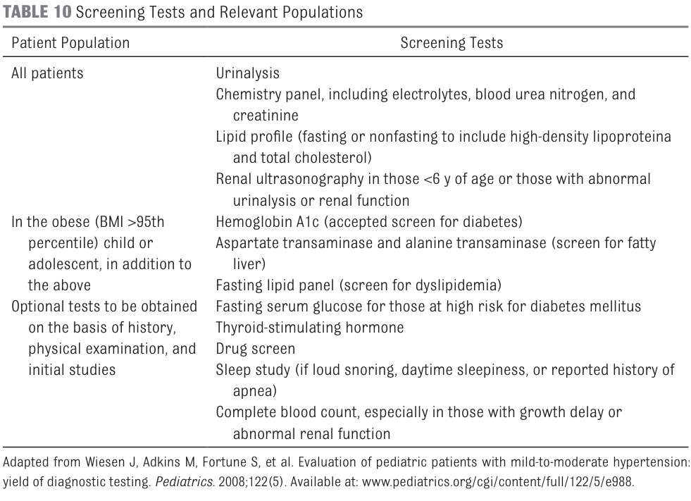
AAP Recommended Labs for Stage 2 HTN

Slide 31
AAP Key Action Statement: Imaging
Doppler renal ultrasonography may be used as a noninvasive screening study for the evaluation of possible RAS in normal wt children and adolescents ≥8 y of age who are suspected of having renovascular HTN and who will cooperate with the procedure.

Slide 32
AAP Key Action Statements
In hypertensive children and adolescents who have failed lifestyle modifications (particularly those who have LV hypertrophy on echocardiography, symptomatic HTN, or stage 2 HTN without a clearly modifiable factor [eg, obesity]),
clinicians should initiate pharmacologic treatment with an ACE inhibitor, ARB, long-acting calcium channel blocker, or thiazide diuretic.
I do not think this patient should wait for a lifestyle modification trial.

Slide 33
A Quick Note on Meds
ACEi and ARB effectively alter blood flow in the kidney.
There is a genuine risk of worsening kidney function if using an ACEi/ARB in the context of RAS.
If the presence of RAS is a real possibility, recommend using Calcium Channel Blockers empirically.

Slide 34
Case 1
Okay, labs are ordered, U/S ordered.
Again, consider reaching out to pediatric nephrology for guidance.
Management:
This is most likely Acute post-infectious Nephritis.
HTN is due to increased activity of Renin-Angiotnesin-Aldosterone system.
Recommended treatment is Calcium Channel Blockers.
Due to increased risk of AKI, ACEi/ARB not first line for post-infectious GN.
Diuretics may also be a treatment option.

Slide 35
AAP Key Action Statement
In children and adolescents diagnosed with HTN, the treatment goal with nonpharmacologic and pharmacologic therapy should be a reduction in SBP and DBP to <90% and <130/80 if over 13 yrs.
For our patient, her 90% for a 7 year old female is 109/70.

Slide 36
Case 1
So, Amlodipine started at 2.5 mg daily. ( 0.1 mg/kg).
Encourage family to limit salt intake to around 1200-1500 mg daily.
Generous creatinine at 0.8, which yields an estimated GFR of 64.5 ml/min/1.73m2.
Rest of RFP acceptable.
C3 is low at 20 and C 4 is normal.
US: increased echogenicity with preserved corticomedullary differentiation.
Follow up for BP check in 2-3 days.
BP resolved after 3 weeks, labs normalized at 8 weeks.

Slide 37
Case 1
BP 3 days after clinic visit 111/68.
Repeat check again 3 days later was 104/64.
Amlodipine weaned off at just over 3 weeks from intiation.
At 8 week follow up to monitor BP and Complement levels, pts mother asks if her ADHD meds could have contributed to her HTN when she first presented.
BP 102/64
Compelement levels returned to normal.
What about stimulants?

Slide 38
Stimulant Medications
Growing body of evidence shows that stimulant medications:
Significantly raise heart rate up to 12 bpm.
Increase SBP by 3-4 mmHg.
Increase DBP by 2-4 mmHg.
These increases are statistically significant, not sure about clinical significance.
Increases in BP and heart rate resolved with med discontinuation.
Potential Cardiovascular risk should be balanced against the beneficial effects of this class of medication.
CNS Drugs 31, 199–215 (2017)
Pediatr Nephrol 21,92-95 (2006)

Slide 39
Case 2
5-month-old former 27-week premature infant.
12 week NICU stay complicated by BPD with prolonged intubation, HTN noted at 6 weeks of age, UTI at 9 weeks of age with E. coli.
No UAC as far as mom can recall. Confirmed on EHR review.
Echocardiogram at time of Dx of HTN was normal except for minimal tricuspid regurgitation.
Following UTI, pt had US which showed right hydropnephrosis and normal left kidney.
Subsequent VCUG after urology consult showed high grade bilateral reflux.

Slide 40
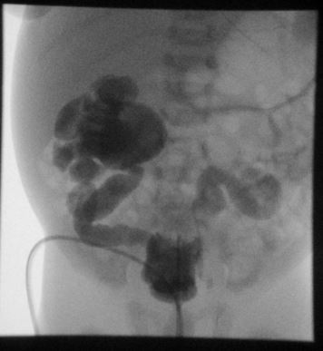
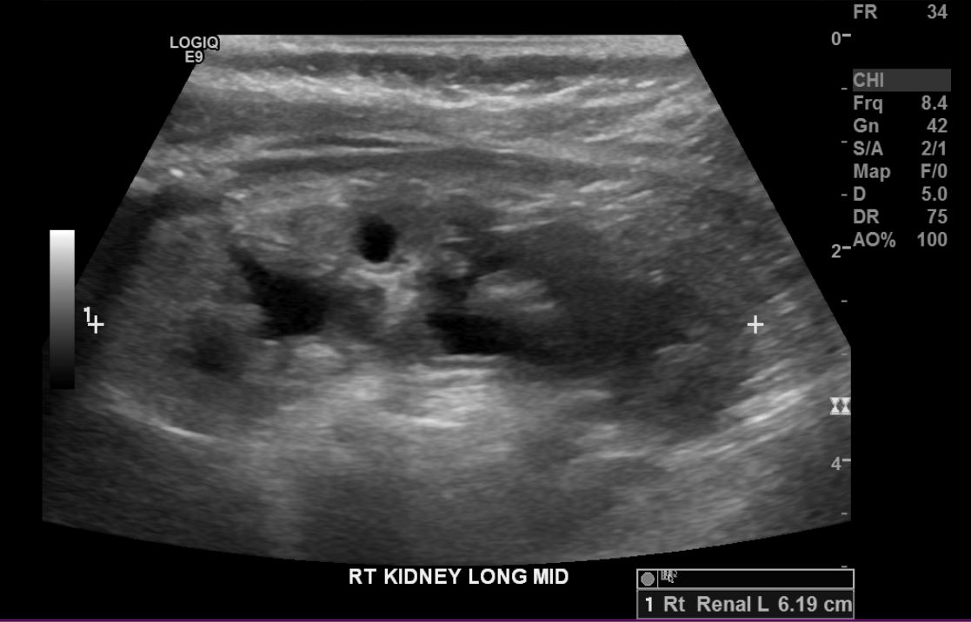
Case 2 - Imaging

Slide 41
Case 2
Pt presents to clinic.
He is on Amlodipine 1 mg BID – Started after nephrology consult in NICU.
BP in clinic 102/60. Proper size Infant cuff used.
Now what?
How do we know if BP is in goal range for this age group?
Based on presence of reflux, pt now meets criteria for diagnosis of CKD.

Slide 42
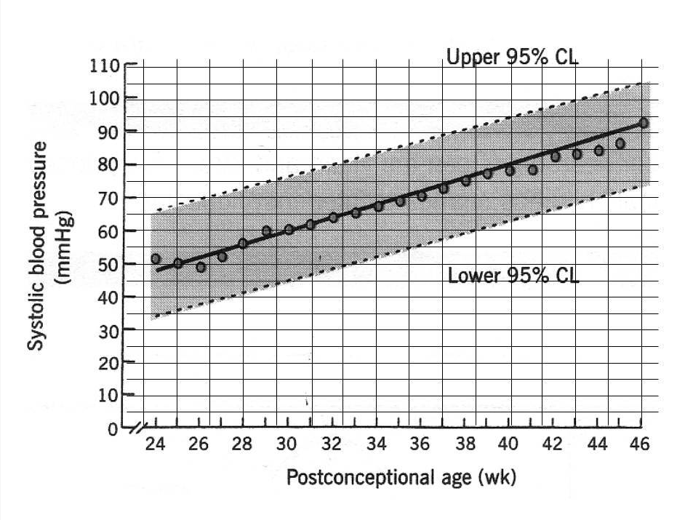
Neonate and Infant BP Charts
For neonates between 26-44 weeks post conceptual age, the graph below is recommended.
Curr Hypertens Rep. 2013;15(5):426–432

Slide 43
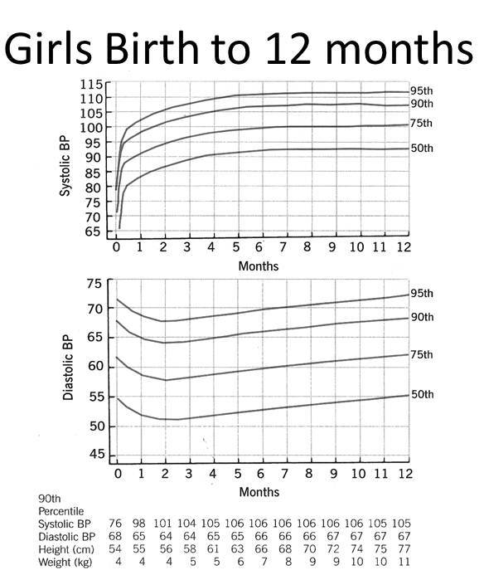
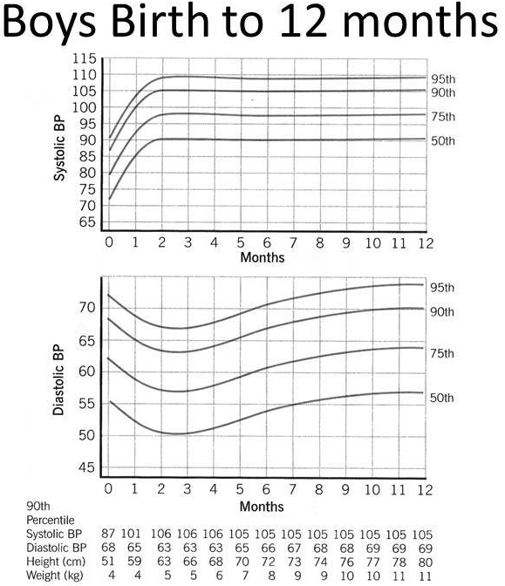
Neonate and Infant BP Charts
For infants 1-12 months, the graphs are separated based on gender.
Pediatrics. 1987;79(1):1–25

Slide 44
Case 2
BP in clinic 102/60. This is in goal range.
Plan to monitor BP every 3-6 months for the first year and then can space out visits.
Continue Amlodipine for the time being.
Monitor for recurrent UTI.
Due to the presence of Vesicoureteral reflux and hydronephrosis, this patient does meet diagnostic criteria for chronic kidney disease (CKD).
This is a patient that would need to be followed in nephrology clinic over time.

Slide 45
Case 3
15 y/o male referred for elevated BPs noted over last 4-5 years.
Pt currently in care of grandparents.
Outside records BP’s ranging 128-138/72-78, trend is higher BP over last 1-2 years.
So pt has been progressing from elevated BP to Stage 1 HTN.
Luckily, our nurses flagged the referral, so we were able to order labs, imaging and Ambulatory Blood Pressure Monitor ahead of time.

Slide 46
Case 3
PMH:
Pt on treatment for anxiety, followed by child psychiatrist.
No surgeries or hosp.
Social:
Lives with maternal grandparents and younger brother.
Parents unable to be more involved at this time.
Does not engage in much physical activity.
FH:
PGF with MI at 35 years old, now 45 and on dialysis.
Father and a paternal uncle with diabetes.
Maternal grandparents both with diabetes and HTN.
Multiple family members with obesity.

Slide 47
Review of Systems for HTN
Headache.
Blurry vision.
Epistaxis.
Nausea/vomiting.
Poor feeding.
Flushing.
Cough.
Ringing/Buzzing in ears.
Diaphoresis.
Snoring/SDB/OSAS
Abdominal pain.
Shortness of breath.
Heart palpitations/irregular rhythms.
Slurred speech.
Confusion.
Fatigue.
Anxiety.
Seizures.
Muscle tremors.

Slide 48
Case 3
PE:
BP 138/74 in office initially in R arm.
4 point BP with 136/72 in left arm.
150/90 in right leg, 148/92 in left leg.
Leg BP should BE 10-20% higher than upper extremity.
BMI 34: Meets criteria for Obesity.
Acanthosis noted around base of neck and in antecubital fossae bilaterally.
US with Doppler before clinic was normal.
RFP, CBC and UA were normal.
Thyroid studies and HgbA1c both normal from a few months ago.

Slide 49
AAP Key Action Statement
Children and adolescents ≥6 y of age do not require an extensive evaluation for secondary causes of HTN if they have a positive family history of HTN, are overweight or obese, and/or do not have history or physical examination findings (‍Table 14) suggestive of a secondary cause of HTN.
No CTA/MRA, renin, aldo, metanephrines, catecholamines.

Slide 50
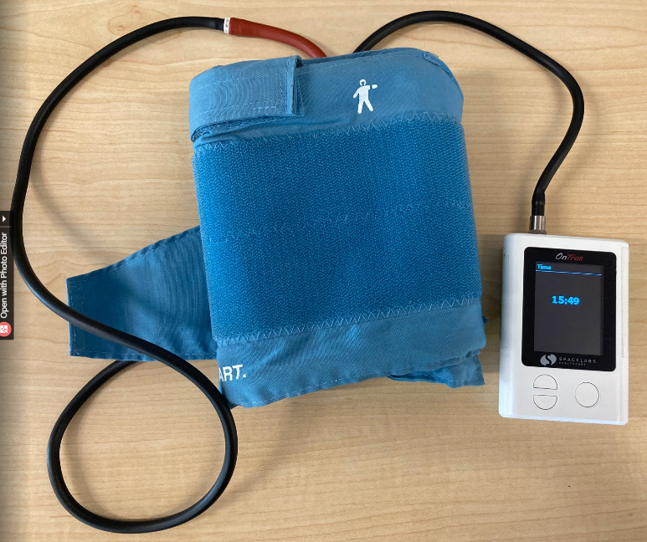
Ambulatory BP Monitor
Ambulatory BP Monitor is an automated device that measures BP every 30 minutes for 24 hours.
This is a service provided through pediatric nephrology clinic.
Allows measurement of BP outside medical setting.
Gold Standard for evaluation of white coat HTN.
Measurement of nocturnal dipping, which is diminished in individuals with obesity.
About $5000 a piece.

Slide 51
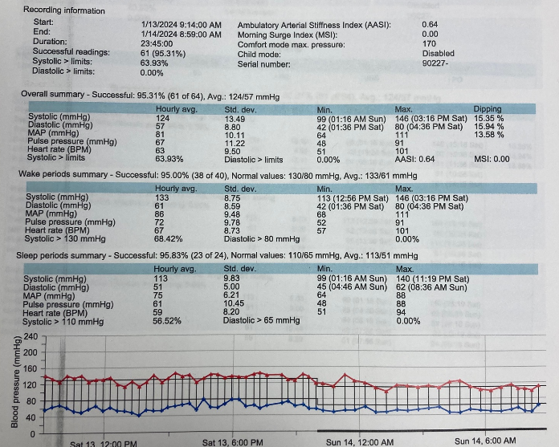
Case 3
Ambulatory BP Monitor Test
Meets criteria for STAGE 1 HTN
on both day and night readings.

Slide 52
ABPM: AAP Key Action Statements
Confirmation of HTN in children and adolescents with office BP measurements in the elevated BP category for 1 year or more or with stage 1 HTN over 3 clinic visits.
Children and adolescents with high-risk conditions to assess HTN severity and determine if abnormal circadian BP patterns are present, which may indicate increased risk for target organ damage.
Suspected WCH should undergo ABPM. Diagnosis is based on the presence of mean SBP and DBP <95% on ABPM.
Monitor treatment effectiveness in children and adolescents with HTN, especially when clinic and/or home BP measurements indicate insufficient BP response to treatment.

Slide 53
AAP Key Action Statement: Home BP Monitoring
Home BP monitoring should not be used to diagnose HTN, or WCH but may be a useful adjunct to office and ambulatory BP measurement after HTN has been diagnosed.

Slide 54
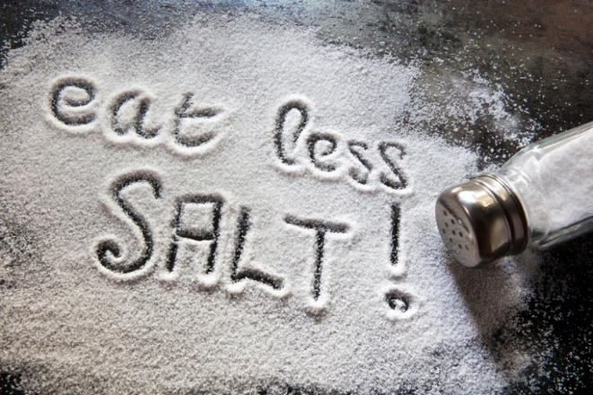
Case 3
Counselled DASH Diet.
Encouraged more physical activity.
Reduce screen time.
Follow up in 6 months.

Slide 55
AAP Key Action Statement: Diet
At the time of diagnosis of elevated BP or HTN in a child or adolescent, clinicians should provide advice on:
DASH diet
Moderate to vigorous physical activity at least 3 to 5 d per week (30–60 min per session) to help reduce BP.
DASH (Dietary Approaches to Stop Hypertension)
Salt Restriction-1200-2000 mg/day
High intake of fruits, vegetables, low fat or nonfat dairy, whole grains, lean meats, fish and poultry; nuts and beans.
Small amounts of red meats, saturated fats, sweets, and sugar-containing beverages.
http://www.kidney.org/professionals/kdoqi/guidelines_bp/guide_6.htm

Slide 56
Case 3 – 6 months later
Weight has increased 3 kg.
BP in clinic 136/76.
Initiation of pharmacologic therapy indicated.
According to AAP KAS:
In hypertensive children and adolescents who have failed lifestyle modifications (particularly those who have LV hypertrophy on echocardiography, symptomatic HTN, or stage 2 HTN without a clearly modifiable factor [eg, obesity]), clinicians should initiate pharmacologic treatment with an ACE inhibitor, ARB, long-acting calcium channel blocker, or thiazide diuretic.
Pt started on ARB.
BP at 3 month follow up 116/70.
Echocardiogram ordered at time of ARB initiation.

Slide 57
AAP Key Action Statement: Echo
It is recommended that echocardiography be performed to assess for cardiac target organ damage (LV mass, geometry, and function) at the time of consideration of pharmacologic treatment of HTN.
I order echo on all patients started on antihypertensive medications.

Slide 58
Obesity and HTN
Obesity and Hypertension are linked.
These health problems do track into adulthood.
Rates of HTN increase in a graded fashion with increasing adiposity.‍
Bogalusa Heart Study:
Overweight children were 4.5 times and 2.4 times as likely to have elevated SBP and DBP, respectively.
Possibility related to:
Sympathetic overactivity.
Insulin resistance.
Altered vascular structure.
Increased salt sensitivity.

Slide 59
Obesity-BMI and HTN in Children
As BMI increases, so does HTN.
Hypertension 2002, 40:441-447

Slide 60
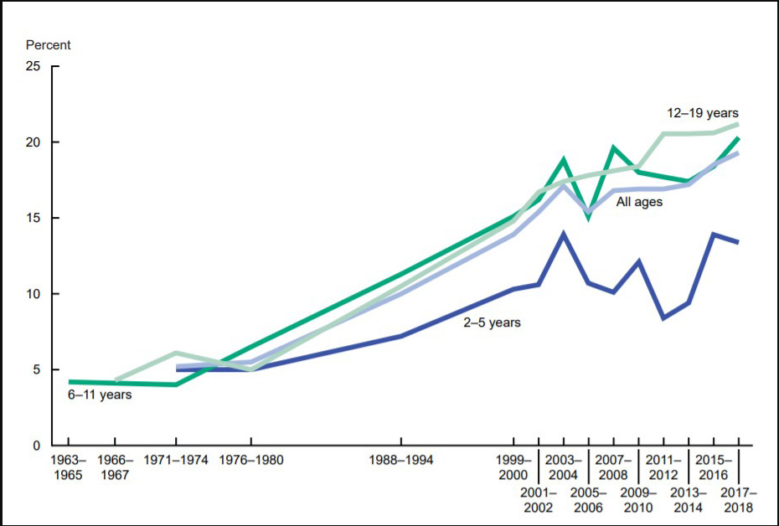
Pediatric Obesity: 1963-2018
2001: Xbox
1994: Playstation
9/13/1985:
Nintendo
released
1971: Legislation signed allowing
use of high fructose corn syrup
in lieu of cane sugar. (Nixon)
1976: High Fructose corn syrup
enters food chain nationally.
https://www.niddk.nih.gov/health-information/health-statistics/overweight-obesity

Slide 61
Case 4
11 y/o found to have BP 170/110 during ER visit for blow to chest playing football.
BP stayed ~170/110 during ER visit. Pt without other complaints.
Referred to cardiology. 3 days later, appropriately started Amlodipine and obtained echocardiogram showing significant LVH with Z score above 3. (That’s bad).
CMP, UA completely normal after cardiology office. Referred to Nephrology clinic for further evaluation.
In Nephrology clinic, has only had 2 doses amlodipine, but BP better at 150/96.
Once again, our nurses flagged this referral, so we were able to get imaging ahead of clinic visit.

Slide 62
Case 4
ROS positive for weekly nosebleeds for the last few weeks.
Histories unremarkable
Term birth, no complications.
FH Negative for HTN, Kidney disease, CVD
Physically active with football and weight lifting.
Generally eats healthy diet, mostly homecooked foods. He will eat school lunch a few times a week.
Circumcision only procedure.
Lives with parents and 2 older siblings, all healthy.

Slide 63
Case 4
PE:
BMI 17.3 (45%)
Manual BP 158/108 right arm
L arm 154/112, R leg 172/120
Remainder of PE notable for bruit just above the umbilicus.
Renal US obtained before clinic demonstrated:
IMPRESSION: Abnormal appearance of both the mid aorta as well as the proximal portions of the renal arteries. Elevated velocities and dampened waveforms suggest renal artery narrowing bilaterally, probably with aortic narrowing as well. Suggest CTA for further evaluation.

Slide 64
AAP Key Action Statement
In children and adolescents suspected of having RAS, either CTA or MRA may be performed as noninvasive imaging studies. Nuclear renography is less useful in pediatrics and should generally be avoided.
We did just that.

Slide 65
Case 4

Slide 66
Case 4
Pt referred to pediatric rheumatology and diagnosed with Mid-aortic syndrome secondary to Takayasu Arteritis.
Despite having significant renal artery stenosis, pt did not have elevated Aldosterone levels or plasma renin activity.
Did not have hypokalemia or alkalosis.
C3, C4, ANCA, anti-dsDNA, ANA all negative.
Very challenging BP management, pt ended up on max doses of Losartan, Amlodipine and Labetalol for BP control.
Pt ended up undergoing surgery at Mid-aortic clinic at Boston Childrens.

Slide 67
Case 4
After a few months, pt wanted to return to sports and weightlifting.
I tend to be more permissive favoring physical activity.
Plus, BP was 122/78.

Slide 68
AAP Key Action Statement
Children and adolescents with HTN may participate in competitive sports once hypertensive target organ effects and cardiovascular risk have been assessed.
Children and adolescents with HTN should receive treatment to lower BP below stage 2 thresholds before participation in competitive sports.
I Include weightlifting in this recommendation.

Slide 69
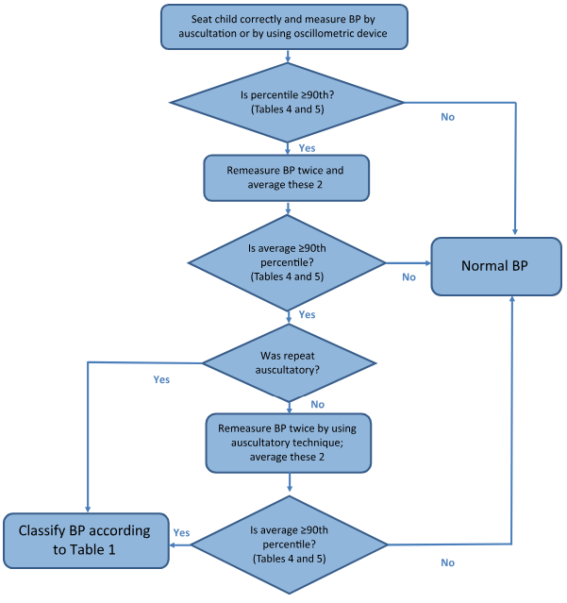
Summary: AAP BP Measurement Algorithm

Slide 70
Summary
BP check at least yearly, at each visit with certain risks.
If you have a patient with HTN, check for kidney disease and vice-versa
If BP normal, check yearly
If BP is elevated, recheck in 6 months.
If still elevated in 6 months:
Check upper and lower ext BP.
Counsel lifestyle modifications.
Repeat BP in 6 months again
If still elevated recommend referral for ABPM and lab evaluation.

Slide 71
Summary
If Stage 1 HTN:
Counsel life style changes
Repeat Bp in 2 weeks.
If still elevated in 2 weeks:
Again counsel lifestyle changes
Check upper and lower extremity BP.
Repeat BP in 3 months:
If Still stage 1, refer for further evaluation
ABPM
Labs, Imaging
Initiation of therapy if indicated.

Slide 72
Summary
If Stage 2 HTN:
Counsel lifestyle changes.
Check upper and lower BP.
Refer to specialty care within 7 days.
Just call our team.
Initiate eval with:
Labs, Imaging, ABPM
Initiation of treatment in conjunction with evaluation.

Slide 73
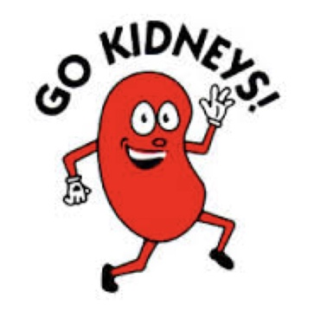
Summary
If at any point in the process of evaluating or treating hypertension, please feel free to reach out to the pediatric nephrology group.
PCH PAL LINE: 801-662-1662
Nephrology Office: 801-213-3599
Fax: 801-213-7699
Thank you.

