Slide 1
Mitigating Malpractice Risks

Slide 2
Presenter
Heather Meyer MBA, BSN, RN, C-LNC, CHSP, CPHRM

Slide 3
Disclaimers
This presentation has no ineligible company content, promotes no ineligible company, and is not supported financially by any ineligible company. I received no financial remuneration from any ineligible company related to this presentation.
Any information provided by Curi in this presentation is the property of Curi and protected by copyright. If you download, record, and/or otherwise utilize the information in this presentation, you agree not to display, distribute, license, publish, reproduce, duplicate, copy, create derivative works from, modify, sell, resell, transfer, or upload for any commercial purposes, all or any portion of these materials for any purpose unless explicitly authorized by Curi.

Slide 4
Learning objectives
Understand the top drivers of physician practice claim drivers
Understand the current legal factors that impact medical malpractice outcomes
Understand the Utah CANDOR Act and potential impact on medical malpractice

Slide 5
Top drivers of physician practice claim drivers

Slide 6
Top claim drivers
Diagnostic errors
OB
Communication

Slide 7
Diagnostic
Surgical
#1 in cost
#2 in occurrence
Diagnostic
OB
Jury Selection
Testimony
Verdict

Slide 8
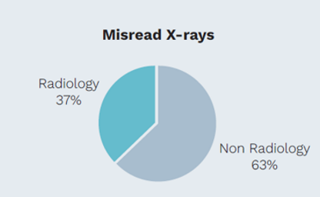
DIAGNOSTIC
Initial Diagnostic Assessment
Tests and Results Processing
69%
23%

Slide 9
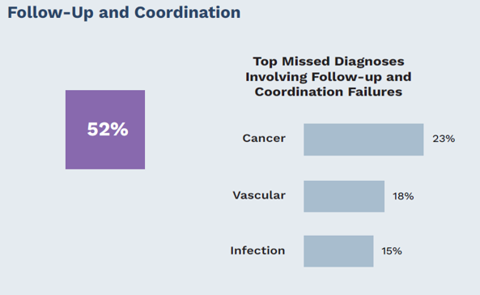
Follow-up and coordination failures
DIAGNOSTIC

Slide 10
Medical treatment
#2 in costs
#1 in occurrence

Slide 11
Top contributing factors
MEDICAL TREATMENT

Slide 12
Medication Rx
#3 in costs
#4 in occurrence
Notes:
.

Slide 13
Top contributing factors
MEDICATION Rx

Slide 14
Surgical
Surgical
#4 in costs
#3 in occurrence

Slide 15
Top contributing factors
SURGICAL

Slide 16
Legal factors that impact medical malpractice outcomes

Slide 17
The four elements of malpractice
Duty of care
Standard of care
Causation
Damages
Medical negligence

Slide 18
What plaintiff attorneys look for
Procedures performed, tests ordered, medications ordered and given, specific treatments performed.
Evidence of patients’ overall condition, response to treatment and follow up care ordered and performed
Lapses in or omissions of care; or the appearance thereof
Inconsistencies/
discrepancies.

Slide 19
Claims Analysis Factors
Medicine
Venue
Demographics
Physicians and plaintiffs as witnesses
Medical records/audit trail
Laws in the state
Plaintiff attorney v. Defense attorney
Judge (pro-plaintiff v. Pro-defense)
Damages/sympathy

Slide 20
The legal process
Pleadings
Discovery
Legal Process
Discovery
Early Disposition
Resolution
Trial

Slide 21
Physicians who are at risk for lawsuits
Display insensitivity to patient concerns
Fail to identify and meet patient needs/wants
Refuse to recognize their limits/skills
Display an authoritarian and/or inflexible attitude
Criticize others

Slide 22
Issues Medical Malpractice Industry is Facing
Changing juror sentiment
Aberrant verdicts nationwide
Higher settlement expectations
Pressure from physicians/personal counsel to resolve cases

Slide 23
Trends Nationwide
Well-funded plaintiff law firms
Social inflation
Reptile theory tactics/safety standards
Conspiracy theory/use of audit trails
Inflated damages/life care plans
Publicity of large verdicts; scarce publicity of defense verdicts

Slide 24
How to Combat Plaintiff Tactics
Careful selection of defense counsel
United defense – no finger-pointing amongst defendants
Physicians stay committed to defending their care
Provide resources to defense counsel
Challenge excessive life care plans
Expert testimony

Slide 25
It's not all bad...
On average 90% of lawsuits brought forward receive a defense verdict
Large verdicts remain an aberration
Industry wide 5-7% cases tried
Of those tried, the defense wins on average 80-85% of the time

Slide 26
Utah Candor Act:
Impact on medical malpractice

Slide 27
Utah Medical Candor Act- Main provisions
Process must be initiated by the healthcare provider
Written notice must be sent to the patient within 365 days of incident
Notice must inform the patient about their rights
If payments are made without a written complaint or demand for payment, no report to NPDB
The patient can still report their concerns to the licensing board and or file suit
Patient can terminate participation in the Candor process
The patient does not have to sign a release of liability
All information provided in/for the CANDOR proceedings are confidential

Slide 28
Closing thoughts
Notes:
•

