Slide 1
Federal Health Quality Measurement - Where We’ve Been and Where We’re Going
Ogden Surgical - Medical Society
May 15, 2024
Ron Kline, MD
Chief Medical Officer
Quality Measurement and Value Based Incentives Group
Center for Clinical Standards and Quality
Centers for Medicare & Medicaid Services

Slide 2
Speaker Conflict of Interest Statement
Speaker name, credentials, workplace and title
Speaker Name has no relevant financial relationships with ineligible companies to disclose.
Ron Kline, MD
Chief Medical Officer, Quality Measurement & Value-Based Incentives Group – Centers for Medicare & Medicaid Services
Dr. Kline has no relevant financial relationships with ineligible companies to disclose.

Slide 3
Centers for Medicare and Medicaid Services (CMS)
Center for Clinical Standards and Quality (CCSQ)
Center for Medicare (CM)
Center for Medicaid and CHIP Services (CMCS)
Center for Program Integrity (CPI)
Center for Medicare and Medicaid Innovation (CMMI)
Center for Consumer Information and Insurance Oversight (CCIIO)

Slide 4

“Turning an Aircraft Carrier”

Slide 5


Why does CMS Measure Quality?
Every successful organization measures the quality and safety of its products or services to remain successful
Retail enterprises measure the quality of the products they purchase from manufacturers to ensure customer satisfaction
Customers comment on the quality of the products and services they purchase
Healthcare is no different
CMS is a payer of healthcare services
Americans are consumers of healthcare services

Slide 6
Why Does CMS Measure Quality? (2)
Can’t improve what you can’t measure
A method to understand performance
Key part of ongoing continuous quality improvement and PDSA
Linkage to payment programs
Consumer Awareness and Action – spurs provider improvement
Current CMS Portfolio
  Approximately 500 measures in active use
    Not the only measures used in most organizations
  Over 2000 in CMS Measures Inventory
  Moving toward more digital, outcome and PROM

Slide 7
How do we measure quality?
Structural Measures – the attributes of settings in which care is provided. This includes material and human resources and organizational structure.
Process Measures – what is actually done in providing and receiving care. It includes both patient and provider activities in making a diagnosis and recommending or implementing treatment.
Outcome Measures – the effects of care on the health status of patients and populations. Improvements in patient behavior and satisfaction with care are included in the definition of health status.
From Donabedian (JAMA, 1986)

Slide 8

What Makes a Good Measure
High Impact
Meaningful to patients and providers
Supports Scientific Evidence and Best Practice
No Unintended Consequences
Valid and Reliable
Feasible (easy to collect data)
Appropriate Risk Adjustment
Availability of Standardized Data Elements
Low Burden
Outcome/Patient reported outcome preferred over Process
CMS and National Quality Forum publications
Many steps in the process for new measure development. Average time from concept to use in value-based program is about 5 years at a cost of approximately $500K-$1M

Slide 9

CMS National Quality Strategy
Mission
To achieve optimal health and well-being for all individuals.
Vision
CMS, a trusted partner, is shaping a resilient, high-value American health care system that delivers high-quality, safe, and equitable care for all.
CMS National Quality Strategy serves as our framework for quality measurement

Slide 10

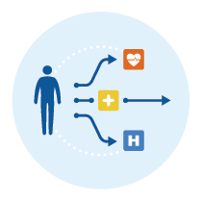


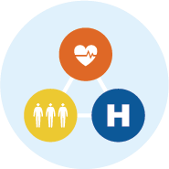




CMS National Quality Strategy Goals
Equity
Advance health equity and whole-person care
Outcomes
Improve quality and health outcomes across the care journey
Equity, Person-Centered Care, and Engagement
Improving Quality, Outcomes, and Alignment
Engagement
Engage individuals and communities to become partners in their care ​
Alignment
Align and coordinate across programs and care settings
Safety
Achieve zero preventable harm
Interoperability
Accelerate and support the transition to a digital and ​data-driven health care system​
Safety and Resiliency
Interoperability, Scientific Advancement, and Technology
Resiliency
Enable a responsive and resilient health care system to improve quality
Scientific Advancement
Transform health care using
science, analytics, and technology

Slide 11

CMS Quality Levers
Payment Policy
Conditions of Participation
Survey and Certification
Quality Improvement Organization Network
Coverage Analysis Group
Clinician Engagement Group
Quality Measures
Value Based Programs (payment and public reporting)
Extensive Stakeholder Engagement

Slide 12
CMS Quality Incentives Programs
Hospital | Clinician and Other | Post Acute Care and Other
Hospital Inpatient Quality Reporting | MIPS – Merit Based Incentive Program | Expanded SNF VBP*
Hospital Readmissions Reduction | MSSP/ACO MIPS | Hospice Quality Reporting
Hospital Value Based Purchasing | CMMI/APN and Model Programs | Home Care Quality Reporting
Hospital Acquired Conditions | Support Act – eRx of Opioids* | Inpatient Rehabilitation Facility
Hospital Promoting Interoperability | Hospital Stars (plus other Stars) | Long Term Care Hospital
Cancer Exempt Hospital | ESRD Quality Improvement | Medicaid Adult Core Set
Inpatient Psychiatric Hospital | Rural Emergency Hospital* | Medicaid Child Core Set
Hospital Outpatient | Home Health VBP (model)* | Marketplace Quality Reporting
Ambulatory Surgery Program | SNF Quality Reporting/NH Stars | Medicare C&D Stars Rating
Red font connotes pay for PERFORMANCE; others are pay for REPORTING *new program

Slide 13
CMS Care Compare Programs (Stars Programs)
Clinician Ratings
Home Health Star Ratings
Home Health CAHPS Star Ratings
Hospice CAHPS Star Ratings
Dialysis Star Ratings (Quality and Patient Survey [CAHPS])
Hospital Star Ratings (Overall and Patient Survey [CAHPS])
Nursing Home Star Ratings (Overall, Health Inspection, Staffing, and Quality)

Slide 14
Are there too many measures or too few?
24 specialties represented in the American Board of Medical Specialties
21 distinct internal medicine sub-specialty boards under the American Board of Internal Medicine
15 distinct pediatric subspecialties under the American Board of Pediatrics
5 distinct subspecialties under the American Board of Surgery
Plus 27 separate quality incentive programs
  481 active measures in the CMS Measures Inventory Tool and 65 specialties ➔7.4 measures per specialty

Slide 15
Measure Development and Implementation
Measure Submission
January—May 2024:
Developers submit measures through the Measure Submissions for CMS Consideration Entry/ Review Information Tool (MERIT)
June—November 2024:
Review of the Measure Submissions for CMS Consideration List by CMS, HHS, and OMB
PRMR
Rulemaking
Implementation
December 2024—January 2025:
Process to seek broad, represent-ative input on the Measure Submissions List with recommend-ations posted February 1
2025:
Notices of Proposed Rulemaking (NPRM) publish
Final Rules Publish
Collection may begin as early as 2026 with reporting 1-2 years after collection
MUC List Development

Slide 16
2023 Measure Submission List Overview
The 42 measures on the 2023 Measure Submission List include
  18 outcome measures (including intermediate and Patient-Reported Outcome-based Performance Measure [PRO-PM]),
  12 process measures,
  4 structural measures, and
  8 cost/resource use measures.
CMS highlights the following about the 2023 Measure Submission List:
  95% of the measures are digitally sourced, advancing the CMS National Quality Strategy goal of prioritizing the development of interoperable and digital quality measures.
  43% of measures are outcome focused, promoting the CMS National Quality Strategy priority of alignment and improved health outcomes across the care journey.

Slide 17
2024 MERIT List Overview
(note – this information does not necessarily reflect the Measure Submissions list to be published in December)
Percentage of Digital Measures:
100% (57 of 57) of all measures submitted had at least one of the digital data sources selected.
75% (43 of 57) of all measures submitted had solely digital data sources
25% (14 of 57) of all measures submitted had non-digital data sources along with digital data sources.
Percentage by Measure Type:
Measure Type | Number of Measure Types by Measure Submissions | Number of Measure Types by PSV
Cost/Resource Use | 3 | 3
Efficiency | 0 | 0
Intermediate Outcome | 5 | 7
Outcome | 14 | 19
PRO-PM or Patient Experience of Care | 13 | 13
Process | 21 | 27
Structure | 1 | 3

Slide 18
2024 MERIT List Overview
(note – this information does not necessarily reflect the Measure Submissions list to be published in December)
Program | Number of PSVs
ASCQR | 1*
ESRD QIP | 1
HH QRP | 5
HQRP | 0
HACRP | 2
HIQR | 11
HOQR | 6
HRRP | 6
HVBP | 3
IPF QRP | 0
IRF QRP | 0
LTCH QRP | 0
Medicare Promoting Interoperability Program | 2
MSSP | 1
MIPS-Cost | 3
MIPS-Quality | 20
Part C | 4
Part D | 0
PCHQR | 3
REHQR | 4
SNF QRP | 0
SNF VBP | 0
Submissions:
Number of Measure Submissions: 57
Number of Program-Specific Versions (PSV): 72

Slide 19
Where We’ve Been:
Early Measurement Efforts
  Early quality metrics were process based and chart abstracted with a high clinician burden
Medicare Access and CHIP Reauthorization Act of 2015
  Implemented in 2017
  Advanced APMs with 5% payment bonus
  Merit-based Incentive Payment Program (MIPS) for practices unable or unwilling to participate in an Advanced APM. Data collection began in 2017 with first payment adjustments in 2019.
  MIPS Value Pathways (MVP) – desire to make quality measurement more relevant to specialist clinicians. Created through the CY 2020 rule making cycle, with policies established in the CY 2021 rule making cycle. Delayed because of the PHE. First year of data collection is in 2023.
  Subgroup reporting is voluntary in 2023 and mandatory beginning in 2026

Slide 20
What We’ve Learned:
The Effects of COVID on Patient Safety in the US Healthcare System
NEJM, 2022

Slide 21

Lessons from COVID Influence Safety Strategy
Expansion of digital and telehealth capabilities
Rapid Scientific Advances
Expanded Collaboration
Stark Equity Gap
Nursing Home care issues
Need for interoperable data
Frailty of safety systems
Resilience challenges - including workforce
Struggling healthcare systems

Slide 22
MIPS Value Pathways (MVPs) - 2023
Adopting Best Practices and Promoting Patient Safety and Emergency Medicine MVP
Advancing Cancer Care MVP
Advancing Care for Heart Disease MVP
Advancing Rheumatology Patient Care MVP
Coordinating Stroke Care to Promote Prevention and Cultivate Positive Outcomes MVP
Improving Care for Lower Extremity Joint Repair MVP
Optimal Care for Kidney Health MVP
Optimal Care for Patient with Episodic Neurological Conditions MVP
9. Patient Safety and Support of Positive Experiences with Anesthesia MVP
10. Supportive Care for Neurodegenerative Conditions MVP
11. Value in Primary Care MVP

Slide 23
MIPS Value Pathways (MVPs) – New for 2024
12. Focusing on Women’s Health
13. Quality Care for the Treatment of Ear, Nose, and Throat Disorders
14. Prevention and Treatment of Infectious Disorders Including Hepatitis C and HIV
15. Quality Care in Mental Health and Substance Use Disorders
16. Rehabilitative Support for Musculoskeletal Care

Slide 24
Candidate MVPs for 2025
Dermatological Care
Comprehensive Ocular Care
Gastroenterology Care
Pulmonology Care
Optimal Care for Patients with Urologic Conditions
Surgical Care

Slide 25
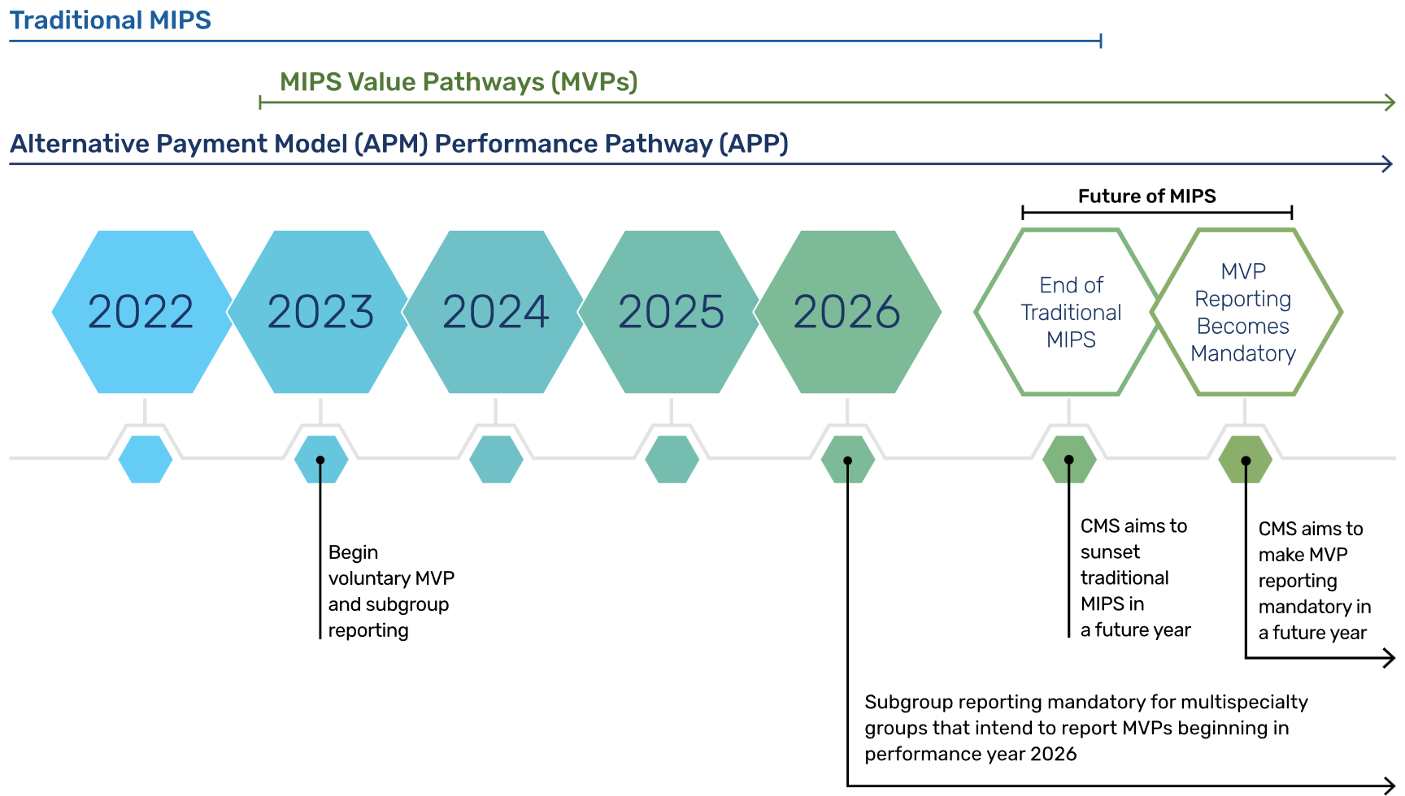
MVPs are the eventual replacement for “traditional” MIPS

Slide 26
Where We’re going: CMS Initiatives for 2024/25
Digital Transformation
Patient Safety
Maternal Health
Behavioral Health
Patient – Centered Care
Health Equity / Social Drivers of Health

Slide 27
Healthcare IT Transformation
Many other industries have been radically transformed by IT
Healthcare still toward beginning of journey
HITECH and Meaningful Use – Promoting Interoperability
TEFCA (Trusted Exchange Framework and Common Agreement)
FHIR (Fast Healthcare Interoperability Resources)
Information Blocking
Digital Transformation of Quality Measures

Slide 28
Digital Transformation
An important element of the CMS National Quality Strategy
A path towards decreasing provider burden in quality measurement
Challenges
  Agreeing on common metrics and data elements
  Broad FHIR implementation requires IT infrastructure investment across the health care continuum
  Modification of existing measurements into digital form
  Goals
  FHIR expansion
  Implementation of USCDI (US Core Data for Interoperability)
  USCDI+ build out to create interoperable data elements for measurement for multiple medical indications (e.g., Public Health, Maternal Health, Quality, Cancer, Behavioral Health,

Slide 29
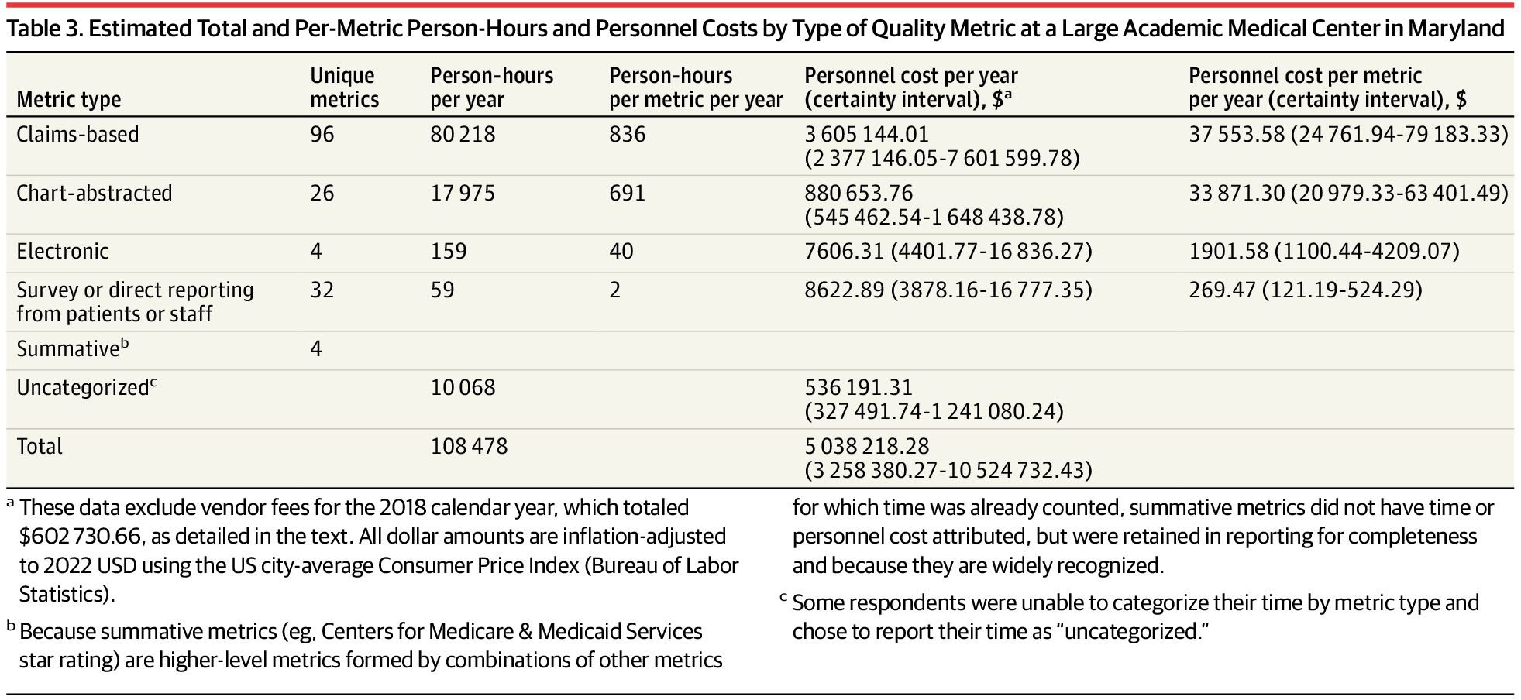
Electronic Quality Measures minimize administrative burden (and cost)
JAMA. 2023;329(21):1840-1847. doi:10.1001/jama.2023.7271

Slide 30
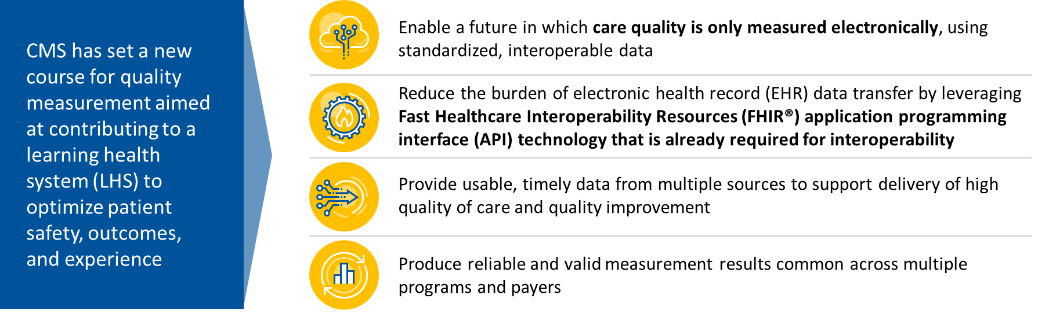
Digital Quality Measurement

Slide 31
Patient Safety
25% of Medicare beneficiaries experienced harm (e.g., adverse events and temporary harm events) during an acute care hospitalization in 2018. 43% were deemed to have been preventable (medication errors, pressure ulcers, infection)
      HHS OIG Report, 2022
Patient Safety is a Biden – Harris Administration priority – PCAST Report
CMS – AHRQ – CDC – FDA have organized a series of webinars on patient safety with recommendations and future action to follow in 2024
CMS is focusing on patient safety as an important domain in quality measurement – Patient Safety Structural Measure in HIQR Program

Slide 32

Patient Safety is an Administration Priority

Slide 33
Proposed New Measure: Patient Safety Structural Measure (IPPS FY25)
Attestation Domain | Intent
Domain 1: Leadership Commitment to Eliminating Preventable Harm | Senior leadership and governing board must be accountable for patient safety outcomes and ensure that patient safety is the highest priority for the hospital. The governing board must oversee safety activities and hold organizational leadership accountable for outcomes.
Domain 2: Strategic Planning & Organizational Policy | Hospitals must use strategic planning and organizational policies to demonstrate safety as a core value. Continual process improvement with the goal of zero preventable harm.
Domain 3: Culture of Safety & Learning Health Systems | Hospitals must integrate a suite of evidence-based practices and protocols that are fundamental to cultivating a hospital culture that prioritizes safety and establishes a learning system both within and across hospitals.
Domain 4: Accountability & Transparency | There must exist a culture that promotes event reporting without fear or hesitation and promotes safety data collection and analysis with the free flow of information.
Domain 5: Patient & Family Engagement | Hospitals must engage patients, families, and caregivers as co-producers of safety and health through meaningful involvement in safety activities, quality improvement, and oversight.

Slide 34
Maternal Health
Between 1999 and 2019, maternal mortality ratios increased from 12.7 deaths per 100K live births to 32.2
Among “wealthy nations”, the US has the highest rate of maternal mortality, which is defined as death during pregnancy or up to a year afterwards.
Common causes include bleeding, infection, heart disease, suicide and drug overdose
JAMA, 2023
Birthing Friendly Designation launched in November 2023 with the Care Compare refresh
25 health plans will use the birthing friendly designation on their websites
Cesarean Section (ePC-02) and Severe Obstetrical Complication Rates (ePC-07) are part of hospital eCQM’s that hospitals can choose from for 2023
For 2024, hospitals must report both rates

Slide 35
Behavioral Health
Identified a core set of 18 behavioral health measures for reporting by state Medicaid and CHIP agencies
Finalized policies to strengthen network adequacy requirements and reaffirm MA organization responsibilities to provide behavioral health services
Finalized policies to expand access to Medicare beneficiaries receiving treatment for Opioid Use Disorder at Opioid Treatment Programs
Enhanced funding for mobile crisis services

Slide 36
Behavioral Health (2)
Created a new benefit category in the CY 2024 OPPS and ASC rules for intensive outpatient program services (more than individual outpatient visits and less than hospitalization)
Soliciting input and comments on Behavioral Health and Suicide Prevention as a measurement topic in the Hospital OQR program
Proposal in the Inpatient Psychiatric Facility rule to adopt the Psychiatric Inpatient Experience survey to measure patient experience in IPFs
Behavioral Health Coordinating Council - cross HHS effort (e.g., AHRQ, ASPE, CDC, CMS, HRSA, NIH, ONC, SAMHSA,) to integrate behavioral health across programs and care settings.

Slide 37
Patient Centered Care – PROMs/PREMs
Extensive research has identified gaps in a clinician and a patient’s perception of care
This can affect the quality of the health care being provided
Patient reported outcomes (PROs) have the potential to address these communication gaps
PROs can track patient’s perceptions (and progress) both longitudinally and compared to other patient populations.
CHALLENGES
  All of us feel “surveyed to death” so clinicians must communicate the clinical importance of PROs to patients
  Will require investment in IT infrastructure
  Meaningful PRO measures must be created and vetted, and IT systems must be developed that allow seamless export to other systems (e.g., CMS)

Slide 38
Equity
Health equity means the attainment of the highest level of health for all people, where everyone has a fair and just opportunity to attain their optimal health regardless of race, ethnicity, disability, sexual orientation, gender identify, socioeconomic status, geography, preferred language, or other factors that affect access to care and health outcomes.
CMS is working to advance health equity by designing, implementing, and operationalizing policies and programs that support health for all the people served by our programs, eliminating avoidable differences in health outcomes experienced by people who are disadvantaged or underserved, and providing the care and support that our enrollees need to thrive.

Slide 39

Equality vs. Equity

Slide 40
Health Equity / Social Drivers of Health
Extensive data shows differences in health outcome based on race/ethnicity, geographic area, and socioeconomic status
Collection of Social Drivers of Health required for acute care hospitals as well as reporting of screen positive rate (food, housing, transportation, utilities) – voluntary in FY 25, mandatory in FY 26
Acknowledgement of the importance of SDoH in health outcomes represents a PARADIGM SHIFT in the medical profession

Slide 41
IPPS Rule for FY 2024
Rewarding Excellent Care for Underserved Populations (REUP)
  Adjustment in the scoring methodology for the Hospital Value-Based Purchasing (VBP) Program that rewards hospitals that serve higher proportions of dual-eligible patients for providing excellent care. The newly finalized scoring methodology allows the opportunity for hospitals to earn up to ten bonus points depending on their performance on existing quality measures and the proportion of dually eligible patients they treat
Increased Medicare DRG payments for beneficiaries experiencing homelessness
  A policy to recognize the higher costs that hospitals incur when treating people experiencing homelessness when hospitals report social determinants of health codes on claims, meaning that hospitals will generally receive higher payments when a patient is experiencing homelessness
3. Sepsis (SEP-1) Measure moves to Hospital VBP
Outcome measure anticipated to be submitted to the measure evaluation process in 2024

Slide 42
FY 2025 - Overview of Hospital IQR Program Proposed Changes
Adoption of seven new measures
Removal of five claims-based measures
Refinement of two current measures
Reporting and submission requirements for electronic clinical quality measures (eCQMs)

Slide 43
Adoption of Seven New Measures
Measure ID | Measure Name | Reporting Period/ Payment Determination
Patient Safety | Patient Safety Structural Measure | Calendar Year (CY) 2025/ FY 2027
Age Friendly Hospital | Age Friendly Hospital | CY 2025/FY 2027
CAUTI-Onc | Catheter-Associated Urinary Tract Infection (CAUTI) Standardized Infection Ratio Stratified for Oncology Locations | CY 2026/FY 2028
CLABSI-Onc | Central Line-Associated Bloodstream Infection (CLABSI) Standardized Infection Ratio Stratified for Oncology Locations | CY 2026/FY 2028
HH-FI | Hospital Harm – Falls with Injury (eCQM) | CY 2026/FY 2028
HH-RF | Hospital Harm – Postoperative Respiratory Failure (eCQM) | CY 2026/FY 2028
FTR | Thirty-day Risk-Standardized Death Rate Among Surgical Inpatients with Complications (Failure-to-Rescue) | July 1, 2023 – June 30, 2025/FY 2027

Slide 44
Proposal: Progressive Increase in the Number of Mandatory eCQMs
Reporting Period/ Payment Determination | Total # of eCQMs Reported | eCQMs Required to Be Reported
CY 2024/FY 2026 and CY 2025/FY 2027 | Six | Three self-selected eCQMs; and Safe Use of Opioids - Concurrent Prescribing eCQM; and Cesarean Birth eCQM; and Severe Obstetric Complications eCQM
Proposed: CY 2026/FY 2028 | Nine | Three self-selected eCQMs; and Safe Use of Opioids - Concurrent Prescribing eCQM; and Cesarean Birth eCQM; and Severe Obstetric Complications eCQM; and Hospital Harm - Severe Hyperglycemia eCQM; and Hospital Harm - Severe Hypoglycemia eCQM; and Hospital Harm - Opioid-Related Adverse Events eCQM
Proposed: CY 2027/FY 2029 (and for subsequent years) | Eleven | Three self-selected eCQMs; and Safe Use of Opioids - Concurrent Prescribing eCQM; and Cesarean Birth eCQM; and Severe Obstetric Complications eCQM; and Hospital Harm - Severe Hyperglycemia eCQM; and Hospital Harm - Severe Hypoglycemia eCQM; and Hospital Harm - Opioid-Related Adverse Events eCQM; and Hospital Harm - Pressure Injury eCQM; and Hospital Harm - Acute Kidney Injury eCQM

Slide 45

The Universal Foundation: Adult Measures
Domain | Measure Identification Number and Name
Wellness and prevention | 139: Colorectal cancer screening 93: Breast cancer screening 26: Adult immunization status
Chronic conditions | 167: Controlling high blood pressure 204: Hemoglobin A1c poor control (>9%)
Behavioral health | 672: Screening for depression and follow-up plan 394: Initiation and engagement of substance use disorder treatment
Seamless care coordination | 561 or 44: Plan all-cause readmissions or all-cause hospital readmissions
Person-centered care | 158 (varies by program): Consumer Assessment of Healthcare Providers and Systems overall rating measures (CAHPS)
Equity | Identification number undetermined: Screening for social drivers of health
Domains are from Meaningful Measures 2.0
Names and identification numbers are from the CMS Measures Inventory Tool

Slide 46

The Universal Foundation: Pediatric Measures
Domain | Measure Identification Number and Name
Wellness and prevention | 761 and 123: Well-child visits (well-child visits in the first 30 months of life; child and adolescent well-care visits) 124 and 363: Immunization (childhood immunization status; immunizations for adolescents) 760: Weight assessment and counseling for nutrition and physical activity for children and adolescents 897: Oral evaluation, dental services
Chronic conditions | 80: Asthma medication ratio (reflects appropriate medication management of asthma)
Behavioral health | 672: Screening for depression and follow-up plan 268: Follow-up after hospitalization for mental illness 264: Follow-up after emergency department visit for substance use 743: Use of first-line psychosocial care for children and adolescents on antipsychotics 271: Follow-up care for children prescribed attention deficit-hyperactivity disorder medicine
Person-centered care | 158 (varies by program): Consumer Assessment of Healthcare Providers and Systems overall rating measures (CAHPS)
Domains are from Meaningful Measures 2.0
Names and identification numbers are from the CMS Measures Inventory Tool

Slide 47
Summary
CMS’ goal is to achieve a health care system where high-quality care is provided to our beneficiaries.
These elements include equity, patient-centered care, patient safety and the avoidance of preventable complications.
Important clinical areas where less than desirable quality is present include maternal and behavioral health. These are CMS areas of focus.
Clinicians must view the provision of health care more broadly and become knowledgeable about the social and environmental factors that affect health. There are many community service organizations that can work with clinicians and health care systems to address these needs once they are identified.
The end goal is to integrate quality measurement into clinician workflow so that the provision of high-quality care is identified through digital measures and claims without clinician administrative burden.

