Slide 1
Sexual Assault
Is Your Practice Prepared?
Jeanlee F. Carver, MS, APRN, ANP-BC, CPNP, SANE A, SANE P
CEO/Clinical Director, Northern Utah Sexual Assault Forensic Examiners

Slide 2
Financial Disclosure
I have disclosed to OSMS all relevant financial relationships with ineligible companies, and I will disclose this information to learners verbally. I will also disclose on the first slide of my slide deck whether I have financial relationships or even if I do not.
Example: “This presentation has no ineligible company content, promotes no ineligible company, and is not supported financially by any ineligible company. I receive no financial remuneration from any ineligible company related to this presentation.”

Slide 3
What Exactly Is Sexual Assault?
Defined as any form of forced or coerced sexual contact without consent, including (but not limited to) rape, incest, molestation, oral sex, harassment, lewdness, forcing a person to take sexual pictures or unwanted touching.
Rape is a specific form of sexual assault and is defined in Utah as sexual intercourse without the victim’s consent.
Rape is the only violent crime for which Utah’s rate is higher than the national average.
This is not a new phenomenon; it has been the case for the past 25 years!

Slide 4
Do We, As Health Care Providers, Really Need To Be Concerned?
Sexual Assault Statistics Encompass
Both Child Sexual Abuse (under the age of 18 years) and Rape of Adolescents/Adults (18 years and older).
The FBI’s Uniform Crime Reporting (UCR) database with rates of rape at 55.5 per 100,000 people.
The national average is 42.6 per 100,000 people and Utah is ranked 9th out of the 50 states for number of rapes per capita. Susan R. Madsen, Linked In Dec 14, 2023
Nearly one in two women in the U.S. will experience some form of sexual violence victimization in her life and Utah has the same overall rate.

Slide 5
Unfortunately-
Many victims of sexual assault and violence in Utah are children.
These children are most likely to be victimized by a family member.
Females are more likely to report than males.
The CDC reports one in four women is sexually abused before the age of 18.
In Utah nearly 13% of the population reports being molested before the age of 18 with 78% reporting this occurred before their 18th birthday and 35% stated they were sexually molested before age 10.

Slide 6
More specifically…
One in three Utah women has been sexually assaulted, and one in six women report having been raped.
Every 68 seconds, an American is sexually assaulted. And every 9 minutes, that victim is a child.
Rape often goes unreported. In Utah, only about 12% of women report sexual assault to law enforcement and only about 12.7% ever seek medical care.
False reporting is RARE. Between 2-10% are found to be untrue.
Most sexual assaults, 80-90%, are committed by male perpetrators who the female victims knows.
Rape by a stranger is very unusual and weapons are rarely used, however physical injury occurs ~ 27% of the time.

Slide 7
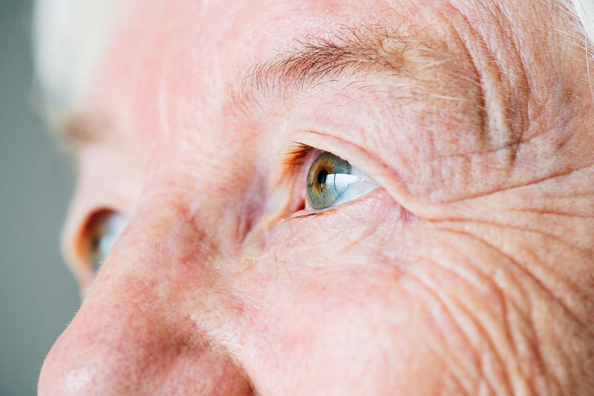
The rate of sexual assault among the elderly is much lower than young women between 18-34years of age.
Only about 30% of people over the age of 65 report sexual abuse. About 83% of older victims reside in an institutional care centers.
Homeless teens and adults are at higher risk of sexual assault.
Women in racial or ethnic minority groups experience a higher burden of sexual violence
People with disabilities are at high risk for sexual assault.
About 27% the sexual assault occurred in the elder’s own home and 80% of the time, the perpetrator was the caregiver.

Slide 8
MYTHS
Sexual assault is an act of lust and passion that can’t be controlled.
If a victim of sexual assault does not fight back, they must have thought the
assault was not that bad or they “wanted it”.
A lot of victims lie about being raped or give false reports.
A person cannot sexually assault their partner or spouse.
When a girl says “no”, she really means yes.
Rape is usually violent and involves a stranger.
If you hadn’t been drinking, you wouldn’t have been raped.
Men can’t be sexually assaulted.
Being sexually assaulted by someone of the same gender can make a person gay
or lesbian.
People with disabilities are at low risk for sexual assault.
A victim has to talk to the police if she wants to receive care or a
sexual assault kit.

Slide 9
Your Practice
And so, if you have a practice of 2000 patients, and 2/3 (1,333) of those patients are women, that means that approximately 440 of them have been a victim of sexual assault within their lives.
Should you be aware of the long-term sequelae of sexual assault, which are similar to other traumatic events?
Are you prepared to ask the questions and appropriately respond to the answers?
Also keep in mind that it is not unusual for a child victim of sexual abuse to also be sexually victimized as an adult.
Will you take the time? Do you have the time?

Slide 10
Short- & Long-Term Effects of Sexual Assault
SHORT TERM EFFECTS | LONG TERM EFFECTS
Unplanned pregnancy | Depression, anxiety, hypervigilance, agoraphobia
Sexual transmitted infections, including HIV exposure | Chronic abdominal pain, headache, body aches
Traumatic physical injuries | Chronic insomnia, fatigue, dizziness
Assaultive bodily injuries including strangulation | GI disturbances, sexual dysfunction, dissociation
Guilt, shame, self-blame | Self harm, eating disorders, panic attacks
Flash backs, isolation, withdrawal. | Substance abuse, emotional disorders, suicide

Slide 11
Should Health Effects of Sexual Assault Be Added to our Differentials?
When you understand the long-term effects of sexual abuse/assault, some of those difficult to understand complaints may make more sense.
Finding the root cause or pathology to explain your patient’s chronic complaints may be a result of past sexual trauma
If nothing more than a consideration, history of sexual assault should be explored.

Slide 12
Patient Care If your patient informs you that they have been sexually victimized. “Thank you for telling me. This information will help me make better decisions regarding your healthcare”
No one wants to divulge that they have been a victim of sexual abuse or rape.
Really, no one wants to acknowledge that it happens at all.
Whether these events took place 40 years ago, or 2 weeks ago, disclosure requires courage and the feeling of being in a “safe space”.
Every time a patient discusses these events, it puts them right back in the experience.

Slide 13
Our Responsibilities i.e. “So, now what?”
LISTEN - ACKNOWLEDGE
Assess time frame of assault/abuse and if anal/genital penetration occurred.
Contact your local sexual assault nursing team if within 6 days of assault.
Provide support, assure your patient that all forensic care is provided free of charge.
If the assault was over 6 days prior –
Consider STI and pregnancy testing.
GC, CT, Syphilis, Trichomoniases, HIV
Refer to local rape crisis center for follow-up care
Group therapy, state resources for victims of crime, counseling
Consider this reason for continued/chronic complaints health issues.

Slide 14
The Reporting Laws in Utah
All citizens within the State are mandated to report any crime against a child (under the age of 18 years) or a vulnerable adult.
1
Intellectually challenged, physically challenged, mentally ill, homeless, etc.
All health care provides are mandated to report any suspected crime against a citizen of Utah. Statute 26-23a-1.
2
Law enforcement, Adult Protective Services, Division of Child & Family Services
3
Statute 53E-6-102, 53E-6-701, 80=-1-102, 82-2-601 through 610, 76-3-204, 76-3-301.

Slide 15
What Will the Forensic Nursing Team Do?
Report to law enforcement if not previously done.
Advocacy center involvement.
General medical history.
Detailed history of the event.
Full physical assessment including detailed anal/genital examination.
Diagrams and photography of any and all traumatic injuries.
Evidence collection including toxicology, if appropriate.
STI and pregnancy prophylaxis.
Detailed documentation.
Collaboration with investigation/prosecution.
Referral for follow-up care with PCP.
Follow-up forensic care.

Slide 16
What Resources Are Available To You?
Contact the sexual assault team in your community
Northern Utah Sexual Assault Forensic Examiners (NUSAFE)
Weber, Morgan, Davis, Box Elder counties
Wasatch Forensic Nurses
Salt Lake, Utah, Wasatch, Summit counties
Cache County SANE
Southwest Forensic Nurses
Washington, Iron counties

Slide 17
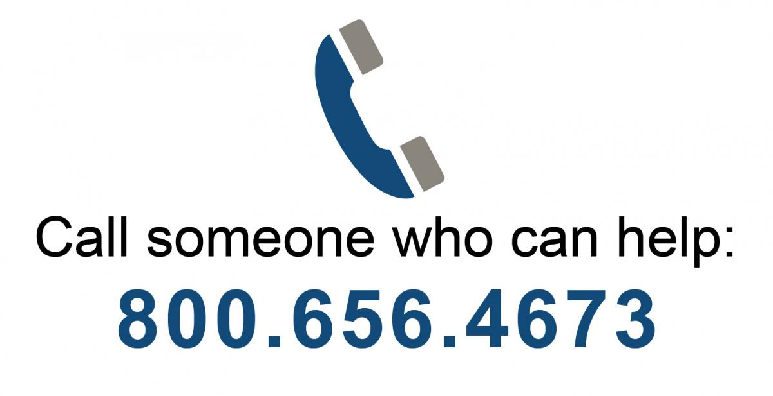
National Sexual Assault Hotline: Confidential 24/7 Support

Slide 18
IN CONCLUSION
5 things we all should know:
Sexual assault can happen to anyone.
Consent is an ongoing mutual agreement.
Sexual assault may include a wide range of experiences.
Sexual assault can be prevented.
Support is available.

Slide 19
REFERENCES
Mental Illness as a Vulnerability for Sexual Assault: A Retrospective Study of 7,455 Sexual Assault Forensic Medical Examinations Miles, Leslie DNP, PMHNP-BC; Valentine, Julie L. PhD, RN, CNE, SANE-A, FAAN; Mabey, Linda DNP, PMHCNS-BC; Downing, Nancy R. PhD, RN, SANE-A, SANE-P, FAAN
Trauma- and Violence-Informed Empowering Care for Sexual Assault Survivors, Klein, L. B.; Melnik, Jessica; Curran, Kimberly; More Journal of Forensic Nursing. : March 21, 2024
The Right to Say No: Why Adult Sexual Assault Patients Decline Medical Forensic Exams and Sexual Assault Kit Evidence Collection. Campbell, Rebecca; Javorka, McKenzie; Gregory, Katie; More Journal of Forensic Nursing. 17(1):3-13, January/March 2021.
The psychological impact of rape victims Campbell R. (2008).. The American psychologist, 63(8), 702–717. https://doi.org/10.1037/0003-066X.63.8.702.
An ecological model of the impact of sexual assault on women's mental health Campbell, R., Dworkin, E., & Cabral, G. (2009).. Trauma, violence & abuse, 10(3), 225–246. https://doi.org/10.1177/1524838009334456.
Stress Reaction Chu, B., Marwaha, K., Sanvictores, T., & Ayers, D. (2020). Physiology,. In Stat Pearls. StatPearls Publishing.
Posttraumatic stress disorder (PTSD) and depression severity in sexually assaulted women: hypothalamic-pituitary-adrenal (HPA) axis alterations. D'Elia, A., Juruena, M. F., Coimbra, B. M., Mello, M. F., & Mello, A. F. (2021). BMC psychiatry, 21(1), 174. https://doi.org/10.1186/s12888-021-03170-w.
Sexual assault victimization and psychopathology: A review and meta-analysis Dworkin, E. R., Menon, S. V., Bystrynski, J., & Allen, N. E. (2017).. Clinical psychology review, 56, 65–81 https://doi.org/10.1016/j.cpr.2017.06.002.
Health Indicator Report of Sexual Violence IBIS-PH. (2021, January 8).. https://ibis.health.utah.gov/ibisph-view/indicator/view/Rape.Adu.html.
Statistics about Sexual Violence National Sexual Violence Resource Center. Retrieved on Sept. 11, 2021. https://www.nsvrc.org/sites/default/files/publications_nsvrc_factsheet_mediapacket_statistics-about-sexual-violence_0.pdf.
Five things everyone should know about sexual assault, Health & Wellness, University of Colorado Boulder

