Slide 1
One CommonSpirit

Slide 2
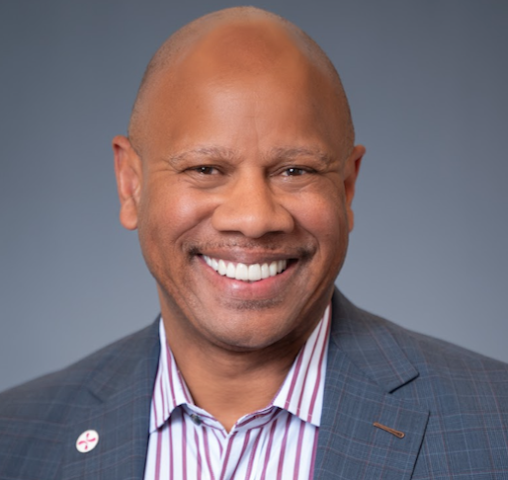
Wright Lassiter III, MHA Chief Executive Officer
“Humankindness is at the heart of our ministry and a powerful reminder
that we all hold the power to heal. At the center of humankindness
are our people who play a vital role in helping fulfill our promise
to lead and transform health care to meet the evolving needs
of our communities and patients.”
Wright Lassiter III, Chief Executive Officer

Slide 3
Our Mission
2,200+
care sites in 24 states coast to coast
35,000 physicians and advanced practice providers across a system of hospitals and clinics
As CommonSpirit Health, we make the healing presence of God known in our world by improving the health of the people we serve, especially those who are vulnerable, while we advance social justice for all.

Slide 4
Our Vision
2,200+
care sites in 24 states coast to coast
35,000 physicians and advanced practice providers across a system of hospitals and clinics
A healthier future for all – inspired by faith, driven by innovation and powered by our humanity.

Slide 5
Our Values
2,200+
care sites in 24 states coast to coast
35,000 physicians and advanced practice providers across a system of hospitals and clinics
Compassion
Inclusion
Integrity
Excellence
Collaboration

Slide 6
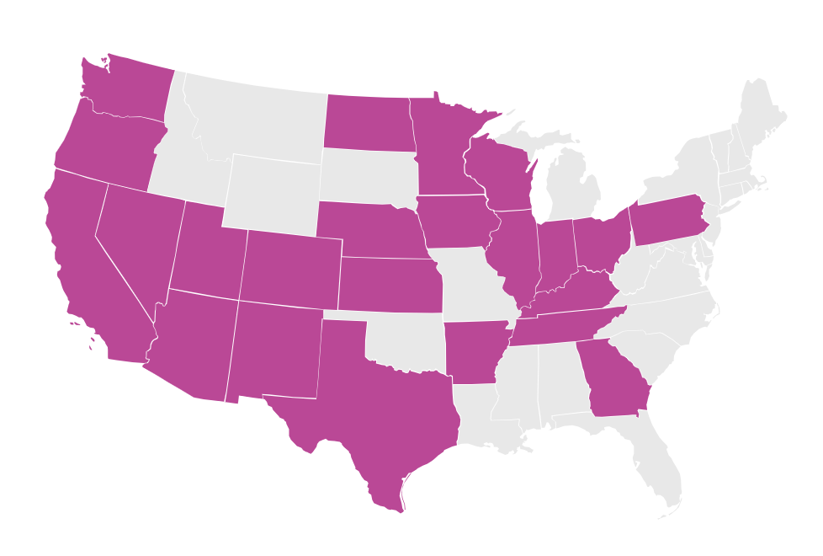
Building healthy communities together
2,200+
care sites in 24 states coast to coast
35,000 physicians and advanced practice providers across a system of hospitals and clinics
Weaving better health on our communities is at the heart of everything we do. It’s how we help more people and places prosper. And it’s all inspired by faith, driven by innovation, and powered by humanity.

Slide 7
Supporting Careers in Nursing
New Graduate Nurse Residency Program: 12-month program provides rotations through key clinical areas, after which nurses are “matched” with one of their three top selections.
RN Clinical Ladder program: Promote clinical excellence and quality outcomes and creates a stimulating practice environment that provides opportunities to attract and retain expert RNs.
Chief Nursing Officer Accelerator program: Program brings CNOs together for professional development. All CNOs team up to complete a high-impact ministry-wide project.
Nursing Focus On Action sessions: Focus groups open that create dialogue around nursing’s highest priorities and allow time to learn more about tangible action nursing leadership can take.
Nursing Professional Shared Governance: Multidisciplinary team tackles proposed process, policy or informatics changes that have an impact on nursing practice and clinical care.

Slide 8
Humankindness makes the world a better place.
2,200+
care sites in 24 states coast to coast
35,000 physicians and advanced practice providers across a system of hospitals and clinics

Slide 9
Health justice starts with humankindness
2,200+
care sites in 24 states coast to coast
35,000 physicians and advanced practice providers across a system of hospitals and clinics
Good health is a human right.
Yet there are vast inequities in health access, quality, and education that disproportionately burden our nation. CommonSpirit® is addressing these systemic challenges on many fronts. But we know that the most powerful catalyst for change is actually found within each of us—in our shared humanity, kindness, and capacity to care.

Slide 10
Everyone has a stake in this.
2,200+
care sites in 24 states coast to coast
35,000 physicians and advanced practice providers across a system of hospitals and clinics
Inequities in our public health system are felt directly and disproportionately in systematically excluded communities. But their suffering indirectly affects us all through billions of dollars in excess medical care costs and lost productivity. There is another kind of cost as well—the cost to our nation’s conscience, its empathetic nature, and its ideals of fairness.

Slide 11
What is health justice?
Everyone should have the opportunity to be healthier. As simple as that sounds, there is formidable complexity behind it. Achieving health justice will require a nationwide commitment to addressing poverty, domestic violence, food scarcity, climate change, drug addiction, childhood education, health policy, and more in meaningful ways.

Slide 12
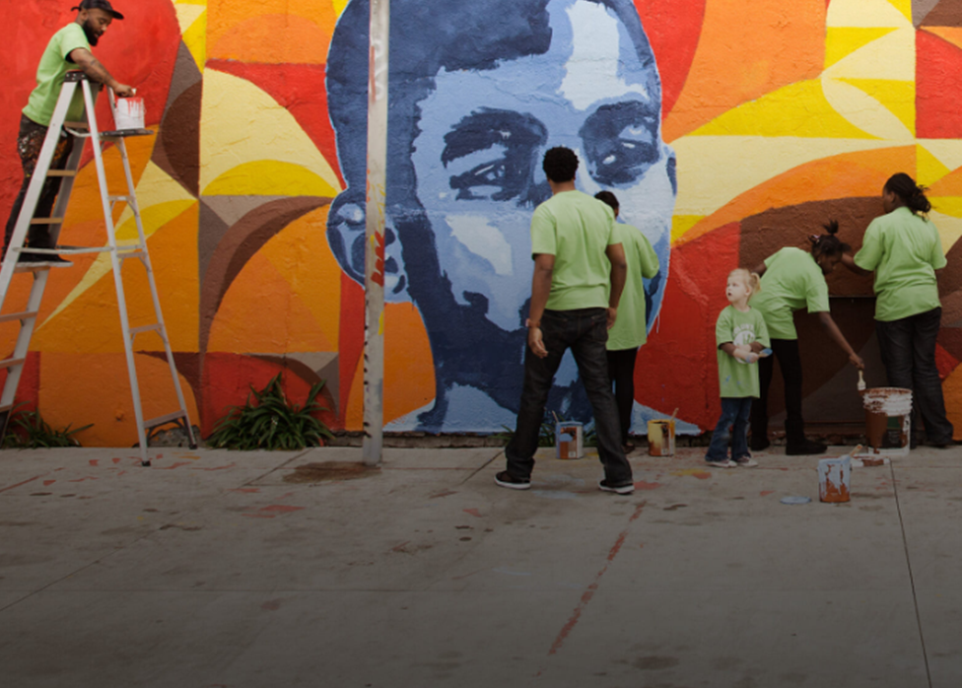
What is CommonSpirit doing?
As one of the nation’s leading health systems, CommonSpirit invests tens of millions of dollars toward finding solutions to these challenges. We are also expanding access to care in underserved communities, supporting a wide range of community health programs, and working with policymakers to advance health justice on a national scale. There is much more work to be done, though, and CommonSpirit is committed to this for the long run.

Slide 13
$5 million in grants were awarded to Utah community-based organizations in 2023.
Grants focus on food security, mental health, and advancing social justice and health equity.
Grants begin at $50,000 and are awarded to support work that:
Serves underserved communities
Focuses on community capacity-building
Leverages collaboration to increase social impact
Grants are awarded yearly throughout the CommonSpirit Health communities.
Health Equity & Advancement Fund​

Slide 14
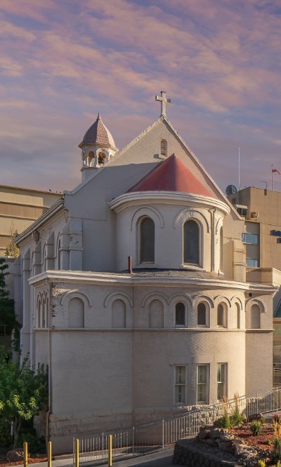
CommonSpirit
Holy Cross Hospitals
Holy Cross Hospital – Davis in Layton​
Holy Cross Hospital – Jordan Valley in West Jordan​
Holy Cross Hospital – Jordan Valley West in West Valley ​
Holy Cross Hospital – Mountain Point in Lehi​
Holy Cross Hospital – Salt Lake in Salt Lake City​

