Slide 1
CommonSpirit Health
Holy Cross Hospital Davis

Slide 2
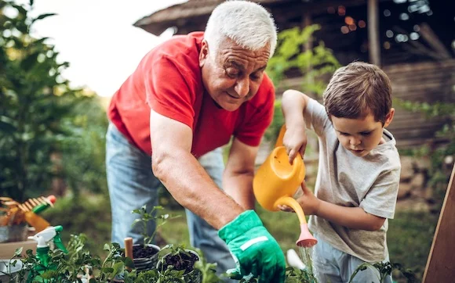
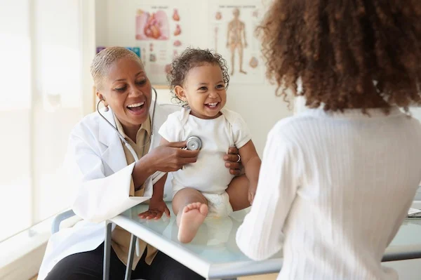

Building healthy communities together.
Weaving better health in our communities is at the heart of everything we do. It’s how we help more people and places prosper. And it’s all inspired by faith, driven by innovation, and powered by humanity.

Slide 3
Our Mission
2,200+
care sites in 24 states coast to coast
35,000 physicians and advanced practice providers across a system of hospitals and clinics
As CommonSpirit Health, we make the healing presence of God known in our world by improving the health of the people we serve, especially those who are vulnerable, while we advance social justice for all.

Slide 4
Our Vision
2,200+
care sites in 24 states coast to coast
35,000 physicians and advanced practice providers across a system of hospitals and clinics
A healthier future for all – inspired by faith, driven by innovation and powered by our humanity.

Slide 5

Our Values
2,200+
care sites in 24 states coast to coast
35,000 physicians and advanced practice providers across a system of hospitals and clinics
Compassion
        Inclusion
              Integrity
                Excellence
                Collaboration

Slide 6
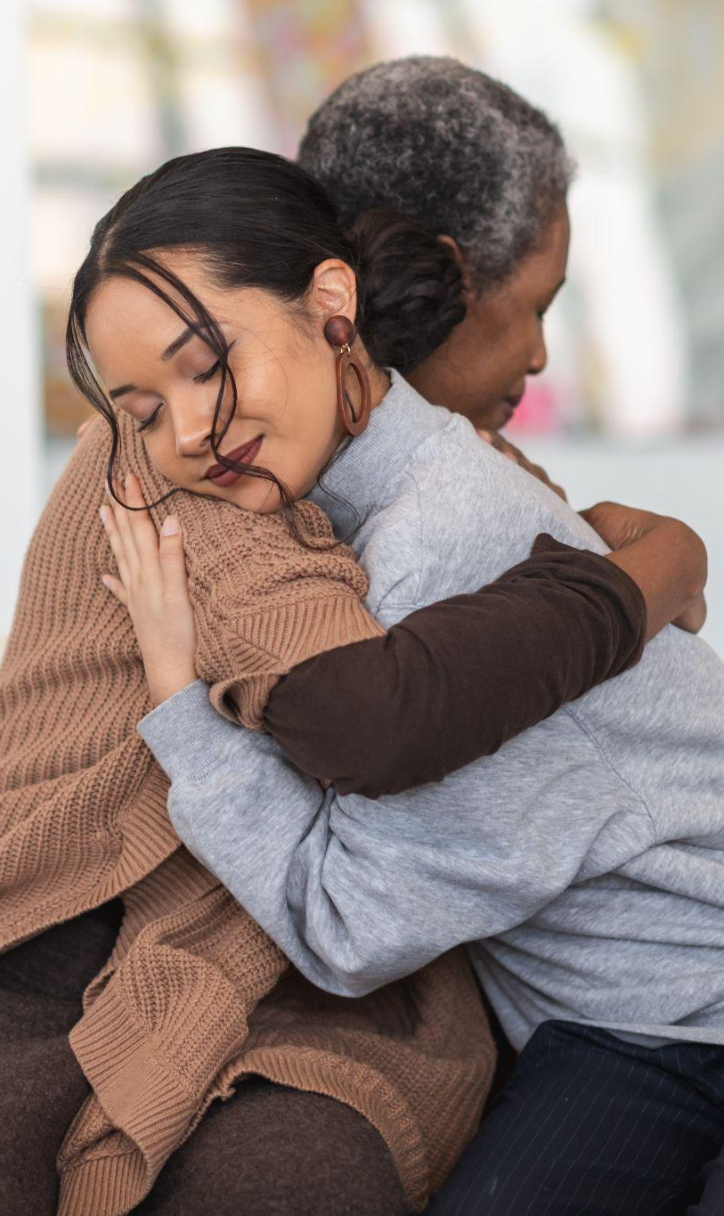
Our Culture
We work collaboratively.
We assume good intentions.
We have a bias towards action and execution.
We hold ourselves accountable.
We empower decision-making at all levels.
We balance resource stewardship with doing what’s right for the patient and their families.

Slide 7
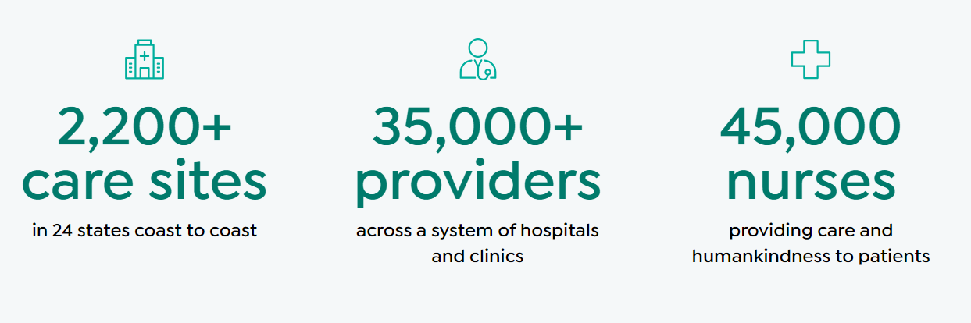
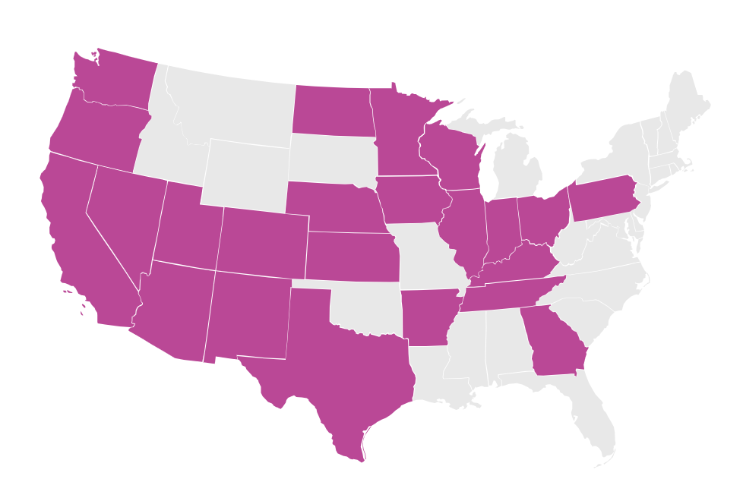
Building healthy communities together
2,200+
care sites in 24 states coast to coast
35,000 physicians and advanced practice providers across a system of hospitals and clinics
Weaving better health on our communities is at the heart of everything we do. It’s how we help more people and places prosper. And it’s all inspired by faith, driven by innovation, and powered by humanity.

Slide 8




Holy Cross Hospital - Davis
Award-winning care that heals, inspires, and connects.
Founded in 1976, Holy Cross Hospital - Davis has grown into a 220-bed hospital of choice for the flourishing communities of northern Utah. With advanced medical services, such as a thrombectomy-capable stroke center, leading-edge radiation therapy, a chest pain-accredited cardiac catheterization lab, and the only Level III neonatal intensive care unit (NICU) in Davis County, our hospital provides innovative, compassionate care to our patients 24 hours a day.
We offer a whole person care experience with a broad range of services in a comfortable and convenient environment. Our Vision is a healthier future for all – inspired by faith, driven by innovation, and powered by our humanity.
1,592
Caregivers
220
Licensed beds
33,948
FY24 ED visits
$10.7 million
FY 24
Charity/Uncompensated Care

Slide 9

Humankindness makes the world a better place.
2,200+
care sites in 24 states coast to coast
35,000 physicians and advanced practice providers across a system of hospitals and clinics
“Humankindness is at the heart of our ministry and a powerful reminder that we all hold the power to heal. At the center of humankindness are our people who play a vital role in helping fulfill our promise to lead and transform health care to meet the evolving needs of our communities and patients.”
Wright Lassiter III, Chief Executive Officer

Slide 10
Humankindness benefits all of us.
2,200+
care sites in 24 states coast to coast
35,000 physicians and advanced practice providers across a system of hospitals and clinics
Our patients
You are our purpose.
We recognize that every patient is a person first. This means getting to know who they are and what they care about. We ask patients “what matters to you today?” through our words, actions, and emotional support. Because feeling truly cared for can make a big difference in your healing journey.
Our physicians
Good care starts with great physicians.
It’s important that every patient feels seen, heard, and encouraged throughout their health journey. That’s why we take great care in selecting the teams who will serve you. Because it’s scientifically proven that when doctors show kindness, patients are more than twice as likely to listen- leading to better health outcomes.
Our community
Good health is a human right.
There are vast inequities in health access, quality, and education that disproportionately burden our nation. We’re committed to building trust in communities that have been systematically excluded from health care over the years. Because we believe that people from all backgrounds deserve outstanding care and opportunities for wellness.

Slide 11
Everyone has a stake in this.
2,200+
care sites in 24 states coast to coast
35,000 physicians and advanced practice providers across a system of hospitals and clinics
Inequities in our public health system are felt directly and disproportionately in systematically excluded communities. But their suffering indirectly affects us all through billions of dollars in excess medical care costs and lost productivity. There is another kind of cost as well—the cost to our nation’s conscience, its empathetic nature, and its ideals of fairness.

Slide 12
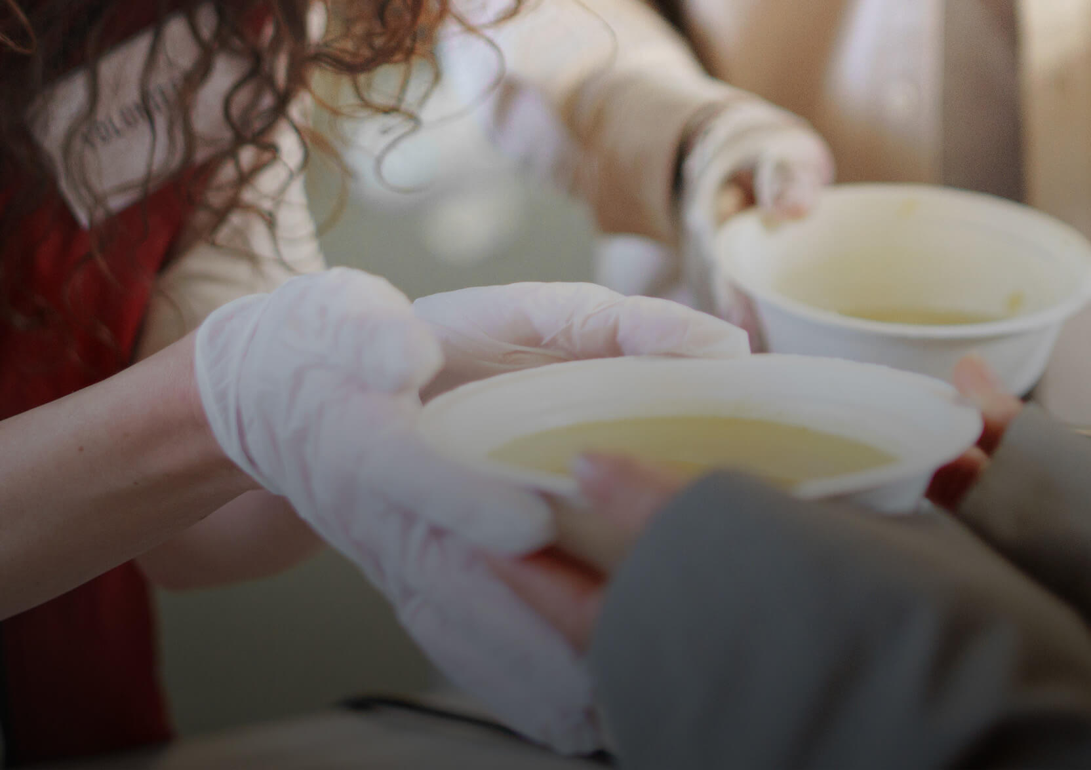
What is health justice?
Everyone should have the opportunity to be healthier. As simple as that sounds, there is formidable complexity behind it. Achieving health justice will require a nationwide commitment to addressing poverty, domestic violence, food scarcity, climate change, drug addiction, childhood education, health policy, and more in meaningful ways.

Slide 13
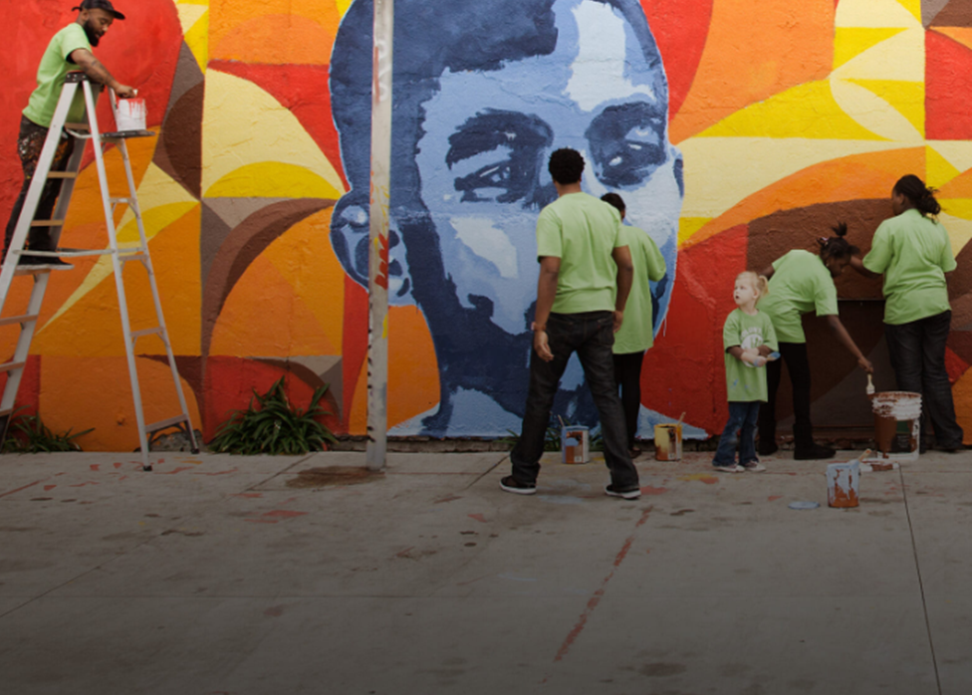
What is CommonSpirit doing?
As one of the nation’s leading health systems, CommonSpirit invests tens of millions of dollars toward finding solutions to these challenges. We are also expanding access to care in underserved communities, supporting a wide range of community health programs, and working with policymakers to advance health justice on a national scale.
There is much more work to be done, though, and CommonSpirit is committed to this for the long run.

Slide 14
Grants are awarded yearly throughout the CommonSpirit Health communities.Grants focus on food security, mental health, and advancing social justice and health equity.
Grants begin at $50,000 and are awarded to support work that:
  Serves underserved communities
  Focuses on community capacity-building
  Leverages collaboration to increase social impact
Health Equity & Advancement Fund​

Slide 15
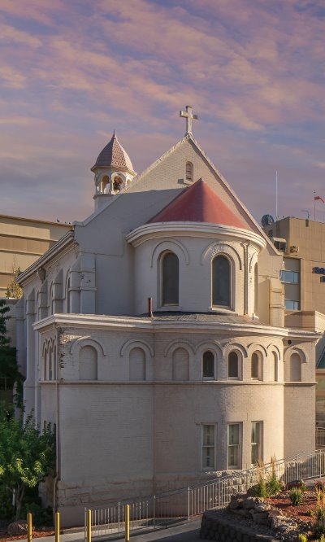
Health care that truly cares
At CommonSpirit, we combine clinical expertise with compassion to deliver humankindness to all we serve. Because we treat more than patients—we treat people. We champion the humanity of everyone who walks through our doors and see beyond what ails them. And we believe that guiding one along their path to healing is as important as walking alongside them.

