Slide 1

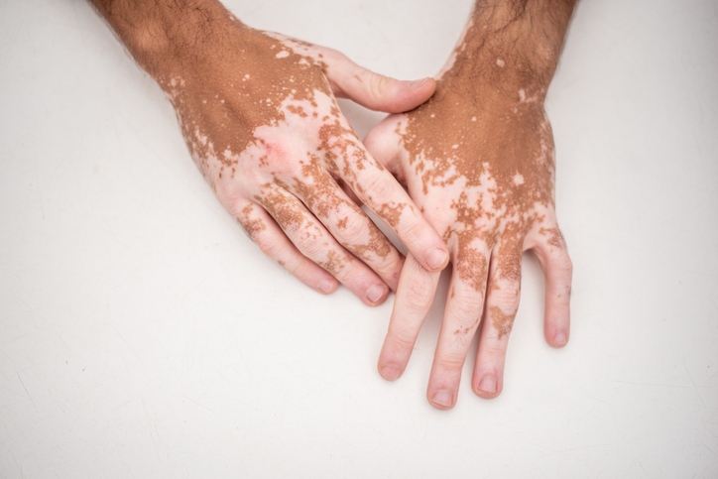
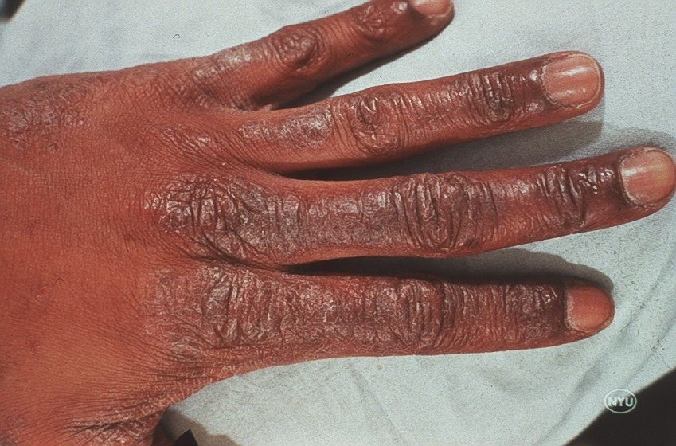
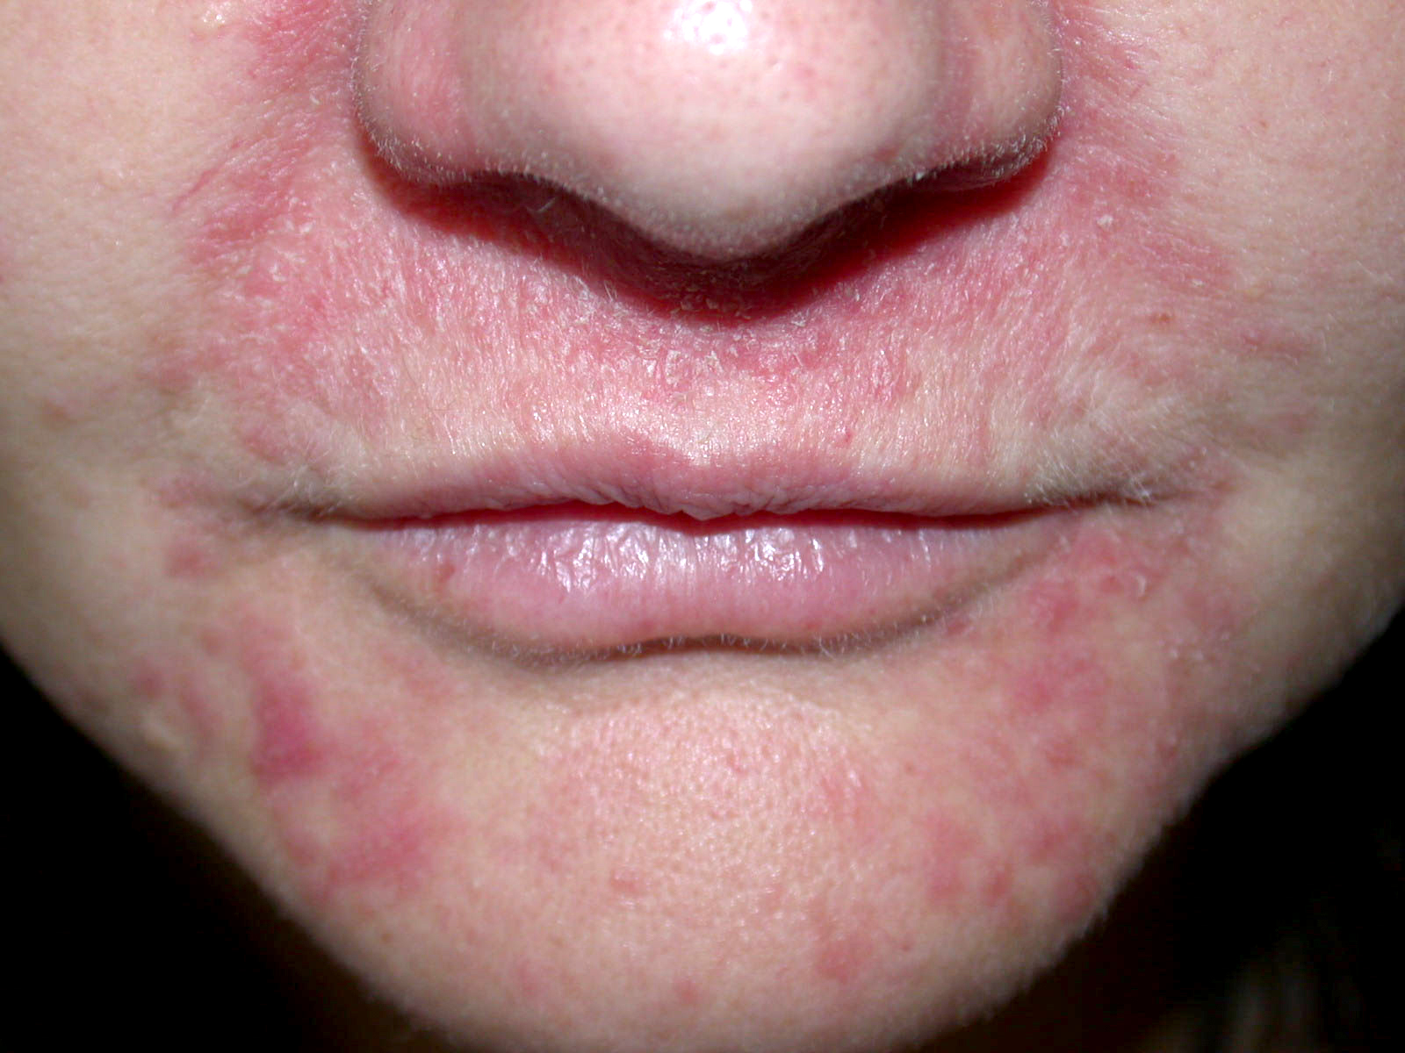
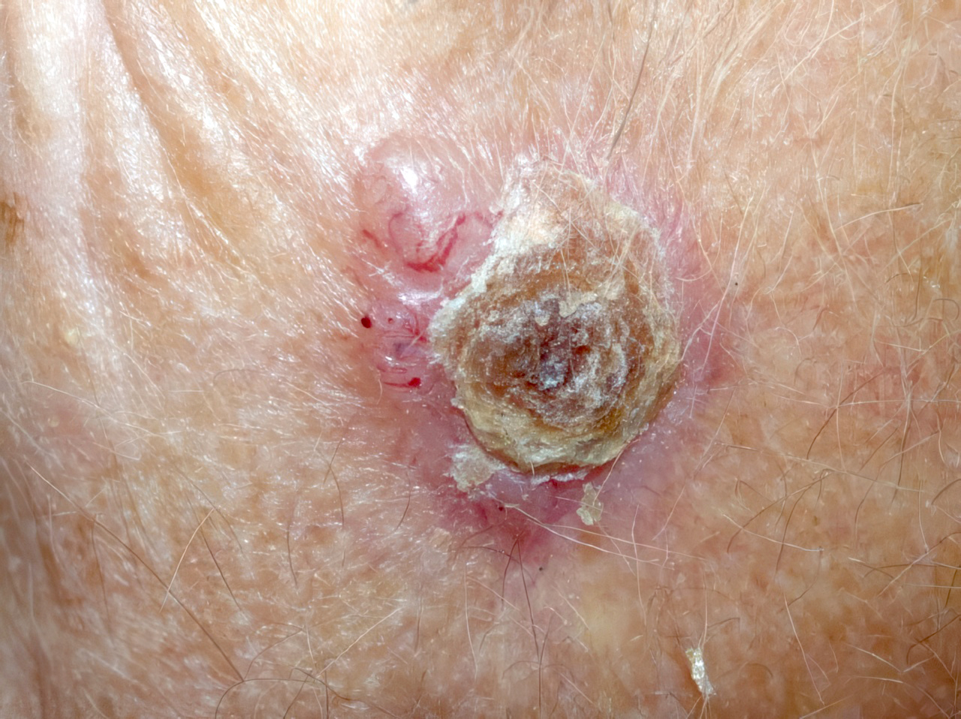
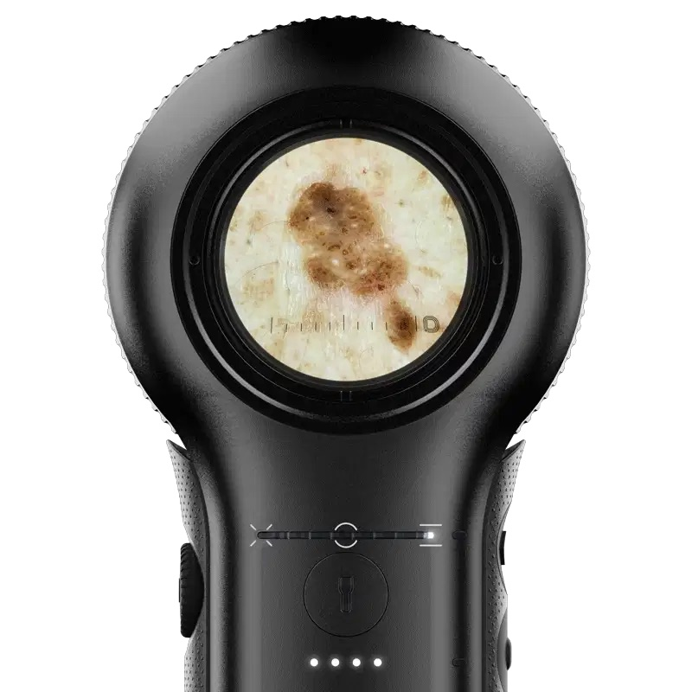
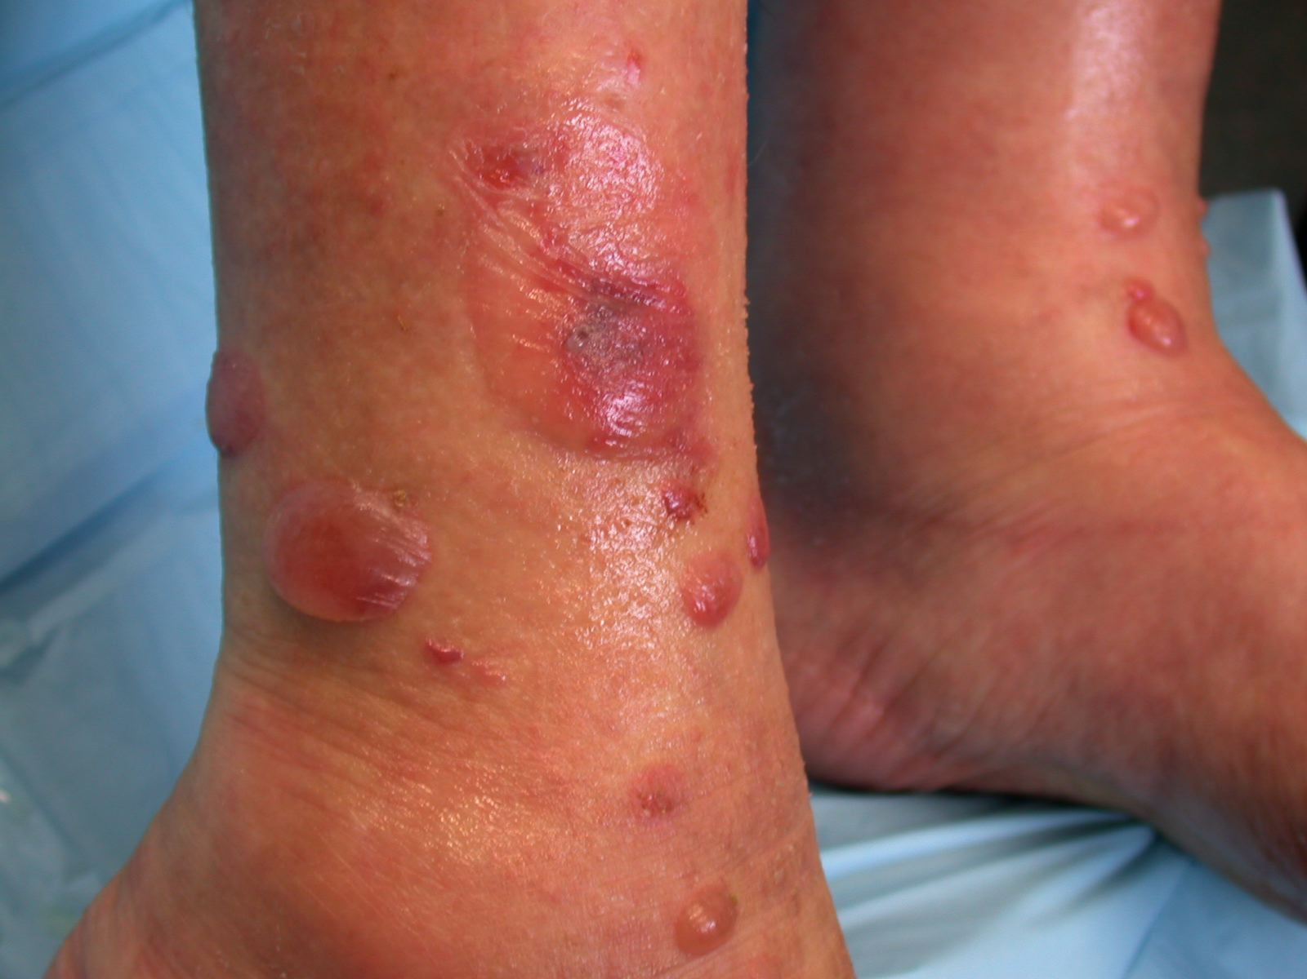
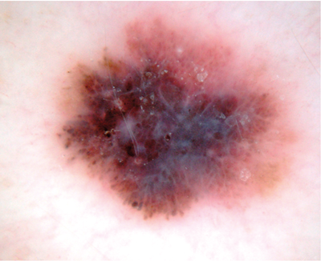
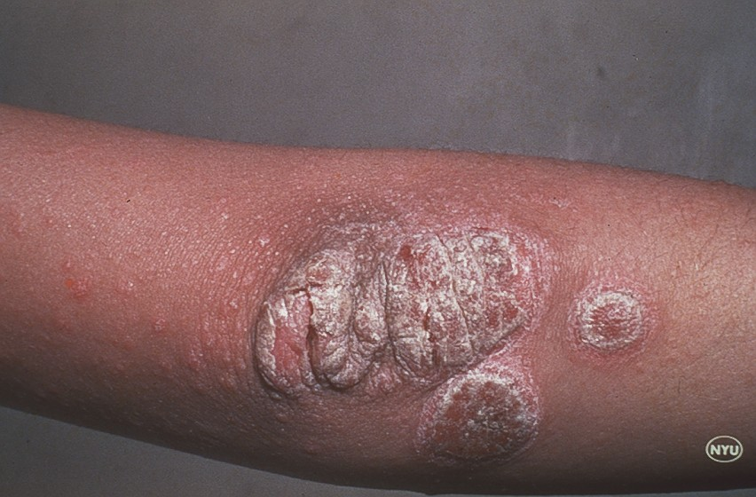
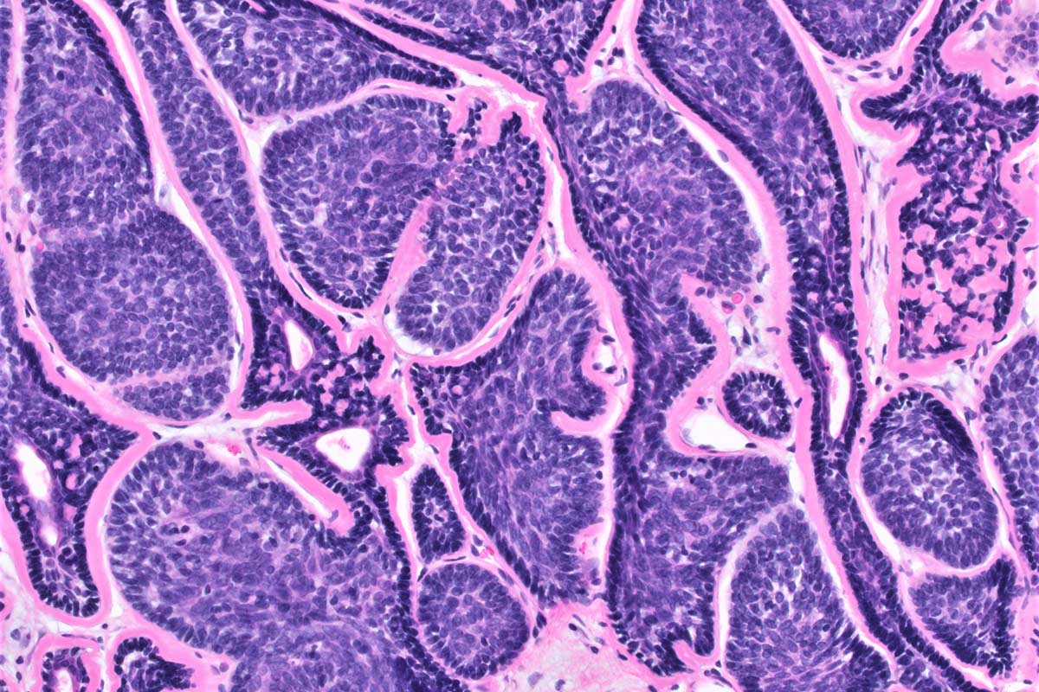

Dermatology
In Specialty and Primary Care
2025

Slide 2








Thank You to our Generous
OSMS 2025 Partners
DR. EZEKIEL R. AND EDNA WATTIS DUMKE FOUNDATION PLENARY SPEAKER

Slide 3
Thank You to our Generous
OSMS 2025 Sponsors
Chad M. Gonzales, MD
California Academy of Family Physicians
Capitol Payroll
Child Richards, CPAs, & Advisors
CommonSpirit Holy Cross Hospital-Davis
Donna & Ralph Friz Family Foundation
Douglas & Shelley Felt Family Foundation
Drs. Willard Z. & Rona Lee Maughn
Intermountain Health McKay-Dee Hospital
Intermountain Health McKay-Dee Surgery Center
Jack W. and Sandra L. Crosland Family
James Tatton, MD
Jeffery Booth, MD
Lawrence T. & Janet T. Dee Foundation- In Memory of William Riley Brown, MD
National Kidney Foundation of Utah and Idaho
Northern Utah Surgeons
Ogden Clinic
Ogden Regional Medical Center
Pathology Watch
Physician Wealth Advisors
Spencer S. & Hope Fox Eccles Family
Steve F. Johnson, MD, Joyce Stillwell & Val B. Johnson, MD In loving memory of Vernal H. Johnson
Stewart Education Foundation
Tanner Clinic
THE DR. EZEKIAL R. & EDNA WATTIS DUMKE FOUNDATION PLENARY SPEAKER
Thomas Dietz, MD
True Vision
Utah Medical Association
Weber County ENTs- Douglas K. Anderson, MD & Nadim Bikhazi, MD
Weber State University College of Science
Weber State University Dumke College of Health Professionals

Slide 4
Annual Hall of Fame 2025
Platinum $1,000 - 4,999 Gold $500 - $999
Jack W. & Sandra L. Crosland Family Thomas Diaz, MD
Douglas & Shelly Felt Family Foundation James A. Tatton, MD
Donna & Ralph Friz Family Foundation
Bronze $100 - $249
D. Edgar Allen, MD
Silver $250 - $499
Heidi Kapanka, MD, MPH
Laurie and Frank Brown, MD
Brent Burdett, MD
Bradley Melville, MD
Noel Nellis, MD
Rifleman Family
Cheryl Walczak, MD
Val B. Johnson, MD
Drs. Willard Z. & Rona Lee Maughan
Gabriel Andeen, MD
Gordon D. Brown, MD
Thomas Hamilton, MD
Heather Heileson, MD
Robert Newman, MD
David Peterson, MD
George F. Snell, MD
Michael Symond, MD
Matthew G. Weeks
Raymond Yaworsky, MD

Slide 5
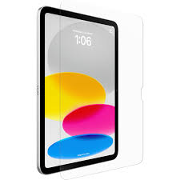
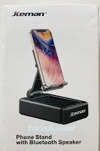
Vendor Game & Prizes
Rules:
Download the Eventmobi app
During scheduled breaks with exhibitors, locate vendor with answer to your Eventmobi question
Receive answer and code from correct vendor
Enter code to app and receive the next question
Locate next vendor
Visit as many vendors as you can
First to find all the vendors and all the
...codes wins!
1st Place
10th Generation
iPad
2nd Place
Bluetooth Speaker
2nd Place
Bluetooth Speaker

Slide 6

Sponsored By

