Slide 1


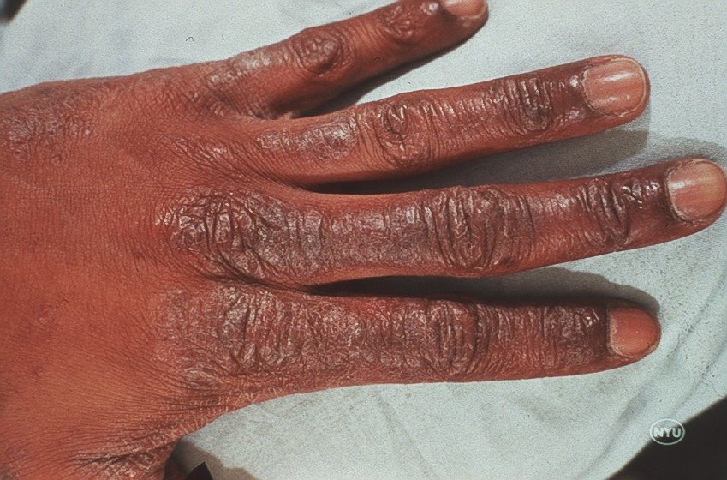
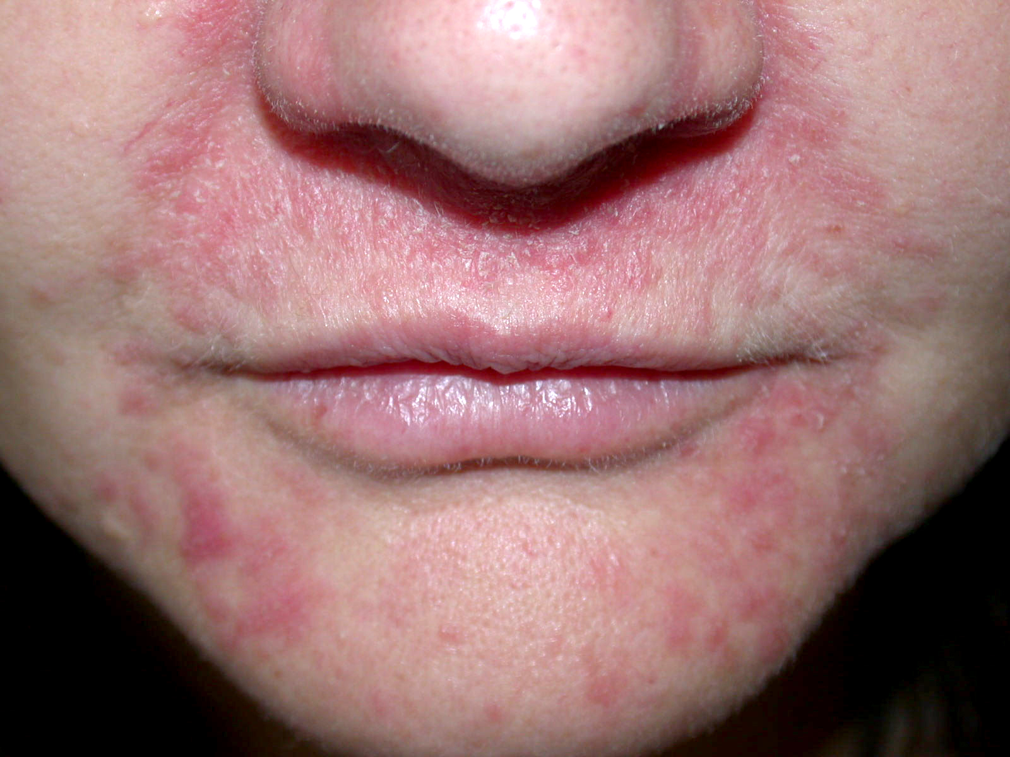
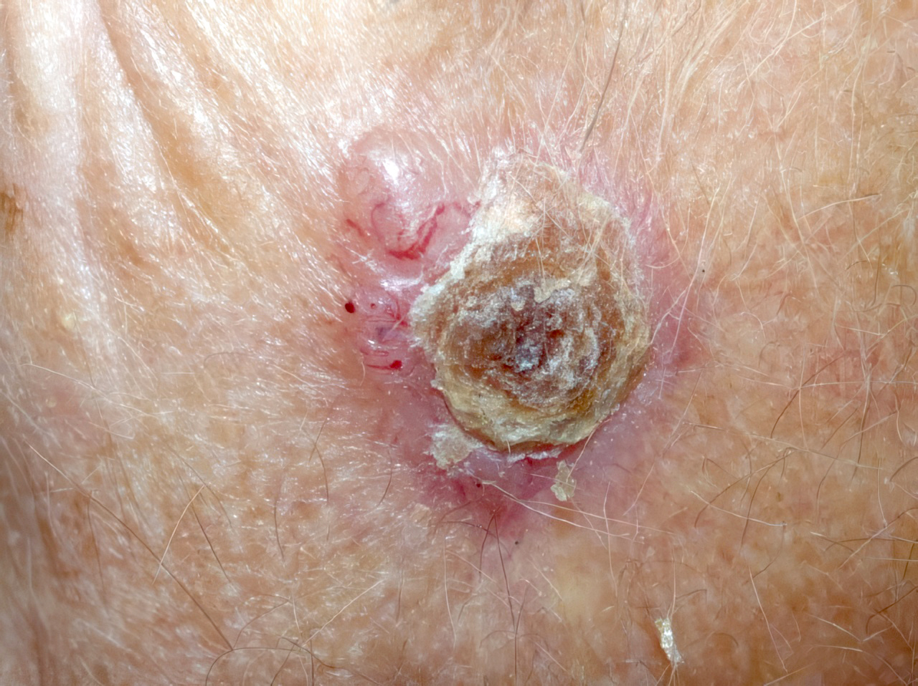
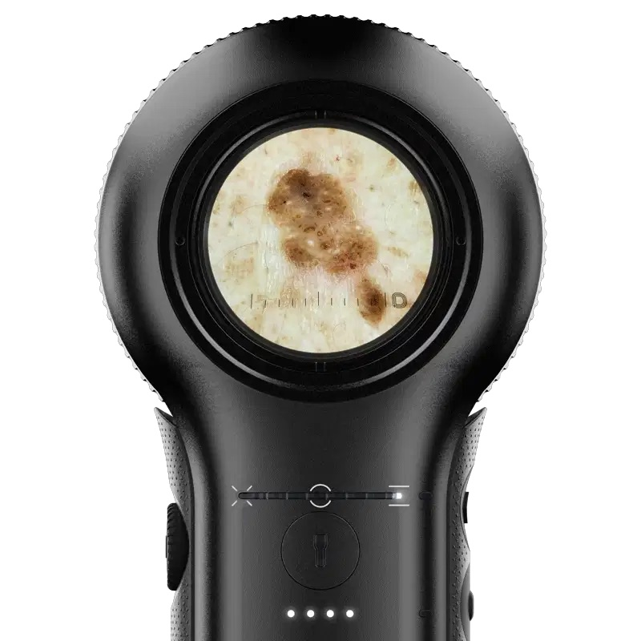
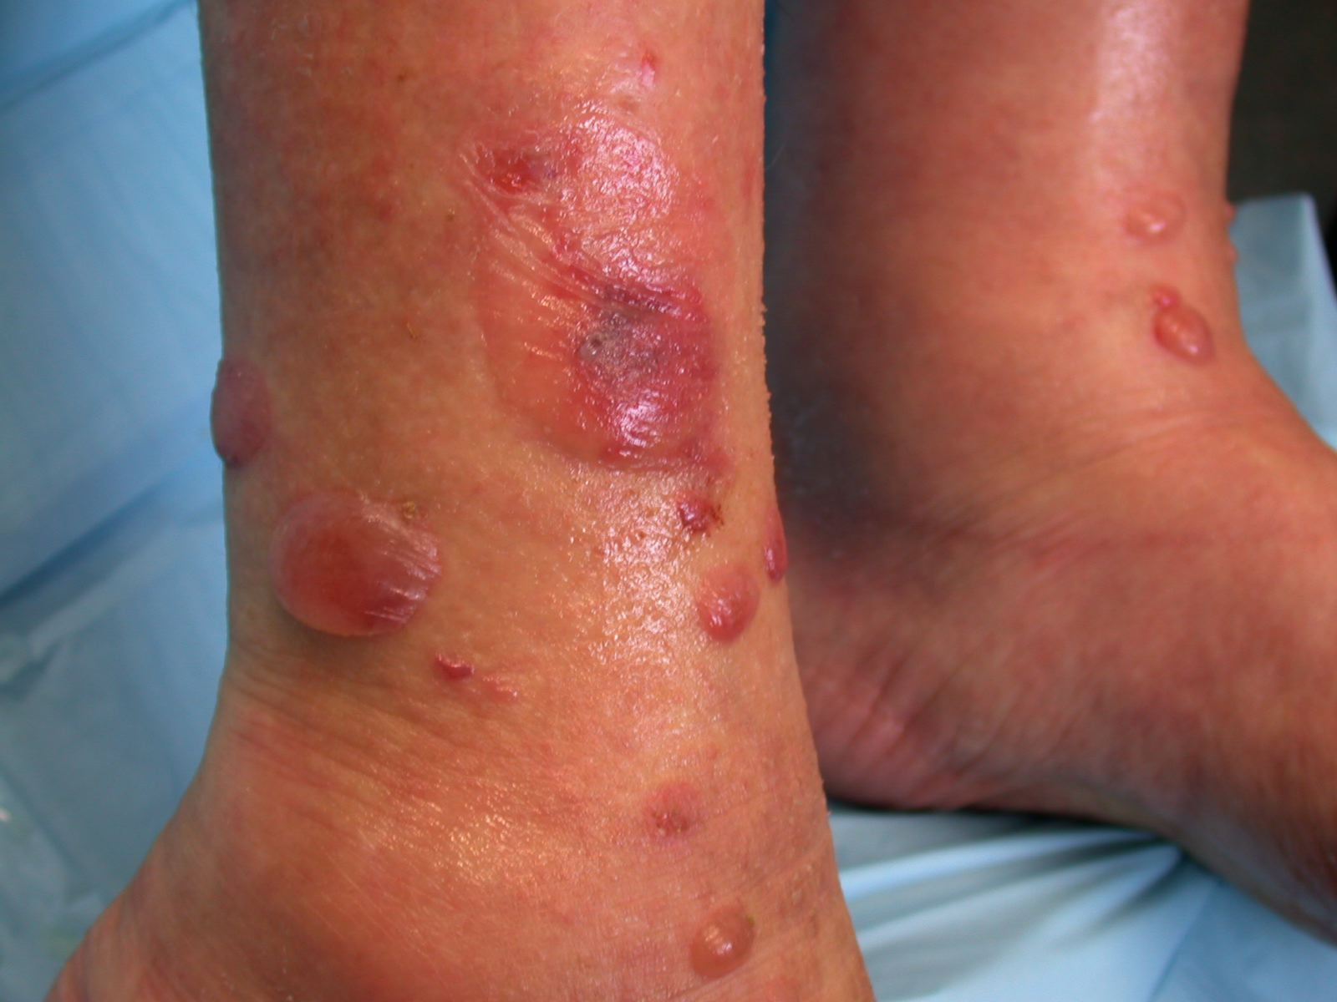
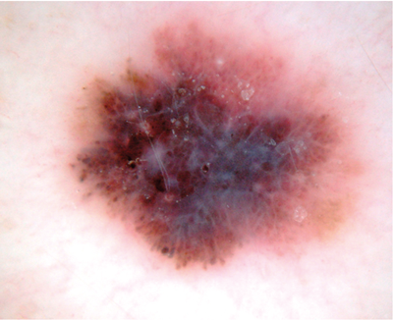
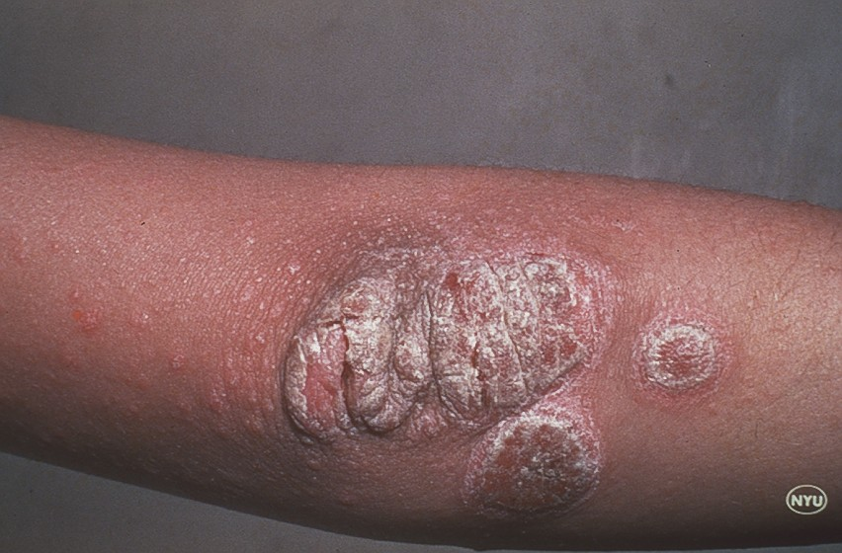
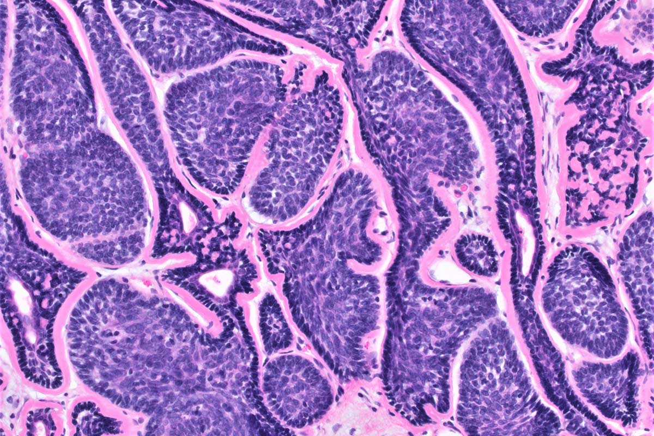
Board Members 2026
Critt Aardema, MD – President
Adam Taintor, MD – Past President
Brian Heaton, MD – President Elect
Marc Johnson, MD – Chair
Heather Heileson, MD – Co-Chair
Steve Scharmann, MD – Treasurer
Kurt E. Rifleman, MD – CME Chair
Bryan Campbell, MD – Secretary
Val Johnson, MD – Historian/Trustee
Douglas K. Anderson, MD – Trustee
Jason R. Hoagland, MD - Trustee
Petronella Adomako, MD – Member-at-Large
Kirsten Baca, MD – Member-at-Large
Frank H. Brown, MD – Member-at-Large
Brian Cowan, MPH – Member-at-Large
Joelle Creager, FNP – Member-at-Large
Michael Grant, MD – Member-at-Large
Albert Hartman, MD – Member-at-Large
Clark Madsen, MD – Member-at-Large
Scott Moore, DO – Member-at-Large
Robert Whipple, MD – Member-at-Large

