Slide 1

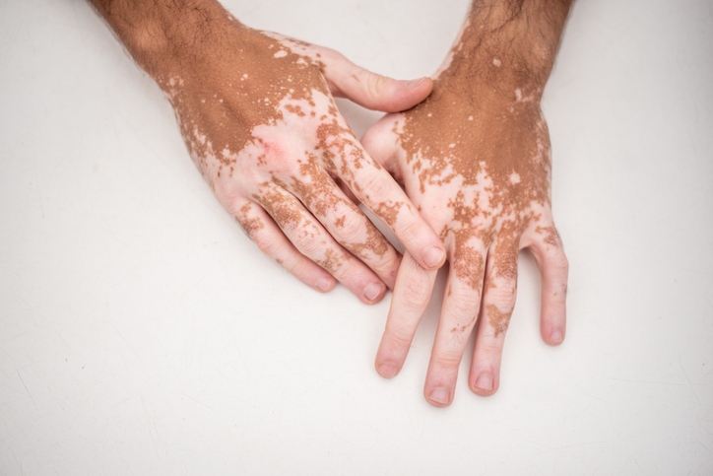
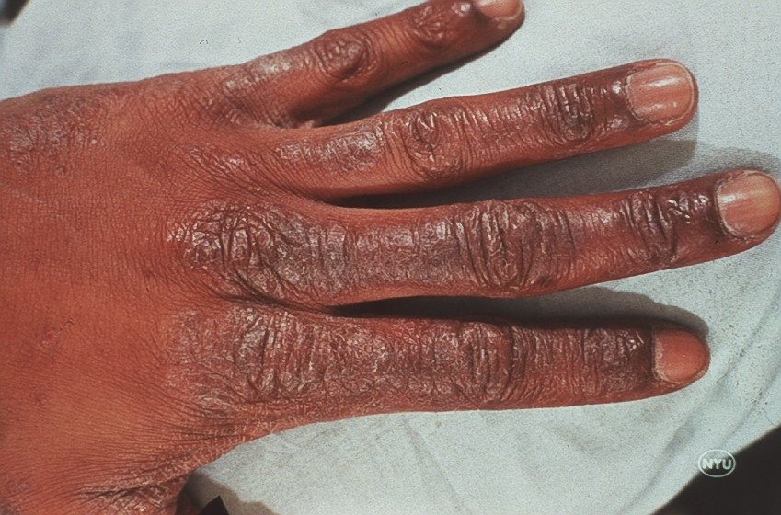
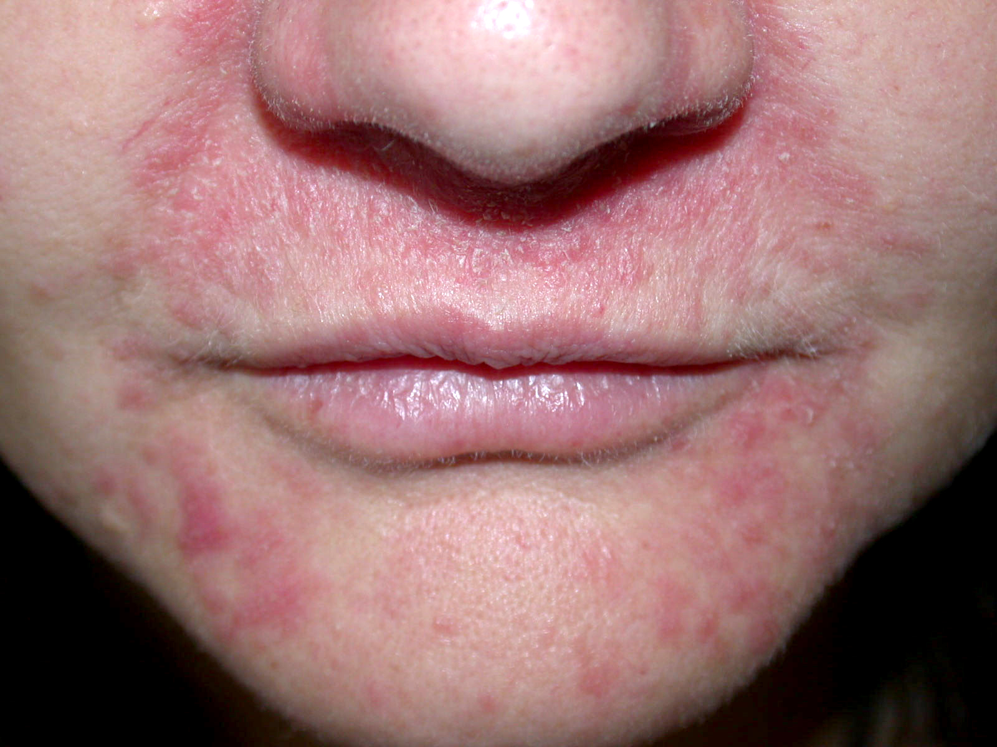
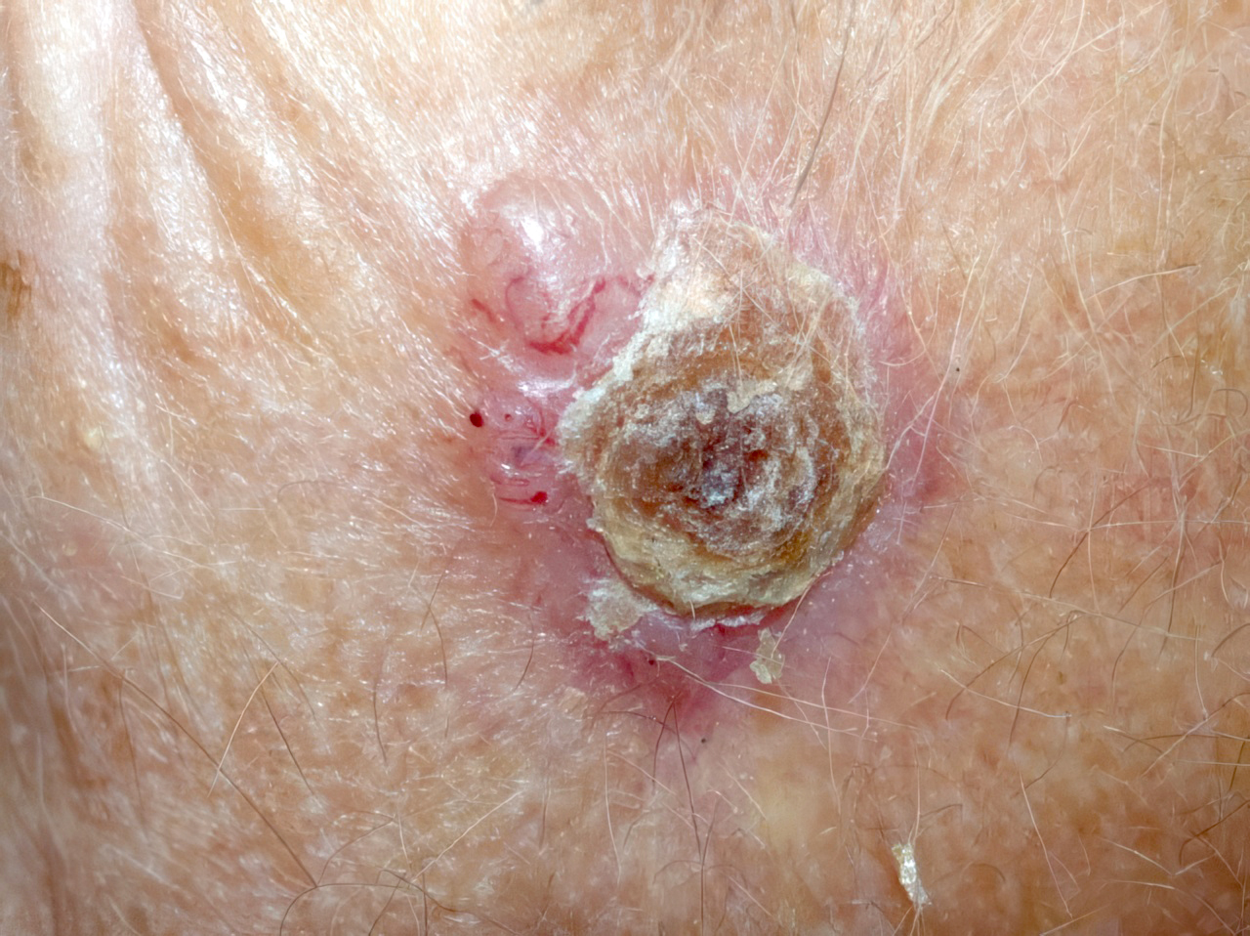
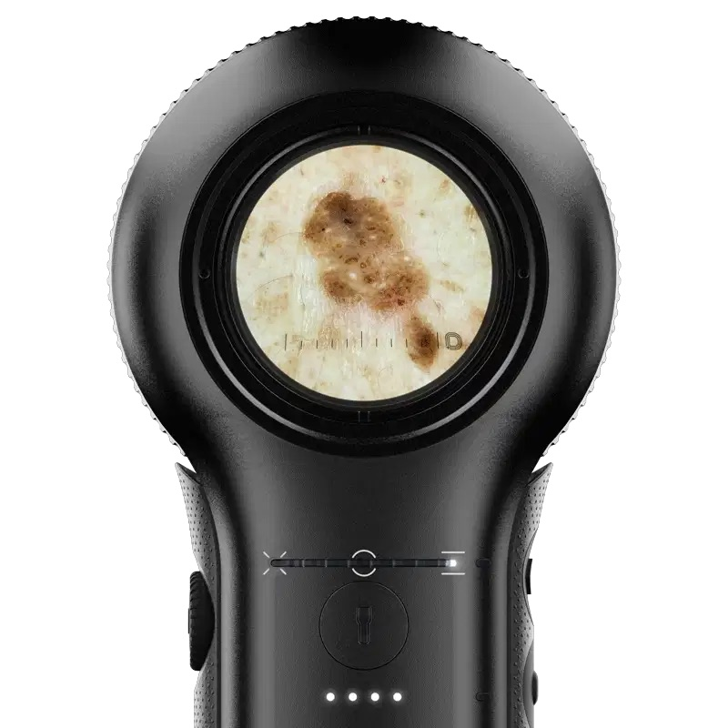
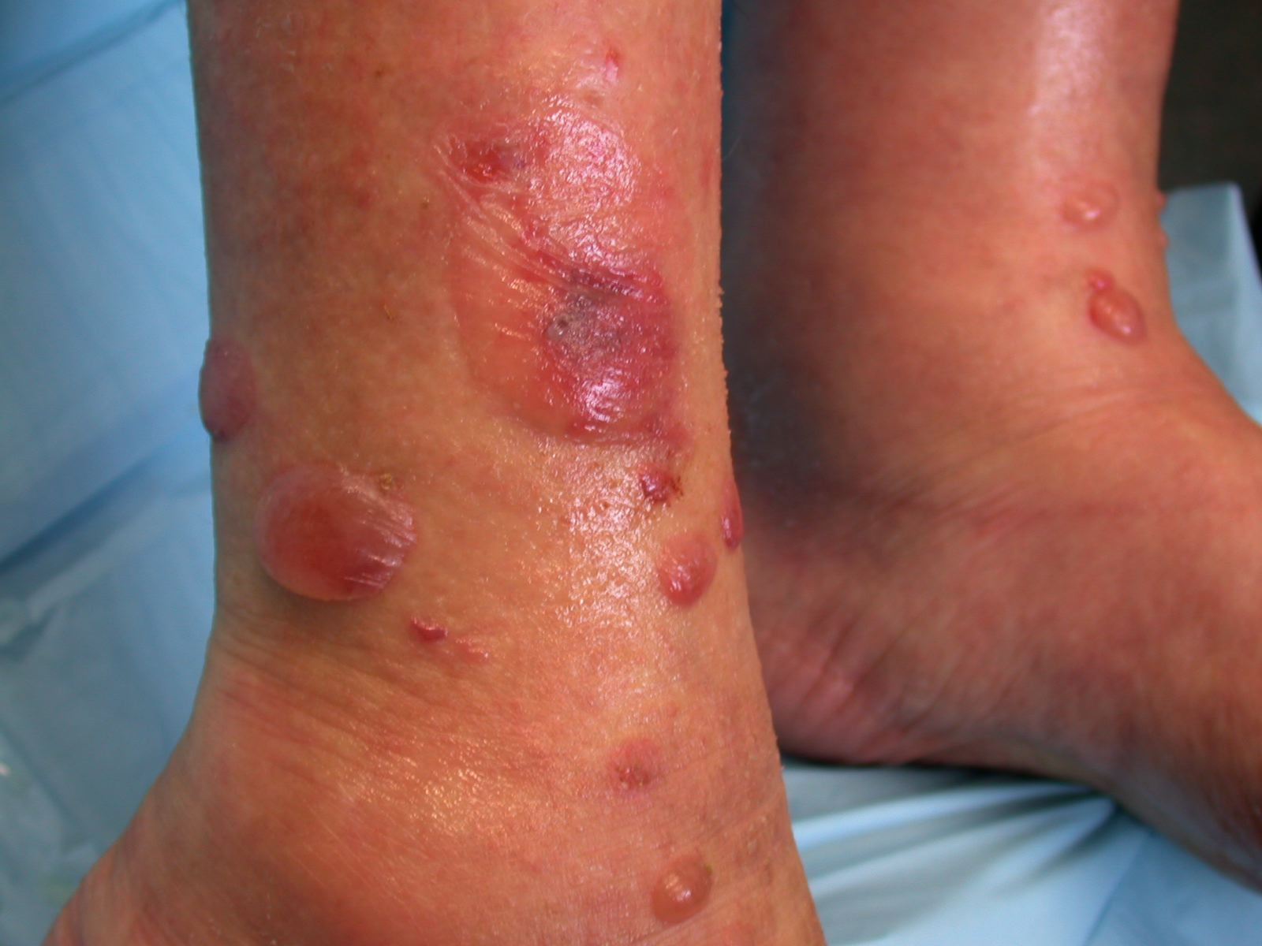
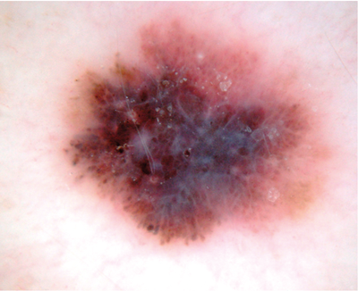
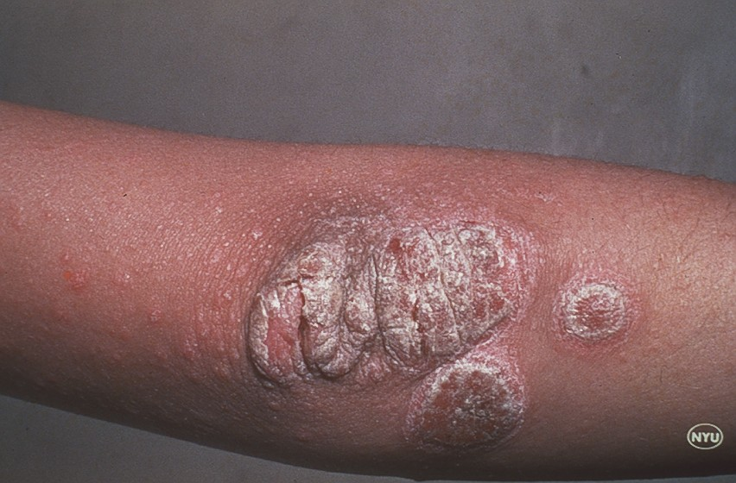
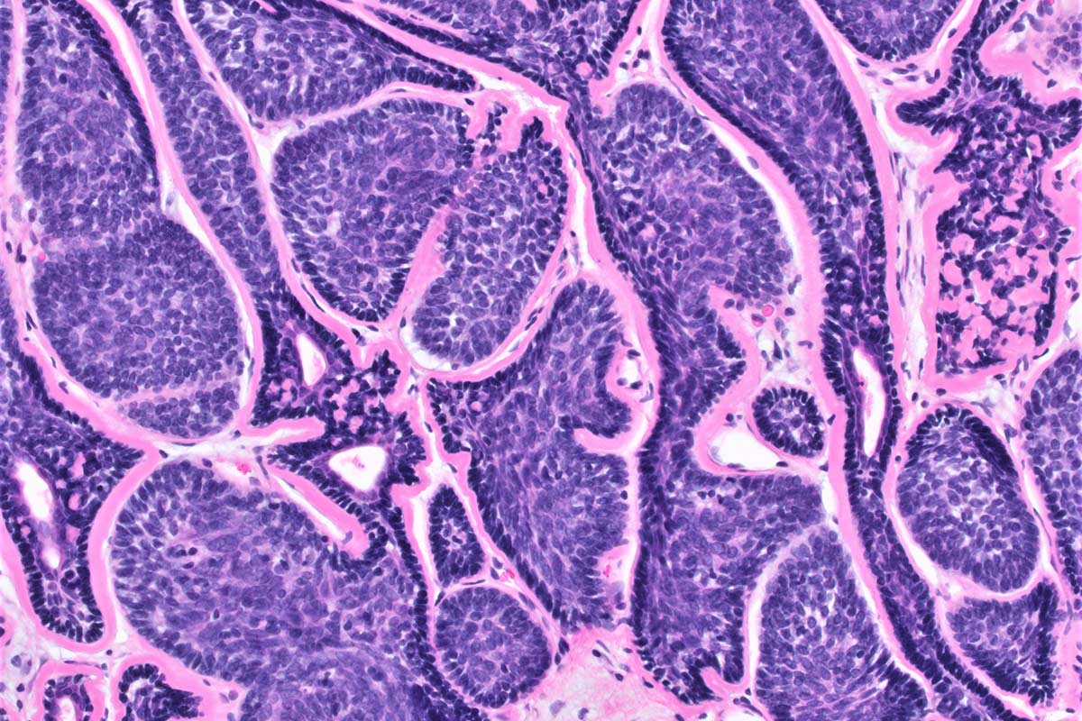

Dermatology
In Specialty and Primary Care
2025

Slide 2








Thank You to our Generous
OSMS 2025 Partners
DR. EZEKIEL R. & EDNA WATTIS DUMKE FOUNDATION PLENARY SPEAKER

Slide 3
Thank You to our Generous
OSMS 2025 Sponsors
Ogden Clinic
Ogden Regional Medical Center
Pathology Watch
Physician Wealth Advisors
Spencer S. & Hope Fox Eccles Family
Steve F. Johnson, MD, Joyce Stillwell & Val B. Johnson, MD In loving memory of Vernal H. Johnson
Stewart Education Foundation
Tanner Clinic
THE DR. EZEKIAL R. & EDNA WATTIS DUMKE FOUNDATION PLENARY SPEAKER
Thomas Dietz, MD
Utah Medical Association
True Vision
Weber County ENT s- Douglas K. Anderson, MD & Nadim Bikhazi, MD
Weber State University College of Science
Weber State University Dumke College of Health Professionals
Chad M. Gonzales, MD
Capitol Payroll
California Academy of Family Physicians
Child Richards, CPAs, & Advisors
CommonSpirit Holy Cross Hospital-Davis
D. Edgar Allen, MD
Donna & Ralph Friz Family Foundation
Douglas & Shelley Felt Family Foundation
Drs. Willard Z. & Rona Lee Maughn
Intermountain Health McKay-Dee Hospital
Jack W. and Sandra L. Crosland Family
James Tatton, MD
Jeffery Booth, MD
Lawrence T. & Janet T. Dee Foundation- In Memory of William Riley Brown, MD
National Kidney Foundation of Utah and Idaho

Slide 4
Annual Hall of Fame 2025
Platinum $1,000 - 4,999 Gold $500 - $999
Jack W. & Sandra L. Crosland Family Thomas Diaz, MD
Douglas & Shelly Felt Family Foundation James A. Tatton, MD
Donna & Ralph Friz Family Foundation
Bronze $100 - $249
D. Edgar, MD Thomas
Silver $250 - $499
Heidi Kapanka, MD, MPH
Laurie and Frank Brown, MD
Brent Burdett, MD
Bradley Melville, MD
Rifleman Family
Cheryl Waczak, MD
Val B. Johnson, MD
Lee Maughan
Gabriel Andeen, MD
Gordon D. Brown, MD
Thomas Hamilton, MD
Heather Heileson, MD
Robert Newman, MD
David Peterson, MD
George F. Snell, MD
Michael Symond, MD
Matthew G. Weeks
Raymond Yaworsky, MD

Slide 5
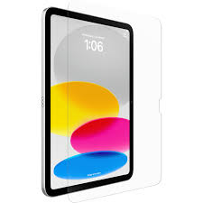
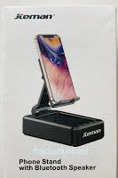
Vendor Game & Prizes
Rules:
Download the Eventmobi app
During scheduled breaks with exhibitors, locate vendor with answer to your Eventmobi question
Receive answer and code from correct vendor
Enter code to app and receive the next question
Locate next vendor
Visit as many vendors as you can
First to find all the vendors and all the codes wins!
1st Place
10th Generation
iPad
2nd Place
Bluetooth Speaker
2nd Place
Bluetooth Speaker

Slide 6
Sponsored By
Sponsored by Steve F. Johnson, MD
Joyce Johnson Stillwell & Val B. Johnson, MD
In Loving Memory of Vernal H. Johnson, MD
&

