Slide 1
Study Hypothesis
Does Roux-en-Y gastric bypass (RYGB) surgery result in improved morbidity when severely obese non-surgical groups (population-based and denied-surgery) are compared to RYGB patients?
Note: Gastric banding was not approved in US
at time of study initiation (2001).

Slide 2
Recruitment Scheme: RYGB Group and Non-surgery Group 1
Patients come to surgeon’s clinic to learn about RYGB and get health insurance advice. Patients informed of study.
Patient agrees to participate
Patient undergoes baseline testing
Health plan approves RYGB or patient provides self-pay and RYGB surgery performed
Health plan denies coverage of RYGB or patient chooses not to have RYGB performed
Patient assigned to
RYGB Group
Patient assigned to
Non-surgical group 1
Notes:
Added this slide - you may want to modify it to better describe the group.

Slide 3
Recruitment Scheme: Non-surgery Group 2
Severely obese participants not seeking bariatric surgery.
Randomly selected from the Utah Health Family Tree program database:
150,000+ families (>1 million family members)
Health data, including reported weight status.
Notes:
Added this slide - you may want to modify it to better describe the group.

Slide 4
Recruitment Hypothesis
Denied surgery patients (Non-surgical Group 1) represent characteristics associated with seeking surgery (potentially self-selected for significant comorbidities and other conditions).
Population-based severely obese participants (Non-surgical Group 2) represent characteristics associated with severely obese subjects in the general population.
Notes:
Added this slide - you may want to modify it to better describe the group.

Slide 5
Long-term Prospective Utah Study
(NIH-funded 2001-2015)
Exam 1
Exam 2
Exam 3
Exam 4
Surgical Center
RYGB
RYGB Surgery
418
410
387
388
No RYGB
Non-Surgery 1
Utah Health Family Tree Program
417
400
388
364
Non-Surgery 2
321
319
315
301
Baseline
2 Years
6 Years
12 Years
Adams et al. Obesity 2010;18:121-30
Adams et al. JAMA 2012;308:1122-31

Slide 6
12-year Results – Follow-up
End Point | RYGB Surgery Group (minus deaths) | Non-surgery Group 1 (minus deaths) | Non-surgery Group 2 (minus deaths)
Potential Participation, n | 392 | 378 | 303
Any data source, n (%) | 388 (98.7%) | 364 (96.3%) | 301 (99.3%)
Minimum of Weight, SBP, and either glucose or HbA1c, n (%) | 353 (90.1%) | 342 (90.5%) | 285 (94.1%)
Later had bariatric surgery, n (%) | --- | 147 (35%) | 39 (12%)
Adams, T. et al. N Engl J Med 2017;377:1143-55.

Slide 7
12-year Results – Mortality
End Point | RYGB Surgery Group (minus deaths) | Non-surgery Group 1 (minus deaths) | Non-surgery Group 2 (minus deaths)
All-cause, n (%) | 26 (6.2%) | 39 (9.4%) | 18 (5.6%)
CVD, (n) (%) | 3 | 17 | 8
Cancer, n (%) | 4 | 5 | 7
Suicide, n (%) | 5 (1.2%) | 2 (0.5%)* | 0
Poisoning, n (%) | 4 (1.0%) | 2 (0.5%) | 0
* = Death subsequent to bariatric surgery
Notes:
Ted, the (minus deaths) label is confusing on this slide. These are actually the deaths, right? Should it say (%) or (% of group total)?

Slide 8
% Change in Baseline Body Weight (mean adjusted)
*
*
-28.0%
-26.9%
*
-35.0%
* = Surgery group differs significantly from non-surgery groups; p<0.001
Adams, T. et al. N Engl J Med 2017;377:1143-55.

Slide 9
% Change in Baseline Body Weight
RYGB Group
# of participants | Baseline | 2 Years | 6 Years | 12 Years
RYGB patients | 418 | 409 | 379 | 387
Deaths | --- | 3 | 9 | 14
Total | 418 | 412 | 388 | 401

Slide 10
% Change in Baseline Body Weight
Non-Surgery Group 1
# of participants | Baseline | 2 Years | 6 Years | 12 Years
Non-surgery group 1 | 417 | 373 | 294 | 217
Had surgery later | --- | 28 | 89 | 146
Deaths | --- | 3 | 11 | 25
Total | 417 | 404 | 394 | 388

Slide 11
% Change in Baseline Body Weight
Non-Surgery Group 2
# of participants | Baseline | 2 Years | 6 Years | 12 Years
Non-surgery group 2 | 321 | 312 | 294 | 262
Had surgery later | --- | 8 | 19 | 39
Deaths | --- | --- | 3 | 15
Total | 321 | 320 | 316 | 316

Slide 12
Weight Loss Maintenance at 12 Years: RYGB Group
360 of 387 RYGB patients (93%) maintained at least a 10% weight loss from baseline to year 12
271 (70%) maintained at least 20% weight loss
155 (40%) maintained at least 30% weight loss
Only 4 of 387 (1%) had regained all postsurgical weight loss
Adams, T. et al. N Engl J Med 2017;377:1143-55.

Slide 13
Diabetes remission after RYGB
Group | 2 years | 6 years | 12 years
Surgery, % | 74% | 62% | 51%
Surgery, n | 66/88 | 54/87 | 43/84
Adams, T. et al. N Engl J Med 2017;377:1143-55.

Slide 14
Diabetes and Hypertension: 12-year Remission
End Point | Surgery% | NS 1, % | NS 2, % | Adj. OR S vs NS 1 | Adj. OR S vs NS 2
T2D | 51% | 10% | 5% | 8.9*** (2.0, 40.0) | 14.8*** (2.9, 75.5)
HTN | 36% | 10% | 14% | 5.1*** (1.7, 15.6) | 2.4 (0.9, 5.9)
*** = P<0.001
Adams, T. et al. N Engl J Med 2017;377:1143-55.

Slide 15
Diabetes and Hypertension: 12-year Incidence
End Point | Surgery% | NS 1, % | NS 2, % | Adj. OR S vs NS 1 | Adj. OR S vs NS 2
T2D | 3% | 26% | 26% | 0.08*** (0.03, 0.24) | 0.09*** (0.03, 0.24)
HTN | 16% | 41% | 47% | 0.23*** (0.11, 0.49) | 0.09*** (0.11, 0.51)
*** = P<0.001
Adams, T. et al. N Engl J Med 2017;377:1143-55.

Slide 16
Conclusions
Long-term durability of weight loss after RYGB with minimal weight increase between the 6- and 12-year follow-up
Very minimal incidence of T2DM
Remission rate 51% at the 12-year follow-up
Marked improvement in systolic hypertension and lipid levels
Adams, T. et al. N Engl J Med 2017;377:1143-55.

Slide 17
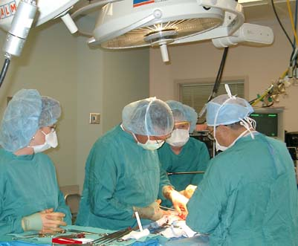
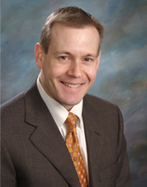
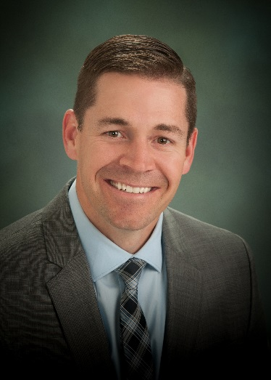
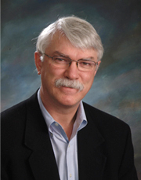
Rocky Mountain Associated Physicians Salt Lake City
Rod McKinlay, M.D.
Nicholas Paulk, M.D.
Steve Simper, M.D.

Slide 18
Additional Research Colleagues
Lance Davidson Ronnie Kolotkin
Steve Hunt Ross Crosby
Sheldon Litwin Paul Hopkins
Jaewhan Kim Nazeem Nanjee
Jonathan Gutierrez Sara Frogley
Anna Ibele Eliot Brinton

Slide 19
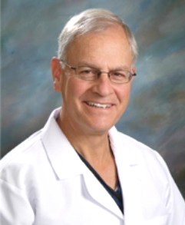
In Tribute to Dr. Sherman C. Smith
1948 – 2015
Notes:
19

Slide 20
Acknowledgement: Funding from NIH-NIDDK

Slide 21
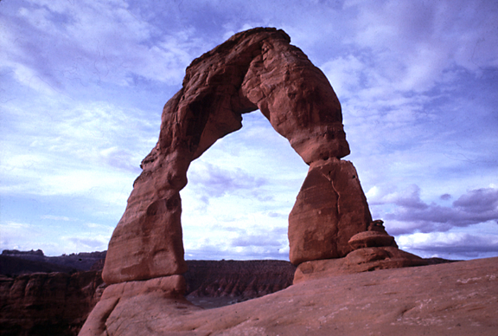
Thank You

